Slide 1
Kern Fan Groundwater Storage Project Water Storage Investment Program Success February 28, 2019

Slide 2
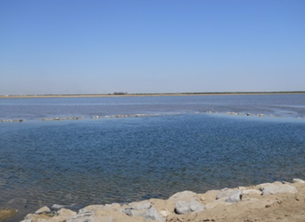
Kern Fan Project Highlights
A groundwater storage project in Kern County that will:
Store water otherwise lost to ocean
Provide water supply benefits
Improve operational flexibility in the State’s water system
Provide benefits to endangered species
Joint implementation by IRWD and Rosedale-Rio Bravo Water Storage District
Sources of water:
Unallocated SWP Article 21 water
Estimated Project Cost: $172 million
Awarded $67.5 million in Prop 1 funds
Water Storage Investment Program (WSIP)

Slide 3
WSIP Grant Application Process
Applications submitted: August 2017
Basic eligibility determinations: September 2017
Public benefit ratios and appeals: April 2018
Project scoring and technical review: May 2018
Maximum conditional funding eligibility determinations: July 2018
California Agencies involved:
California Water Commission
Department of Water Resources
Department of Fish and Wildlife
Challenges:
Valuing water for quantifying benefits
Providing ecosystem benefits to the Delta

Slide 4
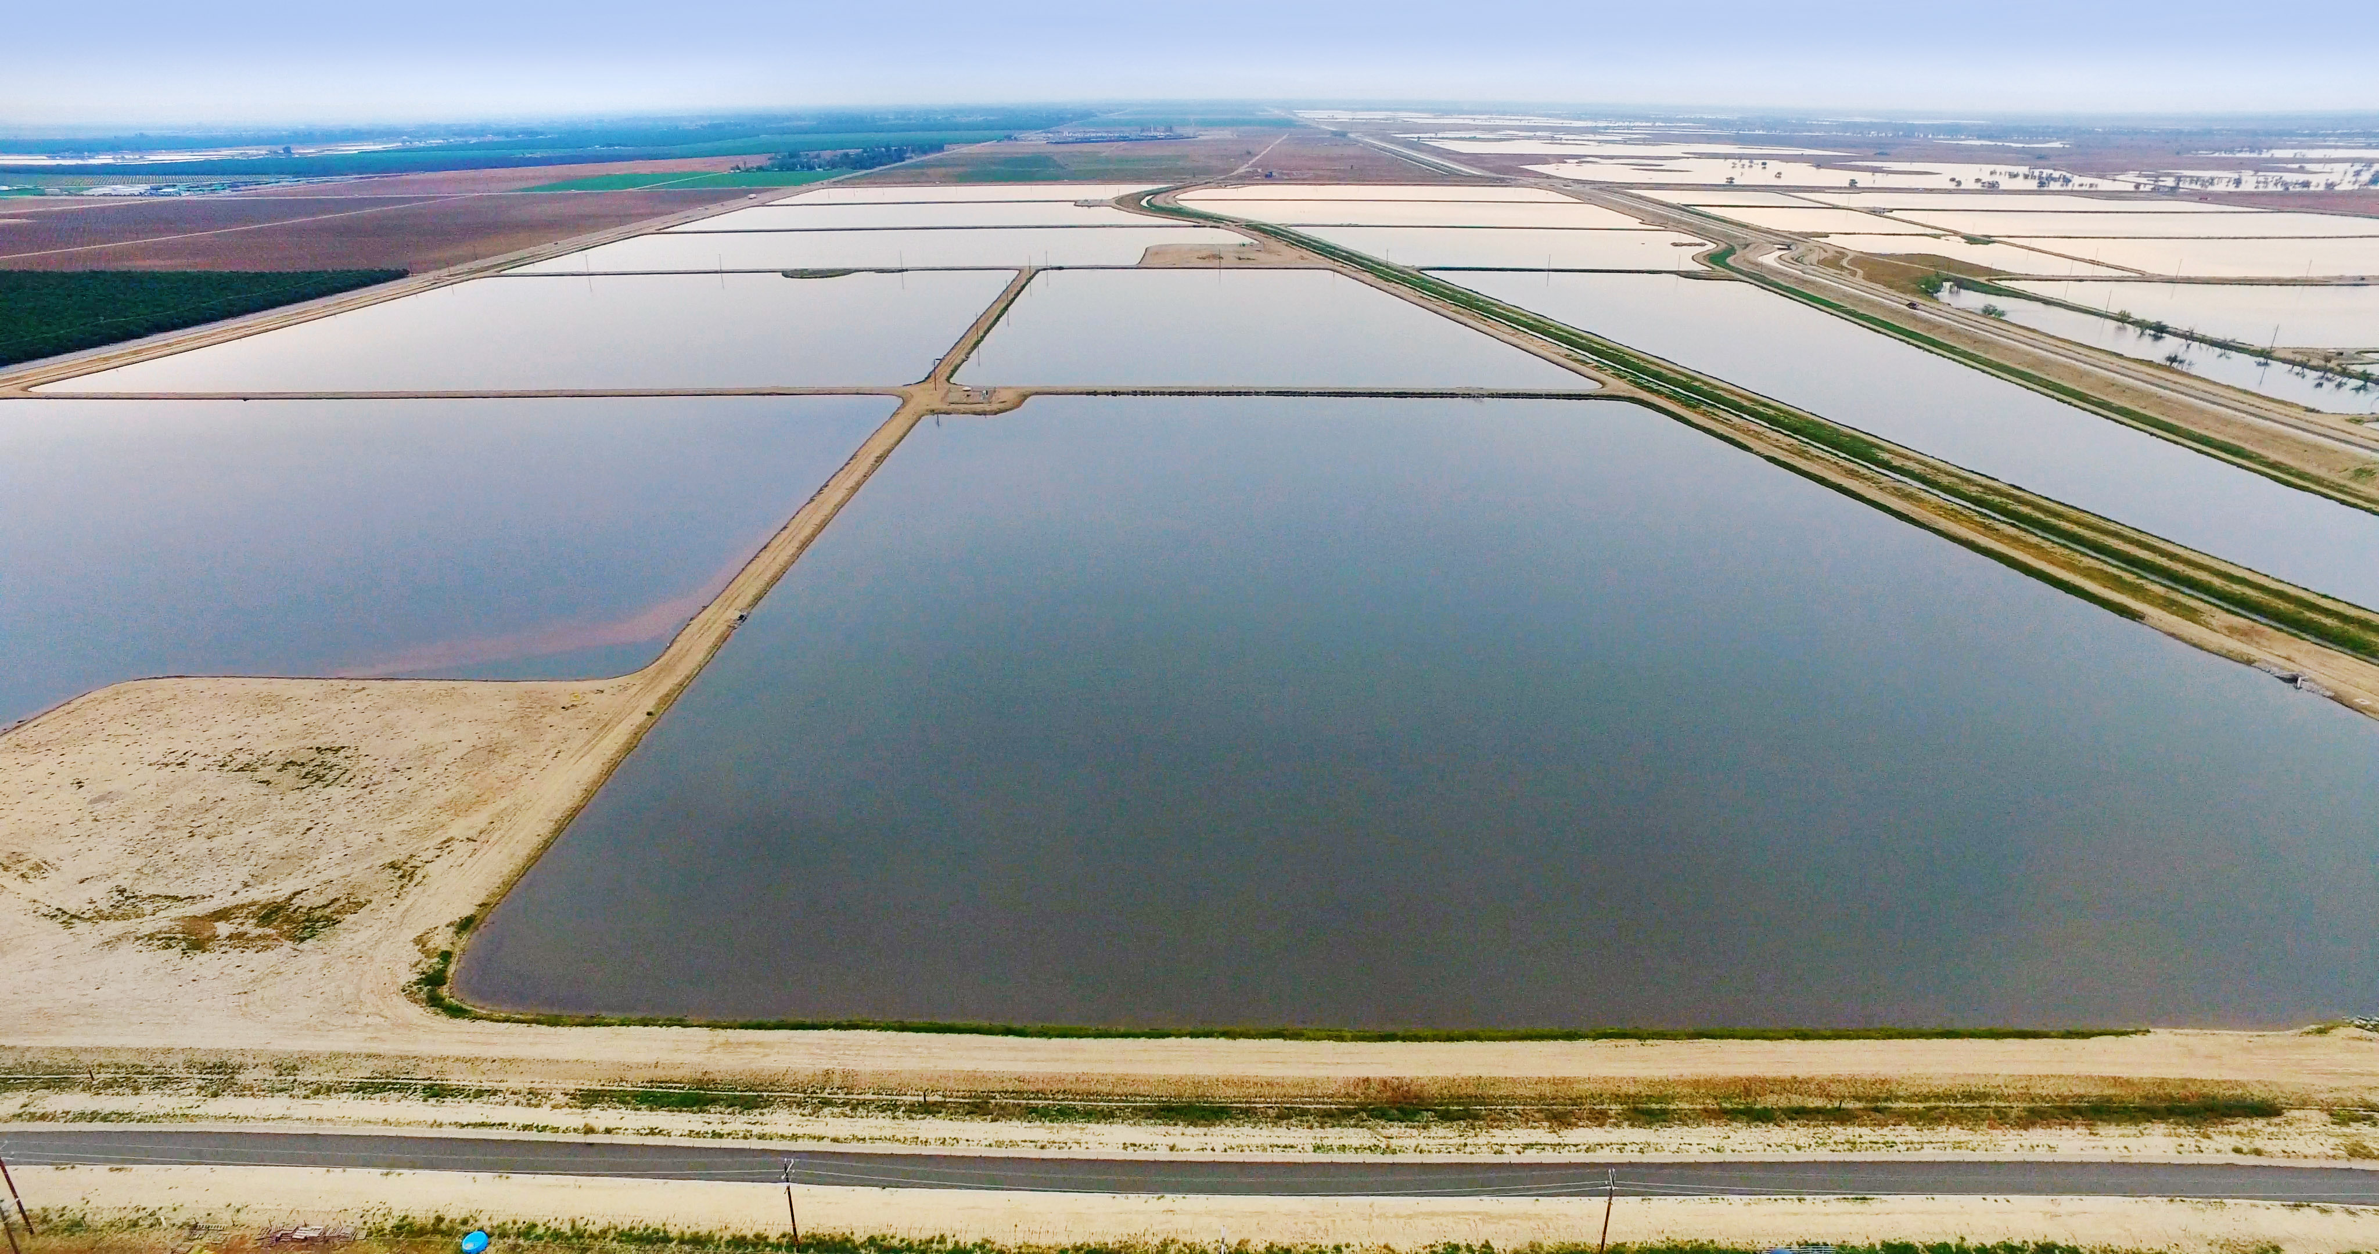
Consulting Firms Used in Application Process
CALSIM II modeling of SWP and Kern Fan Project
MBK Engineers
Fish and wildlife modeling and analysis
Cramer Fish Sciences
Economic modeling and analysis
M.Cubed
Engineering and cost estimating
Dee Jaspar & Associates

Slide 5
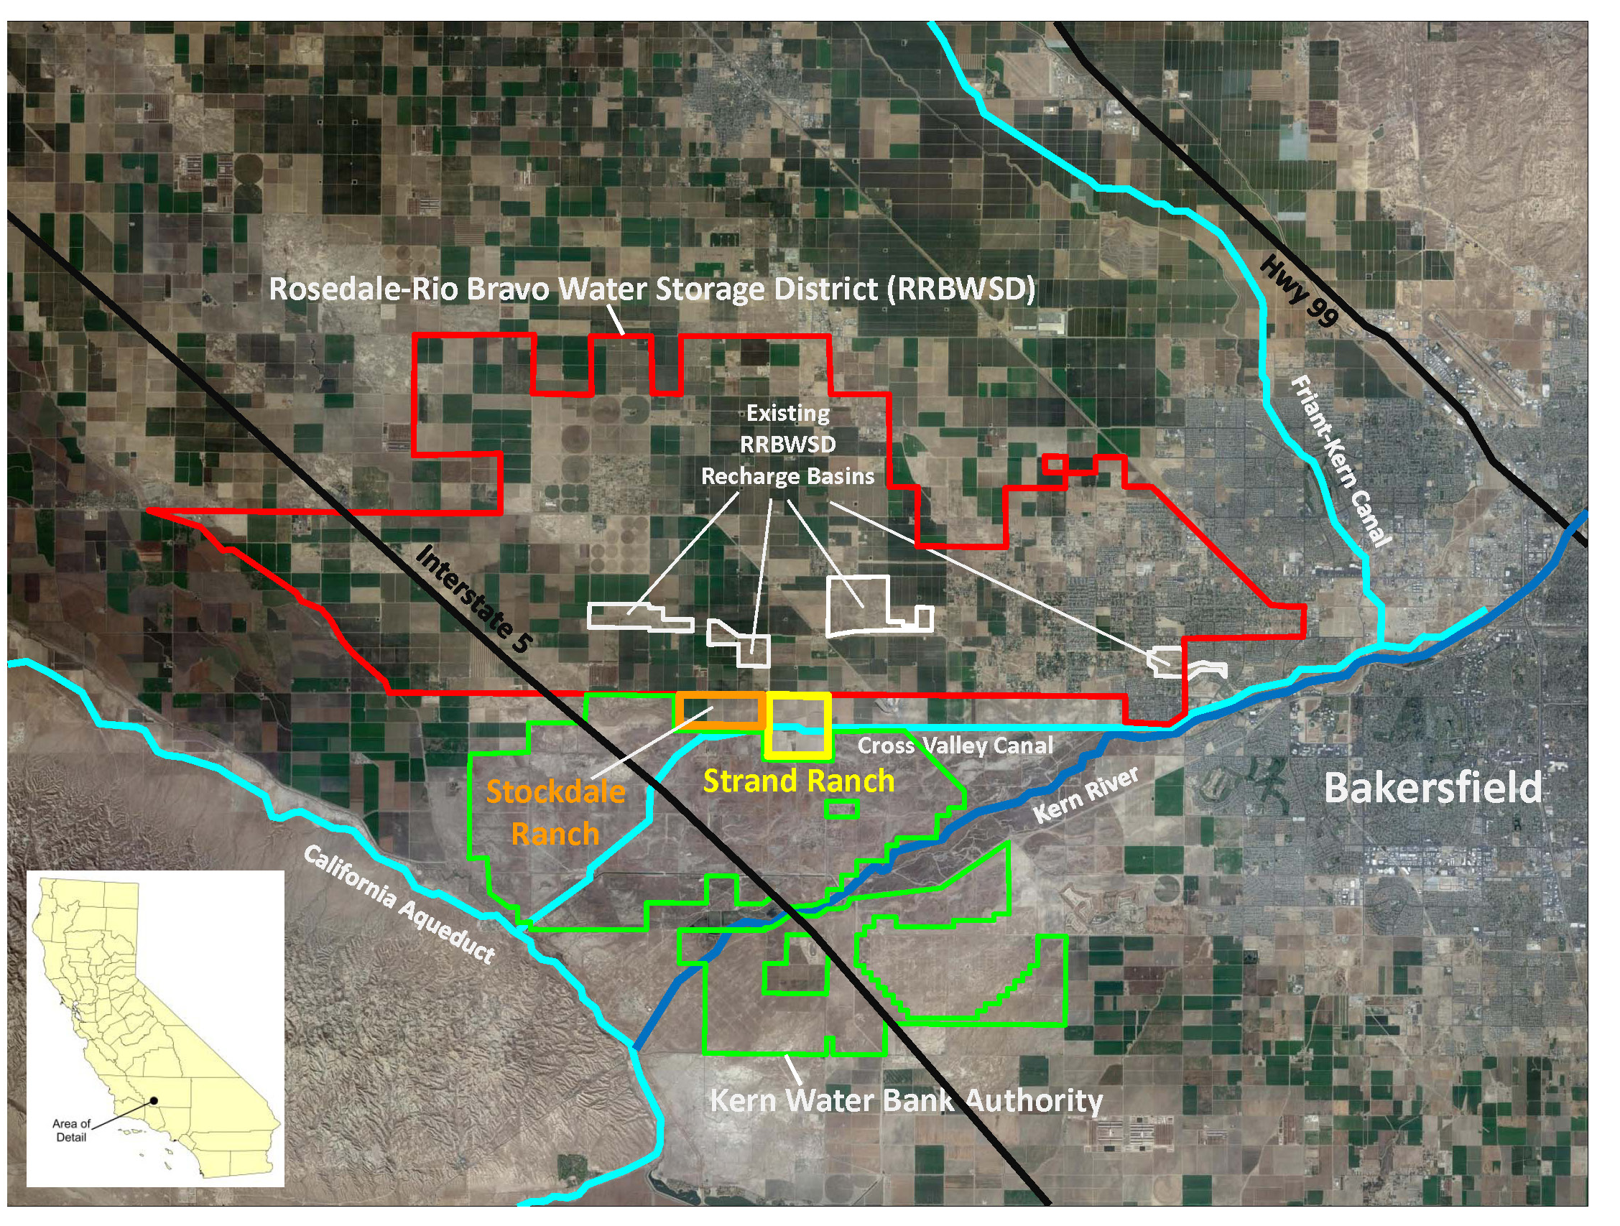
Kern Fan Project Location
1,200 acres of land well-suited for groundwater recharge, storage, and recovery
Overlays the Kern County Groundwater Sub-basin of the San Joaquin Valley
Strategically located near federal, state, and local water conveyance facilities

Slide 6
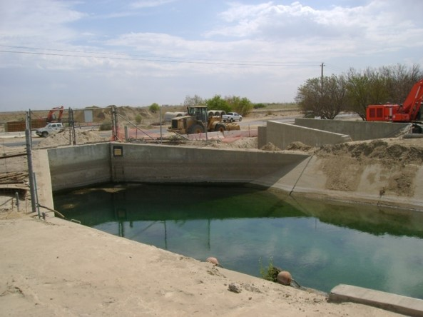
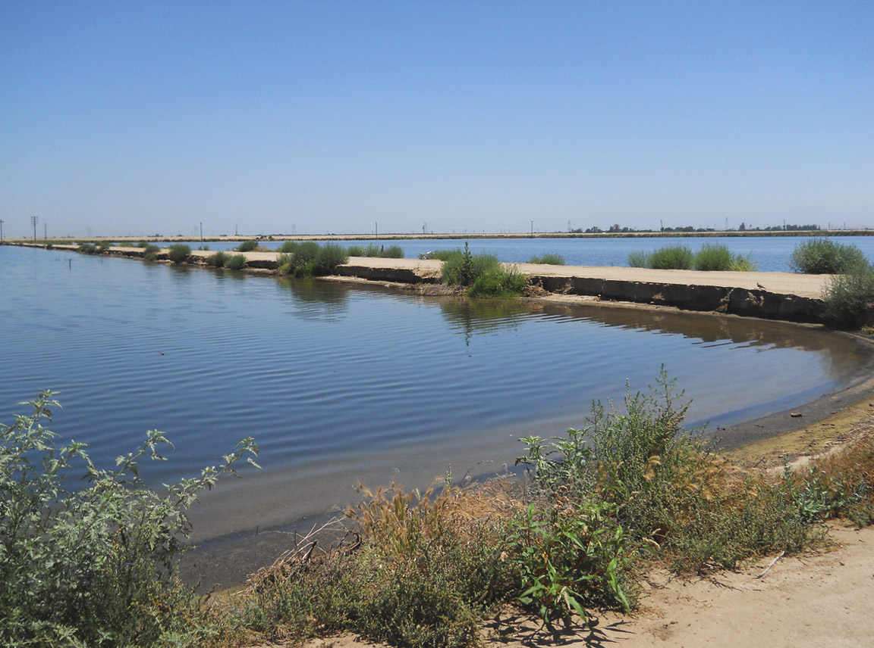
Proposed Kern Fan Project Facilities
Conveyance
New turnout from the California Aqueduct
Up to 10-mile canal with up to 500-cfs capacity
Recharge
1,200 acres of recharge basins
Up to 100,000 AF annually
Storage
100,000 AF
Recovery
12 wells, up to 70 cfs
50,000 AF per year

Slide 7
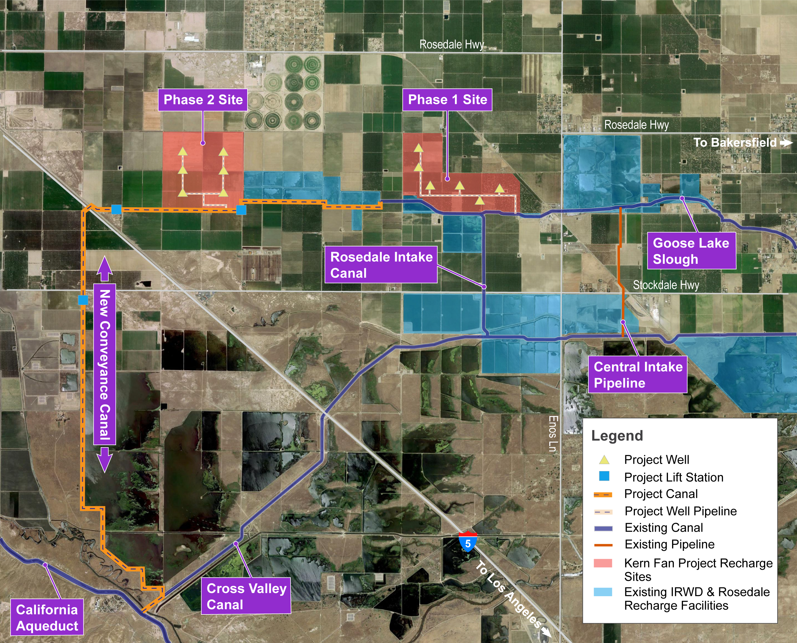
Preliminary Location of Proposed Project Facilities

Slide 8
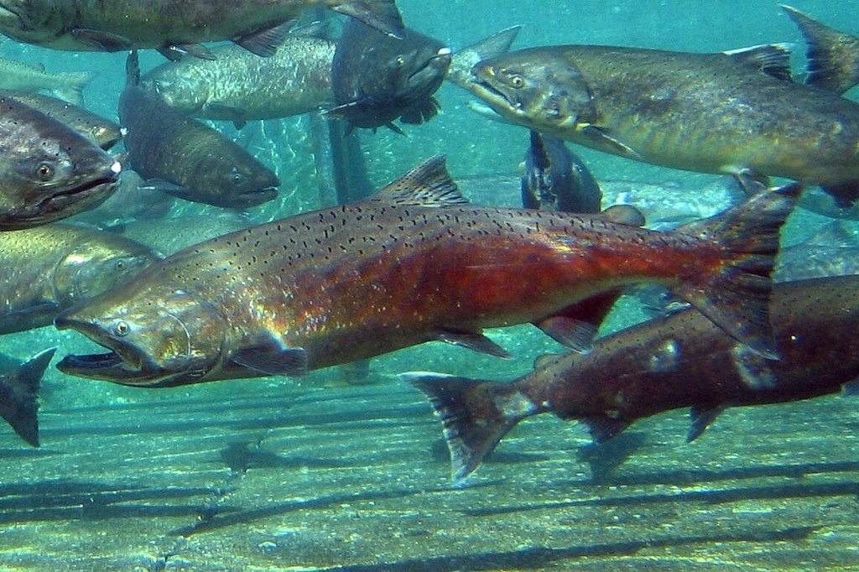
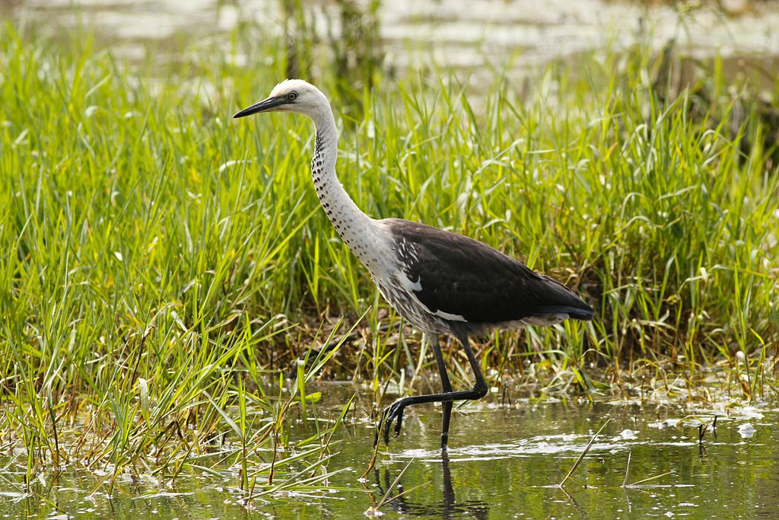
Kern Fan Project Benefits
Emergency Response:
Droughts and Delta levee failures
Ecosystem Benefits:
Reduces stress on the SWP to protect salmon
Flow for chinook salmon and green sturgeon
Intermittent wetland habitat

Slide 9
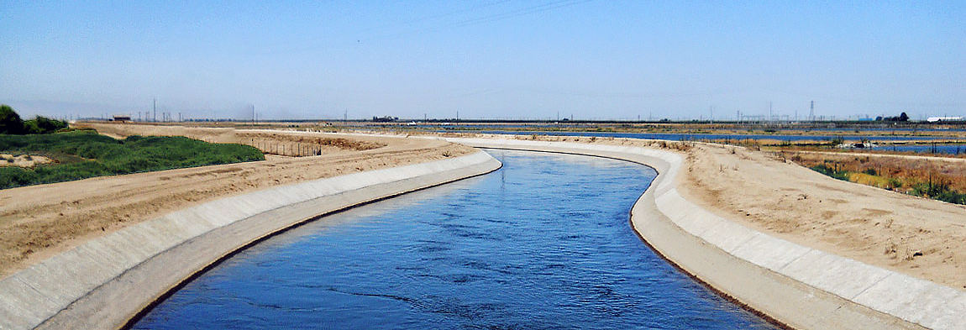
Kern Fan Project Operations
Project will store State Project water otherwise lost to the ocean
Unallocated Article 21 water
Via Dudley Ridge Water District & Kern County Water Agency
New water supply
Recharge up to 70,000 acre-feet during wet years
No impacts to State Water Project or contractors
No changes to water rights or contracts

Slide 10
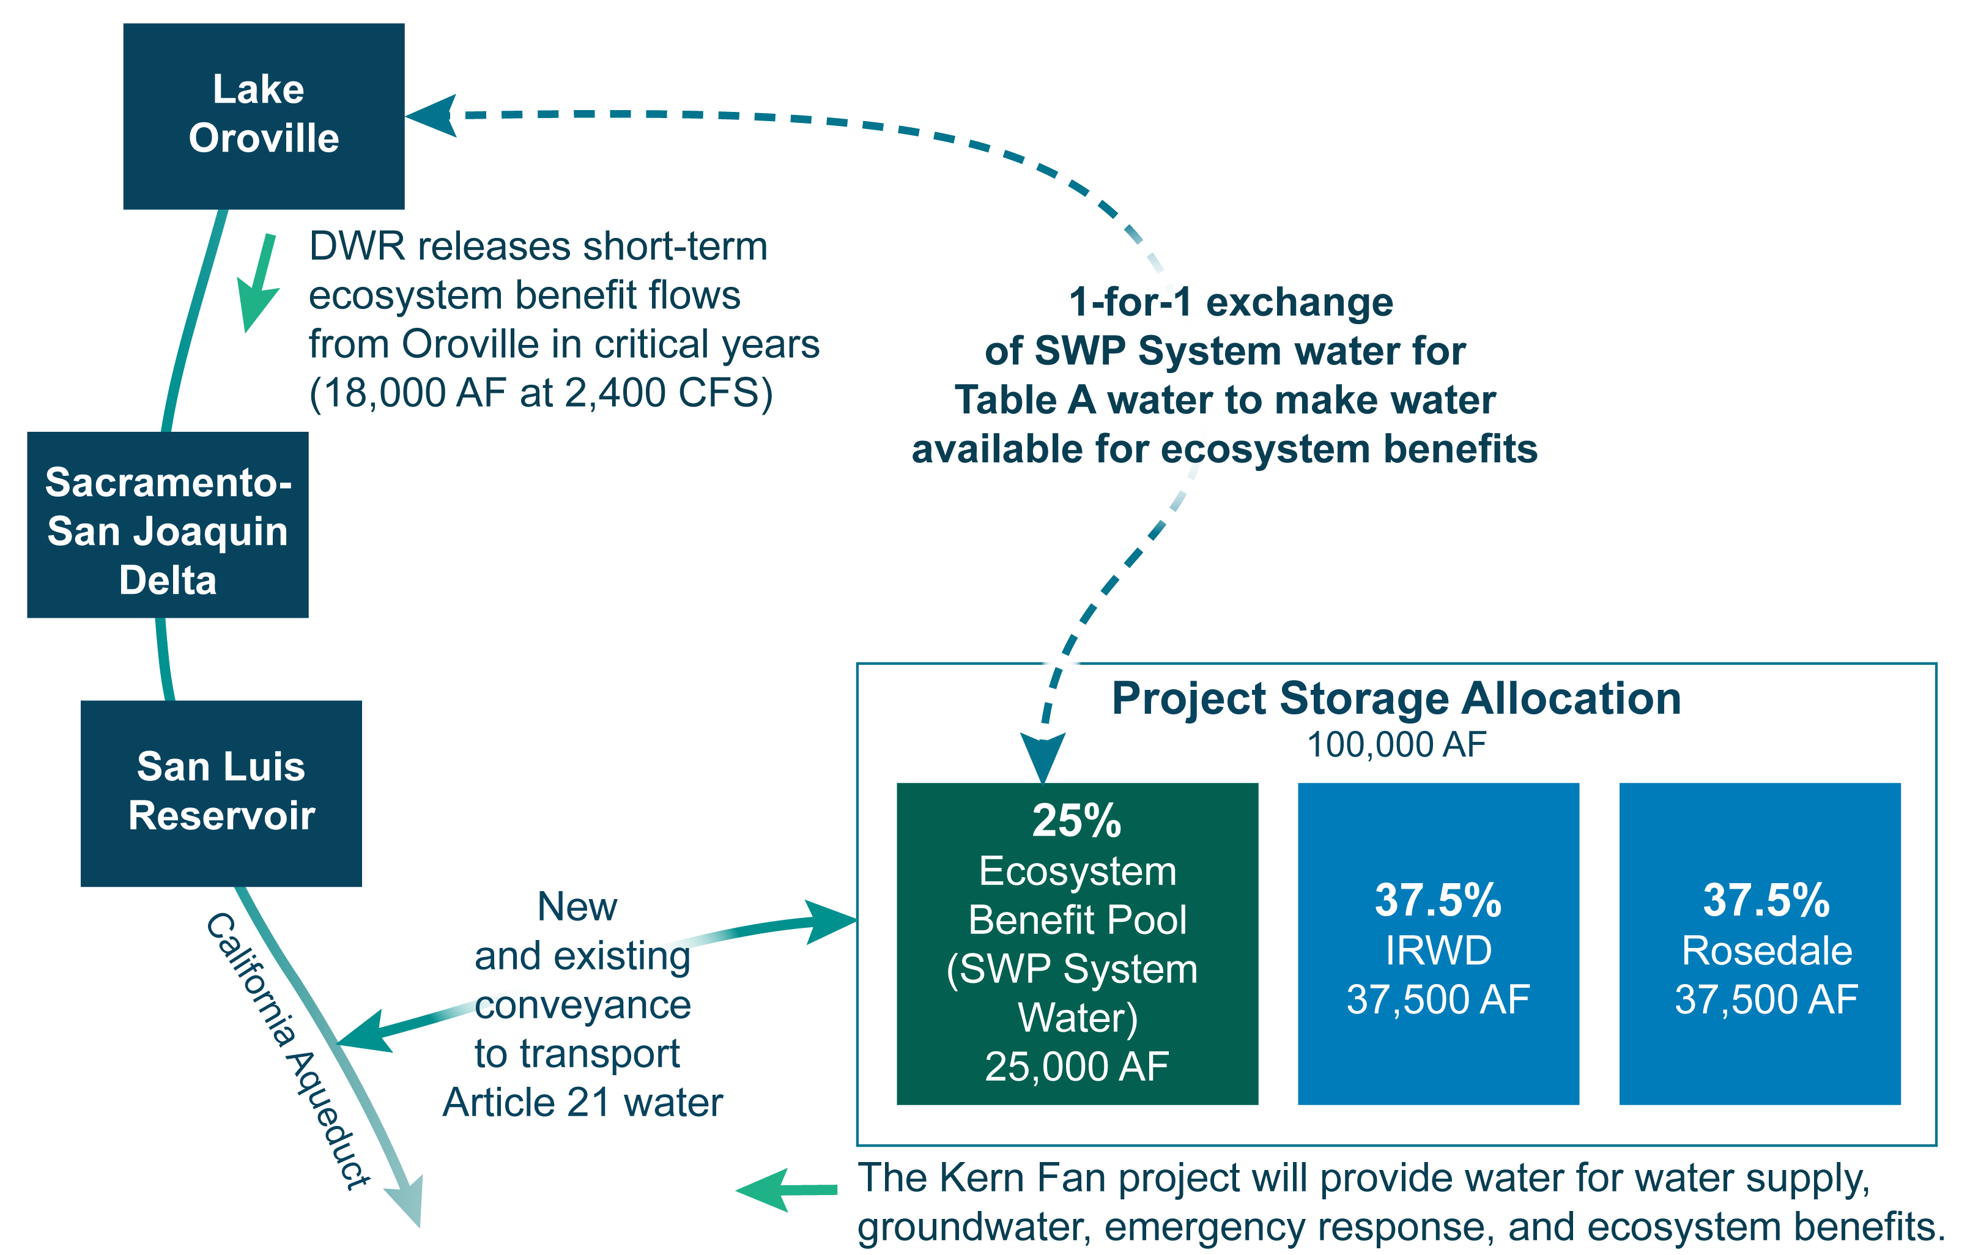
Kern Fan Project Operations

Slide 11
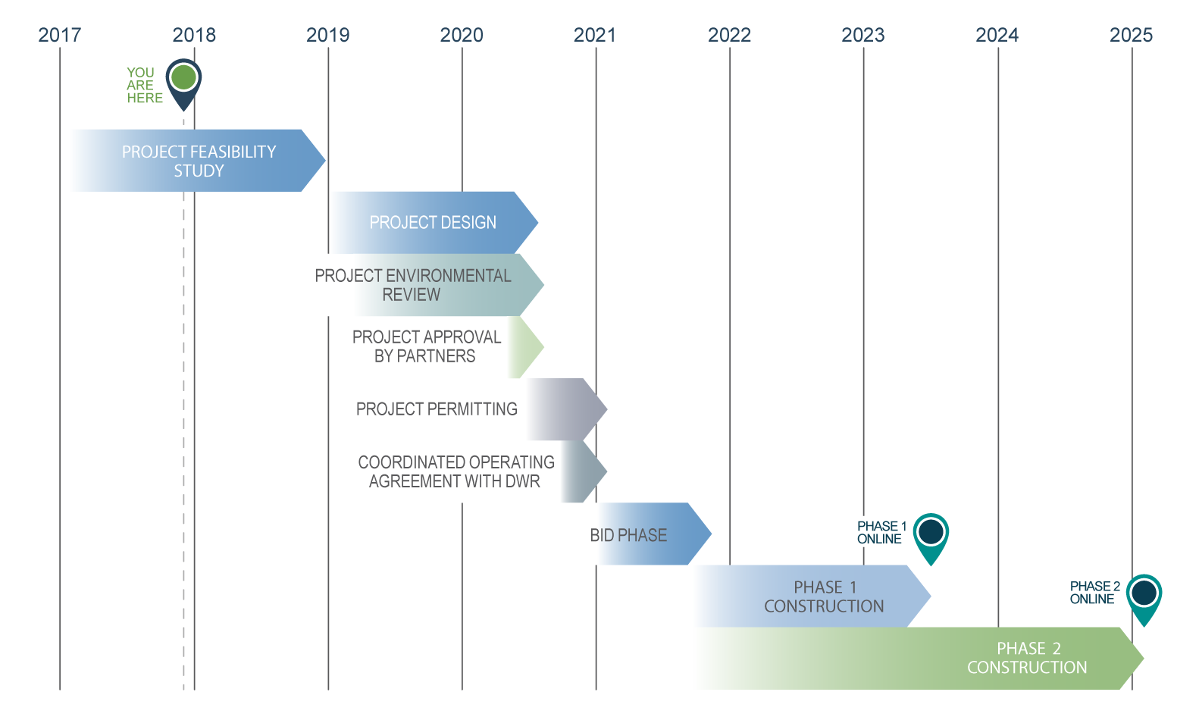
Kern Fan Project Timeline

Slide 12
Contact Information
Irvine Ranch Water District:
Paul Weghorst
Executive Director of Water Policy
Office: (949) 453-5632
weghorst@irwd.com
Rosedale-Rio Bravo
Water Storage District:
Eric Averett
General Manager
Office: (661) 589-6045
eaverett@rrbwsd.com

