Slide 1
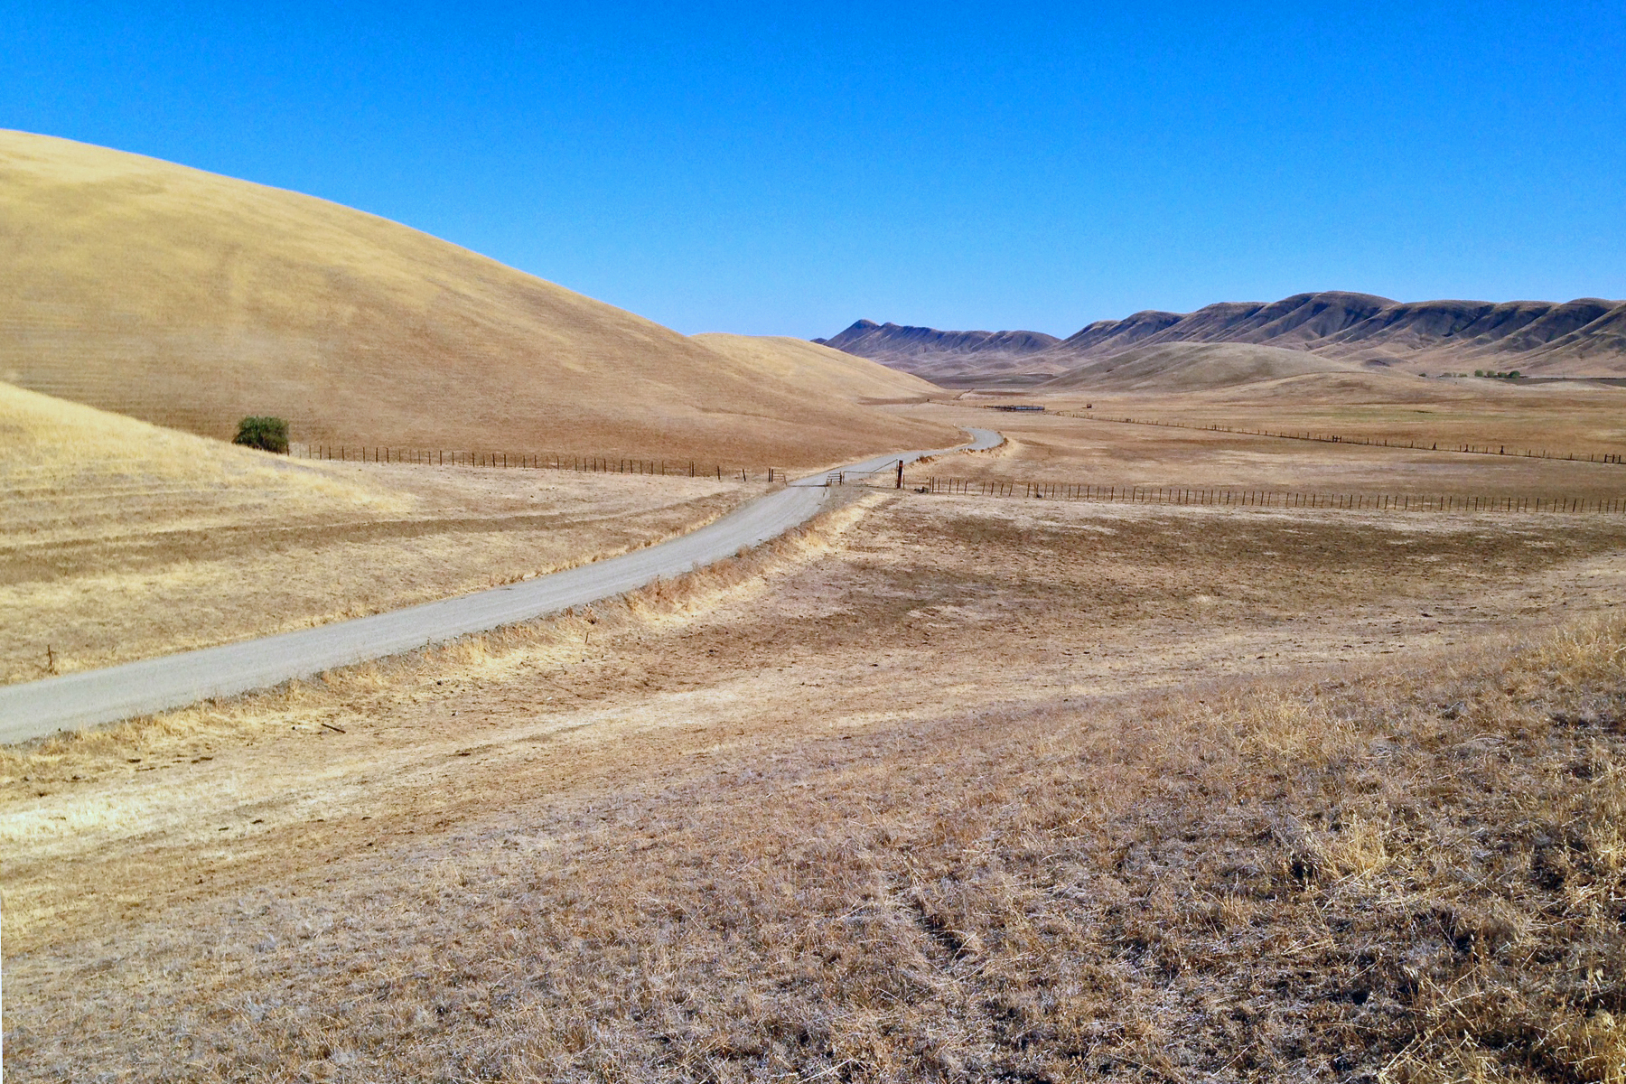
Sites Project: Increasing Dry Year Supplies
            Urban Water Institute
            February 28, 2019

Slide 2
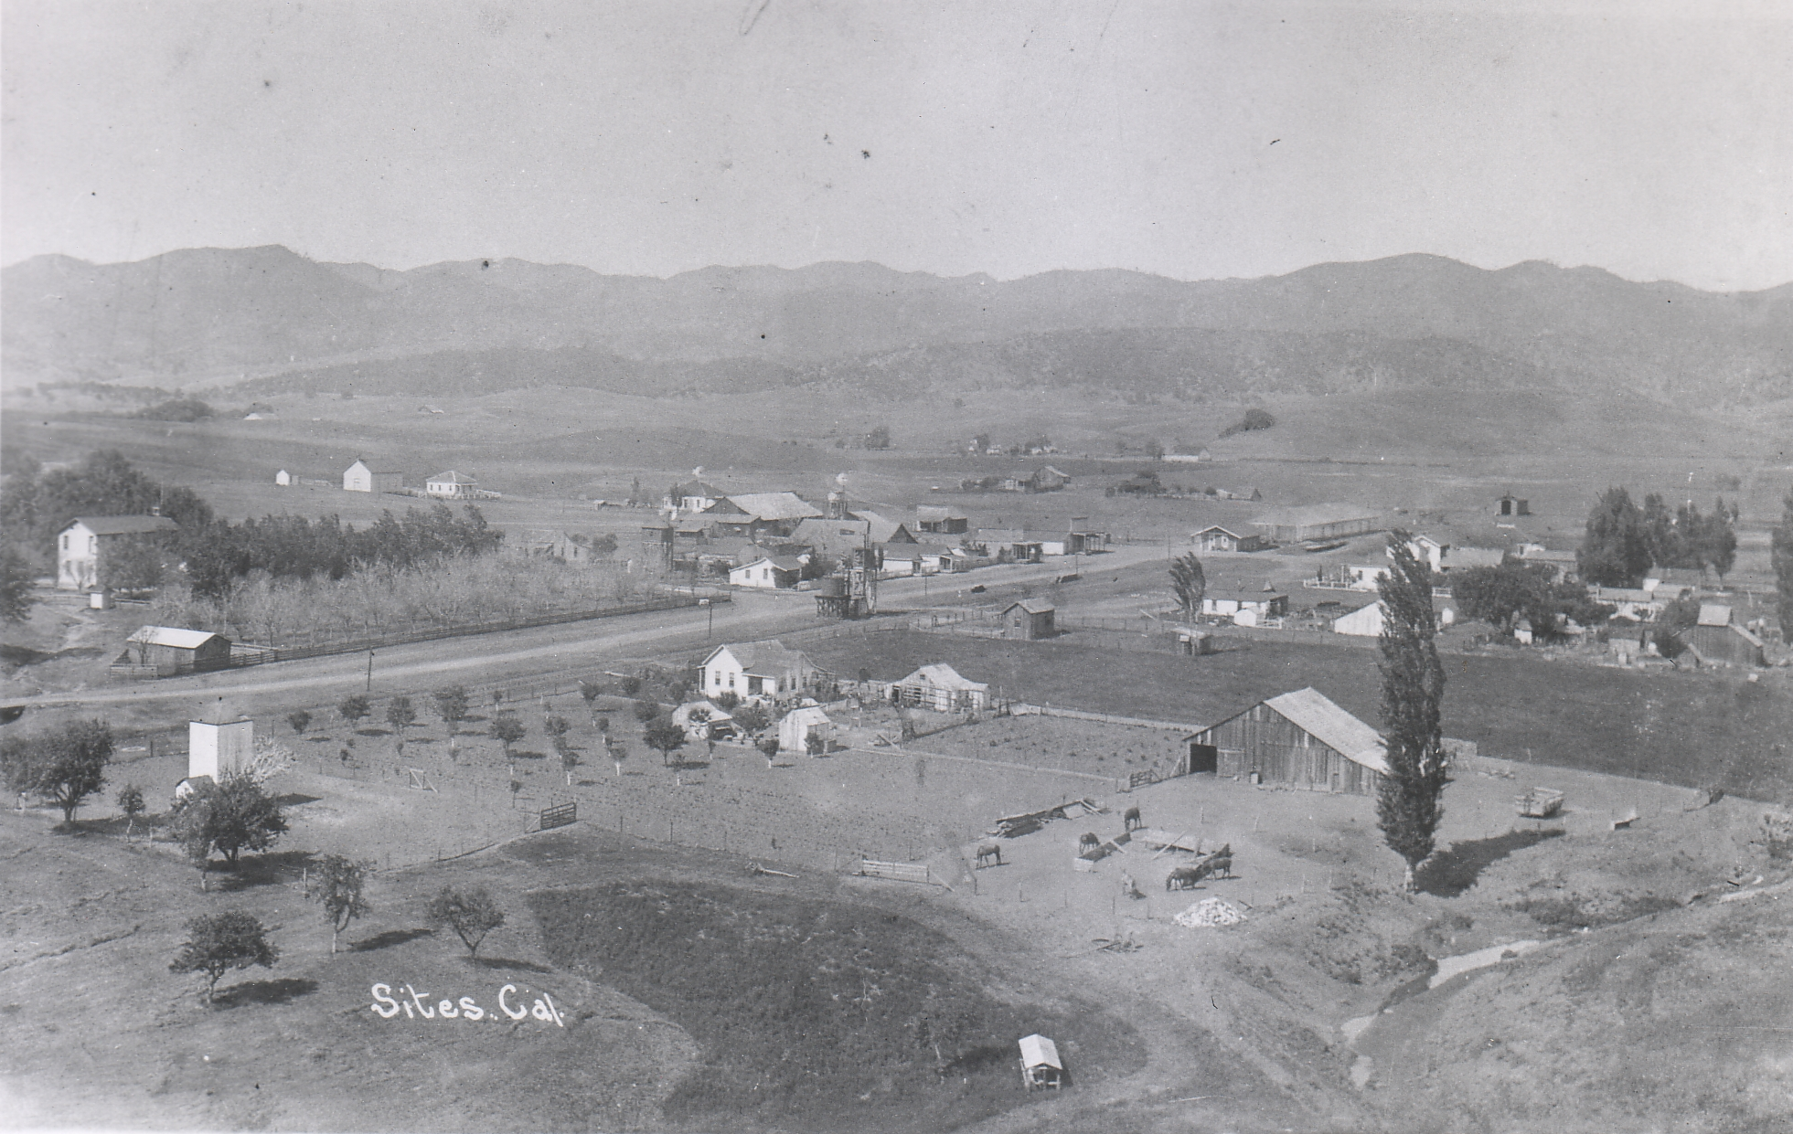
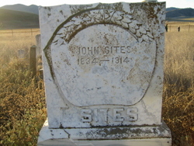
Why is it called Sites?
  Settled in 1850’s by John Sites
    Post office founded in 1887 (closed)
  Storage project identified by DWR in 1957
Town of Sites, Colusa County, circa 1910.
Notes:
German immigrant. Born 1832. Died 1914
Came to California – likely by the Carson Route
Descendants still ranch and farm in the valley

Slide 3
Sites Project Authority & Our Partners
Sacramento Valley
Authority Board (11 agencies) Acre-ft.
Colusa County 10,000.
Colusa County Water District 11,895.
Glenn County -
Glenn-Colusa Irrigation District 5,000.
Placer County WA & City of Roseville -
Reclamation District 108 4,000.
Sacramento Co WA & City of Sacramento -
Tehama-Colusa Canal Authority -
Westside Water District 15,000.
Associate Members (3 non-voting)
Maxwell Irrigation District -
Tehama-Colusa 4
Cortina Water District 300.
Davis Water District 2,000.
Dunnigan Water District 2,717.
LaGrande Water District 1,000.
Western Canal Water District -
Other (2 non-voting)
US Bureau of Reclamation (Cost-share) TBD
California Department of Water Resources -
(Ex Officio)
Sacramento Valley
Reservoir Committee Acre-ft.
American Canyon, City of 4,000.
Carter MWC 300.
Beyond the Sacramento Valley
Reservoir Committee Acre-ft.
Antelope Valley-East Kern WA 500.
Coachella Valley Water District 10,000.
Desert Water Agency 6,500.
Metropolitan Water District 50,000.
San Bernardino Valley Muni WD 21,400.
San Gorgonio Pass Water Agency 14,000.
Santa Clara Valley Water District 16,000.
Santa Clarita Valley Water Agency 5,000.
Wheeler Ridge-Maricopa WSD 3,050.
Zone 7 Water Agency 10,000.
Total acre-ft: 192,662.
Reservoir Comm: 21 Agencies
Working Draft dated 2019 Feb 22

Slide 4
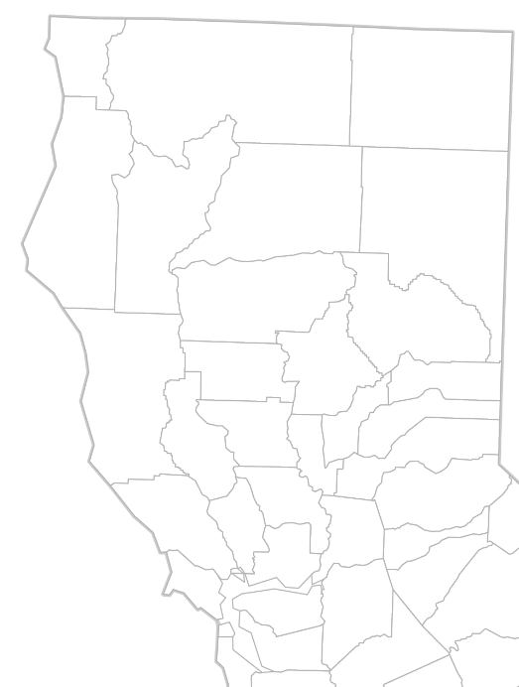
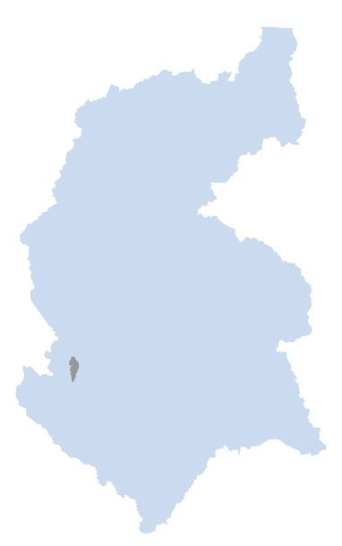

What is Sites?
  Locally led and beneficiary pays
  Large offstream surface
  water storage
    Benefits endangered species
    and wildlife refuges
    Increases water supply in
    drier years
    Reduces local flood risk
    Is more effective with climate
    change
  Supports the state’s co-equal goals
  Can adapt to and integrate with renewable energy
Shasta
TC Canal
GC Canal
Oroville
Sites
Folsom

Slide 5

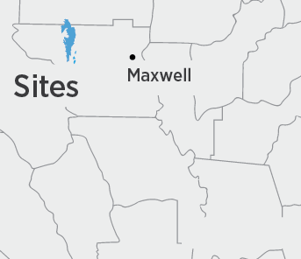
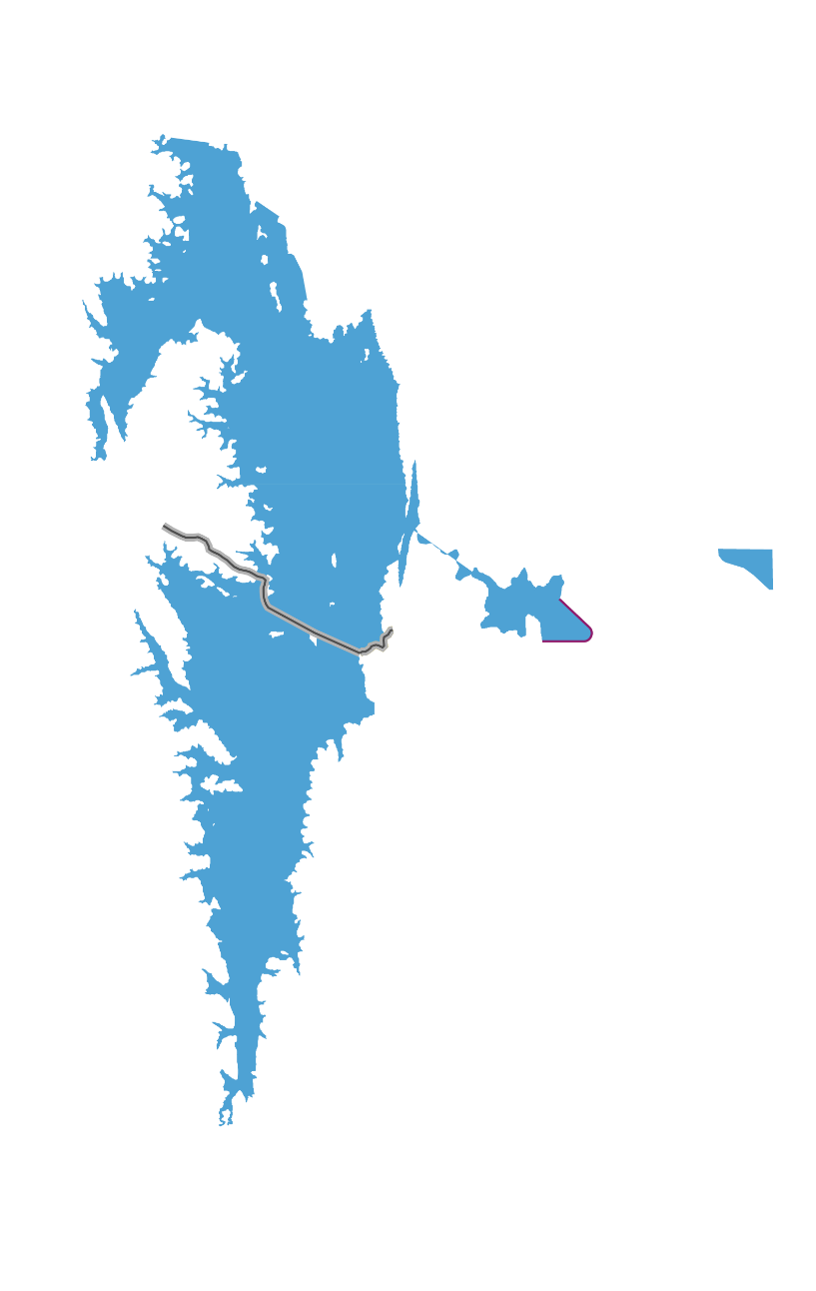
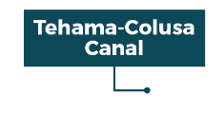
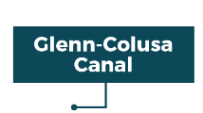


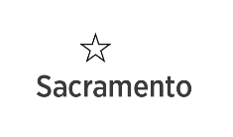
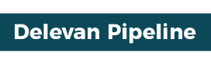

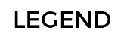

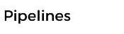

Project Facilities
Sacramento River
Maxwell
Pumping Plants
5

Slide 6
Primary Benefits
SJ Valley Ag (1)
200,000 acre-feet/year
Sacramento
Valley Ag (10)
Annualized Water Benefits
(long-term avg)
Bay Area (3)
Southern California (7)
Salmon &
Operational Flexibility
Available Capacity
Delta smelt & Wildlife Refuges
Loses
Water: Local (21) Federal California
Flood Reduction: ü ü ü
Recreation: ü ü ü
Renewable Power: ü ü
SGMA compliance: ü
Economic production ü Rural Development
Page 6
Notes:
To recalculate pie wedges, use Excel File: Phase 2 (2019) Reservoir Project Agreement-Exhibit A(Latest Version).xls

Slide 7
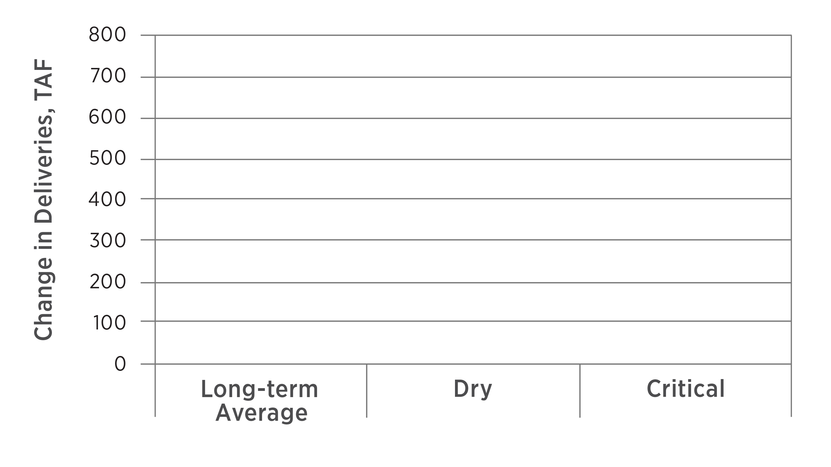
Increases Deliveries in Drier Years
Increases Deliveries
Projected Water Delivery Increase, TAF
2030 Projection
Water Supply North
Water Supply South
Ecosystem Benefits
(Proposition 1-eligible)

Slide 8
Drought Management - Today
(Storage in Shasta, Oroville, & Folsom)
8
Level at which DWR and Reclamation submitted a Temporary Urgency Change Petition on January 29, 2014
Notes:
Click for red line. Then, click for Sites (green bars)
Tools used in last drought: Effectiveness:
Curtailed lower-value uses Limited (hardened system)
Voluntary actions & agreements Marginal results w/o funding
Curtailed junior water right holders first Significant acre-feet
Waivers were negotiated (TUCP) To “close the gap”

Slide 9
Drought Management – with Sites
(Storage in Shasta, Oroville, Folsom, & Sites)
9
Level at which DWR and Reclamation submitted a Temporary Urgency Change Petition on January 29, 2014

Slide 10
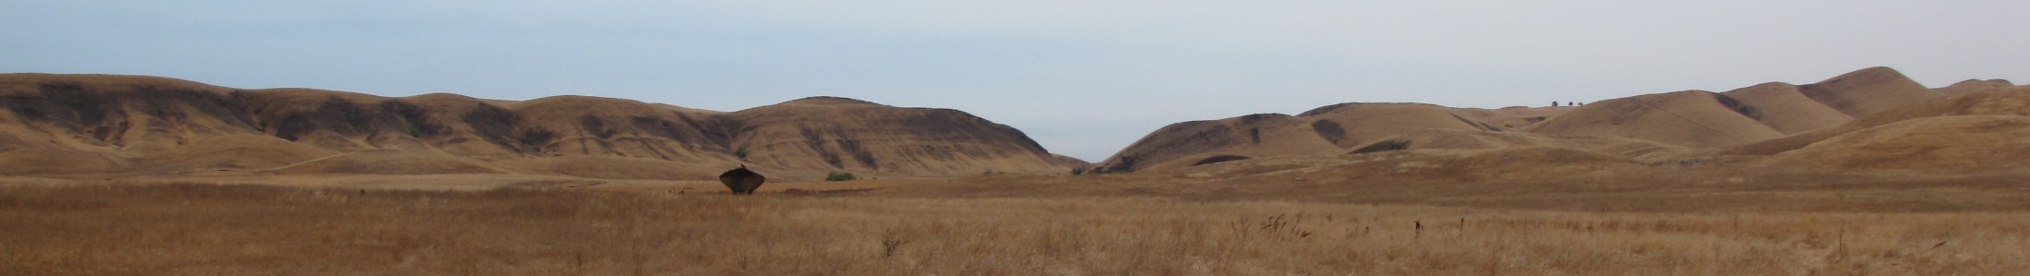
Phase 1 Accomplishments:
Authority became the CEQA Lead agency (2017)
Strong water industry support
Strong bipartisan support: 43 CA Congressional Reps.
Business and labor support
USBR increasing participation from 12% to 25%
$ 10.3 WIIN Act (FY2017 & 19)
$ 816.3 million Proposition 1 ($ 40.8 m for early)
$ 449.2 million USDA conditional construction loan
Notes:
Phase 1: Only 1 funding source
Phase 2: 3 funding sources

Slide 11
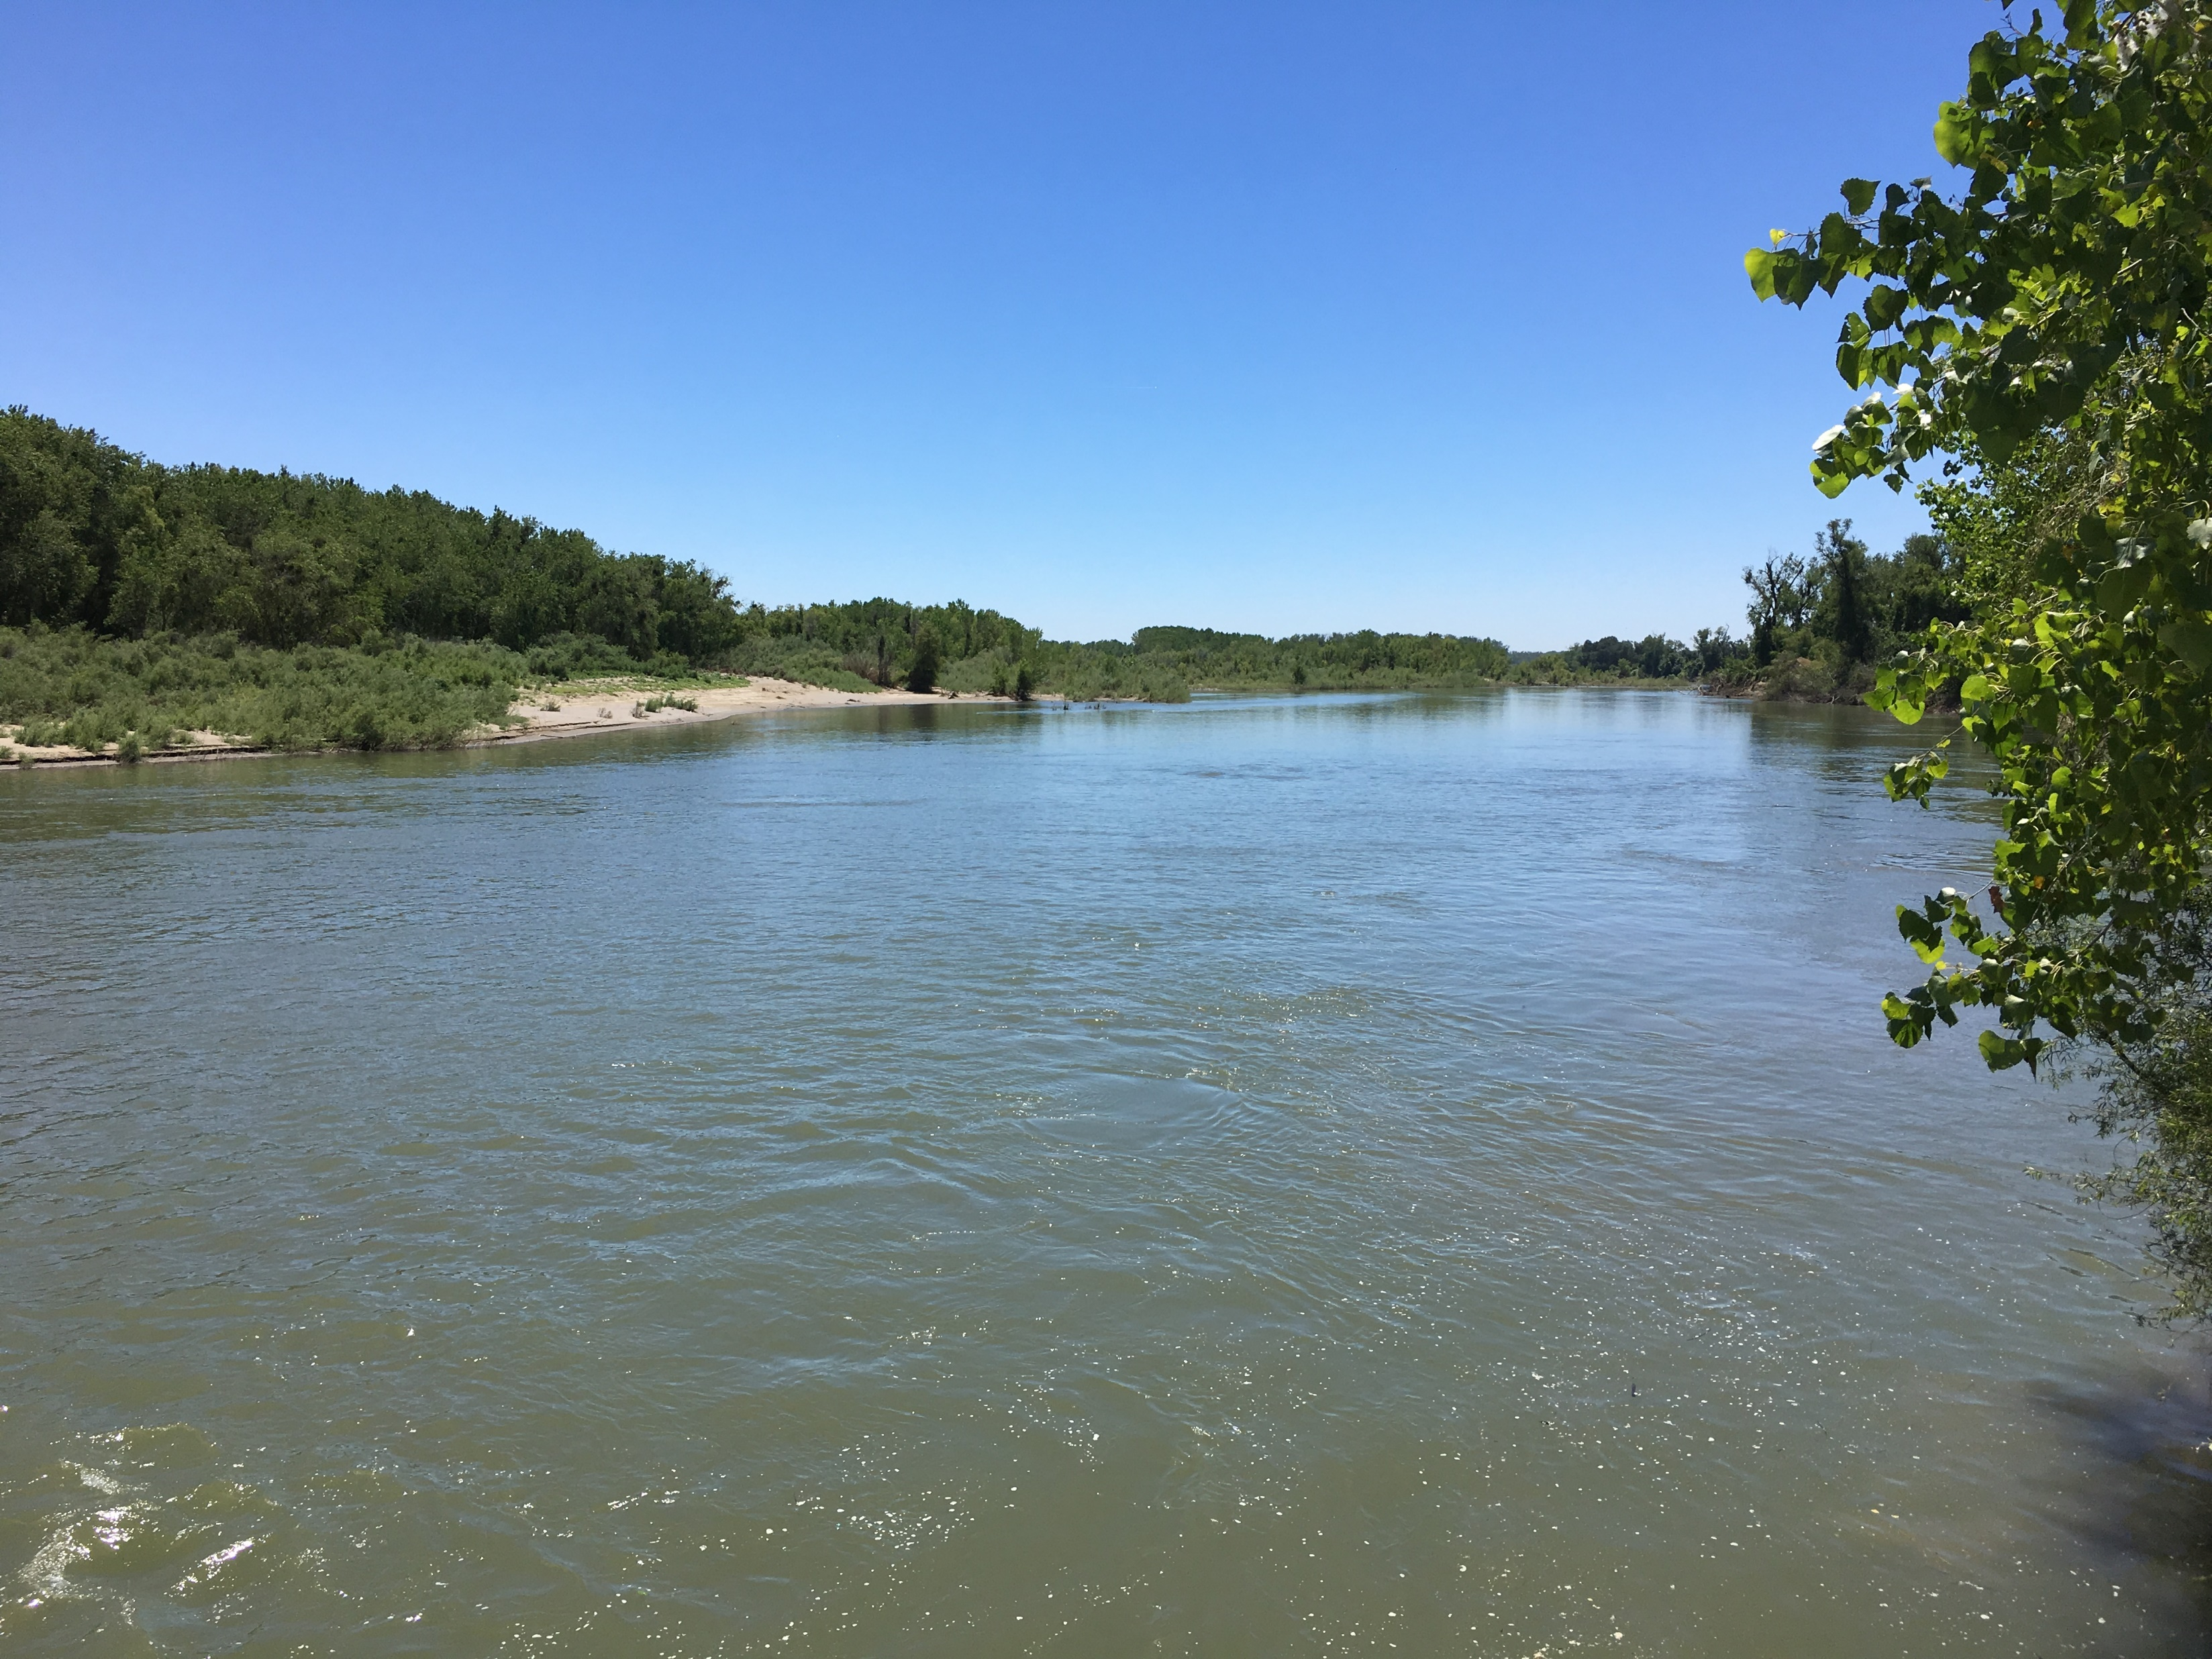

Slide 12
Challenge #1: Establishing Trust
Partners: Objective:
CVP & SWP Operators Maximizing water benefits to achieve co-equal goals & improve system flexibility
Local water agencies Water industry support, improve local water
supply reliability, & incentivize cooperative operations of state’s water system
CA Water Commission Produce water-based environmental benefits
Bureau of Reclamation Produce water-based environmental benefits &
improve operational flexibility of the CVP
Access to lower-interest financing (WIFIA)
Public Resource Agencies Active protection & conservation of fish &
wildlife species
Environmental interests Ensure limited public funds used to produce
environmental benefits are prioritized to maximize the benefits achieved
Communities Local acceptance & support
Bankers Low-cost financing to improve affordability
Business & Labor Cost-effective & accelerated delivery
Notes:
9 types of key Partnerships
Water Agencies
Operators CVP/SWP
Water Commission
Reclamation
Resource agencies
Environmental Organizations
Communities
Bankers
Business and labor

Slide 13
Why Sites?
  Restores systemwide reliability
  Reduce affects of SGMA
  Produces Environmental Water
    100,000+ for Salmon on Sac. R
    30,000+ for Delta smelt
    15,000+ for wildlife refuges
    Capacity available to do more
    More water in dry & critical years
    When operational, can contribute water towards Voluntary Agreements
Shasta
TC Canal
GC Canal
Oroville
Sites
Folsom

Slide 14
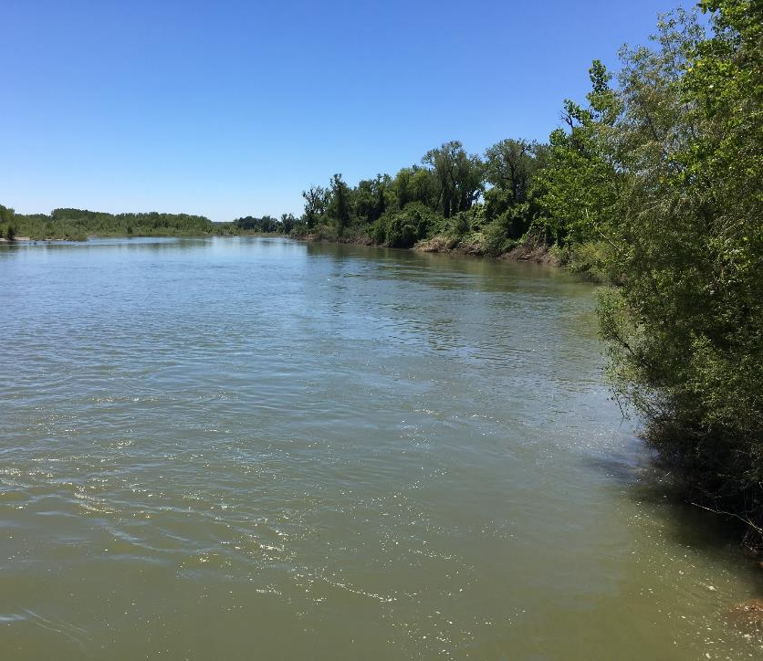
Setting:
All water in the river provides some measure of ecologic value
Future hydrologic conditions will become more volatile
During dry years and
in late summer/fall,
water will become a
scarce resource
Implementation of SGMA
will require additional
surface water resources

Slide 15
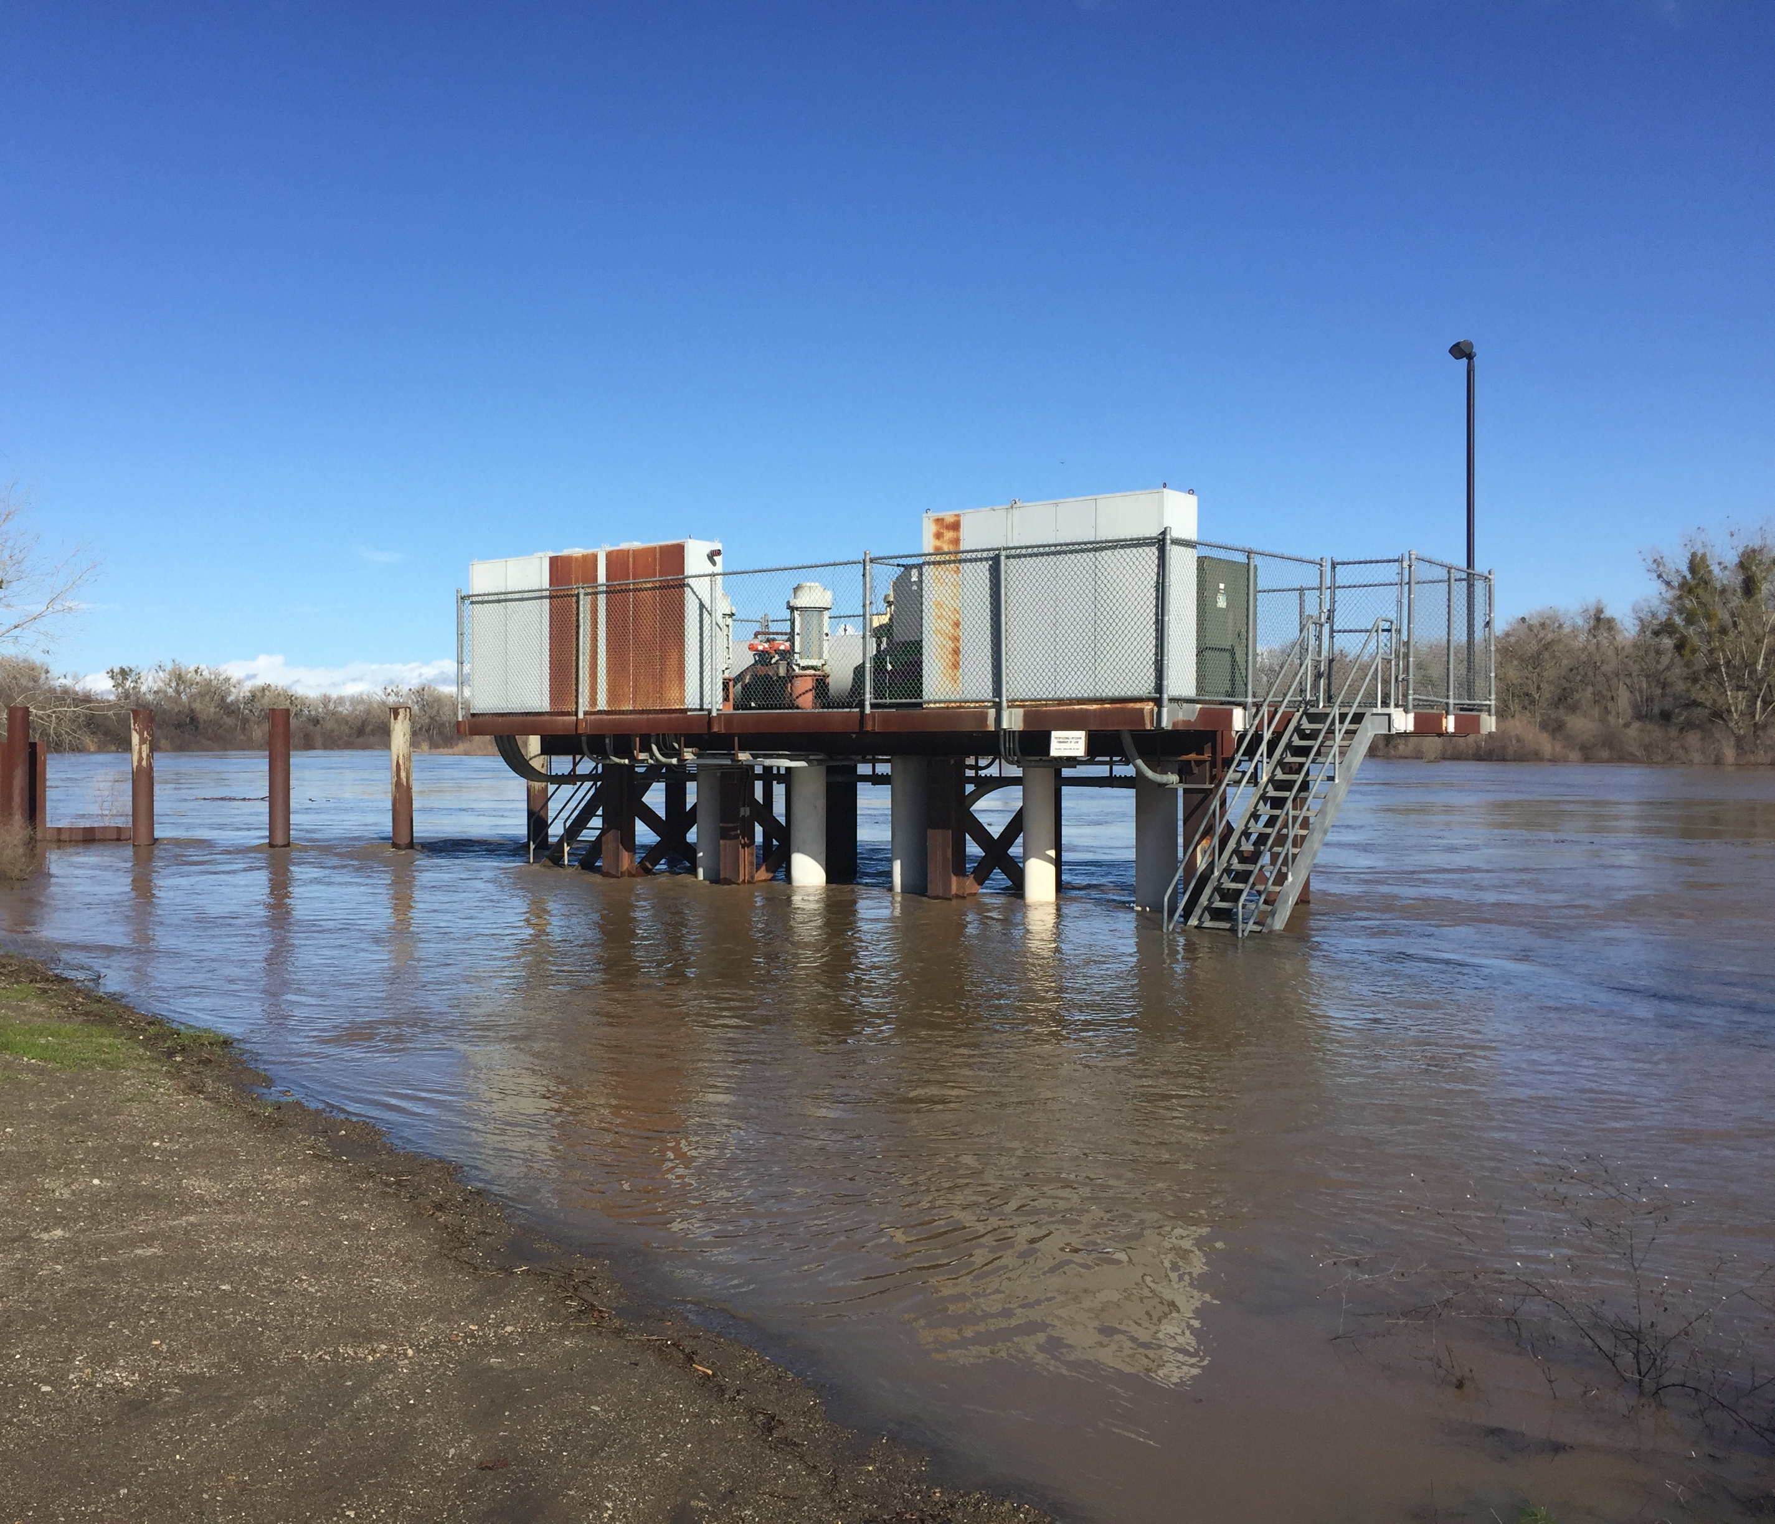
Proposed Operations:
Diverts stormwater when:
  All regulatory measures are met
  All water rights are protected
  Key ecologic services are completed
Cooperatively operates
with existing reservoirs
Releases water when
and where it can provide
the greatest ecologic
values and water supply benefits

Slide 16
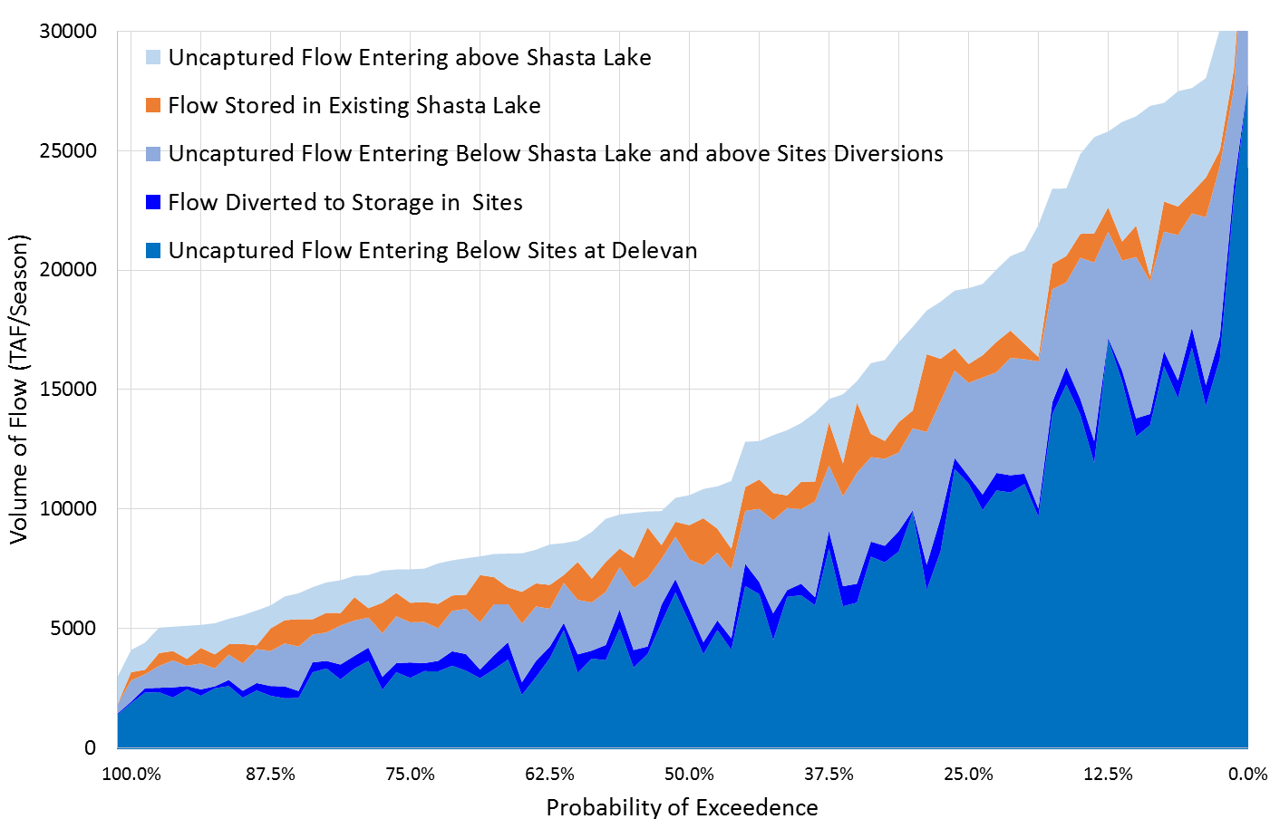
Sacramento River Flows (with Climate Change)
2017
2016
Available to fill Sites Reservoir
Critical
Wet
Tributaries below Keswick

Slide 17
What Makes Sites Different?
  Offstream
  Increases regional storage by 15%
  Locally-led & beneficiary pays
  Support’s state’s co-equal goals
  Creates a water asset for resource agencies to manage in real time
  Cooperative & adaptive operations
  Integrates with renewable power
Shasta
Oroville
Sites
Folsom
17
Notes:
Offstream
15% additional storage
Local sponsorship
Supports state’s co-equal goal
An environmental water budget
Cooperative & adaptable operations
Provides storage to integrate with renewable solar and wind energy

Slide 18
Key Differentiators
Locally led with state
and federal participation
Increased support & more cost-effective implementation
  Use of alternative delivery methods (time & costs)
  Staggered dam approvals for earlier benefits
  Participants have greater control (construction & operations)
Federal and State water contractor participation
Water industry support facilitates approvals
Incentive for cooperative operations w/ CVP and SWP
State’s role (Prop 1)
Environmental water to help smelt & wildlife refuges
(DWR will likely to be the water manager)
Resource agencies have both permit and asset management responsibilities (COI)
  Reclamation’s role
  (non-reimbursable participation up to 25%)
Environmental water will improve salmon runs
Improve operational flexibility for the CVP
Facilitates integration with renewable energy
Current Federal Climate
(Bipartisan support for
water infrastructure)
Access to low-interest financing (WIFIA & USDA)
Fast-tracks environmental compliance of critical water projects in CA (Oct 19, 2018 Memorandum)
Interior & Commerce designate 1 lead agency
2019 Jan 26 Draft

