Slide 1
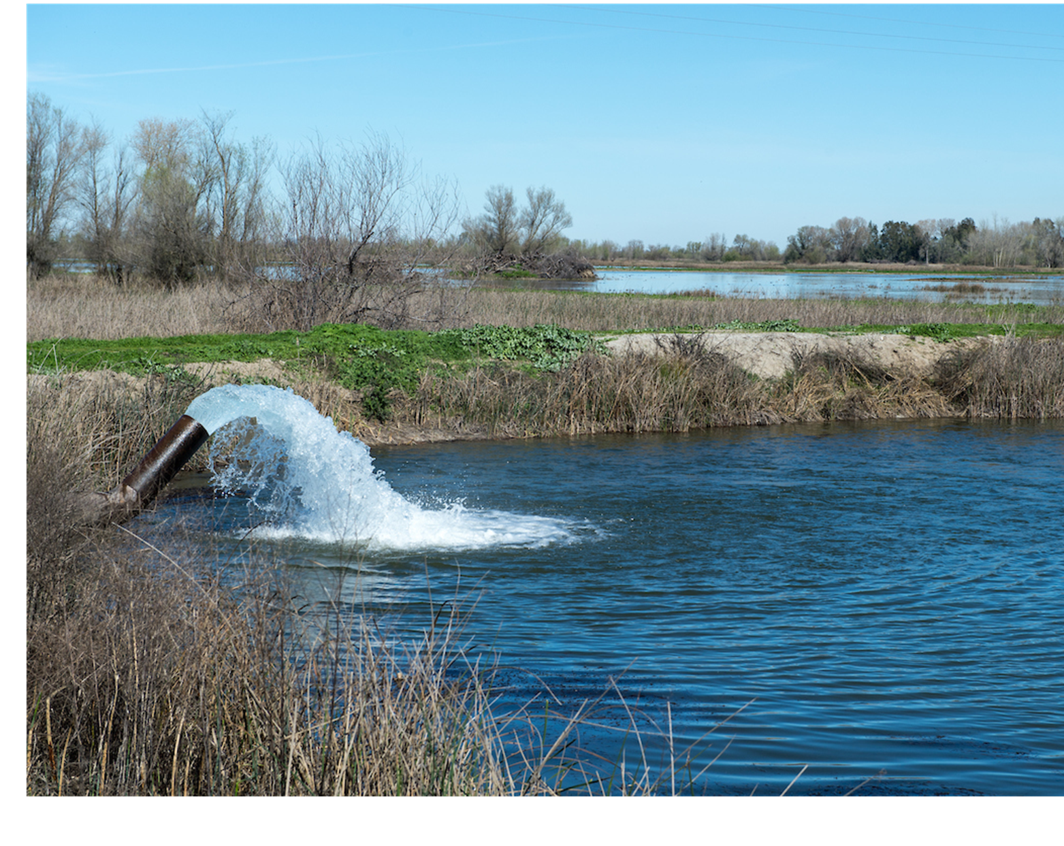

Trevor Joseph, PG, CHG
Hydrogeology Practice Lead
SGMA Planning Considerations

Slide 2
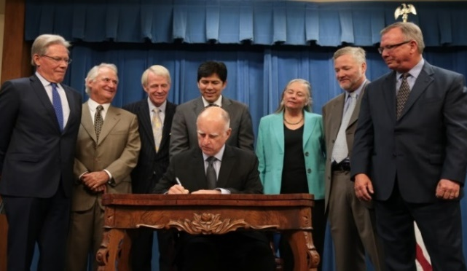
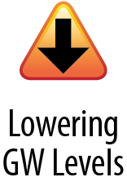
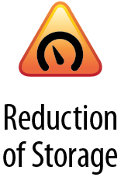

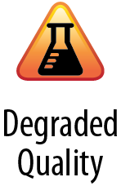
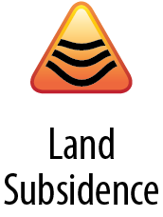
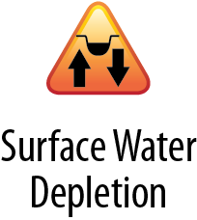
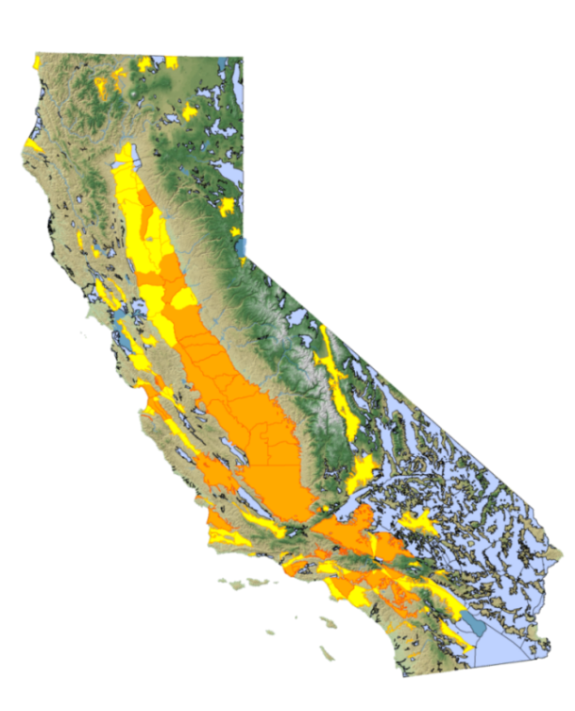
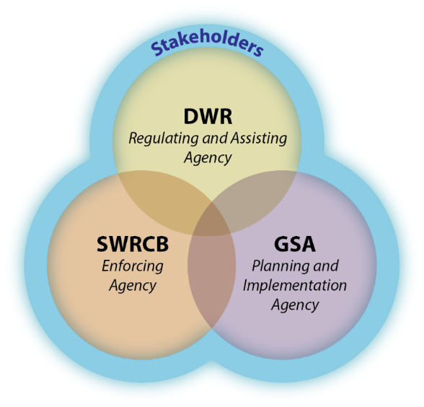
SGMA Overview
Local Control
Sustainability
Avoid Six Undesirable Results
“A central feature of these bills is the recognition that groundwater management in California is best accomplished locally.”
Governor Jerry Brown, September 2014
Groundwater Sustainability Plans required for high- and medium- priority basins by 2020/22
Source: Department of Water Resources

Slide 3

How is Sustainability Defined?
Achievement of Sustainability Goal
A single sustainability goal for the basin
Achieved within 20 years of GSP implementation
Maintained without causing undesirable results
Sustainability
Goal
“A central feature of these bills is the recognition that groundwater management in California is best accomplished locally.”
Governor Jerry Brown, September 2014
Sustainable Groundwater Management
GSP Implementation
Sustainable Yield
Achieved by 2040/42
Avoid Undesirable Results
Undesirable Results
Significant and Unreasonable
Source: Department of Water Resources

Slide 4
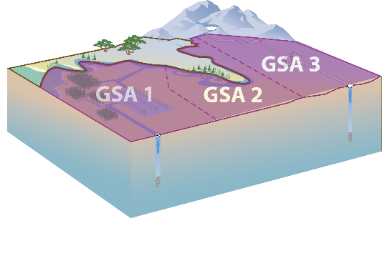
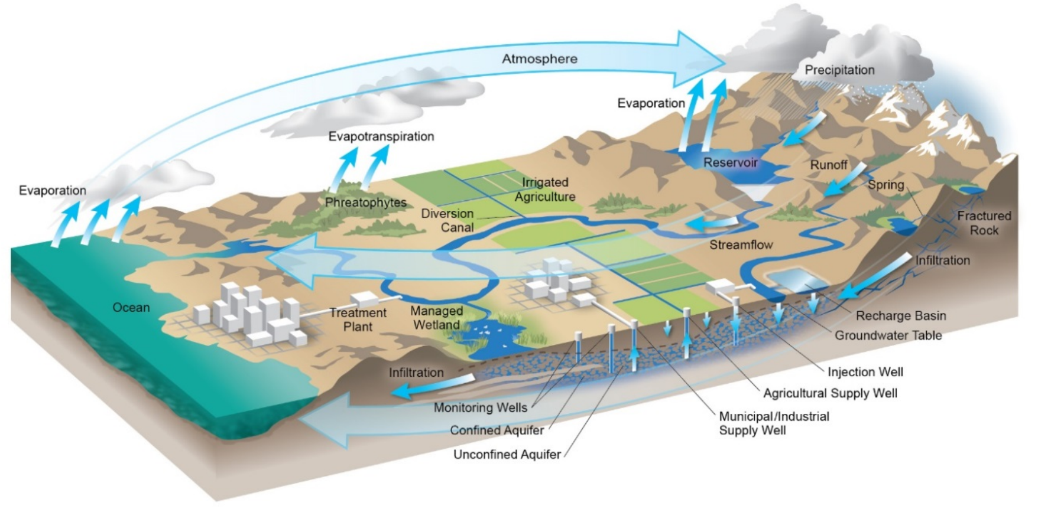
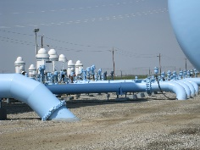
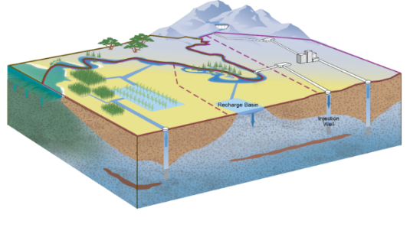





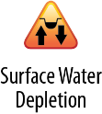
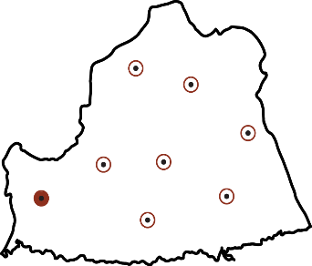
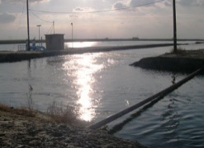
Groundwater Sustainability Plan (GSP) Components
Who
- Administrative Information -
What
- Basin Setting -
Corrective
Actions
GSP
Where
- Sustainable Management Criteria -
- Monitoring Network -
How
- Projects & Management Actions -
Source: Department of Water Resources

Slide 5
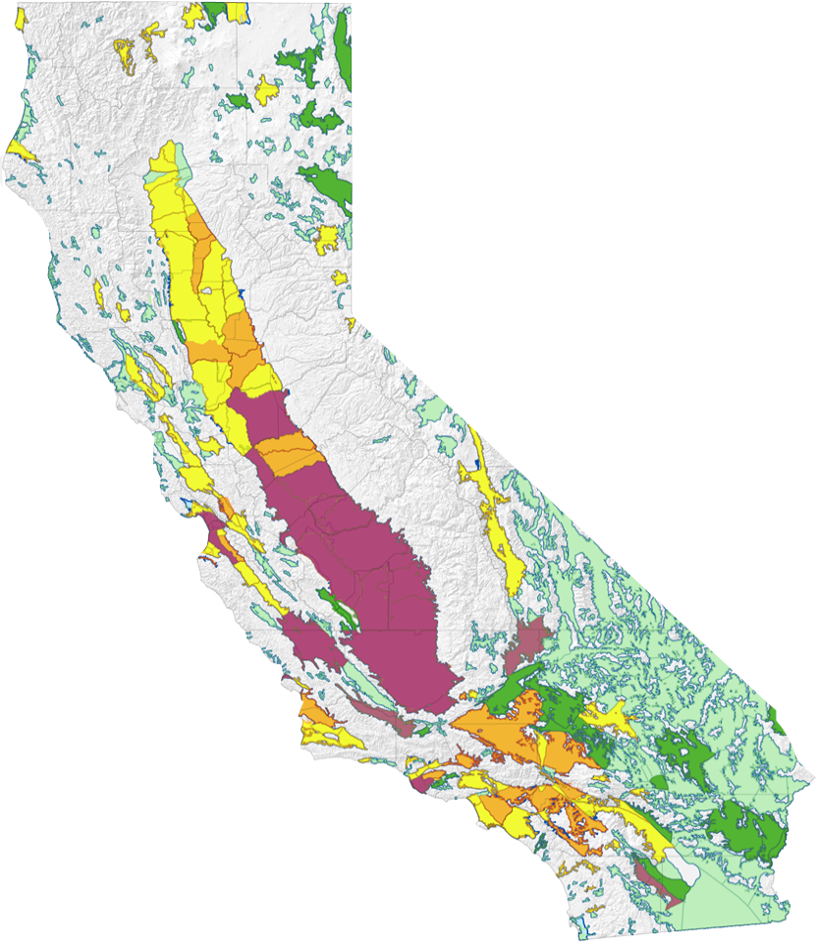
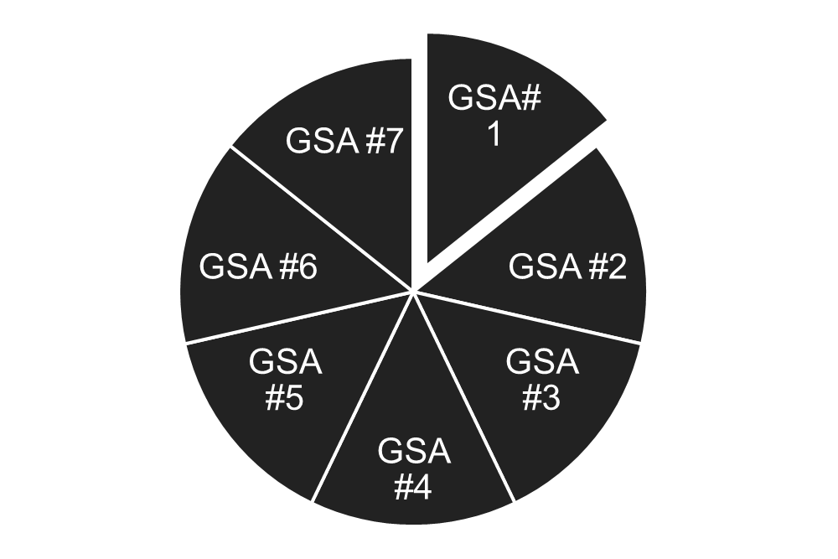
Challenges
Initial focus is largely implementing demand reduction
Integration of groundwater management with regional and statewide planning
High
Medium
Low
Very Low
Critically Overdrafted (COD)
Source: Department of Water Resources
dividing the pie

Slide 6
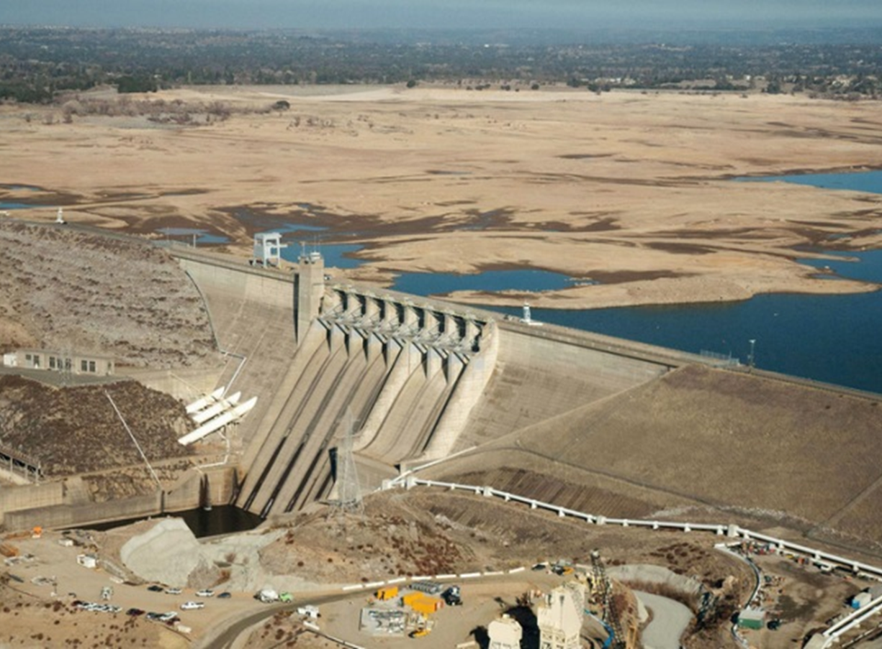
SGMA Uncodified Findings
“Sustainable groundwater management in California depends upon creating more opportunities for robust conjunctive management of surface water and groundwater resources.
“Climate change will intensify the need to recalibrate and reconcile surface water and groundwater management strategies”

Slide 7
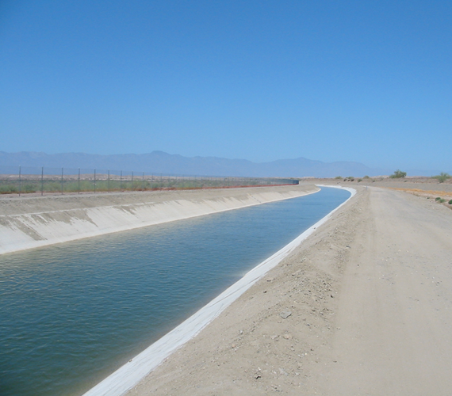
SGMA Legislative Intent
“To enhance local management of groundwater consistent with rights to use or store groundwater…“
“To increase groundwater storage and remove impediments to recharge”

Slide 8
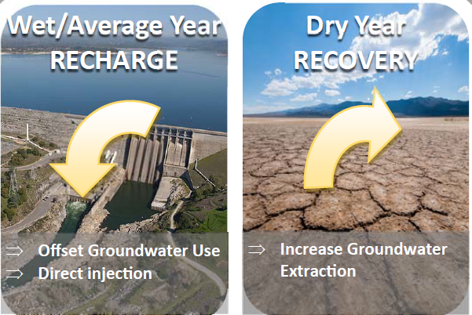
Conjunctive Use Fundamentals
Conjunctive Use Fundamentals
Increased use of surface water in wet years, when ample water is available from rainfall and snow pack, and shift use of groundwater in dry years, when surface water is not as readily available

Slide 9
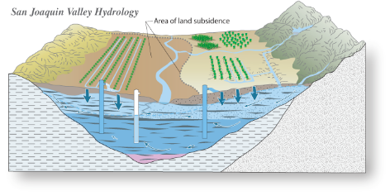
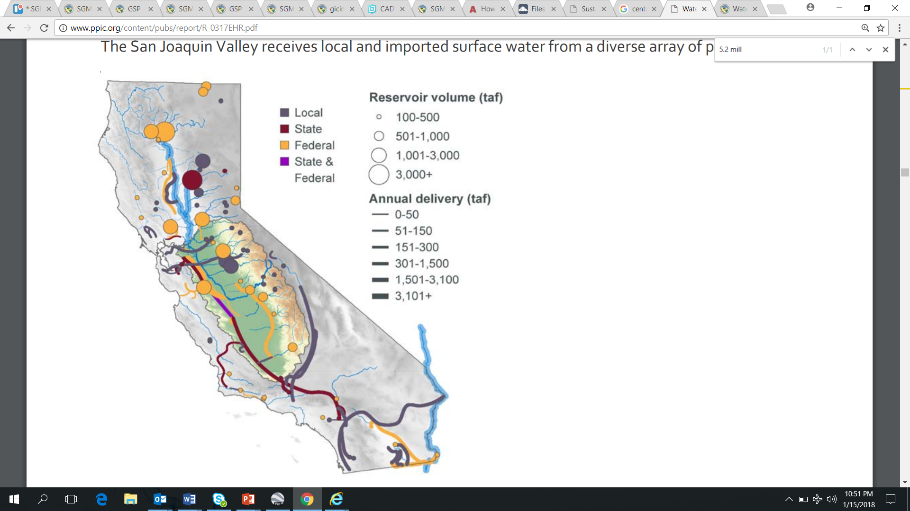
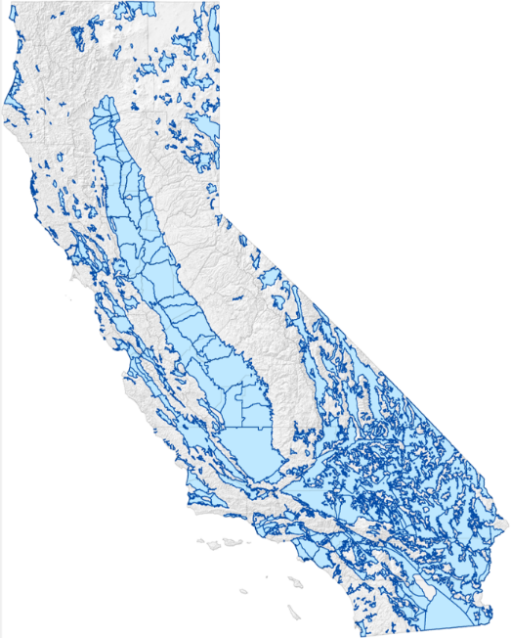
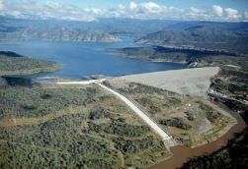
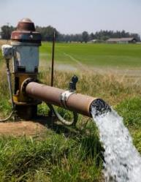
California Surface Water vs. Groundwater Storage Capacity
Modified From Hanak et al. (2011)
517 groundwater basins
Source: Department of Water Resources

Slide 10
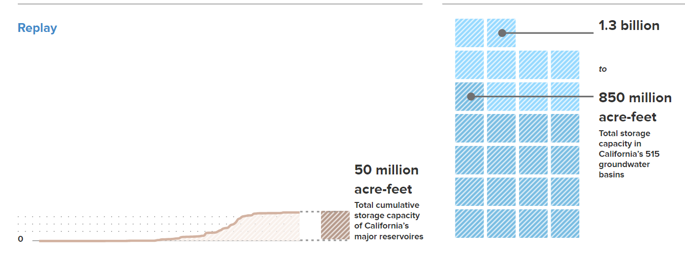
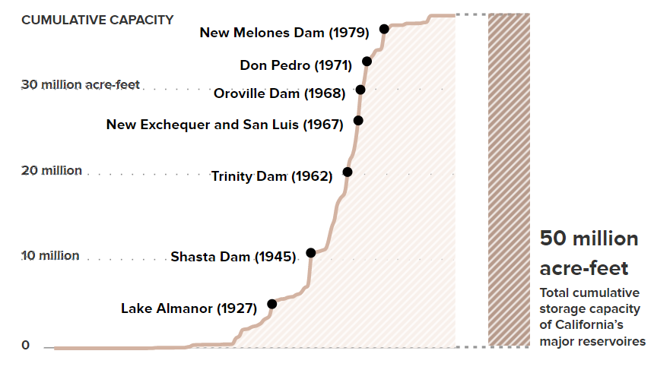
California Surface Water vs. Groundwater Storage Capacity
Reservoir Capacity
>100 years of regulation
Groundwater Basin Capacity
3 years of regulation
Total storage capacity in California’s 517 groundwater basins
Total cumulative storage capacity of California’s major reservoirs
Source: Department of Water Resources

Slide 11



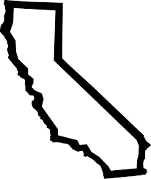



Reevaluate Conjunctive Use
Regional Water Reliability Planning
IRWM
SGMA - GSPs
GSP
Projects and Mgt. Actions
(Structural)
Surface Water Treatment
Intertie
Groundwater Well Rehabilitation/ New Installation
Surface Water Storage
Surface Water Diversion
Recycled Water
(Non- Structural)
Modify Contracts
Transfers
Wheeling
Groundwater Banking
Federal Action/ Collaboration
Institutional Barriers

Slide 12
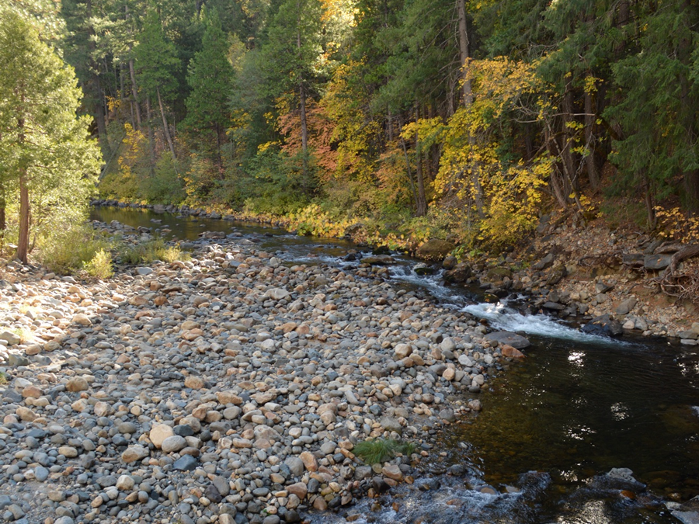
Questions or Comments

