Slide 1
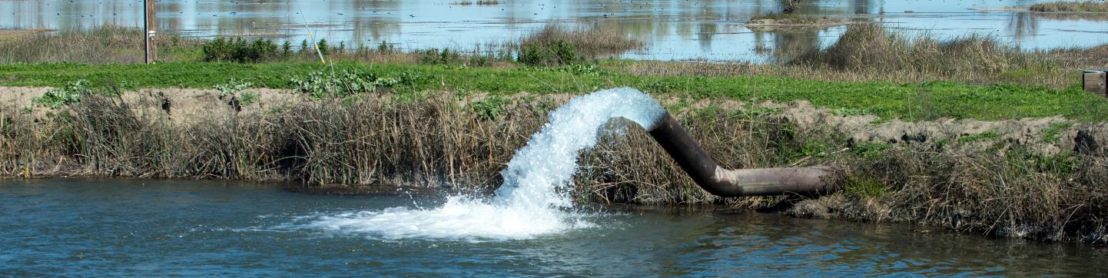

Sustainable Groundwater Management Program
Informational Update
Taryn Ravazzini
Deputy Director, Special Initiatives
Department of Water Resources

Slide 2
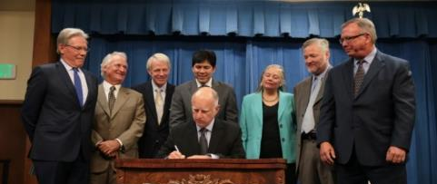






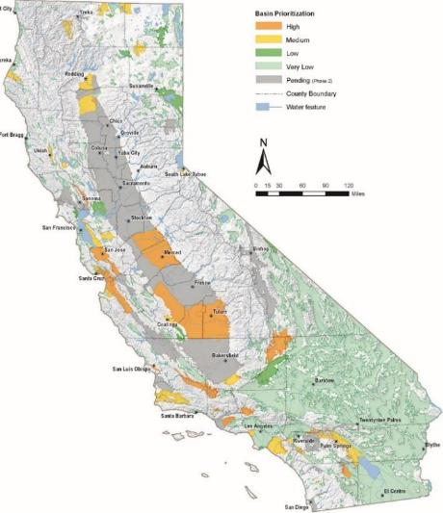
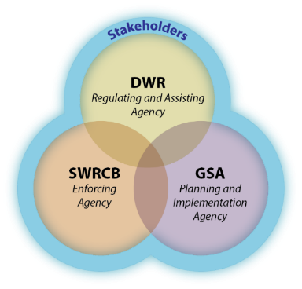
SGMA Overview
Local Control
Sustainability
Avoid Six Undesirable Results
“…[G]roundwater management in California is best accomplished locally.”
Governor Jerry Brown, 2014
Groundwater Sustainability Plans Required for High and Medium Priority Basins by 2020/22
2

Slide 3

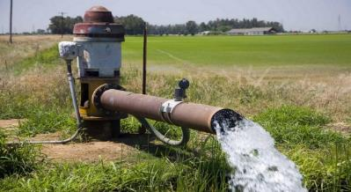

DWR’s Role
Engagement and Advisory Role
Regulatory Role
Financial Assistance
- Prop 1 & Prop 68
DWR Evaluation of GSPs
Sustainable Groundwater Management
Planning Assistance
- Facilitation
- GSA and GSP Support
Technical Assistance
- Statewide Datasets, Analysis, and Tools
- Best Management Practices
- Water Available for Replenishment Report

Slide 4
DWR SGMP Update
  Basin Boundary Modifications
  Basin Prioritization
  Alternative Assessments
  Assistance
      Technical
      Planning
      Financial

Slide 5
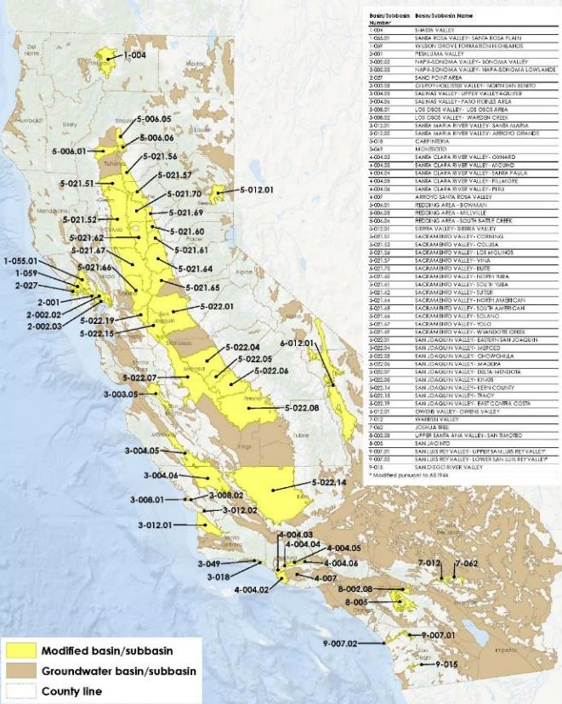
Final 2018 Basin Boundaries
Summary of Final Decisions
(Posted February 11, 2019)
35 Approve
4 Deny
4 Approve with Deny Portion
Summary table, interactive map, and static map
https://water.ca.gov/Programs/Groundwater-Management/Basin-Boundary-Modifications
5

Slide 6
Basin Prioritization - Legislative Directive
Basin prioritization triggered by boundary modifications – 2016 & 2018
Prioritization based on:
  1. The population overlying the basin.
  2. The rate of current and projected growth of the population in basin.
  3. The number of public supply wells that draw from the basin.
  4. The total number of wells that draw from the basin.
  5. The irrigated acreage overlying the basin.
  6. The degree to which persons overlying the basin rely on groundwater.
  7. Any documented impacts on the groundwater within the basin,
  including overdraft, subsidence, saline intrusion, and water quality.
  8. Any other information determined to be relevant by the department,
  including adverse impacts on local habitat and local streamflows.

Slide 7
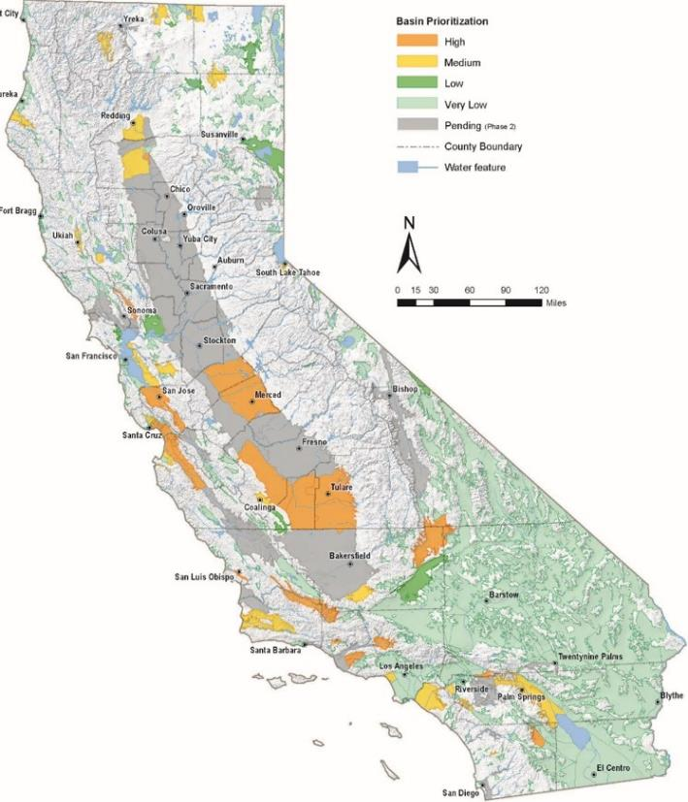
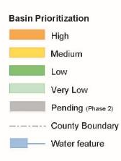
2018 – Basin Prioritization
Jan 2018 –Released Final Priorities for Unmodified Basins (458)
 Spring 2019 – Draft Priorities for Modified Basins (57), Public Comments & Public Meeting
 Late Spring 2019 – Final Priorities for Modified Basins (57)

Slide 8
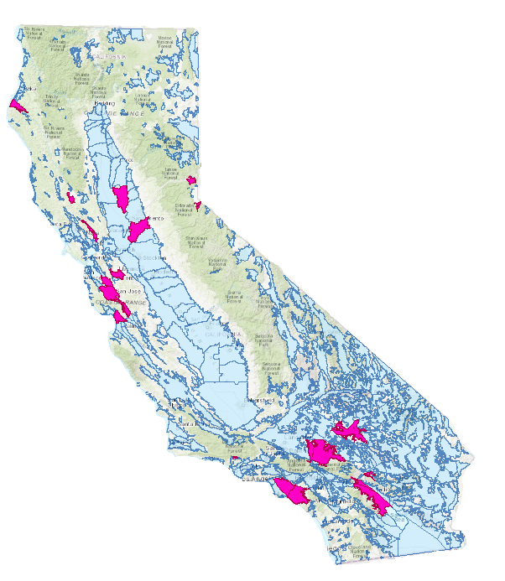
Alternative Submittals
Three types (24 total submittals)
  Existing groundwater management plan (9)
  10-year analysis of operation within the sustainable yield (11; 2 withdrawn early 2019)
  Adjudication (4 submitted by Mojave Water Agency and withdrawn in late 2017)
Submitted by January 1, 2017
Annual Reports for Water Year 2017 received by April 1, 2018
Legend
Alternative Submittals

Slide 9
Alternative Evaluation and Assessment
Next Steps
 Early 2019 – Public Release of Alternative
Assessments
 Alternative Annual Reports – Due every April 1 for the preceding water year
 Alternative 5-Year Update – Local agencies will update and DWR will review Alternative Submittals every 5 years

Slide 10
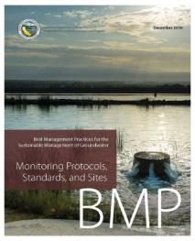
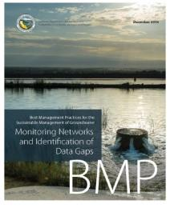
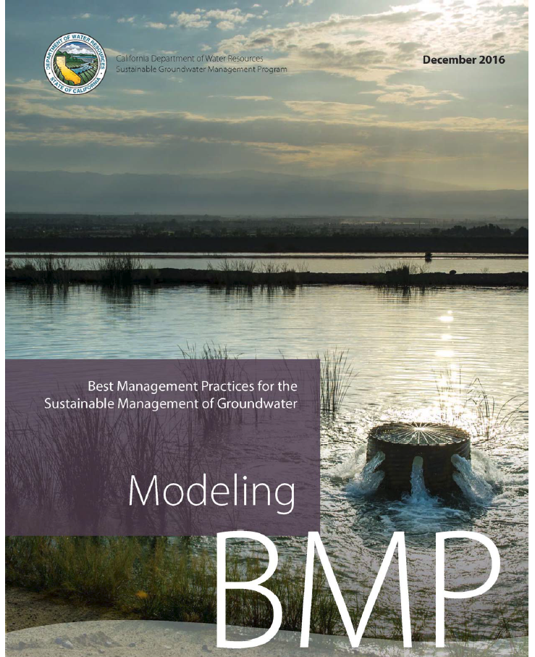
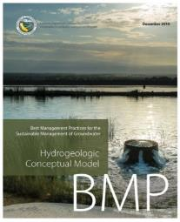
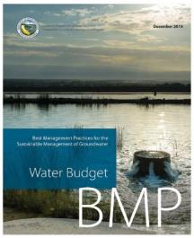
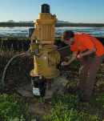
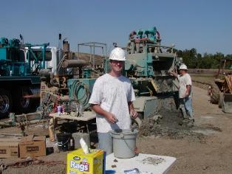
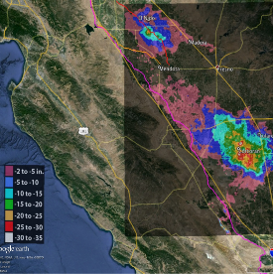
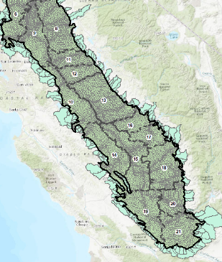
SGMP Technical Assistance
Guidance and Education
  Best Management Practices
  Guidance Documents
  Fact Sheets and Reports (B-118)
Technical Support Services
  Available to GSAs
  Can help fill data gaps
    Field Activities
    Modeling and Tools
Statewide Datasets and Tools

Slide 11
SGMA Funding
Proposition 1
  $100 million in grants awarded!
  Round 1 (Feb. 2016): $6.7M awarded to counties with stressed basins
  Round 2 (Apr. 2018): $85.8M awarded across all 78 applicants
    $16.2M for projects benefiting Severely DACs
    $69.6M for developing GSPs
Proposition 68
  Passed June 2018 (details subject to change)
  Sustainable Groundwater Planning Grant Program ($50M)
  Sustainable Groundwater Implementation Grant Program (~$100M)
https://www.water.ca.gov/Work-With-Us/Grants-And-Loans/Sustainable-Groundwater

Slide 12
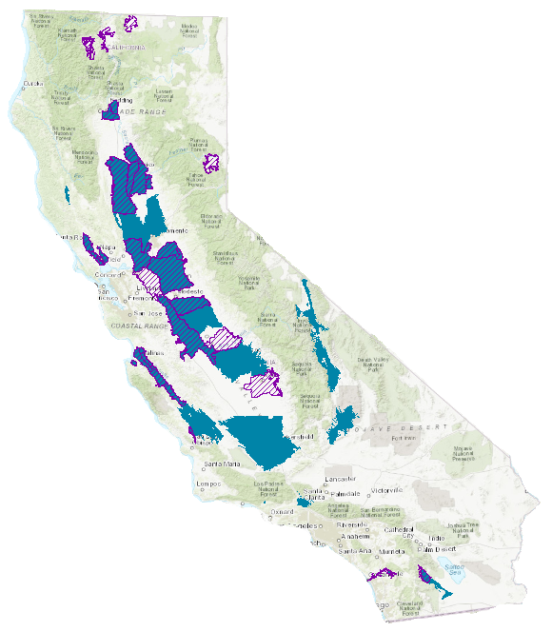
Facilitation Support Services (FSS)
Services offered to GSAs or groups coordinating with GSAs
Funding Priorities:
  Critically overdrafted basins
  Basins without prior FSS
  Funding decisions made on a continuous basis
Services Offered:
        Stakeholder identification and engagement
        Public outreach facilitation
        GSA meeting facilitation
        Consensus building
Legend
FSS - GSA Formation
FSS - GSP Development

Slide 13
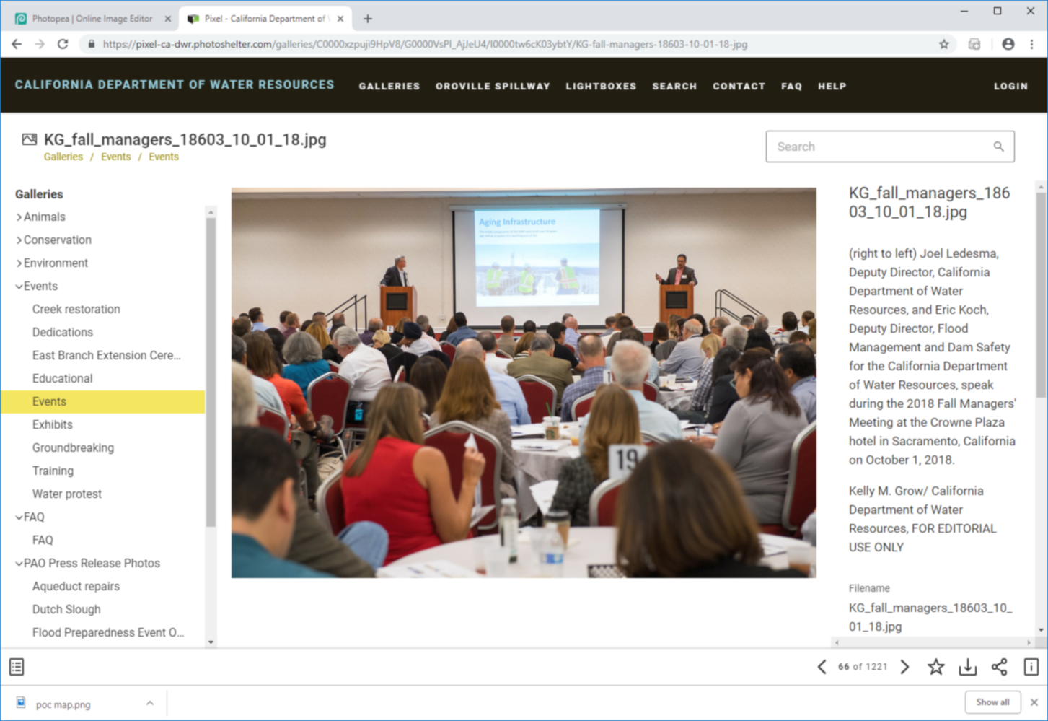

GSA Forum
Scheduled for March 21, 2019 (West Sacramento)
Forum for an exchange of ideas and approaches focused on communication, coordination, engagement, and outreach.
Participants: GSAs and stakeholders

Slide 14
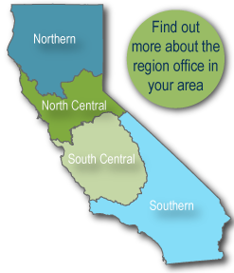
SGMP Contacts & Resources
DWR Sacramento Office:
DWR Regional Offices:
Taryn Ravazzini
Taryn.Ravazzini@water.ca.gov
Steven Springhorn
Steven.Springhorn@water.ca.gov
Keith Wallace
Keith.Wallace@water.ca.gov
NRO: Bill Ehorn
Bill.Ehorn@water.ca.gov
NCRO: Bill Brewster
Bill.Brewster@water.ca.gov
SCRO: Dane Mathis
Dane.Mathis@water.ca.gov
SRO: Tim Ross
Timothy.Ross@water.ca.gov
SGMP Resources:
DWR SGMP Webpage
https://www.water.ca.gov/Programs/Groundwater-Management
Subscribe to DWR SGMP Email List
https://bit.ly/2HdRRGK

