Slide 1
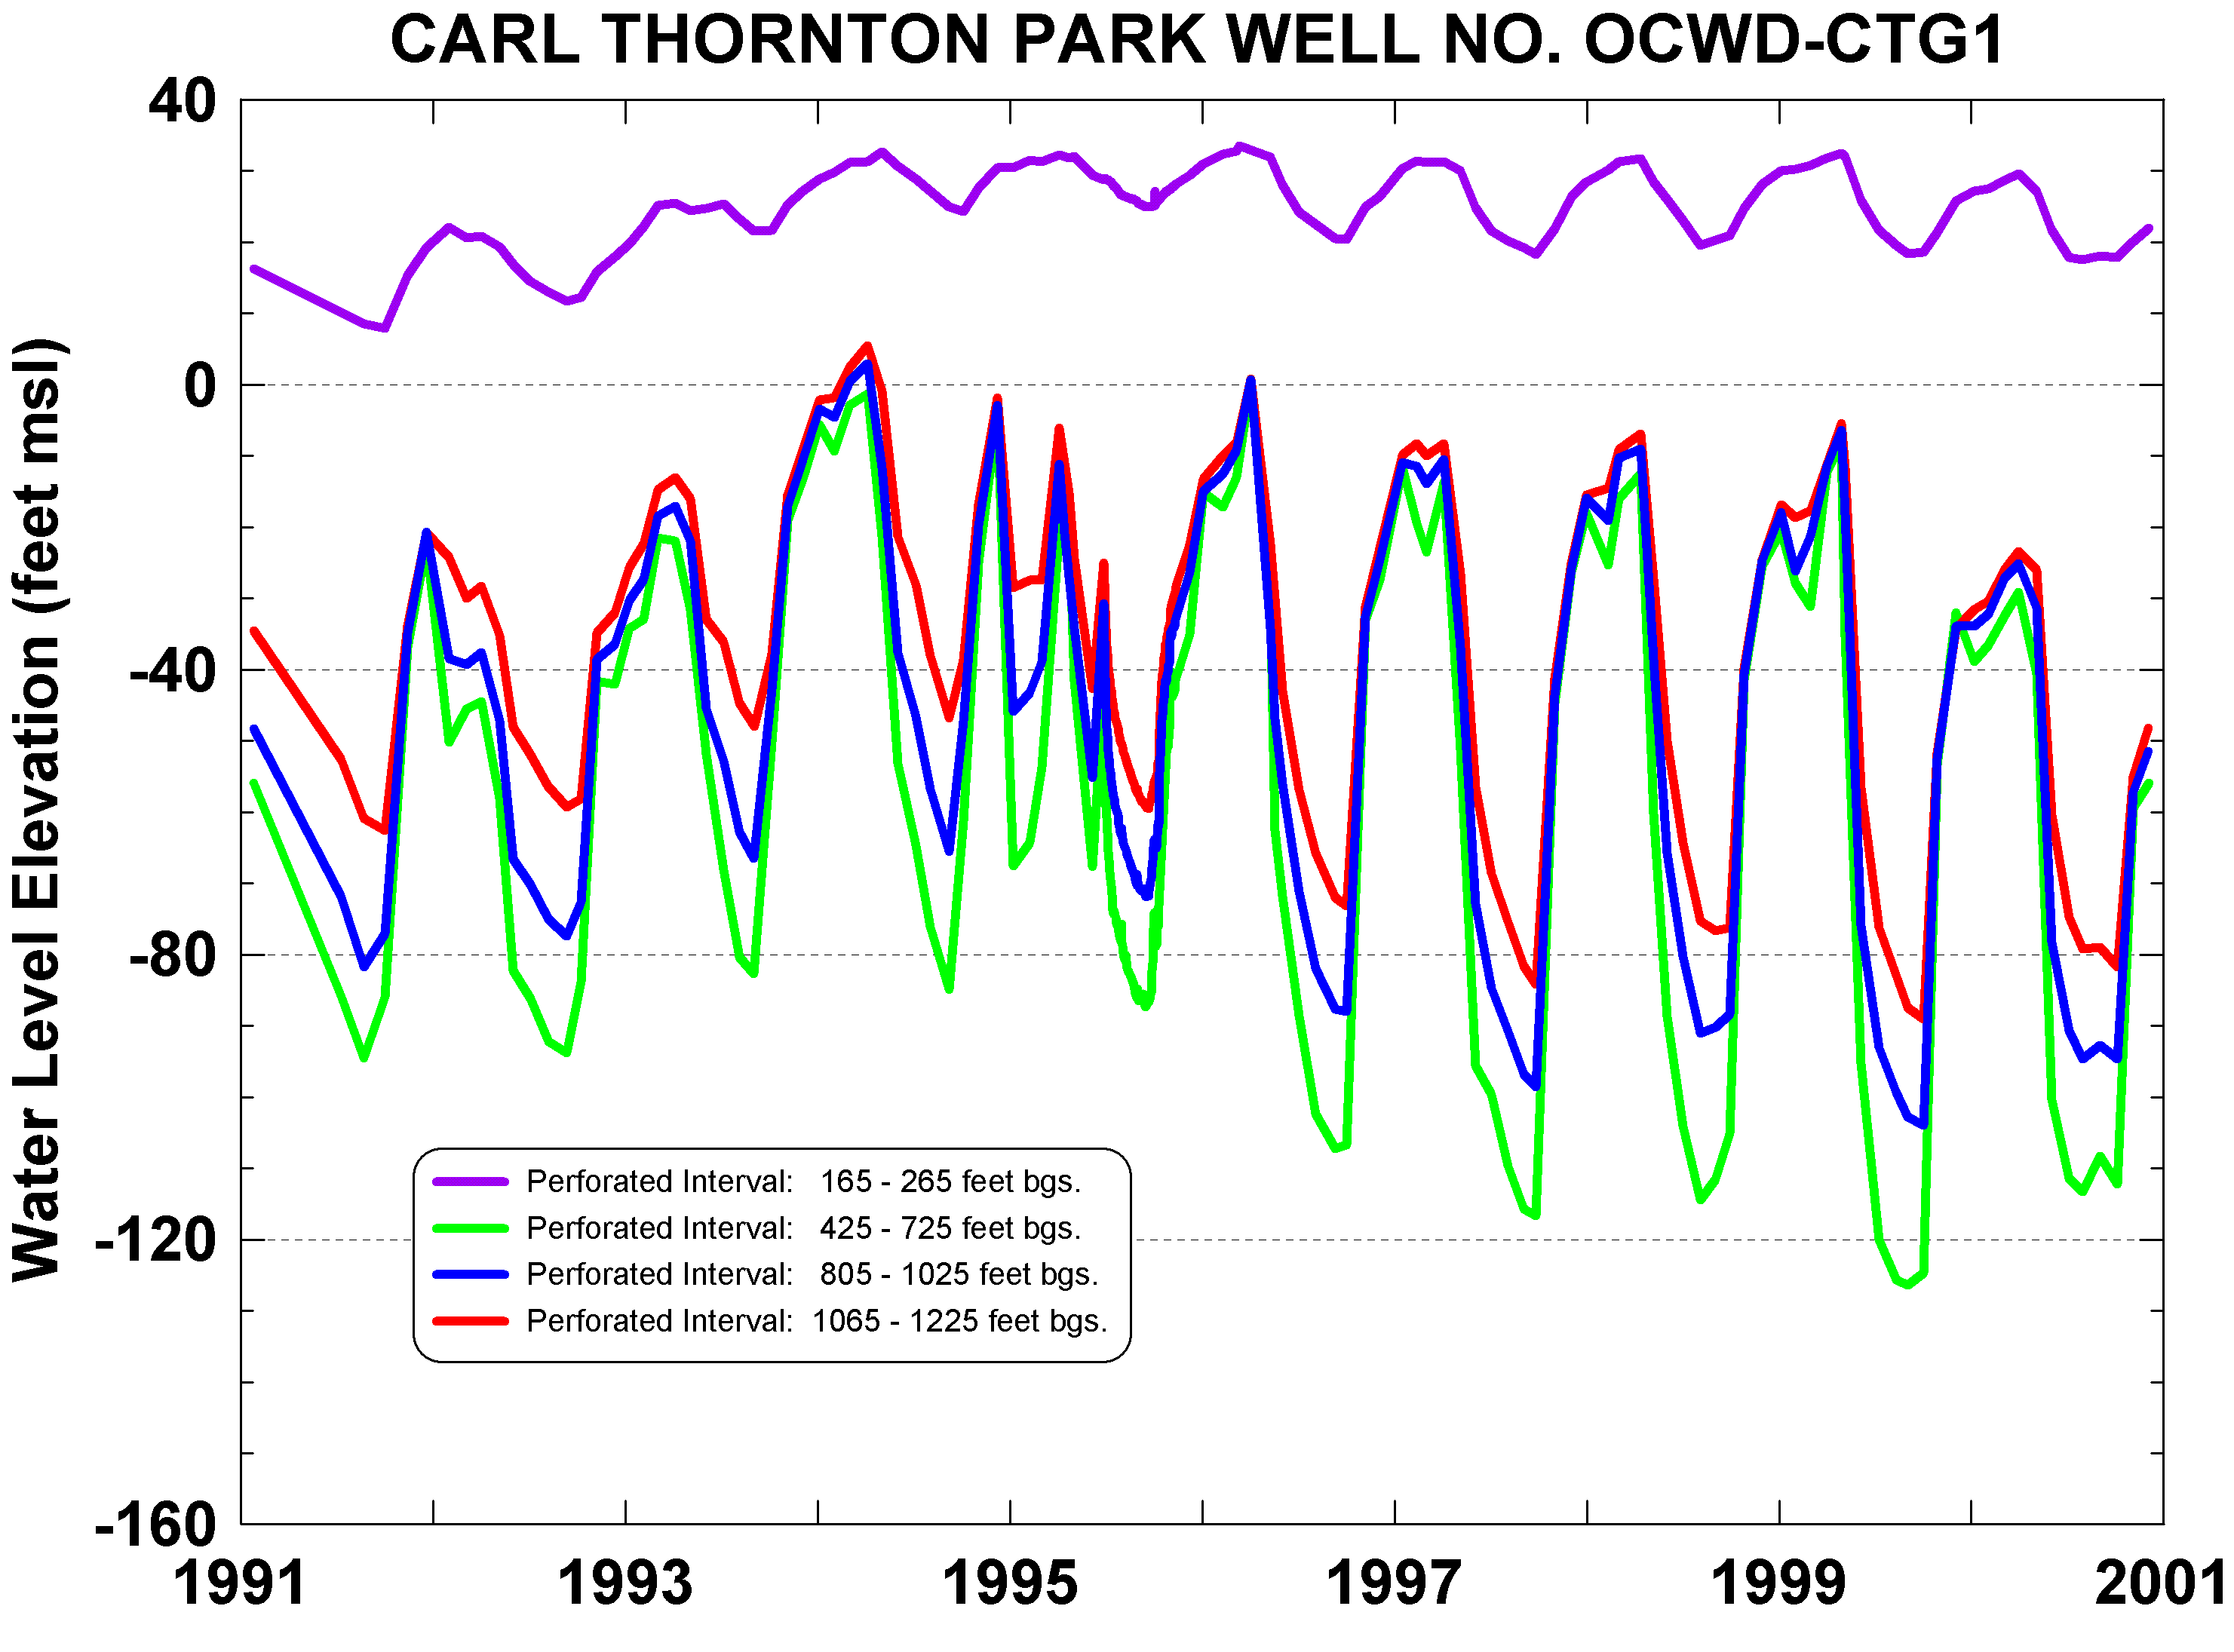
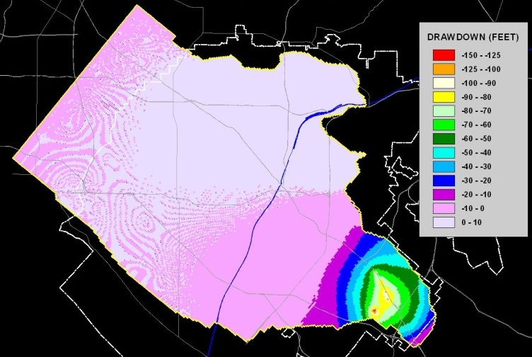
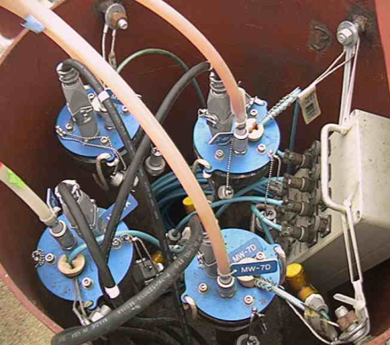
Orange County Groundwater Basin Compliance with SGMA
Roy Herndon
Orange County Water District
Urban Water Institute Conference, Palm Springs, 3-1-19

Slide 2
The OC Basin is the largest urbanized unadjudicated groundwater basin in southern California.
Coastal Plain of Orange County Groundwater Basin (Basin 8-1)
Source: DWR 2018 Basin Prioritization

Slide 3
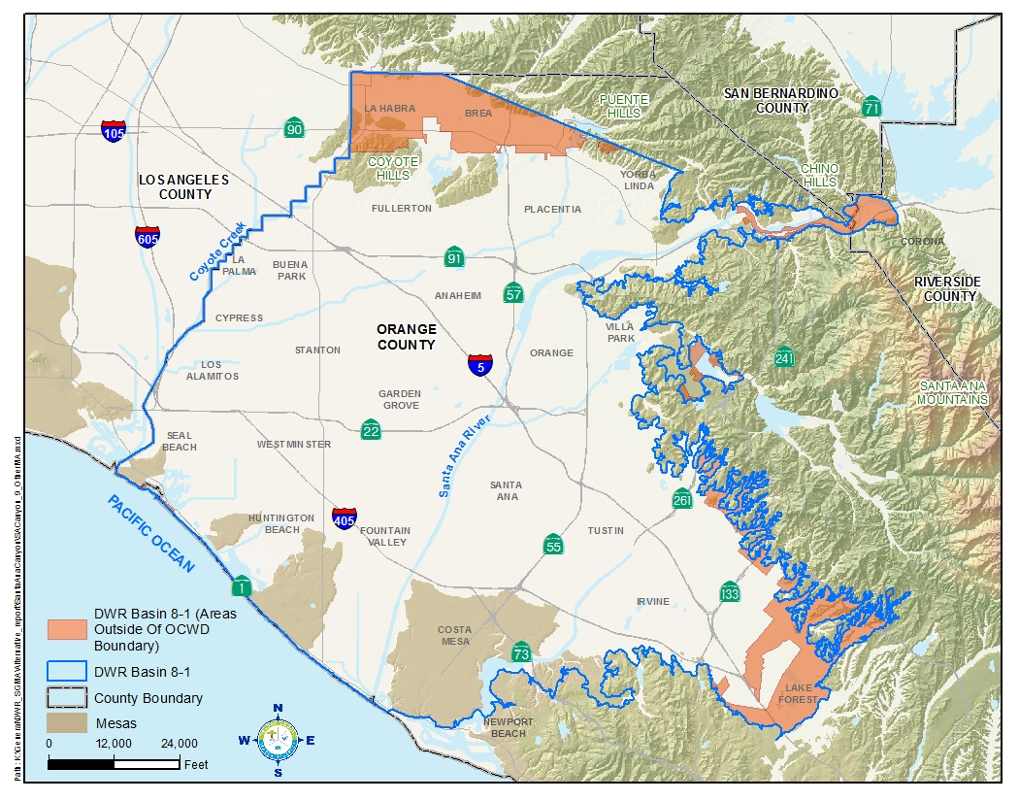
OCWD covers ~89% of Basin 8-1

Slide 4
OCWD is one of 15 special act districts listed in SGMA as “exclusive local agencies” within their statutory boundaries.
Alameda County Flood Control and Water Conservation District, Zone 7
Alameda County Water District
Desert Water Agency
Fox Canyon Groundwater Management Agency
Honey Lake Valley Groundwater Management District
Long Valley Groundwater Management District
Mendocino City Community Services District
Mono County Tri-Valley Groundwater Management District
Monterey Peninsula Water Management District
Ojai Groundwater Management Agency
Orange County Water District
Pajaro Valley Water Management Agency
Santa Clara Valley Water District
Sierra Valley Groundwater Management District
Willow Creek Groundwater Management Agency

Slide 5
This afforded OCWD the option to submit an Alternative Plan in December 2016.
One integrated plan for entire basin (per SGMA)
OCWD jurisdiction stays within its boundaries
Avoids OCWD having to become a GSA and develop a GSP
Uses OCWD’s existing groundwater management structure through the OCWD Act
Avoids interference with La Habra/Brea, Corona or others planning to form a GSA now or in the future.
Avoids need to create GSAs in fringe areas
Notes:
OCWD’s other option is to become a GSA and prepare a GSP, along with coordination agreements with other agencies.

Slide 6
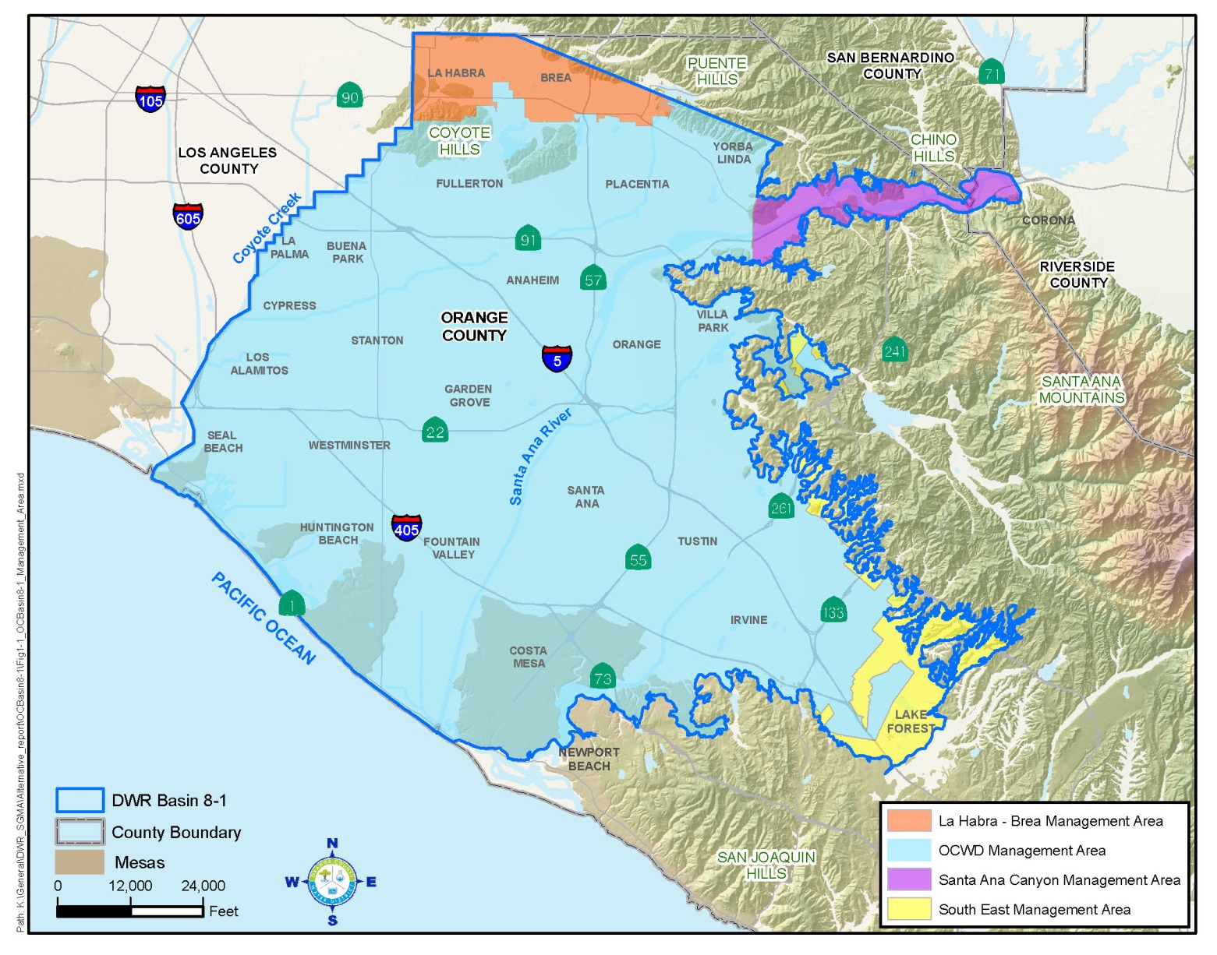
OCWD collaborated with agencies within Basin 8-1 to define four Management Areas: La Habra-Brea OCWD Santa Ana Canyon South East

Slide 7
Basin 8-1 Alternative Plan Preparation
Overview, OCWD and Santa Ana Canyon Mgmt. Area - OCWD
La Habra-Brea Mgmt. Area - La Habra
South East Mgmt. Area – Irvine Ranch WD
Documents basin has been managed sustainably for over 10 years
Summarizes current OCWD programs and does not entail new requirements except updating Alternative Plan every 5 years
Awaiting review comments from DWR

Slide 8
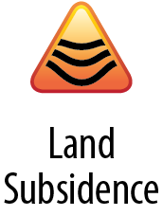
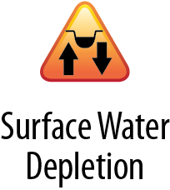
Sustainability in Basin 8-1
Beneficial uses of groundwater are being maintained
Existing barriers and ongoing programs protect basin from seawater intrusion
Maintain Basin within
Operating Storage Range
(0-500,000 af below full)
Insignificant in Basin 8-1
Notes:
To demonstrate sustainability, OCWD describing how it has addressed the six “undesirable results”.

Slide 9
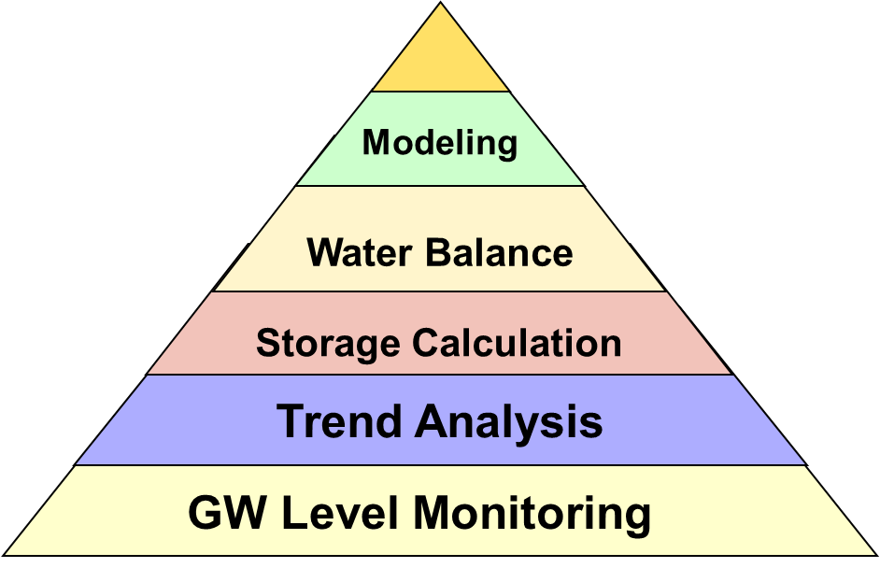
SGMA has raised the bar for basin management throughout the state.
Get to know your basin
Understanding will increase over time
Investments in data collection and analysis will:
improve understanding of basin sustainable yield
demonstrate if GSPs are working and how to fix them if they’re not
State
Involvement
Local BMPs

Slide 10
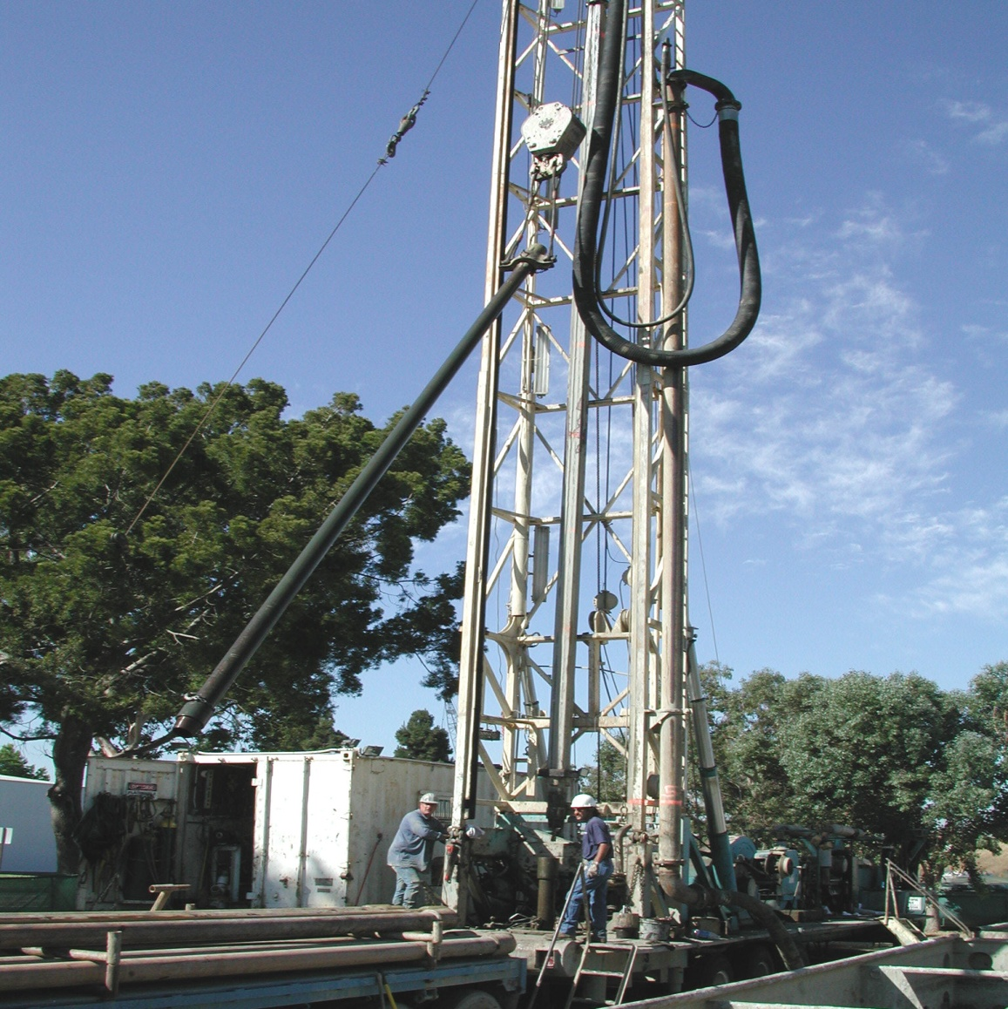
End of Presentation

Slide 11
Extra Slides

Slide 12
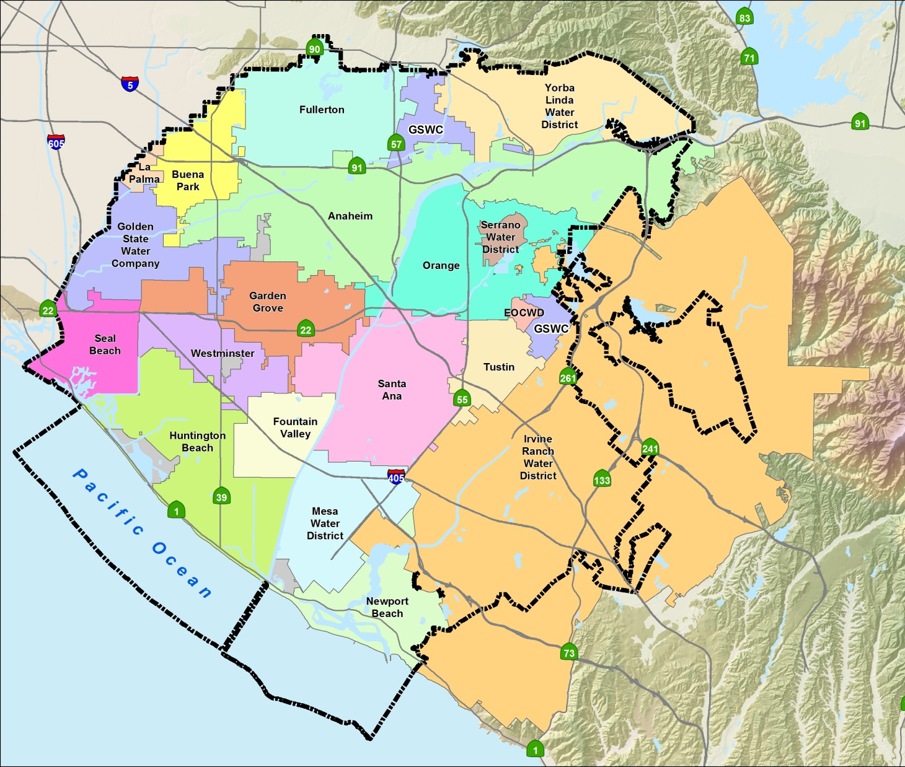
Orange County
Water District
Formed in 1933 by legislative act
Manage the groundwater basin
Replenish aquifers
Control seawater intrusion
Protect & improve groundwater quality
19 Major Retail
Water Agencies

Slide 13
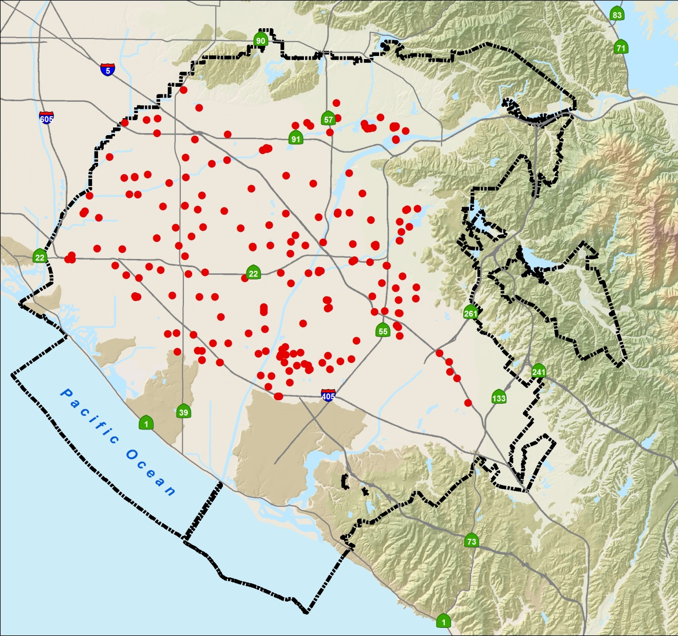
Orange County
Groundwater Basin
(within OCWD)
~75% of northern OC’s water supply
2.5 million people
200 large-capacity wells
300,000 af/yr production

Slide 14
Typical Basin Water Budget
Inflows & Outflows (Average) | Acre-feet
Santa Ana River Flow Recharge | 117,000
GWR System Recharge | 103,000
Imported Recharge Water | 65,000
Unmeasured “Natural” Recharge | 60,000
Total Water Into Basin | 345,000
Total GW Pumping | (330,000)
Storage Change | +20,000
√
√
√
√
√
Notes:
The unmeasured natural recharge and basin inflows/outflows are estimated as the only “unknown” in the basin water budget.

Slide 15
OCWD established a basin operating storage range in 2007.
0 AF
Available storage
for 1-2 wet years
-150,000 AF
Optimal Target Range
-200,000 AF
Typical Operating
Range
Provides ~5 years
of drought supply
Lowest Acceptable Level
Seawater intrusion
Lack of drought protection
Subsidence risk increases
-450,000 AF
Conjunctive Use Storage
-500,000 AF

Slide 16
Each year OCWD sets the basin pumping percentage for the groundwater producers.
GW
BPP = ---------------------------------
GW + Imported Water
(Total Demand*)
*excludes reclaimed water
Notes:
OCWD’s BPP definition and setting authority is contained in the OCWD Act

