Slide 1

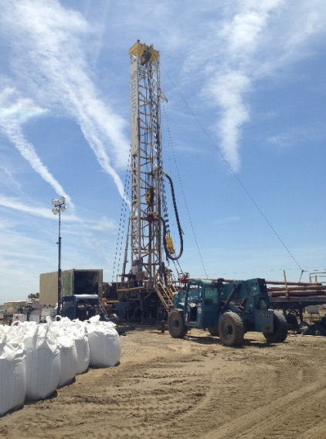

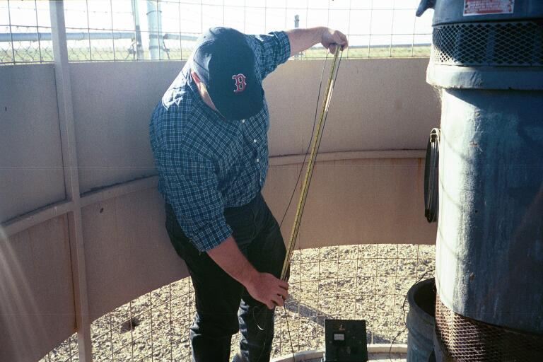

Water Allocation Strategies
In the context of the Sustainable Groundwater Management Act

Slide 2
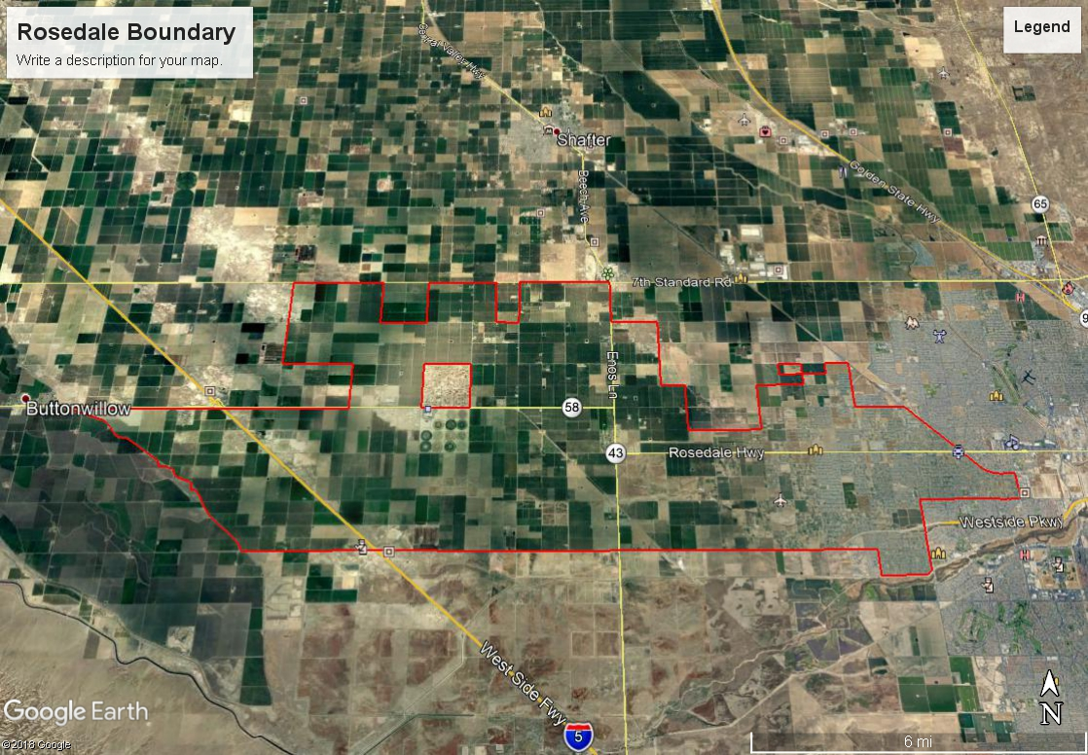
Rosedale-Rio Bravo Water Storage District
Water Allocation Strategies
District is 44,000 acres
  Approximately 9,000 acres of urban development
  Remainder is agriculture
  predominately almonds
100% groundwater pumping
to meet overlying demands
Balanced Water Budget = Sustainable
  Projected minor overdraft
  Within critically overdrafted basin
Lands less than 10 acres and Zoned
Residential or Commercial are
exempt from water budget
Notes:
How many of you in this room know exactly how much water you will have available to you per acre in a post-SGMA / Groundwater Sustainability Planning World?

Slide 3
Water Budgeting requires
Accurate Data!!
APN Based Water Budget Platform
(Landowner Access)
Water Supply
Water Demand
Billing
Water Trading
Open & Transparent
Notes:
How many of you in this room know exactly how much water you will have available to you per acre in a post-SGMA / Groundwater Sustainability Planning World?

Slide 4
Rosedale-Rio Bravo Water Storage District
Water Allocation Strategies
Water Supply
“Project” Supplies
  116,000 Acre Feet (AF)/year on average.
  Allocated to each APN within the district proportional to acreage.
  116,000 AF / 44,000 Acres = 2.63 AF/Acre “Allocation”
“Groundwater”
  Subject of current basin discussions
  Proposal to allocate .5 AF/Acre
Water Supply Allocation (assuming 1 acre) = 2.63+.5 =3.13
“Deposit” is made into landowner APN each January 1
Notes:
How many of you in this room know exactly how much water you will have available to you per acre in a post-SGMA / Groundwater Sustainability Planning World?

Slide 5
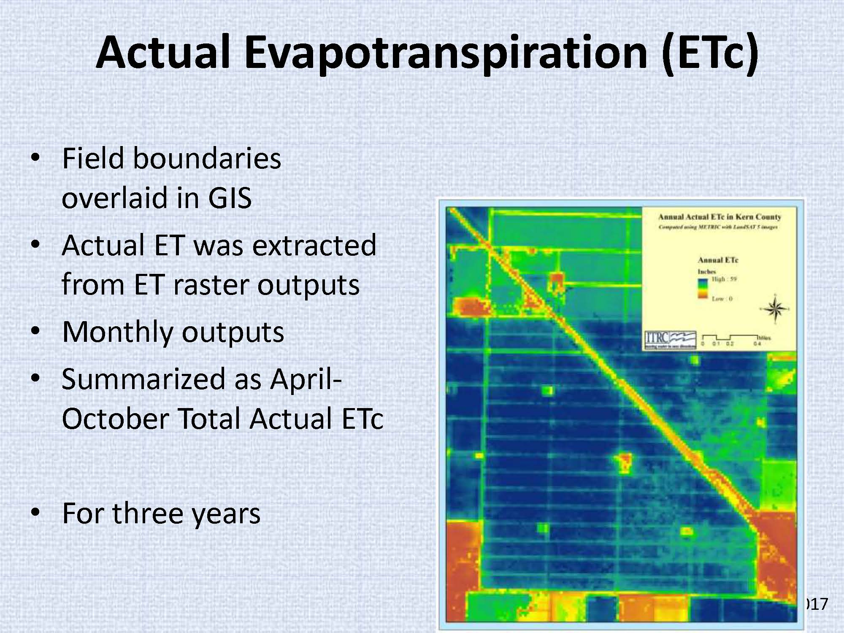
Rosedale-Rio Bravo Water Storage District
Water Allocation Strategies
Water Demand
Demand on each APN is calculated using Evapotranspiration data
  Data is collected every few (5-11) days
  Data is interpolated between images
  Calibration is critical to ensure field level accuracy
Landowner may utilize well head metering
Demand is computed over the course of the
calendar year and is basis for water budget.
January 1 – December 31 ET “demand” is debited
From initial “deposit”
No “Carry-Over” Balance is re-allocated amongst all users
proportional to acreage
Deficit is billed at replacement water rate
Notes:
How many of you in this room know exactly how much water you will have available to you per acre in a post-SGMA / Groundwater Sustainability Planning World?

Slide 6
Rosedale-Rio Bravo Water Storage District
Water Allocation Strategies
District Info
Landowner Access (Unique APN Log-in)
Updated accounting of Supplies and Demands for decision making
Water District Information
  Water Levels
  SGMA compliance data
  Other?
Water Supply
Water Demand
APN Based Water Budget Platform
Notes:
How many of you in this room know exactly how much water you will have available to you per acre in a post-SGMA / Groundwater Sustainability Planning World?

Slide 7

Rosedale-Rio Bravo Water Storage District
Water Allocation Strategies
Water Trading
Trading Platform (Link on Water Budget Platform) for Buyers and Sellers to Post
  APN Based
  Transaction outside of platform – landowner driven
  Transaction “confirmed” by individual log-in to platform and selecting APN and quantity of water to be transferred
  Trading requires evaluation of groundwater transfers in the context of SGMA.
Notes:
How many of you in this room know exactly how much water you will have available to you per acre in a post-SGMA / Groundwater Sustainability Planning World?

Slide 8
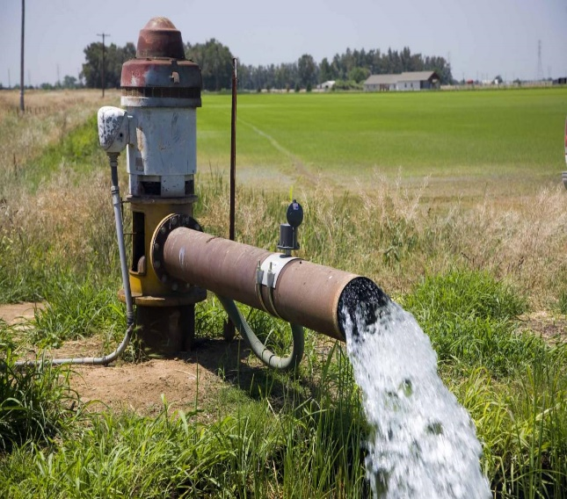
Rosedale-Rio Bravo Water Storage District
SGMA Compliance Strategy – Water Exchange Markets
Groundwater Transfers – Part of the GSP
Water is an asset if it can be managed. It can be a liability if stranded.
Failure to accommodate groundwater transfers will exacerbate SGMA economic impacts.
  Groundwater transfers should be evaluated in the context of the Groundwater Sustainability Planning process
  Projected future deficit in Rosedale
    Empower Landowners!
Notes:
How many of you in this room know exactly how much water you will have available to you per acre in a post-SGMA / Groundwater Sustainability Planning World?

Slide 9
Rosedale-Rio Bravo Water Storage District
SGMA Compliance Strategy – Water Exchange Markets
Groundwater Transfers – Part of the GSP
What needs to be done to ensure Groundwater Transfers are part of the SGMA Strategy?
  Groundwater modeling to evaluate potential impacts
      Evaluation of hydraulic gradients
      Evaluation of water quality
      Evaluation of water level data with and without transfers
  Potential limits on amount that can transferred annually
  Potential limits on distance a transfer can be accommodated
      Ratios for greater distances
  Potential concerns may be addressed through information and analysis.
  System of accounting!

Slide 10
Rosedale-Rio Bravo Water Storage District
SGMA Compliance Strategy – Water Exchange Markets
Groundwater Transfers – Part of the GSP
GSP – Landowner Initiated Actions
  Within Rosedale
    Landowners can aggregate lands (within Rosedale) to manage supplies (Groundwater Transfer)
    Landowners can lease ground from others to augment supplies (Groundwater Transfer)
    Landowners can voluntarily reduce demand (Fallowing)
    Landowners can acquire additional supplies
  If Landowner chooses not to implement the above then……….

Slide 11
Rosedale-Rio Bravo Water Storage District
SGMA Compliance Strategy – Water Exchange Markets
Groundwater Transfers – Part of the GSP
GSP - Rosedale Initiated Actions
  Assessment of “Water Charge” or a Tiered Rate for use above “Sustainable Yield”
    Reserved by District - Economy of scale / aggregate supply needs
    Every five (5) years District will utilize water charge revenues to implement the most cost effective management action:
      New water supply projects/ programs
      Demand reduction (willing sellers!) in areas of potential recharge (double benefit) (Groundwater Transfer)
      Demand Reduction (Groundwater Transfer)
      Water Charge rate will adjust to reflect least cost management action!

Slide 12
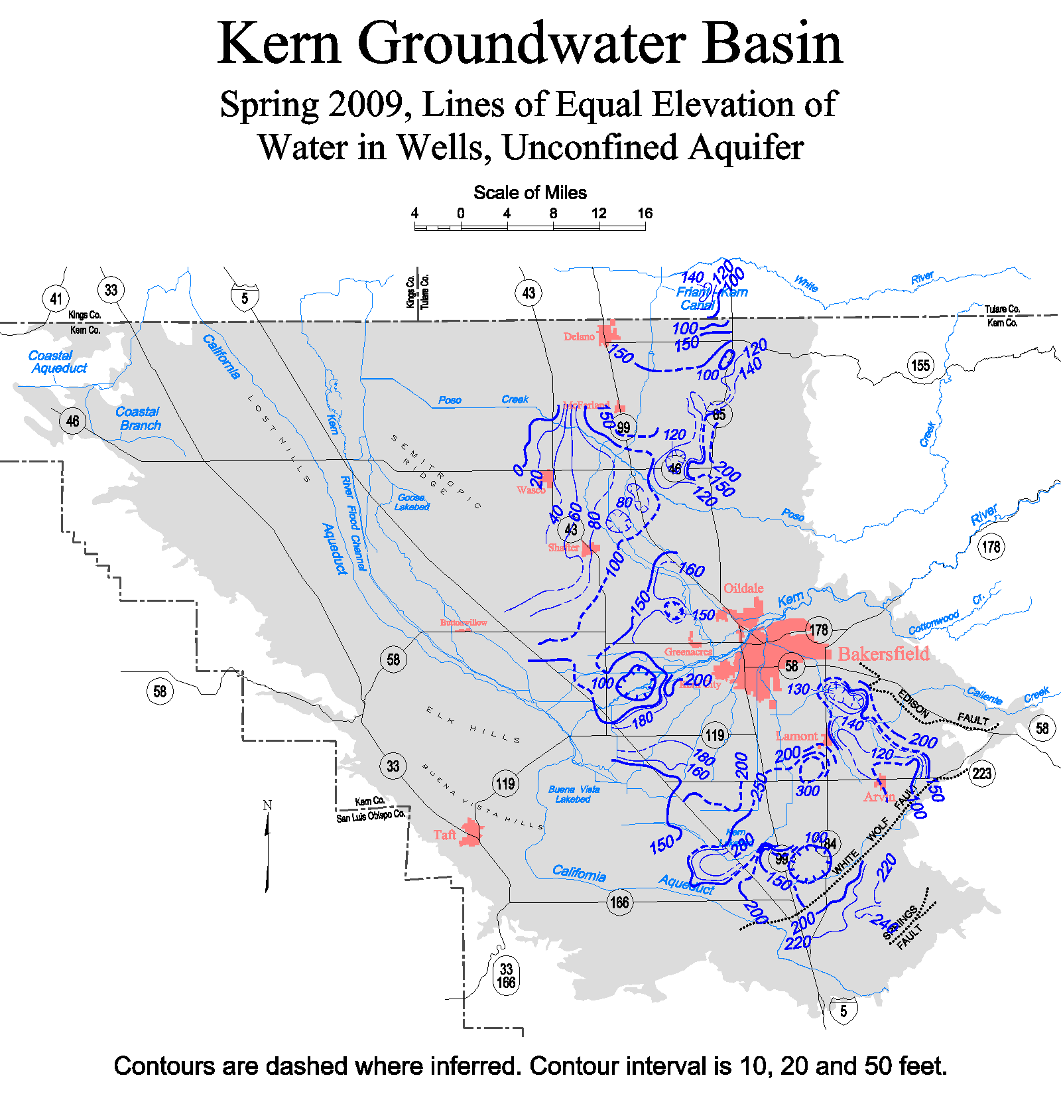
Rosedale-Rio Bravo Water Storage District
SGMA Compliance Strategy – Water Exchange Markets
Groundwater Transfers will be part of SGMA strategy
Delay in accommodating groundwater transfers will result in economic impacts
GSP’s should evaluate the impacts of groundwater transfers to prevent or limit “Undesirable Results”

Slide 13
Sustainable Groundwater Management Act
&
Groundwater Transfers
QUESTIONS

