Slide 1
A Successful Public Outreach Process
Successful Even on Controversial Projects

Slide 2
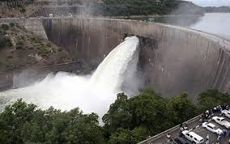
Wouldn’t Build a Dam Without a Plan

Slide 3
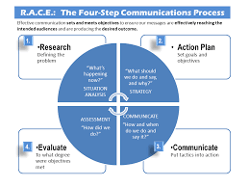
Shouldn’t Do Public Outreach Without a Plan
Here’s a process that builds successful agency or project outreach plan for strong public support
Proven on OCWD’s Groundwater Replenishment System and West Basin’s Water Reliability program
Four step process:
Do Research – formal and informal
Write a communications Plan
Communicate based on the plan
Then Evaluate: have system to measure your success

Slide 4
Let’s breakdown the process
Research – everything in the plan is based on research
Formal - Focus groups & phone survey research provides:
key audiences, their opinions, best messages that reach and motivate
Less Formal
Study your community: power structure, social and political issues (Should already be doing this).
Study outreach experts: Dr. Peter Sandman - laws of acceptance; James Lukaszewski – world renown PR expert; Dr. Hans Bleiker – encourages engaging the opposition
Study other successful industry outreach projects

Slide 5
Cute Sidebar Story
The name “Groundwater Replenishment System” came from research – engineers initially name project: Orange County Reclamation Project
Research told us people did not know what the project was
Survey told us people understood and supported replenishing water supplies
So we successfully changed the name
Outreach people: be
concerned if you see
pocket protectors naming projects

Slide 6
From Research Develop a Plan
Plan should address who oppose and support your project
GWRS: Elderly, mothers, women skeptical
Plan most important audiences
People who pay agency bills and people who can say yes or no to your project/agency
For us, key leaders better than general public
Plan key messages need to gain acceptance
Benefits, safe guards, WQ, backup systems, low cost, etc.
Explain alternatives you investigated and why your solution is the best for your project – shows transparency
Plan effective communications tool kit
Use multiple communication vehicles and channels focused on key audiences, and don’t forget your own employees
Talks, tours, web site, fact sheets, newspaper ads, etc.

Slide 7
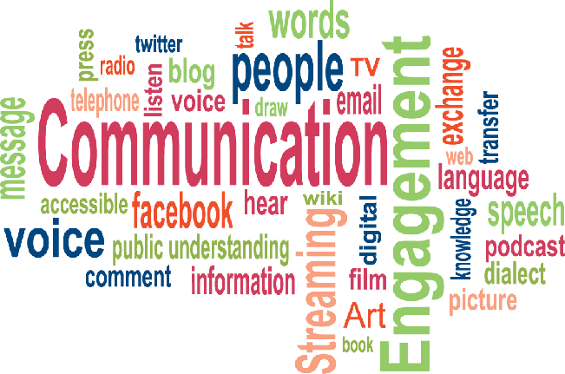
Communicate
Start early, even in conceptual stage to implement the plan
Update plan as project proceeds
For controversial projects, use face-to-face communications
Allows you to show enthusiasm
People believe a person over an advertisement or brochure
Agency people should give key individual and group talks
More benefits = more acceptance
Make people believe their lives will be better because of your project
We found elected officials, community, environmental, minority and business leaders where key and effective audiences

Slide 8
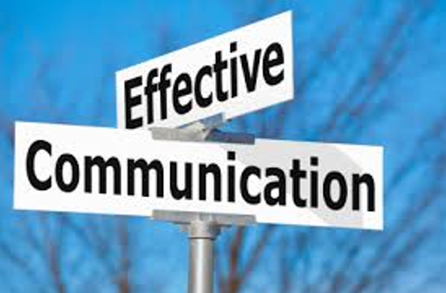
Additional Thoughts on Communicating
In today’s communications environment, NIMBY, social media, etc., new water projects are NOT engineering but are communications projects
“Under the radar” is impossible
You have to be aggressive getting to target audiences, do not wait for them to come to you
Outreach staff must be available 24-7
Try to get to key audiences first, before the media or opponents
Due to water apathy and ignorance, must communicate need for project as well as the solution

Slide 9
Special Note about Leaders
Leaders will help communicate for you
They talk to key people in the community
They helped us immensely
Two-Step theory: people less active in the community take their opinions community issues from friends who are more active in the community
May have to go back as leaders change
Get leaders to commit in writing, then then use their support as an additional tool – develop a supporters list for website and social media, and as a handout

Slide 10
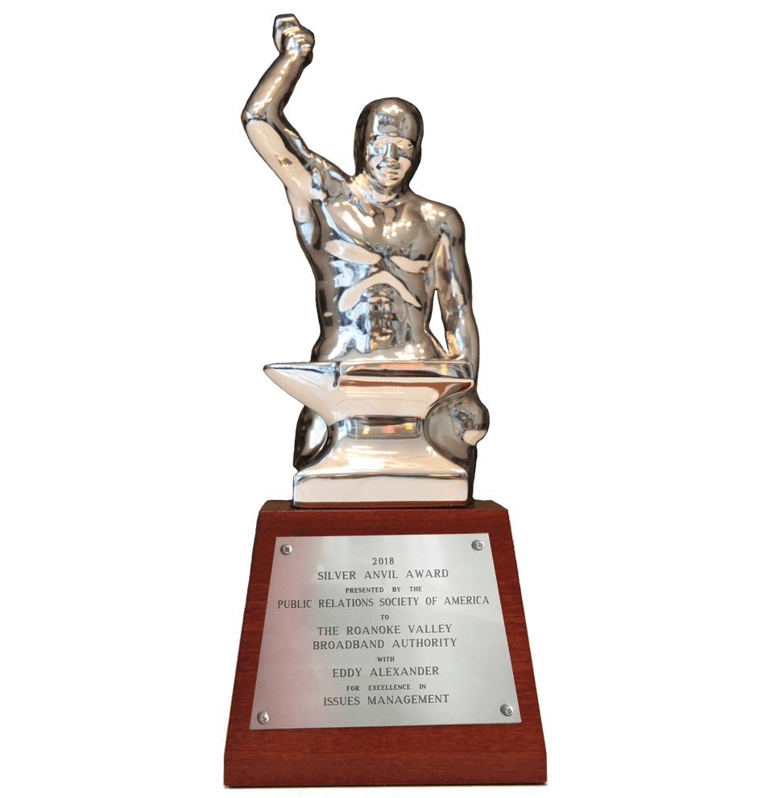
Evaluation: Measure Results
OCWD had no public opposition to drinking purified sewer water and written support from all elected officials and major business leaders. GWRS polling indicated if put to a vote, GWRS would pass.
West Basin had thousands of support cards and polling showed significant increase in project support
Both projects’ results were evaluated by national outreach experts and each received highest outreach award in the nation – Public Relations Society of America’s Silver Anvil Award – equal to an Oscar or Emmy

Slide 11
Thank You!
Research
Plan
Communicate
Evaluate

