Slide 1
How People Learn
Teaching Strategies
by Janet Yamaguchi
Notes:
NOTE:
To change the image on this slide, select the picture and delete it. Then click the Pictures icon in the placeholder to insert your own image.

Slide 2
Attention-getting (Focusing) Strategies
Use of Attractive Props

Slide 3
Attention-getting (Focusing) Strategies
Surprising Introduction

Slide 4
Attention-getting (Focusing) Strategies
Use of Models

Slide 5
How People Learn
Stage One:
By Focusing

Slide 6
How People Learn
Stage Two:
Through Education
Receipt & Processing of Information by the Learner

Slide 7
How People Learn
Stage Three:
By Applying Knowledge

Slide 8
Let Me Tell You a Story
Yes, a Teaching Strategy

Slide 9
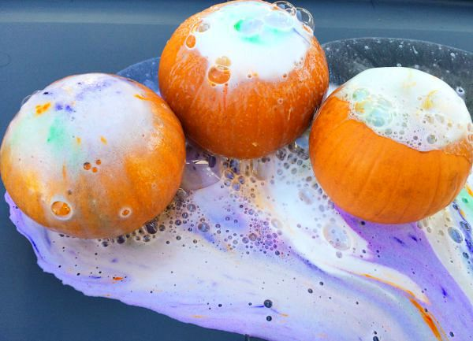
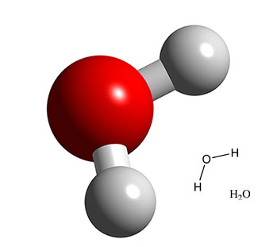
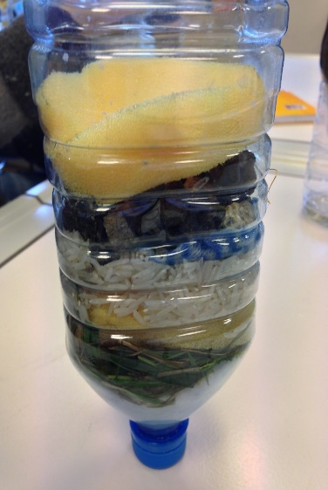
Focus – Educate – Apply
Color-changing
Fizzing / Erupting
Constructing Models
Testing Substances
Telling Stories

Slide 10
Thank You!
Janet Yamaguchi
714-714-2044
kentandjanet@earthlink.net

