Slide 1
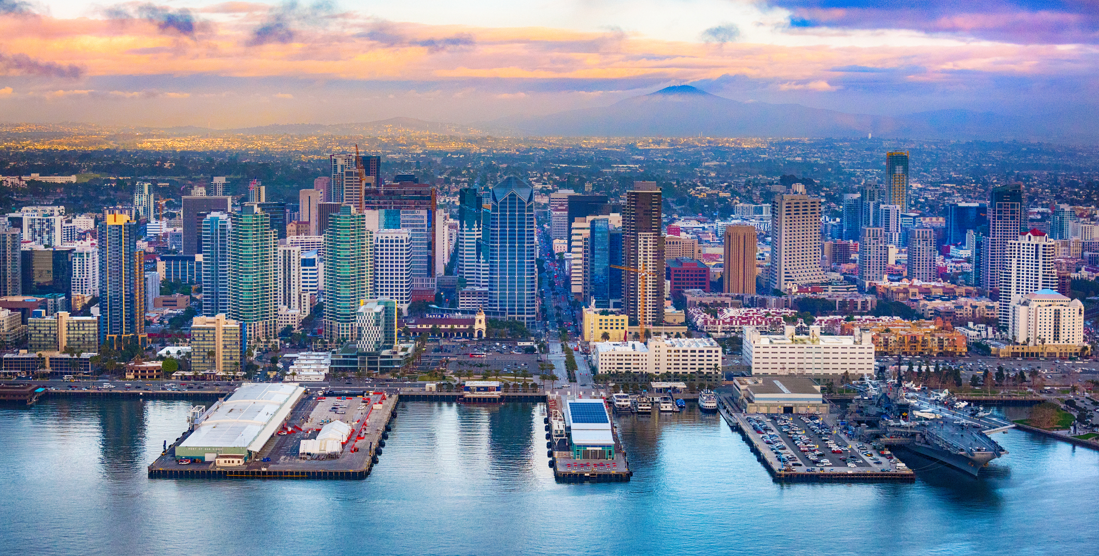
Creating a Culture of Innovation in Your Utility
Urban Water Institute │ August 23, 2018
Jason Carter, PE

Slide 2
Creating a Culture of
Innovation in Your Utility
Group Poll

Slide 3
PollEv.com/jasoncarter492
Notes:
Poll Title: Creating a Culture of Innovation in Your Utility
https://www.polleverywhere.com/surveys/5SYIZxWiJ

Slide 4
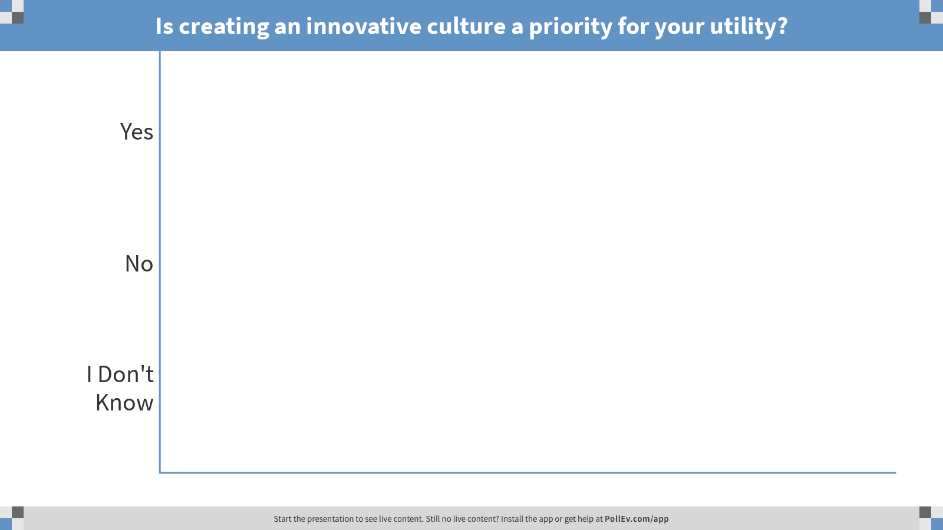
Notes:
Poll Title: Is creating an innovative culture a priority for your utility?
https://www.polleverywhere.com/multiple_choice_polls/XehiCPBUkSd0TeK

Slide 5
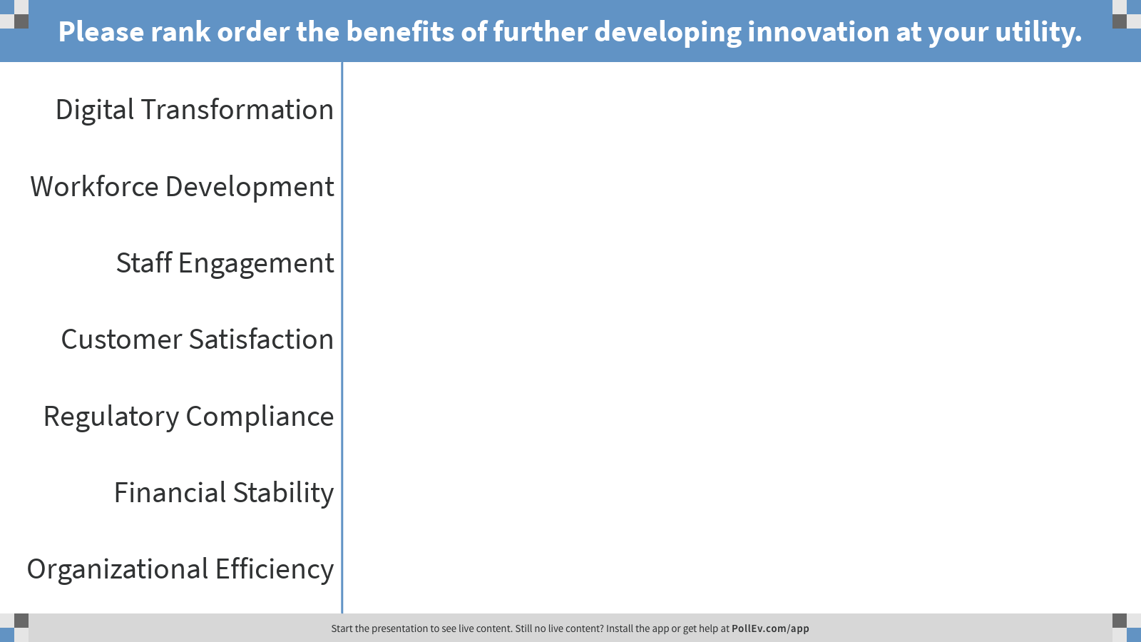
Notes:
Poll Title: Please rank order the benefits of further developing innovation at your utility.
https://www.polleverywhere.com/ranking_polls/j08L03wfjpthtKI

Slide 6
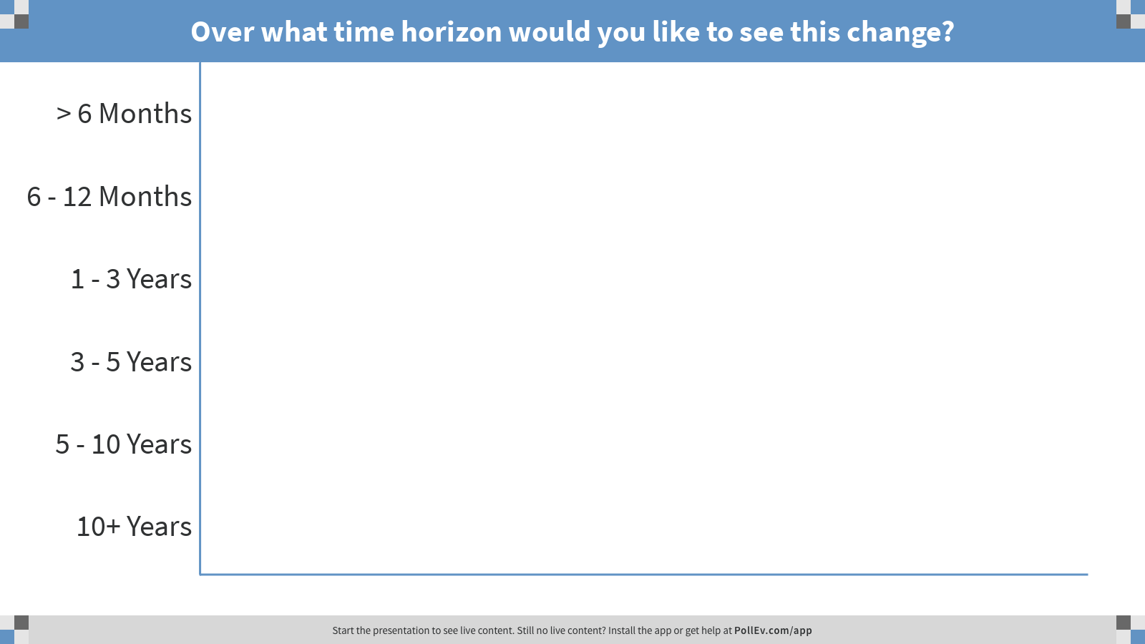
Notes:
Poll Title: Over what time horizon would you like to see this change?
https://www.polleverywhere.com/multiple_choice_polls/P3bi9SwlN6dLagc

Slide 7
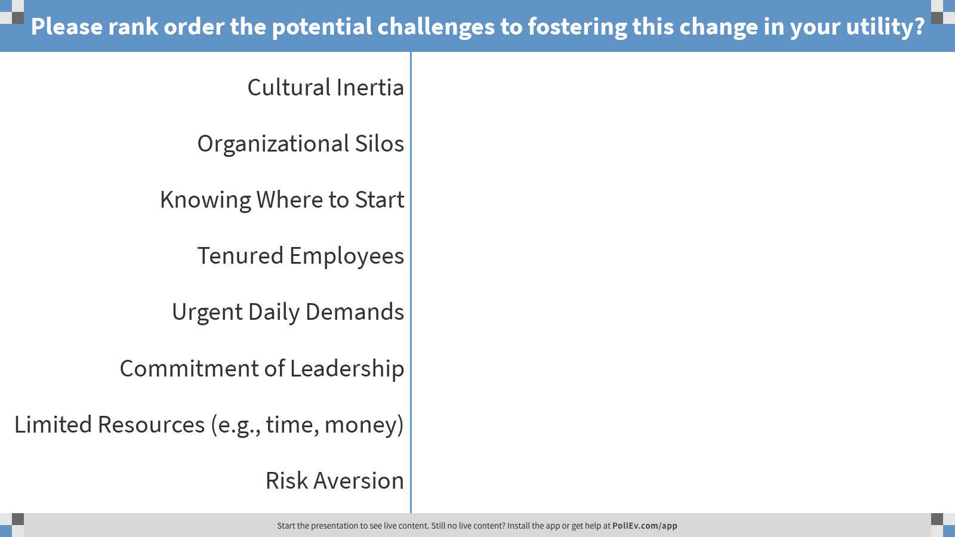
Notes:
Poll Title: Please rank order the potential challenges to fostering this change in your utility?
https://www.polleverywhere.com/ranking_polls/3wm2HuP9dnCHwS9

Slide 8

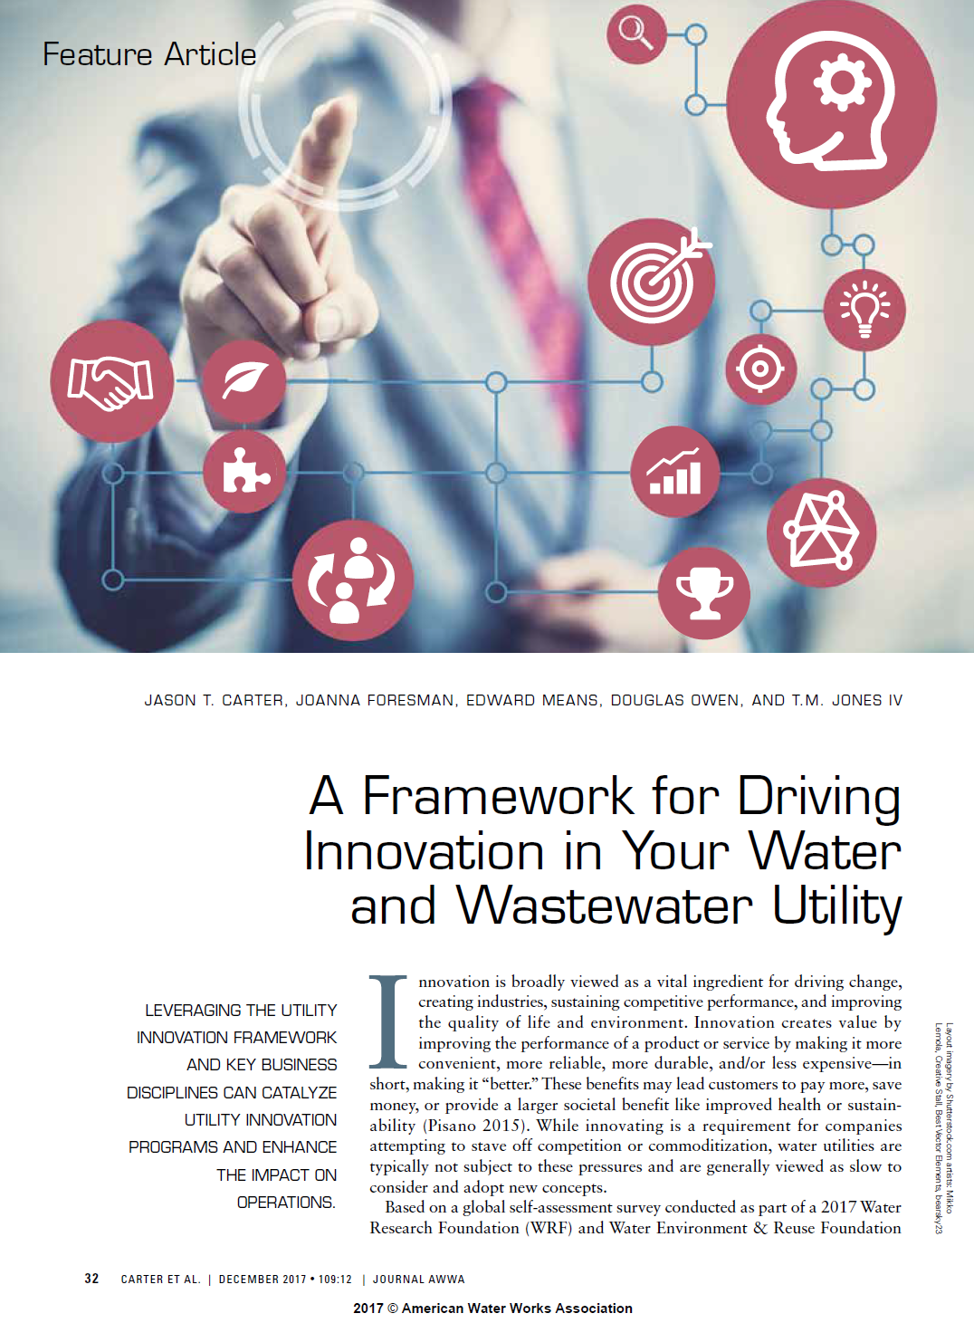
Introduction to
Utility Innovation Management

Slide 9
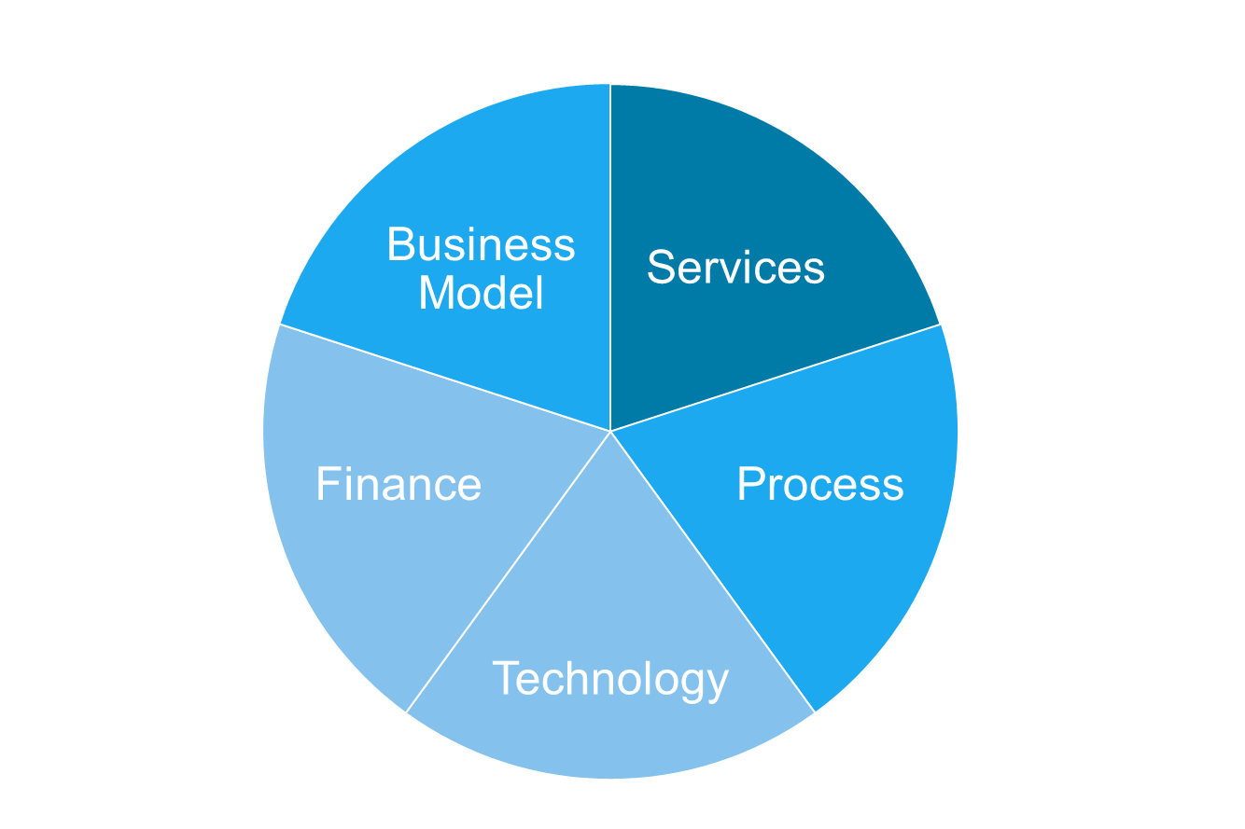
Definition of Innovation
“The application of new ideas resulting in increased value to our customers and/or increased productivity.”
WRF/WE&RF 4642 Definition for “Innovation”
5 Categories of Innovation

Slide 10
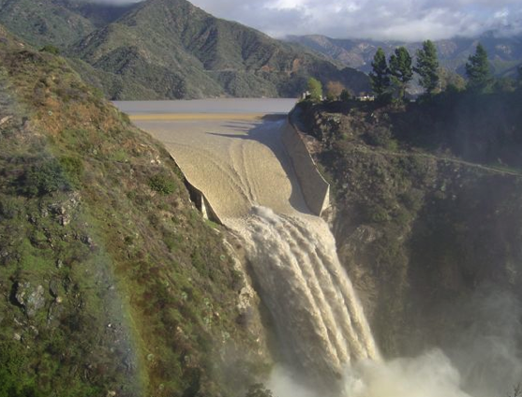
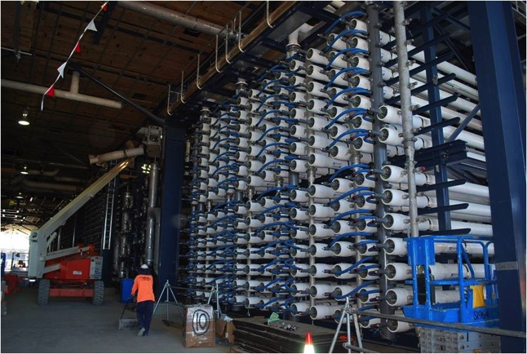
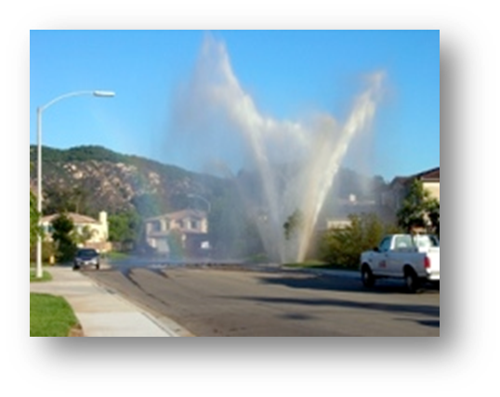

Drivers for Innovation
  Financial instability
  Water resource adequacy
  Shifting water demands
  Aging infrastructure
  Changing workforce
  New technology
  Stakeholder expectation
  Regulations
  Efficiency and optimization
  Climate uncertainty
  Implementation of strategy
  Sustainability / agility
  Customer expectation
  Workforce of tomorrow

Slide 11

Priority of Innovation
91%
Of water utilities believe that innovation is critical to the future of their organization
50%
Approx.
Believe they are effectively leveraging innovation

Slide 12
Impact of Innovation
Sustainability
Better Solutions
Waternet is advancing toward energy neutrality by 2020 with heat exchangers, solar panels and investigating biomass reuse.
AlexRenew leveraged partnerships to bring nutrient removal technologies to US - leading to 20% energy reduction with a projected savings of $400,000/yr.
Financial Impact
Utility Innovation
American Water reduced annual OpEx and achieved a payback time of <2 years with new algae control technology.
Recognition
Queensland Urban Utilities was named Business Review Weekly’s Top 10 Most Innovative Companies.
Stronger Organization
Sacramento Area Sewer District fosters a sustainable workforce through broad collaboration, engagement and communication – 131 employees engaged (over 40% of staff).
Workforce Development
Santa Clara Valley Water District collaborates with 45 utilities and community colleges on to address labor needs in mission critical jobs.

Slide 13
Growing Number of Innovation Programs
¹ 31 participating utility innovation programs; 15 programs had defined launch dates.

Slide 14
Innovation Program Maturity
Program Leverages Open Platform
Program Leverages Value Chain Partners
Internal Program Led with Expectations
Consistent Adoption, Process and Success
Inconsistent Adoption, Process and Success
No Process
Ad hoc
Structured
Standard
Driven
Networked
Open
Supportive
Active

Slide 15

Utility Investment in Innovation
Innovation Leaders
Innovation Budgets
< 500
Employees
50% of utilities had innovation leaders
500 – 1000
Employees
50% of utilities had innovation leaders
>1000
Employees
73% of utilities had innovation leaders

Slide 16
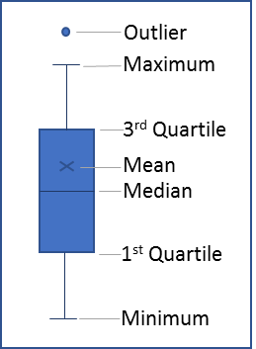
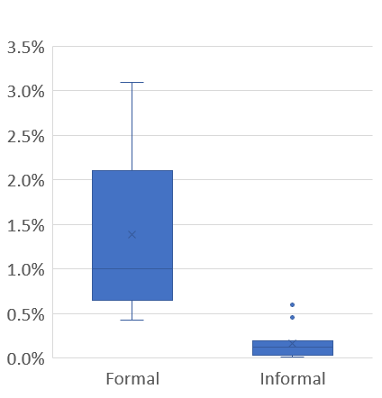
Utility Investment in Innovation
Innovation Spend as a Percent of
Operating Budget
(Average Shown)
Innovation spend of all formal innovation programs averaged 1.39% of OpEx.
Informal programs invested significantly less in innovation.
Legend
  1.39%
0.16%

Slide 17
Challenges to Innovation
33% Cultural Inertia
30% Tenured Employees
26% Organizational Silos
11% Executive Management

Slide 18
Utility Innovation Framework
Results-oriented. Tangible and intangible improvement aligned with leadership and organizational philosophy.
CAPABILITY
IMPACT
ENGAGEMENT
COMMUNICATION
Ecosystem-oriented. Environment encouraging growth and maturation of ideas.
People-oriented. Ideators, mentors, adopters leading initiation and application of innovation.
Notes:
Successful programs are engaged in activities across all three of these areas with a strong communication thread throughout. They build their vision and maintain momentum on stories of successful innovation.

Slide 19
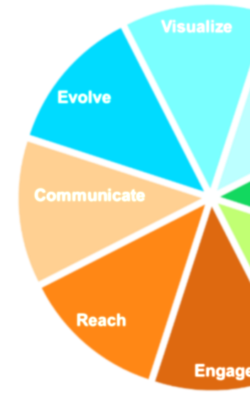
dis•ci•pline /’di-sə-plən/ n.
a practice that molds or perfects the mental faculties or character.
Adapted from Merriam-Webster.com

Slide 20
Eight Key Innovation Disciplines
Visualize - maintain a long view that empowers and inspires innovation
Focus - define challenges that guide investment
Develop - invest resources in new ideas
Evaluate - test concepts in scaled and relevant applications
Engage - motivate, enable and reward stakeholders
Reach - utilize resources outside of the organization
Communicate - capture and convey defining success stories
Evolve - implement concepts and measure impact

Slide 21
State of Utility Innovation

Slide 22
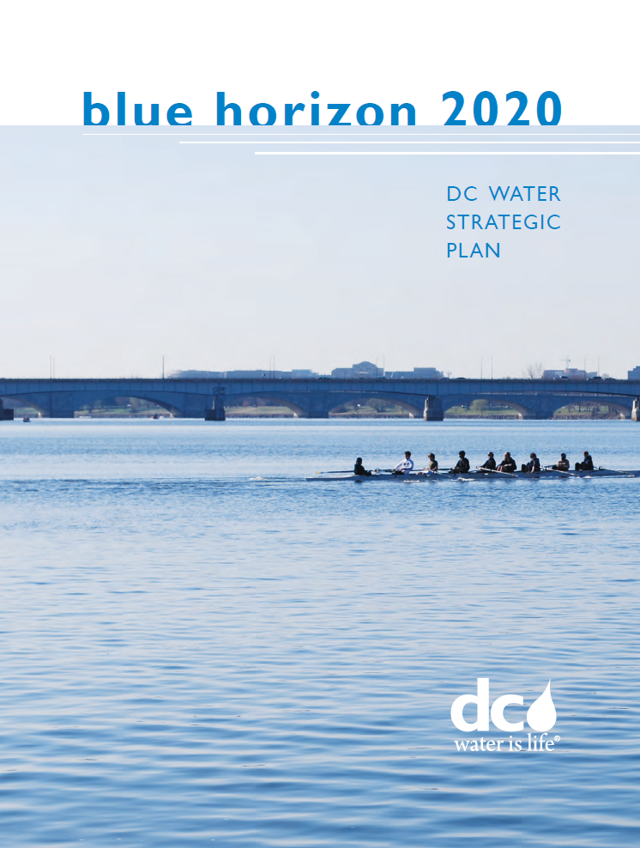
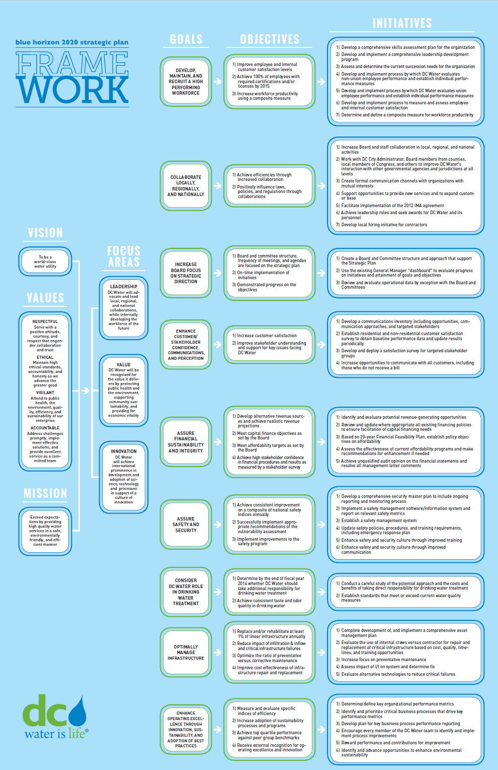
Utility Innovation - Visualize
Vision
To be a world-class water utility.
Focus Area: Innovation
DC Water will achieve international prominence in development and adoption of science, technology and processes in support of a culture of innovation.
Goal: Enhance operating excellence through innovation, sustainability, and adoption of best practices.

Slide 23
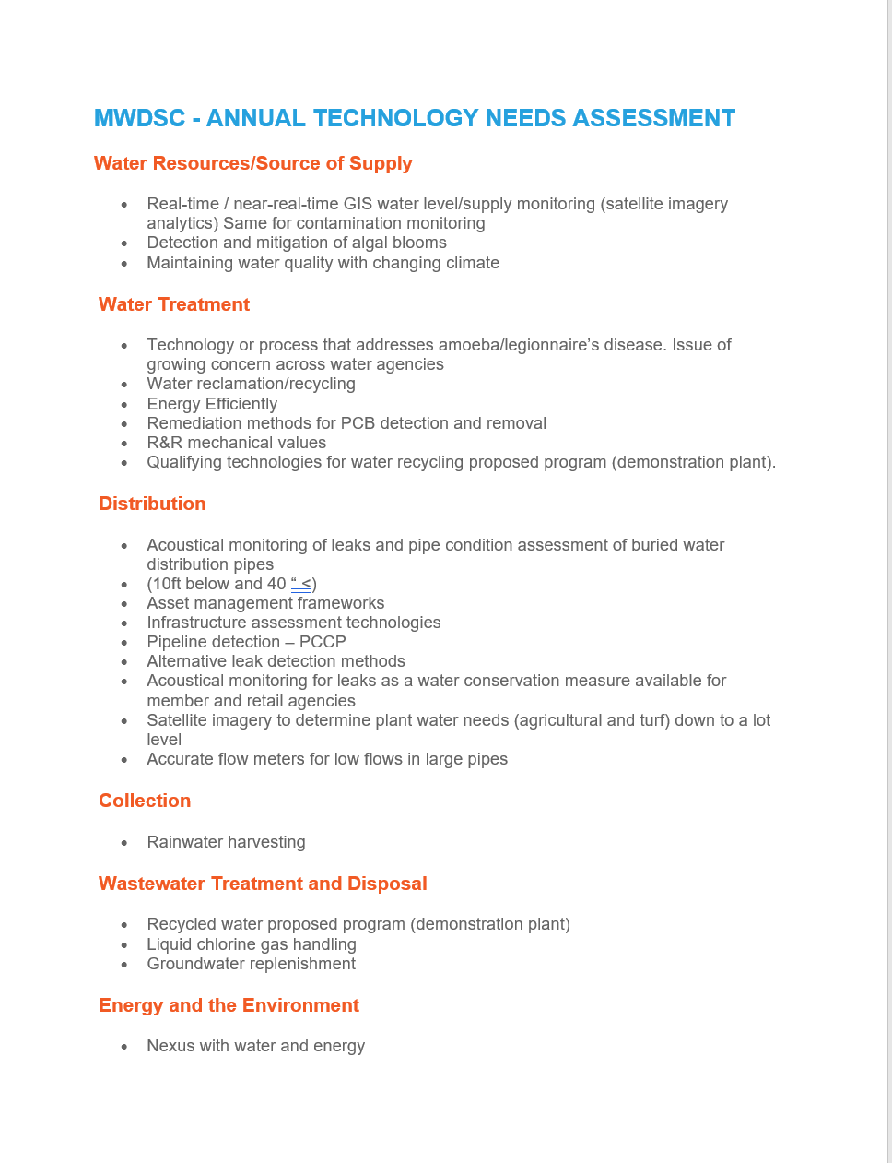
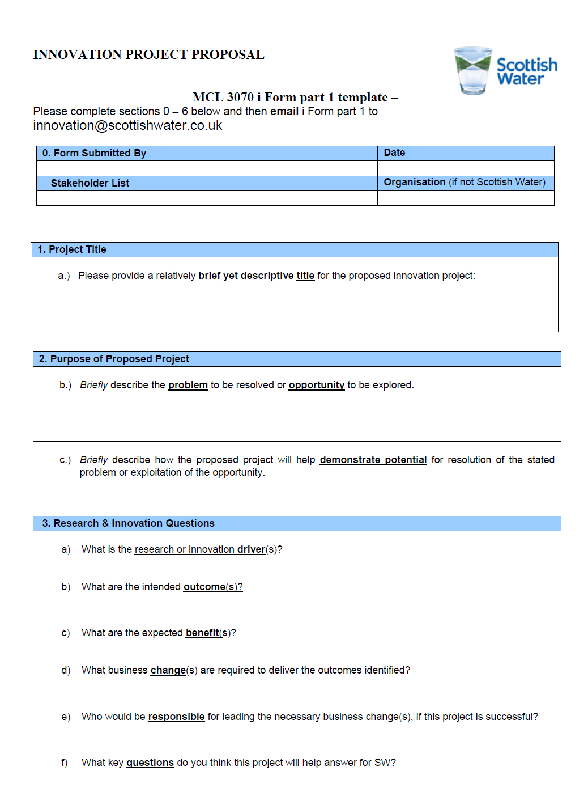
Utility Innovation - Focus
Continuous needs and opportunity assessment
Focus area challenges (e.g., passive, RFP)
Challenge-related funding
Founded on strategic plan
Guidelines for idea submission
Process for idea selection and development

Slide 24
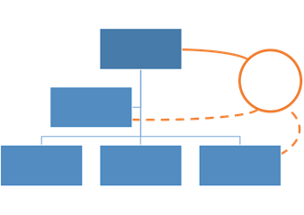
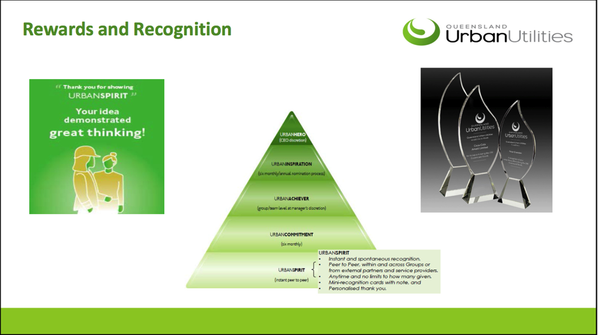
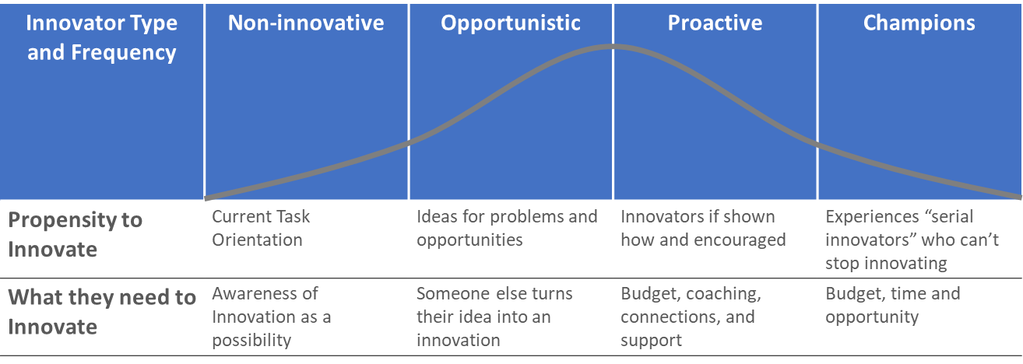
Utility Innovation - Engage
Create connection with Chief Executive and safe space for incremental idea development.
Provide tiered rewards for participation and highlight success.
Create a broad range of roles for participation to meet the interests of stakeholders.

Slide 25
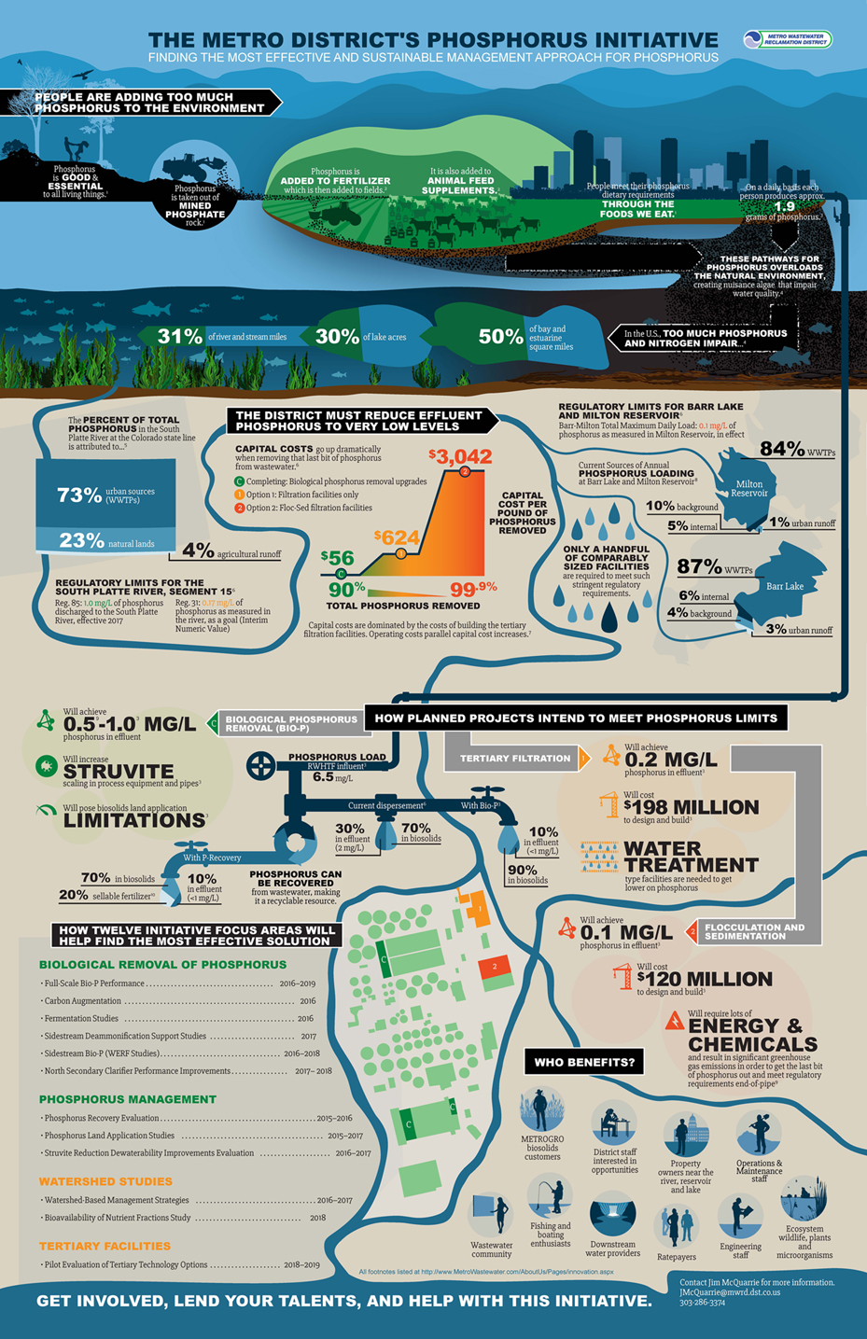
Utility Innovation - Communicate
External Channels
  Challenges
  Partnerships
  Success Stories
  Branding
Internal Channels
  Idea development
  Engagement opportunities
  Impact for individual and organization
  Redefining meaning of employment
  Branding

Slide 26
How to Use the
Utility Innovation Framework

Slide 27
Roadmap for Using Utility Innovation Framework
Assessment and Benchmarking
Target Maturity and Gap Analysis
Innovation Strategy Development
Program Launch and Measurement

Slide 28
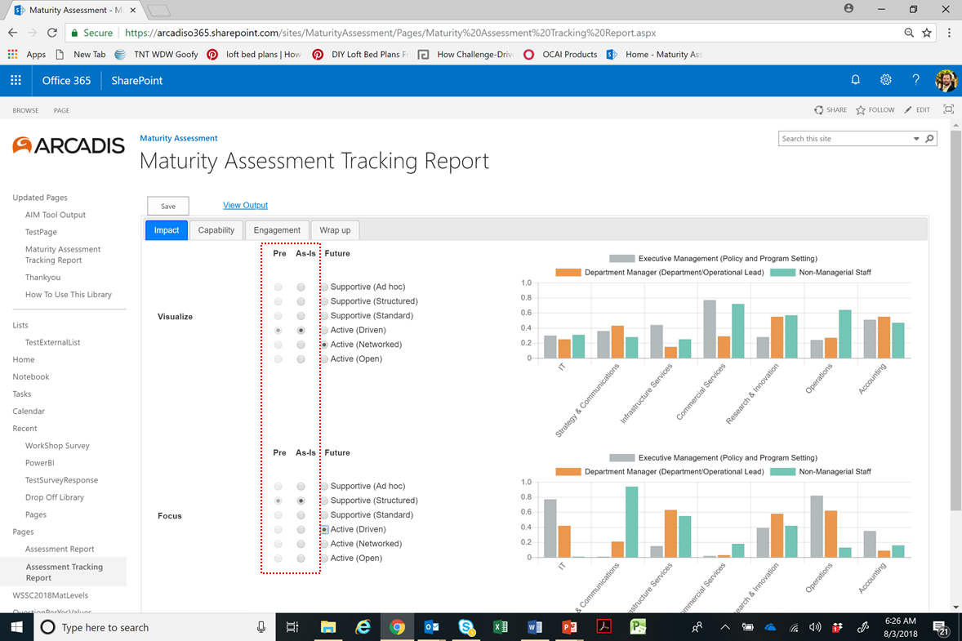
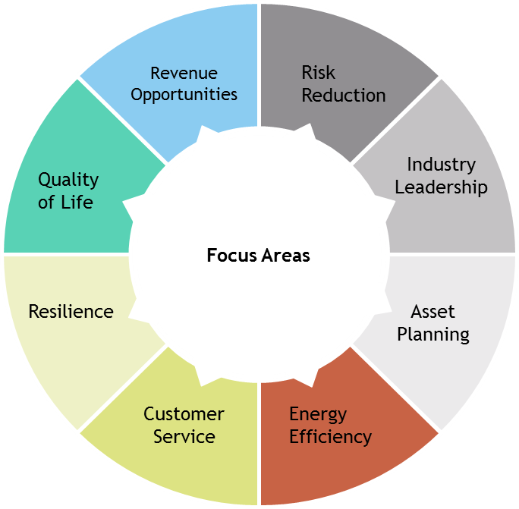
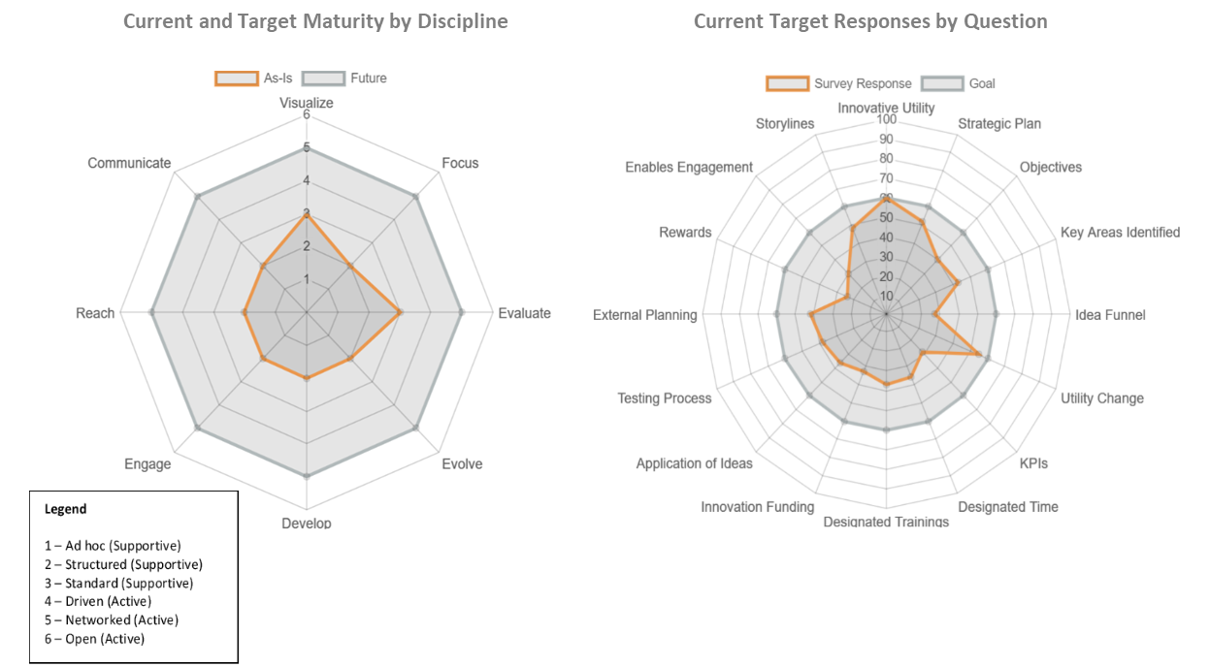
Assessing Current Environment
Self-Assessment
Leverage Current Opportunities
Ideas
Inhibitors
Catalysts
Identify Key Focus Areas

Slide 29
Target Maturity & Gap Analysis
Program Leverages Open Platform
Program Leverages Value Chain Partners
Internal Program Led with Expectations
Consistent Adoption, Process and Success
Inconsistent Adoption, Process and Success
No Process
Ad hoc
Structured
Standard
Driven
Networked
Open
Supportive
Active

Slide 30
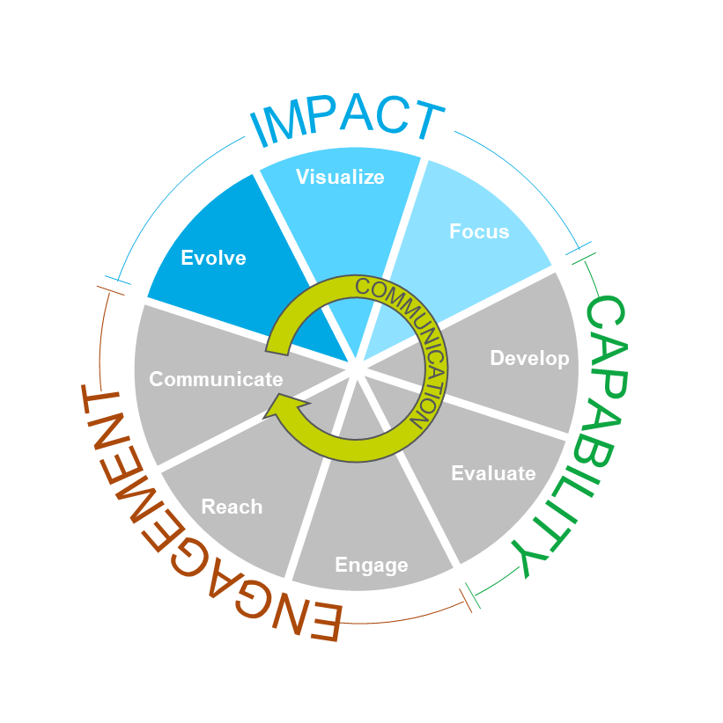
Innovation Strategy: Aligning for Impact
Results-oriented. Tangible and intangible improvement aligned with leadership and organizational philosophy.
Establish desired outcomes
Create coalition
Understand cultural legacy
Define responsibility
Create focus areas
Define selection process
Establish initial investment level
Early metrics – productivity focused

Slide 31
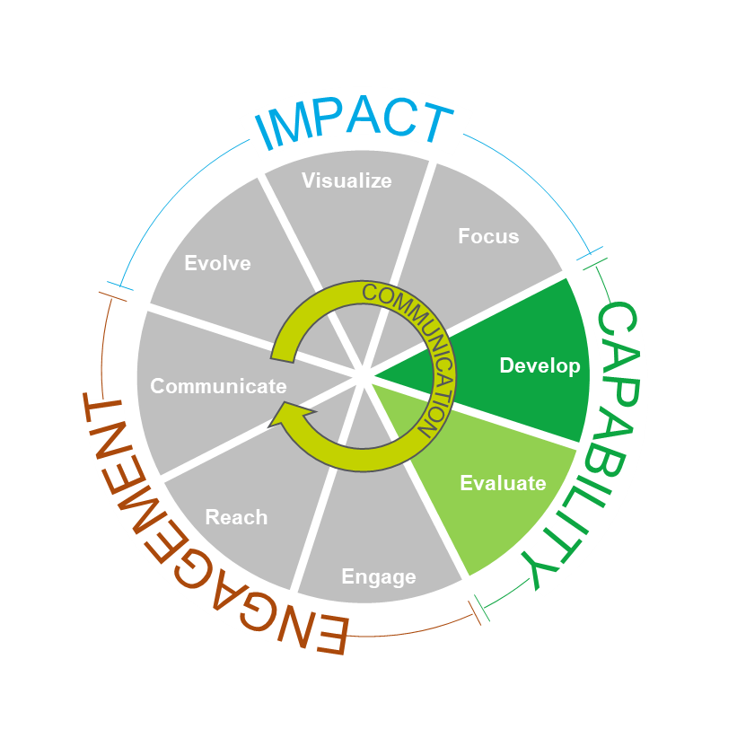
Innovation Strategy: Creating Environment
Ecosystem-oriented. Environment encouraging growth and maturation of ideas.
Identify available resources/assets
Leverage resource tracking
Develop idea platform
Define idea pipeline – acceptance, development and adoption
Identify needed support systems and resources

Slide 32
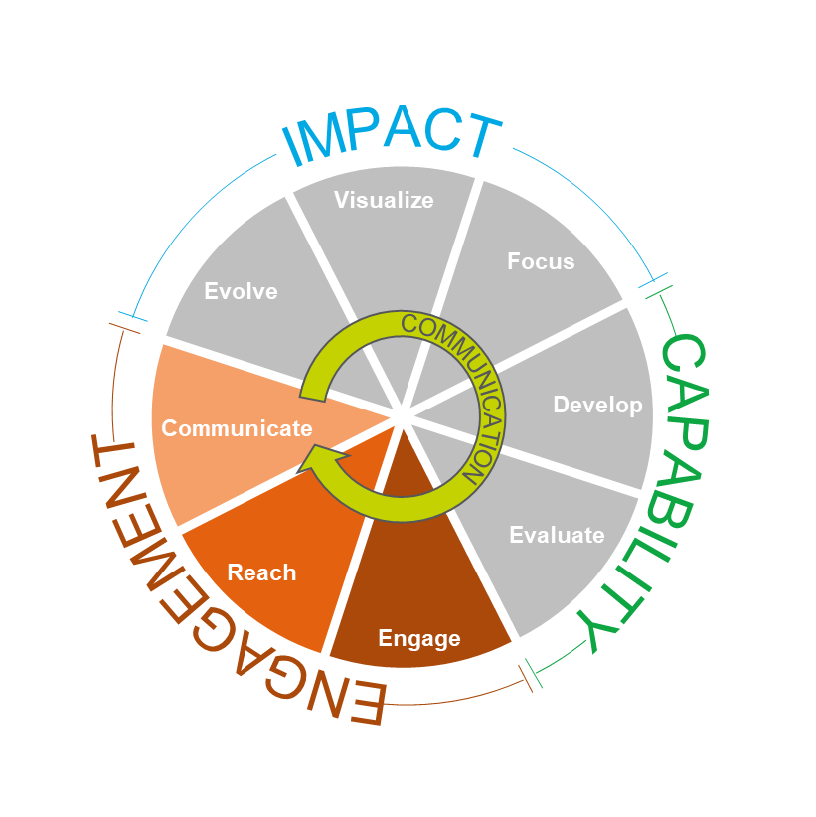
Innovation Strategy: Empowering Stakeholders
People-oriented. Ideators, mentors, adopters leading initiation and application of innovation.
Define roles for participants
Lead engagement events
Reward all levels of participation
Revise employee handbook
Conduct partner (a.k.a ecosystem) gap analysis
Develop collaboration support tools
Define communications plan – internal and external

Slide 33
Creating Your
Innovation Strategy
Vision for Innovation
Expectations
Strategic Framework
Program Elements
Implementation Plan
Resources
www.waterrf.org/fosteringinnovation

Slide 34
Summary and Next Steps
“Business as usual” is unsustainable.
Ideas are being recognized as critical assets.
Utilities are looking beyond one-off or just technology solutions toward organizational agility and creativity.
Innovation management is becoming a business practice and key catalyst for organizational change.
Peer utilities provide a rich resource for lessons learned.
Utility Innovation Framework provides a powerful tool for self assessment and innovation strategy development.

Slide 35
PollEv.com/jasoncarter492
Notes:
Poll Title: Creating a Culture of Innovation in Your Utility
https://www.polleverywhere.com/surveys/5SYIZxWiJ

Slide 36
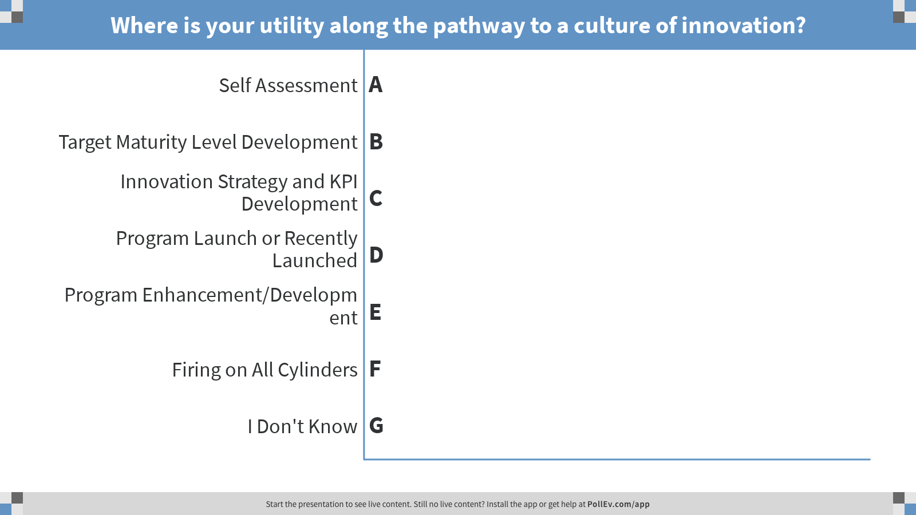
Notes:
Poll Title: Where is your utility along the pathway to a culture of innovation?
https://www.polleverywhere.com/multiple_choice_polls/ILI0jVsBH5gzHj2

Slide 37
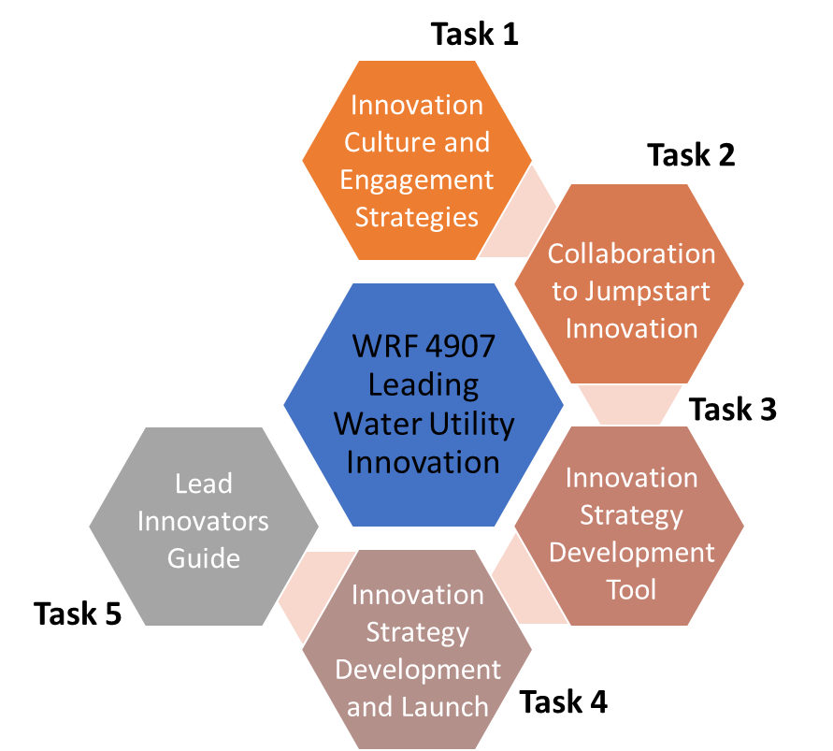
WRF 4907 – Leading Water Utility Innovation
65 Partner Utilities from Australia, US, UK and Canada
WRF, WSAA, AWWA, LIFT, WEF, NACWA
Project Objectives:
  Equip utilities to influence the social dynamics of innovation
  Provide guidance for building partnerships for early wins
  Develop a simple tool for building an innovation strategy
  Demonstrate the strategy development and launch
  Compile an innovation leader’s resource

Slide 38
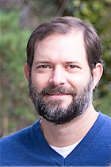
Questions
Jason Carter, PE
Vice President, Water Utility Innovation Leader, Arcadis
o 205 930 5914
c 205 253 2276
e jason.carter@arcadis.com

Slide 39
Creating a Culture of Innovation in Your Utility
Urban Water Institute │ August 23, 2018
Jason Carter, PE

Slide 40

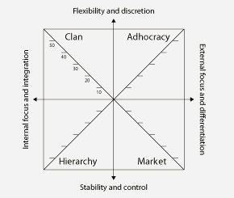
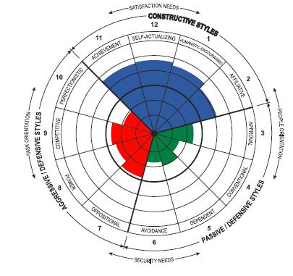
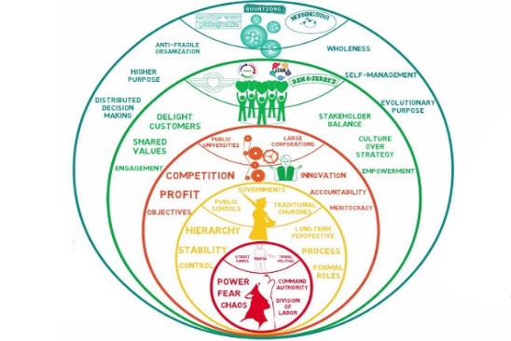
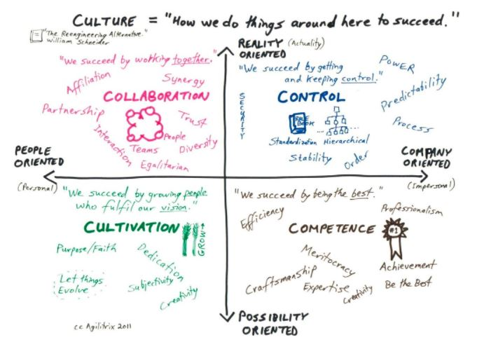
WRF 4907 – Leading Water Utility Innovation
Problem
We need better tools for applying innovation disciplines to create a culture of creativity. Specific challenges include:
Influencing social dynamics
Leveraging partnerships
Creating meaningful strategies
Task 1 – Identify Innovation Roles and Engagement Strategies
Survey of Engagement Strategies
Innovation Leader Profiles
Cultural Assessment Tool Scan
Workshop – hosted by WSSC

Slide 41
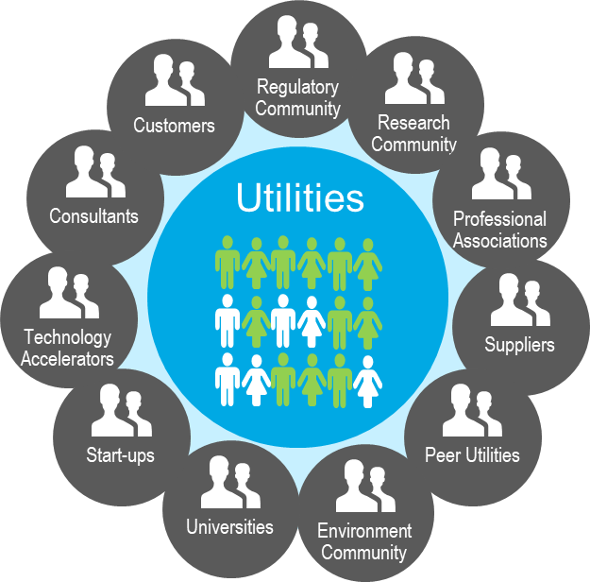
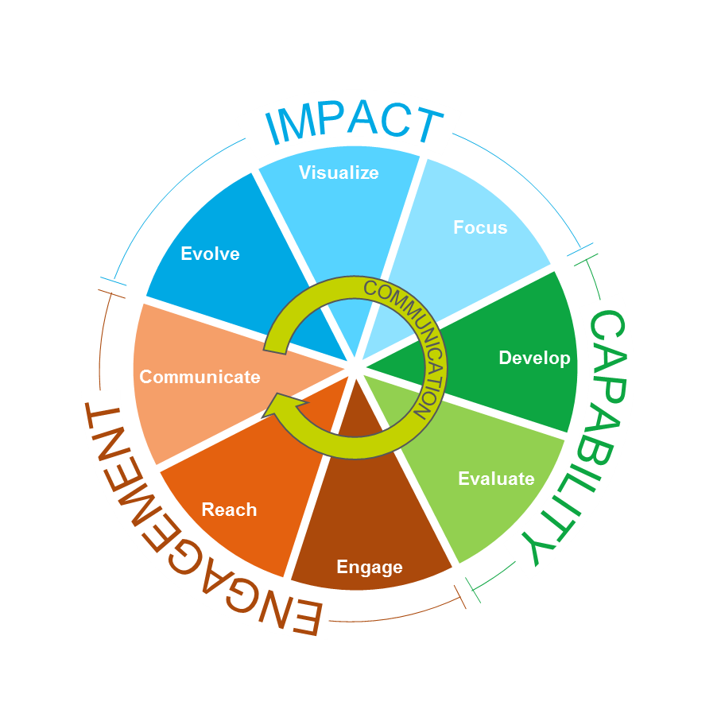
Task 2 – Identify Collaboration Strategies to Jumpstart Innovation
Utility Supply Chain Mapping
Survey of Successful Collaborations
Case Studies
Workshop 2 – hosted by San Jose Water
Task 3 – Create an Innovation Strategy Development Tool
Simple Tool to Apply Framework
Workshop 3 – hosted by WSAA

Slide 42
Task 3 – Create an Innovation Strategy Development Tool
Core Functions of Tool:
Assess their current innovation environment
Set expectations for the program (i.e., desired level of maturity)
Develop innovation strategy elements
Create a dashboard for tracking progress toward goals
Module 1 - Instruction
Module 2 – Self Assessment
Module 3 – Strategy Development
Module 4 - Dashboard

Slide 43
Task 2 – Identify Collaboration Strategies to Jumpstart Innovation
Utility Supply Chain Mapping
Survey of Successful Collaborations
Case Studies
Workshop 2 – hosted by San Jose Water
Task 3 – Create an Innovation Strategy Development Tool
Simple Tool to Apply Framework
Workshop 3 – hosted by WSAA

Slide 44
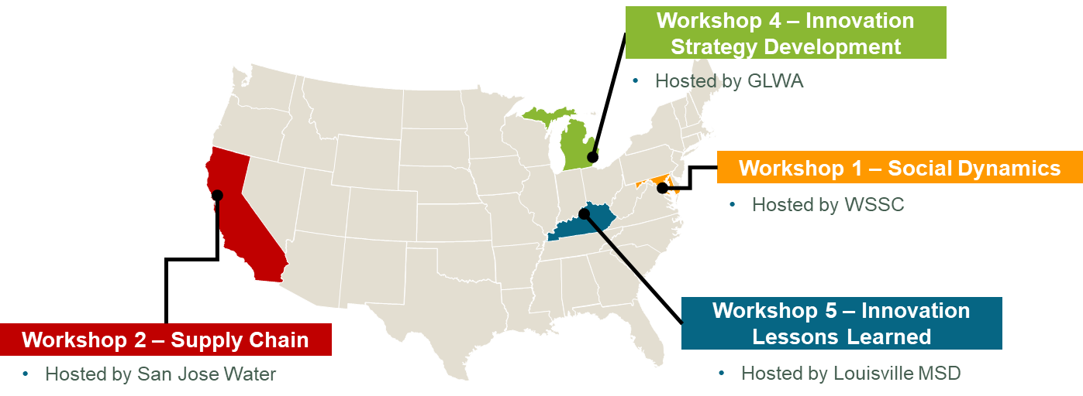
Task 4 – Develop and Demonstrate Innovation Strategy Launch
Three Demonstration Utilities – WSSC, GLWA, and Louisville MSD
Planning Workshop 4 – hosted by GLWA
Lessons Learned – Workshop 5 – hosted by Louisville MSD
Workshop 3 – Innovation Tool Development
Hosted by WSAA Utility Working Group
Innovation Leader’s Resource

