Slide 1
Colorado river next challenges
Anne J Castle
Getches-Wilkinson Center
University of Colorado

Slide 2
the problem
Natural Flow (2000-2018)
Outflows
UB uses 4.4
LB contracts 7.0-7.5
Evap & losses 1.0
Gila and tribs 1.0+
Mexico 1.5
Balance
13.2 MAF
14.9-15.4 MAF
-1.7-2.2 MAF

Slide 3
Likely to get worse
Udall/Overpeck 2017
20-30% reduction in river flows by mid-century
35-55% reduction by 2100

Slide 4
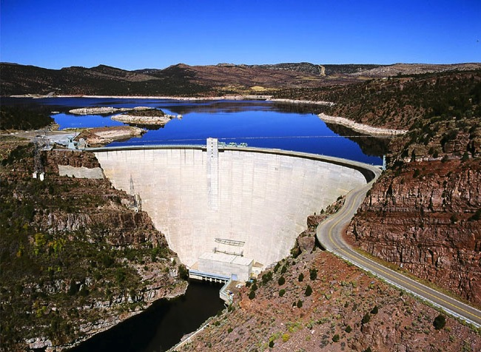
DCP – Upper Basin
Drought operations of UB reservoirs
Release water from upstream reservoirs to keep Powell out of low levels
Flaming Gorge Reservoir
Demand management investigation
Storage in Lake Powell free of balancing obligations
Work ongoing in Upper Basin states to investigate

Slide 5
Actions ≠ consequences
Lower Basin
Structural deficit = LB water users consume more than inflow
Lake Mead drops
Balancing from Powell prevents Mead levels from going even lower

Slide 6
Actions ≠ consequences
Upper Basin
New projects increase risk of curtailment for all water users
Real cost of new projects spread around the basin

Slide 7
actions ☞ consequences
New development in UB pays its own way, offsetting additional risk
If LB uses more than allocation, consequences occur there
Question: What exactly is the LB allocation?
Controlled slide to sustainability

Slide 8
Grand bargain ideas
UB caps new use
LB won’t force curtailment in UB
Bank in Lake Powell free of balancing
Both lakes used to store ICS or demand management savings
Triggers for delivery reductions based on hydrology, not Lake Mead levels

Slide 9
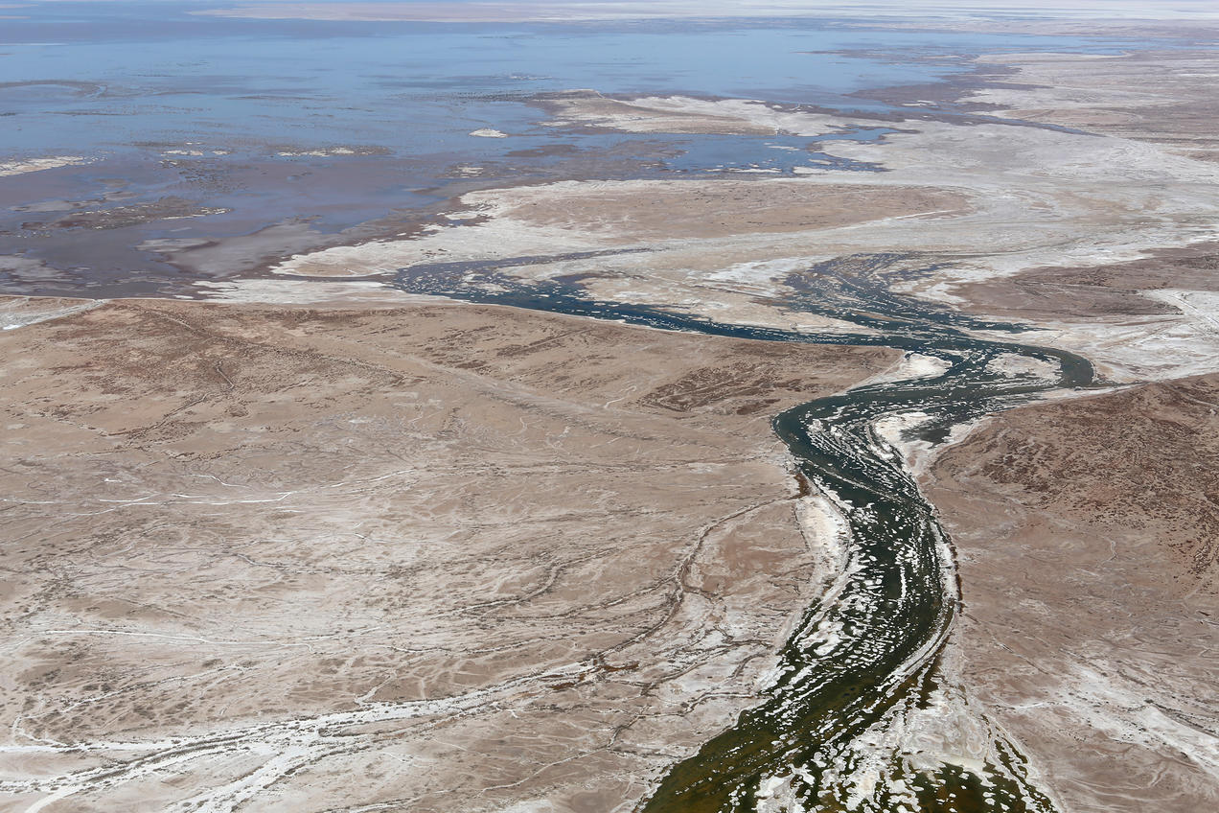
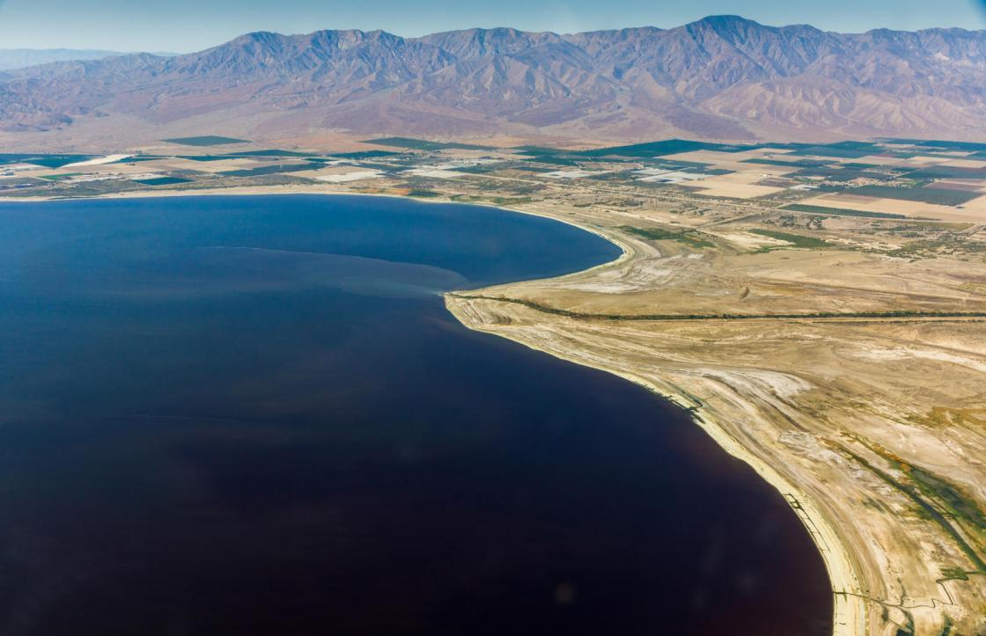
Important components
Development of tribal rights and protection of tribal water values
Protection of ecological values, including in the delta
Salton Sea progress
Colorado River Delta
Salton Sea

Slide 10
Guiding principles
Both basins manage their supplies and live within their hydrological means
Each basin or state decides how risk averse or risk taking it wishes to be
Consequences occur in the basin or state where the actions are taken

