Slide 1

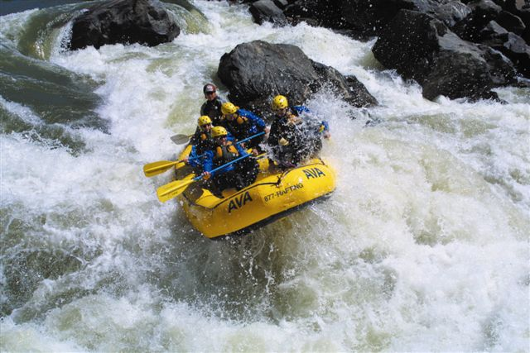
Urban Water Institute
Navigating the Rapid Changes
of the Colorado River
Bill Hasencamp
Metropolitan Water District

Slide 2
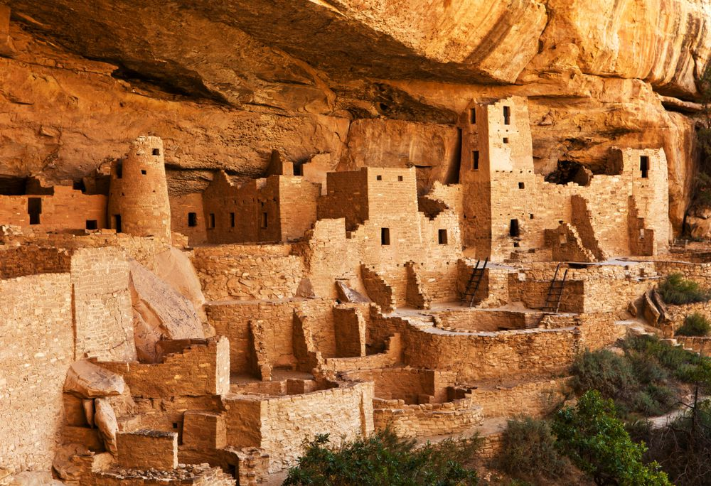
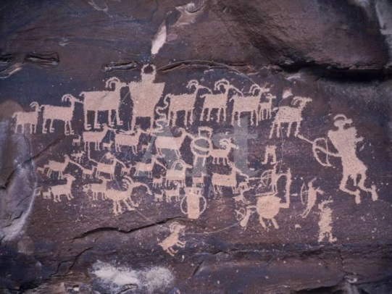
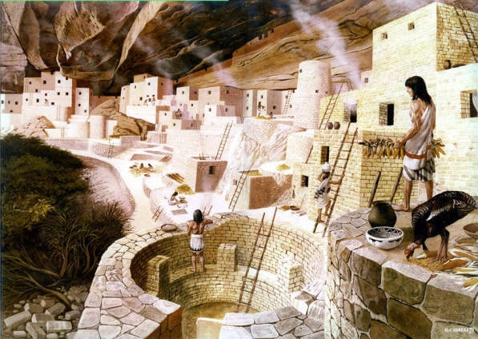
Anasazi Civilization disappeared

Slide 3
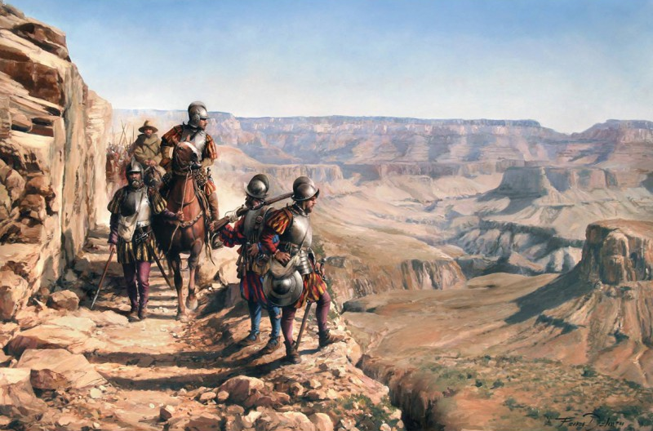
Coronado Expedition Blocked

Slide 4
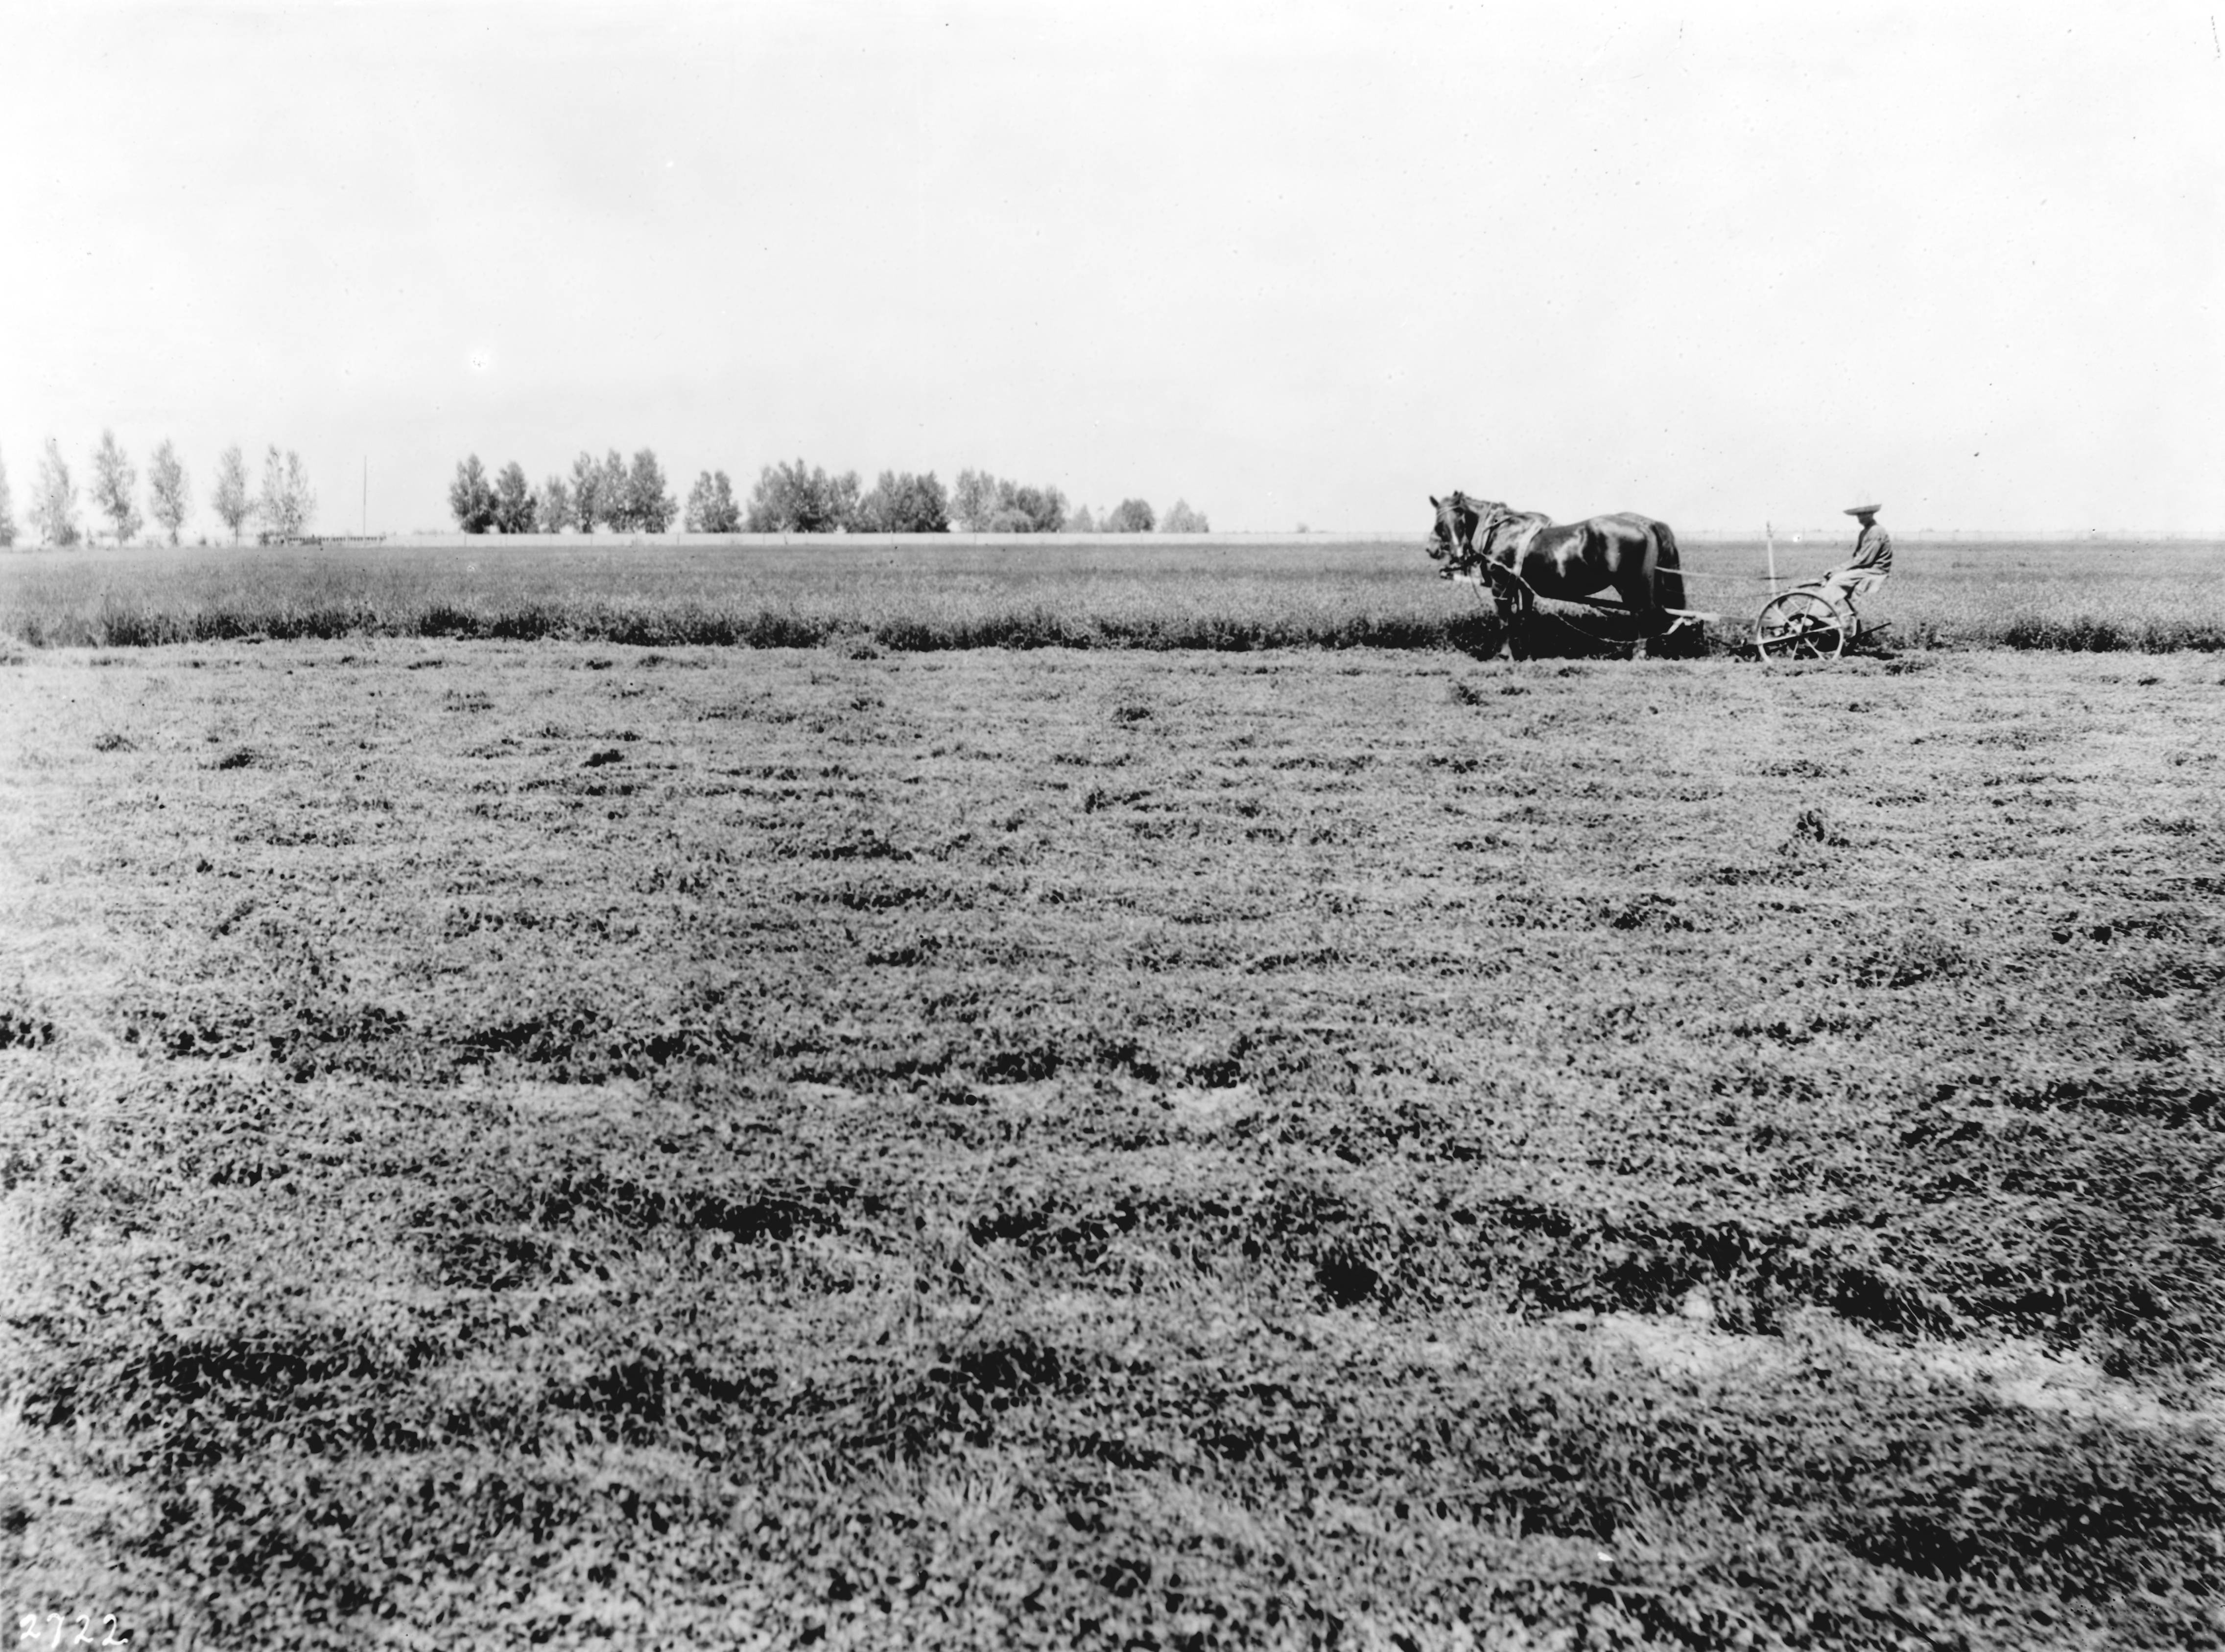
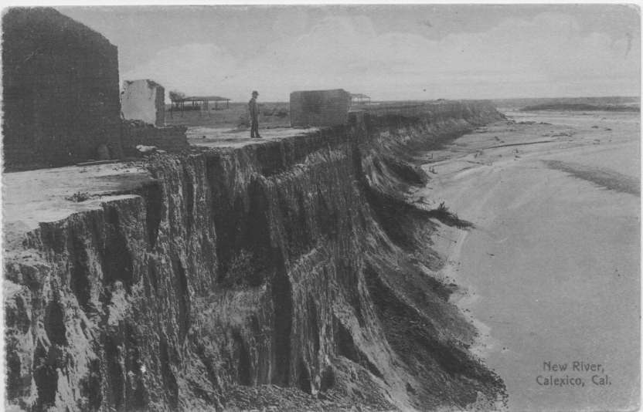
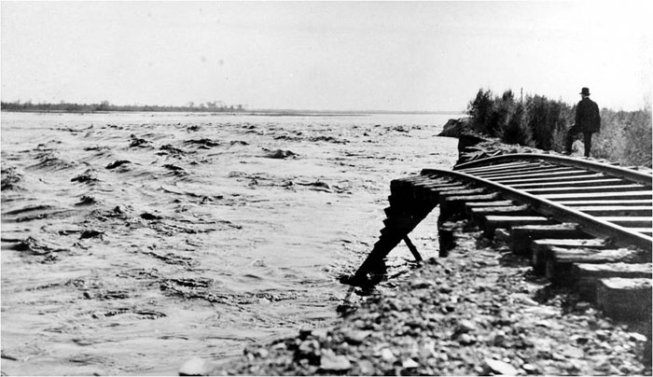
Imperial Valley Flooded

Slide 5
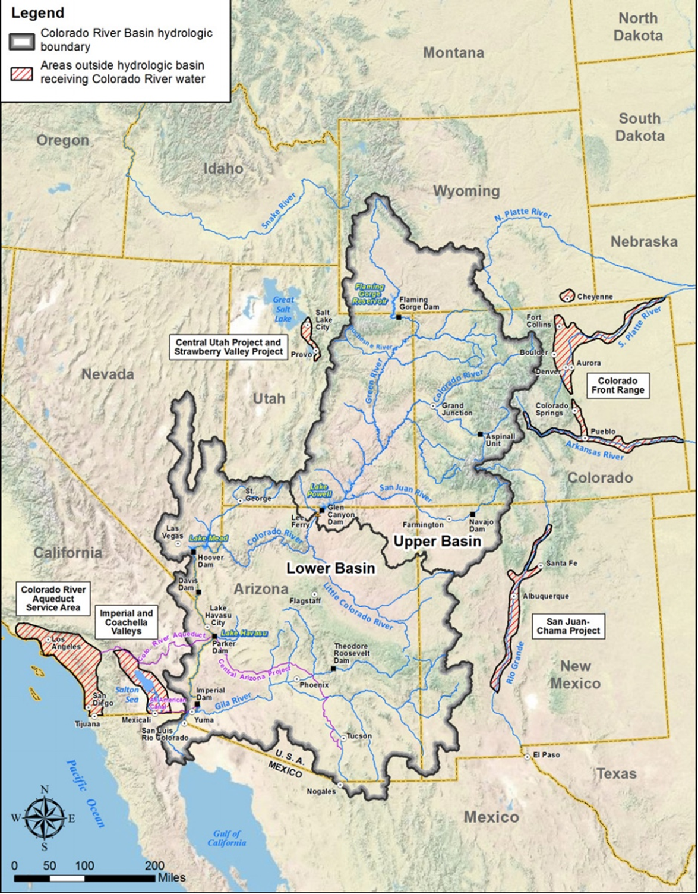

Slide 6
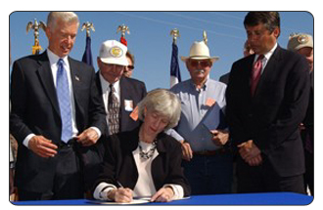
2003: Secretary Norton
Approves QSA

Slide 8
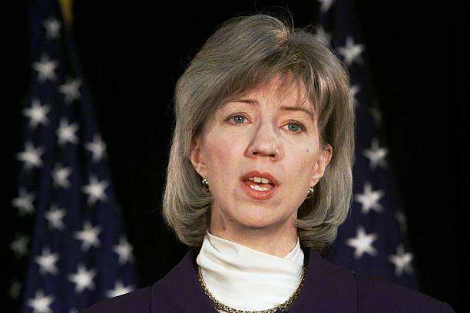
2005: Secretary Norton Provides Sense of Urgency
“Develop a shortage plan or I will do it for you…”

Slide 9
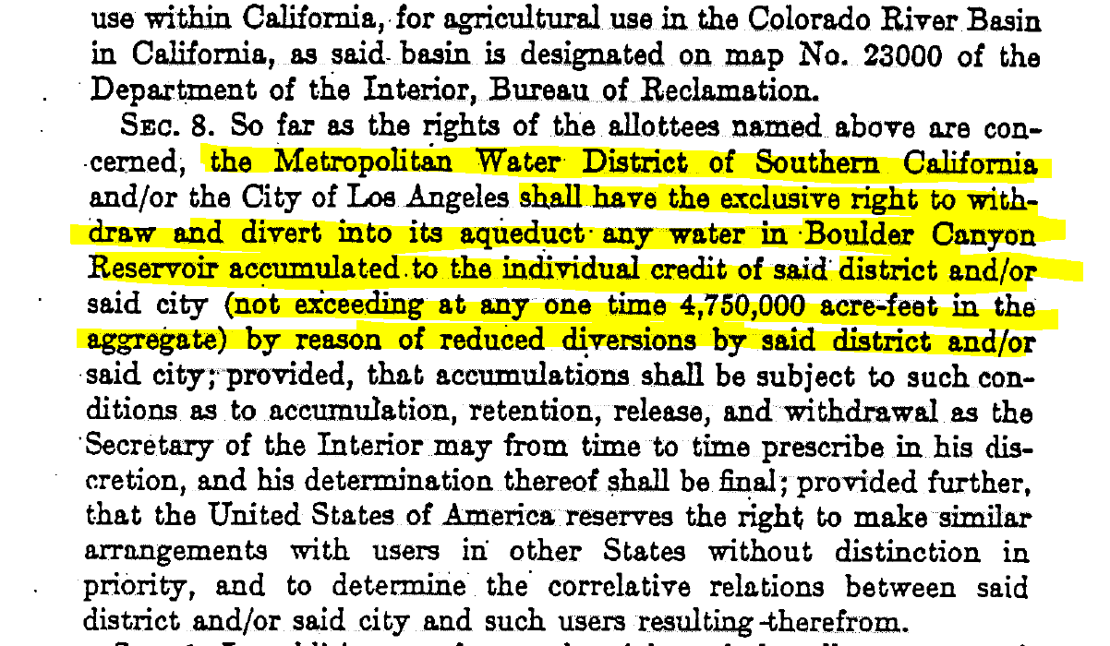
1931 CA Agreement Gave MWD Exclusive Right to Bank 4.7 MAF in Lake Mead

Slide 10

Two years later…
December 13, 2007, Secretary Kempthorne approves Colorado River Interim Guidelines

Slide 12
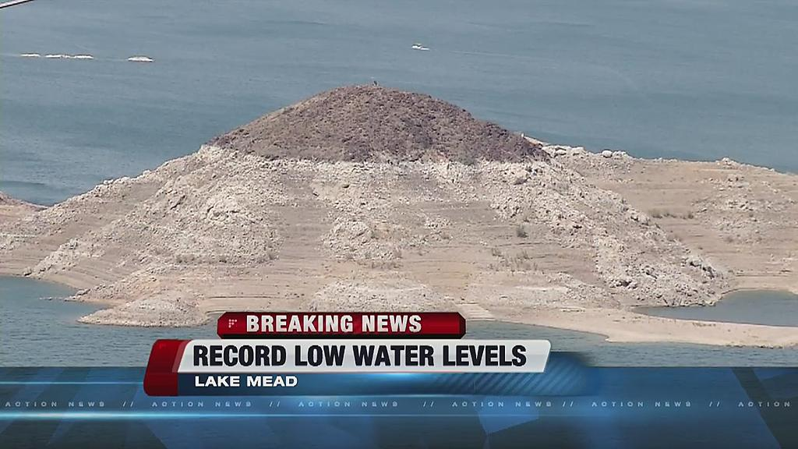
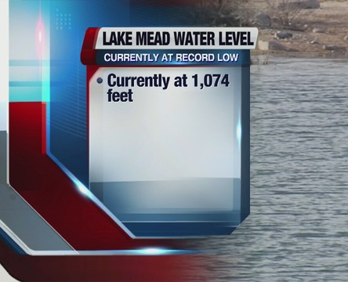
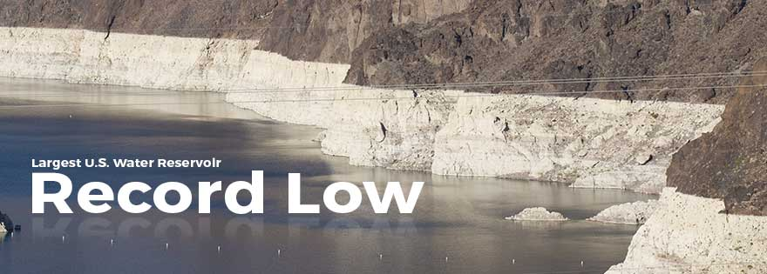

Slide 13
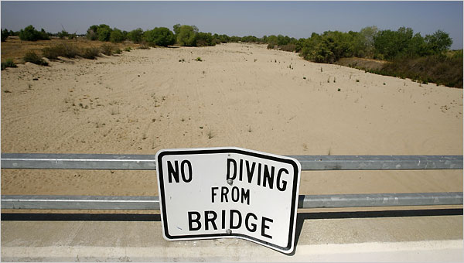
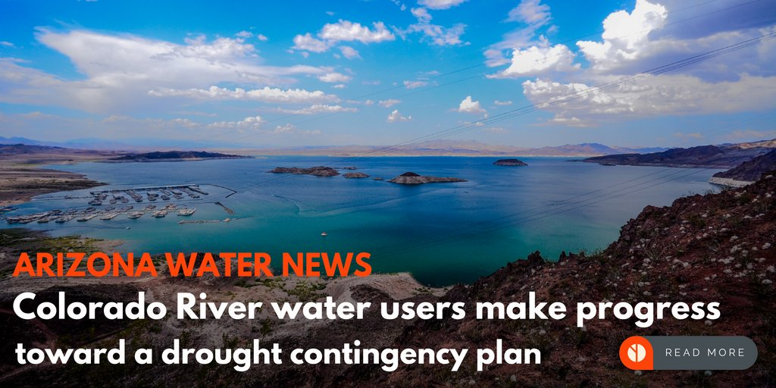
Development of Drought Contingency Plan

Slide 14
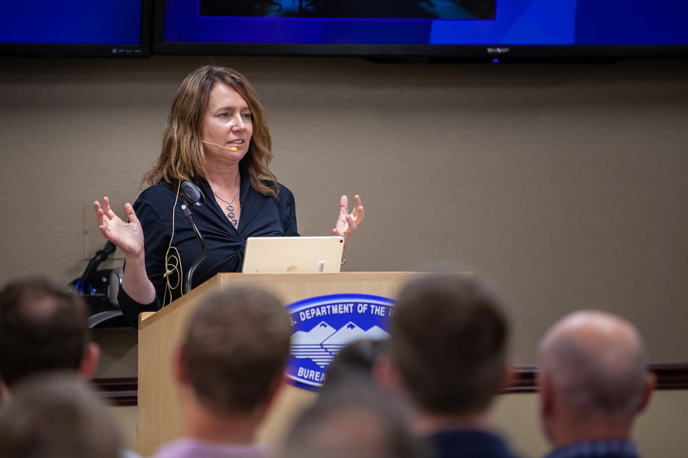
2018: Commissioner Burman Provides Sense of Urgency
“Approve the DCP or I will take action to protect Lake Mead…”

Slide 15
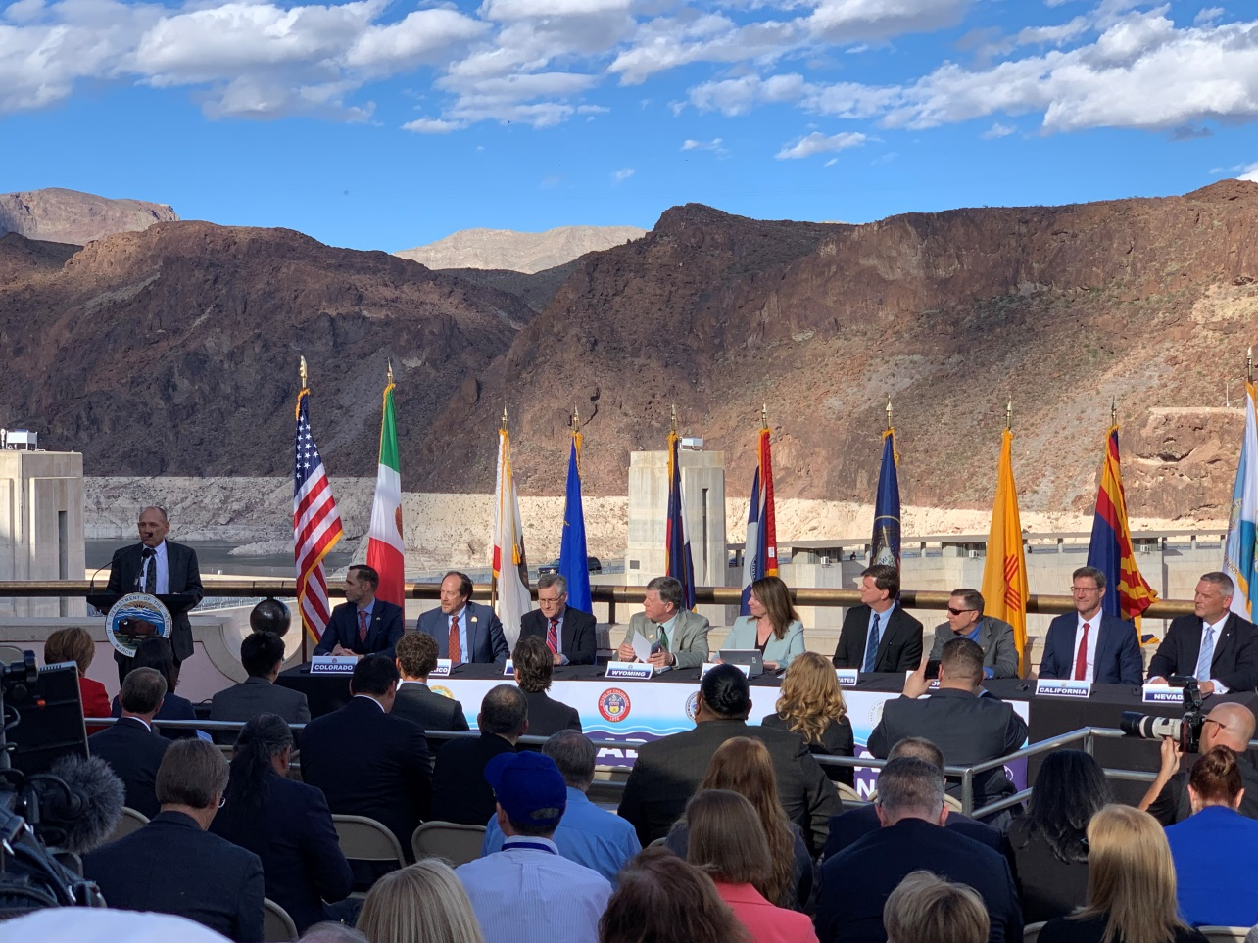
The Following Year…
May 21, 2019, Department of Interior and States approve Colorado River Drought Contingency Plan

Slide 17
MWD ICS Storage Balance
Notes:
Metropolitan Storage in Lake Mead supports IRP dry-year CRA goal of full aqueduct
Year ICS Drop 2 Desalter Total
2006 40262 0 0 40262
2007 41398 0 0 41398
2008 27573 66,000 0 93573
2009 79790 66,000 0 145790
2010 173217 66,000 16,750 255967
2011 344439 66,000 24,397 434836
Projected to store an additional 70 TAF in 2012

Slide 18
Projected EoY 2019 Lake Mead ICS and ICMA
2.54 MAF Net Stored

Slide 19
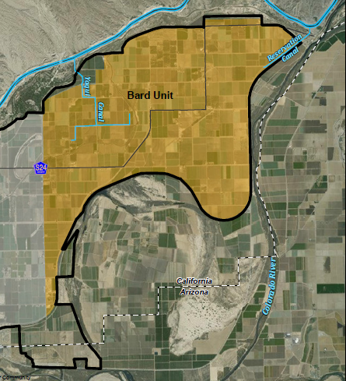
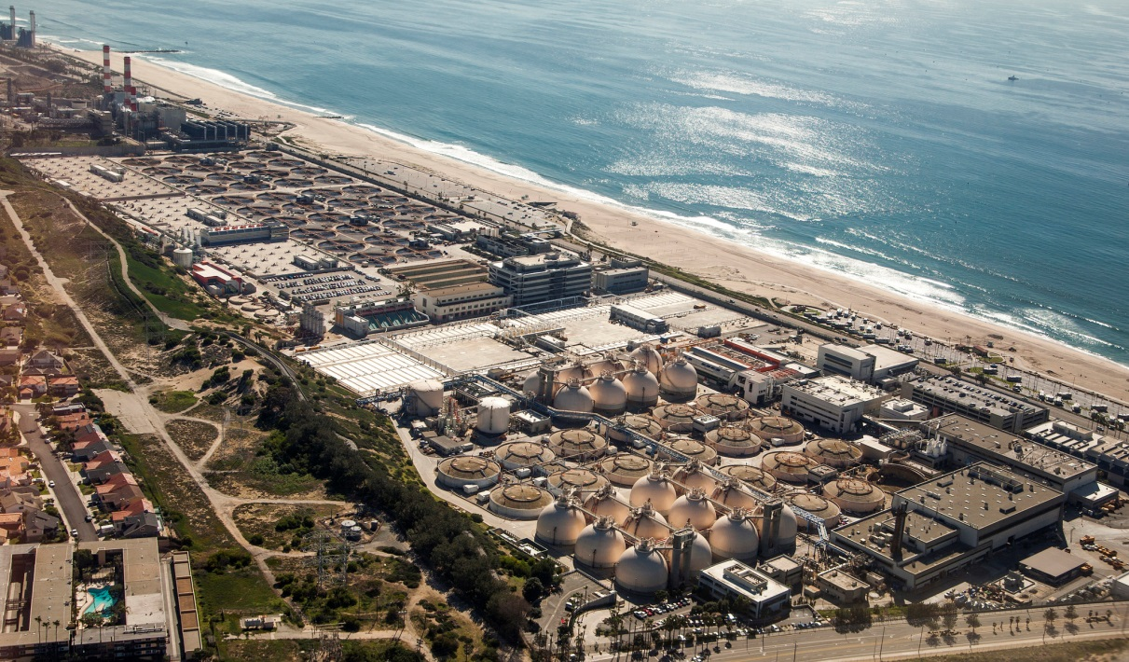
New Demand Reduction:
Seasonal Fallowing, Water Reuse

Slide 20
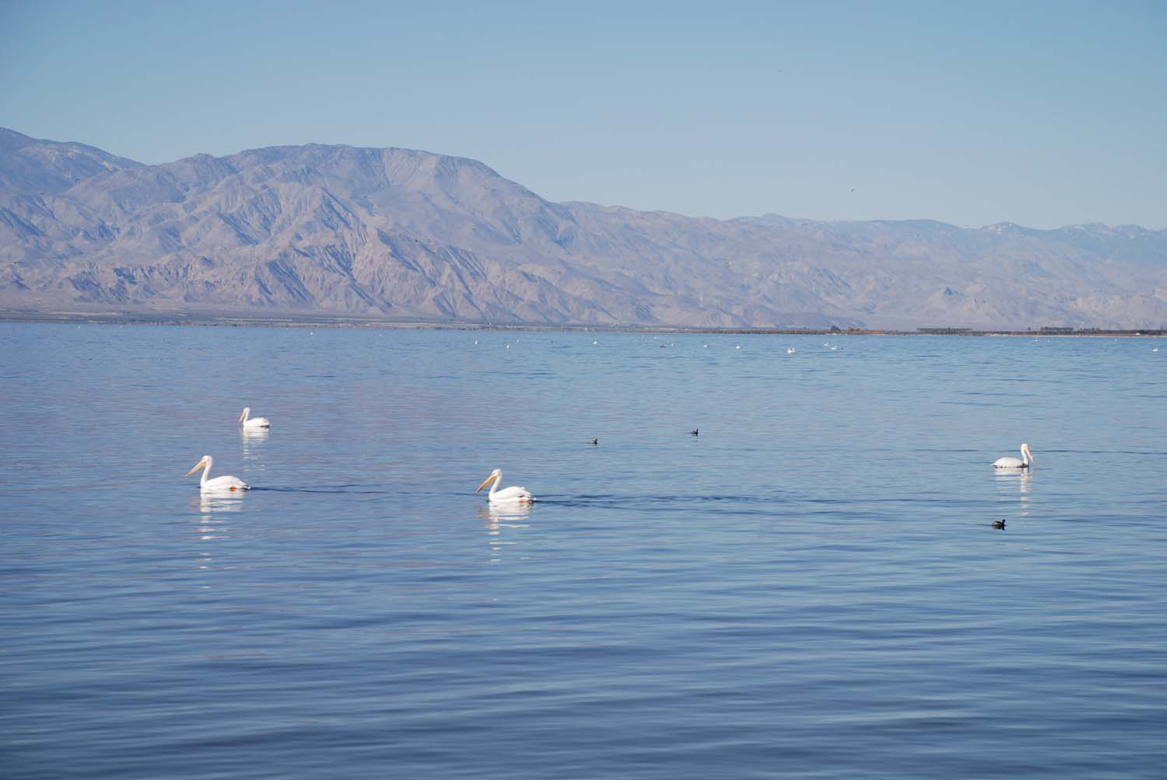
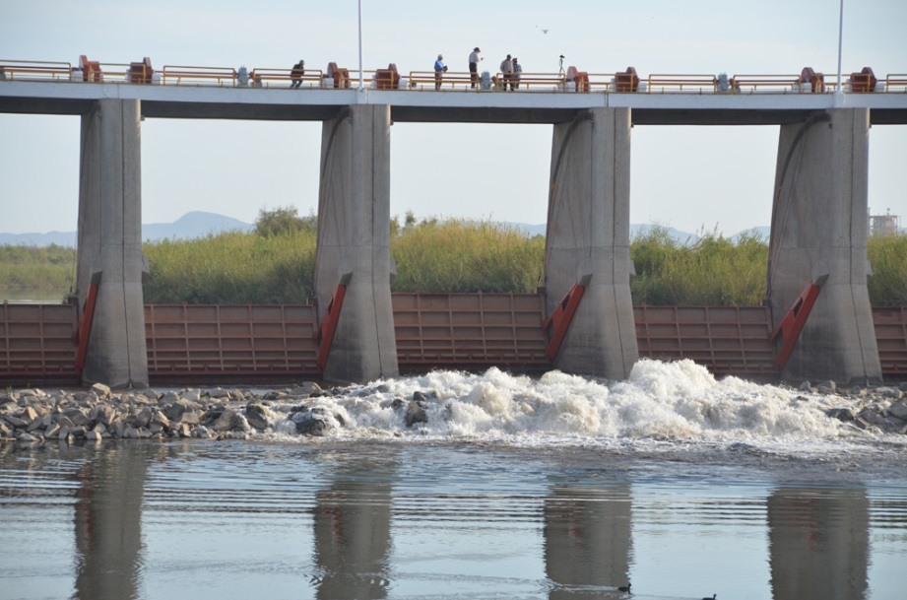
Environmental Issues:
Salton Sea, Colorado River Delta

Slide 21
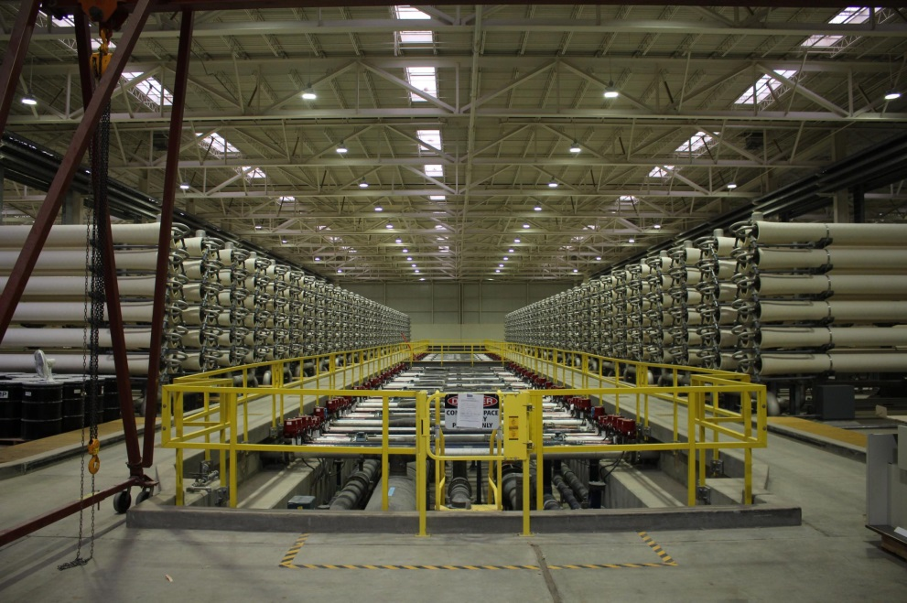
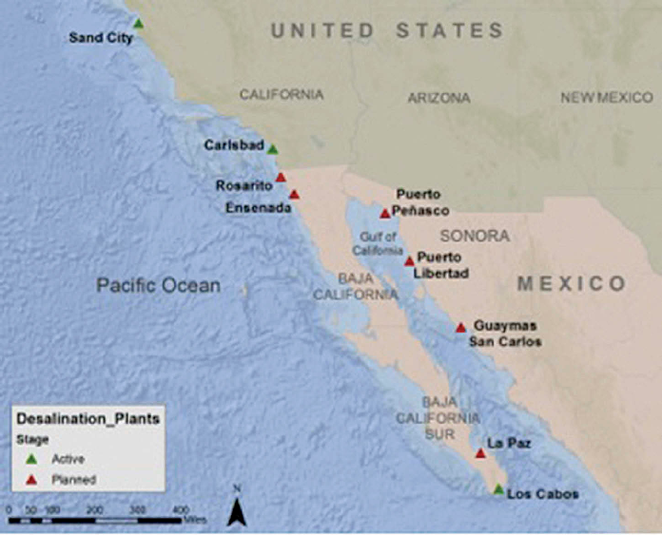
Augmentation:
Desalination

Slide 22

The risks of inaction are too great

