Slide 1
Water Intensive Business Strategic Planning
Ramsey Haddad, California Steel Industries, Inc.
August 23, 2018 – Urban Water Institute Conference

Slide 2
Agenda
About CSI
Water Use at CSI
Water Sources
Challenges

Slide 3
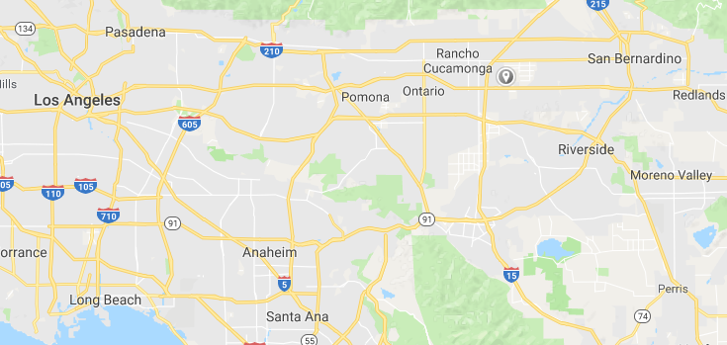
About CSI
Leading producer of rolled steel in the Western United States
In business since 1984, replacing a portion of Kaiser Steel (built in 1942)
Employ about 1000 people

Slide 4

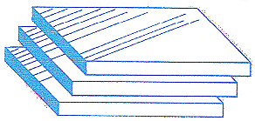
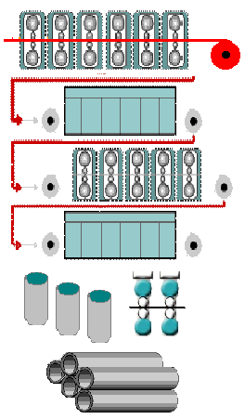

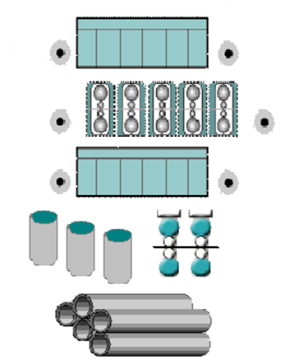
About CSI – Production Process
Slabs: 7.8” to 9” thickness
Reheat Furnace (2)
Hot Strip Rolling Mill
Hot Rolled Coil
Continuous Pickling Line
5 Stand Cold Reduction Mill
#1 & #2 Galvanizing Lines
Hydrogen Annealing &
Temper Rolling
ERW Pipe Mill

Slide 5
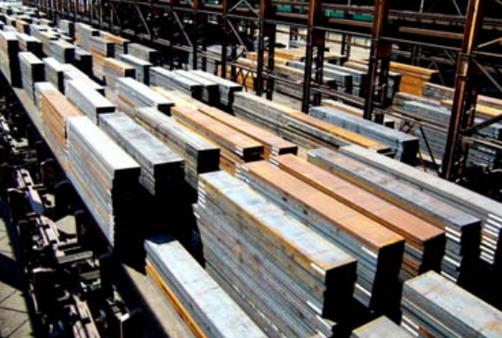
About CSI – Steel Slab

Slide 6
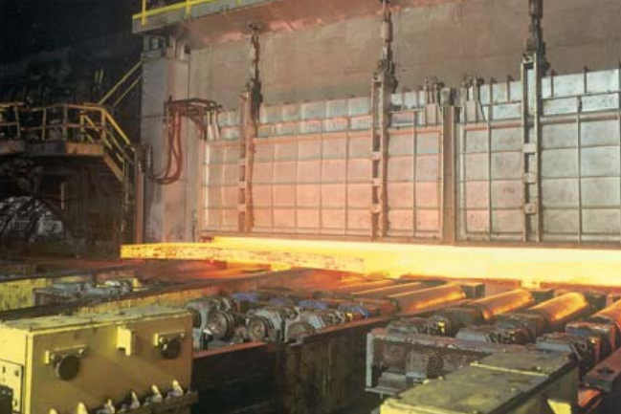
About CSI – Heated Slab

Slide 7
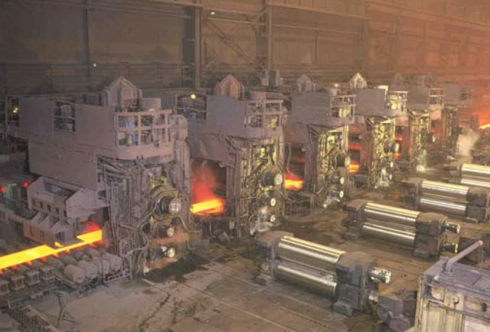
About CSI – Rolling Mills

Slide 8
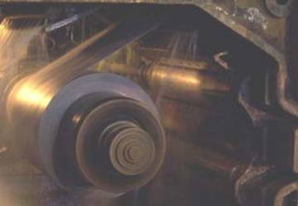
About CSI – Hot Rolled Coil

Slide 9
About CSI – Other Downstream Products
Pickling – Runs steel coils through an acid bath to remove iron oxides from the surface
Galvanizing – Runs steel coils through molten zinc baths to apply zinc coating. Has matte finish and protects against oxidation of the steel
Cold Reduction – Rolling process with no heating. Allows for more malleability in steel
Pipe Mill – Forms coil into pipe shape and straight welds ends to create pipe

Slide 10
Water Use at CSI
Cooling
  Direct contact cooling
  Cooling tower makeup
  Heat exchangers
Domestic
  Nontransient Noncommunity Public Water System
Irrigation
Steam
Cleaning

Slide 11
Water Sources
Two Deep Wells
  Chino Basin Watermaster
Municipal Domestic Water
  Fontana Water Company
Recycled Water
  In Progress

Slide 12
Response to Water Crisis
Better position than most
  Water rights in an adjudicated basin
  Very well managed basin
  Multiple sources
Estimating real reductions from conservation
  Production changes vs. intentional measures
Increased employee/public attention
Participation in industry water advisory groups and local municipalities
Increased cost of water
Capital projects to increase reliability, efficiency, and quality

Slide 13
Challenges
Water Forecasting
  Modeling water use at various rates of production
  Ensuring availability
    Securing multiple sources
    Monitoring water rights
    Maintaining infrastructure
Education
  From operator level to Executives
    Water rights
    Costs of different sources of water
    Regulations
  Conservation
    Potable water and industrial waste waters

Slide 14
Challenges
Balancing Demand
  Maximizing cost efficiency of different sources
    Cost of municipal water is 10 times cost of well water
  Monitoring water system
    Lowering peak demand
    Storage
    Monitoring pressure of inlets into water system
    Balancing production times
Presence in Water Community
  We’re in the steel business not water business
  Staying informed to make proper decisions
  Having input on regulations and groundwater operations

Slide 15
Moving Forward
Balancing Sources
  Cost
  Availability
  Community
Reducing Waste
  Less once-through
  Groundwater recharge potential
Continuing Education
  Keeping up to date with regulations
  Water efficiency and wastewater treatment technologies
  Understanding opportunities of being involved in the water community

