Slide 1
Maureen Martin
Contra Costa Water District
Urban Water Institute Conference February 21, 2020

Slide 2
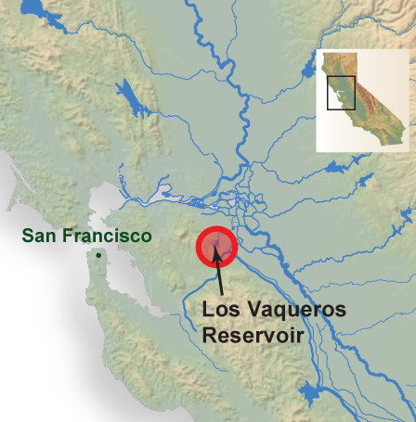
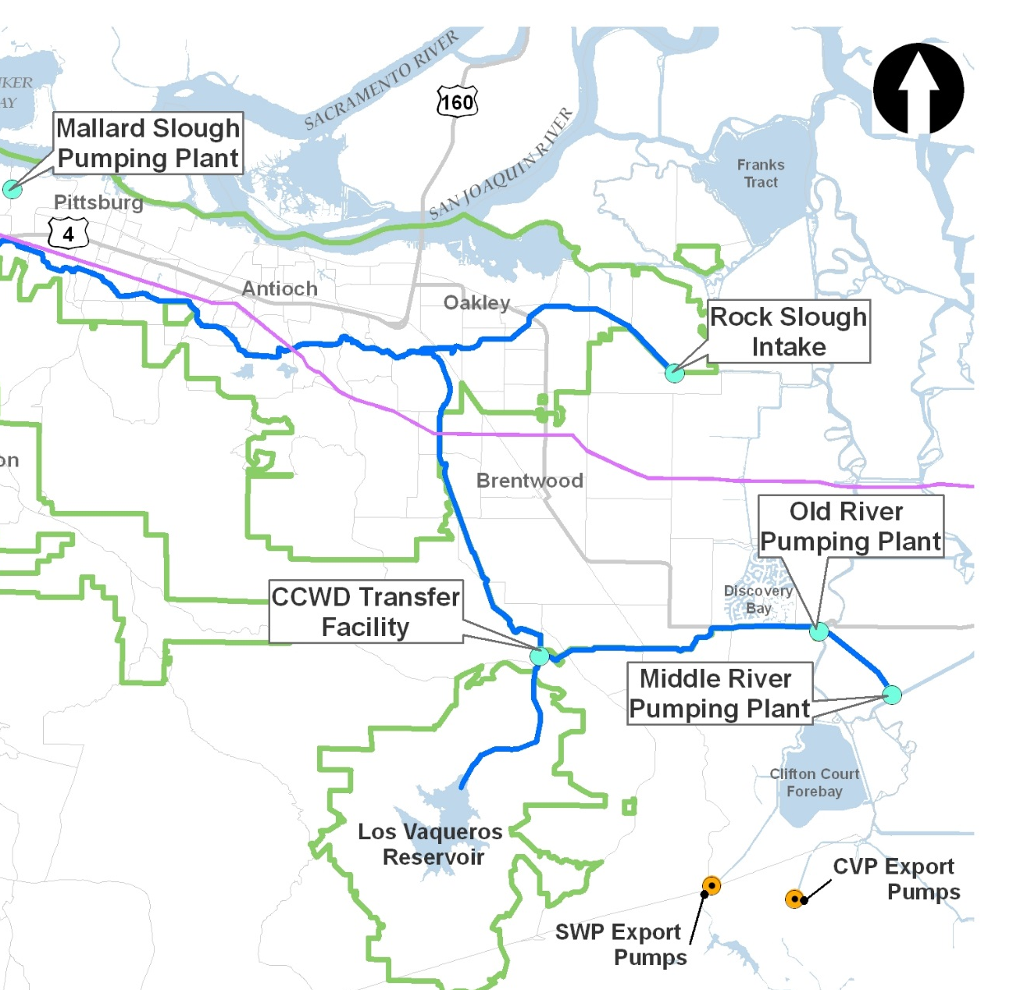
Existing Los Vaqueros Reservoir
Los Vaqueros Reservoir is an off-stream reservoir in Contra Costa County with a capacity of 160 TAF
Contra Costa Water District (CCWD) operates Los Vaqueros Reservoir in conjunction with four Delta intakes
Notes:
Reference: Project Description (Section 3-4)

Slide 3
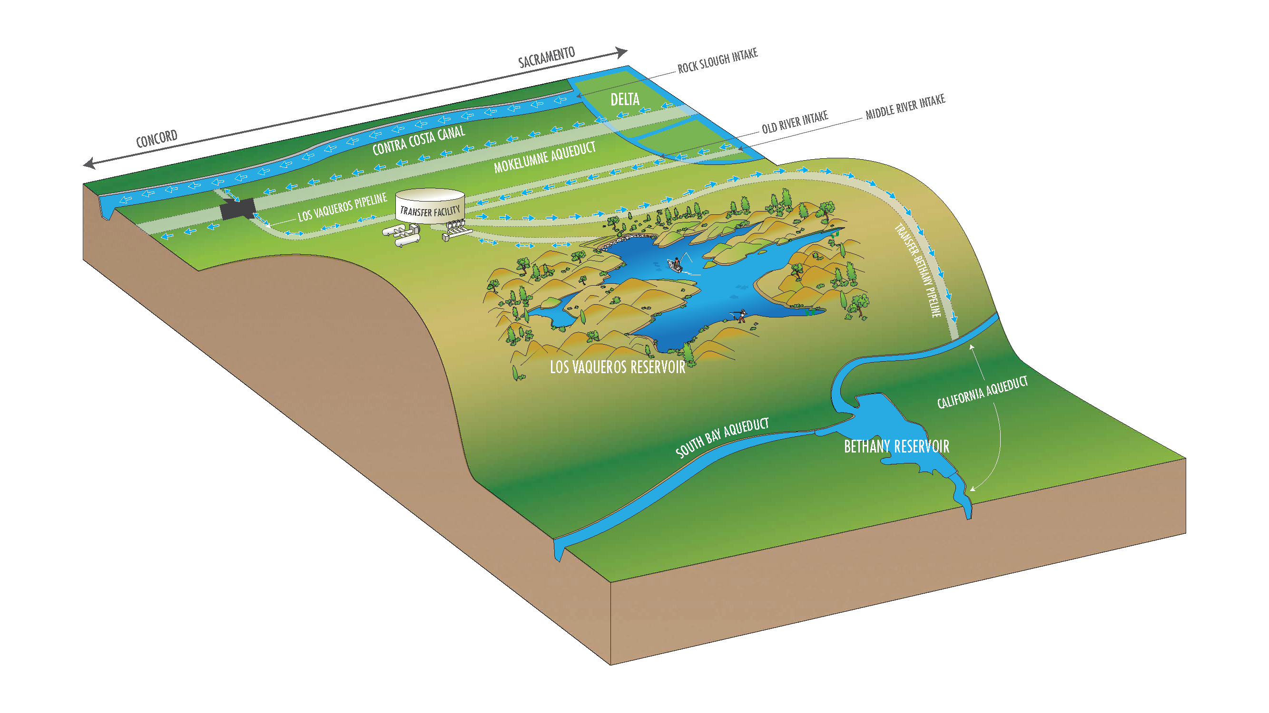
Proposed Project
New Facilities
Expand Reservoir
Add pipeline, connecting CCWD’s system to the California Aqueduct
Benefits
Urban drought
Wildlife refuge
Agriculture
Cost
$980M
Notes:
Project operations are designed to be as efficient as possible to maximize benefits to project partners and wildlife refuges.

Slide 4
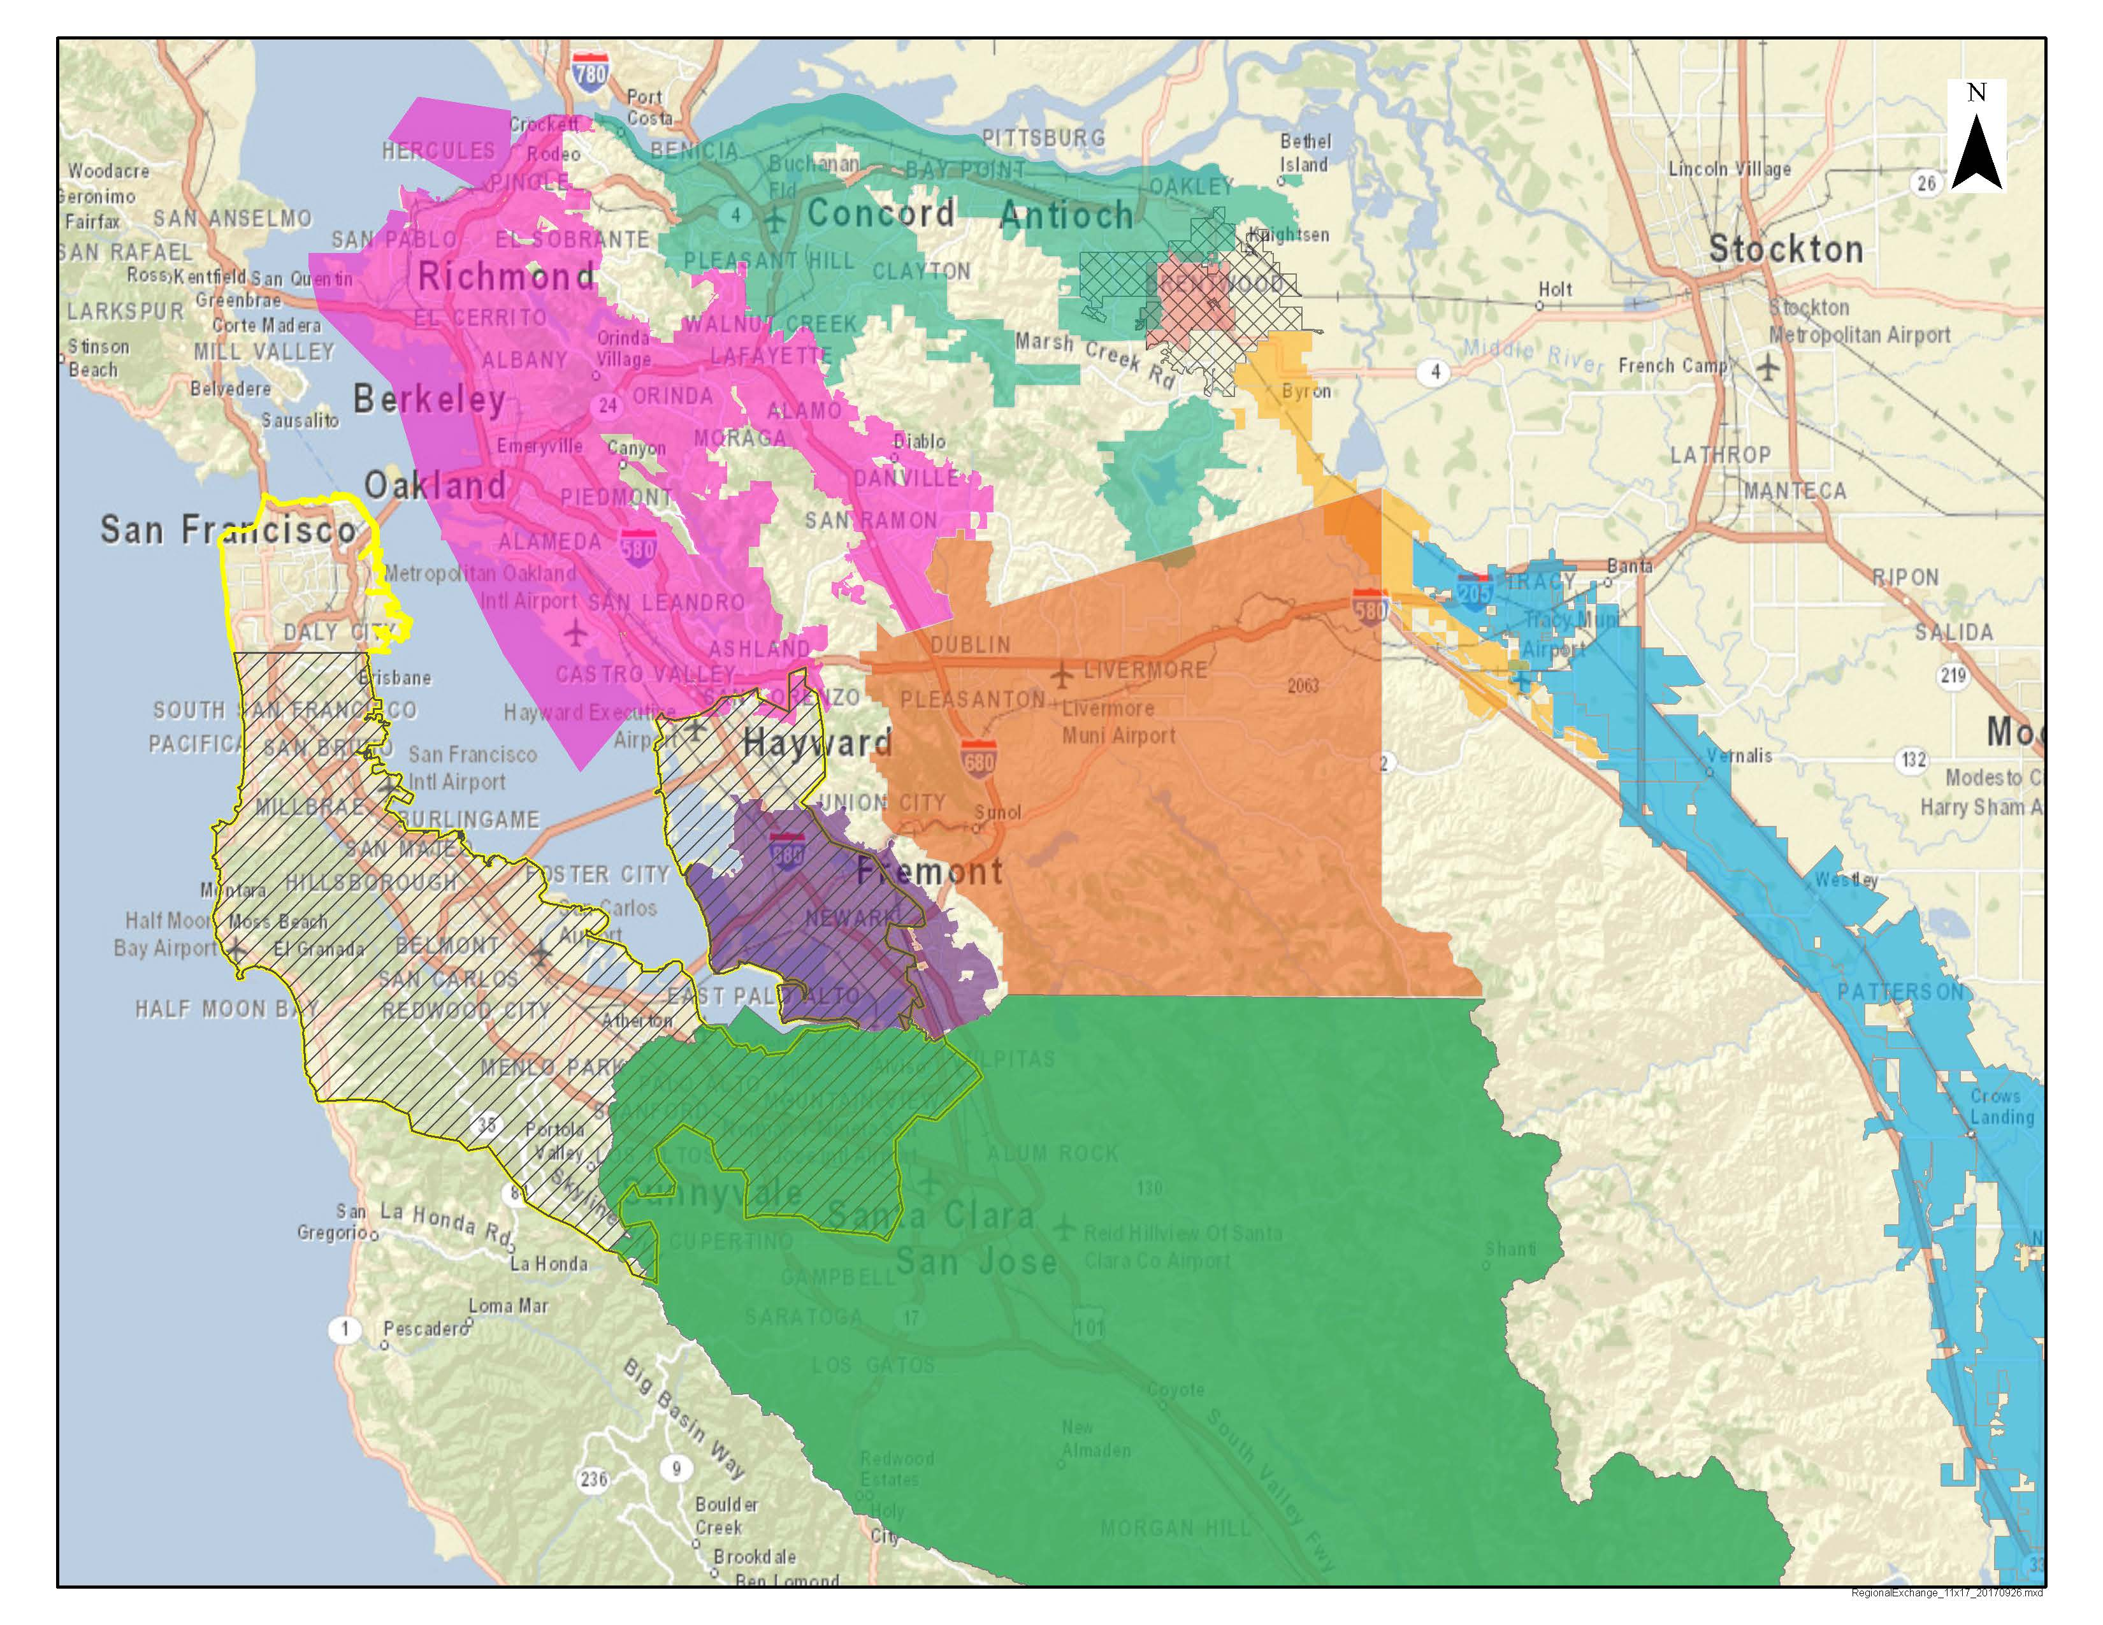
Potential Partners
Alameda County Water District
Bay Area Water Supply and Conservation Agency
City of Brentwood
Grassland Water District
East Bay Municipal Utility District
San Francisco Public Utilities Commission
San Luis & Delta-Mendota Water Authority
Byron-Bethany Irrigation District
Del Puerto Water District
Panoche Water District
Westlands Water District
Santa Clara Valley Water District
Zone 7 Water Agency
CCWD
Brentwood
EBMUD
Los Vaqueros
Reservoir
SFPUC
Zone 7
BAWSCA
ACWD
SLDMWA
SCVWD
Notes:
Reference: Executive Summary & Project Description (Section 3-4)

Slide 5
History of the Project
1998 - Original 100 TAF reservoir completed, serving only Contra Costa Water District
2009 - Planning objectives established for 275-TAF reservoir with regional partners
2012 - Phase 1 expansion completed 160 TAF, no partners
Notes:
The original capacity of Los Vaqueros was 100,000 acre-feet.
Following completion of the planning, design and permitting process, CCWD began construction of the Phase 1 Expansion in 2011 and completed work in 2012.
The Phase 1 expansion maintained the original benefits for CCWD and provided additional storage to improve water supply reliability for CCWD, particularly in droughts.
Even though CCWD customers did a great job conserving during the most recent drought, CCWD relied on this storage to help meet demands.
Throughout the process, have worked with City of Brentwood as well as the County and other local agencies, and key stakeholders such as EB Parks and Save Mount Diablo.
We greatly appreciate the ongoing collaboration.

Slide 6
Motivation for Realizing the Regional Partnership
Lure of Money
2014 - CA voters passed Prop 1 with $2.7 billion for storage projects
2018 - Project conditionally awarded $459M
Drought Crisis!
2015 - CCWD used existing reservoir to transfer water to our potential partners
Actual Money $$$$
2018 - State early funding $13.65M
2020 - Federal spending $2.15M
Notes:
The timing is right to consider the Phase 2 Expansion Project.

Slide 7
Challenges & Opportunities
Integrates existing infrastructure with new
Deliveries represent a relatively small percentage of partners’ supply portfolio
Unusual blend of benefits and water sources
Urban drought, wildlife supply, ag supply reliability
CVP, SWP, Senior water rights, others
Brings together agencies that have not historically worked together
Need to build trust

Slide 8
Next Steps
2020 - Form Joint Powers Authority
2021 - Secure permits & other agreements
2022 - Begin construction

Slide 9
Thank you
Questions?
Project Information
http://www.ccwater.com/lvstudies
Contact Information
Maureen Martin
Contra Costa Water District
P.O. Box H20
Concord, CA 94524
(925) 688-8323
mmartin@ccwater.com

