Slide 1
Leading Water Utility Innovation
Urban Water Institute | February 20, 2020
Jason Carter, PE - Arcadis
Water Strategy & Innovation Lead

Slide 2
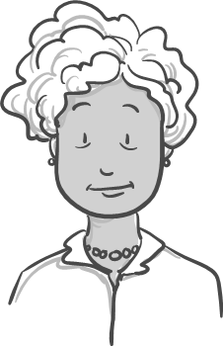
First critical steps
Kristen – Engineering
Ginger - Operations
“What do you think I have been doing for the last 20 years? It is about time others get in the game.”
“Sounds great, but we have heard this stuff before. By the way – can’t you just approve my purchase order?”
John – Finance
Robert – Executive
“We have been pretty successful to date and it sounds risky. Let’s table this until next fiscal year.”
Notes:
What is innovation? – Simply adopting something new to increase value-delivered to your utility, customers and/or community. This could include a new way to finance projects, connect with customers, engage employees. Some use terms like agile, adaptive, entrepreneurial, nimble – most consider these things as the lifeblood of the private sector. Most consider this interesting, some believe it to be out of reach for utilities or worse – a distraction.
Well – Robert came back to his utility fired up from some conference – talking about innovation management. His charge? Let’s build a more innovative organization. One that treats ideas as critical assets and engages everyone in finding new opportunities to transform the organization. One that is recognized for being innovative by their customers, community and peers. But where to start? Talking with his team revealed that there is interest, but also reservation.

Slide 3
Headwinds to innovation
33% Cultural Inertia
30% Tenured Employees
26% Organizational Silos
11% Executive Management
Notes:
Robert’s situation is common.
WRF 4642 and 4907 engaged over 75 water, wastewater and stormwater utilities – small to large from around the world. Along with WEF, AWWA, AMWA, NACWA and WSAA to develop a framework for fostering innovation as well as tools for putting it into action.
Challenges are real.

Slide 4
Leading utility innovation
Define your aspirations and key focus areas
Benchmark your environment
Getting Started
Notes:
What we have learned - regardless of the size of your utility there are some common steps that lead to success.

Slide 5
Define your aspirations and key focus areas
Over 90% of utility employees believe that innovation is critical to the future of their organization.
Less than 40% say their organization has described urgency or shown a vision for innovation.
Only 30% have identified key challenges or opportunities that need to be explored.

Slide 6
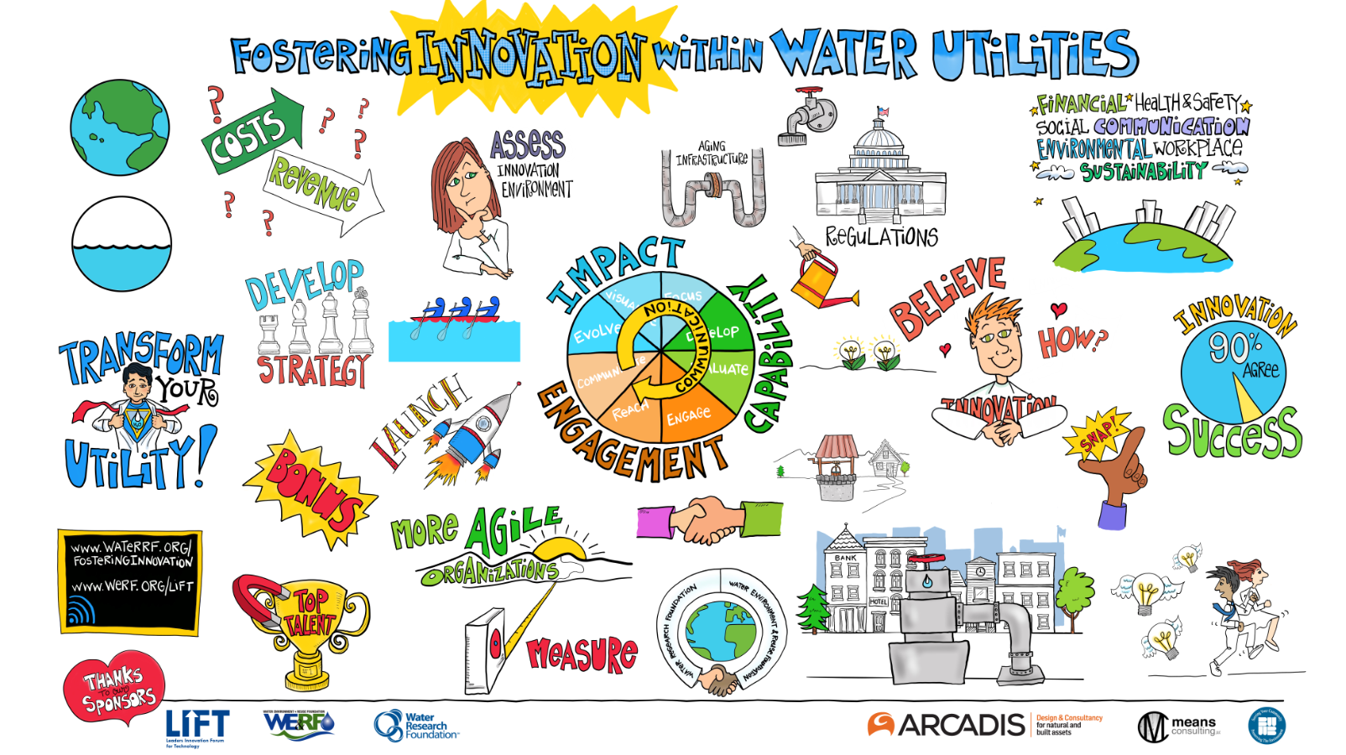
Define your aspirations and key focus areas
Implementation of strategy
Business sustainability / agility
Customer expectation
Workforce of tomorrow
Digital transformation
Innovation scans the far future and empowers the current workforce.
Notes:
Reference material, SOTWI, case studies…Your innovation program should

Slide 7
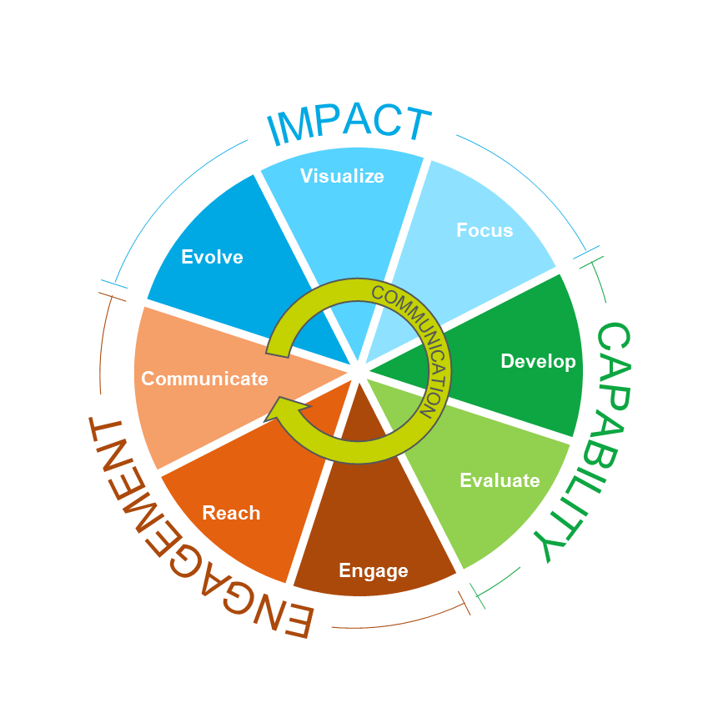
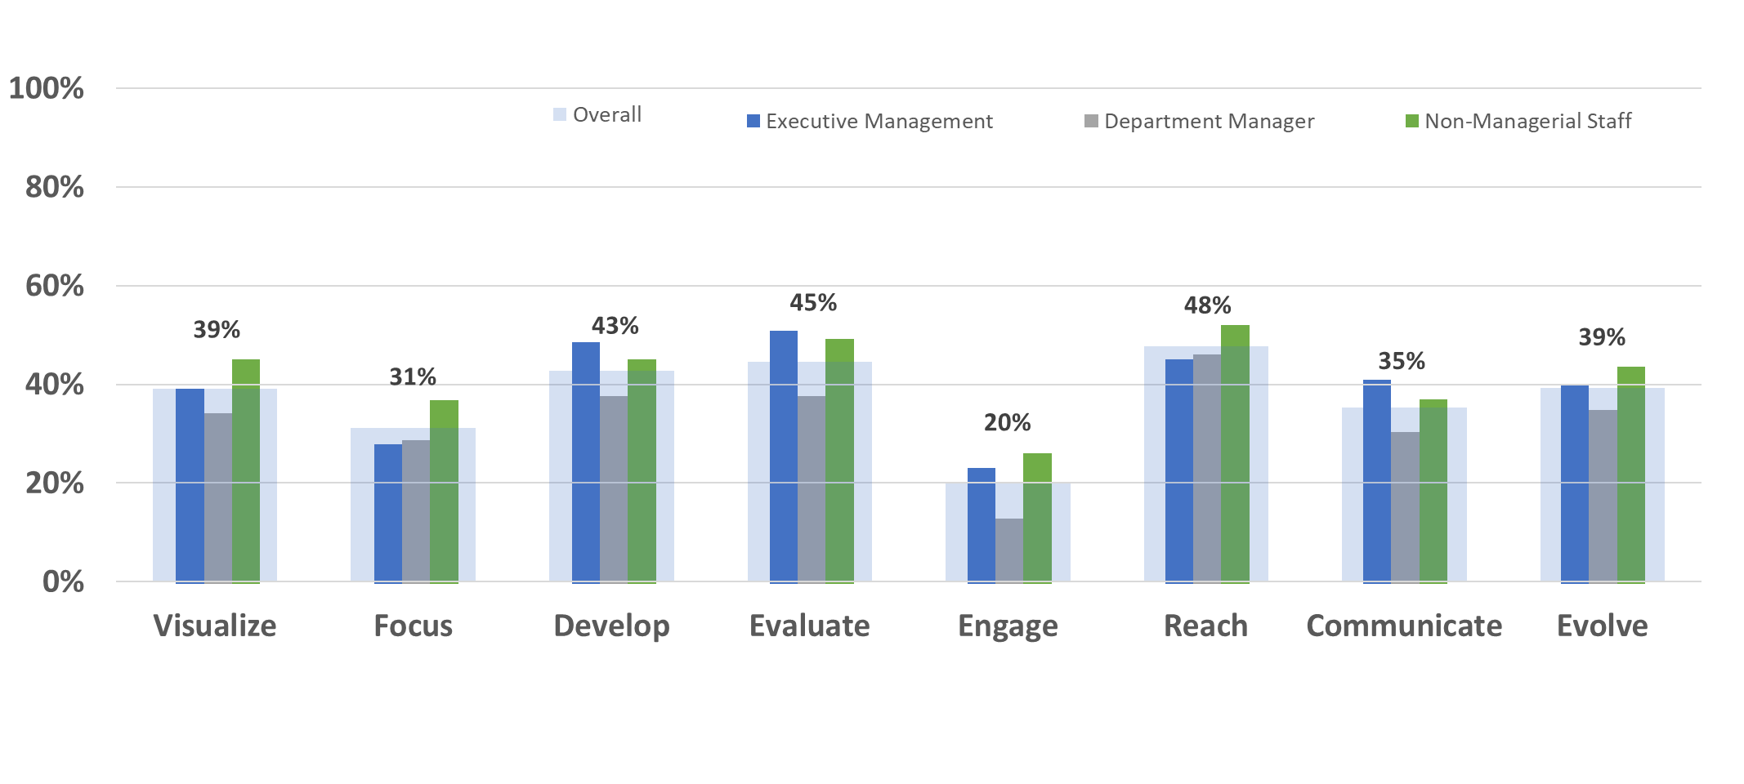
Benchmark your environment
Direct Influence
Selecting, investing, developing an idea.
WRF Utility Innovation Framework
(WRF 4642)
Indirect Influence
Creating the environment for idea creation, development and adoption.

Slide 8
Leading utility innovation
Define your aspirations and key focus areas
Benchmark your environment
Getting Started
Gather a critical mass of leaders and influencers
Draft an innovation strategy

Slide 9
Drafting an innovation strategy
“Without an innovation strategy, innovation improvement efforts can easily become a grab bag of much touted best practices…
“A company without a strategy won’t be able to make trade off decisions…Aping someone else’s system is not the answer.” Pisano, 2015

Slide 10
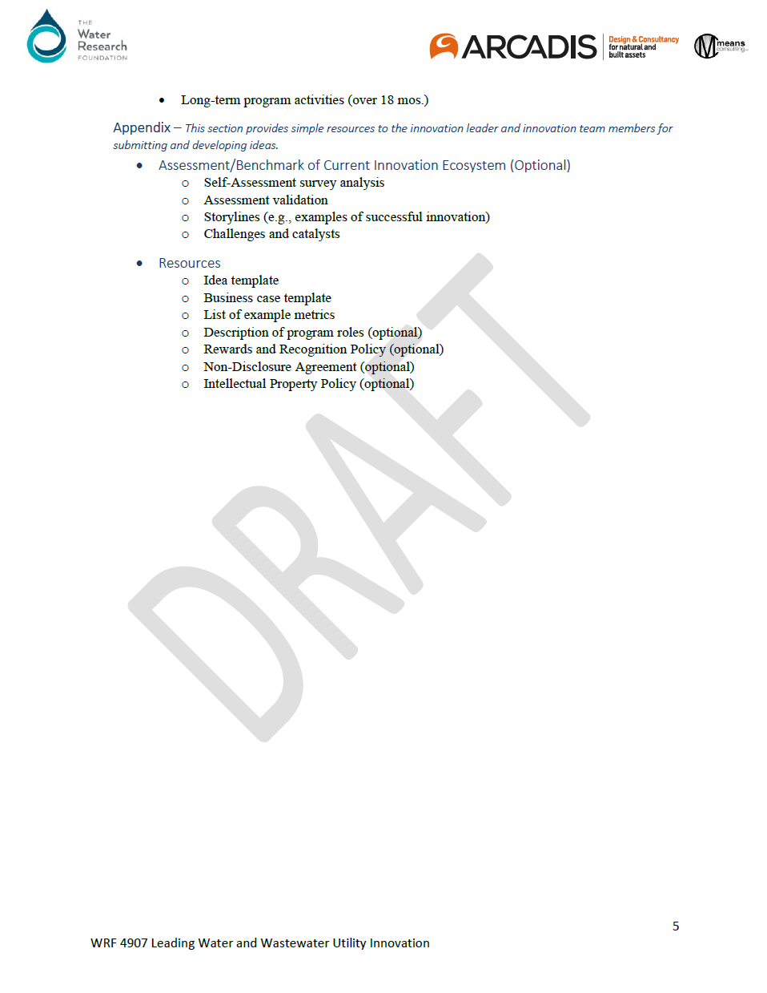
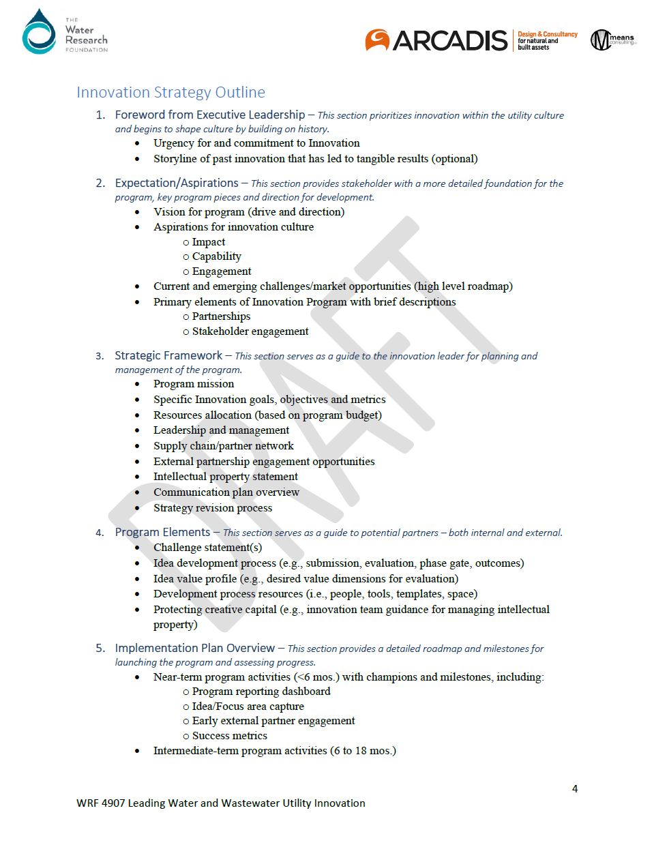
Building an innovation strategy
Urgency & Commitment
Vision &
Definition
Measures of Success
Process
Resources
Next Steps
An innovation strategy is a map that provides direction, pathways, and tracking.

Slide 11
Engaging your people
Only 2 in 10 feel empowered to participate in innovation
No need to go big early. Focus on key leaders and influencers.

Slide 12
Innovation leaders and teams
Innovation Leaders
88% with >10 years in water sector
71% recruited from within the organization
37% are female
6% had formal innovation training
Vision caster, communicator, networker, explorer, facilitator
Innovation Teams or Working Groups
43% of utilities had some form of innovation team
Usually one team (avg 11 people), representing multiple generations and departments
Notes:
Let’s get an energetic and creative leader.

Slide 13
Leading utility innovation
Define your aspirations and key focus areas
Benchmark your environment
Getting Started
Gather a critical mass of leaders and influencers
Draft an innovation strategy
Build idea infrastructure
Refresh your partnerships

Slide 14
Build idea infrastructure
Capture
Screen
Develop
Evaluate
Deploy
Horizon-scanning, recruiting idea submission, evaluating operations to identify concepts.
Generating creative dialog to combine and refine ideas for prototyping and testing.
Adopt into daily use and measure impact.
Sorting ideas that are aligned with organizational goal and focus areas.
Testing ideas in increasingly relevant settings and evaluating for impact and alignment.
Notes:
1.7 billion Google Hits.

Slide 15
Refresh your partnerships
Number of Partners by Organization
Research - 69
Supplier - 31
Peer - 25
Surveyed utilities maintained an average of 12 partners for innovation.
Only 26% of partnerships were perceived as being effective.
Industry - 58
Consultant - 28
Funding
4
Customer 1
Government 16
Accelerator 13
Other 12
Entrepreneur2

Slide 16
Refresh your partnerships
Value Exchange
Process
Culture
Complementarity provides a motive for alliance formation as it yields a higher return than the sum of returns if it were used independently
Compatibility in partners' org. structure and routines reduces uncertainty about intentions, interests and competences
Good fit stimulates joint sense-making, misfit undermines the quality of work relationships

Slide 17
Leading utility innovation
Define your aspirations and key focus areas
Benchmark your environment
Getting Started
Gather a critical mass of leaders and influencers
Draft an innovation strategy
Build idea infrastructure
Refresh your partnerships

Slide 18
Launching innovation as a business practice
Immediate
Near-Term
Long-Term
Ideas
Focus on quick wins
Take credit and repeat
Its about quantity
Process
Establish governance & communication plan
Kick the tires and possibly change a few
Expand the Pipeline
Engagement
Build critical Mass
Scale to broader organization
Open the Invitation
Notes:
There is one other critical piece to your roadmap for leading an innovative utility – Launch. While the team has a plan, the first steps of putting it into action are critical.

Slide 19
Launching innovation as a business practice
Sustainability
Operational Efficiency
Energy neutrality with heat exchangers, solar panels and investigating biomass reuse.
Brought nutrient removal technology to US led to 20% energy reduction with a projected savings of $400,000/yr.
Utility Innovation
Workforce Development
Workforce Engagement
Collaborates regionally to address labor needs in mission critical jobs. Upskills current workforce.
Fosters broad collaboration, engagement and communication (over 40-60% of staff engaged).
Cost Savings
External Recognition
Reduced annual OpEx and achieved a payback time of <2 years with new algae control technology.
Named Business Review Weekly’s Top 10 Most Innovative Companies.
Notes:
Fast forward 6 months, 1 year, 2 years, 5 years. By opening participation in innovation to their entire workforce, Robert and his team are transforming their organization and are achieving some key long-term goals. These real world examples show the possibilities of innovation management within the utility sector.

Slide 20
WRF 4642 – Fostering Innovation within Water and Wastewater Utilities
WRF 4907 – Leading Water Utility Innovation
Jason T Carter, PE
Vice President
Water Strategy & Innovation Lead
(c) 205.253.2276
(e) jason.carter@arcadis.com

