Slide 1
Chino Basin Water Bank Development
Shivaji Deshmukh, General Manager
August 15, 2019

Slide 2
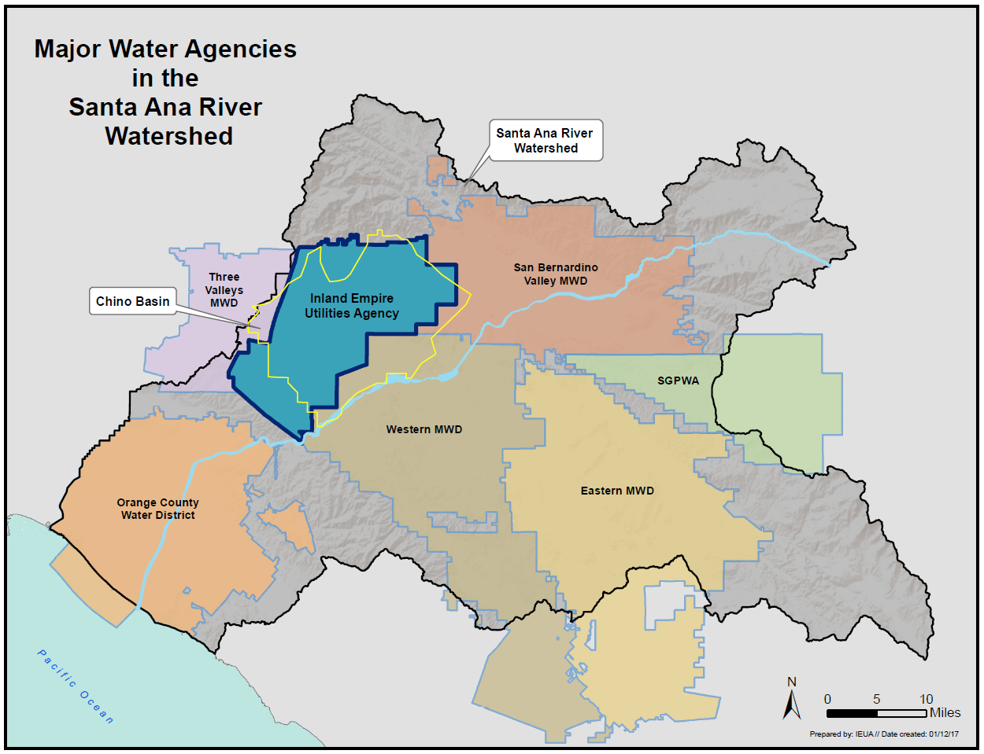
About IEUA
Provides Wholesale Imported Water and Sewage Utility Services
Located in the southwestern portion of San Bernardino County
875,000 residents in our service area
242 – square miles
Key areas of service:
Securing and supplying imported water
Collecting and treating wastewater
Producing high-quality renewable products
i.e. recycled water, compost and energy
Promoting sustainable use of groundwater
and development of local water supplies
Contracting and retail agencies:
City of Chino
City of Chino Hills
Cucamonga Valley Water District
City of Fontana
City of Montclair
City of Ontario
City of Upland
Fontana Water Company
Monte Vista Water District

Slide 3
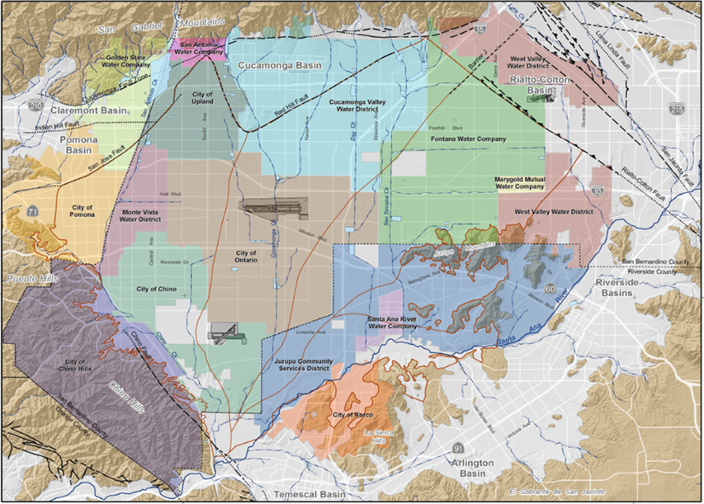
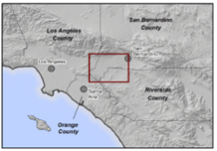
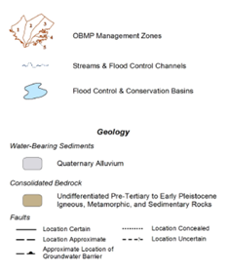
Introduction to Chino Basin
Notes:
Located in the Santa Ana River Watershed
Stretches approximately 235 square miles through San Bernardino, Los Angeles, and Riverside
One of the largest groundwater basins in Southern California
About 6 million acre-feet capacity
Value of Chino Basin
State’s looking more closely at groundwater storage and its sustainable management
Increasing value of dry year yield
Interest in optimizing local storage
IEUA Prop 1 funding - $207M
Prop 68 (June 2018/passed) - $500M for water
Location of CBWB
Value. Water Bank Addresses these opportunities:
Coordinate funding, design, construction, and operation of potential CBWB programs
Allow rapid decision-making to acquire / produce water
Create a market for water storage / sales
Leverage state bond measure opportunities
Provide a responsible party for water acquisition

Slide 4
Chino Basin Water Bank: Phased Approach
Phase 1 – Establish Framework
Phase 2 – Develop Details
Phase 3 – Implement
Each phase requires a ”Go-NoGo” decision by the Partners
Notes:
The goal of Phase 1 was to seek stakeholder input on a Chino Basin Water Bank framework for implementation and operation.
The framework draws from the experience from other California water banks and accounts for the Basin’s current initiatives, stakeholder interests and input, and State and other opportunities.
Outreach efforts to date:
3 Stakeholder Workshops
87 Stakeholders engaged
55 Interviews

Slide 5
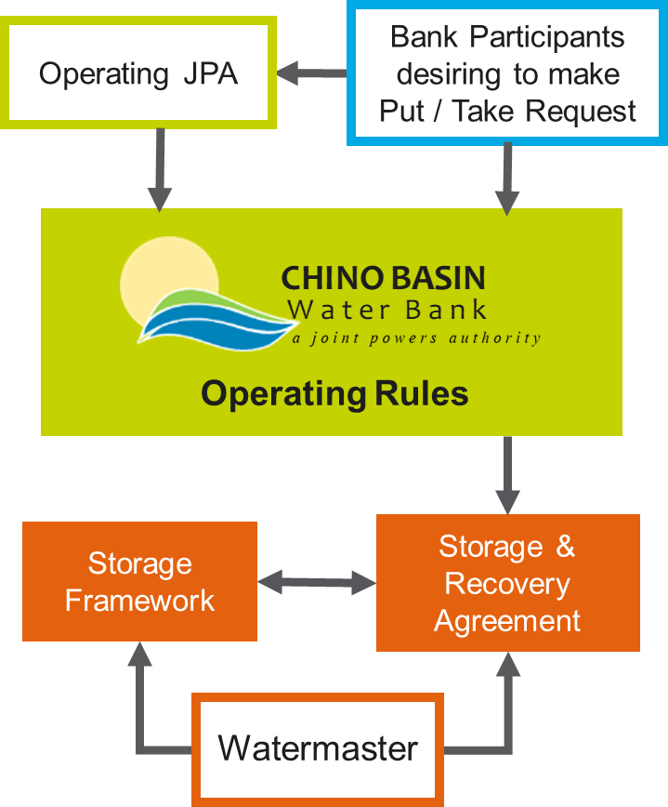
Phase II | Water Bank Operations
Phase II aims to:
Establish operational details
Develop a financial model and structure
Prepare a Storage and Recovery Application
Develop an operations plan
Notes:
Engineering Evaluation:
Evaluating 6 scenarios consistent with Storage Framework
Coordinating with Watermaster’s 10-year cycle of 4-year put, 3-year hold, and 3-year take scenario
Reviewing the existing facilities inventory
Identifying/confirming recharge, in-lieu, and/or extraction facilities needed for each scenario
Developing planning level cost estimates
Operations Plan:
Develop strategy to acquire (1) water and (2) explore participant interest
Create CBWB Operations Plan / Administrative Code
Define management structure for CBWB
Develop put and take documentation that meets Watermaster’s needs
All operations consistent with approved Storage Agreement

Slide 6
Phase II | Storage Agreement
Establish Storage and Recovery Agreement Consistent with Storage Framework
Obtain Approvals from:
Each Individual Pool Committee
Advisory Committee
Watermaster Board
Notes:
Storage and Recovery Agreement to include:
Storage volume
Any required mitigation(MPI)
Agreement life
Locations where recharge and extraction can take place

Slide 7
Project Timeline and Next Steps
Phase 1 CBWB Framework
July 2017 – July 2018
Phase 2 CBWB Development
Aug 2018 – Jun 2019
Phase 3 CBWB Implementation
July 2019 onward
Notes:
Next Steps:
Complete Financial Model
Develop required agreements, Ops Plan, staffing plan, etc.
Prepare Storage and Recovery Agreement Application
Develop strategy to acquire water and explore participant interest
JPA decision on implementation (Phase III)

Slide 8
Thank you!
Shivaji Deshmukh, P.E.
General Manager
Inland Empire Utilities Agency
sdeshmukh@ieua.org

Slide 9
Back Up Slides

Slide 10
Phase I | CBWB Guiding Principles
Protect basin rights
The Guiding Principles serve as the foundation of the CBWB and the benchmark by which its effectiveness can be judged
Enhance safe (basin) yield
Provide added drought resilience
Create value for rights holders
Increase flexibility in basin management
Provide a market where anyone can buy-in
Accommodate new and stored water
Promote transparent / active coordination

Slide 11
Phase I | CBWB Guiding Principles - continued
Create a framework that is scalable and adaptable
CBWB “Elements” conform to these guiding principles
Provide for rapid decision making on put / take
Leverage funding to build facilities
Be attractive to external parties
Help basin sustainability (e.g. subsidence)
Help address desalter replenishment
Help address water quality

