Slide 1
Mutually Beneficial Partnerships in Groundwater Banking Paul Weghorst Irvine Ranch Water District August 15, 2019

Slide 2
Presentation Agenda
Introduction to Irvine Ranch Water District
IRWD’s Water Banking Projects
Overview of mutually beneficial partnerships that make it work

Slide 3
Irvine Ranch Water District
A California Special District Serving Central Orange County
Independent, non-profit, local government agency
Reliable high-quality water & sewer service
Industry leaders in recycled water
High level of customer satisfaction

Slide 4
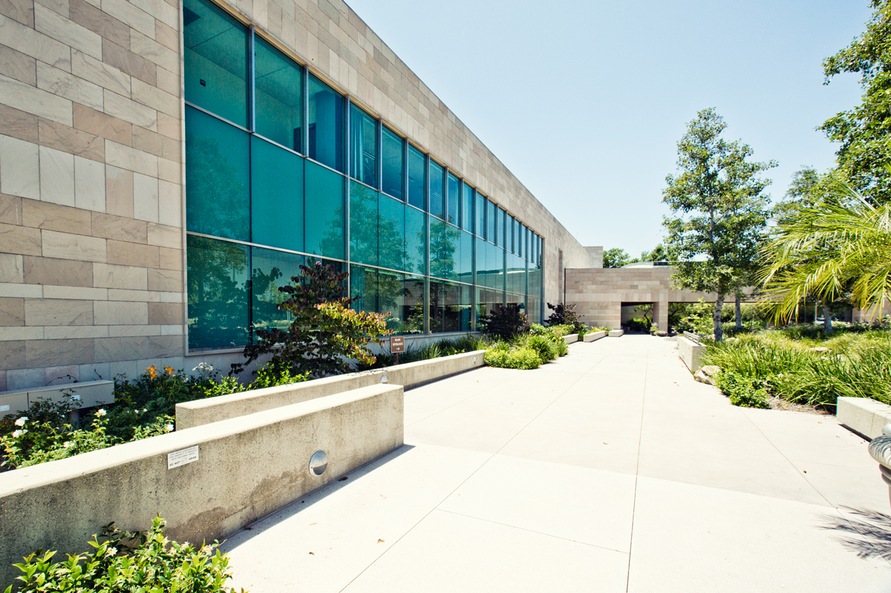
IRWD Service Area
 | 422,000 Residential customers
 | 599,000 District daytime population
 | 469 Square Kilometers 20% of Orange County
 | 6 Cities Irvine, Tustin, Lake Forest, Orange, Newport Beach, Costa Mesa, unincorporated county

Slide 5
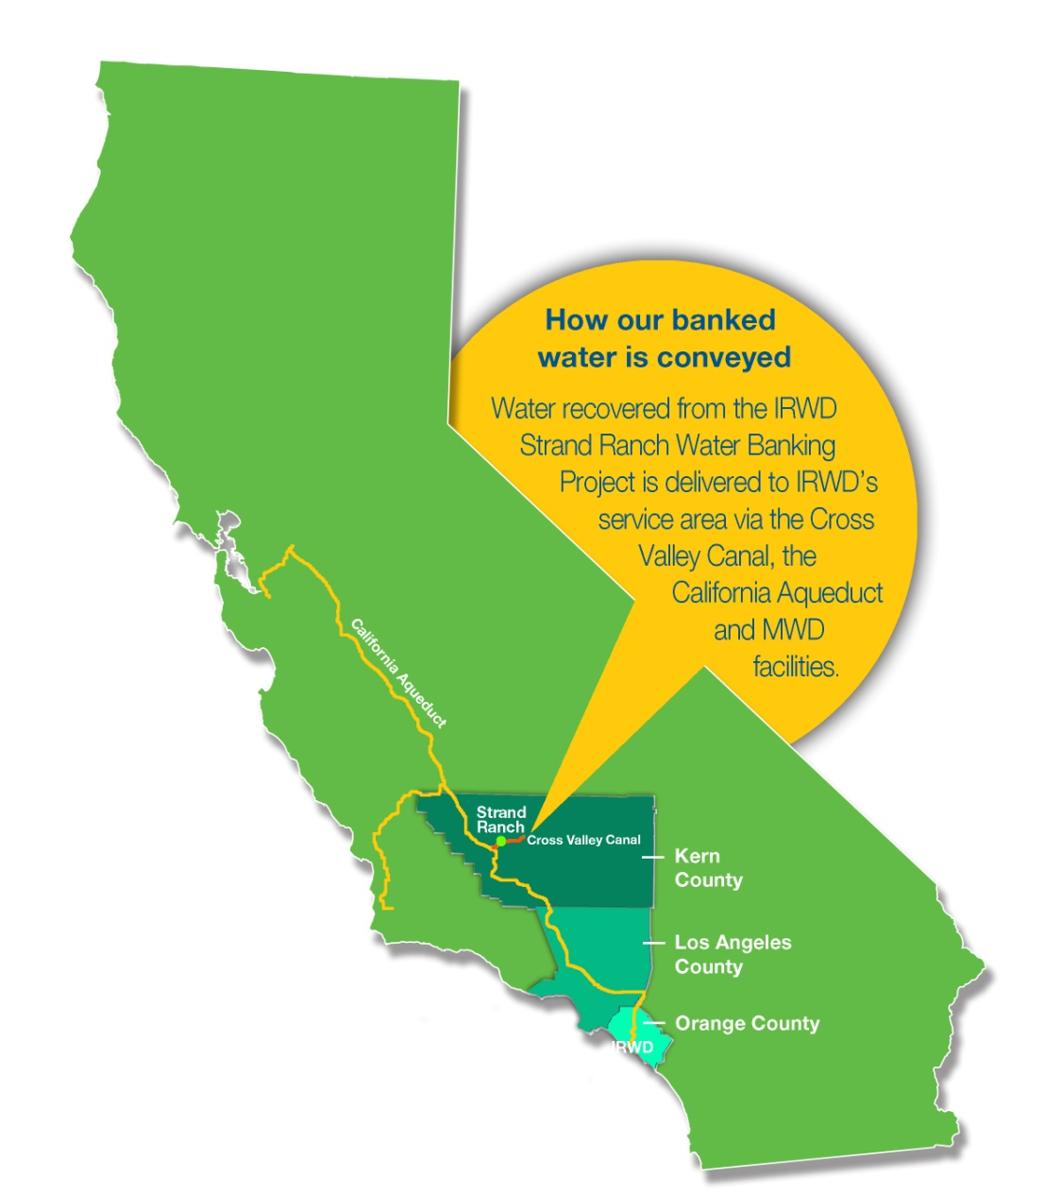
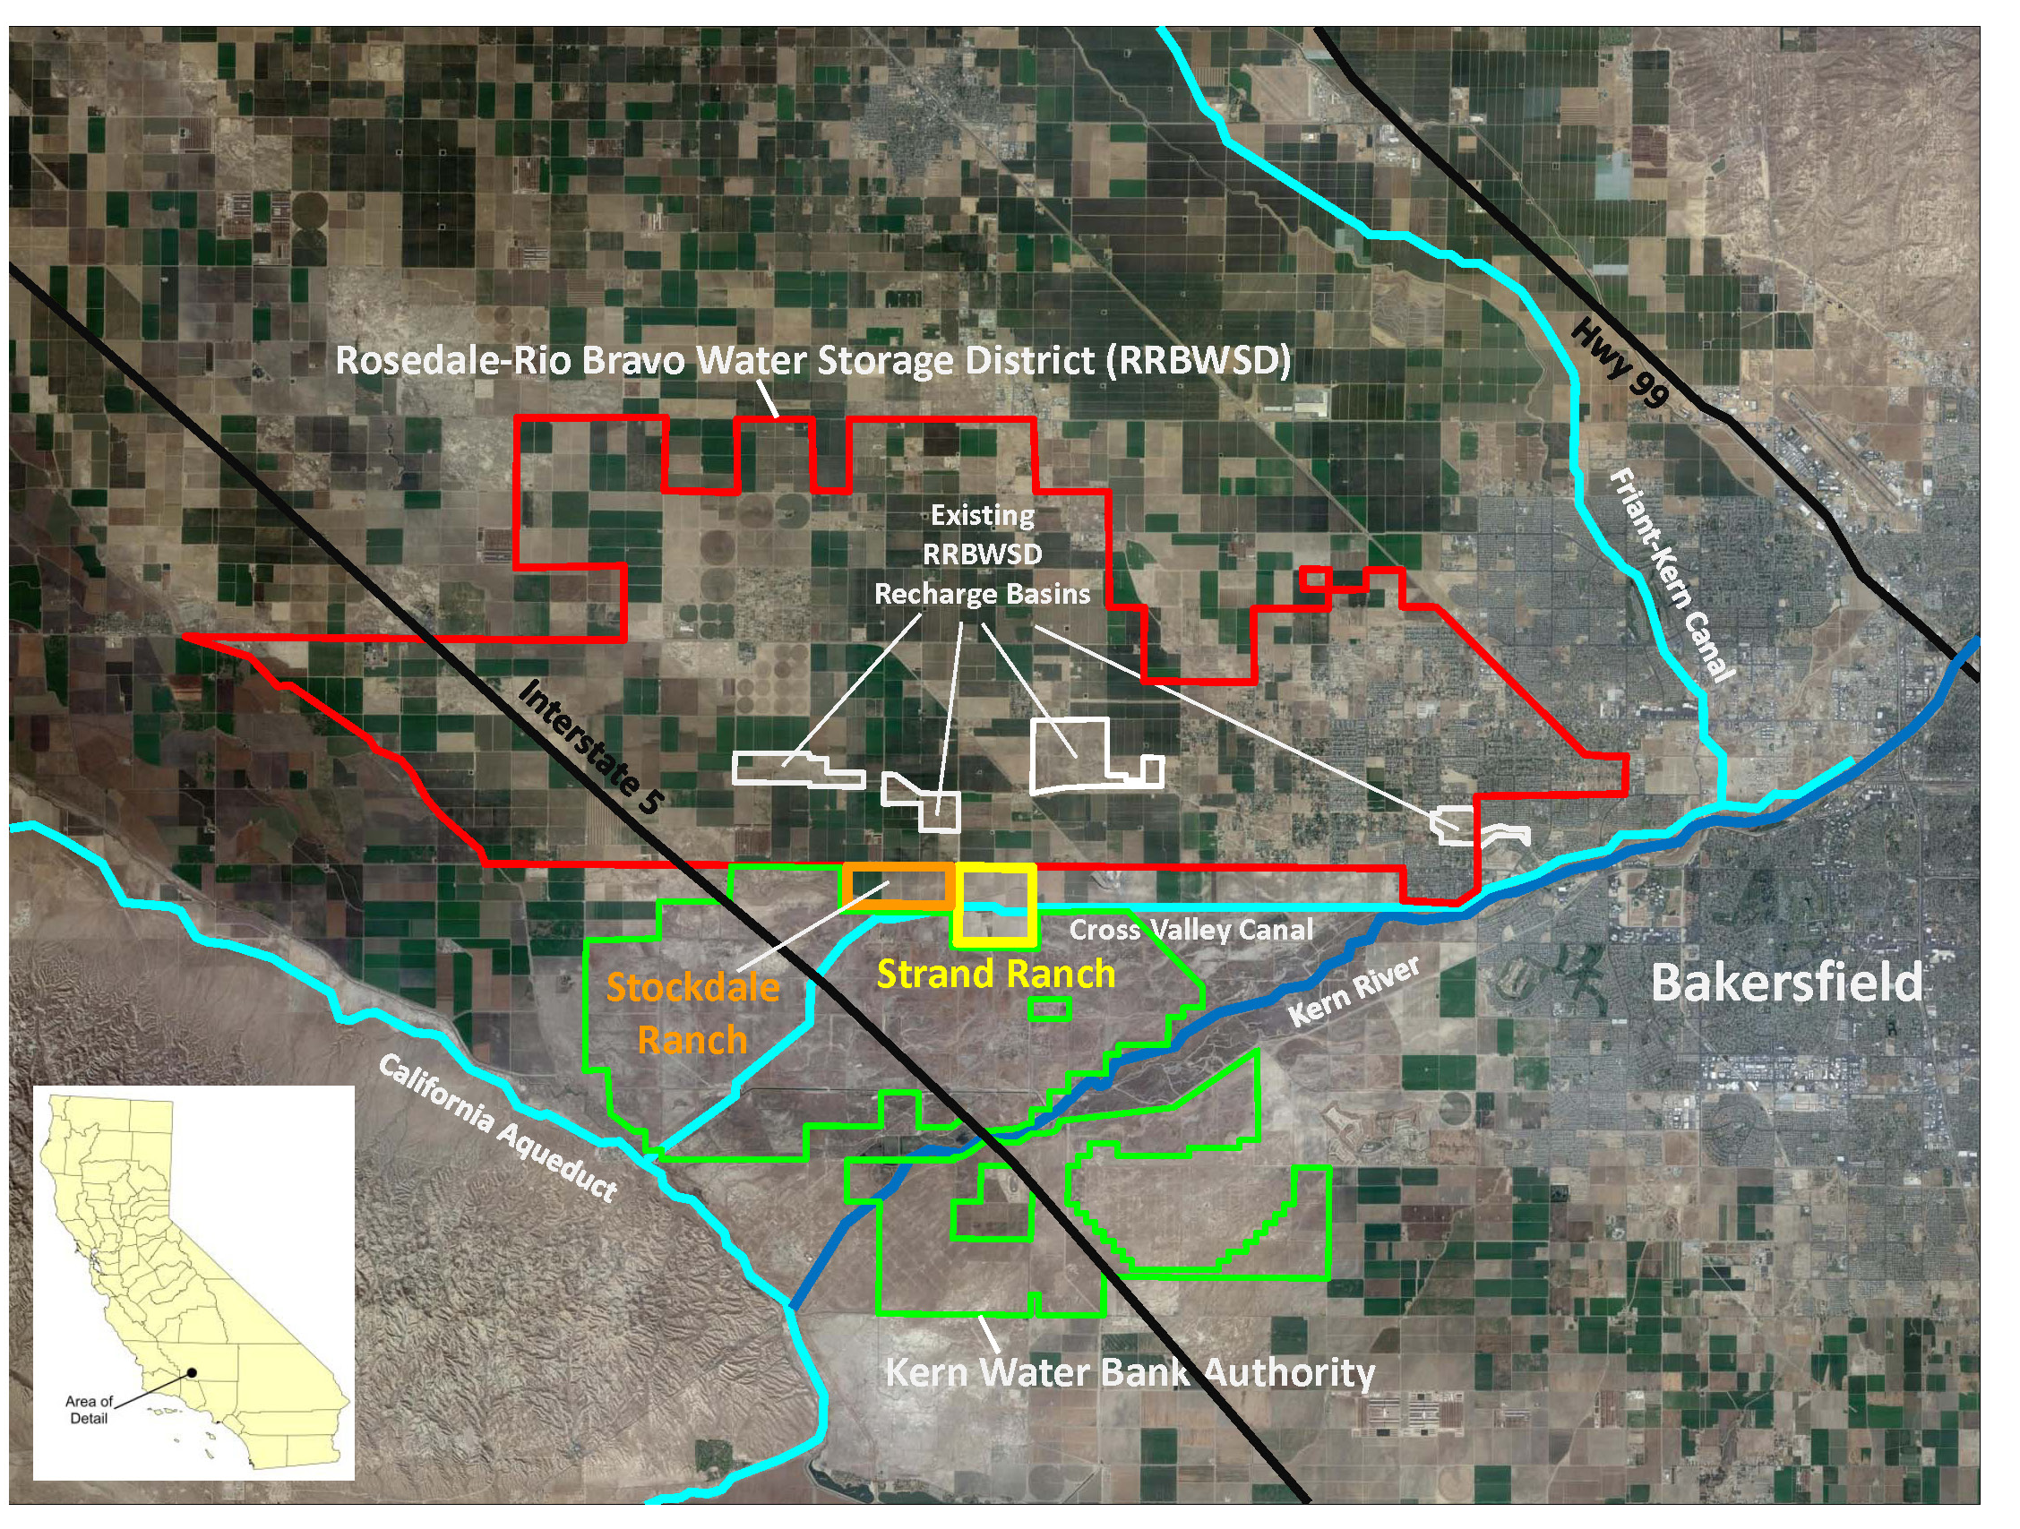
IRWD Water Banking Projects Objective
Water Banking Objective:
Capture and store water available in wet years for use in droughts and periods of supply interruptions
Emergency Supply
Resiliency and Reliability

Slide 6
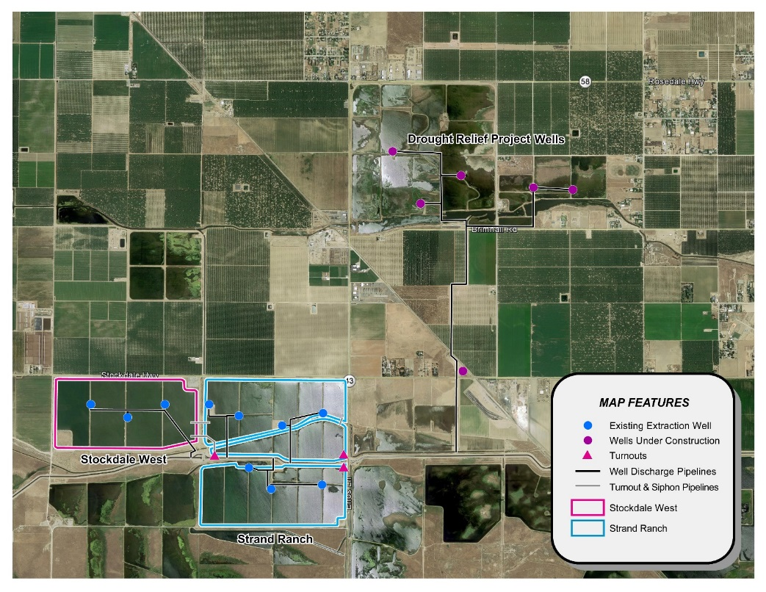
IRWD Existing Water Banking Projects
Banking Components and Facilities:
Aquifer
(126,000 AF of storage)
Land: 761 acres for recharge
(45,000 AFY)
Water Supply
(Unbalanced exchanges, etc.)
Recovery: 13 wells
(70 cfs; 29,000 AFY)
Conveyance: three turnouts
(access to the California Aqueduct and Cross Valley Canal)

Slide 7
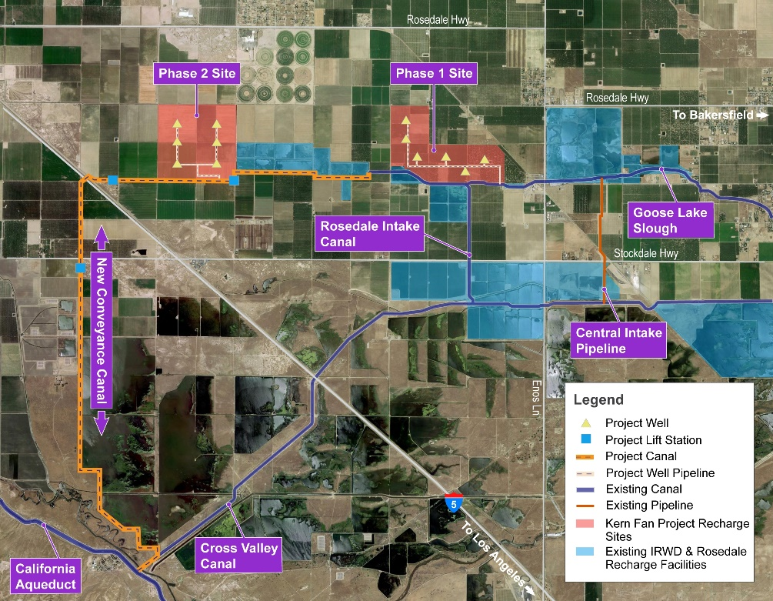
New Kern Fan Groundwater Storage Project
Banking Components and Facilities:
Aquifer
(100,000 AF of storage)
Land: 1,050 acres for recharge
(100,000 AFY)
Water Supply
(Unallocated Article 21 water)
Recovery: Up to 12 wells
(70 cfs, 50,000 AFY)
Conveyance: New 10 mile canal with 3 lift stations
(Turnout from California Aqueduct)
Preliminary Locations
To be implemented in partnership with
Rosedale-Rio Bravo Water Storage District using $68 million in funds from Prop 1.

Slide 8
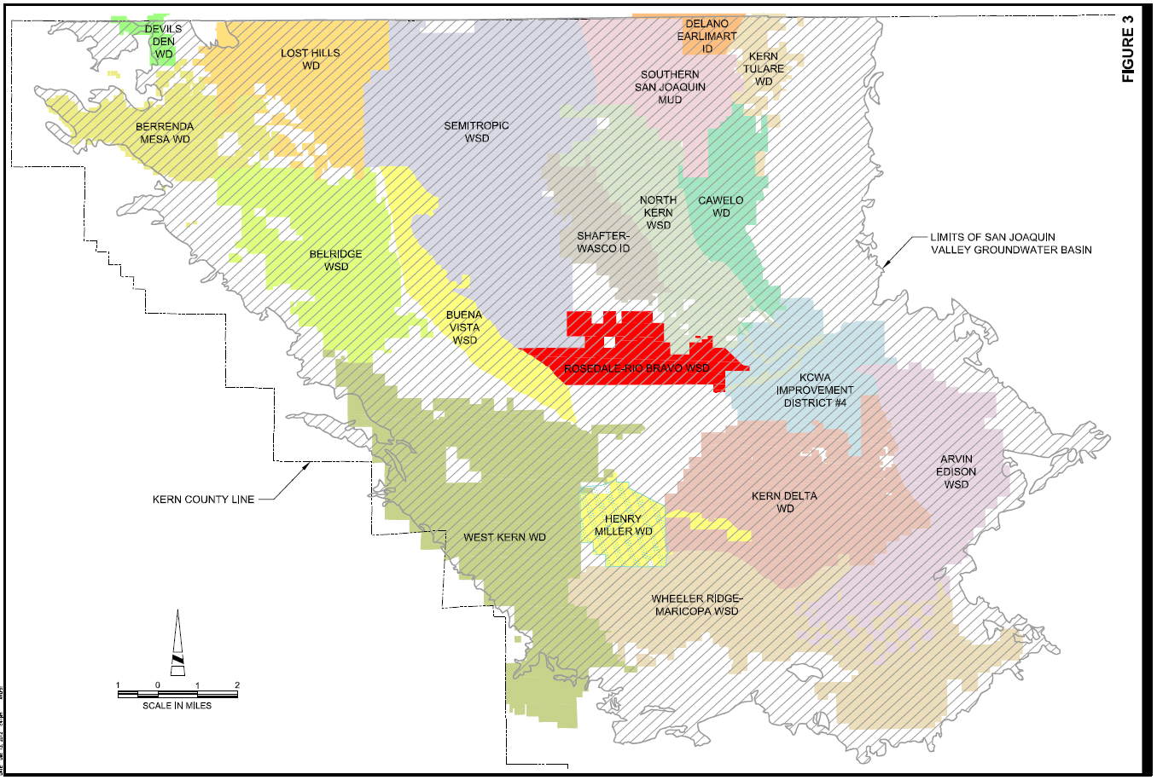
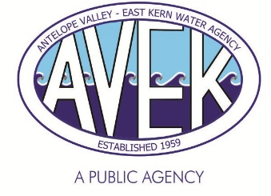
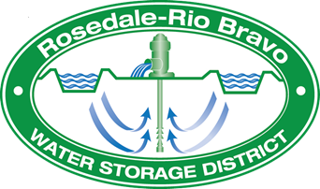
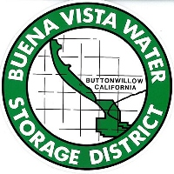
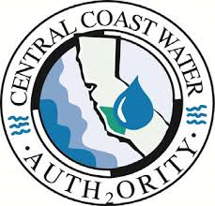
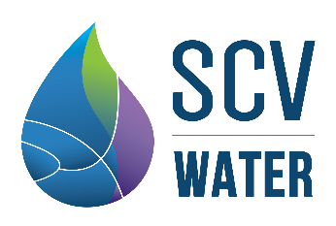
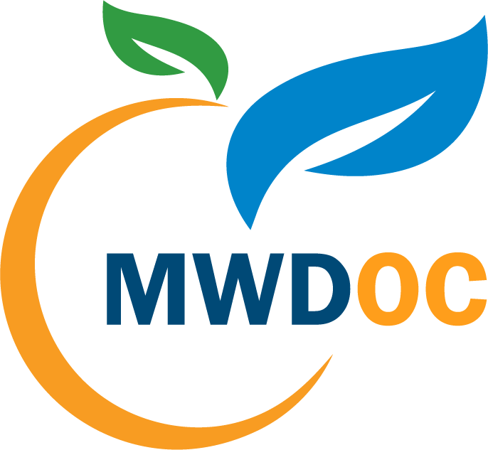
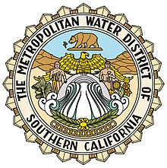
Partnerships with Other Agencies Make it Work

Slide 9
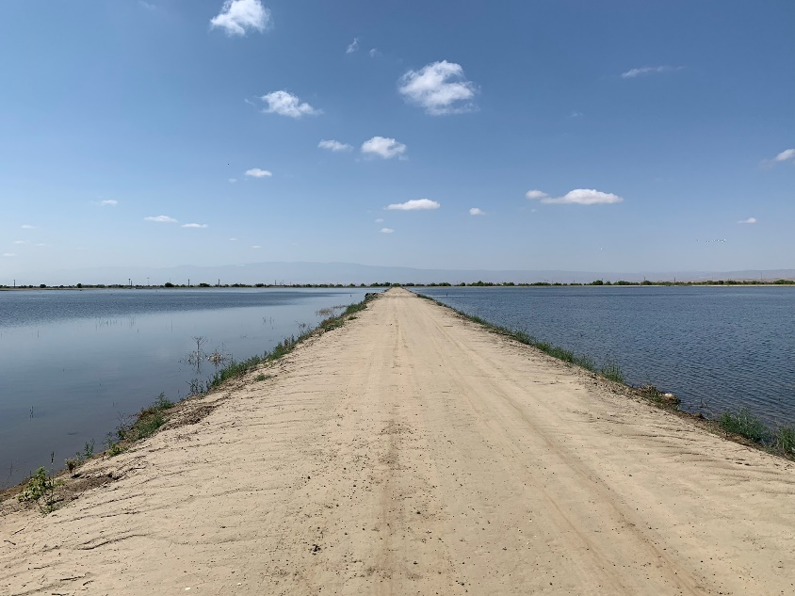
Purpose of Mutually Beneficial Partnerships
Constructing and operating facilities
Securing sources of water
Improved water management
Accessing water conveyance facilities
Avoiding impacts to others
Complying with Sustainable Groundwater Management Act (SGMA)
IRWD has implemented its water banking projects
in a way that provides benefits to its partners.

Slide 10
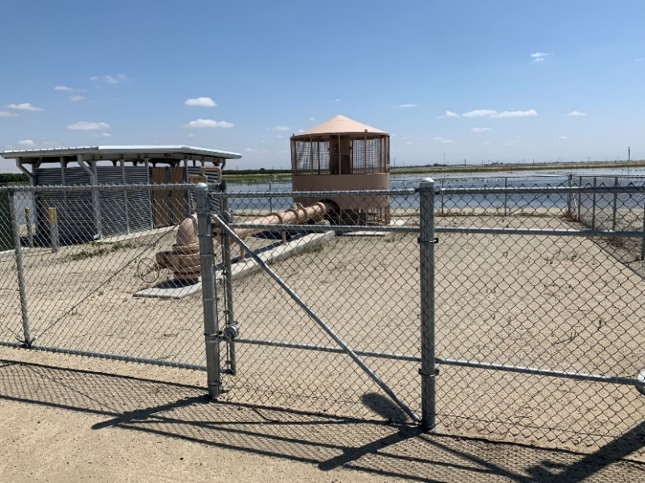
Agreements to Construct and Operate Facilities
Agreements with Rosedale:
Allocate costs to design and construct facilities
Identify ownership of land and facilities
Establish priorities for facility use*
Operation and maintenance roles
Scheduling water deliveries
Allocating costs
* Rosedale benefits from the use of facilities when not being used by IRWD.

Slide 11
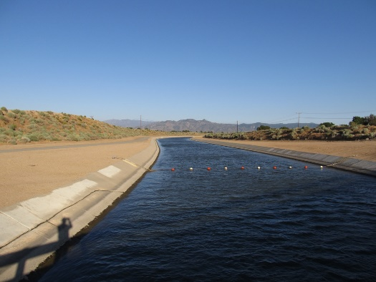
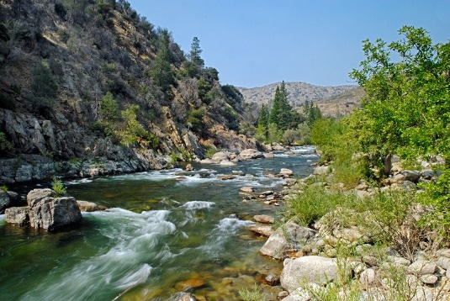
Agreements for Securing Water
Water from State Water Project (SWP) Contractors:
Unbalanced exchange program agreements
Antelope Valley-East Kern Water Agency *
Dudley Ridge Water District *
Central Cost Water Authority *
Water from Senior Water Right Holders:
Agreement with Rosedale for Kern River flood flows
Agreement with Buena Vista for Kern River water *
From pre-1914 water rights
Other wet-year exportable supplies, as available
* Partners benefit from 50% of water being returned during dry years.

Slide 12
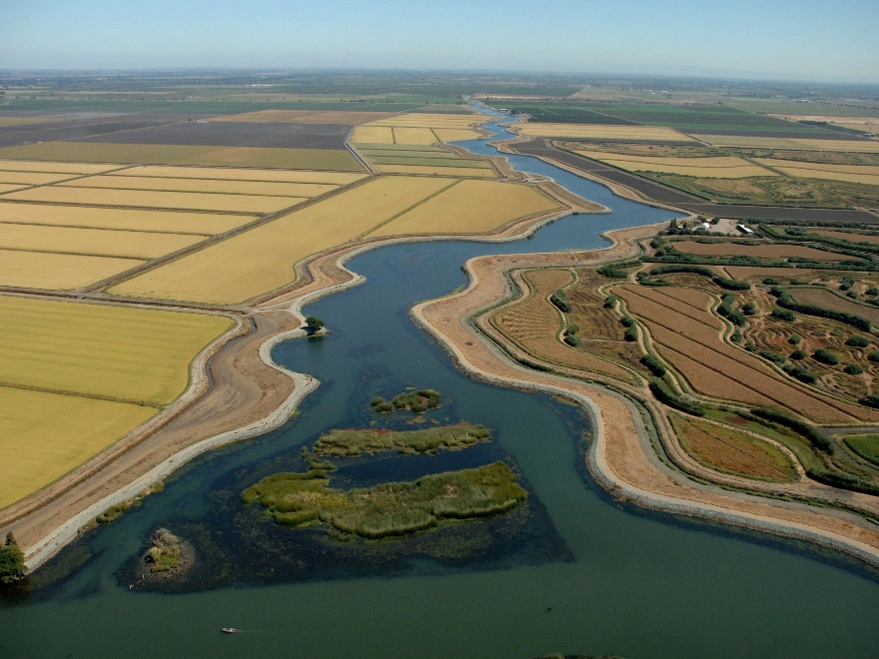
Agreements for Conveying Water
Coordinated Exchange Agreement:
Allows IRWD to secure SWP water *
Metropolitan Water District of Southern California (MWD) delivers water by Exchange
Template Wheeling Agreement:
Allows IRWD access to MWD facilities to transport other water
Must be executed for each transaction
* MWD benefits from being able to borrow SWP water secured by IRWD.

Slide 13
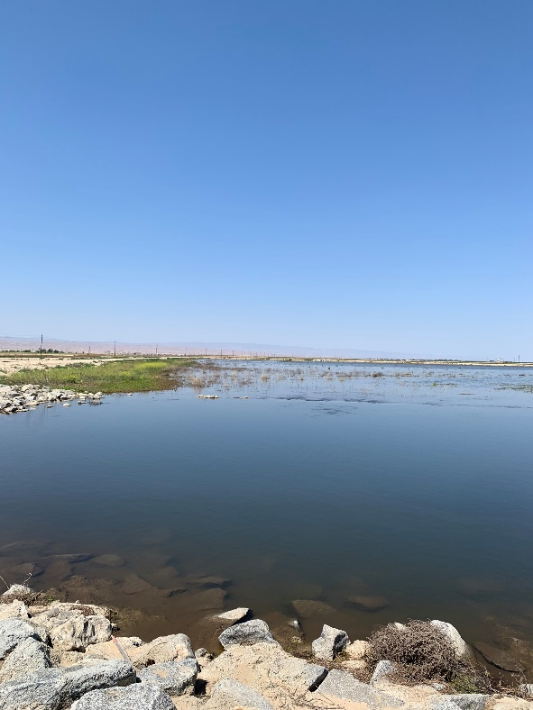
Agreements to Avoid Impacts to Others
Memorandums of Understanding:
Established Monitoring Committee
Monitoring for impacts due to high water
Monitoring of groundwater levels
Monitoring water quality
Establishing standards for losses
Establishing leave behind requirements *
Groundwater Recovery Mitigation Agreement:
Established Joint Operations Committee;
Using groundwater models to predict impacts;
Contributing mitigation funds = $2 per AF
Used to mitigate impacts to nearby wells
* Groundwater basin benefits from water left behind.

Slide 14
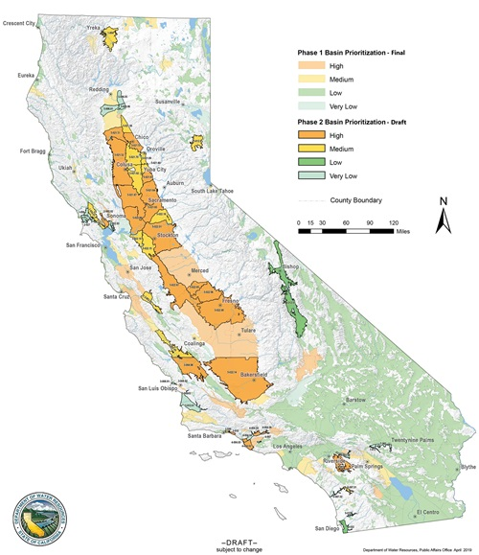
Compliance with SGMA
Landowner Agreement:
Ensures IRWD water banking projects are included in the local Groundwater Sustainability Plan
Kern Groundwater Authority Groundwater Sustainability Agency
Recognizes that the water banking projects leave water behind for benefit of basin *
No impact on native yield *
* Other groundwater users benefit from operations with no net impact.

Slide 15
Contact Information
Paul Weghorst
Executive Director of Water Policy
Office: (949) 453-5632
weghorst@irwd.com

