Slide 1
Antelope Valley-East Kern Water Agency
Antelope Valley-East Kern Water Agency Looking to the Future: Benefits of Groundwater Banking
Urban Water Institute Conference
August 15, 2019

Slide 2
Outline
Introduction to AVEK
Overview of Groundwater Banking
Benefits of Groundwater Banking
Regional Banking and Recharge Projects
Water Supply Scenario
Before and After Groundwater Banking
Building a Sustainable Water Supply for the Future
Notes:
24% area increase

Slide 3
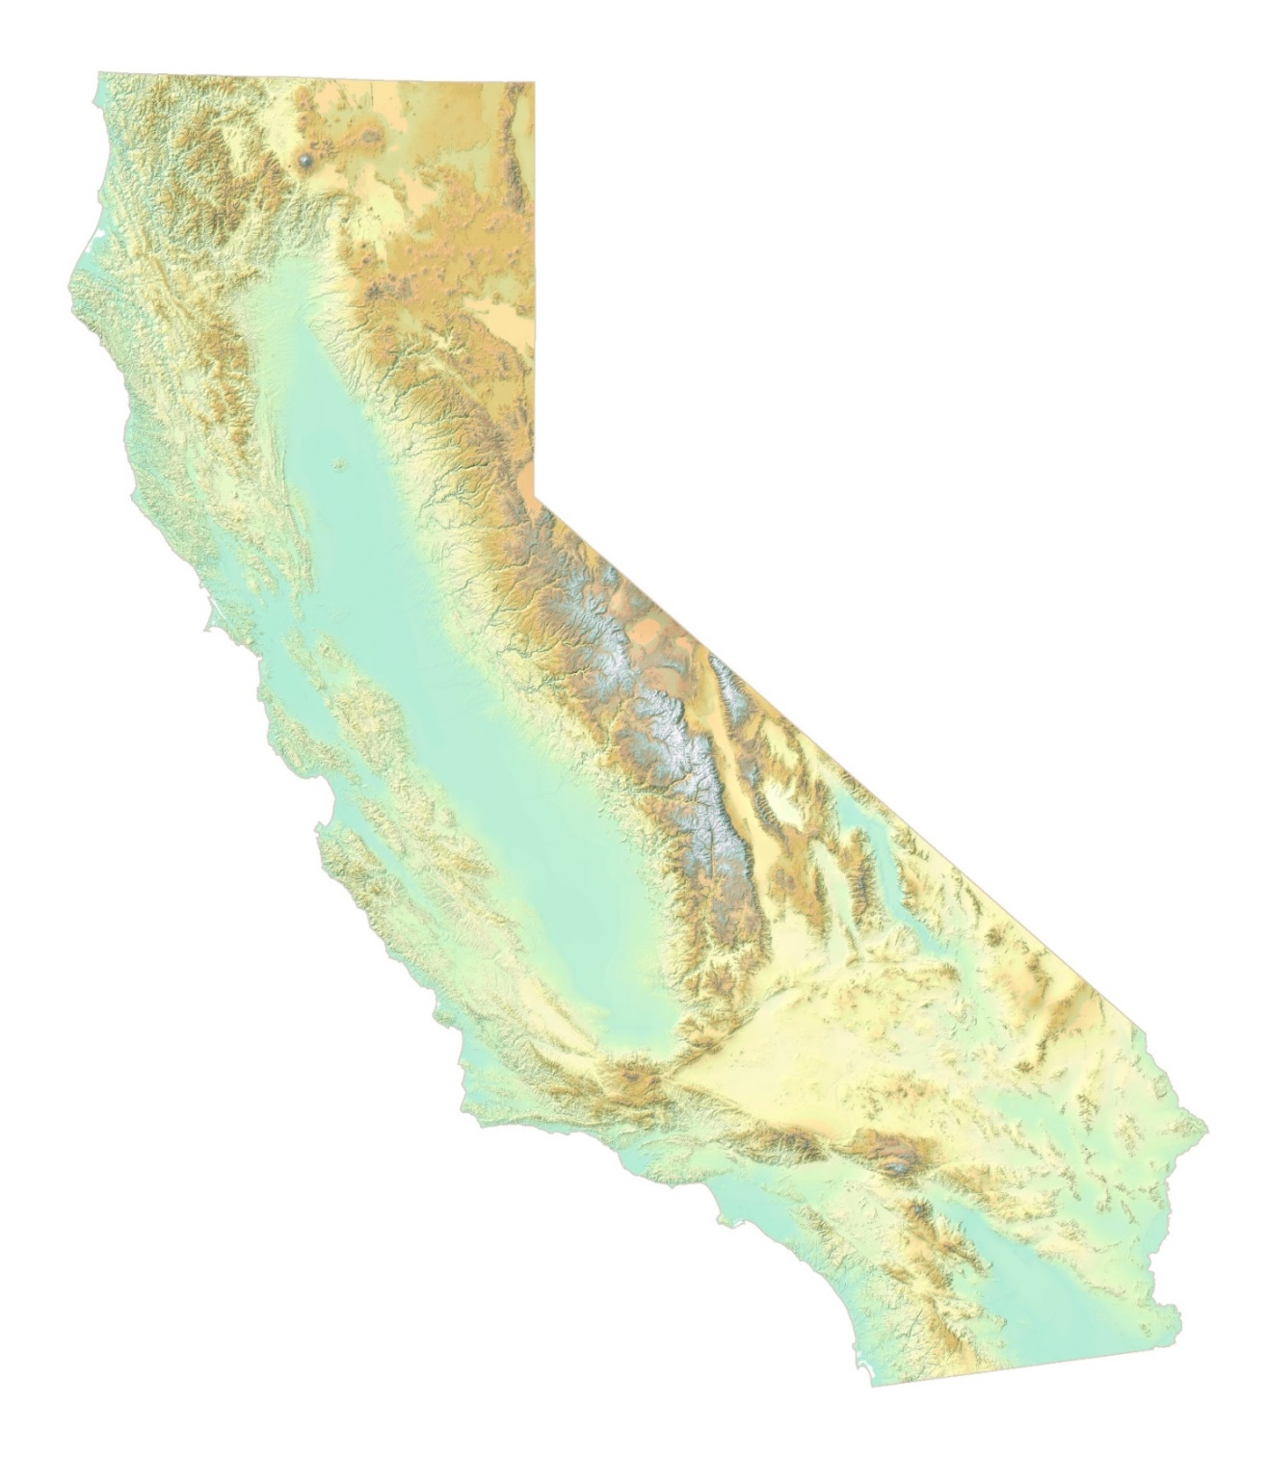
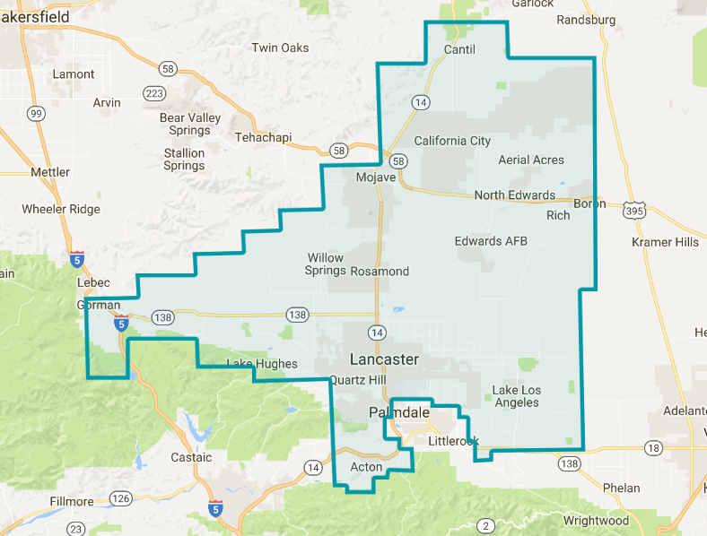
Introduction to AVEK
3rd Largest State Water Project Contractor
144,844 AF SWP allocation
2400 square mile territory with portions of Los Angeles, Kern, and Ventura counties
Wholesale water supplier serving a population of approx. 500,000
Over 20 municipal users including Edwards Air Force Base, Plant 42, and U.S. Borax
Antelope Valley Region
Notes:
24% area increase

Slide 4
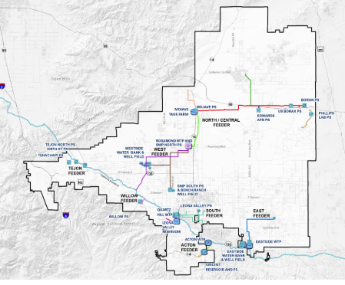
Introduction to AVEK
4 water treatment facilities
State-of-the-art laboratory
17 water storage reservoirs with 72 million gallon capacity
180+ miles of distribution pipeline
Notes:
24% area increase

Slide 5
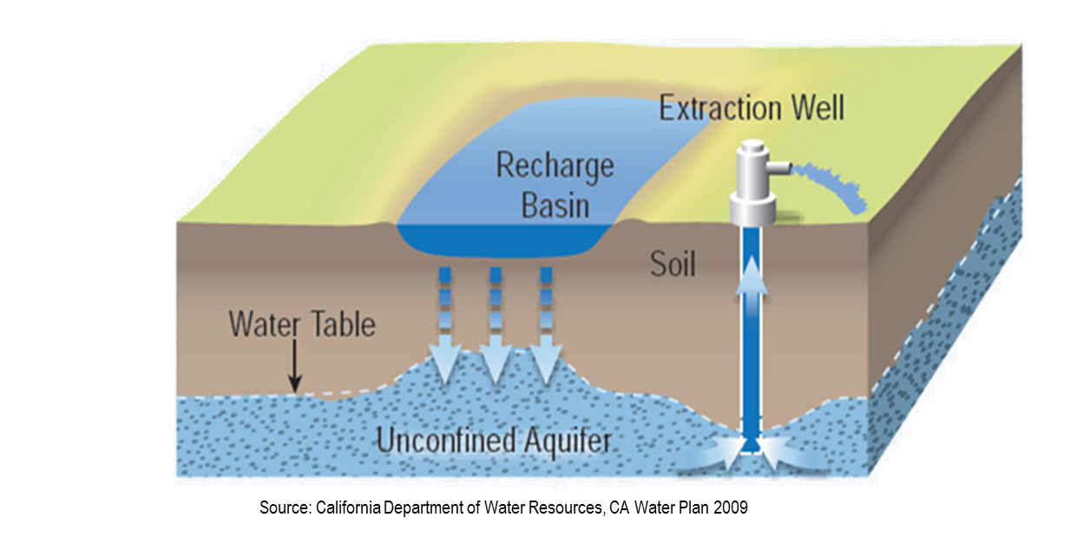
Overview of Groundwater Banking
Surplus imported water stored locally during wet years
Recover stored water for beneficial use at time of need.
Notes:
24% area increase

Slide 6
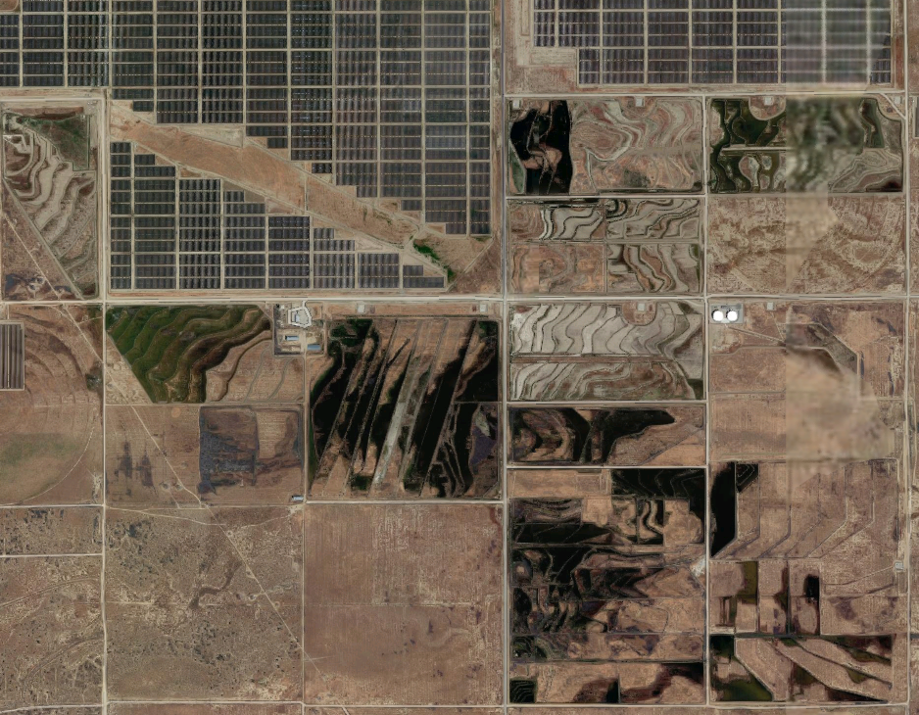
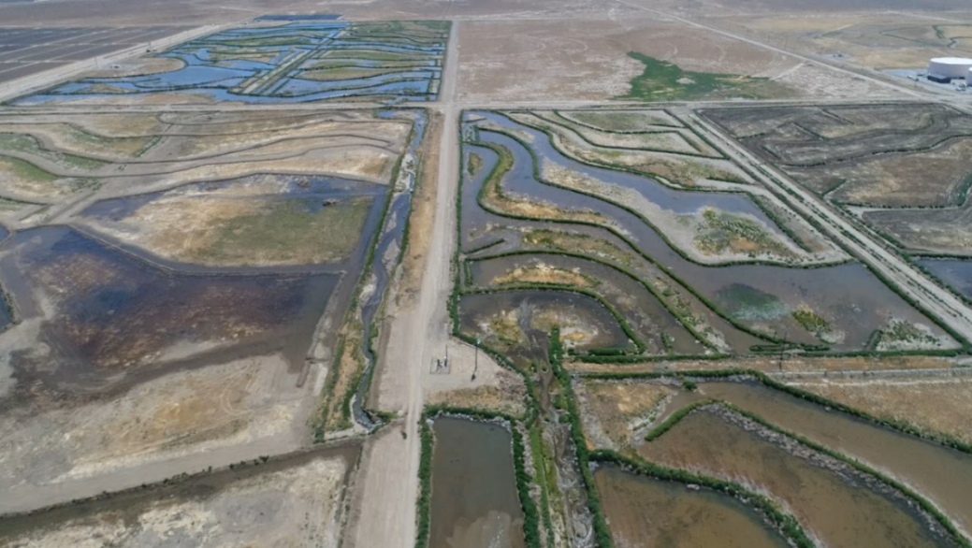
Overview of Groundwater Banking
Notes:
24% area increase

Slide 7
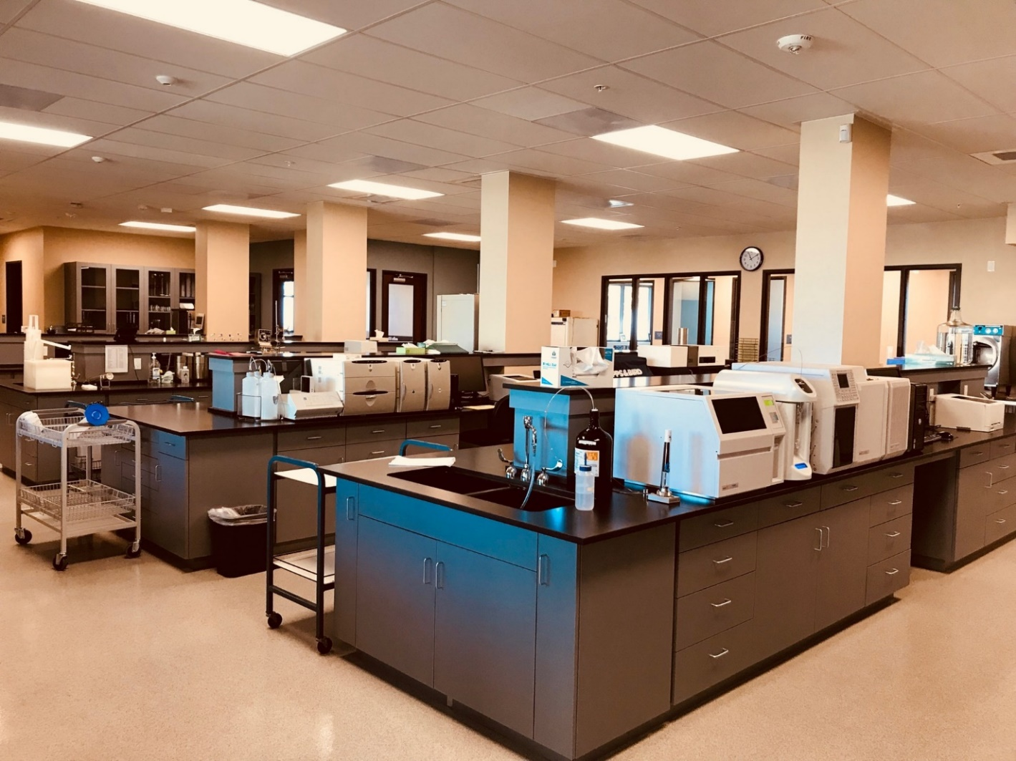
Benefits of Groundwater Banking
Water Supply Reliability
Safety net for drought and SWP outages or interruptions.
Increased supply yield by capturing water that otherwise would have been lost.
Allows for delivery of stored/banked water under nearly any condition.
Increased assurance within an adjudicated groundwater basin.
Water Quality Improvement
Geo-purification / Soil-Aquifer Treatment (SAT) provides high quality recovered water without treatment
Economical, relative to other treatment alternatives
Blending recovered groundwater with imported supply has been shown to reduce THM level by 17-25 µg/L
Continued regulatory compliance
Notes:
24% area increase

Slide 8
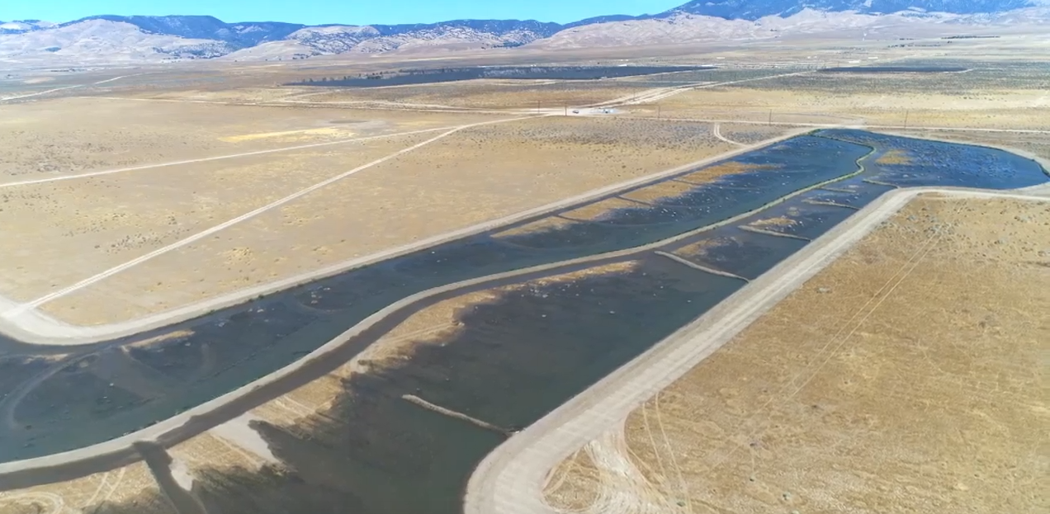
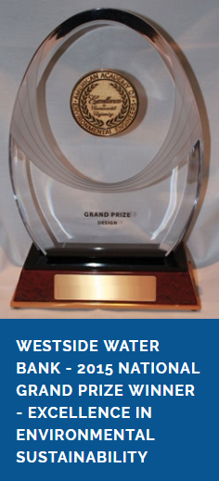
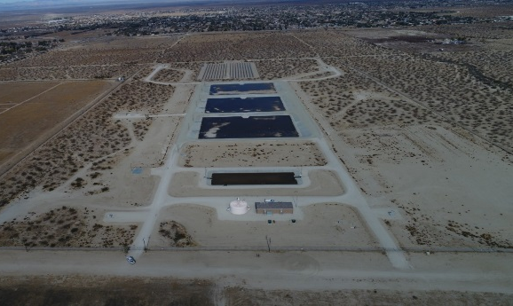
Regional Banking & Recharge Projects
Westside Water Bank
Completed in 2010
Annual recharge and recovery: 40,000 AF
Total storage: 150,000
Eastside Water Bank
Completed in 2016
Annual recharge and recovery: 2,200 AF
Total storage: 5700 AF
Primary purpose is to improve raw water quality
High Desert Water Bank
Under development
Annual recharge and recovery: 70,000 AF
Total storage: 280,000 AF
Notes:
24% area increase

Slide 9
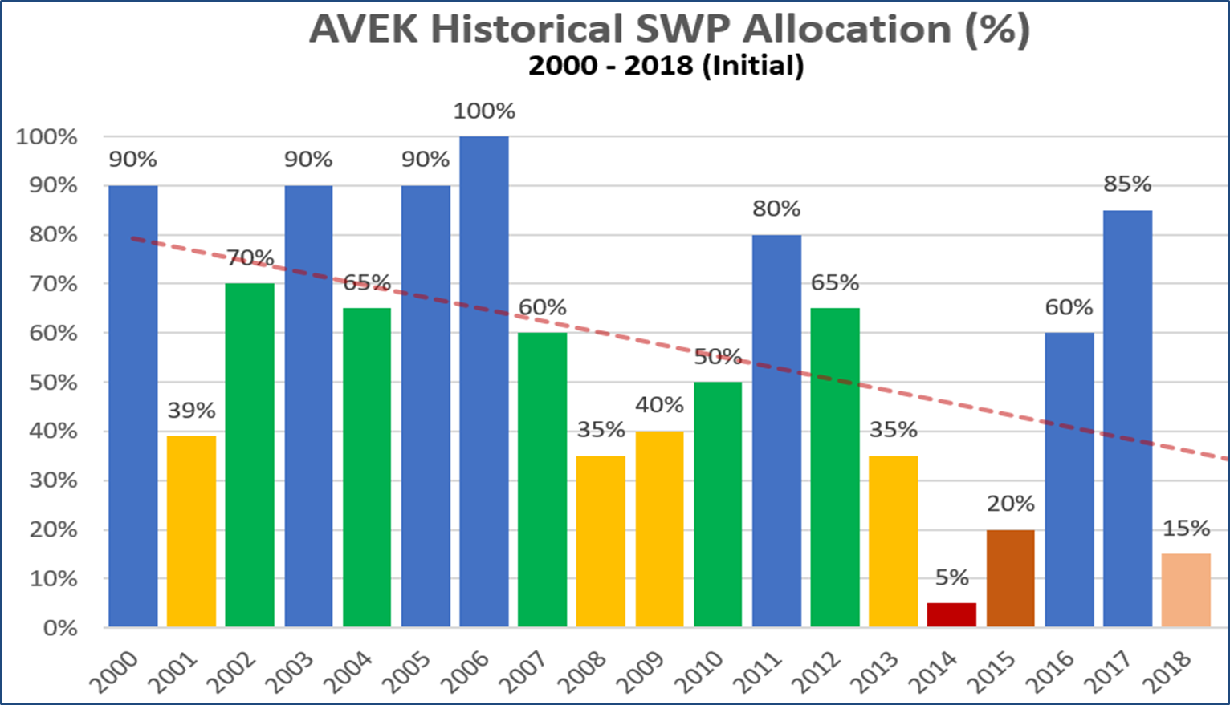
Water Supply Scenario
SWP Allocation History
Difficult to predict
Drought, aging infrastructure and climate change threaten future supply reliability
SWP allocations trending downward since 2000
Notes:
24% area increase

Slide 10
Drought Impacts Before Groundwater Banking
Supply impacts
Pump back program - pay farmers to pump well water back to aqueduct
Water Storage Contingency Plan
Limited customer deliveries
Pumping water from over-drafted groundwater basin
Financial impacts
Seek new “high cost” water sources
Additional treatment and operational costs related to low allocation
Power
Chemicals & supplies
Labor
Revenue Impacts
Reduced water sales
Increased rates to customers
Notes:
24% area increase

Slide 11
Drought Resiliency after Groundwater Banking
Supply
Can rely on current supply and operational modes
No longer rely on pumping local groundwater supplies
Can provide adequate supply for customer demands
Improved water quality with blending of imported surface water
Financial
Reduced costs without the need to import additional water sources
Reduced pass-through costs to customers
Reduced treatment and operational costs
Stable rate structure
Notes:
24% area increase

Slide 12
Supply, Demand & Surplus
Average historical supply 2010-2018
78,000 AF per year
SWP Table A
Annual average customer demand
42,000 AF per year
Surplus water supply
Approximate loss before water banking: 35,000 AF per year
No local drought supply protection prior to 2010
Ability to bank 60,000 AF per year
Current drought supply stored: 80,000 AF
Notes:
24% area increase

Slide 13
Building a Sustainable Water Supply for the Future
Groundwater banking objectives
Develop groundwater bank resources to meet established water reliability goals
Establish long-term storage goals for the agency
Secure appropriate supplies to meet future customer demand
Align groundwater banking goals with local adjudication
Sustain the region’s groundwater basin for future generations
Coordinate with other agencies to share our groundwater banking capabilities
Secure agreements with other agencies and looking to expand our capacity as demand increases
Notes:
24% area increase

Slide 14
Building a Sustainable Water Supply for the Future
QUESTIONS?
Notes:
24% area increase

