Slide 1
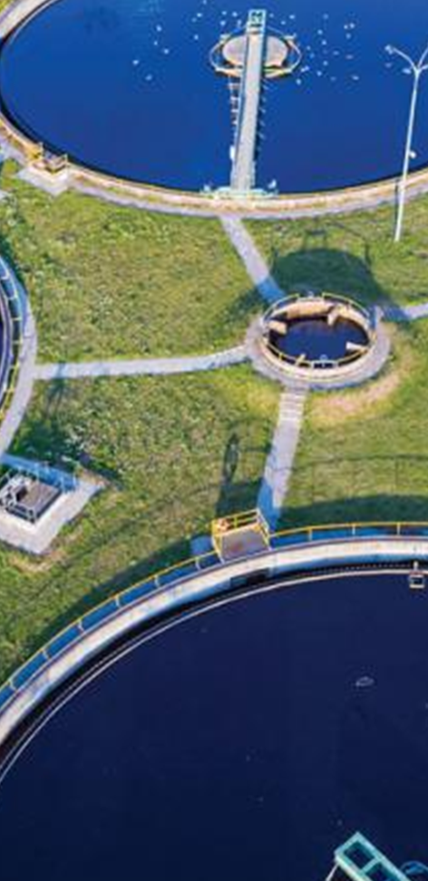
Understanding the Cyber Threat to Water Utilities
Eric Conway
Technical Director | Jacobs Cybersecurity
February 20, 2020

Slide 2
Agenda: Understanding and Protecting Against the Threats
Understanding the Threat
Understanding the Vulnerabilities
Take Action to Reduce the Threat

Slide 3
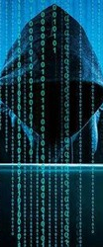
Understanding the Threat
Examine incidents that are useful to understand how a cyber attack can be executed against a water utility.

Slide 4
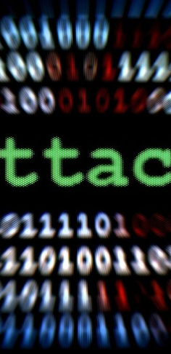
There are Many Reasons for Cyber Attacks
Crime – extortion (ransomware), theft of financial data, credit card numbers
Data – theft of personal data, business records, client lists
Intellectual Property – theft of industrial designs, technical specifications
Cyber Operations – botnets and spammers use your servers as infrastructure
Activism - making a social or political point (‘hactivism’)
Terrorism
Advanced Persistent Threat (APT) - Nation State attack
  Espionage, data collection, intelligence
  Create lack of confidence and trust in US infrastructure (including water/wastewater)
  Pre-positioned ‘logic bombs’ that can be executed on demand

Slide 5
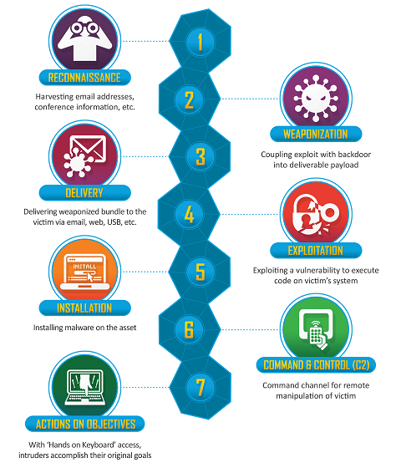
Understanding Tactics, Techniques, and Procedures (TTPs)
Cyber Attacks occur in a multiple phases approach, often referred to as a ‘kill chain’.
Early phases exploit the following weaknesses:
  Publicly available information (web sites, social media)
    Alert TA18-074A referenced a high-res photo the adversary used that displayed control systems equipment models/status in the background
  Publicly-facing IT infrastructure with remote access
  Human element (social engineering, weak passwords, accidental spillage, poor cyber hygiene)
Success in the early phases enables the access that provides the attacker access to the control systems and devices on the OT network
https://www.lockheedmartin.com/en-us/capabilities/cyber/cyber-kill-chain.html

Slide 6
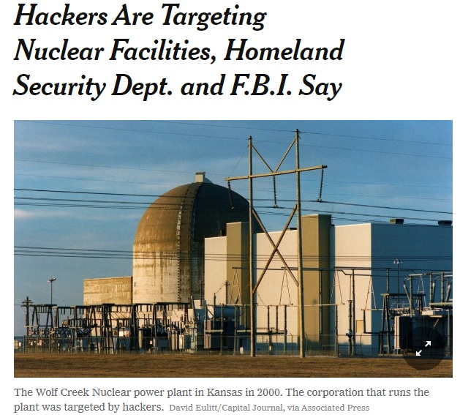
Wolf Creek Nuclear Power Plant – 2017 Attack
Hackers were ‘determined to map out computer networks for future attacks’ (network reconnaissance)
Similar techniques observed by a known nation state group focusing on energy sector
Used common attacks on IT systems to steal credentials used to access the network
  Phishing – highly targeted email messages with fake MS Word resumes
  Watering Hole – compromise legitimate websites victims frequent
  Man in the Middle – redirect victim internet traffic through own machines
https://www.nytimes.com/2017/07/06/technology/nuclear-plant-hack-report.html

Slide 7
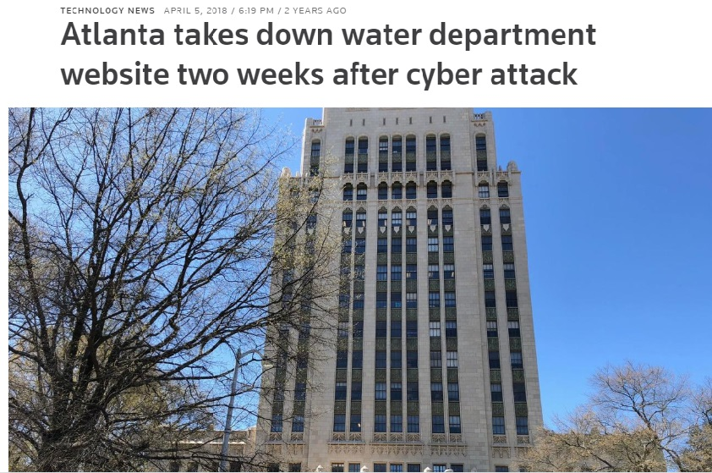
City of Atlanta Water Department, March 2018
Ransomware Attack that disrupted city utilities, courts, and operations
Watershed Management employees unable to turn on work computers
Estimated costs up to $5M
SamSam virus that uses:
  Vulnerable network services:
    remote desktop protocols (RDP)
    Java-based web servers
    file transfer protocol (FTP) servers
  Weak passwords to obtain initial foothold
https://www.reuters.com/article/us-usa-cyber-atlanta-water/atlanta-takes-down-water-department-website-two-weeks-after-cyber-attack-idUSKCN1HC2WB

Slide 8
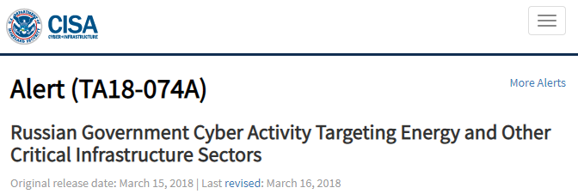
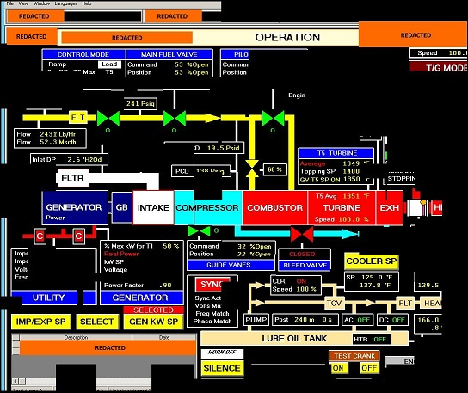
DHS Alert Cyber Activity Targeting Critical Infrastructure Sectors, April 2018
Foreign government campaign to exploit public-facing infrastructure devices critical to utility operations in the water and other sectors.
Targeted Vulnerabilities included:
  Insufficient antivirus, integrity-maintenance and other security tools
  Manufacturers build and distribute the devices with exploitable services
  Failure to change vendor default settings, enhance security and regularly patch systems and software;
  Failure to remove or update antiquated or outdated equipment that is no longer being supported by the manufacturer or vendor
The threat actors in this
campaign employed a
variety of TTPs…
spear-phishing emails (from compromised legitimate account)
watering-hole domains
credential gathering
open-source and network reconnaissance
host-based exploitation
targeting industrial control system (ICS) infrastructure.
https://www.us-cert.gov/ncas/alerts/TA18-074A

Slide 9
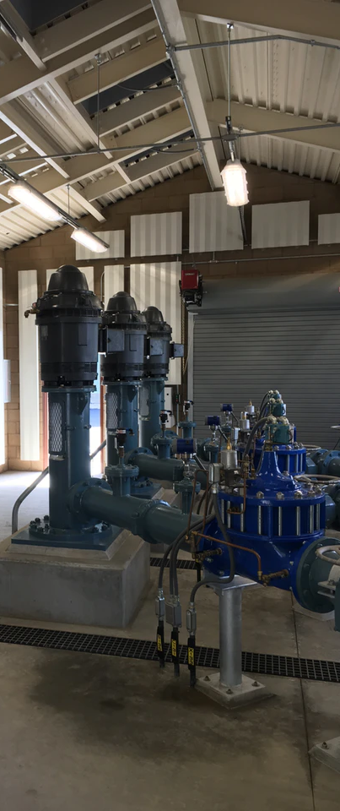
Understanding the Vulnerability
Examine the characteristics of water utility networks and control systems that make them vulnerable to cyber threats

Slide 10
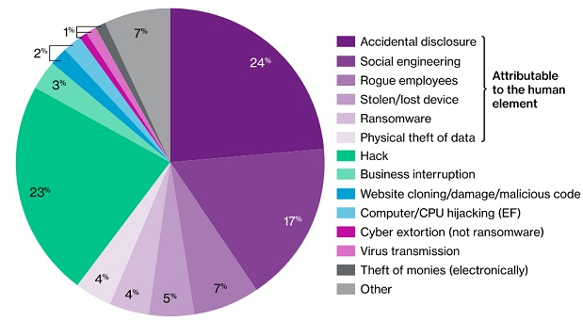
Understanding the Human Element
The Human Element is a Leading Cause of Cyber Risk
Social Engineering, Phishing, USB attacks, Weak Passwords, Accidental Disclosures open doors to attack
Willis Towers Watson 2017-18 Reported Cyber Claims Index
  Examined 288 cyber claims with varying industries, incidents, severity and loss amounts
  Loss attributable to the human element associated with 61% of the claims
Security/OPSEC Training & Awareness will significantly reduce risk!
(61%)
https://www.willistowerswatson.com/en-PH/Insights/2019/01/decode-cyber-brief-winter-2019-edition

Slide 11
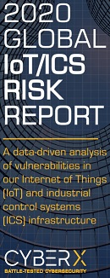
Understanding the Cyber Element
CyberX study highlights how IoT/ICS environments continue to be soft targets for adversaries, with security gaps in key areas
Based on data collected over 12 months from 1,821 production IoT/ICS networks
Covered ‘a diverse mix of industries worldwide’
Basic Cyber Hygiene would reduce a significant amount of risk!
62%
64%
Outdated Operating Systems
Unsupported Windows software
Unencrypted passwords
Passing in Plain Text
54%
Remotely accessible devices
Standard Protocols configured to permit attacker access
66%
27%
No automatic AV updates
22%
Direct internet connections
Unseen indicators of threats
Signatures of known malware
Observed suspicious behavior
https://cyberx-labs.com/resources/risk-report-2020

Slide 12

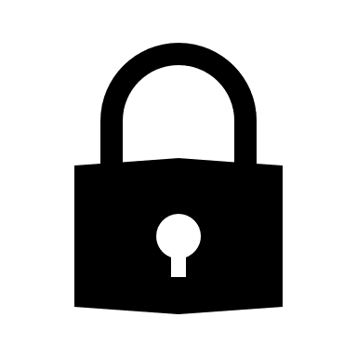
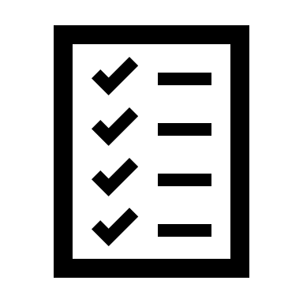

Convergence of Information Technology and Operational Technology
Information Technology (IT) or Enterprise system
  Business operations, billing, revenue collection, asset tracking, customer information
  Prioritizes Confidentiality, Integrity, Availability
Operational Technology (OT) or Production system
  Front-end, field based devices that perform actual operations, operating in real or near real-time environment
  Prioritizes Availability, Integrity, Confidentiality
IT/OT convergence - integrating OT with IT systems
  SCADA, remote terminal unit, programmable logic controllers, and meters and sensors, which work in real time or near real time
  Integrates the Cyber, Human, and Physical Elements
Confidentiality
Security
Integrity
Availability

Slide 13
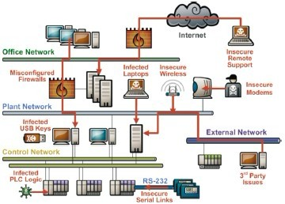
Typical Sources of Vulnerabilities in Control and SCADA Systems
Proliferation of 'soft' targets
  SCADA and ICS devices are designed for reliability and real-time I/O, not robust and secure networking.
  Many ICS devices will crash if they receive malformed network traffic or even high loads of correctly-formed data
  PCs in these networks often run without security updates, susceptible to outdated malware.
Multiple points of entry - control systems are accessed by numerous external sources
Poor internal network segmentation - problems originating in one part can quickly spread to other areas.
http://www.iebmedia.com/ethernet.php?id=8460&parentid=74&themeid=255&hft=68&showdetail=true&bb=1&PHPSESSID=vk9tck0p6rq69jt6d3l6co7lh7

Slide 14

Typical Sources of Vulnerabilities in Control and SCADA Systems
Proliferation of 'soft' targets
  SCADA and ICS devices are designed for reliability and real-time I/O, not robust and secure networking.
  Many ICS devices will crash if they receive malformed network traffic or even high loads of correctly-formed data
  PCs in these networks often run without security updates, susceptible to outdated malware.
Multiple points of entry - control systems are accessed by numerous external sources
Poor internal network segmentation - problems originating in one part can quickly spread to other areas.
http://www.iebmedia.com/ethernet.php?id=8460&parentid=74&themeid=255&hft=68&showdetail=true&bb=1&PHPSESSID=vk9tck0p6rq69jt6d3l6co7lh7

Slide 15
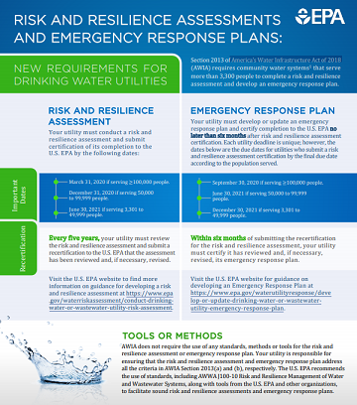
Regulatory Compliance Pressure is Mounting
Implementing security guidelines while controlling costs & remaining competitive
Understanding new regulations and the impact on security operations
Section 2013 of America’s Water Infrastructure Act of 2018 (AWIA)
  Affects community water systems that serve more than 3,300 people
  Requires risk and resilience assessment of the security of any electronic, computer, or other automated systems used
  Requires an emergency response plan
  Submit certification of completion to the U.S. EPA.
Size (# People Served) | Certification Due
100,000+ | 03/31/2020
50,000 – 99,999 | 12/31/2020
3,301 – 49,999 | 06/30/2021
https://www.epa.gov/sites/production/files/2019-04/documents/awia_factsheet_04-16-2019_v2-508.pdf

Slide 16
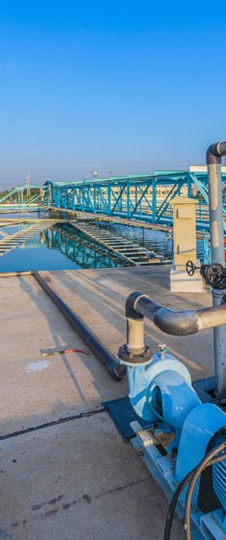
Take Action to Reduce the Threat
Explore the steps that can be taken to reduce the threat of Cyber Attack on the Water/ Wastewater Sector

Slide 17
How To Get Started
Establish Security Objectives
Expand Knowledge of Cyber Threats
Establish a Culture of Security
Identify your Assets and Vulnerabilities
Identify Gaps and Begin to Fill Them
Communicate and Connect
Adapted from Minimizing the Risk of Cyber Attack, Ernie Hayden & Steve Roberts, Presented at Water & Sewer Risk Management Pool, March 2015

Slide 18
Establish Key Security Objectives
Restrict Physical and Logical Access to ICS Network and Enterprise Network
  Principle of Least Privilege - reduces the risk of attackers gaining access to critical systems or data by compromising a low-level user account, device, or application
Separate Systems into Zones/Functional Groups
Implement Layered/Tiered Defense (Defense in Depth)
Protect individual components and computers from exploitation
  Patching, Disabling Ports and Services, Access Rights/Controls, etc.
Establish Cyber Incident Recognition and Response
Adapted from Minimizing the Risk of Cyber Attack, Ernie Hayden & Steve Roberts, Presented at Water & Sewer Risk Management Pool, March 2015

Slide 19
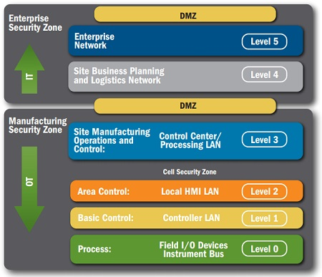
Establish Key Security Objectives
Network Segmentation – Layered Defense
  Identify groups of devices with common functionality/security requirements
  Create clear boundaries in order to effectively apply multiple layers of defense
Common Architectural Zones define boundaries, assets, risk, priority, security requirements & capabilities
  Enterprise Security Zone – connected to internet, other locations, business networks.
  Manufacturing Security Zone – monitoring and control, management of the control network
  Cell Security Zone(s) – local or remote area controls, sensors, actuators, and safety systems.
https://www.us-cert.gov/sites/default/files/recommended_practices/NCCIC_ICS-CERT_Defense_in_Depth_2016_S508C.pdf

Slide 20
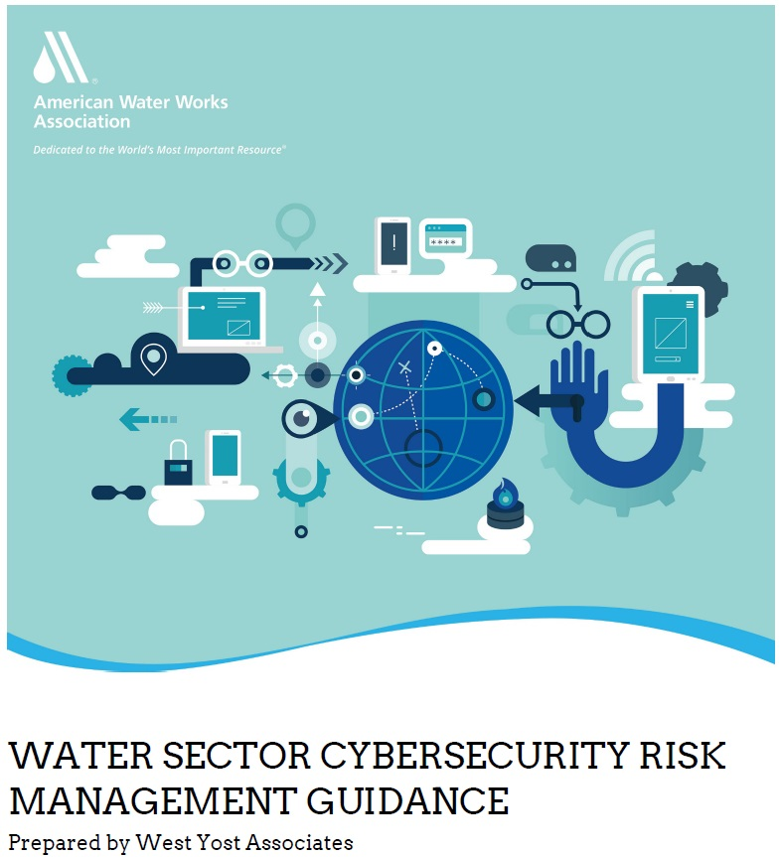
American Water Works Association (AWWA)
Recommended Cybersecurity Practices
The Assessment Tool to collect user input on the utility’s current cybersecurity posture and provides recommended controls to facilitate AWIA 2018 compliance and cybersecurity improvements.
  The sector-specific approach for implementing the NIST Cybersecurity Framework (CSF).
Practice Categories
Business Continuity and Disaster Recovery | Telecommunications, Network Security, and Architecture
Governance and Risk Management | Physical Security of PCS Equipment
Server and Workstation Hardening | Service Level Agreements (SLA)
Access Control | Operations Security (OPSEC)
Application Security | Education
Encryption | Personnel Security
Data Security | Cyber-Informed Engineering
https://www.awwa.org/Portals/0/AWWA/ETS/Resources/AWWACybersecurityGuidance2019.pdf?ver=2019-09-09-111949-960

Slide 21
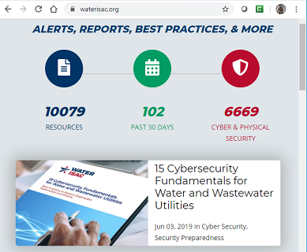
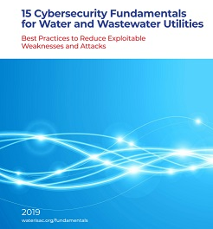

Expand Knowledge of Cyber Threats
https://www.waterisac.org/
Water Information Sharing & Analysis Center (WaterISAC) is a service created by drinking water and wastewater utility managers to:
  Provide tools for identifying and managing risks
  Help managers target limited resources where they are most needed
  Arm utility directors and security personnel with critical knowledge and best practices
  Communicate threat warnings and incident reports to water systems, 24 x 7 x 365
  Save time and effort by serving as a clearinghouse for government and private resources

Slide 22
Establish a Culture of Security
Integrate cyber and physical security into:
  Organizational culture
  Leadership
  Daily Operations
Address the Human Element of Cybersecurity with
  Policies that lay the framework for rigorous controls that secure ICS/Operational technologies and provide the governance needed to manage human factors
  Procedures – standard and repeatable means to accomplish task in safe manner
  Training and Awareness – security specific training, recognize indicators of compromise (IoC), steps to take when an event is detected
Weave Security into Procurement, Services, Contracts
  Vendors, supply chain, contractors & subcontractors
Adapted from Minimizing the Risk of Cyber Attack, Ernie Hayden & Steve Roberts, Presented at Water & Sewer Risk Management Pool, March 2015

Slide 23
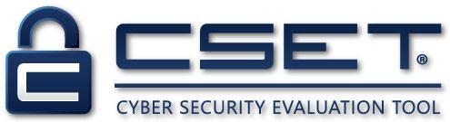
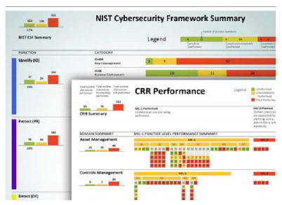
Identify your Assets and Vulnerabilities
Get a baseline of assets using one of the following self-assessment tools:
  DHS Cybersecurity Evaluation Tool (CSET)
  https://www.us-cert.gov/ics/Assessments
  AWWA Cybersecurity Guidance Tool - The sector-specific approach for implementing the NIST Cybersecurity Framework (CSF).
  https://www.awwa.org/Resources-Tools/Resource-Topics/Risk-Resilience/Cybersecurity-Guidance
  DHS Critical Infrastructure Cyber Community (C3) Voluntary Program - Cyber Resilience Review (CRR) self assessment and report generation tool
  https://www.cisa.gov/ccubedvp
Adapted from Minimizing the Risk of Cyber Attack, Ernie Hayden & Steve Roberts, Presented at Water & Sewer Risk Management Pool, March 2015

Slide 24
Identify Gaps and Begin to Fill Them
Prioritize identified vulnerabilities
Make immediate Impact with Lower Cost/High Gain Changes
  Employee training and awareness
  Password Policy and 2 Factor Authentication
  Patching systems and updating AV software
  Mapping your system infrastructure
Work other repairs into your budget and planning
Establish a Security Manager/Leader – even Part Time – to Sustain the direction
Learn from the Industry and Examples

Slide 25
Identify Gaps and Begin to Fill Them
WaterISAC – 10 basic cyber security recommendations for water and wastewater utilities
  Reduce exploitable weaknesses
  Defend against avoidable data breaches and cyber-attacks
Developed in partnership with
  DHS Industrial Control Systems Cyber Emergency Response Team (ICS-CERT)
  FBI
  Information Technology ISAC
Maintain an Accurate Inventory of Control System Devices and Eliminate Any Exposure of this Equipment to External Networks
Implement Network Segmentation and Apply Firewall
Use Secure Remote Access Methods
Establish Role-Based Access Controls and Implement System Logging
Use Only Strong Passwords, Change Default Passwords, and Consider Other Access Controls
Maintain Awareness of Vulnerabilities and Implement Necessary Patches and Updates
Develop and Enforce Policies on Mobile Devices
Implement an Employee Cybersecurity Training Program
Involve Executives in Cybersecurity
Implement Measures for Detecting Compromises and Develop a Cybersecurity Incident Response Plan

Slide 26
Communicate, Connect, Stay Informed
NIST
DHS
AWWA
EPA
WaterISAC
Good cybersecurity not a single product, or even a secured system, but rather an operational disposition to be incorporated, holistically, into business planning and operations. Naturally there is a clear role for robust, physical security systems, but these must be bolstered by continuous and proactive engagement with maintaining security through business practice and employee culture. Above all, as threats evolve, so too must defenses.
(Steel, William. Cybersecurity for Water Utilities. https://www.waterworld.com/water-utility-management/article/16190093/cybersecurity-for-water-utilities )

Slide 27
Thank You!
Eric.Conway@Jacobs.com

