Slide 1
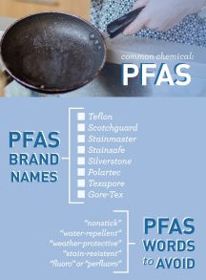
PFAS (PFOA & PFOS) – Now What? Fullerton – A Retail Agency Perspective
Urban Water Institute’s Spring Conference – Palm Springs
Meg McWade, City of Fullerton
February 19, 2020

Slide 2
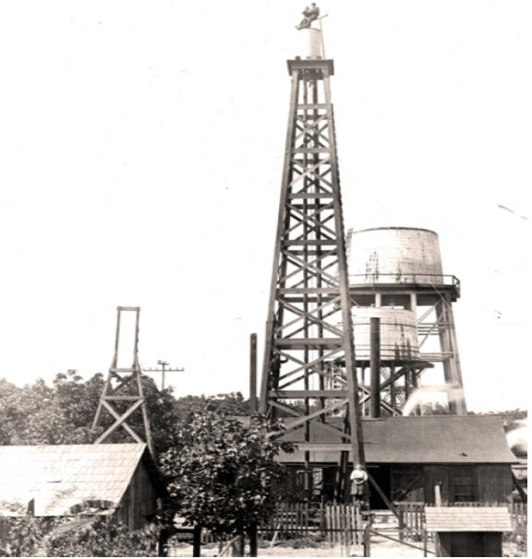
City of Fullerton’s Water System
City founded in 1887 – Incorporated in 1904 – currently 22.3 square miles
The City was an agricultural community that specialized in growing oranges and walnuts. In order to serve this growing agricultural and domestic community, a municipal water system was formed on August 25, 1906
As the City continued to grow and change from an agricultural community to an urban community, the need for additional sources of water was needed for economic growth
Home to several major college campuses, regional hospital, and many businesses
Water system serves about 142,000 residents

Slide 3
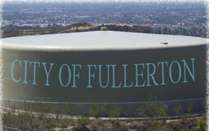
City of Fullerton’s Water System, cont.
10 Wells (oldest drilled in 1927)
6 Active MWD Connections (soon to be 7)
14 Booster Stations
67.5 Million Gallons Storage Capacity
21.3 MGD Average Daily Water Consumption
36.0 MGD Peak Demand
Over 420 Miles of Pipeline (over half of which exceed useful life)
Notes:
How do we provide that water to our customers?

Slide 4
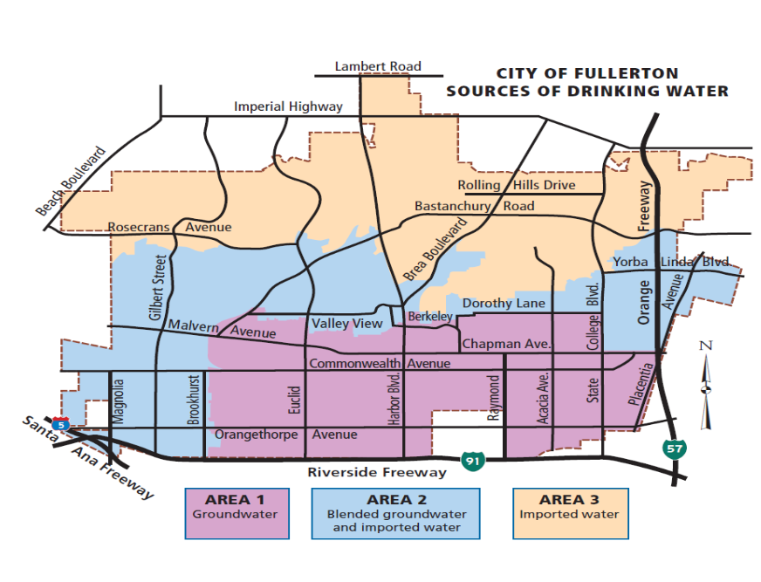
Fullerton’s Sources of Water
The City relies on a combination of imported water and local groundwater to meet its water needs.
75% groundwater
25% imported
The City partners with two primary agencies
Orange County Water District (OCWD) – Groundwater
Metropolitan Water District of Southern California (MWD) – Import Water
Goal is to provide a safe and reliable water supply that will continue to serve the community in periods of drought and shortage.
Groundwater is local, reliable, and least expensive source of water
Notes:
Where do we get our water?

Slide 5
PFAS – “Forever Chemical”
PFAS = Per- and Polyfluoroalkyl Substances (family of 1000s of chemicals)
PFOA = Perfluorooctanoic Acid (C₈HF₁₅O₂)
PFOS = Perfluorooctane Sulfonate (C₈HF₁₇O₃S)

Slide 6
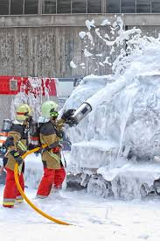
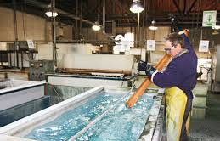
PFAS Used Across A Wide Range of Industries and Consumer Products: Water/Oil/Stain Resistant
Notes:
Coined the “forever chemical,” PFAS is composed of a bond between carbon and fluorine which makes it functionally stain resistant and water repellant.
The strength of this bond makes it nearly impossible to break down. This means that the chemicals don’t go away quickly when they get into the environment.
Linda Birnbaum, Director of the National Toxicology Program (NTP) testified to the strong nature of the bond in the Senate reporting, “the carbon fluorine bond is one of the strongest ever created by man, and it’s rarely seen in nature.”

Slide 7
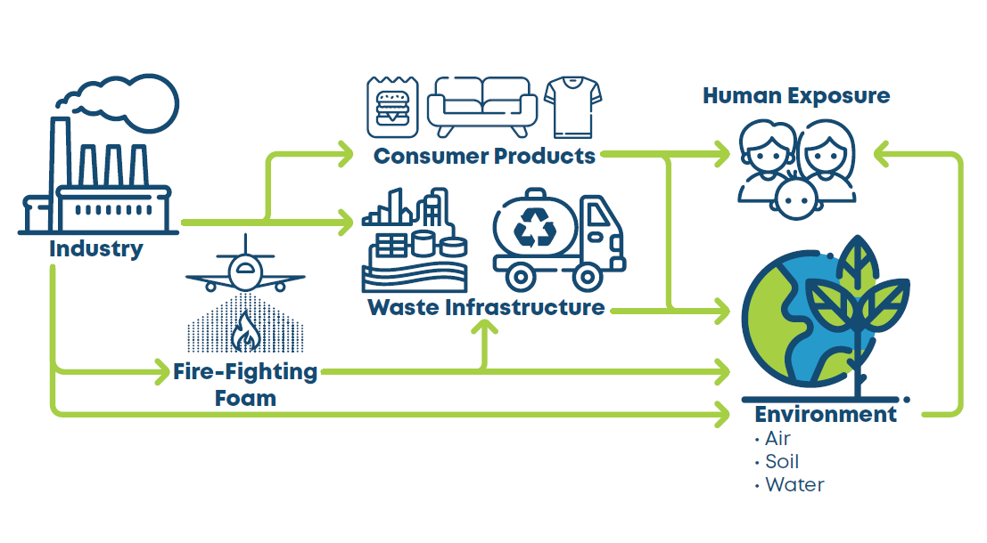
Notes:
According to the Agency for Toxic Substances and Disease Registry (ASTDR), some studies in humans suggest that certain PFAS may be associated with:
Fertility issues and pregnancy-induced hypertension/preeclampsia
Increased cholesterol
Changes in the immune system
Increased risk of certain cancers (e.g., testicular and kidney cancer)
Changes in fetal and child development
Liver damage
Increased risk of thyroid disease
Increased risk of asthma
Although some studies have reported these possible health outcomes, the overall scientific and medical evidence is currently inconclusive. Learn more about the Agency for Toxic Substances and Disease Registry.

Slide 8
PFAS Exposures

Slide 10
Division of Drinking Water (DDW)
In July 2018, DDW established interim drinking water Notification and Response Levels for PFOA and PFOS.
NOTIFICATION LEVELS (NL) - require agencies to notify the governing body (NL lowered in late August 2019)
RESPONSE LEVELS (RL) – DDW recommends removal of the water source from service or provide treatment.
April 2019 – DDW sent monitoring orders to 200 water systems across CA to test for PFOA and PFAS. 12 agencies in OCWD area including Fullerton.
Wells were selected on the basis of proximity to either landfills, municipal airports or past detections of PFAS in wells.
Notes:
When Did OCWD First Detect PFOA and PFOS in the Groundwater?
From 2013-2015, the Orange County Water District (OCWD) performed testing for the local Orange County
water retailers it serves as part of the Environmental Protection Agency (EPA) Third Unregulated Contaminant
Monitoring Rule (UCMR3). The results of this testing were provided to the EPA, the State Water
Resources Control Board (SWRCB) Division of Drinking Water (DDW) and individually to the 19 water retailers
OCWD serves. The UCMR data serves as a primary source of occurrence and exposure information that
EPA uses to develop regulations.
What is the EPA Doing About PFOA and PFOS?
In 2009, EPA published provisional health advisories for PFOA and PFOS. As science and technology
advanced, in May 2016, it replaced the provisional advisories with a lifetime health advisory, including the
most sensitive populations, of a combined 70 parts per trillion (ppt). Based on preliminary information from
EPA, 63 water suppliers in the United States detected PFOA and PFOS in their drinking water supplies.
Twenty-six of these water systems are located in California. EPA's health advisories are non-enforceable
and non-regulatory and provide technical information to states’ agencies and other public health officials
on health effects, analytical methodologies and treatment technologies associated with drinking water
contamination. EPA is moving forward with the enforceable Maximum Contaminant Level (MCL) process for
PFOA and PFOS. It is also gathering and evaluating information to determine if regulation is appropriate
for a broader class of PFAS. While EPA is responsible for the safety of drinking water, the FDA regulates
bottled drinking water. EPA standards are more stringent regarding the regulation of public drinking water.

Slide 11
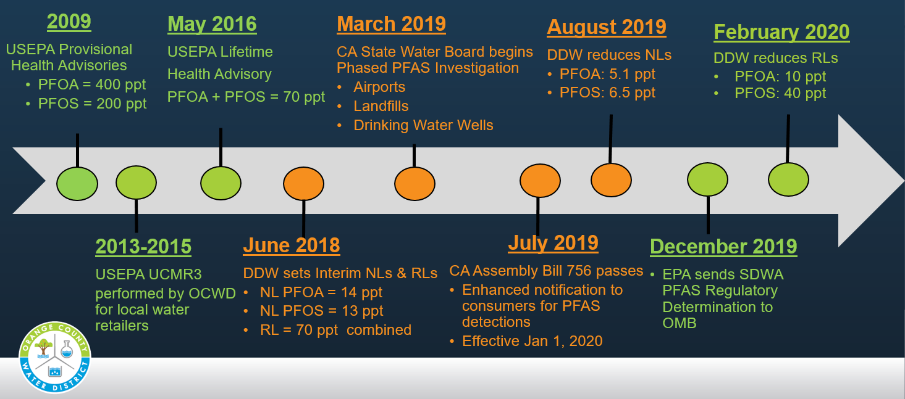
EPA and CA Regulatory Timeline

Slide 12
Division of Drinking Water NLs & RLs
Based OEHHA review of recent National Toxicology Program (NTP) study data
“Lowest observed effect”/1 – in – 1 million cancer risk estimate
PFOA = 0.1 ng/L (pancreatic cancer endpoint)
PFOS = 0.4 ng/L
Standard | PFAS Compound | Previous | Revised 8/19 Revised 2/6/20 | Adjustment from “lowest observed effect” level
Notification Level | PFOA | 14 ng/L | 5.1 ng/L | Reliable Detection Limit
Notification Level | PFOS | 13 ng/L | 6.5 ng/L | Reliable Detection Limit
Response Level | PFOA | 70 ppt combined | 10 ng/L | 100x 1-in-1-million cancer risk
Response Level | PFOS |  | 40 ng/L | 100x 1-in-1-million cancer risk

Slide 13
PFAS Testing of Fullerton’s System
DDW requested testing of 5 of Fullerton’s 10 wells
Testing performed on 4 wells (one is currently out of service)
Notes:
Wells exceeded notification levels – necessary notification has been provided

Slide 14
Fullerton Wells – Division of Drinking Water Testing Orders - 2019
Testing Orders:
Well 3A
Well 4 (not in service)
Well 5
Well 6
Well 8
Forebay – blended water delivered to customers

Slide 15
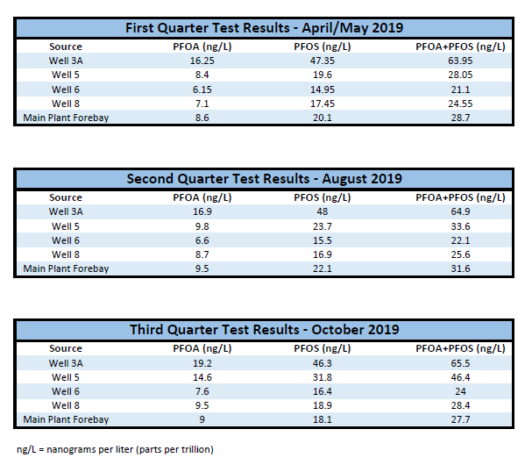
PFAS Testing of Fullerton’s System
Initial Response Level
PFOA and PFOS – combined
70 parts per trillion (ppt)
February 6, 2020
Division of Drinking Water
Revised Response Levels
PFOA – 10 ppt
PFOS – 40 ppt
Notes:
Wells exceeded notification levels – necessary notification has been provided

Slide 16
Impacts and Actions
Continue working with OCWD and DDW to Develop Groundwater Treatment
Redirected capital funds for activation of defunct Import Water Connection – almost complete
2/6/2020
Well 3A – Removed from service based on new Response Level
Wells to be tested

Slide 17
Budget and cost concerns
Annual cost for water (50% of our groundwater)
Up to $5M per year – maybe more
Used for import water
Does not build or operate the project
Capital costs – $10.9M or more
Ongoing operational costs - TBD
Notes:
Customer Impacts
$156.25 - $5M to $234.38 - $7.5 M

Slide 18
Budget and Cost Concerns, cont. Thanks to Orange County Water District Board, Staff, and Other Groundwater Producers

Slide 19
Public Trust Issues
“We drink the filtered water from the fridge but it makes me sick to my stomach to think that I have been giving my children contaminated water”
email from concerned mother
Personal health and safety
Is my water safe to give my children?
Noticing if continue to serve water
Other contaminants & system design
Zones of the City – Disadvantaged Community (DAC) receives water from these sources
Water Rates
Over a year long process to raise rates that would fund very specific improvements
Use of funding for other purposes

Slide 20
Other potential items
Hazardous Waste Potential
Ability to obtain grants with Response Level vs MCL
Staffing and training
Public education and understanding

Slide 21
Next Steps for Fullerton
Activate Import Water Connection for eastern side of City
Continue working with OCWD and Division of Drinking Water on testing and treatment options
City Council consideration of situation and options – including rate increase for import water
Continue public outreach and community meetings

Slide 22
Advice for other retailers
Stay involved
Work with partner organizations
Engage with Regulators and Legislators – ensure broader approach to future contaminants

Slide 23
Thank you
Meg McWade, City of Fullerton
mmcwade@cityoffullerton.com

