Slide 1
Lighting Water Solutions
UWI Conference: . . . And the beat goes on . . . Time to change the beat
February 24, 2023, Palm Springs

Slide 2
Trends in the Utility Management Column
Visioning: One Water – all for one, one for all
Operations: Luddite culture shift to technological explosion
Organizational resiliency: aligning organizational environment with organizational and social resiliency
Organization transformation: Human Capital Ecosystem Management

Slide 3
Vision shift to One Water view (US Water Alliance)
The mindset that all water has value, from the water resources in our ecosystems to our drinking water, wastewater, and stormwater.
A focus on achieving multiple benefits, meaning that our water-related investments should provide economic, environmental, and societal returns.
Approaching decisions with a systems mindset, one that encompasses the full water cycle and larger infrastructure systems.
Utilizing watershed-scale thinking, action that respects and responds to the natural ecosystem, geology, and hydrology of an area.
Intervening with right-sized solutions to achieve the desired outcome.
Relying on partnerships and inclusion, recognizing that real progress will only be made when all stakeholders have a seat at the table.

Slide 4
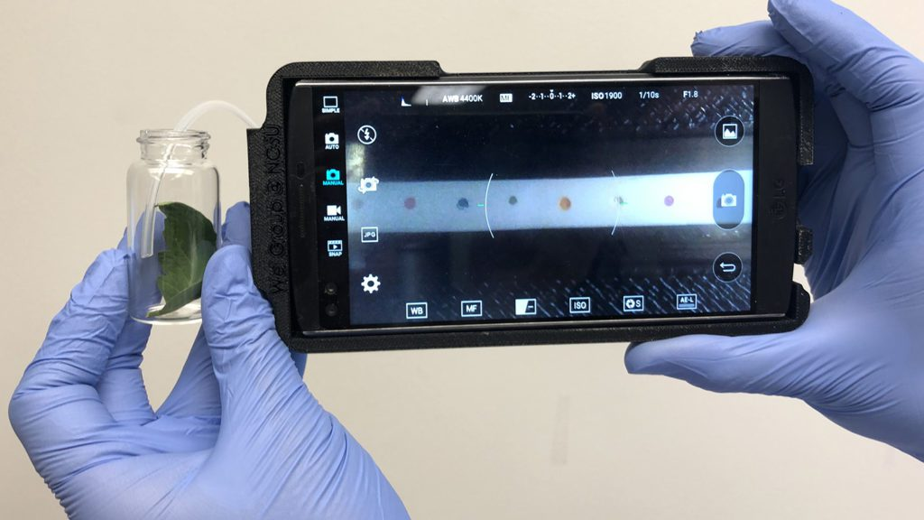
Utility culture
Changing culture in the face of a technological explosion is an imperative all utilities could learn, and there’s plenty of examples where a luddite culture failed to grasp the demands of customers. (Roger Smith, General Manager, Oracle Energy and Water)
This Photo by Unknown Author is licensed under CC BY-SA

Slide 5
Utilities Policies Internationally (Elsivier, Dec 2022)
The water sector has signalled the need to advance organisational and social resilience efforts.
There is a lack of understanding of whether the organisational environment in water utilities is conducive to organisational resilience.
There is a need to broaden the cognitive frame of utilities to account for flexible concepts of enhanced sense-making.
Categories of organisational silos and a set of cultural attributes contribute to and impact organisational resilience.
Interventions are needed to develop the cognitive, behavioural, and contextual properties of utilities that support organisational resilience.

Slide 6
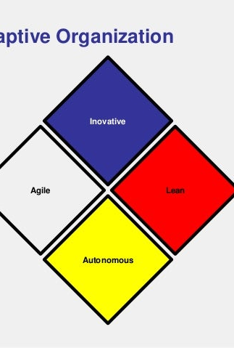
Organization Transformation: Building an adaptable organization to sustain performance
We are in a world of continuous transformation. Organization transformation can occur at the enterprise, business unit, or functional level.
As employers and their providers navigate the Human Capital ecosystem, they face a variety of challenges that require critical change management solutions.
These transformations often include adopting new technologies, increasing sustainability, changing the organization’s culture, modernizing specific functions, and adapting its very structure through organizational design.
(Deloitte)

