Slide 1
SCV Water Matt Stone Urban Water Institute February, 2023

Slide 2
SCV Water Story
Merged 4 Water Providers in 2018
Facts and Figures
2019 Strategic Plan Guided Much of Our Progress
Recently Completed Fifth Year of Service
9 Member Board transition
Notes:
A merger of 1 wholesaler (Castaic Lake Water Agency), and 3 retailers (Newhall County Water District, Santa Clarita Water Division, and Valencia Water Company) Unified facilities, resources, assets, staff, and governance. Scaled to local watershed.
73,000 active retail services. 295,000 people in service area
About 50/50 Import and Local
-SWP Table A, BVRRB Supply Contract, Semitropic Water Bank, Rosedale Water Bank
-2 Treatment Plants, Backbone Large Diameter regional conveyance system
Alluvial and Saugus Aquifers
-45 wells (36 Alluvial, 9 Saugus)
-History of GW contamination– perchlorate and voc’s,
-5 GW treatment systems (and counting)
Recycled Water
Strategic planning process in 2019 (updating later this year)
Completed fifth year of service
Board transition from original 15 to single 9 member elected Board

Slide 3
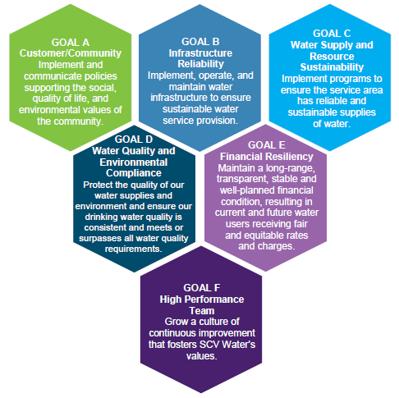
Vision, Mission, Goals
Vision:
Exemplary water management for a high quality of life in the Santa Clarita Valley.
Mission:
Providing responsible water stewardship to ensure the Santa Clarita Valley has reliable supplies of high quality water at a reasonable cost.
Notes:
6 Overarching Goals in the Strategic Plan
A – Customer and Community B – Infrastructure Reliability
C – Water Supply and Resource Sustainability
D – Water Quality and Environmental Compliance
E – Financial Resiliency
F – High Performance Team
In a recent review of the goals and objectives identified, we have accomplished the majority of them, and made significant progress on most that have not been completed We plan to update the plan and look ahead again this year But… despite the best plans…

Slide 4
The Unexpected Inevitably Happens
PFAS Response Level Impacts Numerous Wells
EPIC Drought – 15%/5%/5%
COVID-19
Supply Chain Challenges
Inflationary Pressures
New Mandates
Notes:
The unexpected inevitably happens!
For this panel, I thought the intersection of two (or three) of those unexpecteds would illustrate how the things you did do to plan for other reasons, can sometimes make a big difference.
In 2019 sampling orders led to the discovery of PFOA and PFOS in some of our wells. We decided to sample all of them so we would know what was there and start planning for the worst case before a revised Response Level was issued by the Division of Drinking Water. We also started to triage which wells could have treatment added the fastest, with the least potential for site complications, and the greatest restoration of supply in the most helpful locations in the system. We also accelerated planned system interconnects to improve interoperability. We started treatability bench scale studies of different treatment media, formed a PFAS Strike Team of staff and consultants, and launched the design of the first location. We also pre-ordered vessels for a first treatment plant to restore 3 wells to service.
In 2020, that revised RL knocked out 22 wells. And we had a 15% State Water Project Allocation. In late 2020 our first PFAS plant went online. Our second went online

Slide 5
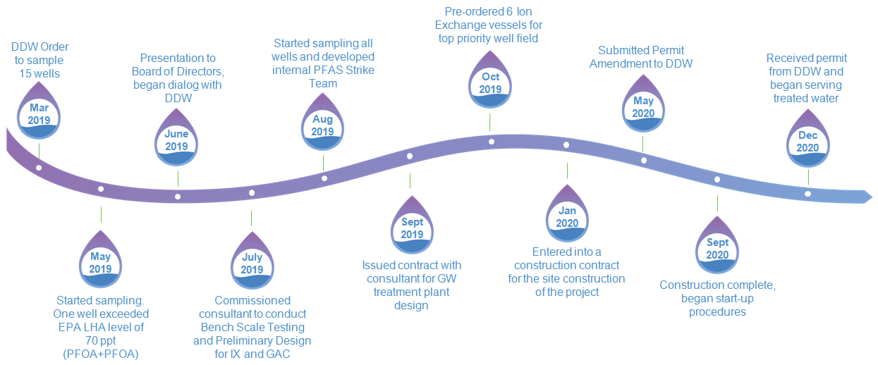
SCV Water PFAS Timeline
Notes:
In March 2019 sampling orders led to the discovery of PFOA and PFOS in some of our wells. We decided to sample all of them so we would know what was there and start planning for the worst case before a revised Response Level was issued by the Division of Drinking Water. We also started to triage which wells could have treatment added the fastest, with the least potential for site complications, and the greatest restoration of supply in the most helpful locations in the system. We accelerated planned system interconnects to improve interoperability. We started treatability bench scale studies of different treatment media, and formed a PFAS Strike Team of staff and consultants, and launched the design for the first location. We also pre-ordered vessels for a first treatment plant to restore 3 wells to service.
In early 2020, that revised RL knocked out 22 wells. And we had a 15% State Water Project Allocation. In December 2020 our first PFAS plant went online. In 2021 the SWP allocation as 5%, and in 2022 it ended up at 5%. Water we had banked for future dry years was instrumental in helping us to meet demand.

Slide 6
PFAS Impacts and Drought Response
One Staff
Optimize 4 Water Systems
Optimize Resource Strategy
Ultimate Team Building
One Board – Decisions, Budgeting, Grants
The Upshot? Fortune Favors the Prepared (even when you didn’t prepare fully for THAT).
Notes:
What went right?
A single staff was probably better positioned to plan and direct the needed work and resources to respond to both situation in a coordinated manner.
The four systems strengths helped adapt to the conditions. Water banking investments made now, for many years in the future, proved to be more valuable sooner then envisioned.
It was the ultimate team building experience for our staff – engineering, water resources, finance, water quality and operations, public information, grants, CEQA, permitting, etc. With One Board we were better able to get critical early decisions and commitment of resources.

Slide 7
How Does This Inform New Generational Investments in Reliability?
We are on the cusp of big investments in conveyance, surface and groundwater storage, local resources, and conservation.
Water quality is going to get ever more complex and expensive.
Energy transition has some difficult to predict outcomes, but we are launching.
Climate change factors into every new resource investment.
Project viability and dependability of project partners matters.
Either/or is a false dichotomy and a temptation to not take action.
Economics and cost will matter. The cost of chronic shortages or catastrophic failure must also be considered.
Diversified early investments may spare us from mayhem.
Notes:
We are on the cusp of big investments in conveyance, surface and groundwater storage, local resources, and conservation.
Water quality is going to get ever more complex and expensive.
Energy transition has some difficult to predict outcomes, but we are launching.
Climate change factors into every new resource investment.
Project viability and dependability of project partners matters.
Either/or is a false dichotomy and a temptation to not take action.
Economics and cost will matter. The cost of chronic shortages or catastrophic failure must also be considered.
Diversified early investments may spare us from mayhem.

Slide 8
Bonus Slide SCV Water 5-year Anniversary Video
https://youtu.be/Jd0lySEHd0g

