Slide 1
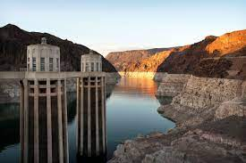

Slide 2
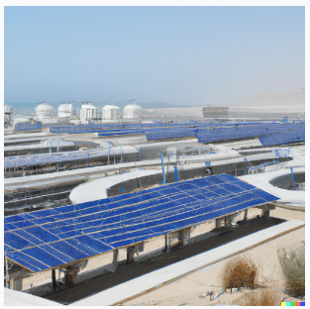
Using tools like ….
A slide rule
Calculators
Fortran
Spread sheets
MATLAB
ChatGPT
To estimate the yield and utility of solar power

Slide 3
How do you solve the Colorado River water problem?
The Colorado River water problem is a complex issue that requires a multi-faceted approach involving various stakeholders, including federal and state governments, tribal communities, water users, and conservation groups. Here are some strategies that could be considered:
Increase Water Conservation: One way to address the water shortage issue is to increase water conservation efforts. This could include incentivizing households and businesses to reduce their water usage, implementing efficient irrigation systems for agriculture, and promoting the use of drought-resistant crops.
Manage Water Demand: Managing water demand is also important in addressing the water shortage. This could involve the implementation of water pricing policies to encourage conservation, reducing water usage in the landscaping industry, and promoting the use of recycled water for non-potable uses.
Increase Water Supply: Increasing the water supply is also an option, which could be achieved through building new water infrastructure, such as desalination plants, or using innovative technologies to recycle water.
Implement Water Trading and Banking Systems: Water trading and banking systems could also be implemented to allocate water more efficiently and equitably among different users. This could involve allowing farmers to sell their water rights to urban areas or creating a market where water users can trade or exchange their water rights.
Foster Collaborative Solutions: Finally, fostering collaborative solutions among the various stakeholders involved in the management of the Colorado River is key. This involves engaging in open dialogue, actively seeking solutions that benefit all parties, and implementing policies that are based on sound scientific research.
Overall, the Colorado River water problem requires a comprehensive and collaborative approach that considers both short-term and long-term solutions to address the water shortage and promote sustainable water management practices.

