Slide 1
A new Drumbeat!
Direct Potable Reuse
Jennifer West, Managing Director
WateReuse California
February

Slide 2
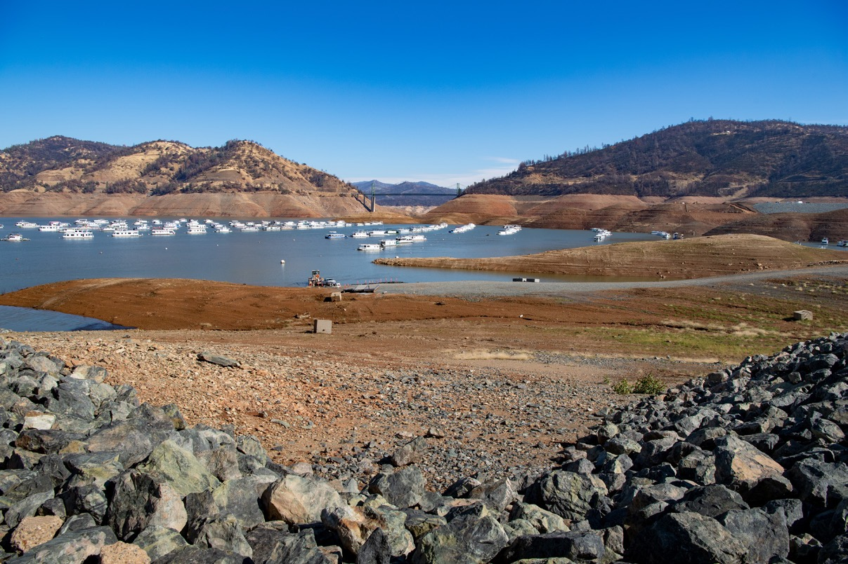
CALIFORNIA’S WATER SUPPLY STRATEGY
Adapting to a Hotter, Drier Future
New Goals for Recycled Water
800,000 AFY by 2030
1.8 MAF by 2040
Water Board “Strike Team” assessing where the state will be in meeting these goals and challenges – beyond funding!

Slide 3
WSS Recycled Water Goals
1.8M
AFY
2040
Thank you DWQ, Water Board for the graphic!
2030
800K
AFY
732K
AFY
2021

Slide 4
2019 - 2021 Recycled Water Use Category
Acre-feet per year (AFY)
AFY rounded to the nearest 1,000
2019 - 2021
Agricultural Irrigation
Industrial & Commercial Application
Potable Uses
Landscape & Golf Course Irrigation
Geothermal Energy Production
Other Non-Potable Uses

Slide 6

The Path to Direct Potable Reuse

Slide 7
Direct Potable Reuse Adoption Timeline
April: Release of New DPR Draft
April 45 day comment period -- board workshop
Dec. 31 Board adopts regulations
Summer: Expert panel approves regulations

Slide 8







DPR Pathogen Control
Groundwater
Recharge
Surface Water
Augmentation
Direct Potable
Reuse
Can only drop below these levels 10% of the time. Most design to exceed these levels
Virus
12
10
10
12 to 14
10 to 12
10 to 12
20
14
15
20
14
15
Giardia
Acceptable operation for 24 hours
within 4-log buffer
16
10
11
Cryptosporidium
Within 60 minutes, notify State Board and each public water system
Notes:
Because of the challenging nature of pathogen detection, particu
larly in highly treated water, the drinking water industry has histori-
cally relied on a log removal value (LRV) framework to ensure adequate
protection of public health (Pecson et al., 2015).

Slide 9
Expand DPR by Using New Pathogen Research
  Use new dataset from DPR Research “DPR 2” and other high quality historical datasets to develop removal requirements
  Change minimum log removal targets for pathogens from:
  16/10/11 13/10/10
  13 log removal equates to 99.999999999% removal
Virus

Slide 10

Need Broad Alternatives Clause
Requirement
Alternative
Demonstration
Independent advisory panel
Public Meeting
Written Approval
Need broad alternative clause same as other potable reuse regulations: Now only applies to chemical requirements
Allows DPR regulations to adapt over time to new research and project experience
Requires equivalent or better levels of performance to protect public health
Notes:
There are no projects in the ground so how do we know what flexibility we may need for the future. For example pathegen, source control monitoring and staffing

Slide 11
Questions?

