Slide 1
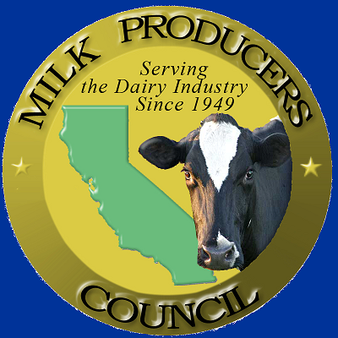
Urban Water Institute Spring Water Conference Impact of Water Supply Constraints on the California Dairy Industry
Geoffrey Vanden Heuvel
Director of Regulatory and Economic Affairs,
Milk Producers Council
February 23, 2023

Slide 2
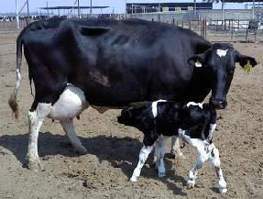
Fun Facts About Milk and Dairy Cows
Real milk comes from cows
A cow needs to have a calf to start producing milk

Slide 3
Fun Facts About Milk and Dairy Cows
A calf:
Weighs about 100 pounds at birth
Walks and starts nursing its mother at about 1 hour after birth
Gains about 2 pounds per day, and is weaned at about 75 days of age
Is ready to breed at 15 months old
The gestation period of a cow is 9 months
So at 2 years old, a cow is ready to have her first calf and start producing milk

Slide 4
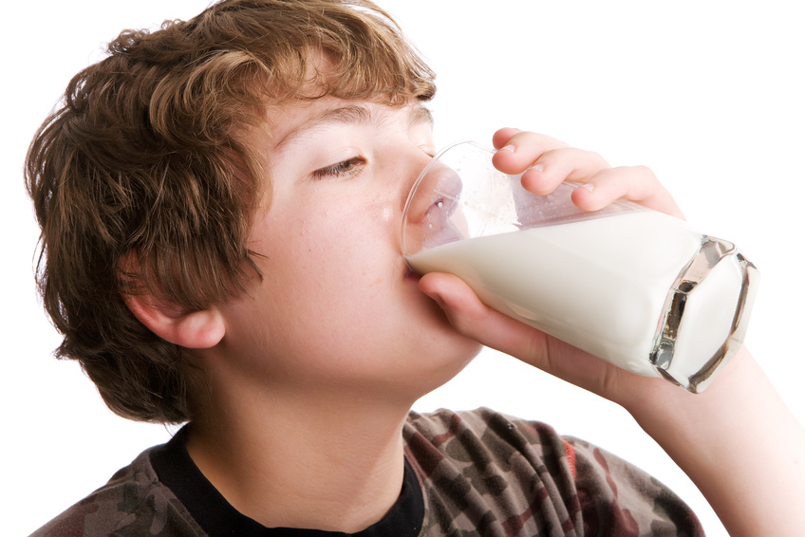
What Is Milk Made Of?
“Average” Holstein cow milk is made up of:
3.5% butterfat
3.2% protein
5% lactose
0.5% minerals
87.8% water

Slide 5
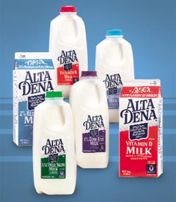
What Is Milk Made Of?
So in the grocery store:
“Whole milk” is 3.5% butterfat
“Lowfat milk” is 2% butterfat
“Skim milk” is 0.25% butterfat or less

Slide 6
Cheese
About 45% of California’s milk is manufactured into cheese
Cheese is really the binding together of the protein in milk, 80% of which is casein (or glue), with the butterfat in milk
So when you make cheddar cheese, the butterfat and protein end up in the cheese, and the lactose and non-casein proteins end up in “whey”
“Eating her curds and whey…”

Slide 7
Milk and Dairy Products
Milk weighs about 8.6 pounds per gallon- the same as water
It takes about 1.16 gallons of milk to make 1 pound of cheddar cheese
We produce more than 2.4 billion pounds of cheese per year (mostly cheddar and mozzarella), which makes up about 18% of the total U.S. production of cheese
We also make about 670 million pounds of butter per year (about 33% of the U.S.), and more than 850 million pounds of milk powders per year (about 43% of the U.S.)
Only 11-14% of California’s milk is actually sold as fluid milk in the stores

Slide 8
Lactose Free Milk

Slide 9
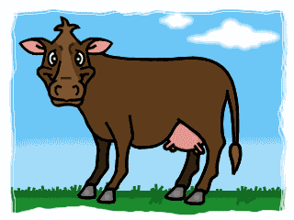
How About Chocolate Milk? Do You Know Where It Comes From?
“Bessy the Brown Cow”

Slide 10
What Cows Eat
A cow is a “ruminant” animal, which means they need a certain amount of forages in their diet
About 40% of a dairy cow’s diet needs to be forage, which consists of silages and/or alfalfa hay
Mature milking cows eat about 50 pounds of “dry matter” per day

Slide 11
California’s Dairy Industry
About 1.7 million milking cows in California on about 1,000 dairy farms generating about $7.57 Billion in annual cash receipts from milk production.
California dairy related economic activity is about $57.7 billion.
180,000 jobs depend on the state’s milk production and processing
$1.8 Billion of California dairy products are exported

Slide 12
California Alfalfa Hay Acres
2012 900,000 acres of alfalfa in California
2022 500,000 acres of alfalfa in California
700,000 horses in California eating at least 10# per head per day
1,275,000 tons of alfalfa per year are grown to feed horses. It takes at least 500,000 acre feet of water to grow that much alfalfa
The price of dairy quality alfalfa increased from $300/ton to $450/ton in the last 12 months

Slide 13
https://www.dairycares.com/sgma

Slide 14
Study Assumptions

Slide 15
San Joaquin Valley Dairy Feed Production Areas

Slide 16
San Joaquin Valley Herd Size Impacts

Slide 17
SJV Dairy SGMA Output and Jobs Impacts

Slide 18
The FIX - Wet year Supply in the North Massive Storage in the Central Valley Dry Year Supply for Southern California

Slide 19
The Fix – Increase Wet Year Water Supplies for Recharge
Environmentally friendly water diversions in the delta are the key to getting more water into the San Joaquin Valley and Southern California
This is the linchpin of the Water Blueprint for the San Joaquin Valley Plan.

Slide 20
Subsurface diversions

Slide 21
How would it work in the Delta

Slide 22
Possible Locations of Infiltration galleries

Slide 23
Pilot Project to Fine tune the technology

Slide 24
Southern San Joaquin Water Resiliency Project Bi-directional conveyance

Slide 29
New Water from eliminating fish impacts

Slide 30
Other factors impacting the California dairy industry

Slide 31
SGMA Impacts to California Dairy Industry

Slide 32
San Joaquin Valley Study Region

Slide 33
Estimated Direct SJV Dairy SGMA Impacts

Slide 34
Key Findings

