Slide 1

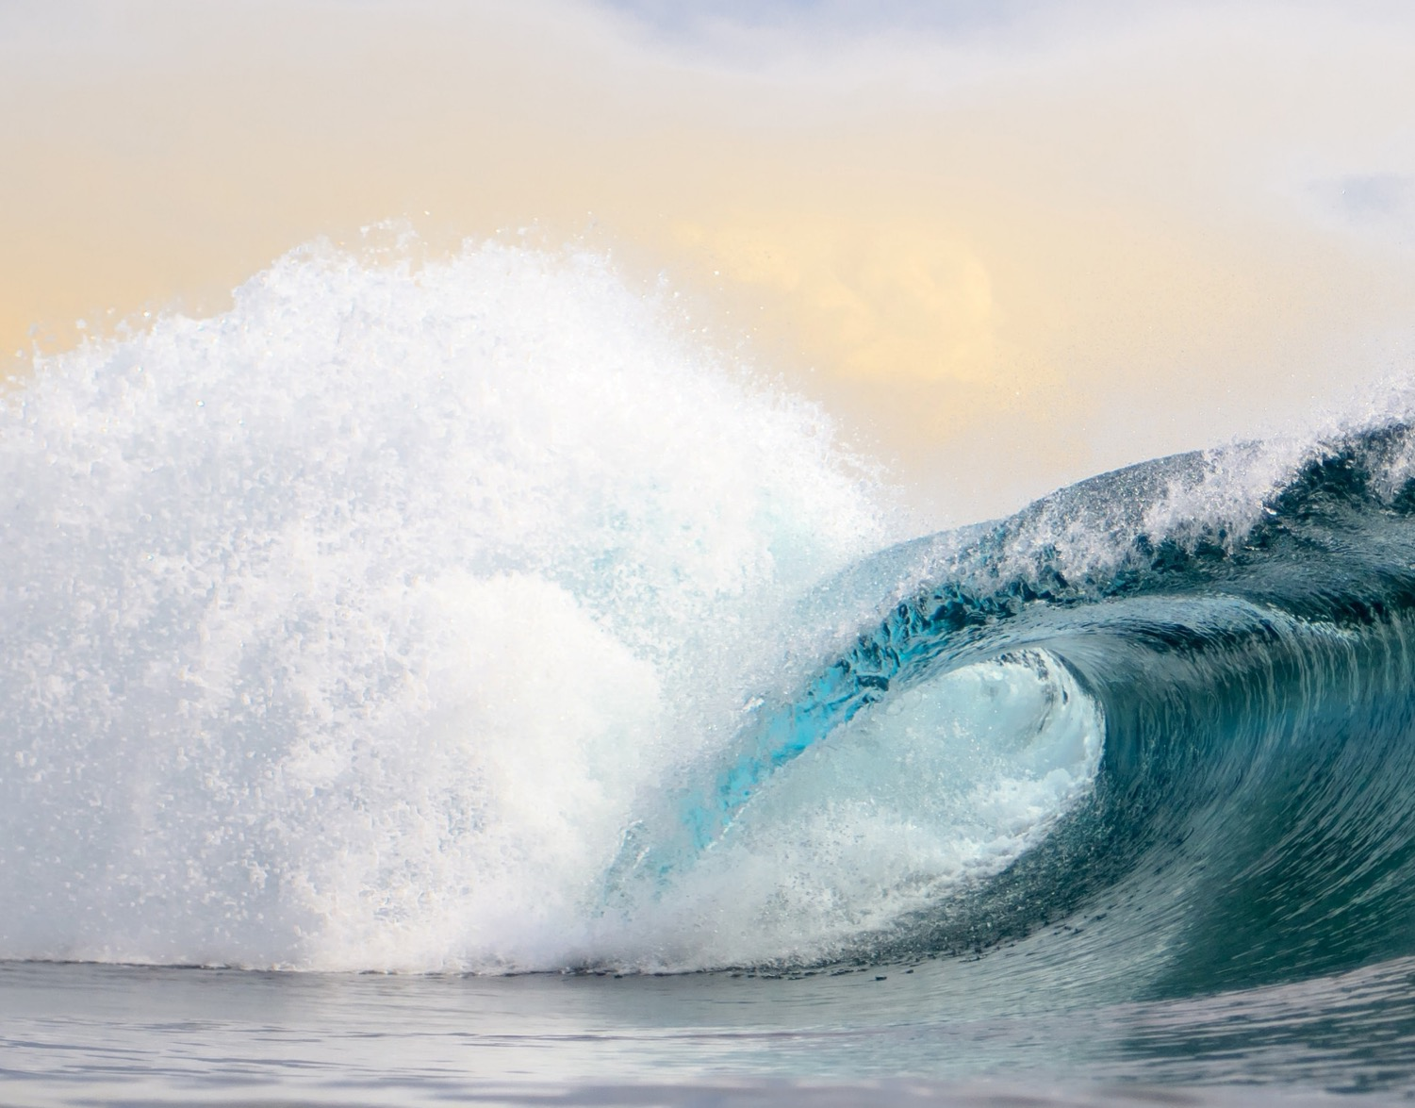
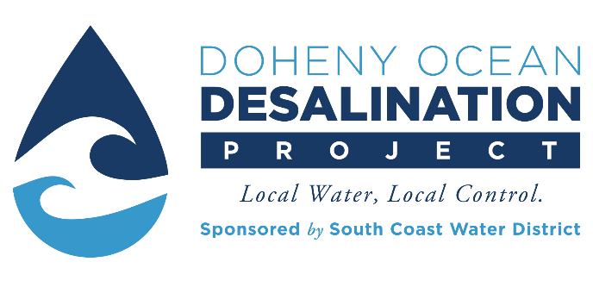
Doheny Ocean Desalination Project
Urban Water Institute’s Spring Conference
February 23, 2023
Rick Shintaku, General Manager
South Coast Water District

Slide 2
Agenda
South Coast Water District
Need for the Project
Project Description
Project Permitting

Slide 3
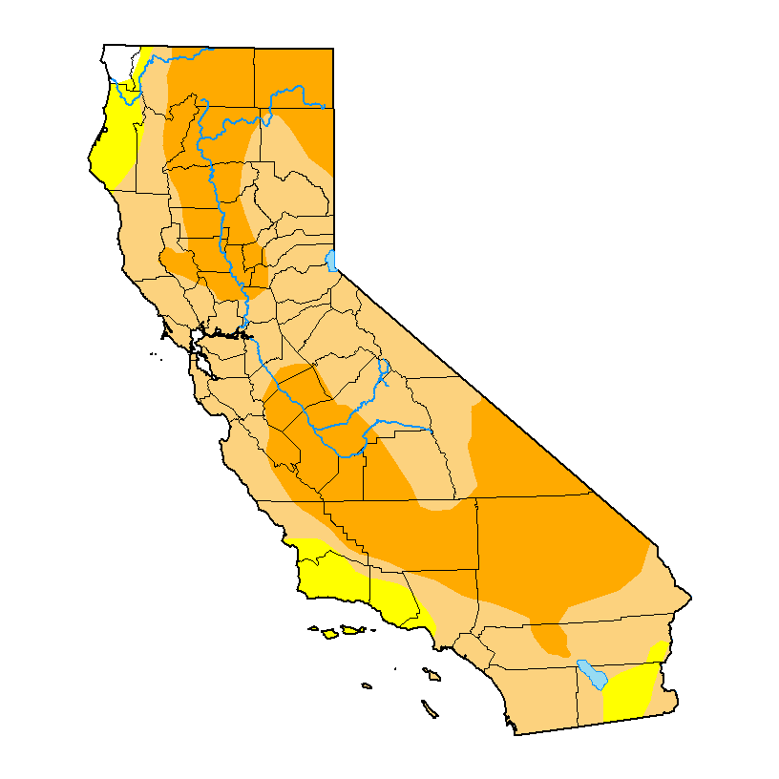
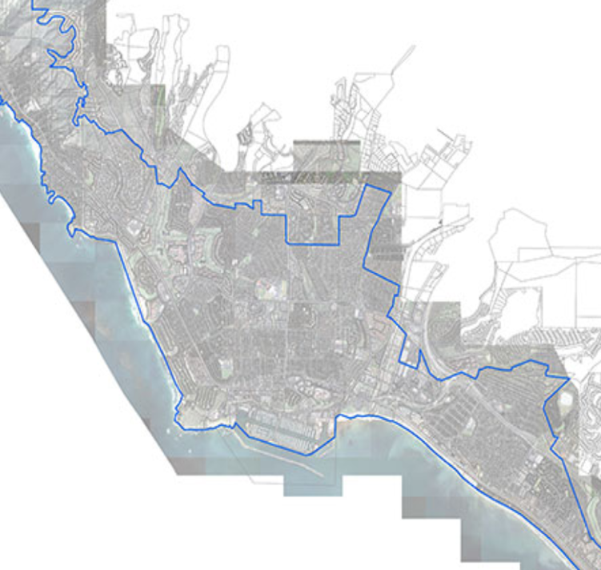
South Coast Water District (SCWD)
Water, Recycled Water,
and Wastewater Public Agency serving:
  South Laguna Beach
  Dana Point
  Portions of San Clemente
  Portions of San Juan Capistrano
  ~40,000 Residents
  1,000 Businesses
  Over 2 Million visitors per year
South Laguna Beach
San Juan Capistrano
Dana Point
San Clemente
Doheny Ocean Desalination Plant Project Site
Notes:
Critical water supply situation:
SCWD currently provides potable water, recycled water, and sewer services to approximately 40,000 residents, 1,000 businesses, and over 2 million visitors per year
SCWD is currently relying on imported water for approximately 85 to 100 percent of its drinking water needs
Significant drought and/or emergency could interrupt supplies for extended periods
Doheny Ocean Desalination Project is in unique position to directly relieve water supply pressure for the entire South OC Region
Reducing imported water supply reliance provides necessary water reliability during seismic emergency and extended drought
State Parks can play a critical leadership role in the Project
SCWD Governance
Public agency formed by popular vote and owned by the people it serves.
As a special district, the District is different from similar agencies because it operates independently of county government, answering only to the State of California and the people it serves.
Board of Directors is elected by voters of the District and is charged with the responsibilities of establishing policies and rates, constructing and maintaining facilities, and any other decisions necessary to provide water and sanitation services to the District’s customers.
Must comply with the California Constitutional provisions added by Proposition 218 when setting customer rates, and all rates must reflect the actual cost of service.
As a public agency, the District is constitutionally prohibited from making a gift of public funds.
It is critical that rates are reflective of service level needs, transparent. The District has done extensive studies to determine the economic feasibility of desalinated water and to estimate the likely cost of the Project. This has included peer-reviewed cost estimates and detailed cost assumptions.

Slide 4
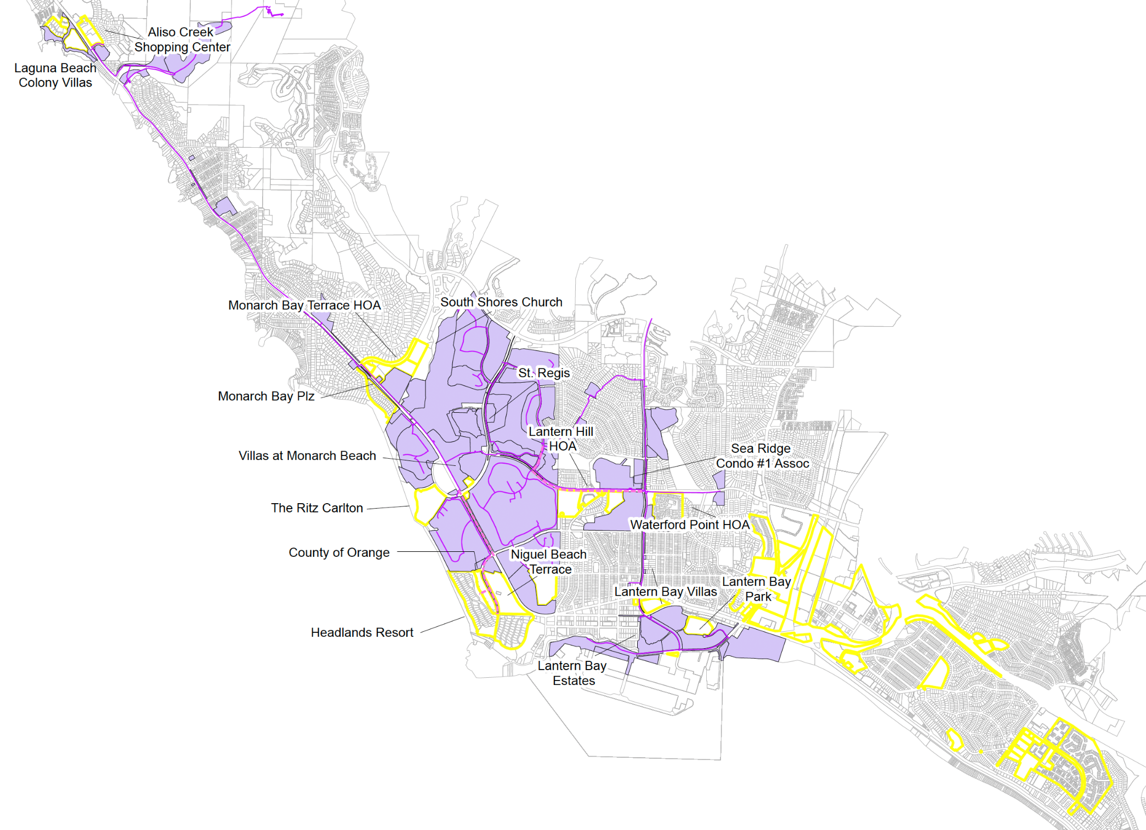
SCWD’s Commitment to Maximizing Recycled Water Since the 1980’s
LEGEND
    Own two Advanced Water Treatment facilities
    Currently recycle 70% of Wastewater at Coastal Treatment Plant (CTP) with plans to achieve 100%
    Since 2015, 37 site conversions (i.e., HOAs, commercial site, shopping plaza) from potable to recycled water use
Proposed 8” Lines
RW Pressurized Main
Existing RW Area
Future Recycled Area
Parcels
South Coast Water District – SCWD.ORG/DohenyDesal

Slide 5
SCWD’s Commitment to Conservation and Local Resources
Brackish Groundwater Recovery Since 2007
    Produces 700 to 900 AFY of potable water, during Normal & High Rainfall Years
Water Use Efficiency
SCWD Current indoor residential use is ~50 gpcd, meeting the State goal of 55 gpcd
SCWD utilizing AMI (Advanced Metering Infrastructure) and AMR (Automated Meter Reading) to further minimize customer water waste
Water Loss Control
    4% water system loss is among best in the State
    Lowest system water loss in all of Orange County
    In Sept. 2016, SCWD’s Board Committed to 20% of SMWD’s Stormwater Capture (Rubber Dam) Project

Slide 6
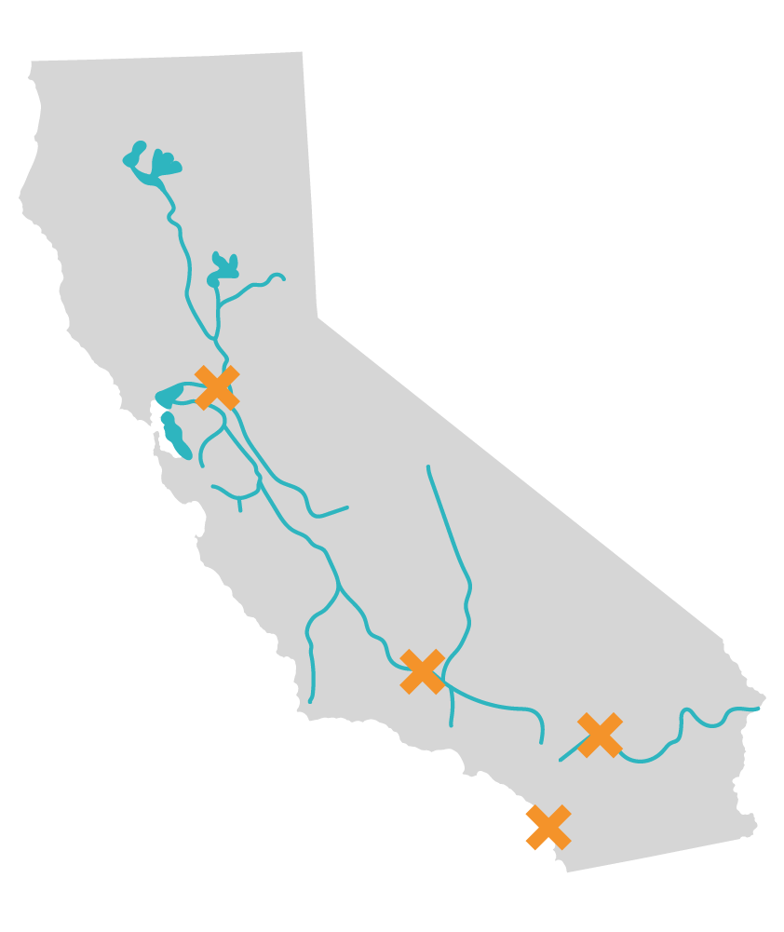
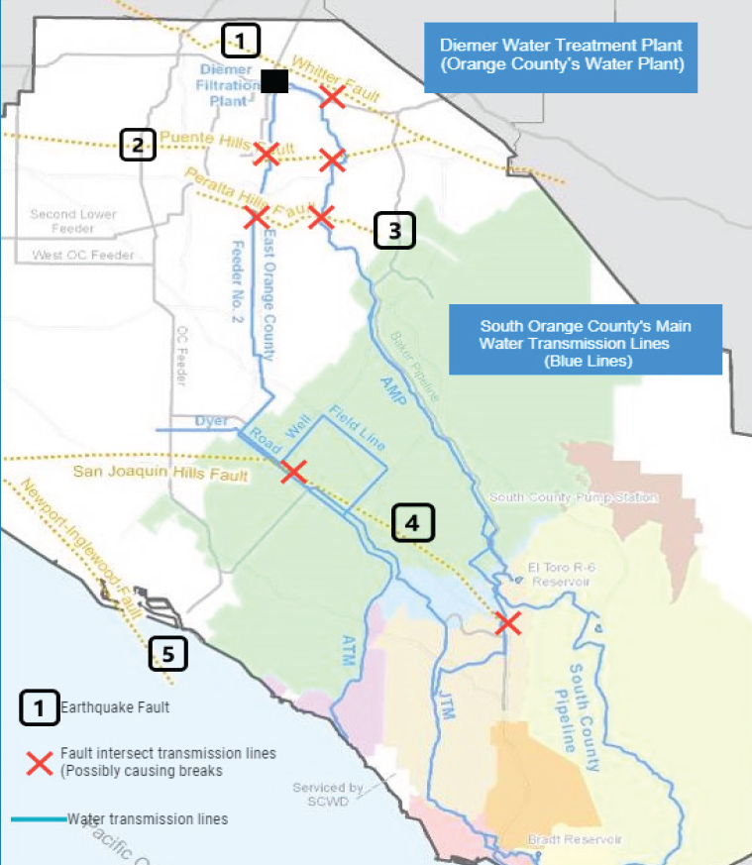

Water Reliability for Seismic Risks
Lake Shasta
Lake Oroville
Sierra Nevada Mountains
Snowpack
Los Angeles
Aqueduct
Colorado
River
Aqueduct
Potential Earthquake Locations
South OC – 90% Dependent on
MWD Imported Supply

Slide 7
SCWD’s Water Supply Portfolio
Doheny Project would provide up to 5 Million Gallons per Day (MGD)
Metropolitan Water District (MWD) Imported
Local Groundwater
Recycled Water
Doheny Ocean Desalination
Indirect/Direct Potable Reuse (IPR / DPR)
*SCWD’s Board Approved 2021 Integrated Water Resource Plan (IWRP)

Slide 8
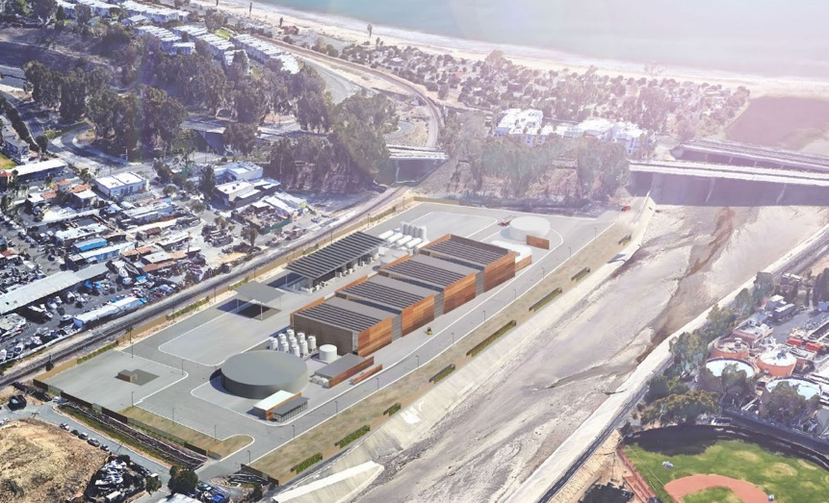
Doheny Ocean Desalination Project
Why Ocean Desalination?
System and Supply Reliability – Drought and Earthquakes
Drought Proof and Resilient to Climate Change
Sustainable Local Water at a Reasonable Cost
Up to 5 MGD of drinking water supplies
Potential Long-Term Local and Regional Benefits
Notes:
Doheny desalination will help to ensure a resilient future not affected by climate change or natural and manmade disasters.
We need to be prepared for a minimum 60-day water outage, and Doheny Desalination would provide a continuous supply – well over the 60 day supply we need.
RO technology, 10 gal of ocean water – you get 5 gallons of drinking water and 5 gallons of brine at roughly twice the concentration of ocean water

Slide 9









Project History
2007
Engineering
Feasibility Report
2018
$10M Prop 1
Grant Funding
2019 - 2020
$20M USBR
Grant Funding
2020
USEPA WIFIA
Funding
Shortlist
2022
SDRWQCB NPDES Permit Approval
2022
CA State Lands
Land Lease Approval
Stakeholder Outreach
2004 - 2013
Test Slant Well Installed, Operated and Studied at Doheny State Beach
2014 - 2016
MWD Foundational Actions Funding Program
2019
EIR
Certification
2021
Cost of Water
Analysis / IWRP*
2022
CA Coastal Commission
Conditional Approval
*SCWD’s Board Approved 2021 Integrated Water Resource Plan (IWRP)

Slide 10
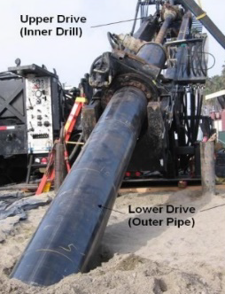
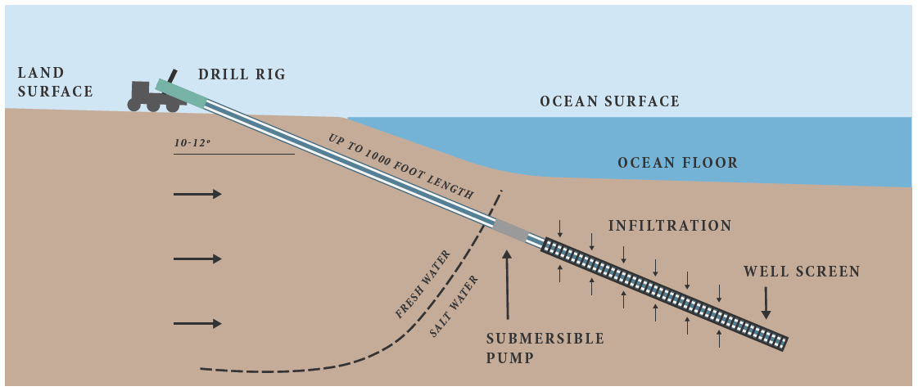
State Ocean Plan Preferred Methods: Subsurface Intake
Subsurface Water Intake – Slant Well Technology
Intake method preferred by regulators and Ocean Plan Desalination Amendment
Wells draw ocean water from below the ocean floor
Slant Wells fully buried at Doheny State Beach
Submersible pumps reduce noise
Subsurface intakes avoids all impacts to marine life
Notes:
Talking Point: Pilot testing (reference drilling image).

Slide 11
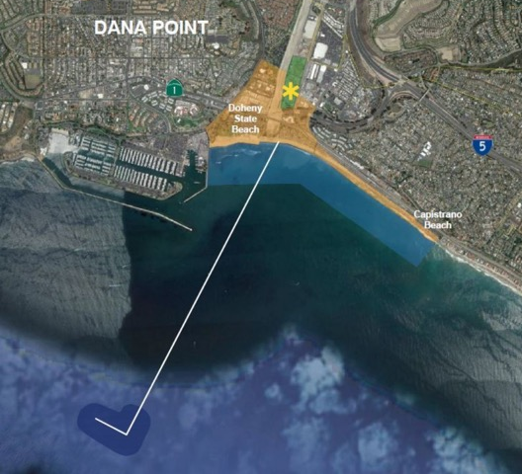
State Ocean Plan Preferred Methods: Commingled Discharge
Commingled Discharge
Brine diluted with treated wastewater through existing San Juan Creek Ocean Outfall more than two miles offshore
Blended effluent would minimize impact on coastal and marine water quality
Notes:
Talking Point: Pilot testing (reference drilling image).

Slide 12
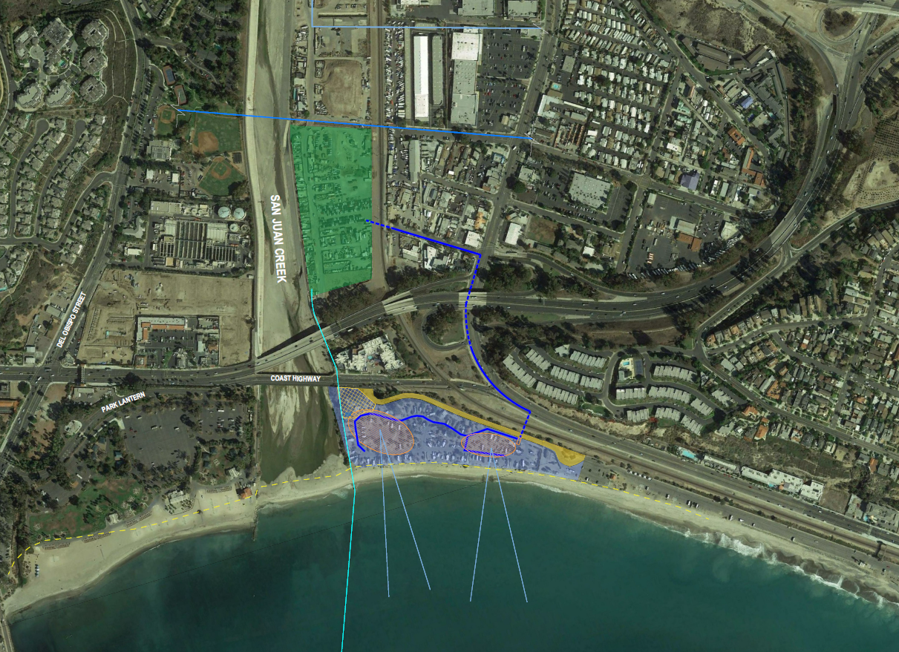
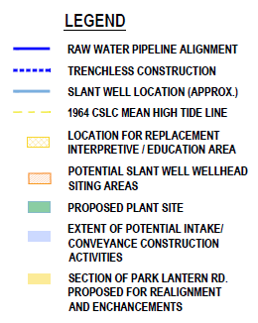
Modified Project – Reduced Footprint and Impacts
WATER IMPORTATION PIPELINE
JOINT TRANSMISSION MAIN
SCWD OWNED
FACILITY SITE
JBL WASTEWATER TREATMENT PLANT
NEW RAW WATER CONVEYANCE PIPELINE
DSB CAMPGROUND
DSB NORTH DAY USE AREA
DSB SOUTH DAY USE AREA
SLANT WELLS
EXISTING SAN JUAN CREEK TWO-MILE OCEAN OUTFALL
N

Slide 13

Project Cost
Grants Secured:
California Department of
Water Resources Desalination Construction Grant
$10M
US Bureau of Reclamation Water Infrastructure Improvement for the Nation (WIIN) Act Grants (Sponsor: Congressman Levin)
$20M
EPA Grant – Slant Well
(Sponsor: Senator Padilla)
  $2.4M
  SCWD will continue to pursue grants up to Federal Cap of $30M
Capital Cost $140 Million
Grants Received
$32.4 Million
Potential
Grants
~$10 Million
$97.6 Million

Slide 14
Doheny Ocean Desalination Customer Survey Findings
SCWD Customer Survey conducted during pandemic & recession
Results:
  74% favor Project after Description
  80% favor Project after Education
  72% favor Project after Critical Statements
78% willing to pay
$5 more per month
76% willing to pay
$7 more per month
69% willing to pay
$10 more per month
63% willing to pay
$15 more per month
Economic/Cost
Environment
Perceived unproven technology
SCWD Residential
Rate Impact:
~$2 more per month
for 5 MGD Project

Slide 15
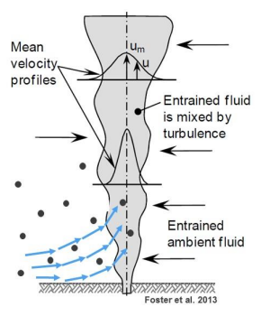
PERMITTING - State Water Board and San Diego Regional Water Board
PERMIT APPROVED on March 9, 2022
Ocean Plan Compliance Determination
NPDES Discharge Permit
Mitigation
  …and mitigation measures to minimize intake and mortality of all forms of marine life
  Turbulence Mortality of incremental brine discharge
  Preliminary Estimates are 7.45 acres

Slide 16

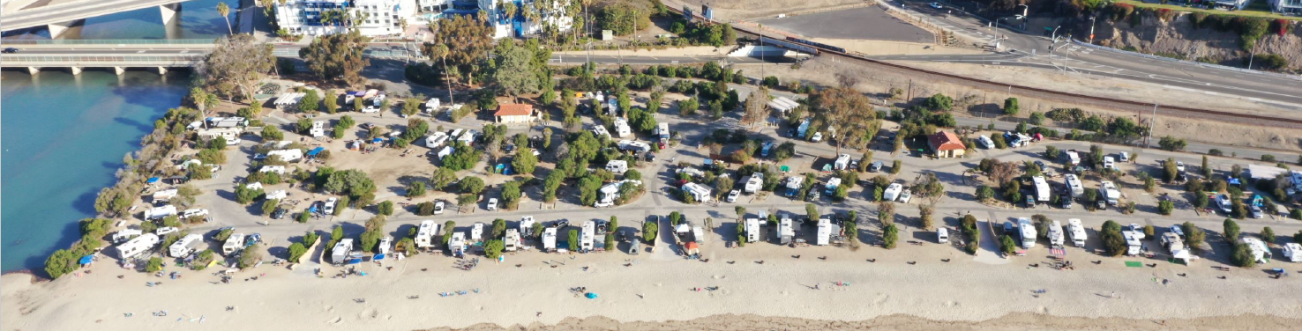
California State Parks Agreement
Collaborative effort - Align Project construction with State Parks DSB General Plan implementation
Repair and restoration of DSB Campground:
• New water sewer and electrical hookups
• Improvements to pedestrian/bike access and circulation
• Replace interpretive area, landscape, and restrooms

Slide 17

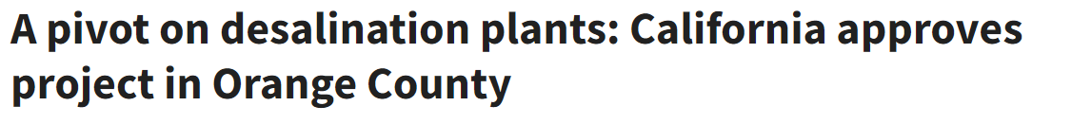

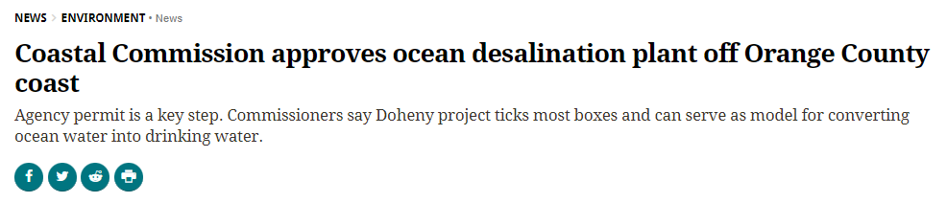
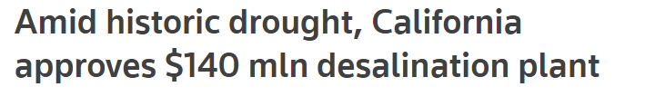
PERMITTING - California Coastal Commission
PERMIT APPROVED on October 13, 2022
Conditionally Approved Coastal Development Permit
16 Special Conditions
  Public Coastal Access, loss of coastal camping
  Energy and Greenhouse Gas
  Minimization
  Environmental Justice / Low-Income Ratepayer Assistance
  Tribal Consultation and Cultural Resources

Slide 18

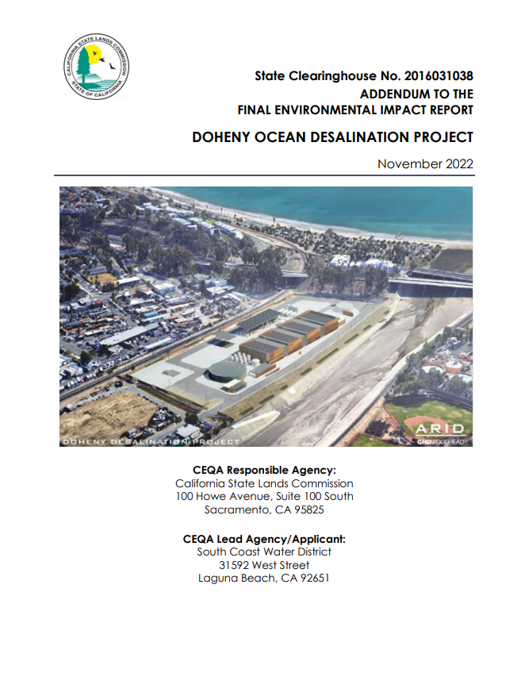
PERMITTING - California State Lands
November 2022 - Addendum to Final EIR to address Campground Modifications
PERMIT APPROVED on December 9, 2022
Land lease for slant wells below mean high tide line and modified lease for ocean outfall
Areas of Concern
  20-year slant well lease
  Greenhouse Gas Mitigation – preference to local projects

Slide 19
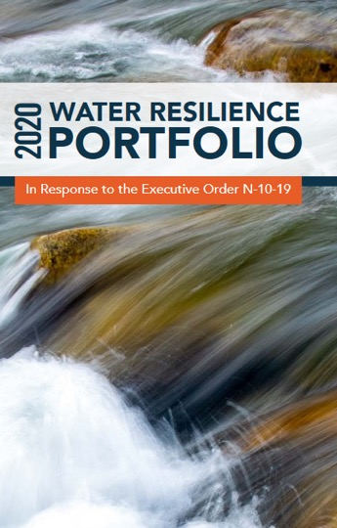
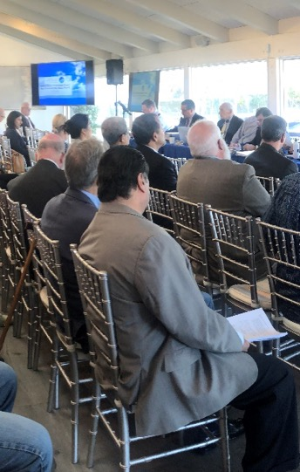

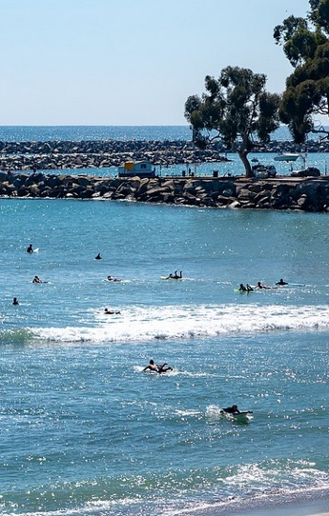
Bi-partisan and Collaborative Support
Community Support and Potential Partner Letters of Interest
Bi-partisan
Elected Official
Support
Environmental and Regulatory
Support
State and Federal Grant Funding Support
California Department of
Water Resources Desalination Construction Grant
$10M
US Bureau of Reclamation Water Infrastructure Improvement for the Nation (WIIN) Act Grants (Sponsor: Congressman Levin)
$20M
EPA Grant – Slant Well
(Sponsor: Senator Padilla)
  $2.4M
CA State Parks
South Laguna Water & Sewer Advisory Committee
LA and OC Building and Construction Trades Council
HOAs: Cape Cove, Harbor Creek, Regatta
Cities of:
Dana Point, Laguna Beach, San Juan Capistrano, San Clemente
Neighboring Agencies & Utilities:
MWD, MWDOC & ISDOC, ETWD, IRWD, EBCSD, EVMWD, IEUA, LVMWD, Mesa Water, TCWD, SMWD, Rancho Water, SOCWA
Letters of Interest
City of San Clemente
Laguna Beach County Water District
Eastern Municipal Water District
US Senator Feinstein
US Senator Padilla
Congressman Mike Levin
Congresswoman Michelle Steel
CA State Senator Pat Bates
CA State Senator Dave Min
CA State Assemblymember Cottie Petrie-Norris (AB-1752)
CA State Assemblymember Laurie Davies
OC Supervisor Lisa Bartlett

Slide 20

Anticipated Implementation Schedule
January
2021
January
2022
January
2023
Plant Online 2028
Alternative Power Supply Assessment
DPR/Ocean Augmentation Concept Study
Financial Assessment &
Rate Impact Analysis
USGS Third Party Review
of Groundwater Modeling
Partnership Education
Permitting & Easements
Project Delivery:
Progressive Design Build Operate Maintain Contract Development & Award
Design/Construction/ Performance Testing

Slide 21








It Takes a Team!

Slide 22





Thank You!
SCWD.ORG/DohenyDesal
@SouthCoastWater

