Slide 1

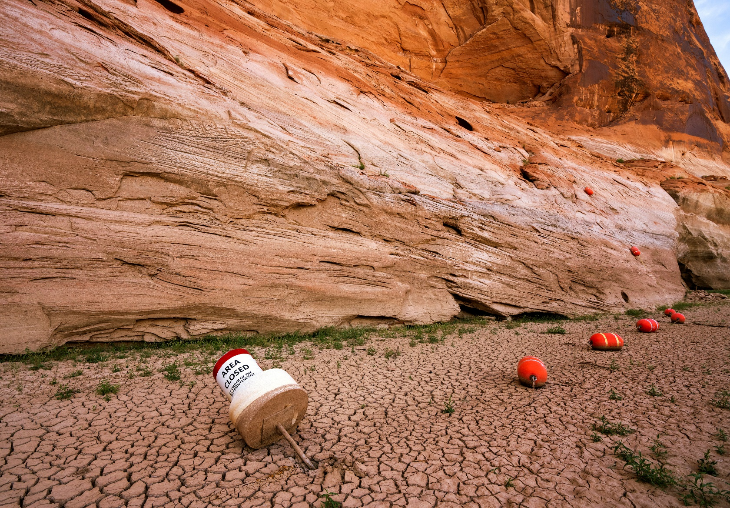
Urban Water Institute’s “Spring” Conference
February 23, 2023
Critical Conditions on the Colorado River: Can Deadpool be Avoided?

Slide 2
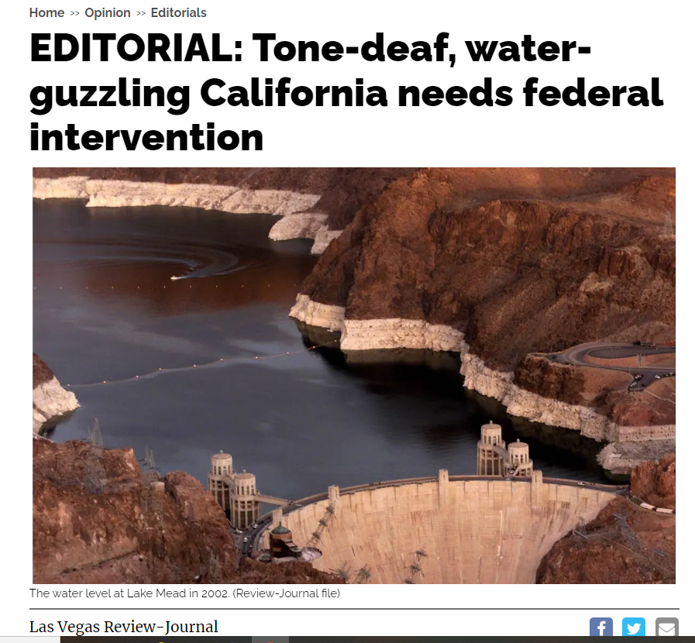
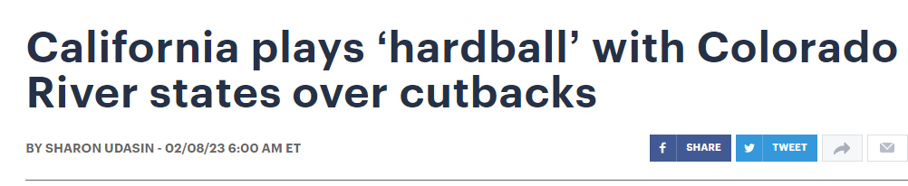
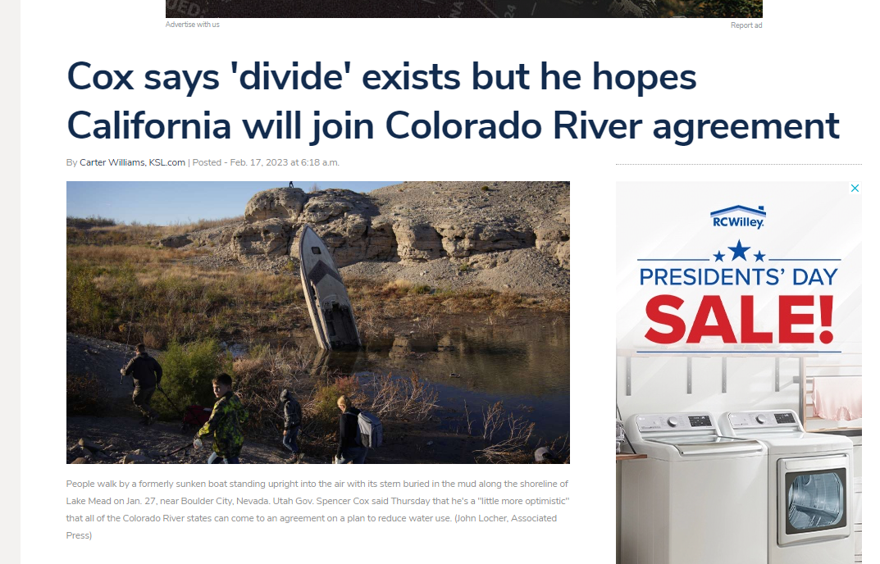
Recent Stories

Slide 3
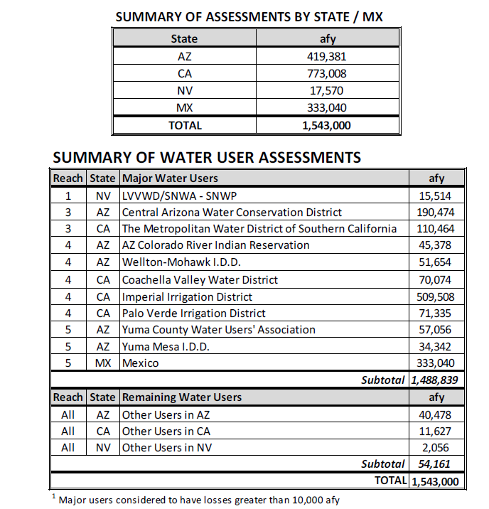
SNWA’s Initial Evaporation Proposal

Slide 4
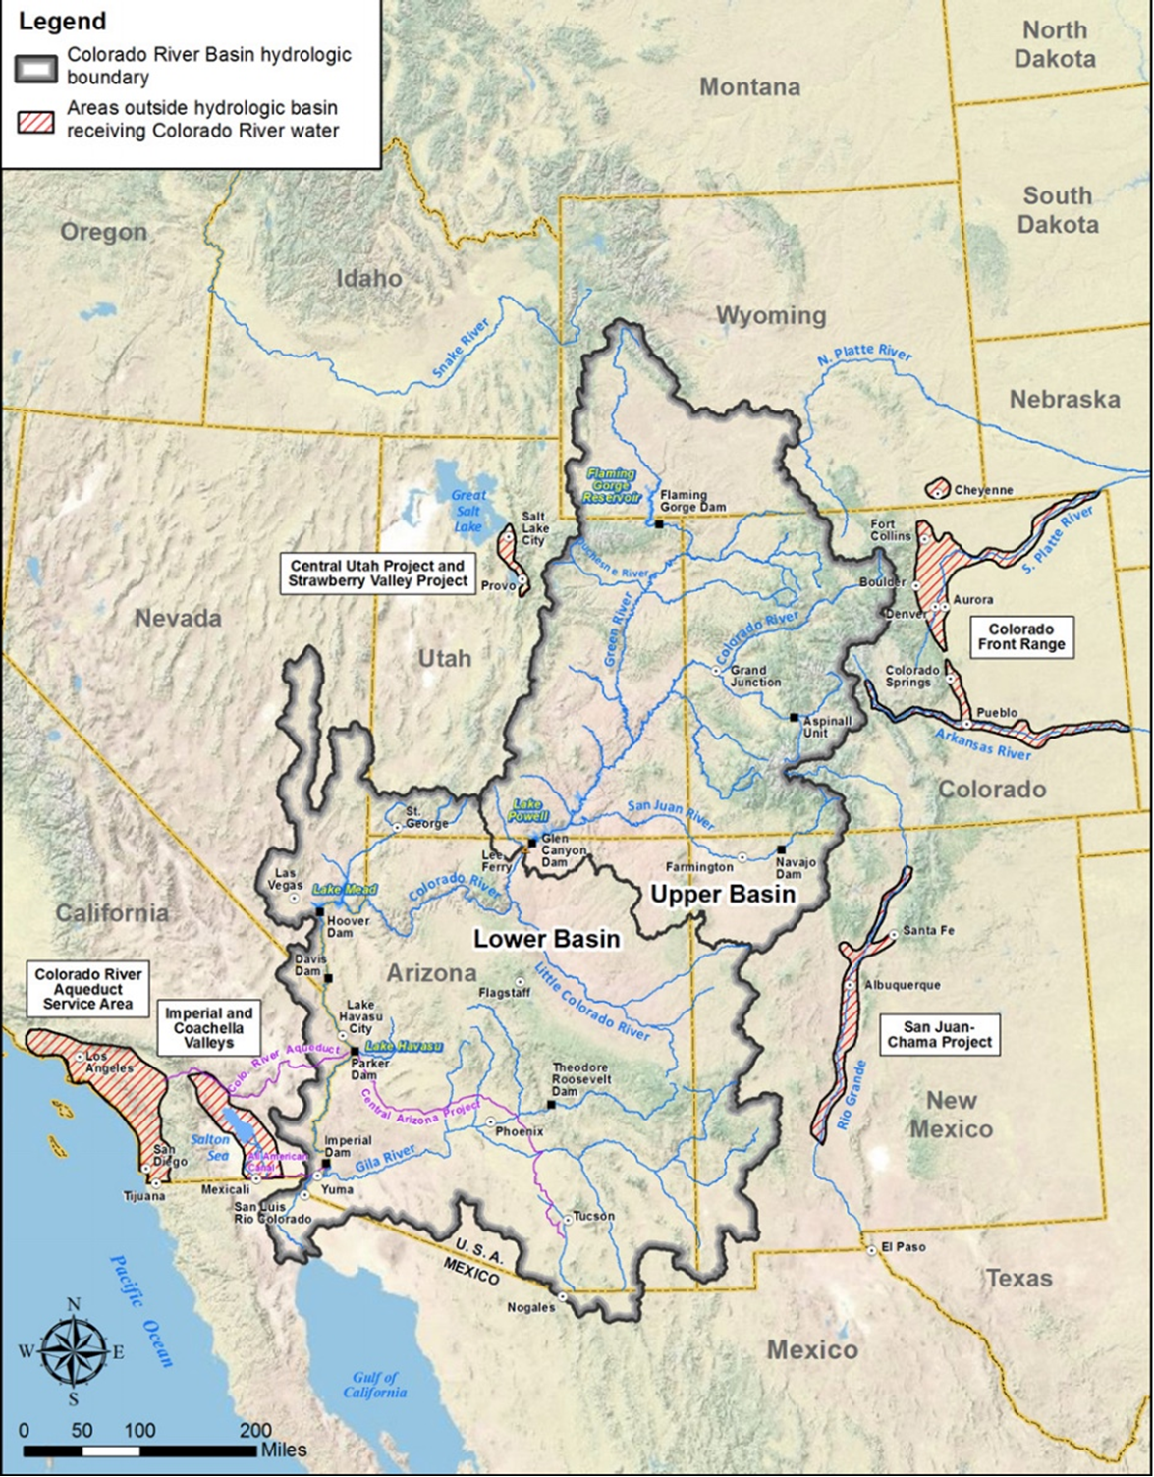

Slide 5
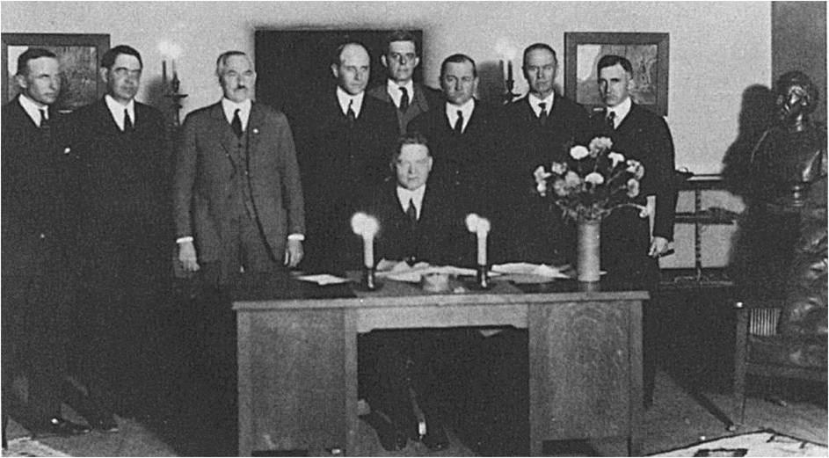
Colorado River Compact Signing
November 24, 1922

Slide 6
1922 Compact and
1944 Treaty Allocations
Upper Basin Lower Basin Mexico | 7.5 mafy 7.5 mafy + 1.0 mafy 1.5 mafy
Total | 17.5 mafy

Slide 7
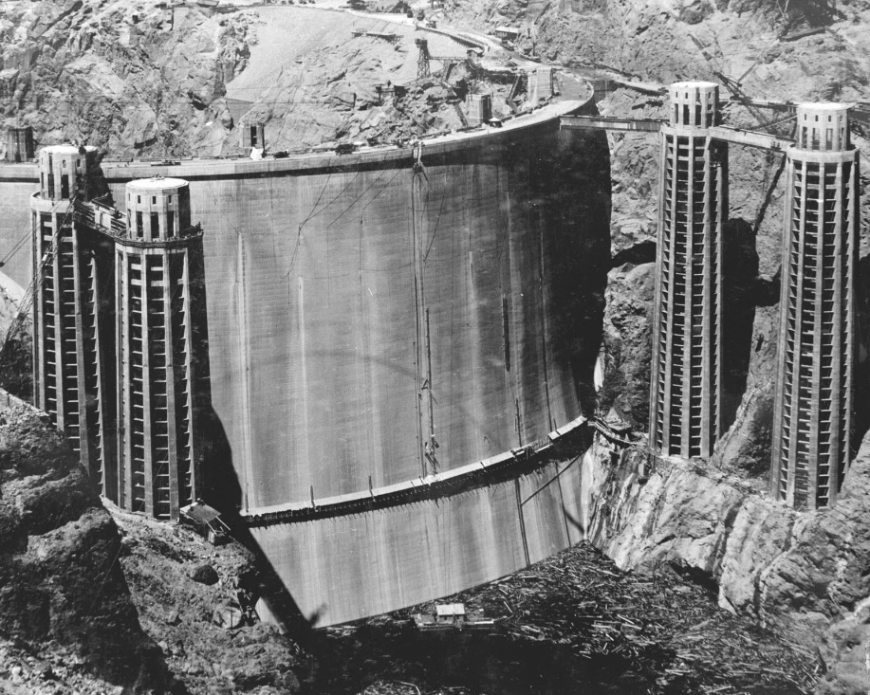
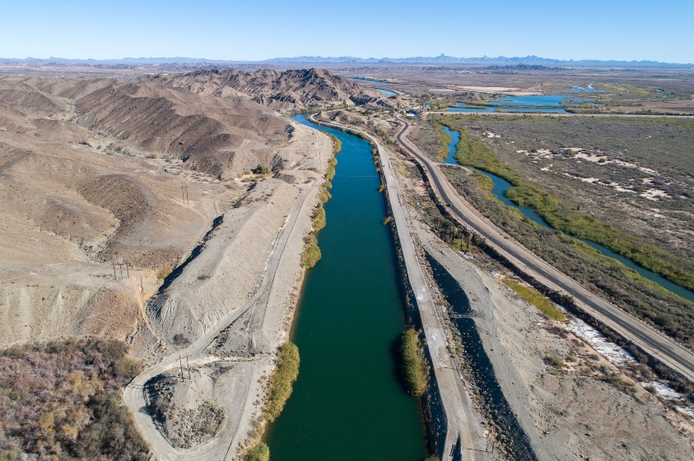
Boulder Canyon Project Act 1928

Slide 8
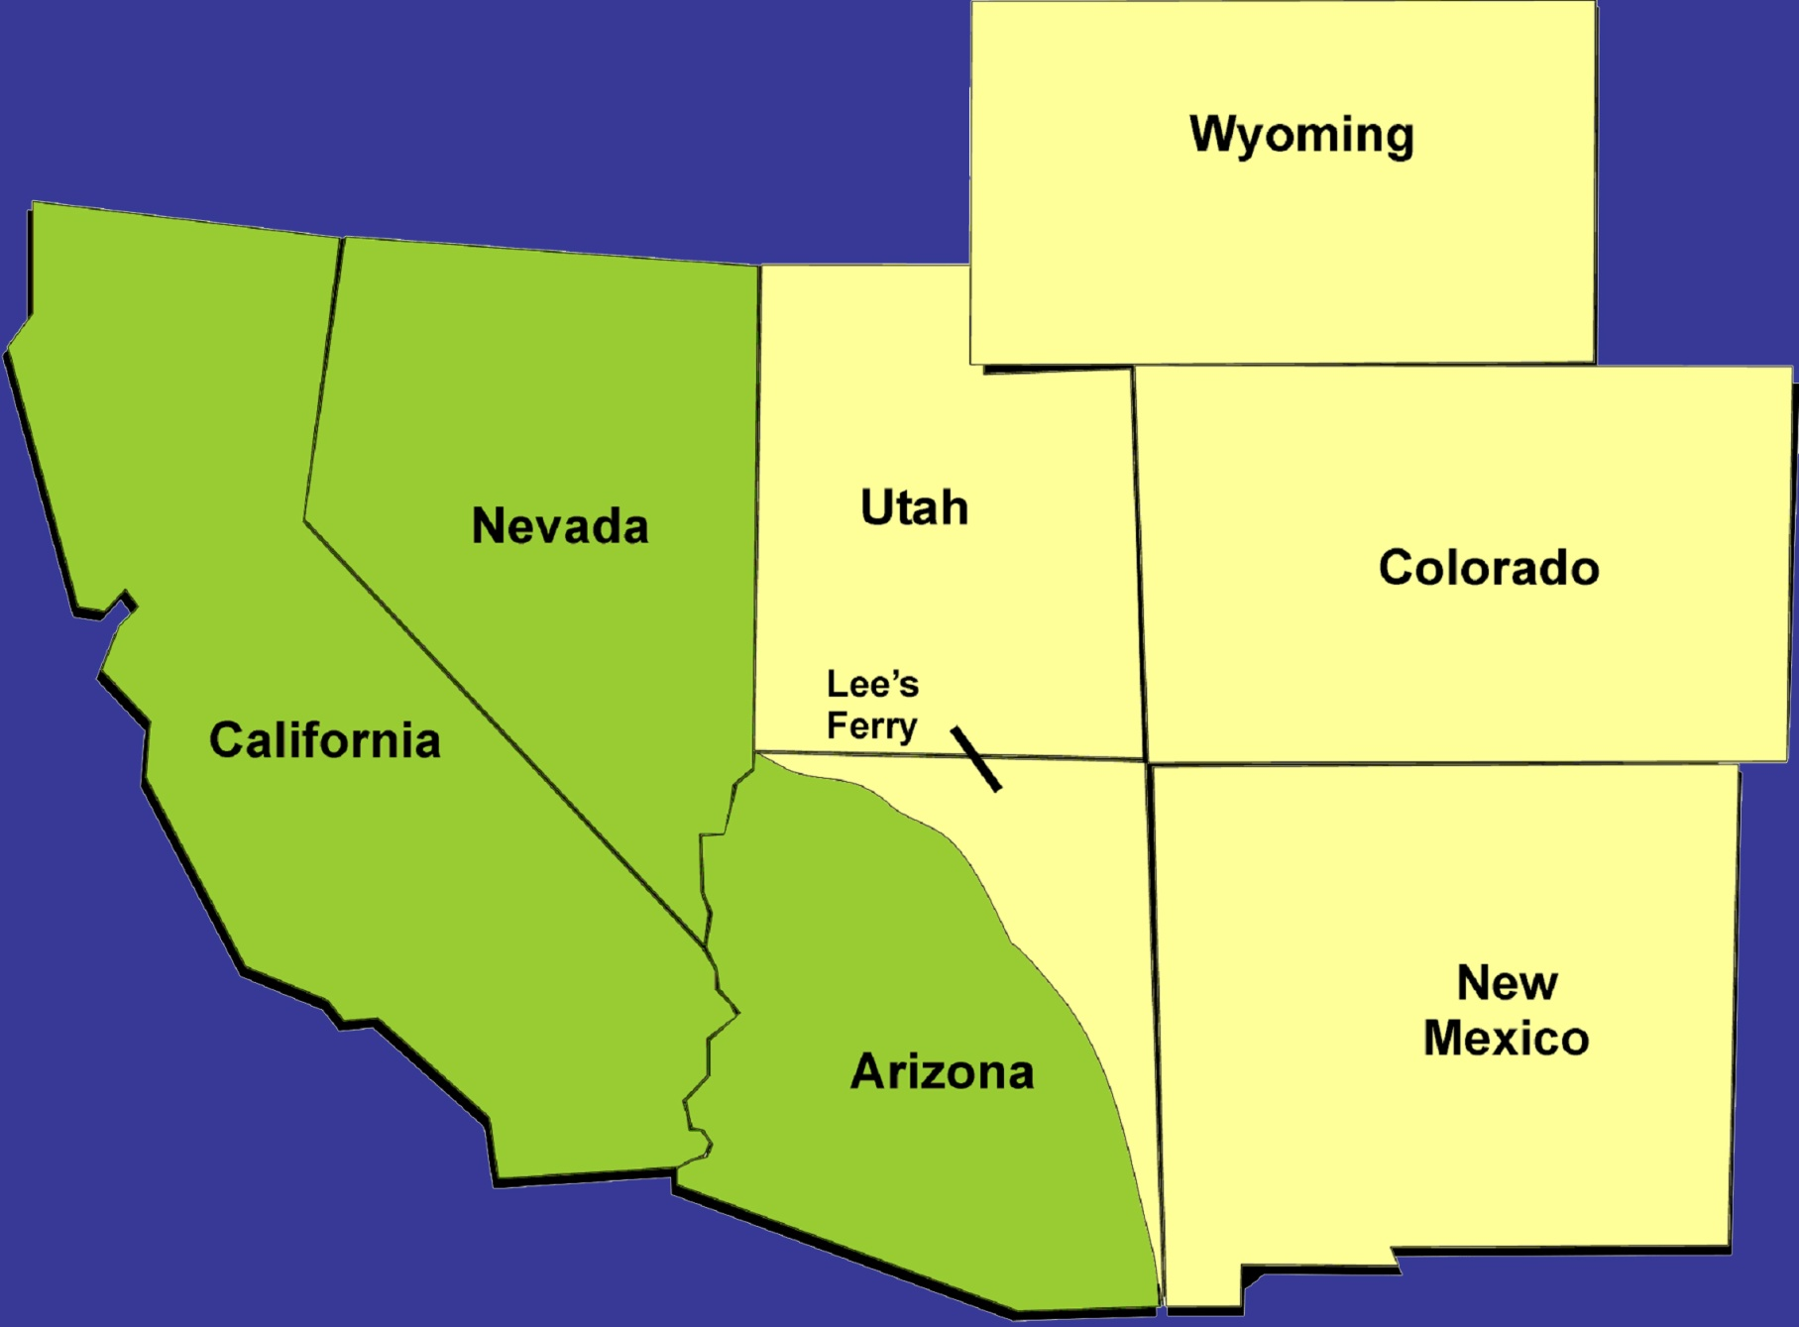
Colorado River Apportionments (Million acre-feet)
Upper Basin States
Lower Basin States
1.04
3.86
1.71
.3
.05
4.4
2.8
Apportionments
.84
1.5
Mexico
Notes:
So as you probably got a sense of yesterday, the Colorado river is divided up between a series of compacts and decrees
The upper basin received 7.5 maf, the lower basin received 7.5 maf and through a Treat with the US, Mexico received 1.5 maf
Subsequent agreements further divided the river and as you can see here each state received an apportionment of that water
So why all the fuss… this looks pretty straightforward… not everything is as simple as it looks.
So these are the apportionments… now here is how the actual water deliveries looked like in the 1990’s. All states, except for one, was using well below their apportionments.
CA developed faster then the other states, and it was able to use water the other slower developing states were not using and this allowed CA to bring in 5.1 maf.
OK, so this worked, for a while… that all changed in 2002 when NV and AZ started to use their full apportionments and told CA, you need to live within your means.
So CA had to develop a plan to reduce its use down to 4.4 maf

Slide 9
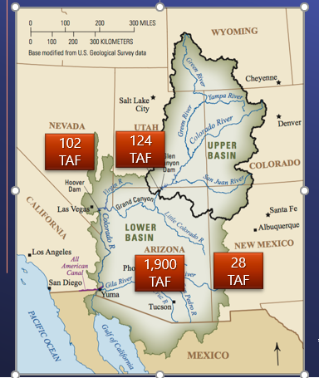
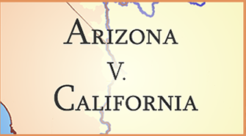
Estimated Lower Basin Tributary Use

Slide 10
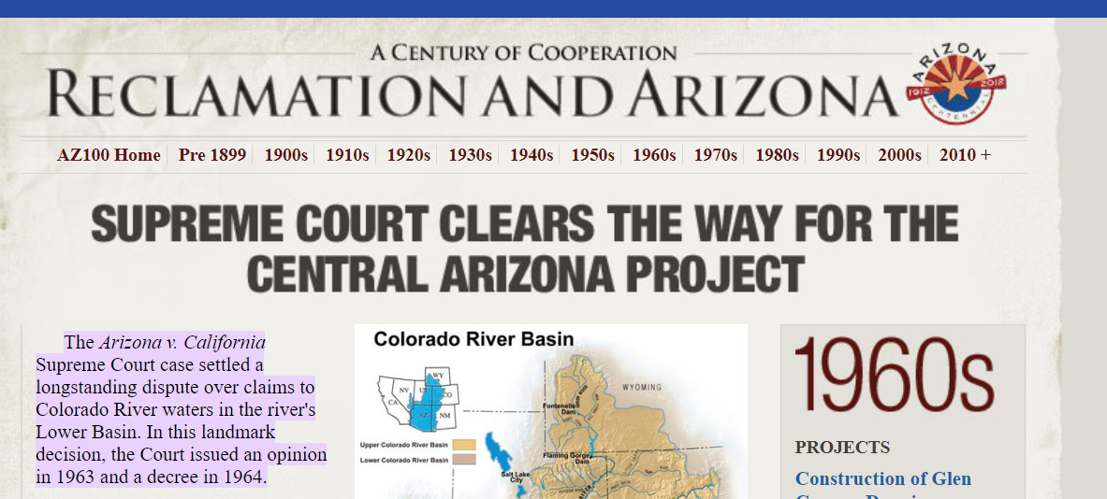
1963 Arizona v. California Decree

Slide 11
1968 Basin Canyon Project Act
(when) there is insufficient …Colorado River water available for release to satisfy annual consumptive use of 7.5 million acre-feet in Arizona, California, and Nevada, diversions from the mainstream for the Central Arizona Project shall be so limited as to provide …users in the State of California … 4.4 million acre-feet of mainstream water, and by users of the same character in Arizona and Nevada. Water users in the State of Nevada shall not be required to bear shortages in any proportion greater than would have been imposed in the absence of this subsection 301(b).

Slide 12
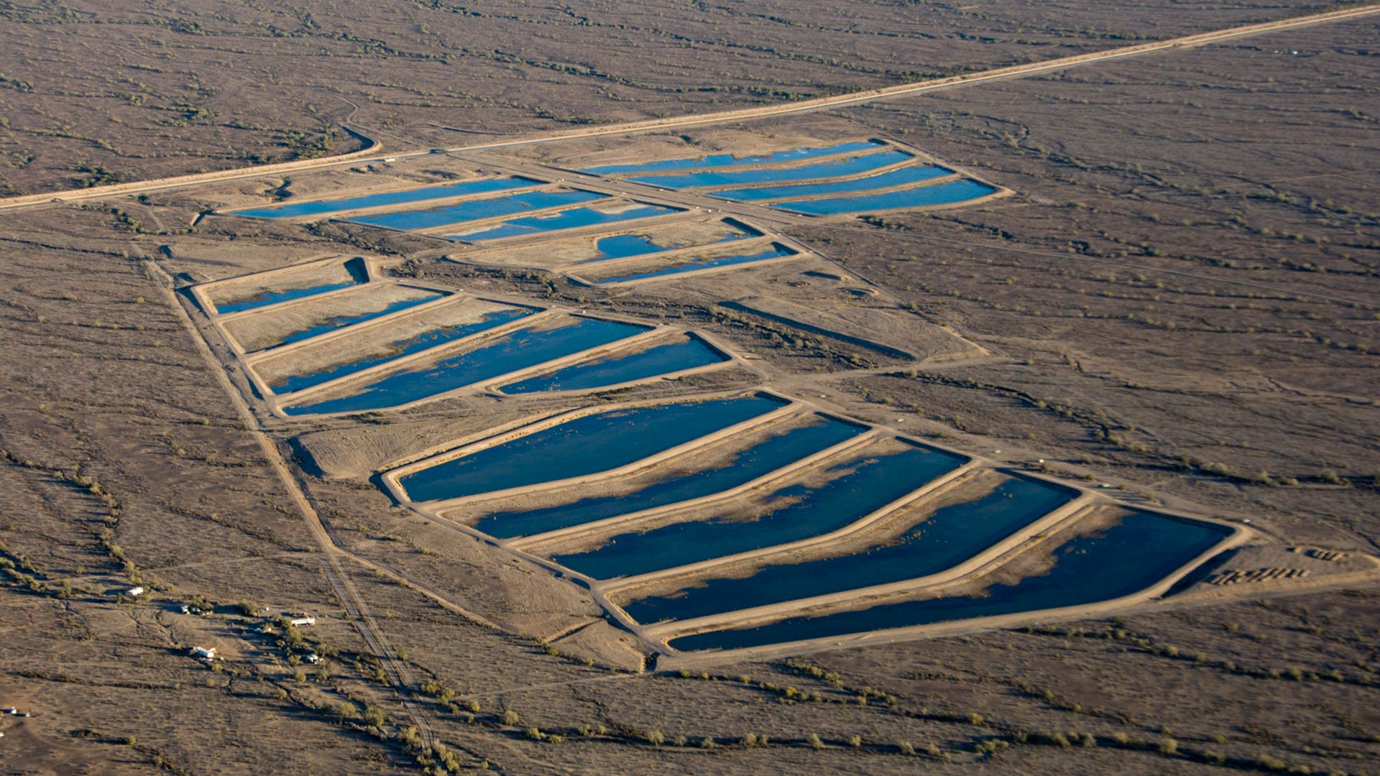
Arizona stored over 4 MAF of Colorado River Water Underground

Slide 13
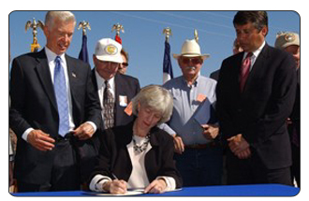
2003: Quantification Settlement Agreement Approved

Slide 14

Interim Shortage Guidelines 2007

Slide 15
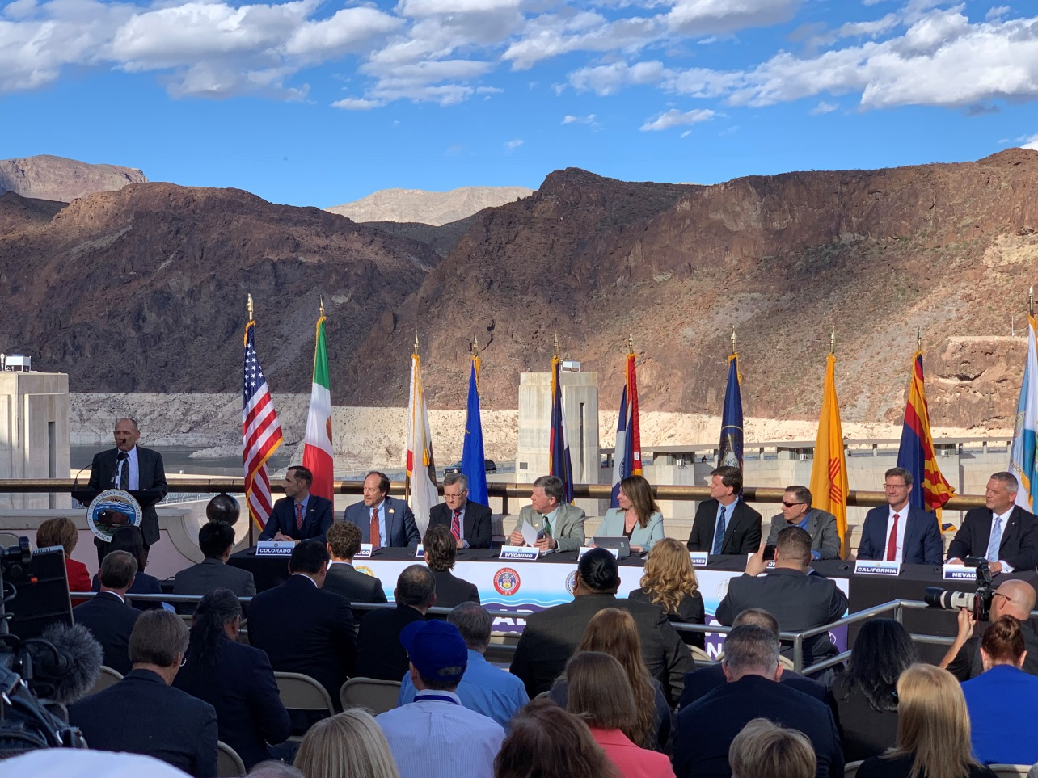
May 21, 2019: Interior, 7 States Approve Colorado River Drought Contingency Plan

Slide 16
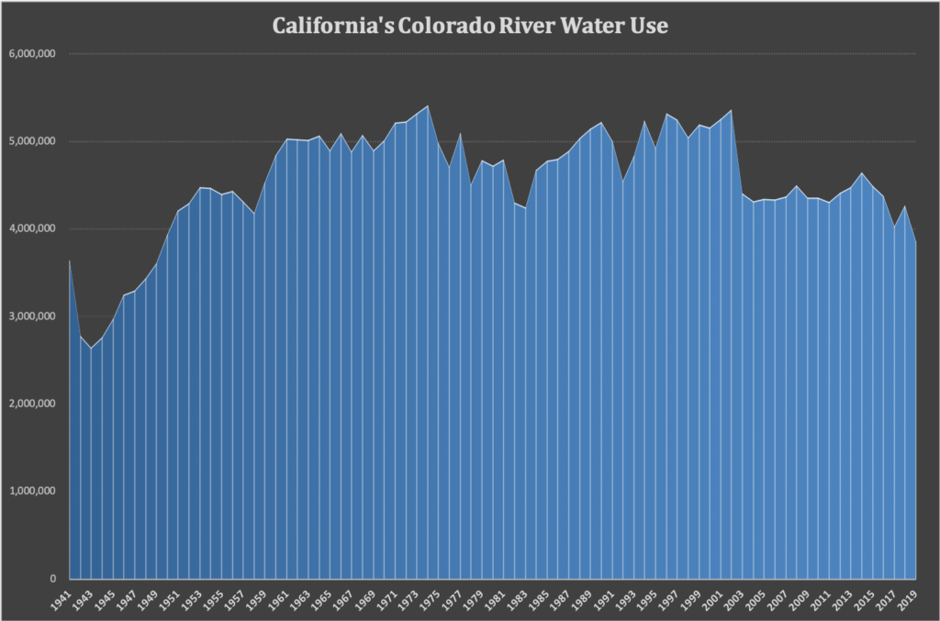
California’s 2019 Colorado River Water Use Lowest in 70 years

Slide 17
Colorado River Water Use Comparison
2002 Total = 5,366 TAF
2019 Total = 3,852 TAF

Slide 18
California’s Colorado River
Water Use Decline
30% drop

Slide 19
MWD’s Lake Mead ICS Storage Balance (E of Y)
*Metropolitan’s Estimated End-of-Year Storage in Lake Mead

Slide 20
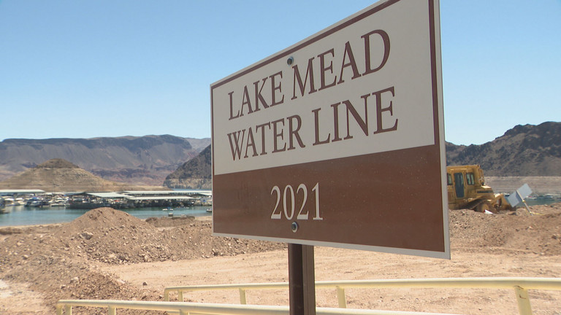
Lake Mead dropped 25 feet in 2022

Slide 21
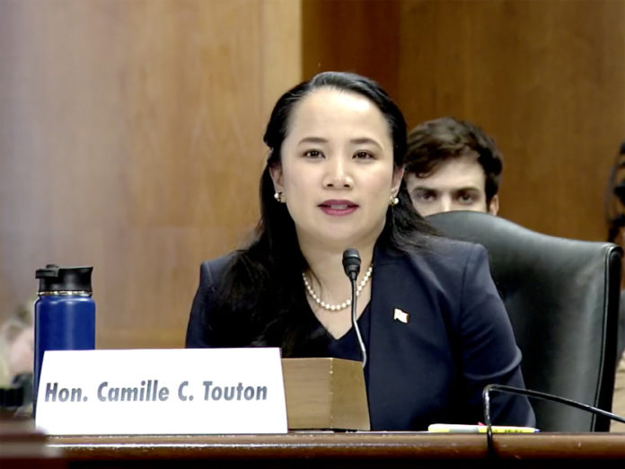
June 14, 2022: Commissioner Touton Calls for 2 – 4 MAF of Water Reductions in 2023

Slide 22
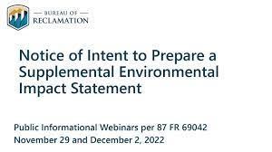
USBR to Amend 2007 Guidelines

Slide 23
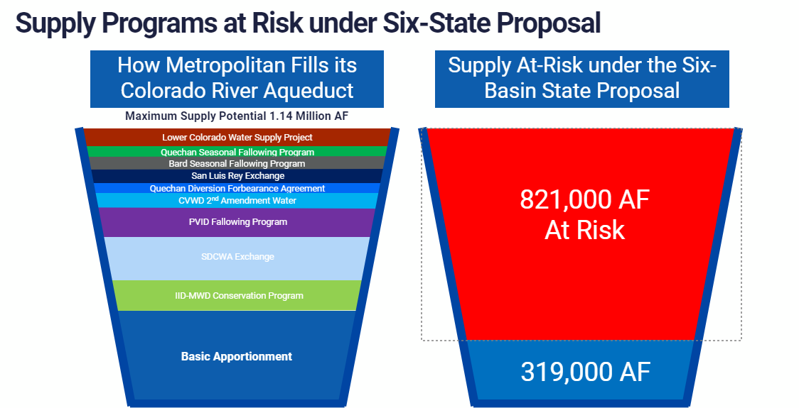

Slide 24
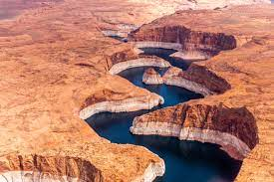
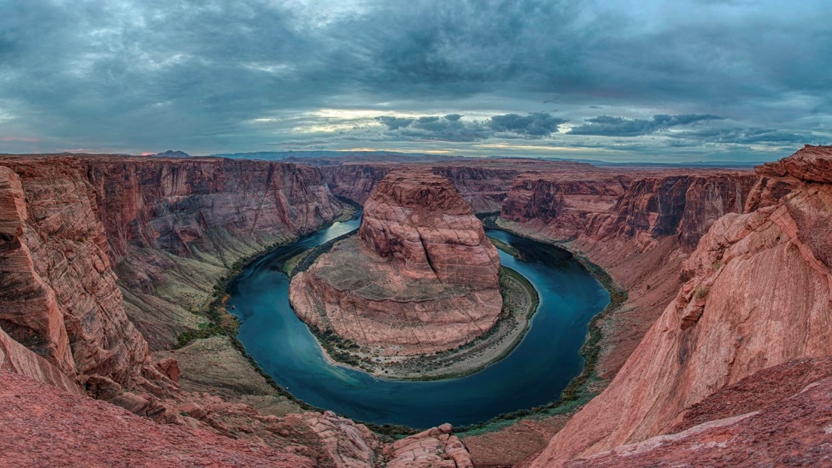
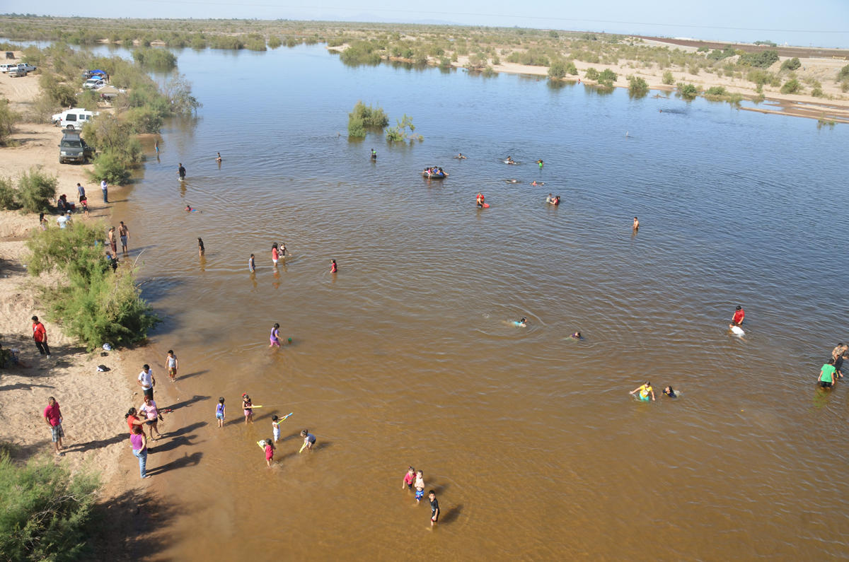
Long-term: Focus on Solutions Not Cuts

