Slide 1
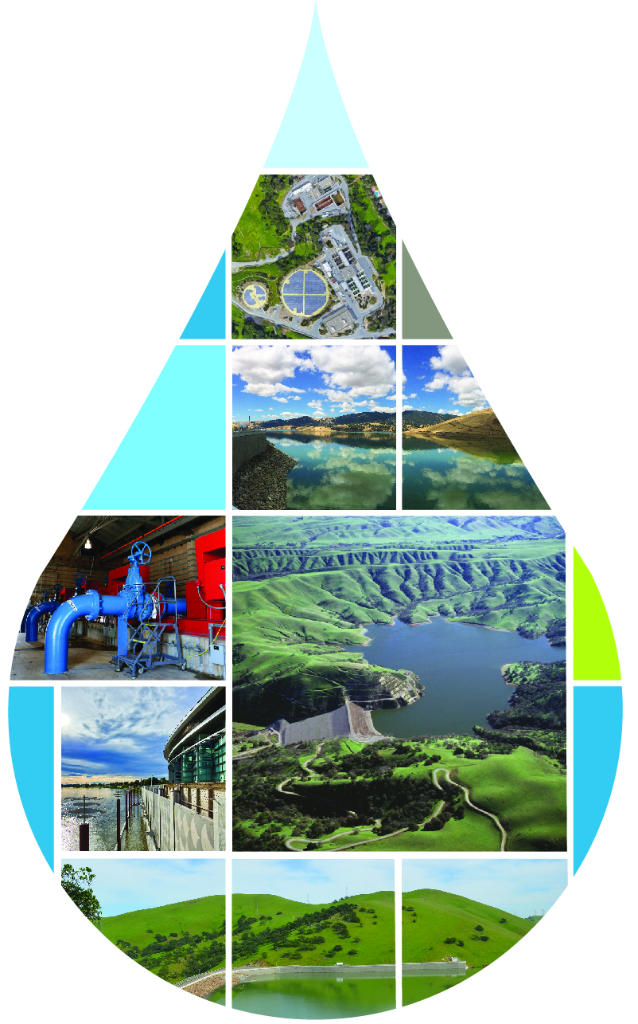
Bay Area Regional Reliability Partnership

Slide 2
BARR – Program Facts
Purpose = to develop regional solutions to improve the water supply reliability for the over 6 million residents and thousands of businesses and industries located therein
Formed in 2014
Each agency adopted “BARR Principles”
BARR Memorandum of Agreement (MOA) entered between Partner Agencies
MOA amended in 2019 and 2022
BARR Partners formed a stakeholder task force to allow for input into BARR work efforts
Stakeholders included business groups, environmental NGOs, university reps, etc.
Significant BARR efforts
Development of a Drought Contingency Plan (Completed in 2017)
Development of a Shared Water Access Program (to be Completed in 2023)
Website created in 2017 = https://bayareareliability.com/

Slide 3
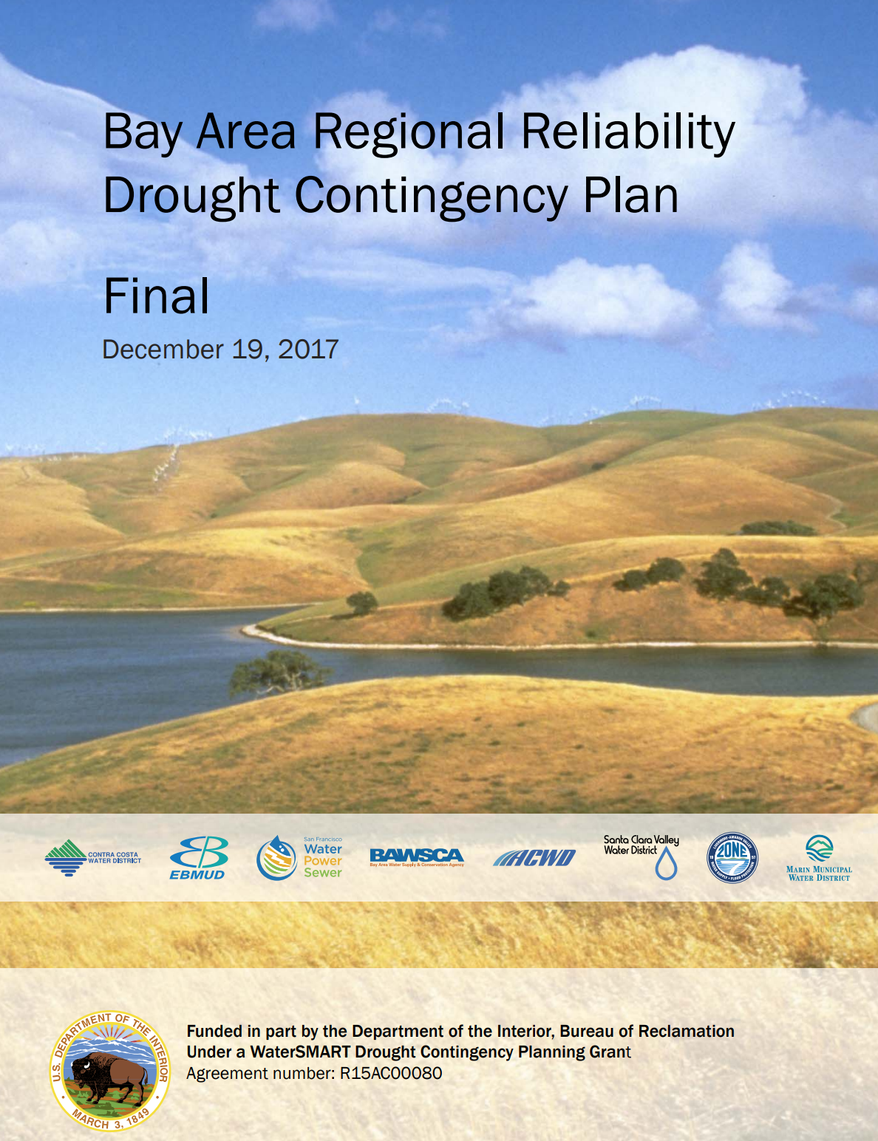
Drought Contingency Plan: Addressing Regional Vulnerabilities
Funded in part by the U.S. Bureau of Reclamation
Focused on drought mitigation and response
Builds regional resilience amid other uncertainties, beyond drought
Key elements:
Assesses vulnerability of supply sources
Proposes regional drought response actions and mitigation measures

Slide 4
Assessing Regional Vulnerability – Projected Source Dependency During a Prolonged Drought
Risk varies by agency (significance of supply) and based on factors contributing to possible supply reduction/loss.
2
3

Slide 5
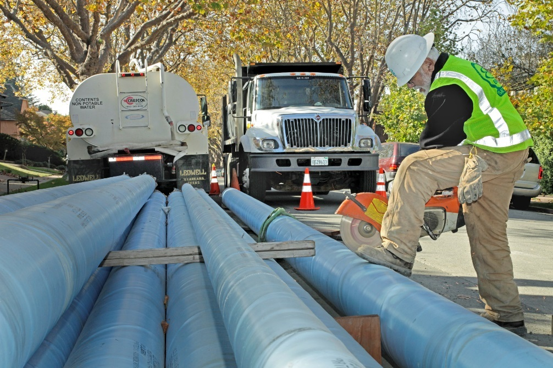
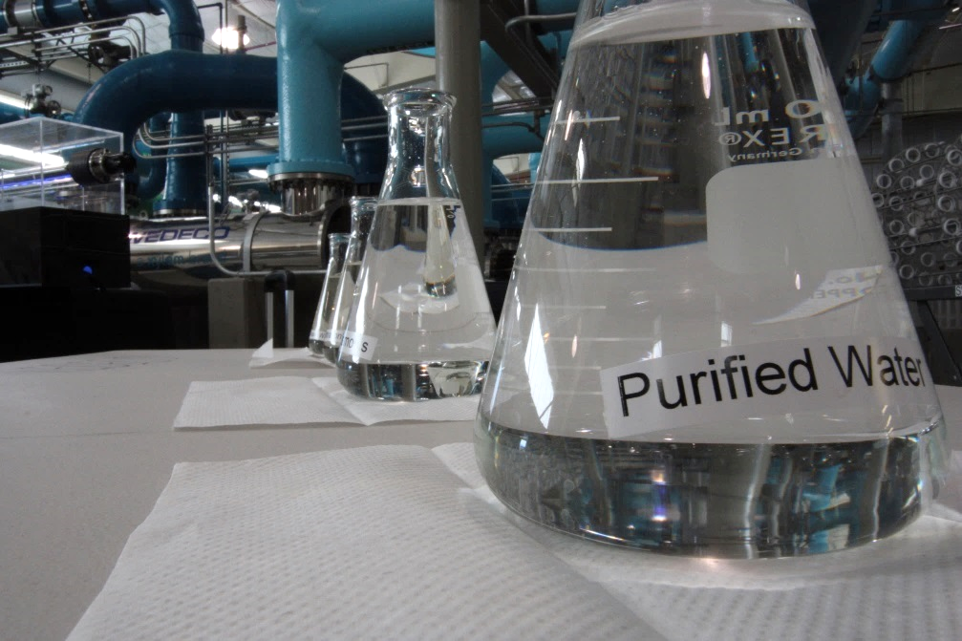
Drought Mitigation Measures Selected Thru Study
Mitigations are actions, programs and strategies implanted before a drought
Each mitigation measure in the plan engages two or more BARR agencies
15 mitigation measures; 4 categories:
Interties
Storage
Treatment/Supply
Operations
Characterized by benefits, costs, implementability, social & environmental considerations

Slide 6
15 Drought Mitigation Measures
4 Categories
Interties
Storage
Treatment/Supply
Operations
6

Slide 7
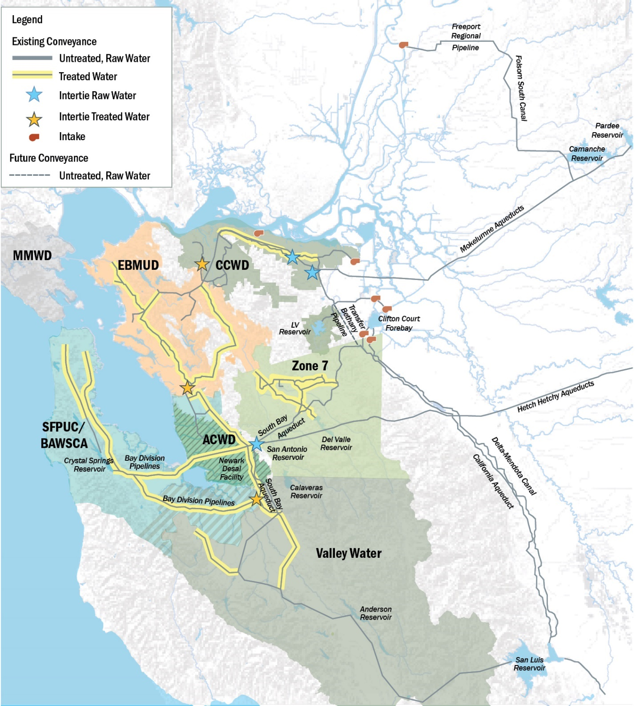
Shared Water Access Program
Purpose:
To establish a roadmap and guide future water supply transfers and exchanges
Approaching the work:
Identify existing assets, infrastructure, and water rights that can be leveraged
Build from prior transfers
Test and have tested new concepts
Navigate future opportunities by building from the BARR partnership
Produce a final report detailing the work effort and findings

Slide 8
Shared Water Access Program – Pilot Transfers Studied
Pilot | Participants | Purpose | Amount
1a | Alameda County Water District Bay Area Water Supply & Conservation Agency San Francisco PUC | Simulate supply exchange to ACWD and direct delivery of water supply stored in Los Vaqueros Reservoir to San Francisco PUC | Up to 20 TAF
2a | Contra Costa Water District Valley Water | Test supply exchange and storing of Valley Water’s CVP contract water in Los Vaqueros | 5 TAF
3 | Contra Costa Water District East Bay MUD | Test storing and delivery of supply from Los Vaqueros with Freeport via exchange of CVP water | 2 TAF
Notes:
GS

Slide 9
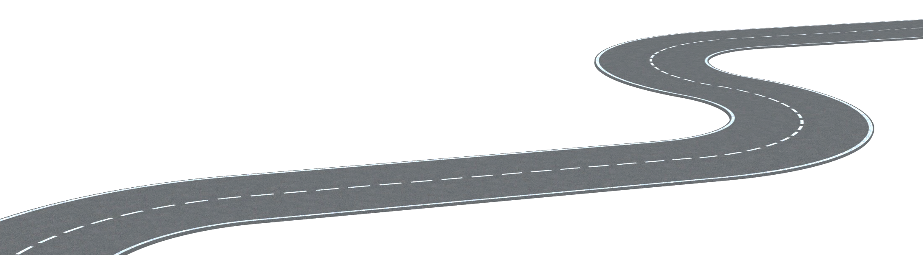
Roundmap Developed for SFPUC/BAWSCA/ACWD Pilot
Step 5: Implement transaction
Step 3: Identify Water for Transfer
Step 4: Establish Agreements
Step 1: Destination & Starting Point
Assessed through simulation of scaled-down version of pilot to confirm feasibility.
New and revised agreements developed
SFPUC 20 TAF potential delivery and exchange with ACWD
Step 2: “Rules of the Road”
Exchange of existing resources between SFPUC and ACWD
Requires amendment of existing agreements between agencies

Slide 10
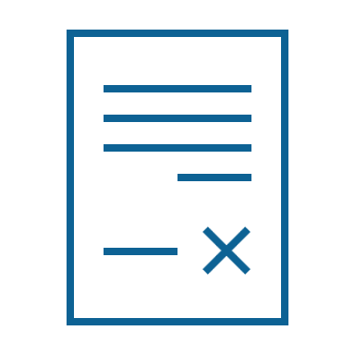
BARR SWAP – Findings of Work Effort Lessons Learned
Transfers and exchanges of project supply (SWP/CVP) among contractors is easier.
Staff limitations impact approval process.
Drought as a window of opportunity.
Costs are largely variable.
Environmental benefits can be realized.
Negotiate terms ahead of shortage.
Allow sufficient time for planning multi-year transfers.
Engage approval agencies.
Communicate with participants and interested parties.
Notes:
Speaking points (below are the full notes from the “cheat sheet”):
* Important to communicate that these lessons learned (and their write-up) have been influenced by input from the Task Force as well
First column:
- Transfers and exchanges of project supply (SWP/CVP) among contractors is easier. The relative ease of conducting water transfers and exchanges of SWP and/or CVP supply depends on whether the participating agencies are contract holders. Exchanges between SWP contractors are the most straightforward, followed those between CVP contractors.
Staff limitations impact approval process. Limited internal staff experience with water transfers and staff turnover at local, state, and federal levels can prolong the approval process.
Drought as a window of opportunity. Drought conditions enable opportunities to learn what can be achieved when adverse conditions bring regulators and water managers together with even greater incentive to achieve wise water management. Conditions involving reduced SWP/CVP contract allocations also increase the need for transfers/exchanges and generally intensify market competition for water supplies among buyers.
Costs are largely variable. Past experiences are not inherently indicative of future costs for water transfers.
Environmental benefits can be realized. One that was particularly important for our Task Force members is that environmental benefits can be realized. Releases of transfer water can be coordinated from upstream reservoirs to support temperature management for salmonids and/or to allow recharge of local groundwater basins, which can help manage saltwater intrusion and subsidence.
Second column:
- Negotiate terms ahead of shortage. Negotiating terms and executing new institutional agreements among participating BARR agencies and others in advance of water shortage is a best practice. This enables increased stakeholder engagement, improves agency readiness, and reduces uncertainty and risk.
- Allow sufficient time for planning multi-year transfers. Because multi-year transfers typically require extensive environmental review and documentation and possible Delta Stewardship Council approval, planning and developing the arrangement must be initiated well in advance of implementation.
- Engage approval agencies. Early engagement and communication with approval agencies is important for the timing and successful completion of transfers and exchanges, especially when aligning windows of opportunity for transfers.
- Communicate with participants and interested parties. Communication is needed early in the transfer development process to seek input and understanding among participating agencies and interested parties. Diverse perspectives and representation often add new dimensions to problem-solving and may strengthen protections of other users, the environment, and local economies when conducting transfers as part of BARR SWAP.

Slide 11
BARR – Next Steps
U.S. Bureau of Reclamation reviewing Draft Final Report
BARR Partners anticipate a Final Report to be prepared in Summer 2023
The BARR Partners are now reviewing options for the next work effort
A list of options will be made available to partner agency GMs
BARR Partners will identify if grant funding is possible to support the next work effort
Work assignments will be identified for participant agencies
New agreements will be entered into by partner agencies detailing the future work effort including assignments and financial commitments
The BARR website will be updated this spring
Water supply conditions for the coming summer and fall will be known
Drought Contingency Plan project updates will also be included in the website update

