Slide 1
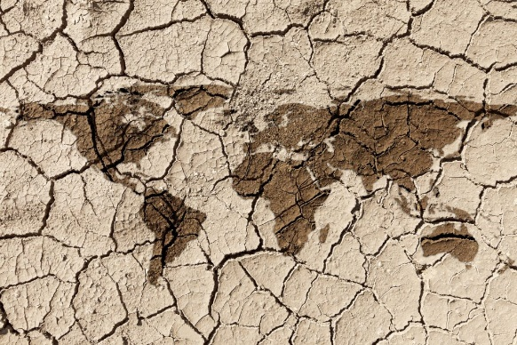
Climate Change and Supply Reliability in California
Is the Drum Beating?
Urban Water Institute Conference
February 22, 2023

Slide 2
Major Considerations
California is the 5th Largest Economy in the World
Role and Brand of Infrastructure in California’s Water
We’re All Connected By Water
Scarcity, or Appropriate Investment?
Underinvestment - Farming and Environmental Water
Scarcity, Zero-Sum Thinking, and Conflict

Slide 3
Major Considerations
The Scale of the Problem
Uncertainty and Risk Tolerance
Thinking 20 Years Ahead - Urban, Farming, Enviro Needs
Water as a Human Right – Access and “Affordability”
Prepared for Climate Change Disruption?

Slide 4
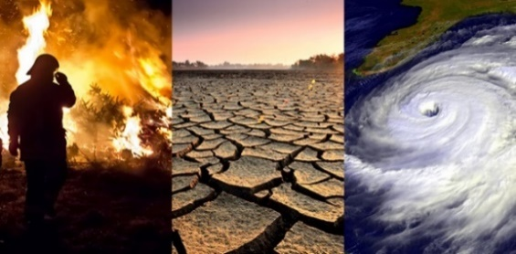
Climate Change and Infrastructure
Global Warming = Average Temp. Rise
Climate Change = Extremes
Snowpack Changes – Decline, Runoff Yield and Timing
Intense Precipitation Events, and Seasons
Intense, Multi-Year Dry Periods
Decreasing Infrastructure Effectiveness
The Need – Increased Resiliency to the Extremes

Slide 5
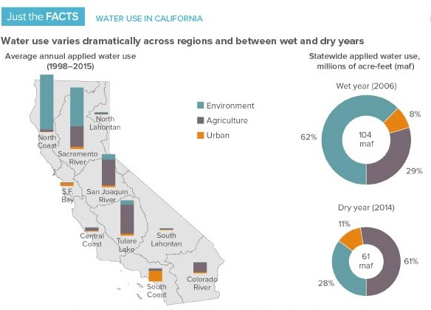
Source: PPIC
Groundwater Use
16maf
Urban – 8maf Farming 32maf
Environment – 40maf

Slide 6
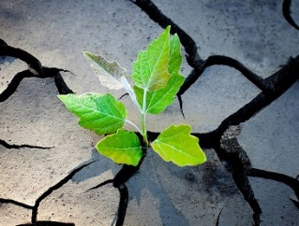
A Resiliency Approach Establishing the Scale of the Problem
Supplies ≠ Storage Achieving Scale Requires Storage
Our Major Asset – 40maf Drought Resiliency Storage
50% Increase in Resiliency
2 More Years to 2018-2022 Pattern In 20 Years…Risk Tolerance?
Unsustainable Assets
G/W Overdraft – 4maf/year..?? CO River Decline – 2maf/year…??
Scale of Problem - 25 to 35maf of Stored Water
Farming and Enviro Water Needs? 20 Years From Now?

Slide 7
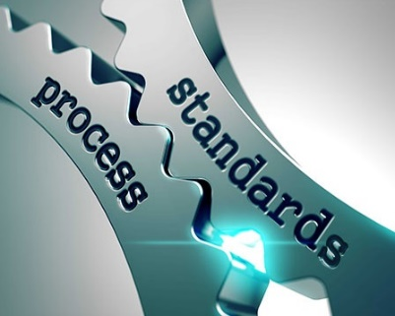
A Generational Investment $200 Billion Over 20 Years? (0.3% GDP)
Appropriate Investment in Urban, Farming, Environment
Addresses the Scale of the Problem
Integrated Thinking, Efficient Investments
Near-Term Urban Reliability, Water as a Human Right
Much Larger Investments in Farming, Environmental Water
G/W Storage and Replenishment, Conveyance

Slide 8
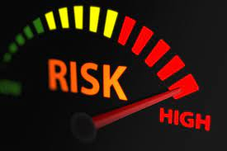
Things to Avoid - Risks
Continued Under-Investment, Scarcity, and Conflict
Under-Investment in Backbone…Inefficient Investments
15-20 Years of Urban Water Scarcity
Larger Declines in Farming…Impacting Other Uses
Expensive Urban Investments…Higher Rate Increases
Unsatisfactory Environmental Mitigation, and Adaptation
Relatively Low Levels of State and Federal Funding

Slide 9
Other Considerations, Questions
Efficiency of Our Investments – Local vs. Backbone
Collaborating with Stakeholders, Political Will
Parallels to Clean Water Act, Initial Investments in CA Water Infrastructure, CA Education System…
Potential for Storing Deluge Water?
Optimum Environmental Investments?
Ability to Invest and Build Fast Enough?
Disruption – Trust in Water Sector and Government

