Slide 1
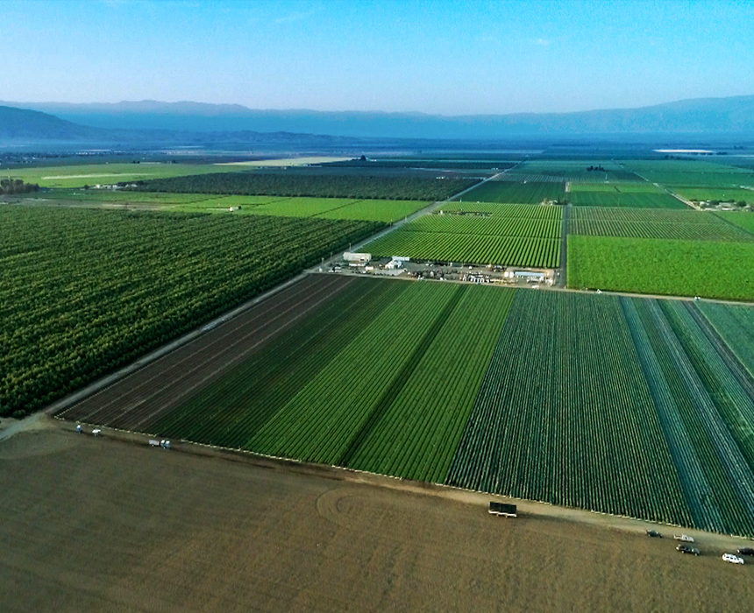
Urban Water Institute Spring Conference Palm Springs, California Segue to New Beat: The Importance of Farmland and Food
Randy Fiorini
Fiorini Ranch
Turlock, California

Slide 2
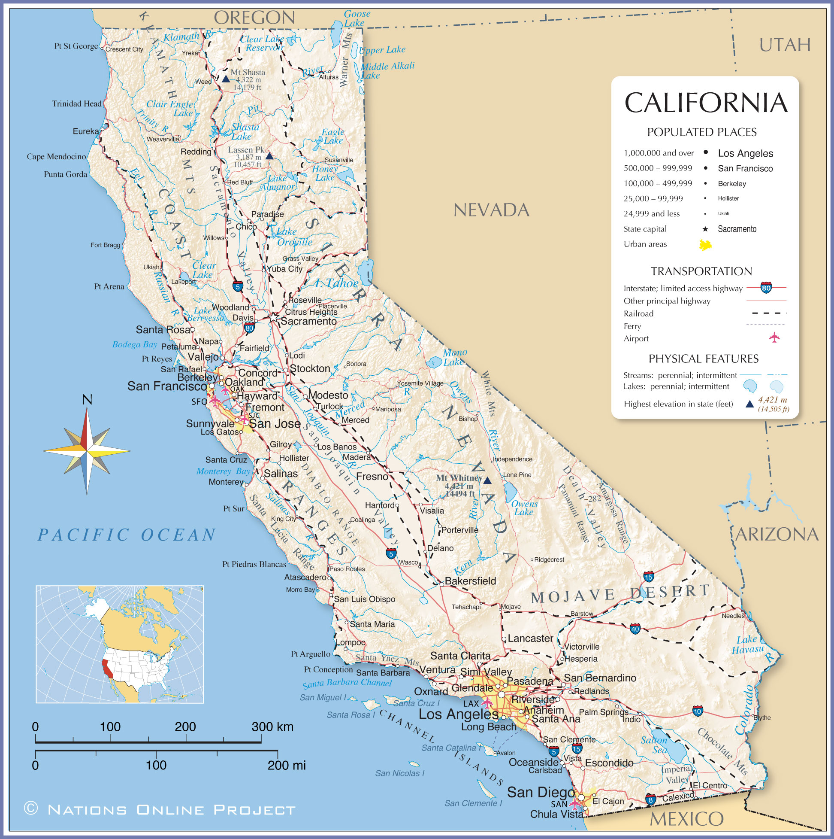

Slide 3
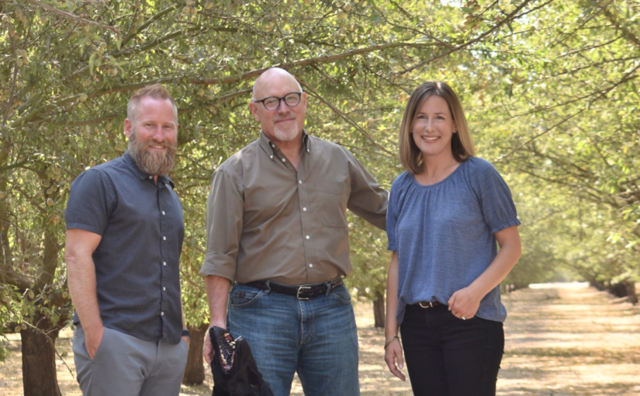
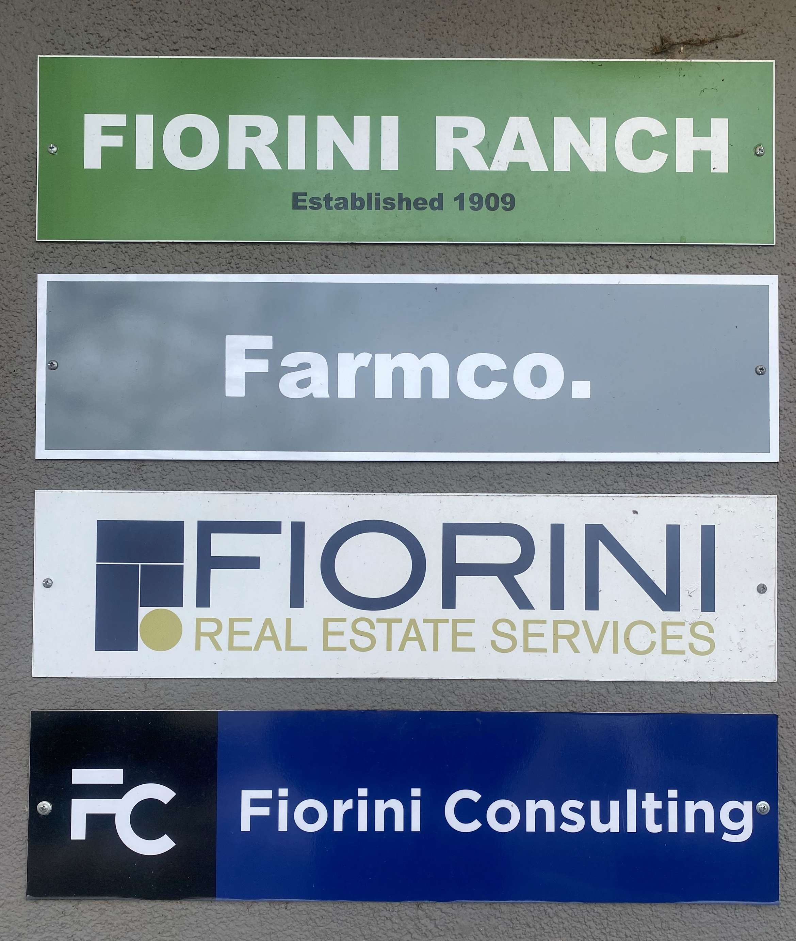
Fiorini Ranch
Established in 1909
Four Generations of Family Farming

Slide 4
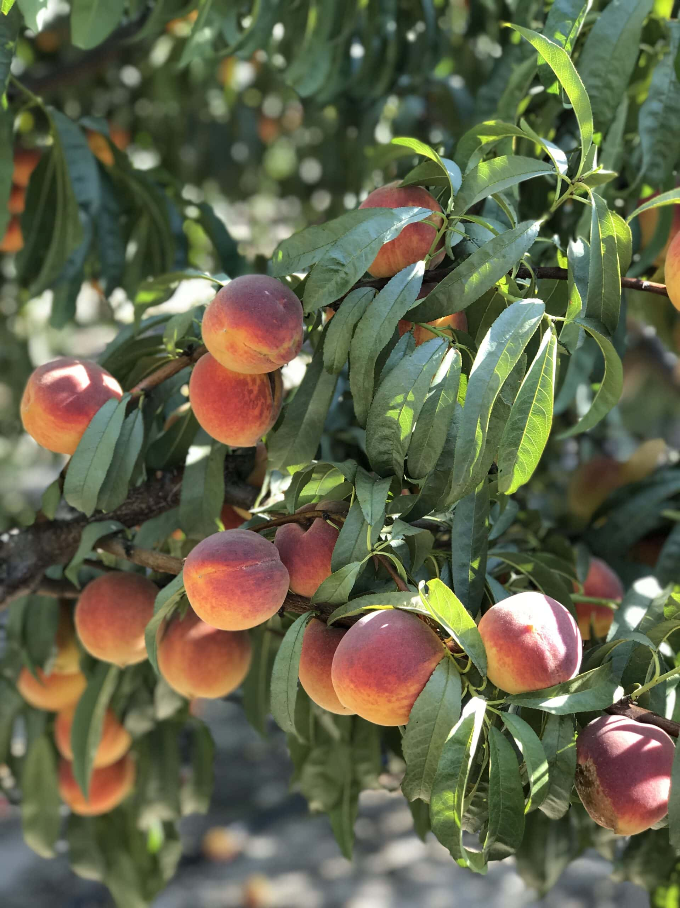
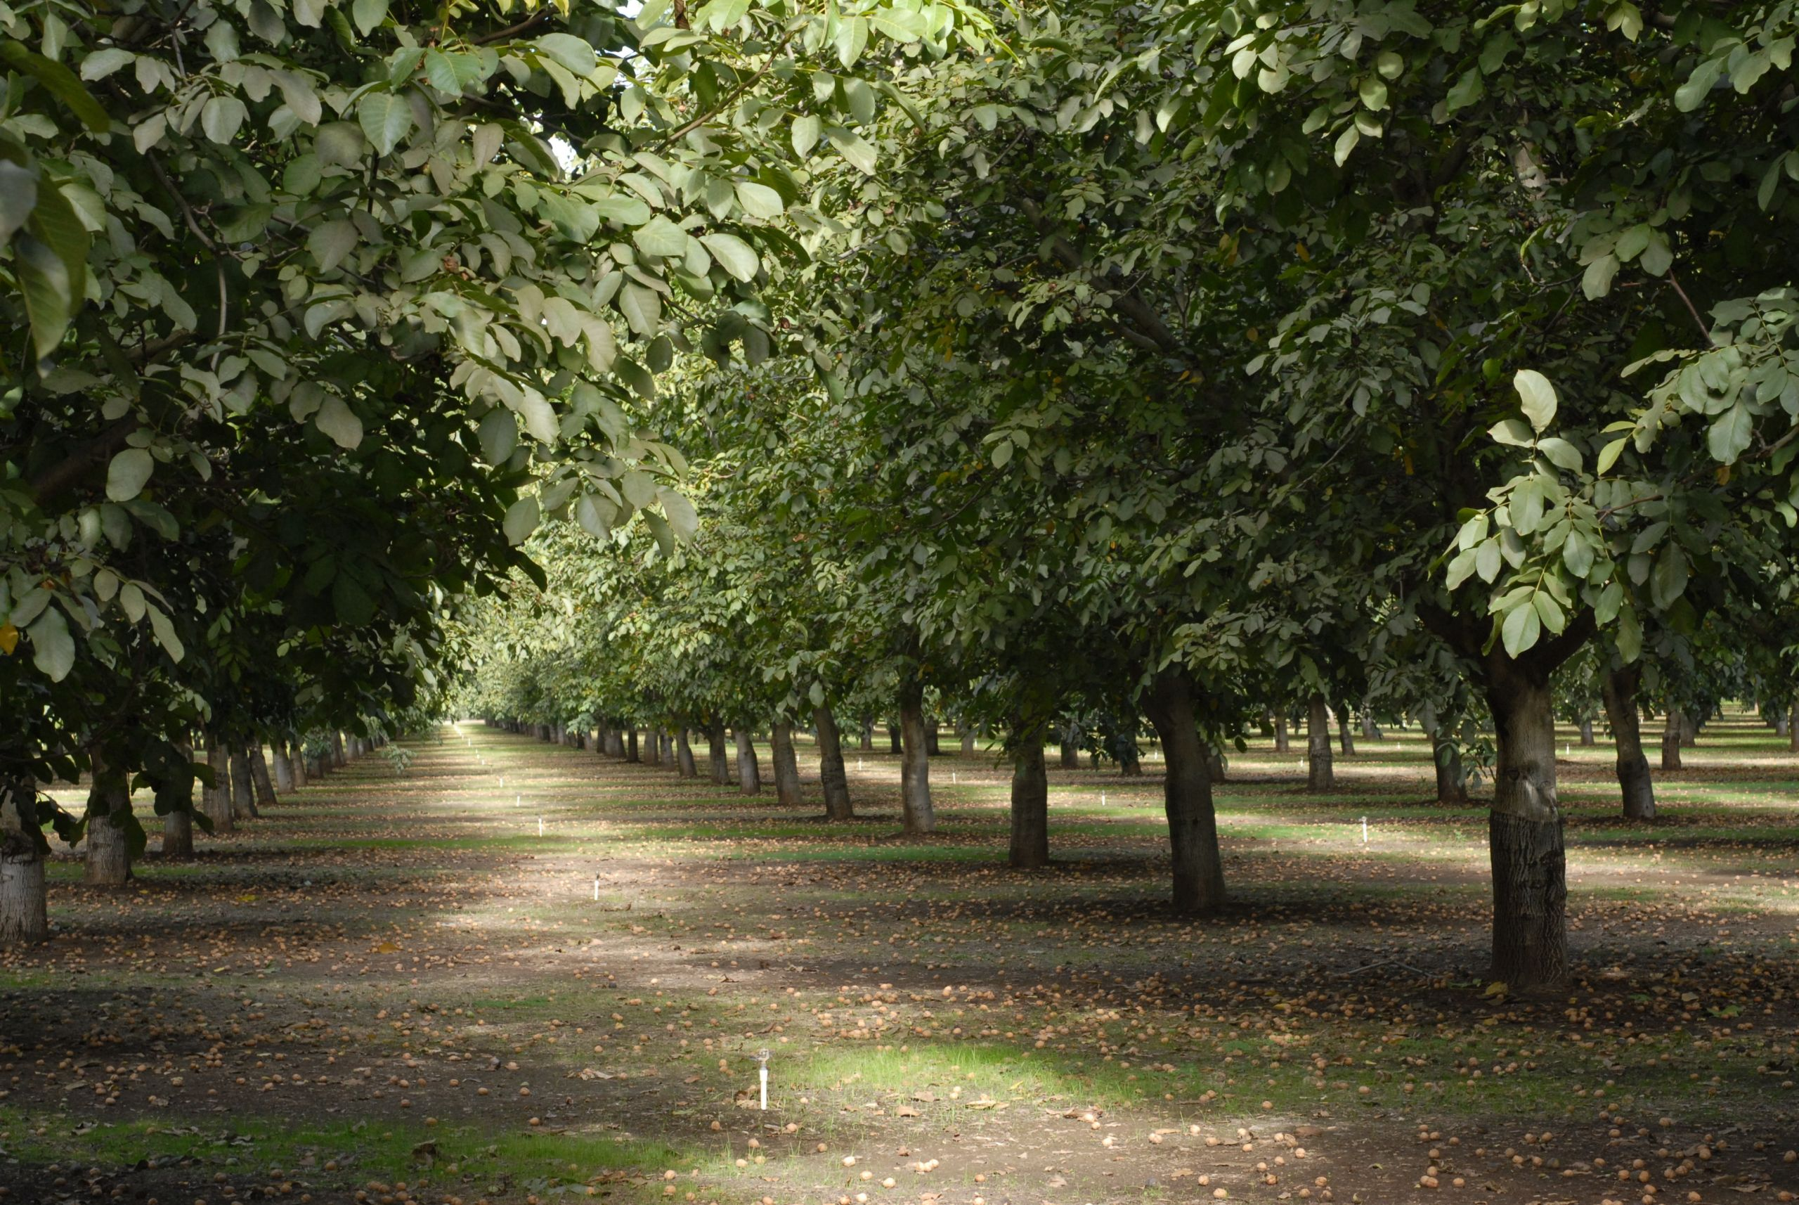
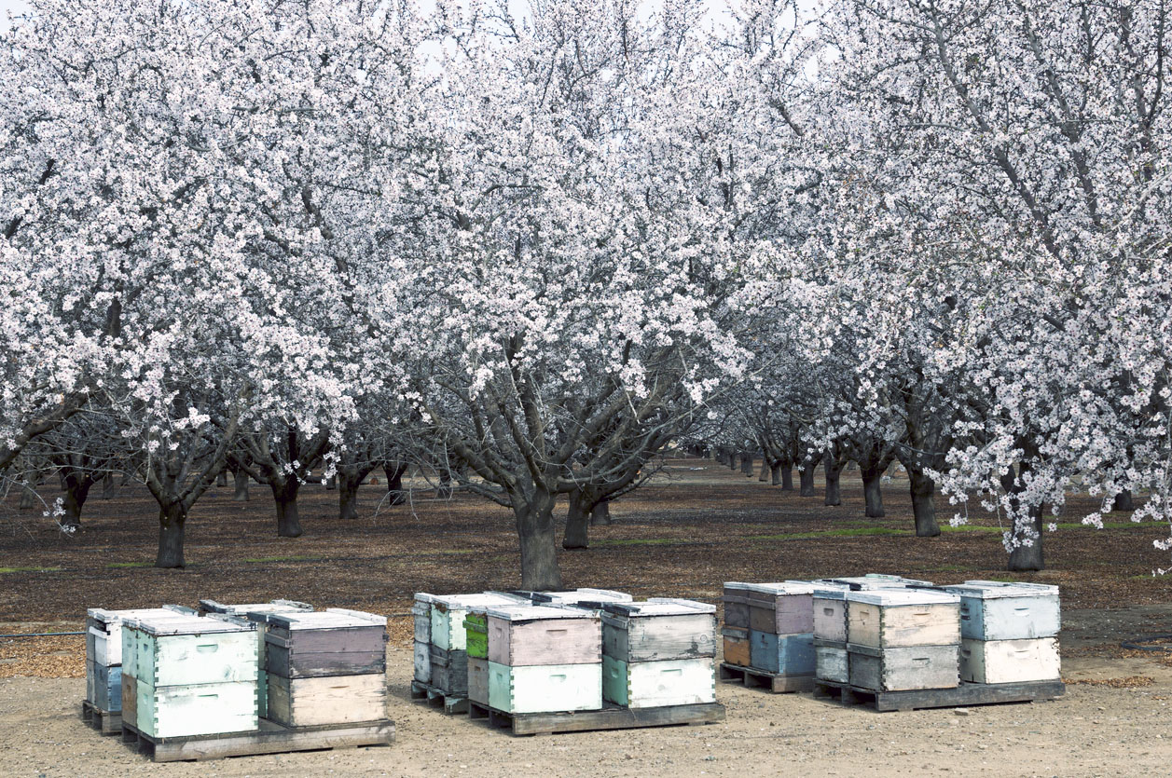

Slide 6
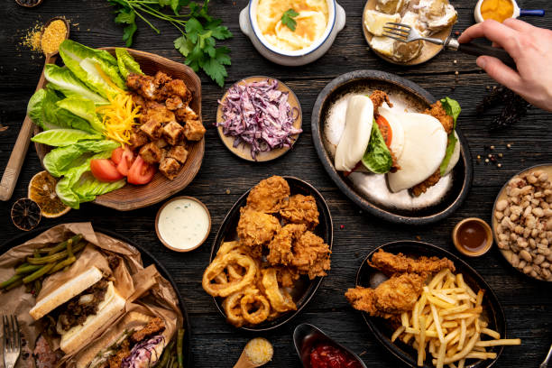
What I’ve learned:
Food is important to everyone
California agriculture feeds the nation
Food Grows Where Water Flows…. or

Slide 7
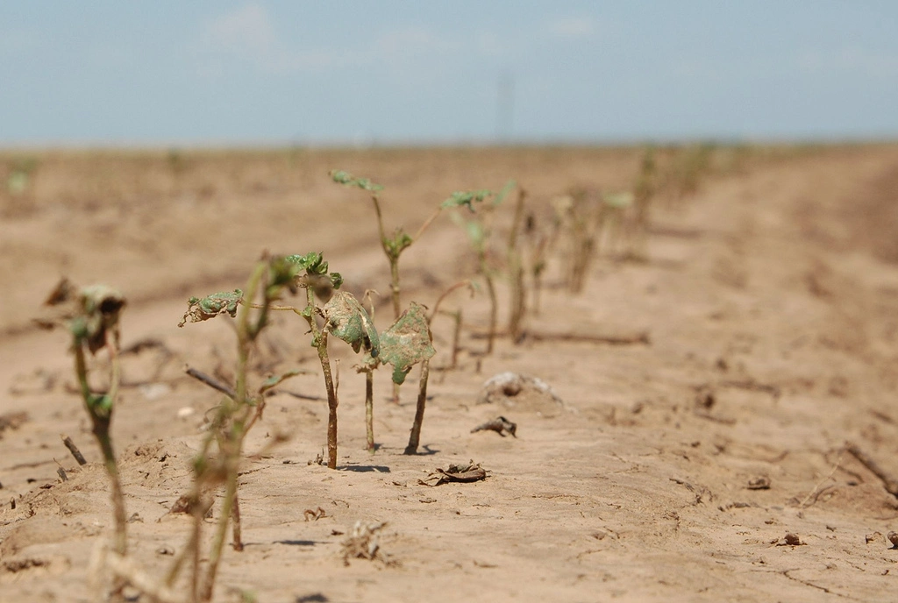
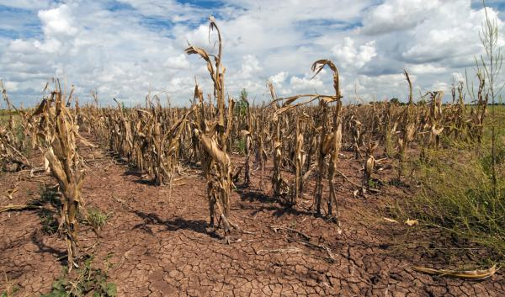
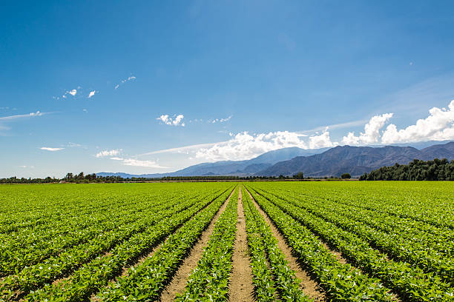
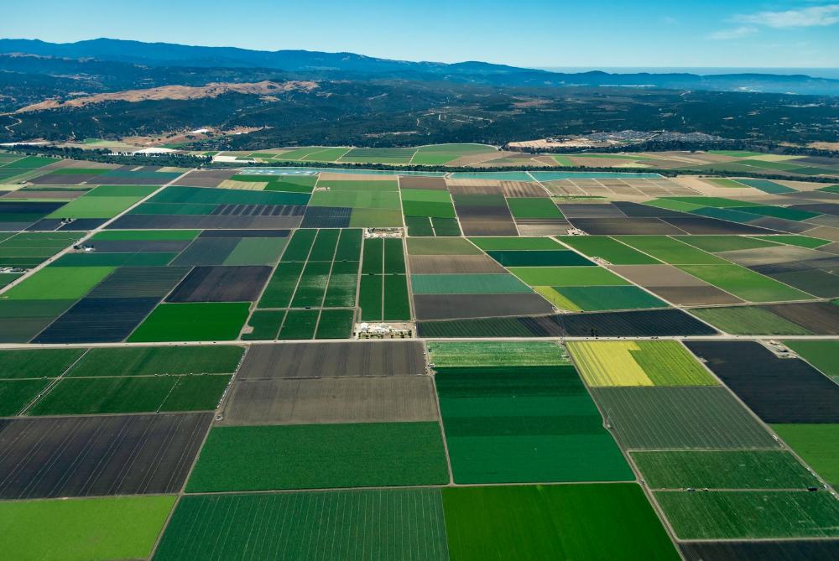
Which do you prefer?

Slide 8
Policy Briefs
April 2022 Drought and California Agriculture
July 2022 Exploring the Potential for Water Limited Agriculture in the SJV
August 2022 Drought Requiring New Strategies for Managing Cropland
February 2023 The Future of Agriculture in the San Joaquin Valley

Slide 9
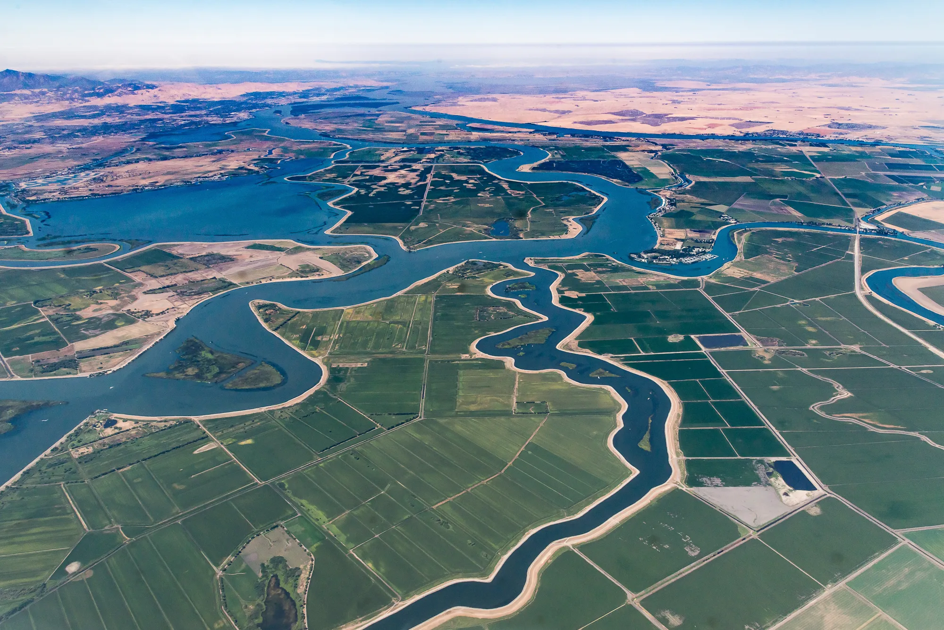
A New Beat #1: Improved Conveyance

Slide 10
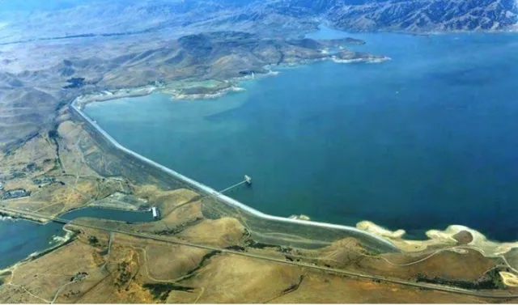
A New Beat #2:
Increased Off Stream
and
Groundwater Storage

Slide 11
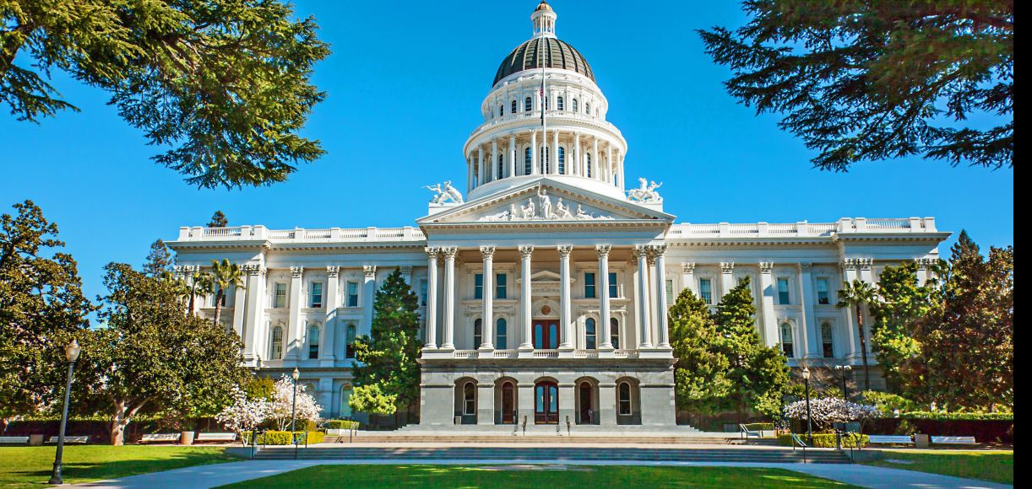
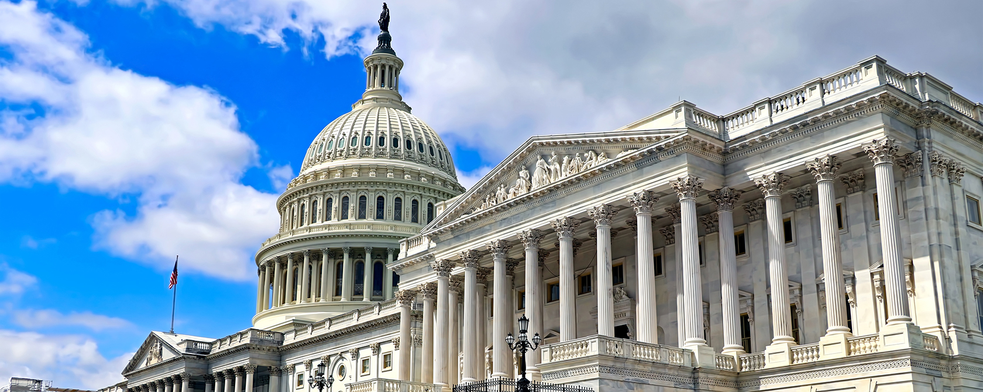
A New Beat #3: Modernized Regulations

Slide 12
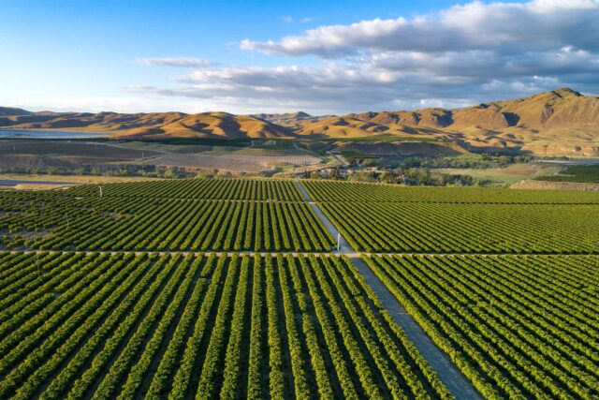
Questions ?
Randy Fiorini
fioriniconsulting@gmail.com

