Slide 1
Time to Build Public Trust

Slide 4
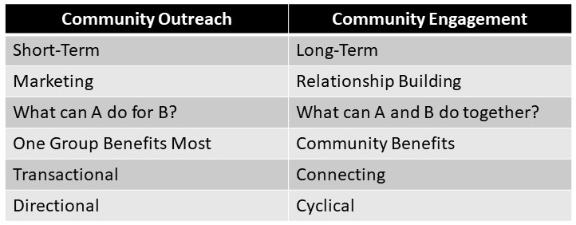
Outreach vs Engagement
Outreach:
A one-way communication to generate attention
Engagement
A two-way conversation to generate change

Slide 5
Engagement
Outreach
Involve
Collaborate
Consult
Empower

