Slide 1

The Wild, Wild West Coast and Central Basins:
A History Lesson
Spring Conference
February 20, 2020

Slide 2

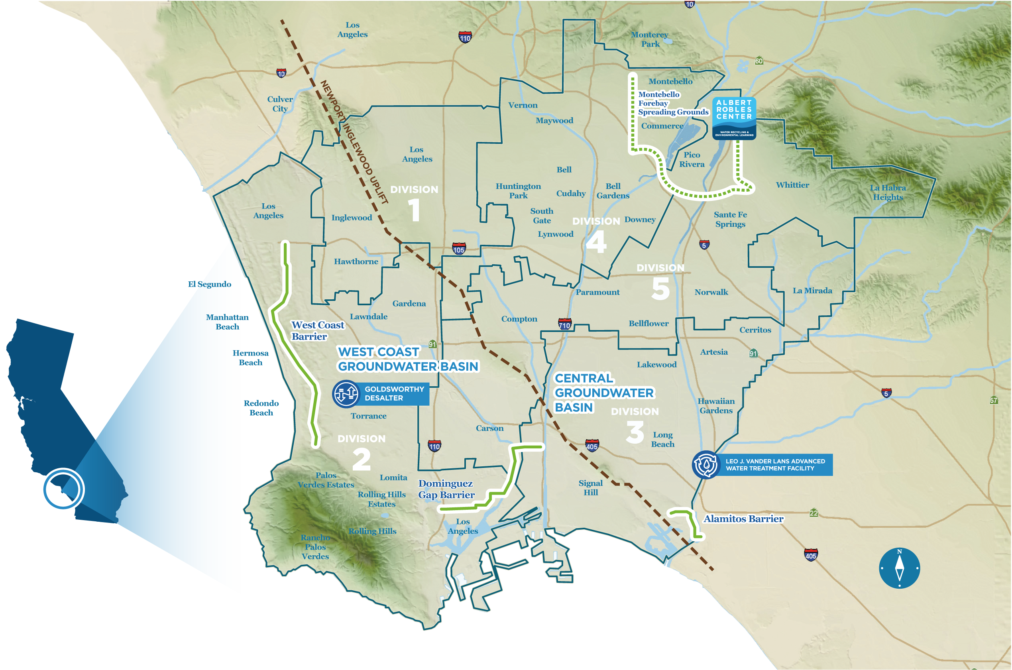



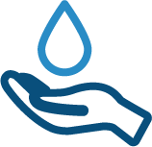

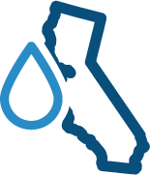

  The Water Replenishment District
Service Area
420 Sq. Miles
43 Cities
Over 4 Million Residents
Water Demand & Supply
550,000 acre-feet
used per year
50% supplied from groundwater wells
50% supplied by imported water
WRD replenishes
the groundwater basins and monitors water quality
Seawater barriers & spreading grounds are owned and operated by the Los Angeles County Department of Public Works

Slide 3
Central Groundwater Basin Storage Categories
Community Storage
111,250 AF
Adjudicated
Storage
Capacity
220,000 AF
Available
Dewatered
Space
330,000 AF
Individual Storage Allocation (ISA)
108,750 AF
(50% of pumping rights)
Basin Operating Reserve
110,000 AF
WRD

Slide 4
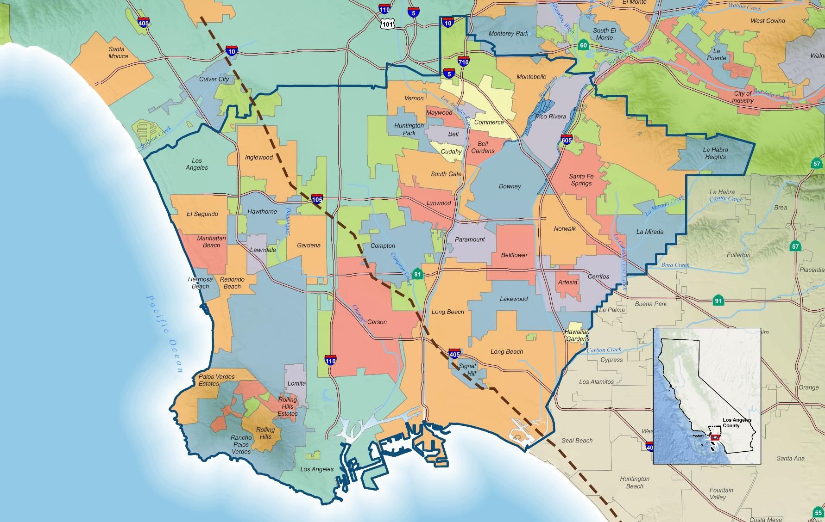
Los Angeles
Whittier
Central Basin
West Coast Basin
Torrance
Long Beach
Newport - Inglewood Uplift

Slide 5
Thank You

