Slide 2
Outstanding Specialty Entrepreneurship Program
Arts & Entrepreneurship Program
Sharon T. Alpi, Director
William “B.J.” Warren, Arts & Entrepreneurship
Andy Heise, Program Coordinator

Slide 3
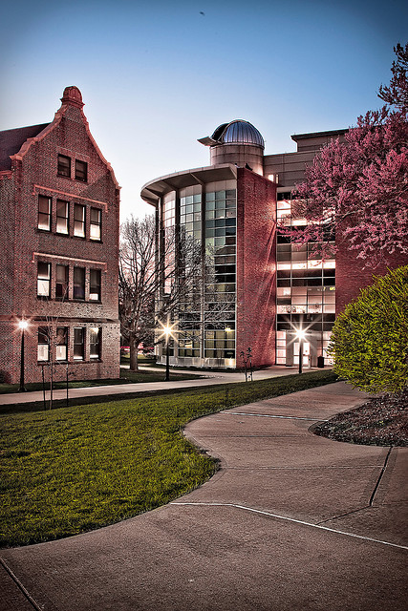
Millikin University
Colleges:
College of Arts & Sciences
College of Fine Arts
College of Professional Studies
Tabor School of Business
Student Body Size: 2,300 students
Average Class Size: 23 students
Campus: Decatur, IL - 75 acres
“A place where the industrial and practical reside with equal importance with the literary and the classical.”
- James Millikin, Founder

Slide 4
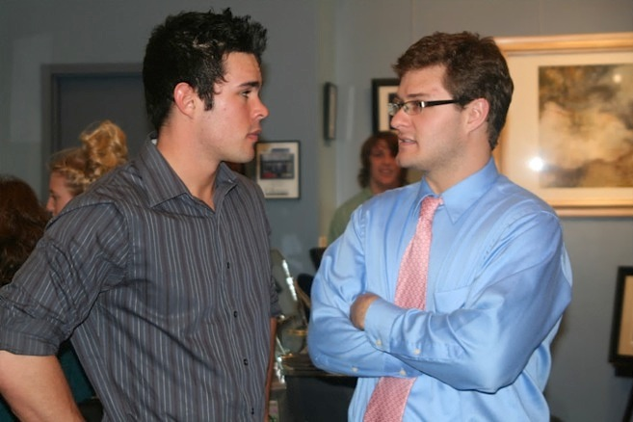
Arts & Entrepreneurship Program
Vision: Be the leader in multidisciplinary arts entrepreneurship education.
Program Goals
Help students become self-sufficient
Provide students a creative outlet to perform business
Establish an ethos of collaboration (multidisciplinary program)
“I learned how to work as part of a diverse group where everyone has different personalities and different projects they are working on, while we all have the same shared goal.”
Domonique Howell
(Entrepreneurship Major, 2011)

Slide 5
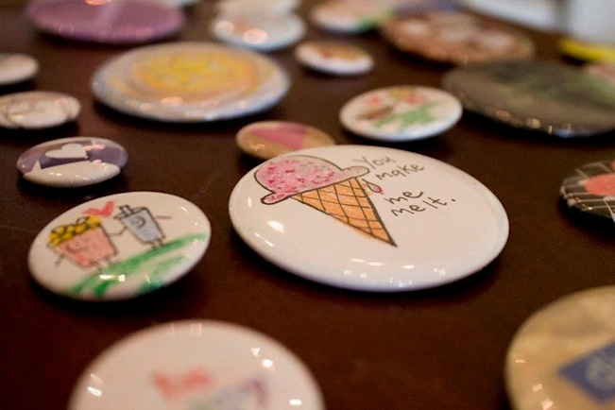
Arts & Entrepreneurship Program
Student Learning Outcomes
Link passion and skills to professional opportunities as an owner or free agent
Identify opportunities, marshal resources, and assess risk in business creation
Identify and leverage financial, human, and intellectual resources necessary to launch and grow a venture
“I learned so much about what it means to go out there and make your art happen. Opportunities are everywhere, and you have to have this entrepreneurial side of you in order to find them.”
Kaylie Honkala
(B. A. Theatre, 2012)

Slide 6
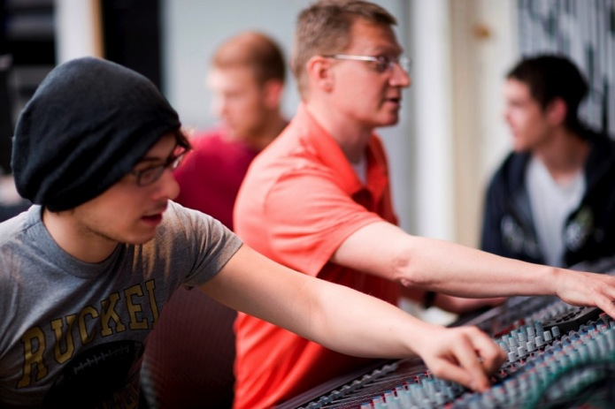
Arts & Entrepreneurship Program
Launched in 2003
Six credit, two course sequence:
Course I: The Art of Entrepreneurship (ET380)
Course II: Student-venture Experience (ET390)

Slide 7
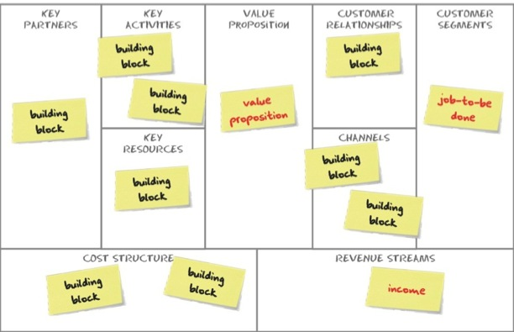
Course I: The Art of Entrepreneurship
Students start a micro-venture
Students develop a business model based on Business Model Generation text
Pitch their models to a panel of investors
Investors determine investment amount (up to $50)
Investors determine whether or not venture receives space in incubator (BC Studios)

Slide 8
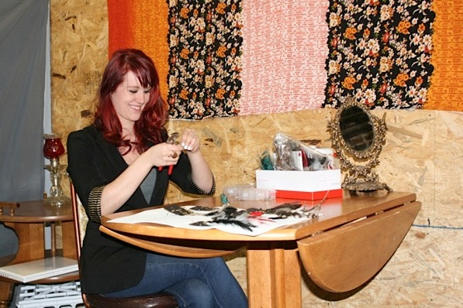
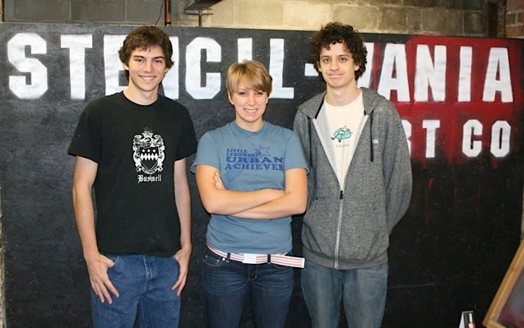
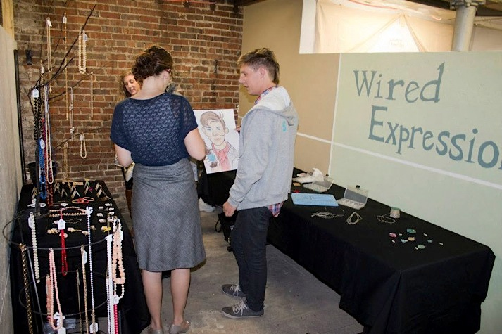
Course I: The Art of Entrepreneurship
Launch the micro-venture

Slide 9
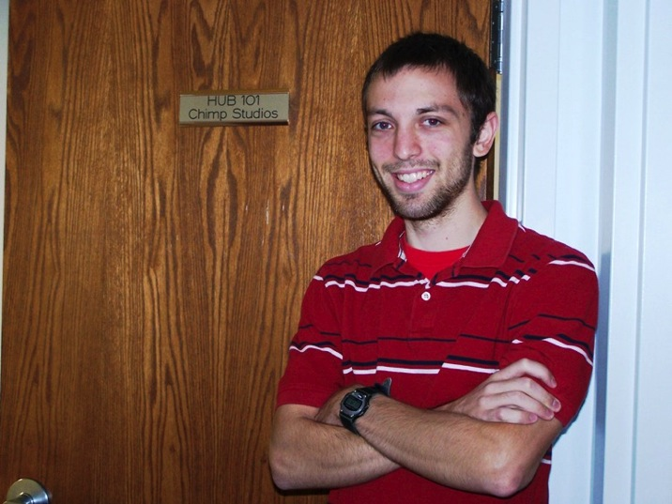
Course I: The Art of Entrepreneurship
Students must repay their investors with earnings from their ventures to pass the class
After completion of the course, students determine next phase of their business
“Graduate” into Millikin’s business incubator (The Hub)
Pivot business model
Cease operations

Slide 10
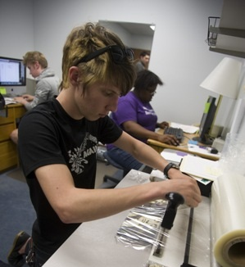
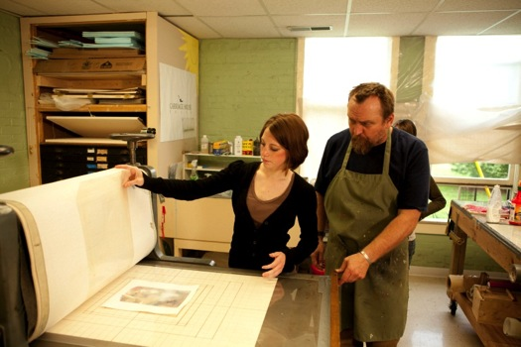
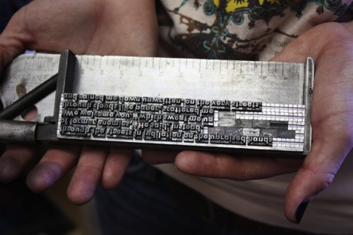
Course II: Student Venture Experience
Students innovate and operate a student venture

Slide 11
Course II: Student Venture Experience
Millikin’s definition of a student-run venture is:
A laboratory of practice delivered as a course grounded in an academic discipline
Student-centered with faculty, alumni, and practitioner coaching and mentoring
Profit and mission driven focus
A business operating in the community where students design, produce, promote, and sell products
Adaptive, offering ample opportunities for student experimentation as each new class enrolls (each semester)
An environment to experience risk with real opportunities for failure and success

Slide 12
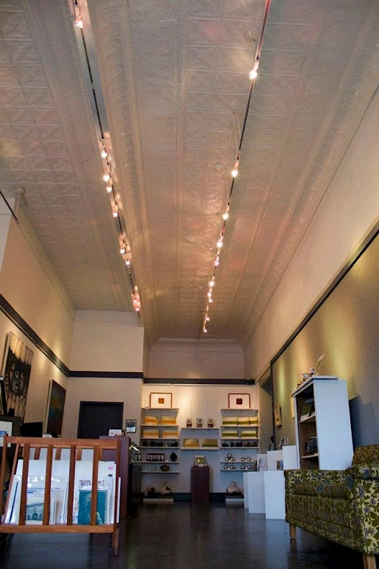
Course II: Student Venture Experience
Retail Art Gallery
Student, Faculty, & Alumni Art

Slide 13
Course II: Student Venture Experience
Studio Theatre Company
Launch and mount new works

Slide 14
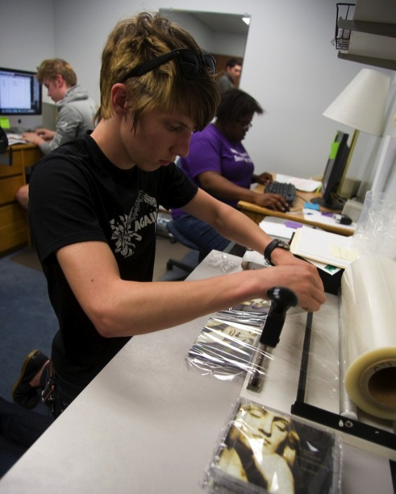
Course II: Student Venture Experience
Record label and publishing company
Millikin Student and Faculty ensembles and compositions
Record label
Commercial artists

Slide 15
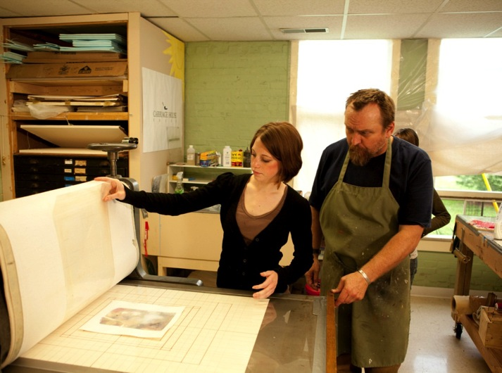
Course II: Student Venture Experience
Fine art printing press studio
Student, Faculty, Alumni, & Resident Artists

Slide 16
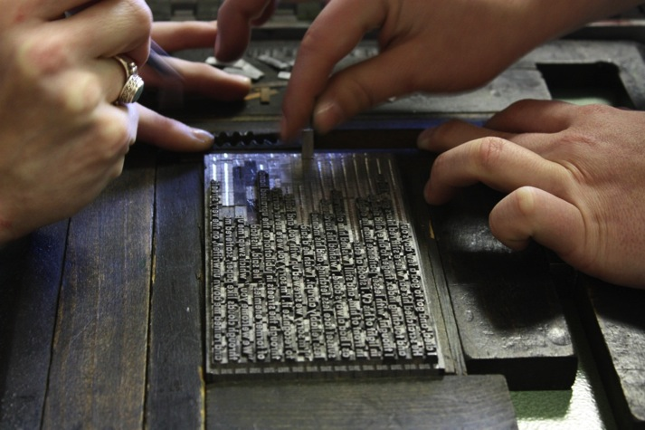
Course II: Student Venture Experience
Letterpress poetry broadside press
Student designed using works from Professional Poets

Slide 17
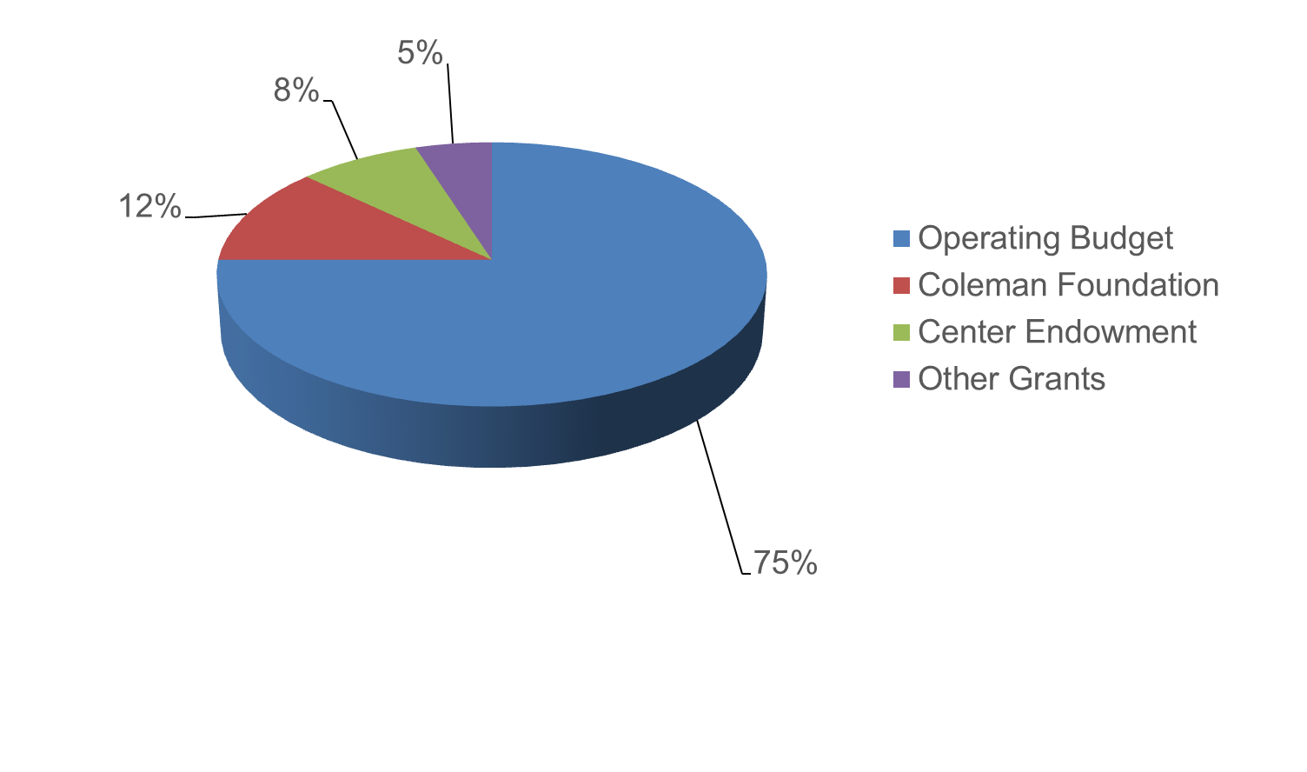
Program Funding Sources

Slide 18
Student Feedback
"Getting thrown into the ‘deep end,’ which is how I felt when we first had to start our own business, was the best thing that I could have ever asked for in a collegiate program.“
Alissa Kim
(B.M. Commercial Music & Music Business, 2013
"From my first day of college, I was immersed into the business world, and since that day I've started two businesses, written numerous business plans, presented a consulting project to the Zambian government, and so much more. I don't think there are very many schools that offer their students this many opportunities.”
Anna Hartman
(Entrepreneurship Major, 2013)
18

Slide 19
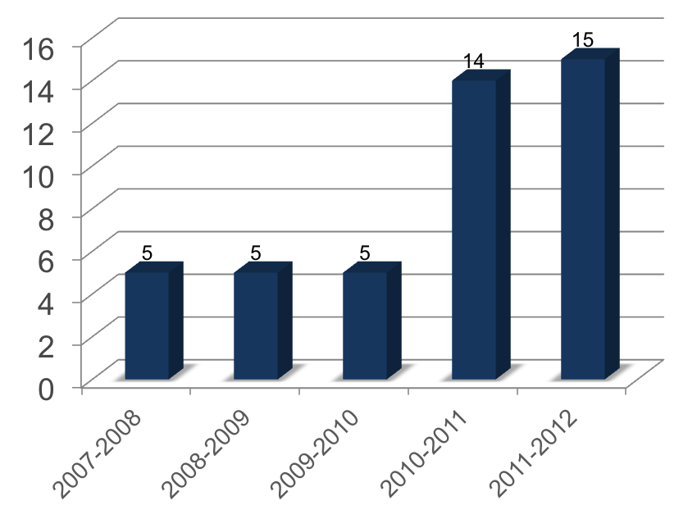
Student Impact
Businesses Financially Supported
“Know how to succeed, how to fail,
how to recover from a failure and
not letting a success get to your
head before having this be your real
job is a definite positive to the
course….”
Alex Scholinsky
(B.A. Theatre, 2012)
“I had pride in seeing my hours of
work for the company produce
results, and most importantly see
the groundwork I had laid down be
continued by new members of the
company.
Bekki Lambrecht
(BFA Design/Production, 2011)

Slide 20
Millikin University
Center for Entrepreneurship
www.millikin.edu/entrepreneurship
e-center@millikin.edu
Sharon T. Alpi, Director
William “B.J.” Warren, Arts & Entrepreneurship
Andy Heise, Program Coordinator

