Slide 1
BALL STATE UNIVERSITY
ENTREPRENEURSHIP PROGRAM
Nominee for National Model Undergraduate Entrepreneurship Program Award
USASBE Conference 2013 – San Francisco

Slide 2
Muncie, Indiana
INSERT VIDEO FILE

Slide 3
Comprehensiveness

Slide 4
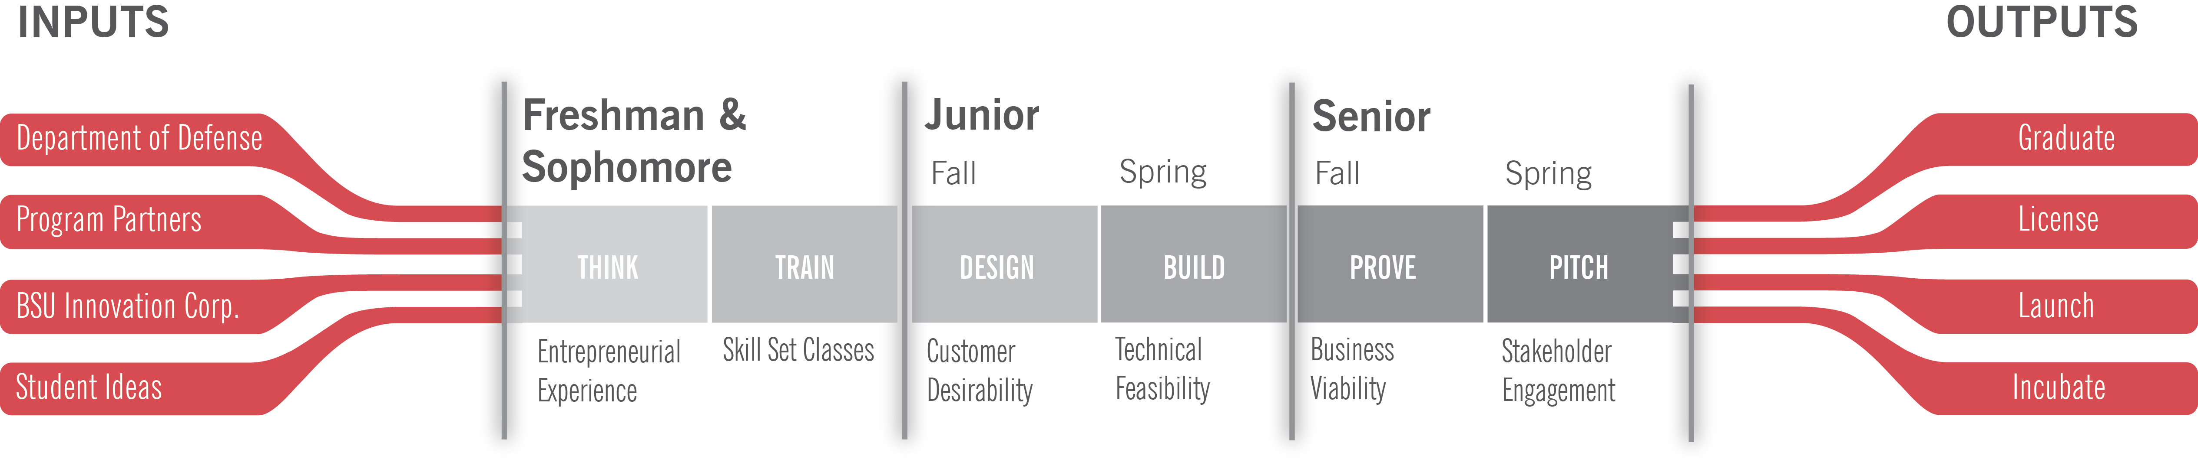
The Entrepreneurship Channel

Slide 5
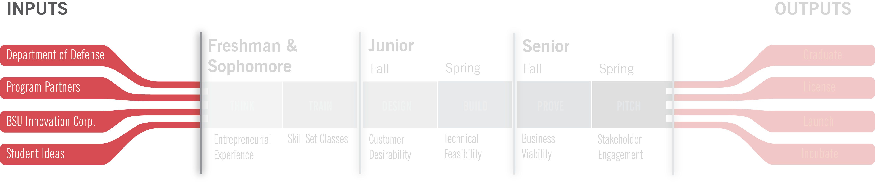
Inputs

Slide 6
Entrepreneurship Partners:
AED Motorsports
AGS Capital, LLC
Anson Group, Inc.
Bastian solutions
Beacon Venture Capital
Biomet, Inc.
Blackboard, Inc.
Cambridge Capital Management, Inc.
Charles G. Koch Charitable Foundation
CJ Racing
Clarian Health, Inc.
Department of Defense
Eli Lilly Corporation
Gaylor Group, Inc.
Gazelle Tech Ventures
Geneva Capital Group
Hewlett Packard, Inc.
Hunt Construction Group
Indiana Inventors Association
Indiana Motorsports Association
Indiana Small Business Development Center
Katz, Zapper, & Miller, LLP
Monument Advisors
Papa Johns International, Inc.
The Disney Company
U.S. Navy
U.S. State Department
Vectren Corporation
Walker Information
Woodard, Emhardt, Moriarty,McNett, & Henry, LLP
Xtreame Alternative Defense Systems
Notes:
We extend this innovation to our partners. To highlight a few

Slide 7



Military 2 Market

Slide 8
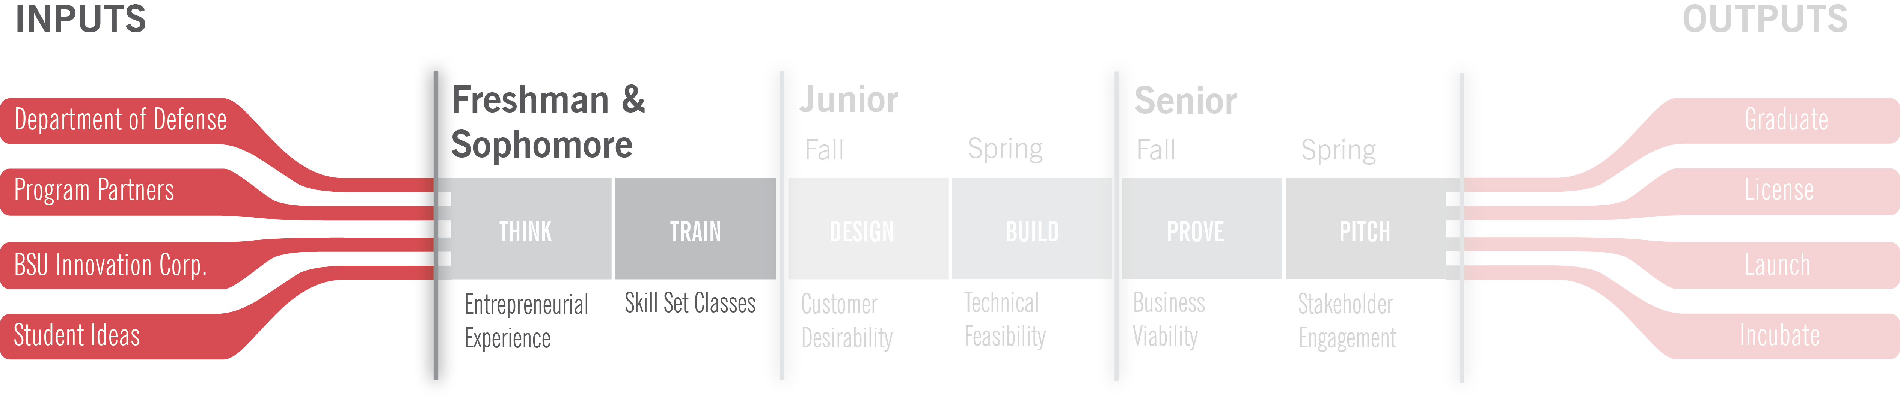
Freshman & Sophomore Years

Slide 9
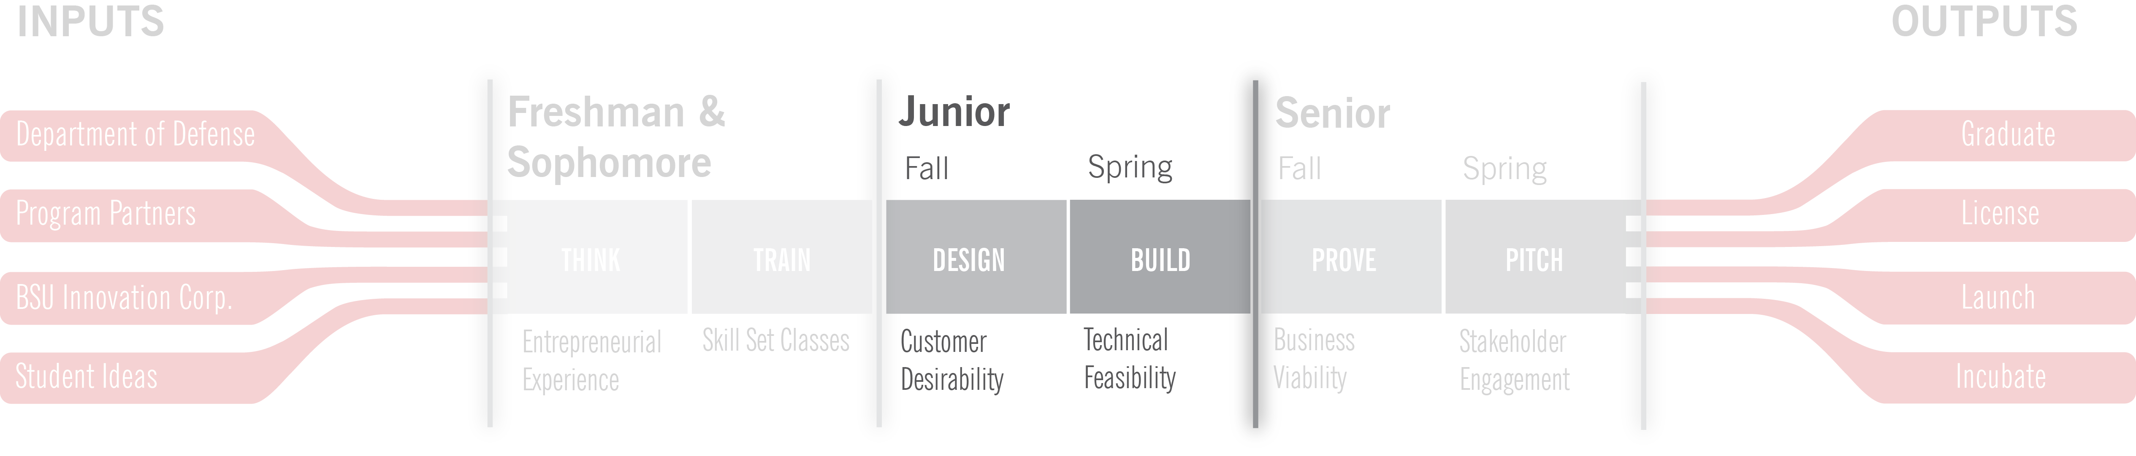
Junior Year

Slide 10
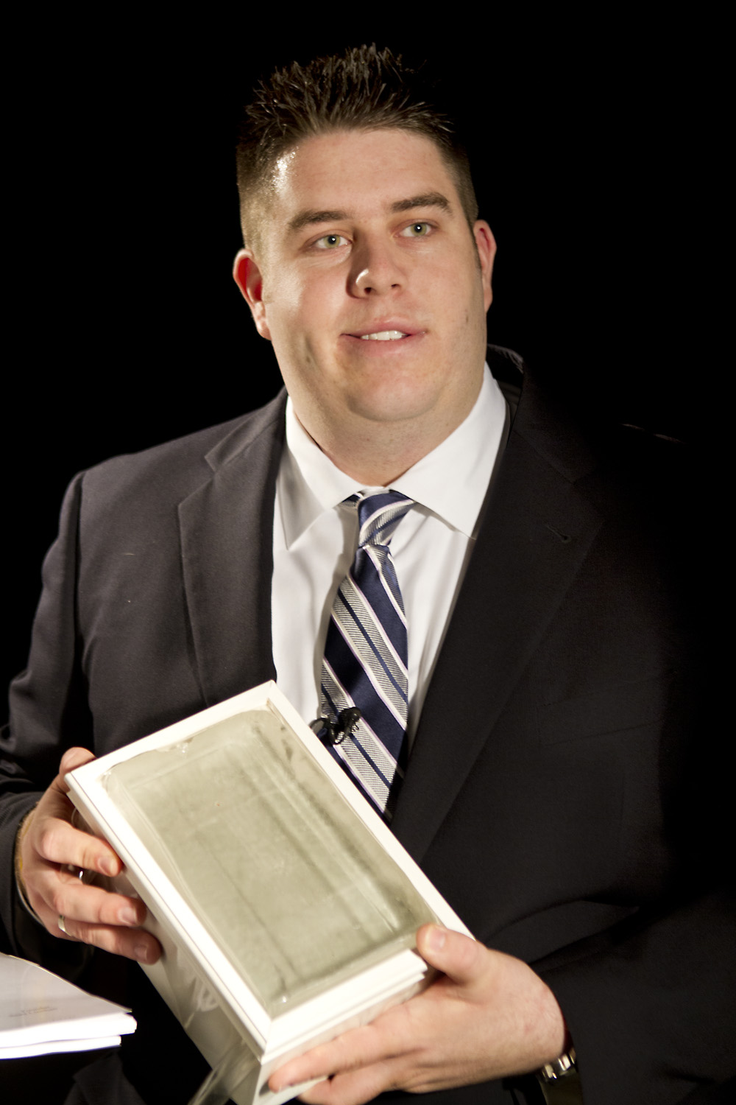
Simulated Skin: Iteration

Slide 11
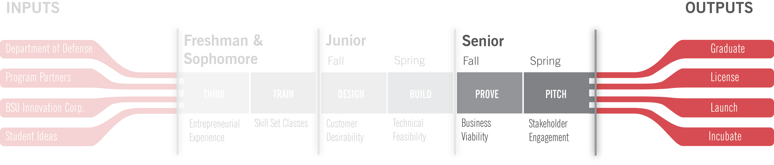
Senior Year

Slide 12
Simulated Skin: Iteration

Slide 13

Quality
Business Plan Competitions
E-Day

Slide 14
Transferability
Notes:
But it’s not just what we do, it’s that our program can be created almost anywhere.
Our Military to Market program can be applied anywhere there’s a military lab. Which is...

Slide 15
Federal Laboratory Consortium
Military 2 Market was ranked
“Best Technology Transfer Program in the Nation”
- April 2013

Slide 16
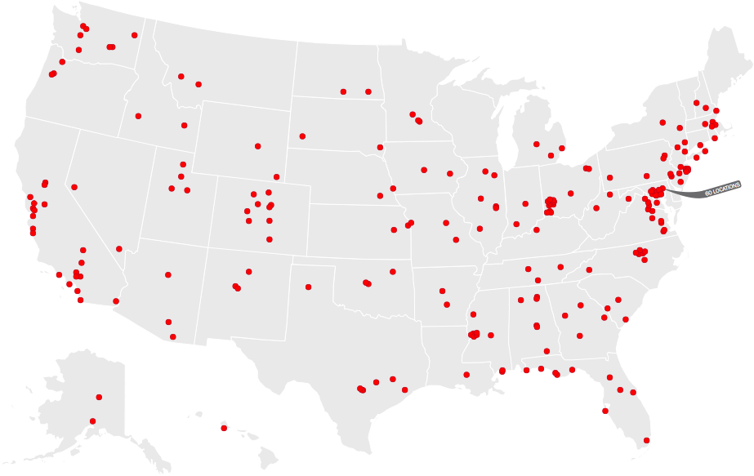
Notes:
Well almost everywhere.

Slide 17
Sustainability

Slide 18



30 Years of Entrepreneurial Excellence... Top 15 since 1999

Slide 19
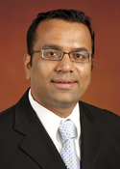



New Hires
???
Dr. Pankaj Patel
Dr. Macus Wolfe
Dr. Susan Clark Muntean
Senior Professor

Slide 20
Effectiveness

Slide 21
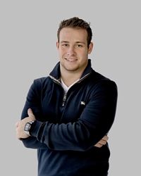
Post Graduation Opportunity: Corporate Employment
Kyle Kuntz
Business Development at Hunt Construction Group

Slide 22
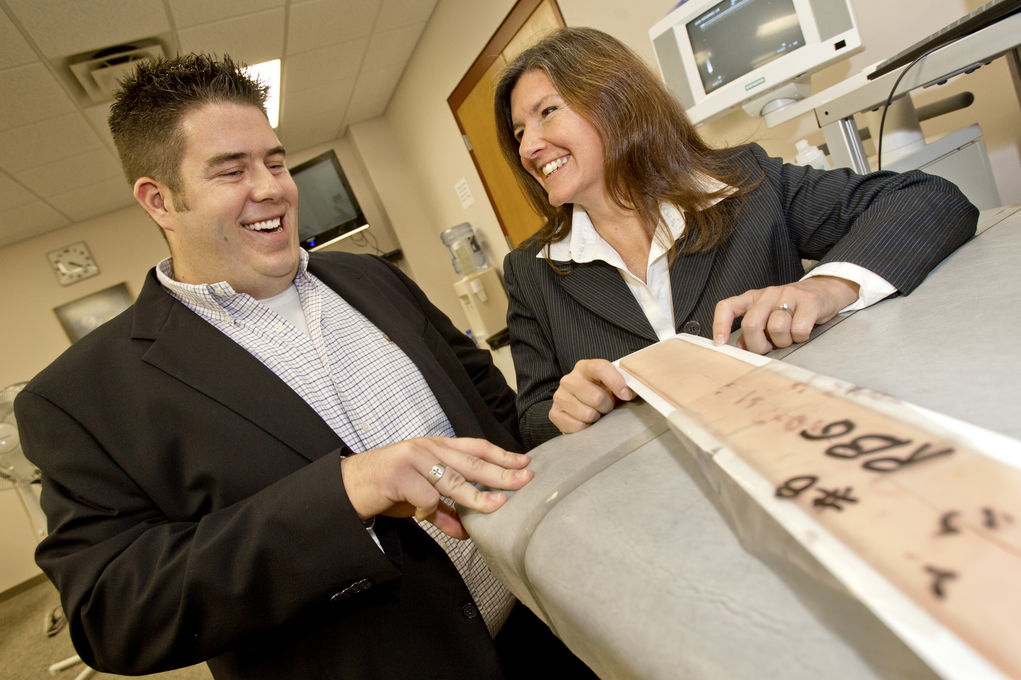
Post Graduation Opportunity: License and Incubation
Sean Linehan
Founder of PonoLogic Technology, LLC
Licensed Technology from US Navy
Simulated Medical Skin

Slide 23
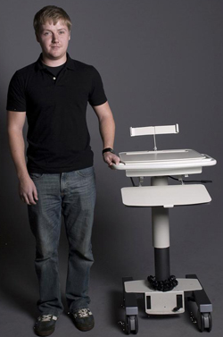
Post Graduation Opportunity: Launch (Product Business)
Eric Lundberg
Founder of Lund DataCart
Expansion of Family Business
Over 3,000 units sold

Slide 24

Post Graduation Opportunity: Launch (Service Business)
Emily Eoff
Founder of Stitch Sisters, LLC
Branding and Apparel Design Business
IZOD Racing and National Tennis Association

Slide 25
Entrepreneurship at Ball State:
INSERT VIDEO FILE

