Slide 1
MBA Entrepreneurship Program Henry W. Bloch School of Management University of Missouri-Kansas City
USASBE National Model MBA Program Finalist Session
2012 USASBE Conference
January 13, 2012

Slide 2
Aligned Mission, Common Vision

Slide 3
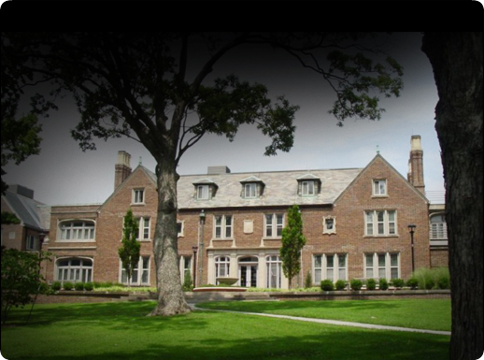
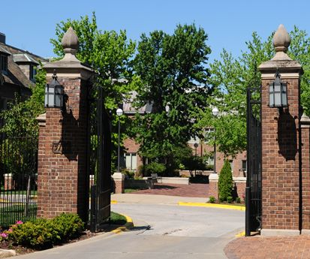
Kansas City: A rich entrepreneurial tradition
Legacy…
…Foundation…
…and Future
Kemper
Hall
Bloch
Stowers
Illig
Cummings
Berry
Burrell
Helzberg
Kao
Nelson

Slide 4
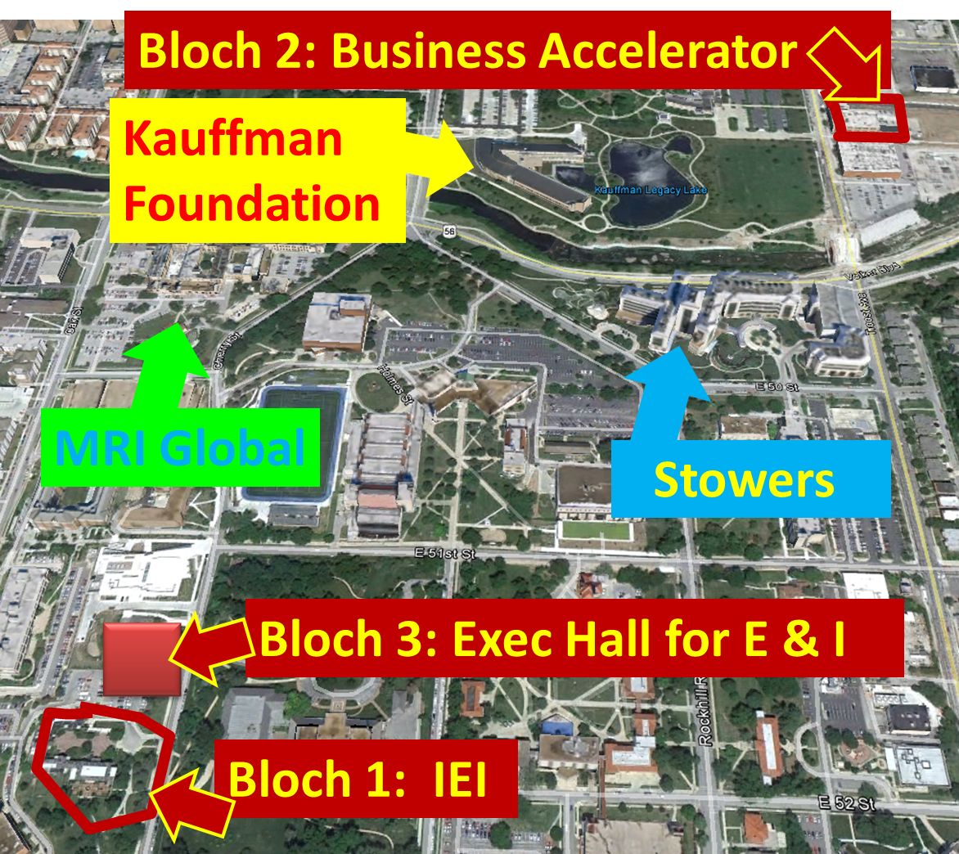
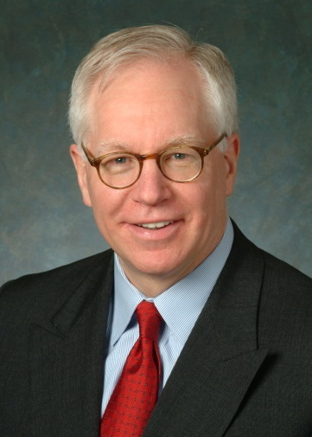
A special place for entrepreneurship
“[W]ith the Kauffman Center here, with the Stowers Institute and MRI Global across the street, and The Bloch School just two blocks up the hill, this is probably the most entrepreneurial corner in the world.” –Kauffman Foundation President Carl Schramm, 11/5/2011

Slide 5
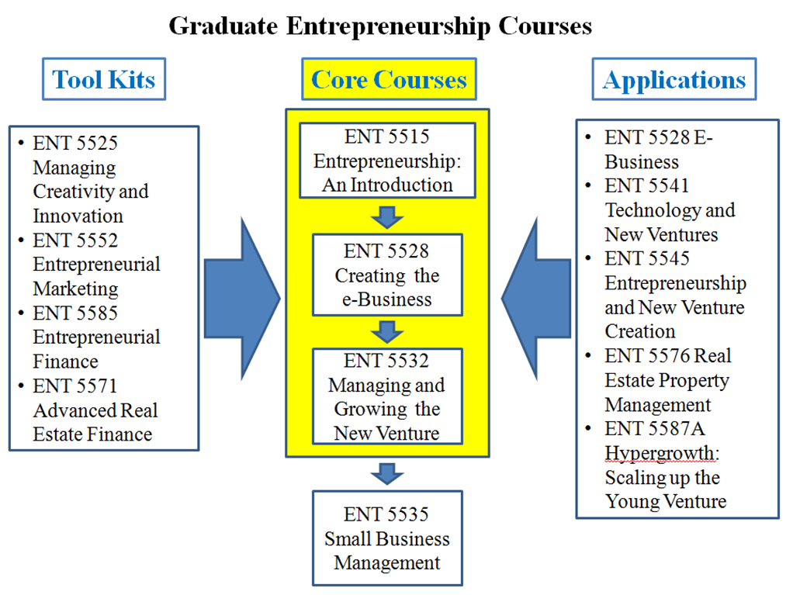
MBA Program Elements Curriculum and Ecosystem

Slide 6
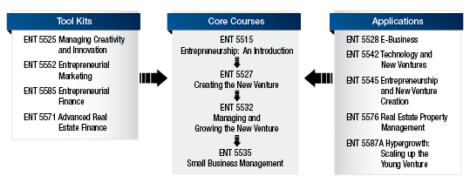
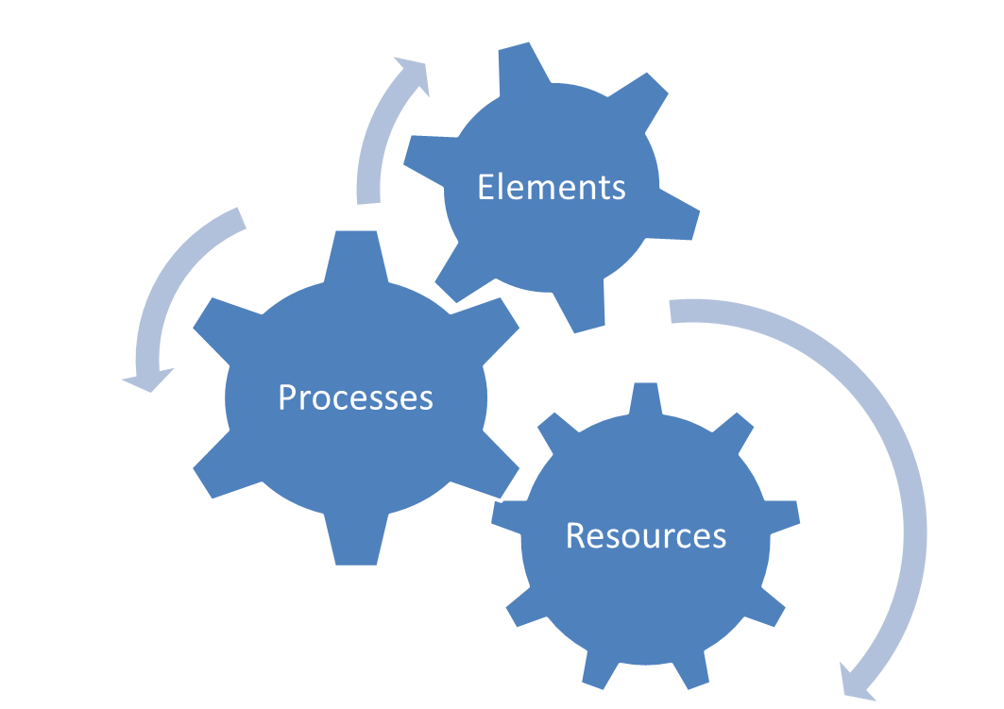
Entrepreneurial Ecosystem
Resource workshops
Entrepreneurs-in-Residence
Formal mentoring program
Entrepreneurship Scholars
Student-run clubs
Regnier Family Foundations Venture Creation Challenge
Student venture accelerator
Venture seed fund
Capital Access Network

Slide 7
Innovation
Transferability
Depth of Support
Impact
Innovation
Quality
Comprehensiveness
Sustainability
Course sequencing
Support ecosystem
Entrepreneurship and New Venture Creation—CE 311, ENT 5545, LAW 8757N
Entrepreneurship Scholars

Slide 8
How the E-Scholar Program Works
Pre-Application:
Idea Generation
Workshops
Phase 1:
Feasibility Analysis
Competitor Analysis
Customer Analysis
Value Analysis
Simple Financials
Revised Idea Summary
Phase 2:
Planning
Marketing Plan
Operations Plan
Financial Statements
Legal Issues
Complete Business plan
Application:
Idea Summary:
Problem
Size
Solution
Competitors
Differentiation
Pricing Strategy
Fit
Strengths/ Weaknesses
Phase 4:
Implementation

Slide 9
Quality
Transferability
Depth of Support
Impact
Innovation
Quality
Comprehensiveness
Sustainability
Faculty Achievement
Program Recognition
Successful entrepreneurs
Mentors commit a minimum of ten hours each month to coaching our students
60 CEOs and Founders → 1:1 student teacher
Community Support

Slide 10
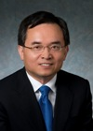
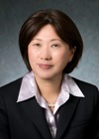
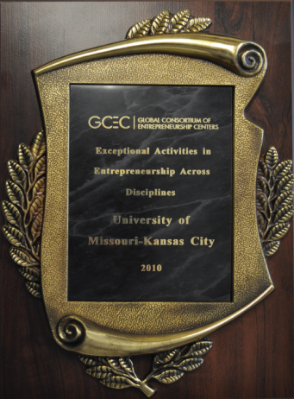
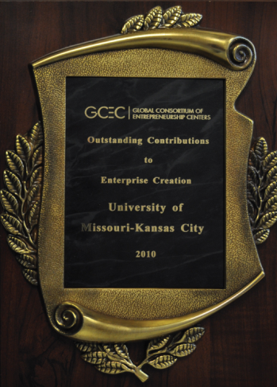
Recognition: Peer institutions, academic colleagues
JPIM: “World’s No. 1 Innovation
Management University”
JPIM: “World’s No. 1, No. 4, and
No. 50 Innovation Management Scholars”
The Princeton Review: “Undergraduate and MBA programs ranked in the Top 25”
GCEC: Exceptional Activities in
Entrepreneurship Across Disciplines
GCEC: Outstanding
Contributions to Enterprise Creation

Slide 11
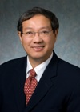
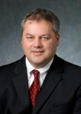
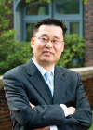
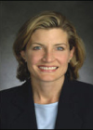
Faculty and Entrepreneurs in Residence

Slide 12
Comprehensiveness
Transferability
Depth of Support
Impact
Innovation
Quality
Comprehensiveness
Sustainability
Core curriculum + Tool kits and Applications
Cross-disciplinary curriculum integrated with other schools
Support ecosystem: Mentor programs, network, legal clinic, workshops, Regnier Family Foundations/Bank of Blue Valley Venture Creation Challenge

Slide 13
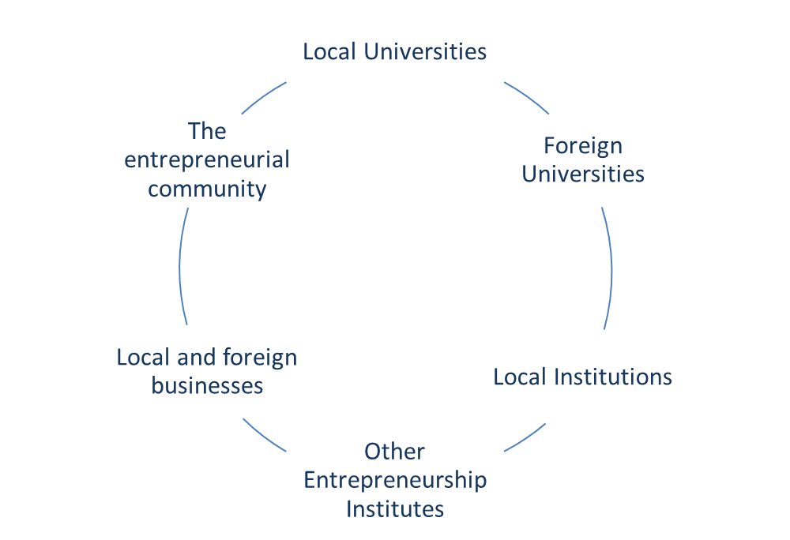
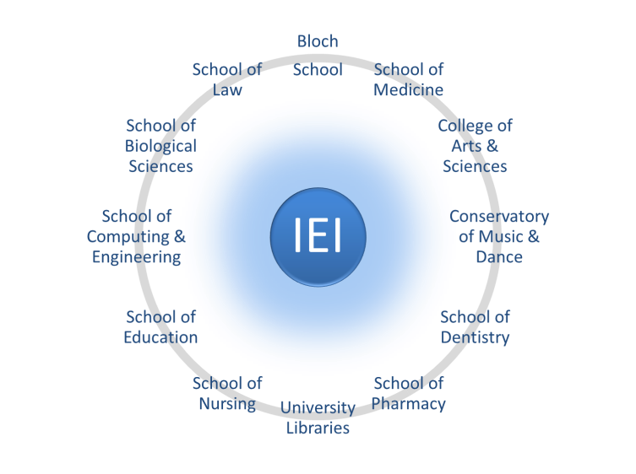
Cross-Campus Entrepreneurship Education
Cross-Border
Collaboration

Slide 14
Sustainability
Transferability
Depth of Support
Impact
Innovation
Quality
Comprehensiveness
Sustainability
Entrepreneurial focus at all university levels, President to Chancellor to Dean to Director
Permanent, dedicated department
Permanent university financial commitment
Henry W. Bloch Executive Hall for Entrepreneurship and Innovation
Part of Kansas City’s “Big 5” Initiative

Slide 15
Transferability
Transferability
Depth of Support
Impact
Innovation
Quality
Comprehensiveness
Sustainability
Start small and bootstrap—use volunteers and in-king support
Plan—develop a complete business plan with set initiatives
Strategic focus, on goals and on metrics
Get the business community excited about results
Cross-campus champions in other schools
Modular, yet integrated program components—anyone can adapt and use
Heavy documentation to enable replicability

Slide 16
Depth of Support
Transferability
Depth of Support
Impact
Innovation
Quality
Comprehensiveness
Sustainability
Scholarships, angels, and investment fund
Mentors from 26 business and technical functions, 22 major industry groups
Institute Teaching Fellows, Mentors in Residence
Entrepreneurship Legal Clinic
Support and money come as a result of achievement

Slide 17
Impact
Transferability
Depth of Support
Impact
Innovation
Quality
Comprehensiveness
Sustainability
On business education
On the disciplines of entrepreneurship and innovation management
On the regional economy
On students’ lives
On mentors
On donors
On university health and morale
On community pride

Slide 18
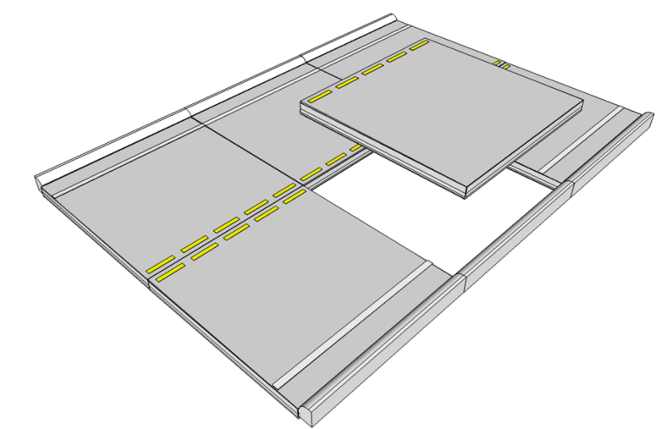
Student Ventures

Slide 19
Thanks
Transferability
Depth of Support
Impact
Innovation
Quality
Comprehensiveness
Sustainability
http://www.youtube.com/watch?v=61rQczKZB0w

