Slide 1





WELCOME!
2026 Property Management Licensing Update
A few announcements before we get started...

Slide 2
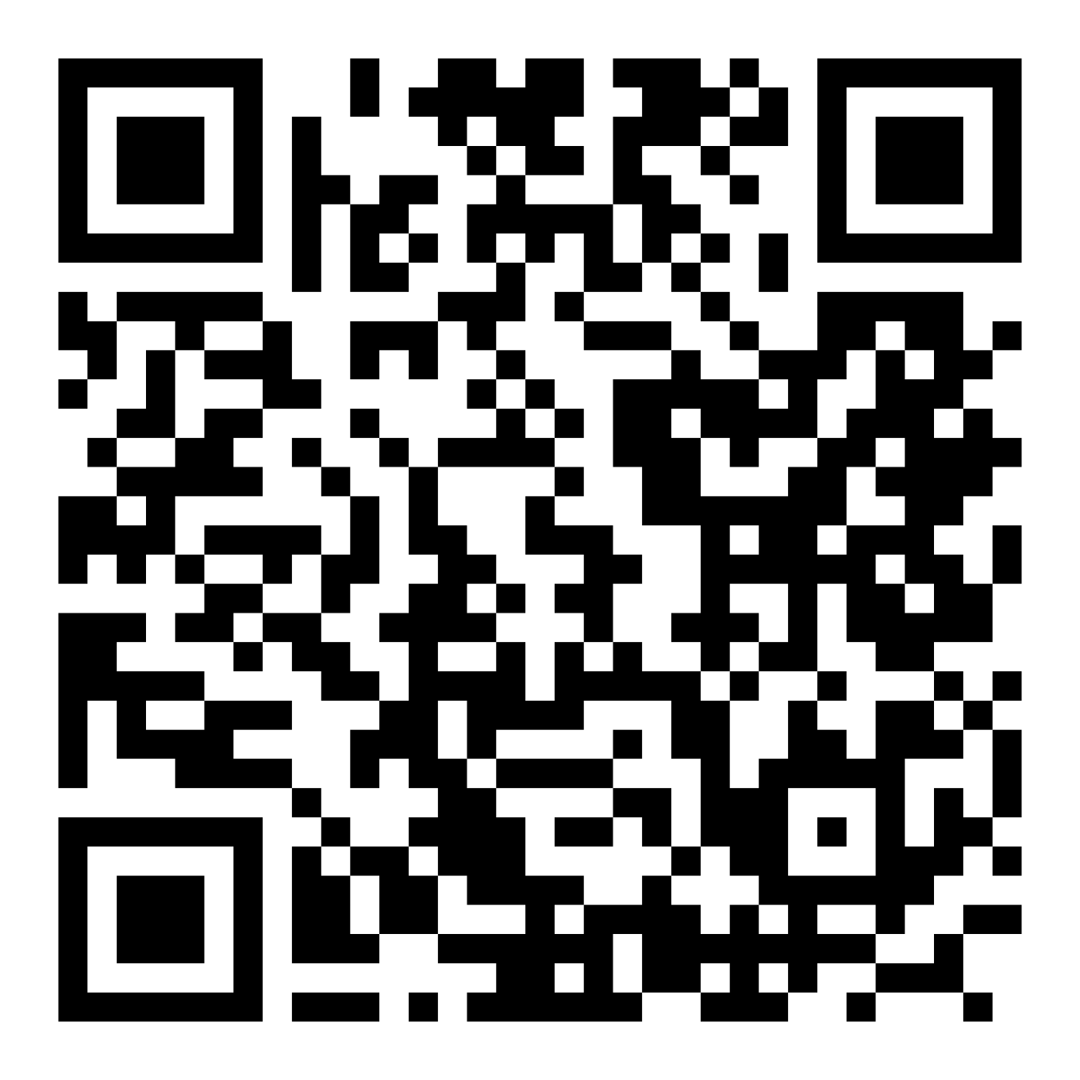

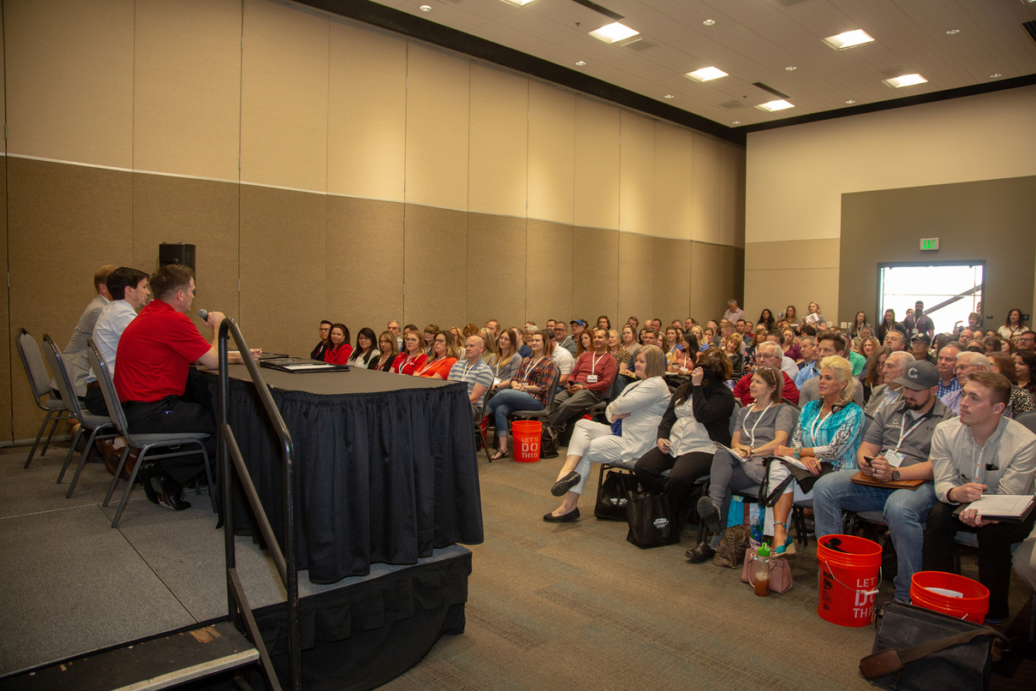
Scan QR Code for Access:
Education Resources
Today’s Conference Presentation
Available Here

Slide 3
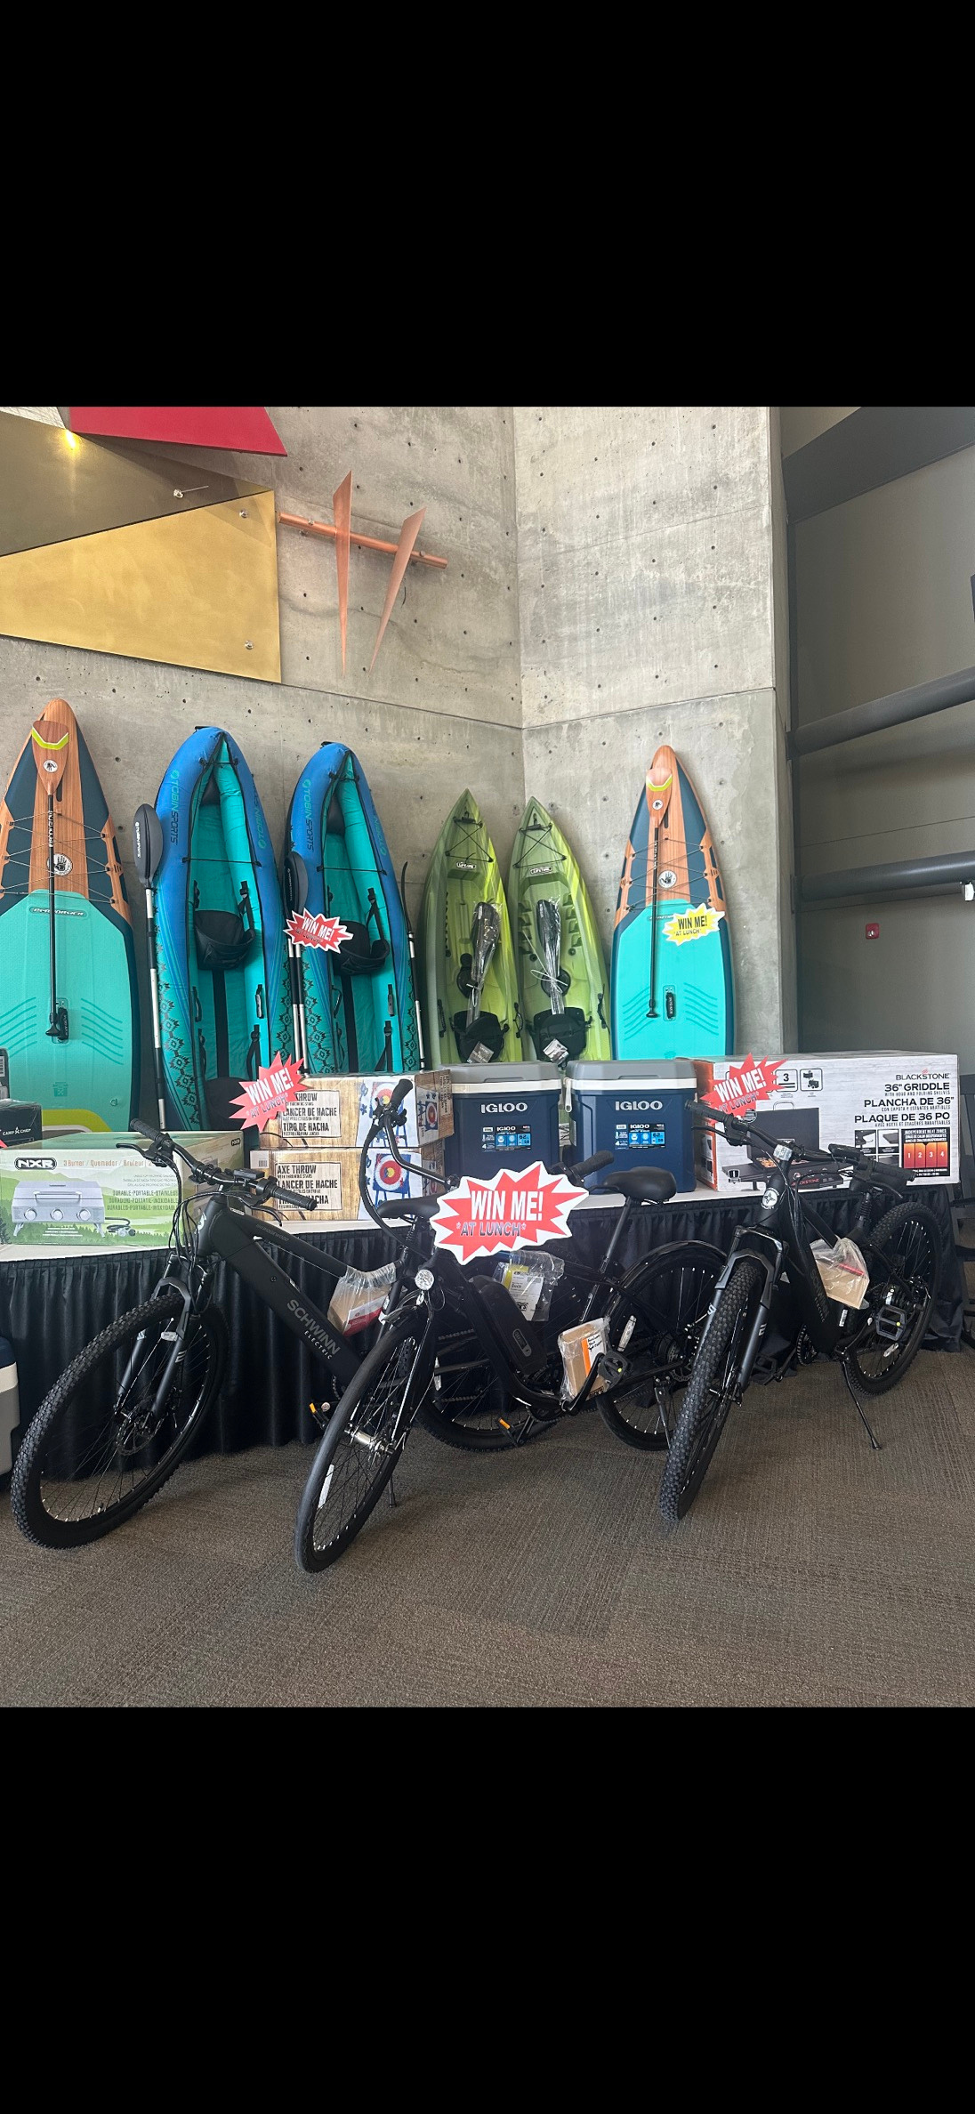
Lunch Time Prize Giveaways
Lunch is in Hall 4, southeast side of the trade show floor. There will be $10K in prizes given away!

Slide 4
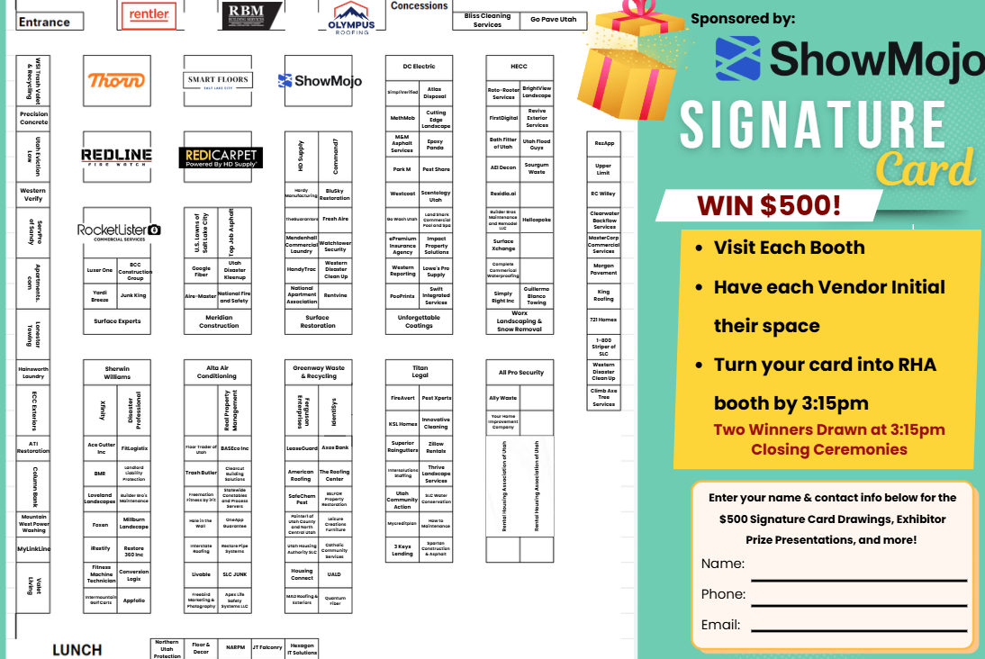
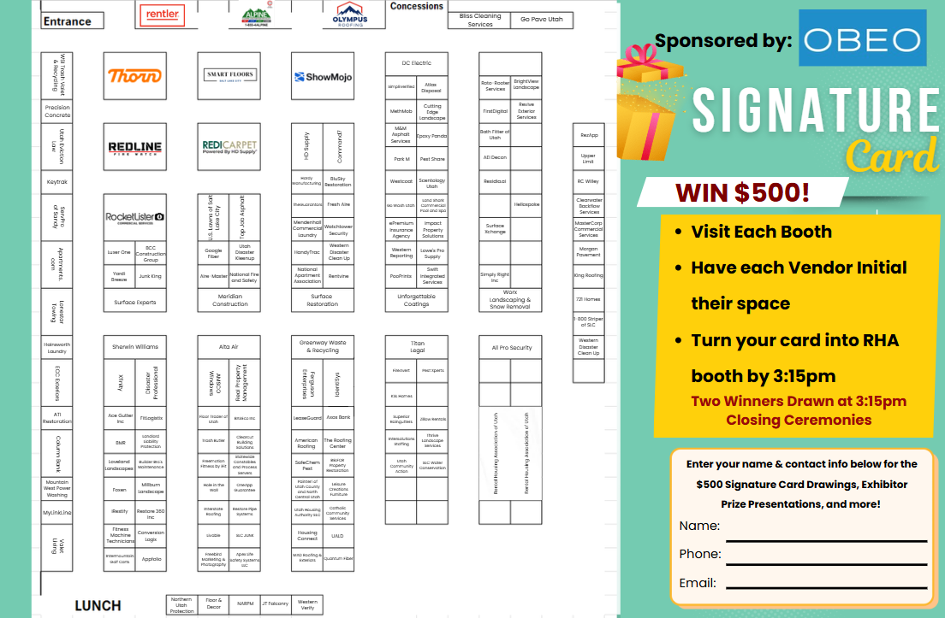
Signature Cards
As you visit the trade show floor, remember to get your signature card filled out. Turn it in at registration by 3:15 PM to be entered to win two $500 Cash prizes at the 3:30 closing ceremonies, also in Hall 4.

Slide 5

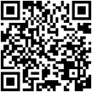
RHA P.A.C. Fundraising Giveaway
Donate $25 or more to the RHA PAC for a chance to win $500!
Winner announced at 3:30 Closing Ceremonies.

Slide 6


