Slide 1
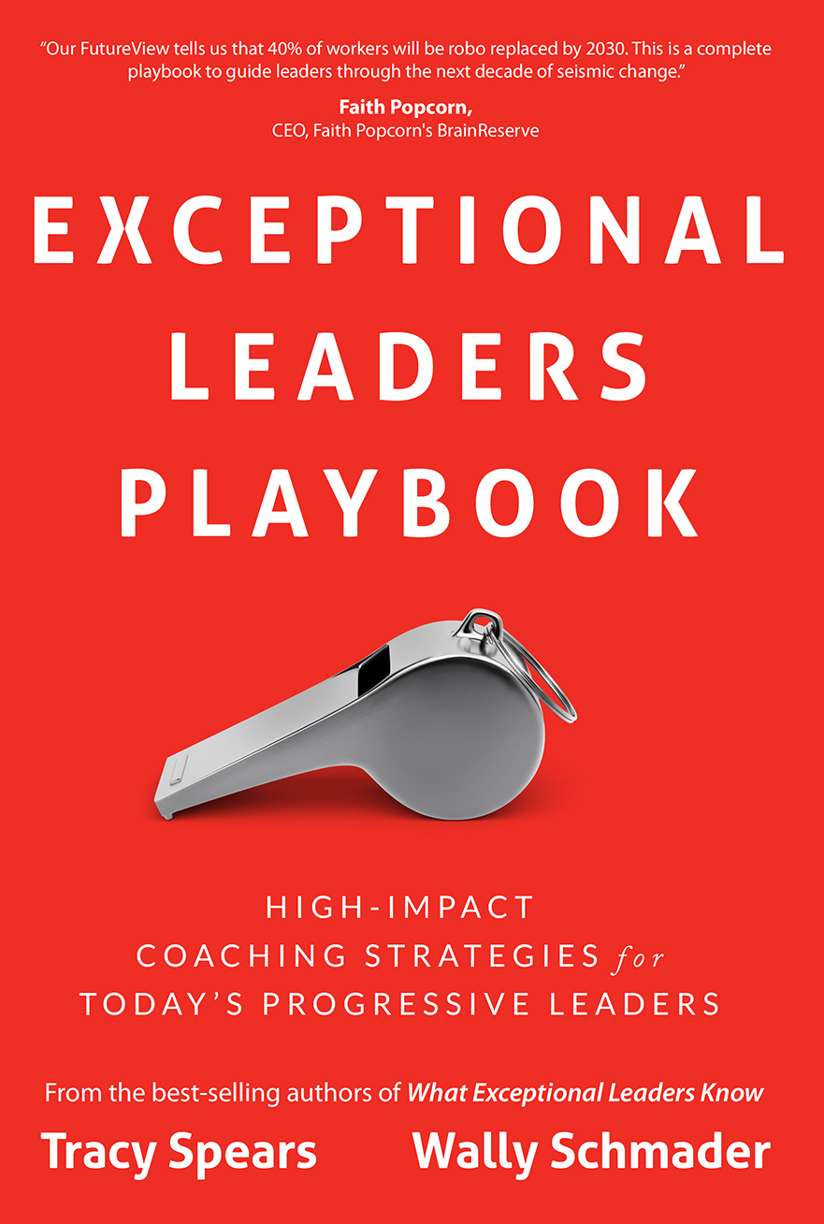
Temperament Fluency
For Leaders
Tracy Spears
Founder
Exceptional Leaders Lab
Register Now at ExceptionalLeadersLab.com

Slide 2
Temperament is the part of your personality that is genetically based. It’s like having brown eyes or
being left-handed.
- Exceptional Leaders Lab
Copyrighted Material © All Rights Reserved

Slide 3
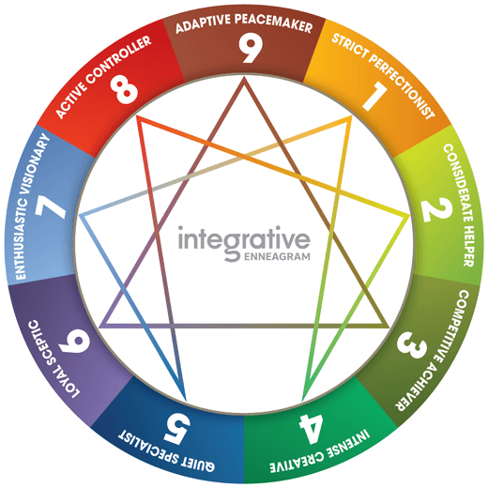
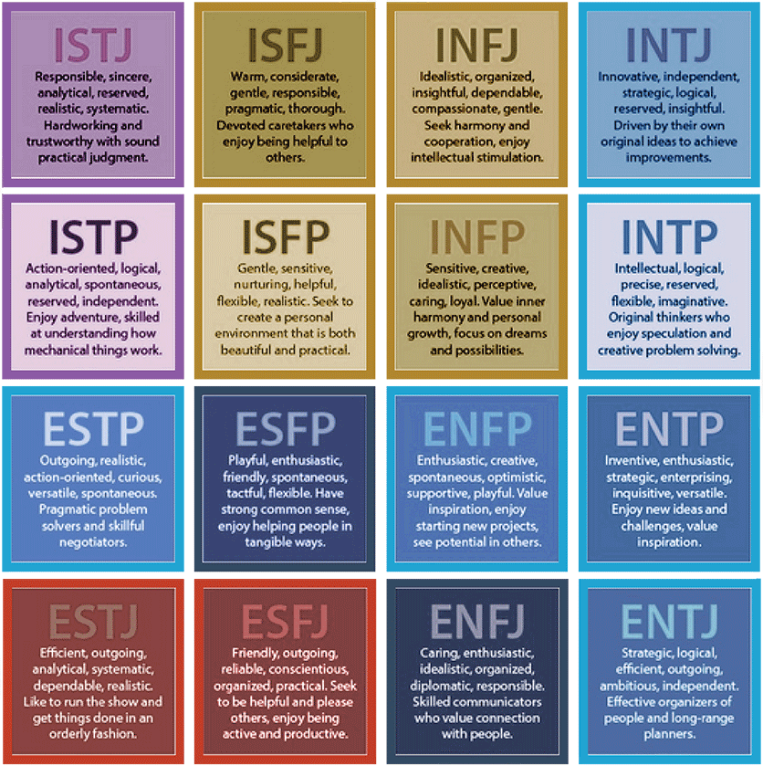
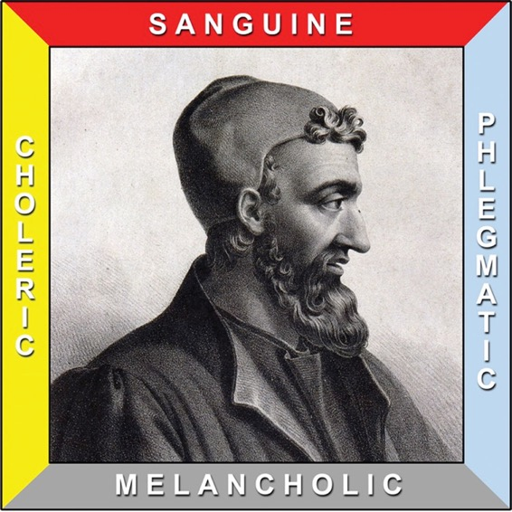
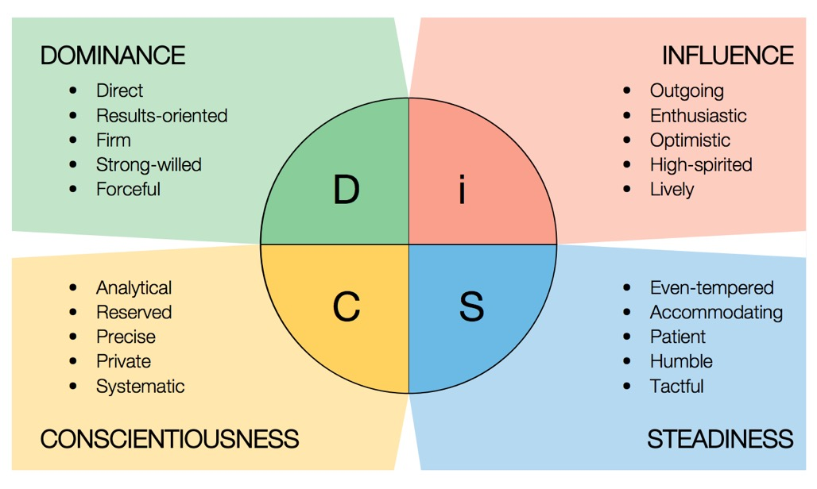
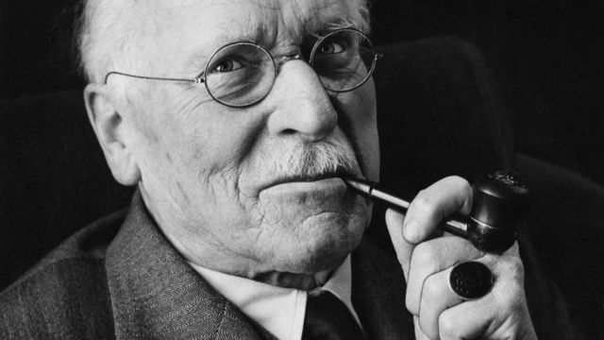
The Study of Temperaments Started Out Simply
Copyrighted Material © All Rights Reserved

Slide 5
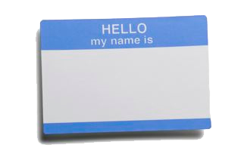
Your Name Tag
BLUE
GOLD
GREEN
ORANGE
Place the dots on your name tag, from left to right, in order of most like you to least like you.
Most
Like
You
Least
Like
You
Copyrighted Material © All Rights Reserved

Slide 6
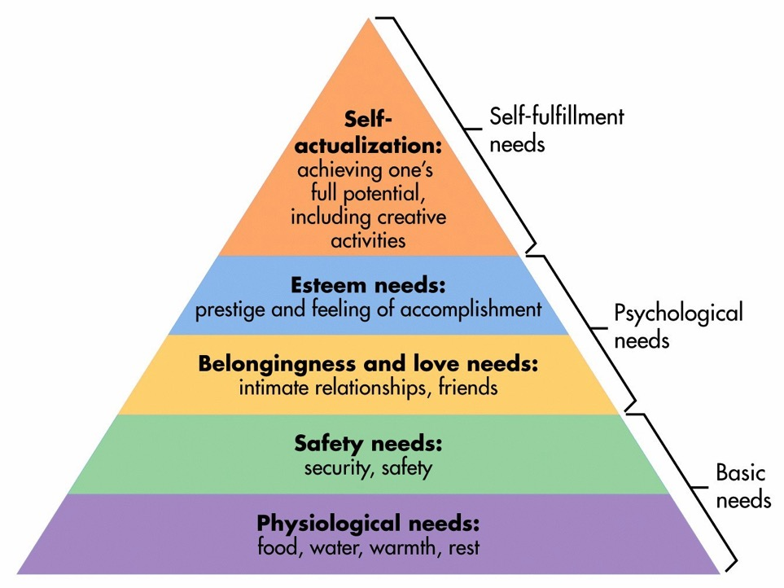
Maslow’s Hierarchy of
Fundamental Human Needs

Slide 7
Needs vs. Wants
Copyrighted Material © All Rights Reserved

Slide 8
The Four P’s
We are all a combination of all four of them
Promoter
Planner
Ponderer
Performer
Copyrighted Material © All Rights Reserved

Slide 9
Promoter
Key Value = Relationships
Copyrighted Material © All Rights Reserved

Slide 10
Promoter
Relationships
Optimistic
Genuine
Idealistic
Intuitive
Friendly
Tactful
Supportive
Imaginative
Empathetic
Compassionate
Nurturing
Devoted
Spiritual
Peacemaker
Romantic
Emotional
15-20%
Copyrighted Material © All Rights Reserved

Slide 11
Promoter Stressors
Non-communication
Rejection
Competition
Insincerity
Selfish thoughts & actions
Putting things before people
Conflict
Hurt and pain of others
Superficial relationships
Self-righteousness
Judgment
Lack of emotion
Copyrighted Material © All Rights Reserved

Slide 12
Promoter
BLIND
SPOTS
Makes exceptions to avoid confrontation
May postpone important conversations
Can build up resentment and explode
Can be overly emotional
Copyrighted Material © All Rights Reserved

Slide 13
Planner
Key Value = Responsibility
Copyrighted Material © All Rights Reserved

Slide 14
Responsibility
Planner
Organized
Consistent
Realistic
Steadfast
Direct
Proper
Loyal
Prepared
Predictable
Committed
Traditional
Detailed
Dutiful
Punctual
40-45%
Copyrighted Material © All Rights Reserved

Slide 15
Planner Stressors
Blaming
Procrastination
Confusion
Nonconformance
The unknown
Inconsistency
Tardiness
Disorganization
Non-commitment
Vagueness
Unexpected change
Too many tasks at one time

Slide 16
Blind Spots:
Can get stuck on their own point of view
May micro-manage projects and people
Can suppress creativity
Can lose sight of the big picture
BLIND
SPOTS
Planner
Copyrighted Material © All Rights Reserved

Slide 17
Ponderer
Key Value = Competence

Slide 18
Competence
Ponderer
Insightful
Inquisitive
Analytical
Visionary
Rational
Conceptual
Investigative
Perfectionist
Logical
Direct
Researcher
Strategic
Problem Solver
Factual
Knowledgeable
Contained
5-10%
Copyrighted Material © All Rights Reserved

Slide 19
Ponderer Stressors
Subjectivity
Know-it-alls
Mundane tasks
Redundancy
Fluff and fillers
Narrow-mindedness
Inability to think outside
the box
Loss of control
Not knowing
Time restraints
Dependency
Lack of cognitive stimuli
Working with perceived incompetence
Copyrighted Material © All Rights Reserved

Slide 20
Blind Spots:
Can have a short strategic attention span
Plans or initiatives may lack details
Can lack empathy
Will disregard input from emotional people
Ponderer
BLIND
SPOTS
Copyrighted Material © All Rights Reserved

Slide 21
Performer
Key Value = Freedom
Copyrighted Material © All Rights Reserved

Slide 22
Performer
Freedom
Adventurous
Spontaneous
Playful
Flexible
Resourceful
Courageous
Motivational
Deal Maker
Competitive
Generous
Creative
Multi-tasker
Action-oriented
Entertaining
Approachable
25-30%
Copyrighted Material © All Rights Reserved

Slide 23
Performer Stressors
Predictability
Routine
Drawn-out projects
Waiting
Pessimism
Governed by others
Delay
Losing
Focus on detail
Rigidity
Confinement
“No”, “Can’t”, and “Shouldn‘t’
Watching instead of doing

Slide 24
Blind Spots:
Can be impatient with people
May lack organization
May steamroll over introverts
Can lack accountability on team projects
Performer
BLIND
SPOTS
Copyrighted Material © All Rights Reserved

Slide 25
Temperament Fluency Makes You Much More Influential
Treat everyone “equally” but not the same.
You can learn to leverage differences & similarities.
Here’s how you can connect with and lead everyone…
Copyrighted Material © All Rights Reserved

Slide 26
To Connect with Each Temperament, Remember…
Promoter:
Connect first. Show appreciation for them personally.
Planner:
Provide structure and clarify expectations. Provide Details.
Ponderer:
Keep things high-level, objective and unemotional.
Performer:
Provide options and freedom. Don’t micro-manage.
Copyrighted Material © All Rights Reserved

Slide 27
WORKPLACE
With: Without:
Promoter
Nurturing
Peaceful
Teamwork
Sterile
Cold
Disconnected
Organization
Safety
Structure
Chaos
Unpredictable
Unstable
Planner
Strategy
Innovation
Vision
Stagnant
Stuck in the Past
Subjective
Ponderer
Fun
Adventure
Creativity
Bored
Belabored
Unimaginative
Performer
Copyrighted Material © All Rights Reserved

Slide 28
Strength: Weakness:
LEADERSHIP
Promoter
Nurturing
Peaceful
Teamwork
Sterile
Cold
Disconnected
Organization
Safety
Structure
Chaos
Unpredictable
Unstable
Planner
Strategy
Innovation
Vision
Stagnant
Stuck in the Past
Subjective
Ponderer
Fun
Adventure
Creativity
Bored
Belabored
Unimaginative
Performer
Copyrighted Material © All Rights Reserved

Slide 29
The next time you have a conflict or misunderstanding with someone.
Remember the issue may not
be about who they are...
It may be who you’re not.

Slide 30
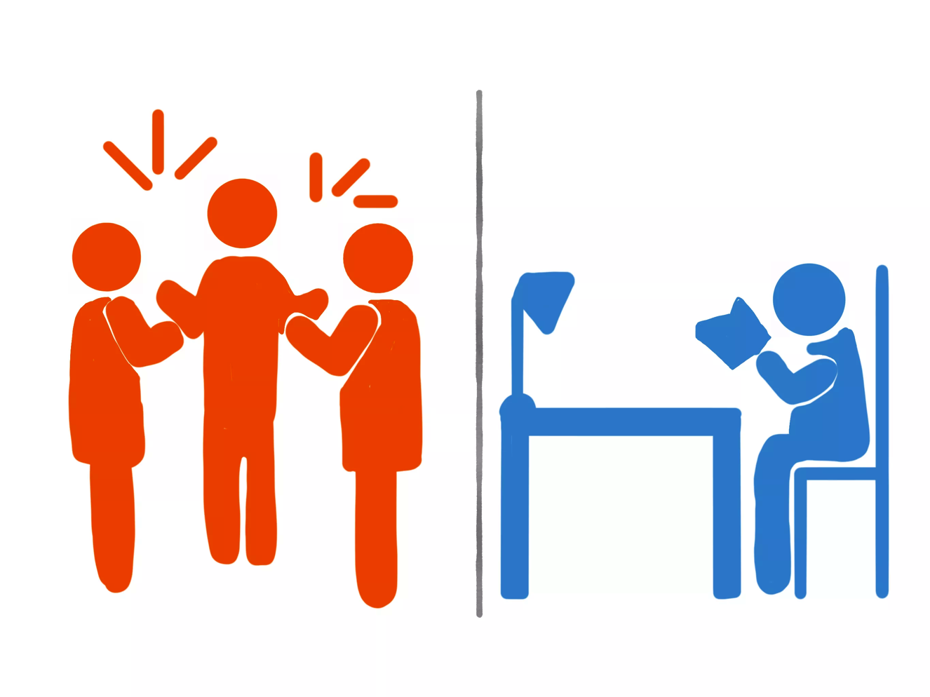
Now Let’s Look at Personal Interaction Styles
Copyrighted Material © All Rights Reserved

Slide 31
Introvert
Extrovert
1. Processes internally before speaking 1. Speaks while thinking
2. Measured or deliberate pace 2. Fast paced
3. Waits to talk until other person is done 3. Wants to speak immediately, will interrupt
4. Smooth and consistent voice tone 4. Animated and expressive tone
5. Soft to moderate voice level 5. Moderate to loud voice level
6. Indiscernible facial expressions 6. Obvious facial expressions
7. Minimal gesturing and body movement 7. Broad gestures and body movements
8. Likes silence and pauses while talking 8. Uncomfortable with silence and pauses
9. Prefers not to call attention to self 9. Attracts and enjoys attention
10. Waits for others to approach 10. Readily talks to strangers
Total = ☐ Total = ☐
10 - - - - - - - - - -  - - - - - - - - - - 10

Slide 32
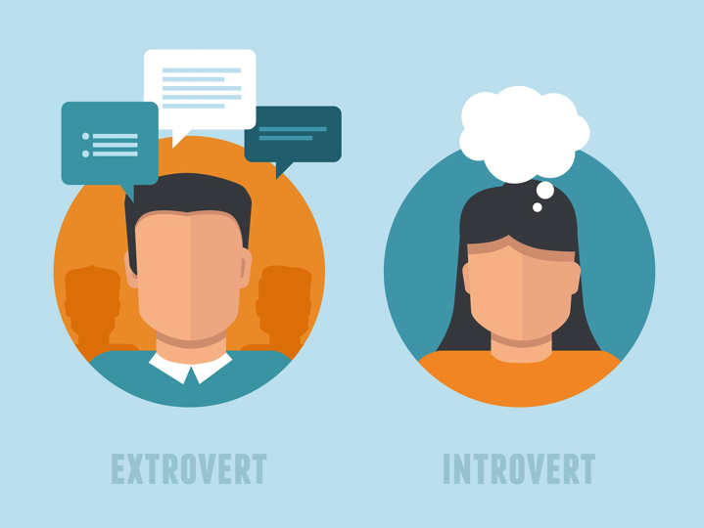
Interaction Styles
How you process information
Where your energy comes from
Copyrighted Material © All Rights Reserved

Slide 33
Extrovert
External thinking process
Gathers energy externally
Copyrighted Material © All Rights Reserved

Slide 34
Extrovert Stressors
Not able to give opinion
Isolation from others
People who are not open
Not being heard
Being left out – excluded
Silence
Extended time alone
Keeping it all inside
Lack of interaction
Being ignored
Copyrighted Material © All Rights Reserved

Slide 35
Introvert
Internal Thinking Process
Gathers Energy Internally
Copyrighted Material © All Rights Reserved

Slide 36
Introvert Stressors
Meeting new people
Non-stop interaction
Socializing in groups
Interruptions
Being put on the spot
No privacy
Invasion of space
Small talk – chit-chat
Group activities
Public affirmation
Copyrighted Material © All Rights Reserved

Slide 37
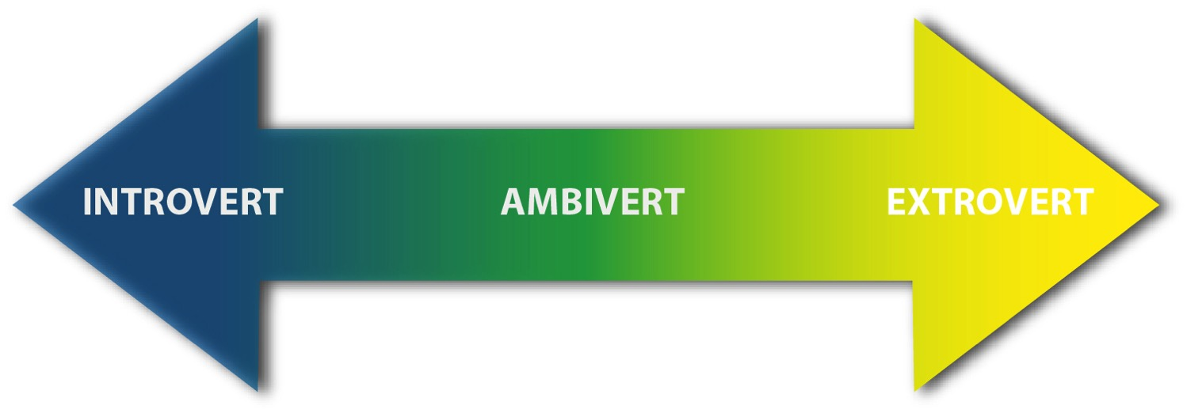
What if you are halfway between both?
Copyrighted Material © All Rights Reserved

Slide 38
Text TRACY to 66866
Text TRACY to 66866

Slide 39
Stop
Keep
Start
What are your takeaways.
What do you need to reflect on?
What will you take action on?
Copyrighted Material © All Rights Reserved
Notes:
What we do as individuals do?
Today’s takeaways…. Reflection items... Actions items... What will you do with the information?

Slide 40
Text: Tracy
To: 66866
Newsletters
Promotions
Events
Announcements
*We never sell or share our list

Slide 41
Ready?

Slide 42
The Four P’s
We are all a combination of all four of them
Promoter
Planner
Ponderer
Performer
Copyrighted Material © All Rights Reserved

