Slide 1


Managing in an
Uncertain Economy
Alex Chausovsky
Director, ITR Economics

Slide 2
“I do not mistrust the future.
I do not fear what is ahead.
For our problems are large,
but our heart is larger.
Our challenges are great,
but our will is greater.”
-George H. W. Bush

Slide 3
2018 Forecast Results
If you heard ITR around two years prior…
3
 | Duration | Accuracy
US GDP | 24 | 99.9%
US Ind. Production | 34 | 99.4%
Europe Ind. Production | 24 | 99.2%
Canada Ind. Production | 27 | 97.1%
China Ind. Production | 30 | 99.9%
Retail Sales | 28 | 99.6%
Housing (Single Family Units) | 26 | 99.2%
Employment (Private Sector) | 30 | 99.4%
ITR Economics provides the best economic intelligence to reduce
risk and drive practical and profitable business decisions.
Notes:
@@@ Updated April 9, 2019

Slide 4

Summary December 2019
Macroeconomic Slowdown 2019 – 1H20
US
Global
Global Issues Impacting Businesses
Tariffs/Trade Uncertainty
Long-term Outlook
Profit Concerns
Leading Indicator Signals are Mixed
Know where you are in the cycle
Know which ones matter to you

Slide 5



Macroeconomic Trends

Slide 6
US Economy Stalls in 2019 and Into 2020
US Gross Domestic Product, SAAR, Chained 2012 $
US Gross Domestic Product
Annual Trend $19.1 trillion
1.7%
C
1.9%
2.0%
2.1%
Source: BEA
Notes:
@@@ 3/21/19 Forecast updated!! Brian TEC Generic 1 GDPCON Charts 11/27/2019

Slide 7
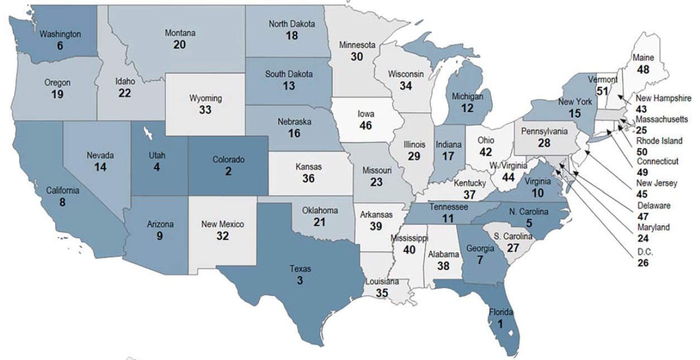
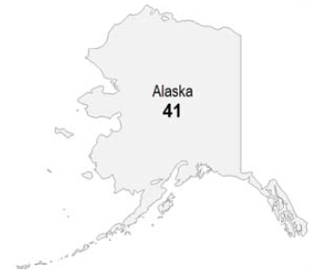
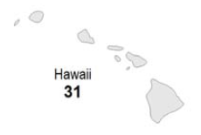
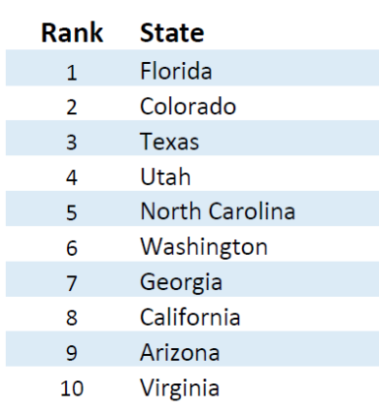
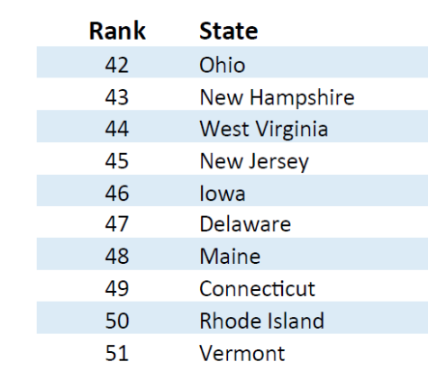
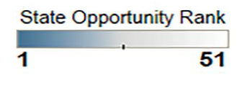
Overall State Growth Opportunity Index Rankings
Source: ITR Economics

Slide 8
The Business Cycle vs. the Political Cycle
Real Gross Domestic Product
3/12 Rate-of-Change
Source: BEA
Notes:
Powerpoint Charts/Charts Reserve/Assorted 18 Charts/ GDPCONwLines312 12/2/2019 Qtrly data
GDP

Slide 9



US GDP by Consumption
Percent
Sources: BEA, ITR Economics
Notes:
PPT Charts/Misc Imp Charts/Alex/gdp by industry Jan 2016.xlsx 2016 7/27/17

Slide 10
Slowing Growth in 2019; Mild Recession in 1H20
US Industrial Production Index
US Industrial Production Index
109.5
0.5%
C
0.7%
1.5%
2.0%
Source: FRB
Notes:
11/15/2019 (Powerpoint Charts/ Misc Important charts/ USIP Charts from TD Report
Using Aug 2018 forecast TIPRO12MMA less forecast

Slide 11




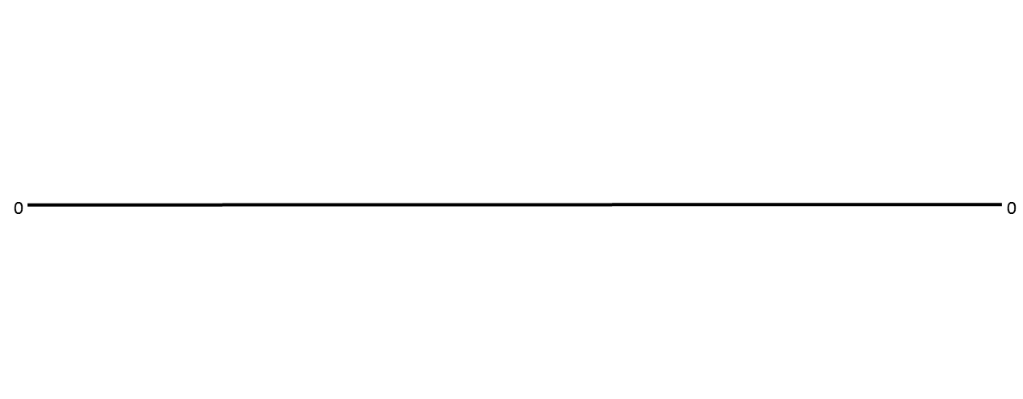
Business Cycles
Phase A - Recovery
Annual Sales are BELOW Year-Ago Levels, but the Rate-of-Decline is SLOWING.
Phase B – Accelerating Growth (Best)
Annual Sales are ABOVE Year-Ago Levels, and are GROWING at a RAPID Pace.
Phase C – Slowing Growth (Caution)
Annual Sales are ABOVE Year-Ago Levels, BUT the Rate-of-Growth is SLOWING
Phase D - Recession
Annual Sales are BELOW Year-Ago Levels, and are DECLINING at a RAPID Pace.
Notes:
Why is explaining the phases so important? Remember the Key Management Objectives that we have corresponded to each phase? This will allow you know when you will be moving through those phases.
Understanding the Phases helps with the mentality of managing a business.
For example: If you are in Phase D, Recession, you are most likely tightening your belts, cutting costs, and are in “save the business” mode. However, if your rate of decline is slowing in the next few months, and you transition into Phase A, Recovery, you may “miss the boat” by staying in this “hunkered down” state of mind. Or you may be too nervous to start those training programs and managing the company with the mindset you will resume growth at ‘x’ period in time.
In this example: you will miss out on opportunities by reacting rather than being proactive.
Another Example: If you are in Phase B, the strongest growth phase, you are feeling great! Momentum is great, the teams are feeling great, orders are coming in the door, and you’re thinking of opening that new office or expanding that facility or upgrading that factory. All is well in the world. However, if you don’t see that you are about to transition into Phase C, slower growth, you can very easily over extend yourself, create too many expenses, and lose out on profitability that could have otherwise been had.
Using this navigational tool will help to know when to hire, when to fire, when to build, when to penetrate new markets and more!

Slide 12
Riding the Business Cycle
Reduce Risk Exposure
and Increase Liquidity
Reduce Risk Exposure
and Increase Liquidity
Increase Risk Exposure
and Decrease Liquidity
Notes:
May 2019

Slide 13

Leading Indicators System Approach

Slide 14
Leading Indicators
May 2010
May 2011
December 2018
The Indicator has a 12-month lead time to the Industry Data
Rates-of-Change
Sources: FRB, ITR Economics
Notes:
Powerpoint charts/ FRB 17 charts/ FABMX ITRLI 11/15/2019 FABMX to ITRLI is actually 10 months ANIMATION is on 3/1/18
FRB & ITRLI

Slide 15
Leading Indicator System as a Powerful Tool
US Industrial Production Index to Various Leading Indicators
Rates-of-Change
Sources: FRB, OECD, ISM, Yahoo Finance, IHS Markit
Notes:
Charts-Special/Connor’s TIPRONSA Comps Base ITRLI Monthly 12/2/2019

Slide 16
Possible Good News for 2020
US Domestic Corporate Cash Holdings
Good News!
Trillions of Dollars
Sources: US Census Bureau
Notes:
W:ITRDATA/PowerPoint Charts/Charts – Reserve/Mixed Bag 12 Charts CORPCASH SOC 9/6/2019

Slide 17

Preliminary Indication of Rise in 2020
US Single Unit Housing Starts
As seen in
Millions of Units
Source: Census Bureau
Notes:
Tec Generic 3 HS2FAM 12/2/19

Slide 18


Impact of Tax Reform: Now and in the Future

Slide 19
Slowing Rate of Rise in CAPEX Trend
US Nondefense Capital Goods New Orders w/o Aircraft
Billions of Dollars
Source: Census Bureau
Notes:
TEC Generic 2 NDFCGXA 11/4/2019

Slide 20
Leading Indicators Signal Business Cycle Decline for CAPEX
US Nondefense Capital Goods New Orders to Leading Indicators
Rates-of-Change
Sources: US Census Bureau, NFIB, FRB, ITR Economics, WSJ
Notes:
W:ITRDATA/PowerPoint Charts/Charts – Special/Connor’s NDFCGXA Comps Base ITRLI Monthly 11/26/2019

Slide 21
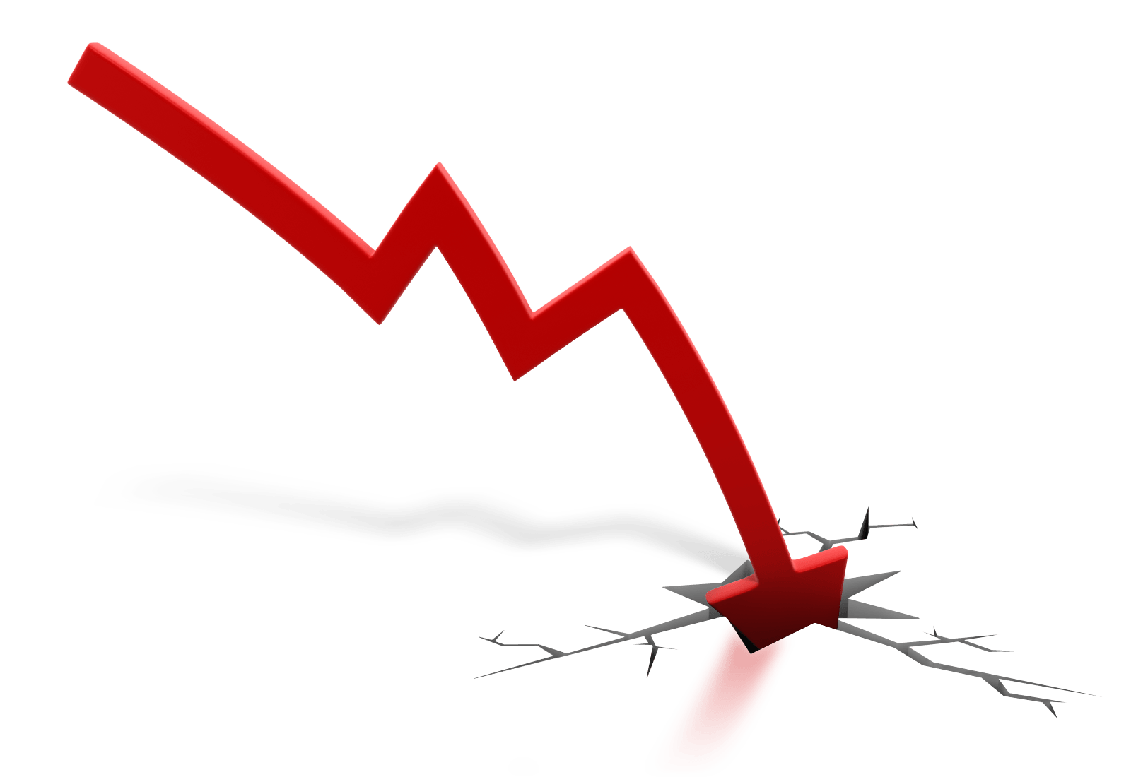
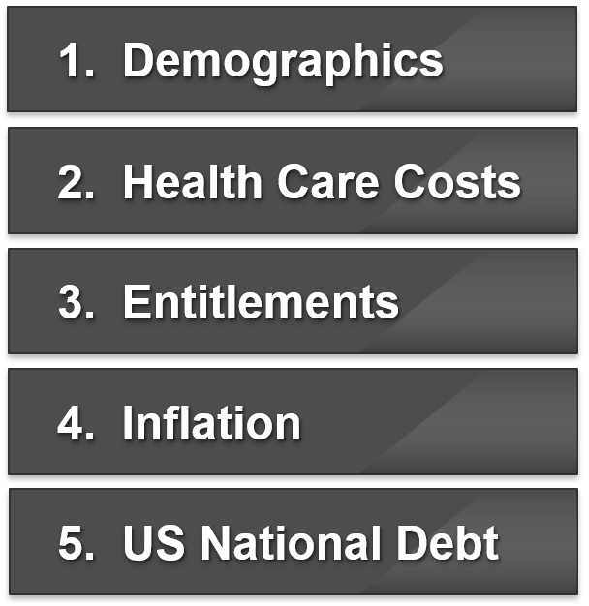
Depression Drivers
1. Demographics
2. Health Care Costs
3. Entitlements
4. Inflation
5. US National Debt
Notes:
Actual text boxes are underneath image (because transparency doesn’t work in pdf)

Slide 22

What to Tell the Kids
Live below their means
Learn a second language
Each household should have multiple or diverse income streams
Choose career(s) oriented toward the “opportunities”
Pay off as much debt as possible by 2030
Be ready to at the price cycle low in the depression
Be self-reliant
buy

Slide 23

Tariffs and Other Fun Things

Slide 24
Is the Current Trade Policy Having the Desired Effect?
US Trade Balance for Goods and Services
Billions of Dollars
Source: US Census Bureau
Notes:
PowerPoint Charts/Charts Reserve/ SOC 25/ GDSSVCTBAL MMT 11/12/2019 SQL

Slide 25
US Trade in Goods with World (Exports) are an important part of economic health
US Trade in Goods with World: Exports to Imports
Exports are 8% of US GDP
3/12 -1.7% A
12/12 Rates-of-Change
Sources: Census Bureau, FRED
Notes:
Tec Generic 5 USEXPWRLD USDTWEX 11/21/2019

Slide 26
Tariffs: There Will Be Winners and Losers
“Fair trade”
Specialization is a good thing
Competition is a good thing
Economics is not a zero sum game
Potential disruption to supply chains
Price increases
Retaliation
Notes:
NOW REALLY THIS ONE!! Charts-Special\Alex Tariff chart data Tariffs 9/20/19

Slide 27
Industrial Commodity Decline Relieving Inflation Pressure
US Consumer Price Index to US Producer Price Index
Material Costs
Shipping Costs
Labor Costs
1/12 Rate-of-Change
Source: BLS
Notes:
TEC Generic 5 CPIUA PPI 1.12 12/2/2019
PPI & CPI

Slide 28
FOMC Member Interest Rate Projections
September 2019
Fed Open Market Committee
Source: FRB
Notes:
HF 9/26/19 Updated Quarterly. TEC Generic 4 Charts updates in Dec 2019 FOMC Projections
Chart Size: 4.54”x10.1” Chart Position: H .27”, V .66”
http://www.federalreserve.gov/monetarypolicy/fomccalendars.htm

Slide 29
In Search of More and More Labor
US Private Sector Employment
Annual Data Trend
Source: BLS
Notes:
Tec Generic 1 EMPPS 11/1/2019
EMPPS (in Employment) = Private Sector Employment Growth (12/12)
EMPPRVJO (Employment) = Job Openings (12/12)
EMPPTER (employment) = Involuntary Part Time Employment (12/12)
U6 (employment) = UNEMP%MAPTE (Monthly #)
Employment Quit Rate = EMPPRQR (see 12MMA – for rising) (4/13/17 per CL)
EMPLOYMENT

Slide 30



Your Markets

Slide 31
Electrical Equipment Production Under Pressure
US Electrical Equipment Production w/o Appliances
2012 = 100
Source: FRB
Notes:
R:/PowerPoint Charts/Charts Reserve/SOC 6 Charts ELEQPX 12/2/19

Slide 32
New Orders are Slowing as Well
US Electrical Equipment New Orders
Billions of Dollars
Source: US Census Bureau
Notes:
Charts-Reserve/New Orders 1 Charts ELEQNO SOC 12/2/19

Slide 33
Appliance Production Facing Near-term Headwinds
US Electrical Equipment, Appliance and Component Production Index
2012 = 100
Source: FRB
Notes:
R:/PowerPoint Charts/Charts Reserve/SOC 17 Charts ELMACX SOC 12/2/19

Slide 34
…but Appliance New Orders are Seeing Healthy Growth
US Electrical Equipment, Appliances and Components New Orders
Billions of Dollars
Source: US Census Bureau
Notes:
R:\Powerpoint Charts\Charts – Reserve\SOC 25 Charts ELMACNO SOC 12/2/19

Slide 35
Computer Equip. NOs are on the Back Side of the Cycle
US Computer & Electronic Products New Orders
NAICS 334, Billions of $
Source: FRB
Notes:
R:\PowerPoint Charts\Reserve Charts\New Orders 1 Charts COMELNO 12/2/19

Slide 36
Industrial Machinery Production is Down; Trend Reversal in Place
US Industrial Machinery Production Index
2012 = 100
Source: FRB
Notes:
R:/PowerPoint Charts/Charts-Reserve/SOC 18 Charts INMACX SOC 12/3/19

Slide 37
Machinery New Orders Indicate Upside Momentum
US Industrial Machinery New Orders
Billions of $
Source: Census Bureau
Notes:
Powerpoint Charts/Charts Reserve/SOC 14 Charts/ INMACNO SOC 12/3/19

Slide 38
Power Sector Will be Pressured in the Near Term
US Electric Power Generation, Transmission and Distribution Production Index
2012 = 100
Source: FRB
Notes:
Charts – Reserve/SOC 6 Charts.xlsx ELUGENX 12/3/19

Slide 39
Power Construction Growing, but Tentatively Peaked
US Total Power Facilities Construction
Billions of Dollars
Source: US Census Bureau
Notes:
TEC Generic 3 CONPOWER SOC 12/3/19

Slide 40
North American Market Sectors – 2018/19 Outlook
Industry | Phase | 12/12 | F2020*
US Electrical Equipment w/o Appliances Production | C | 1.3% | 0.4%
US Electrical Equipment w/o Appliances New Orders | C | 2.1% | 0.5%
US Electrical Equipment, w/ Appliances Production | C | 0.5% | 0.7%
US Electrical Equipment, w/ Appliances New Orders | C | 4.1% | 0.4%
US Computer & Electronic Products New Orders | C | 4.0% | 3.0%
US Industrial Machinery Production Index | D | -6.2% | 4.8%
US Industrial Machinery New Orders | B | 2.0% | -4.2%
US Electric Power Generation/Transmission/Distribution | D | -1.4% | 1.2%
US Total Power Facilities Construction | C | 5.5% | -1.2%
Notes:
W:ITRDATA/PowerPoint Charts/Charts – Special/Misc 5 Tables North American Market Sectors 12/3/19
US Electrical Equipment w/o Appliances Production ELEQPX
US Electrical Equipment w/o Appliances New Orders ELEQNO SOC
US Electrical Equipment, Appliances and Components Production ELMACX SOC
US Electrical Equipment, Appliances and Components New Orders ELMACNO SOC
US Computer & Electronic Products New Orders COMELNO
US Industrial Machinery Production Index INMACX SOC
US Industrial Machinery New Orders INMACNO SOC
US Electric Power Generation Transmission and Distribution Production Index ELUGENX
US Total Power Facilities Construction CONPOWER SOC

Slide 41
Summary

Slide 42

The Road Ahead
It is important to know where you are relative to the general economic trend
2019 Decelerating growth through the rest of the year
2020 Mid-20 low point in the business cycle, growth in 2H20
2021 Growth
2022 Backside of the Business Cycle
Notes:
AB 5.14.19

Slide 43
5 Pieces of Actionable Advice for Phase C
1. Develop your rates-of-change so you will know when the trough is near
(Use the ITR Checking Points™)
2. Focus on the segments of the business that are the most profitable in Phase C
3. Trumpet your Phase C competitive advantages and start developing your
message for the next phase (B or D, depending on your industry)
4. Cash Management for proper allocation and Inventory Control if applicable
5. Ask yourself what you shouldn’t be doing? (resource management and
diversion to more profitable parts of the company)

Slide 44

@achausovsky

