Slide 1

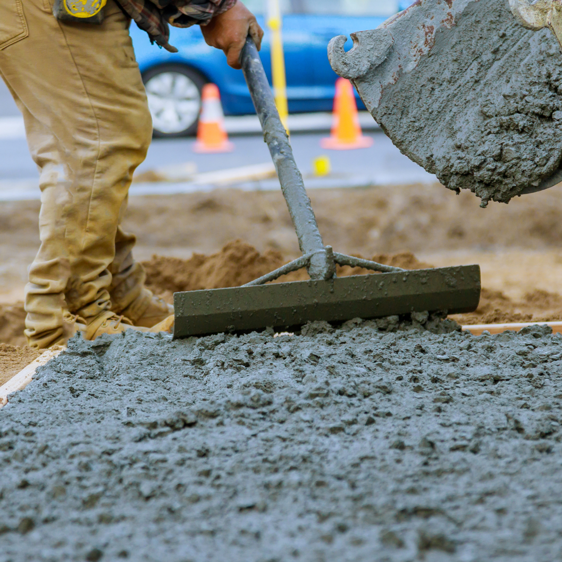
Concrete Carbonation Study
Preliminary Report

Slide 2


PRESENTER
Alan Sparkman
Executive Director
Tennessee Concrete Association

Slide 3
IMPORTANT CONCEPTS - TERMS
Embodied Carbon
Process of Making Cement
Concrete Carbonation
pH
Phenolphthalein

Slide 4
Why Study Carbonation
The Context: There is increasing importance and emphasis on the environmental impact of construction.
The Shift: Low embodied carbon concrete mixes, which use blended cements and higher proportions of supplementary cementitious materials (SCMs), are becoming more common.
The Role of Concrete: Concrete acts as a carbon sink by absorbing CO2​ from the atmosphere through the process of concrete carbonation.
The Tool: Models like the MIT CSHub Whole Life Cycle Carbon Uptake Tool (uptake tool) predict the CO2​ concrete can absorb during its lifecycle.

Slide 5
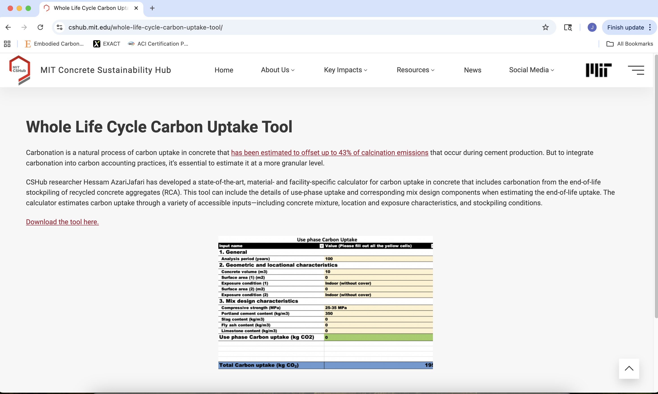

Slide 6
The TCA Study
Project Overview: TCA has completed the first-year readings of a 10-year concrete carbonation study funded by the Concrete Advancement Foundation (CAF).
Key Goals:
Educate the public and promote concrete as a sustainable building material.
Gather data on the carbonation rates of concrete using varying levels of SCMs.
Observe the impact of surface orientation and the use of sealers on carbonation.
Provide data to help validate the inputs (k-factors and correction factors) used in the MIT CSHub uptake tool.

Slide 7
k-Factors used in Uptake Tool for Different Strength Classes and Exposure Conditions
Concrete Strength | <15 MPA | 15-20 MPA | 25-35 MPA | >35 MPA
Parameters | Value of k-factor, mm/year^{0.5}
Civil Structures Exposed to rain Sheltered from Rain In Ground |  | 2.7 6.6 1.1 | 1.6 4.4 0.8 | 1.1 2.7 0.5
Buildings Outdoor Exposed to rain Sheltered from rain Indoor/ dry climate With cover Without cover In Ground | 5.5 11 11.6 16.5 | 2.7 6.6 6.9 9.9 1.1 | 1.6 4.4 4.6 6.6 0.8 | 1.1 2.7 2.7 3.8 0.5

Slide 8
MIXES
Mixes Placed (April 2024):
Standard Commercial (SC) Mix: Type IL cement and 20% fly ash replacement.
Low Embodied Carbon (LEC) Mix: Type IL cement, 20% fly ash, and 30% slag replacement.

Slide 9
ELEMENTS REPRESENTED
Exterior Wall (EW): Full Depth Cores, either Exposed to Rain (ER) or Protected from Rain (PR).
Exterior Slab (ES) & Interior Slab (IS): Cylinders with a broomed (ES) or hard trowelled (IS) finish, stored indoors or outdoors.
Unsealed (US).
Acrylic Sealer (AS): Waterborne film-forming acrylic co-polymer (sprayed at placement).
Penetrating Sealer (PS): Water-based silane/siloxane (brushed at 28 days).

Slide 10
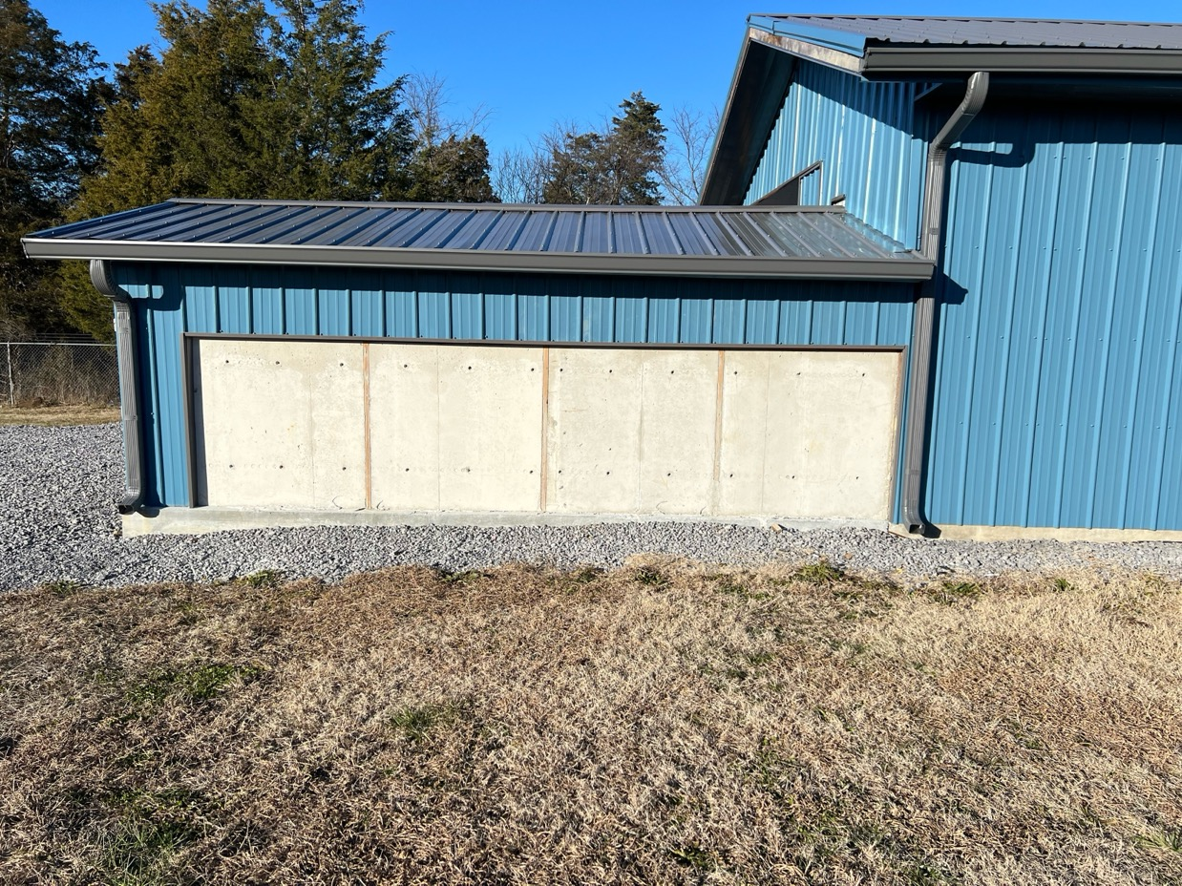
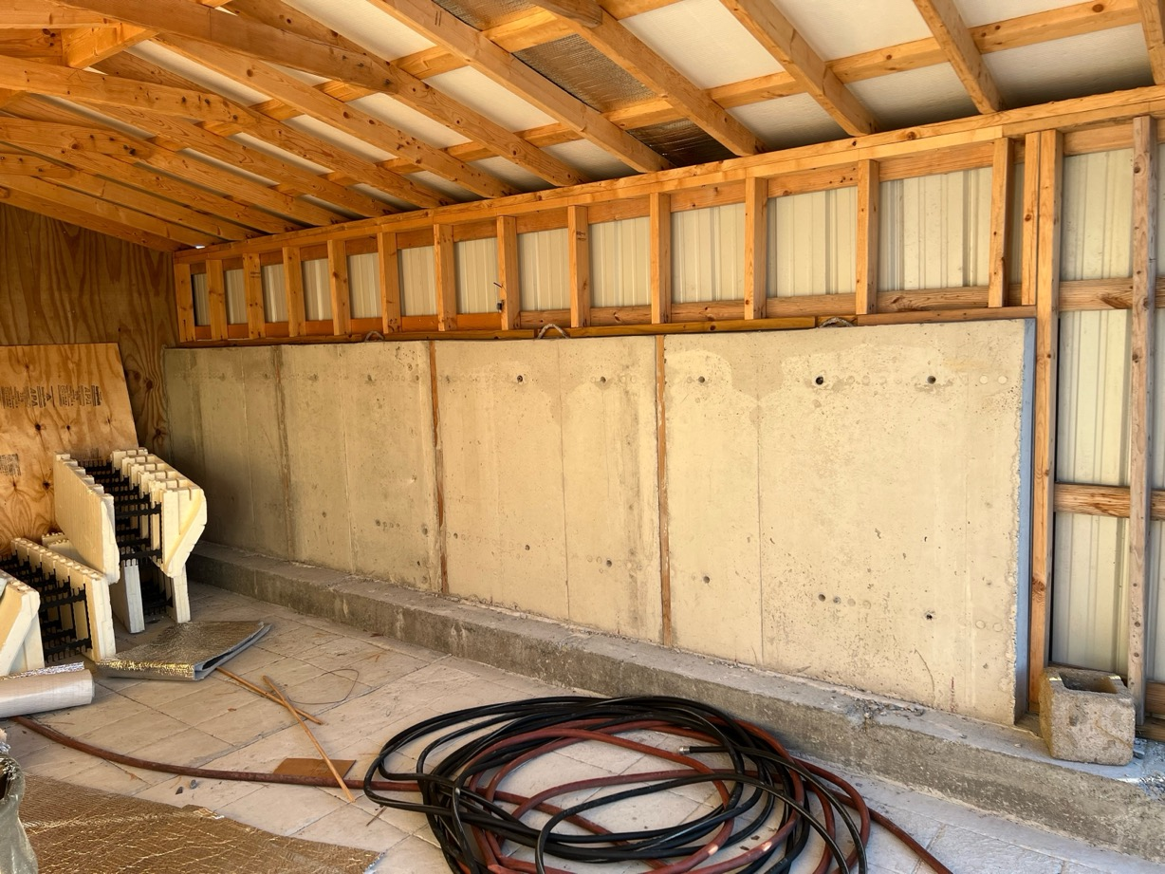
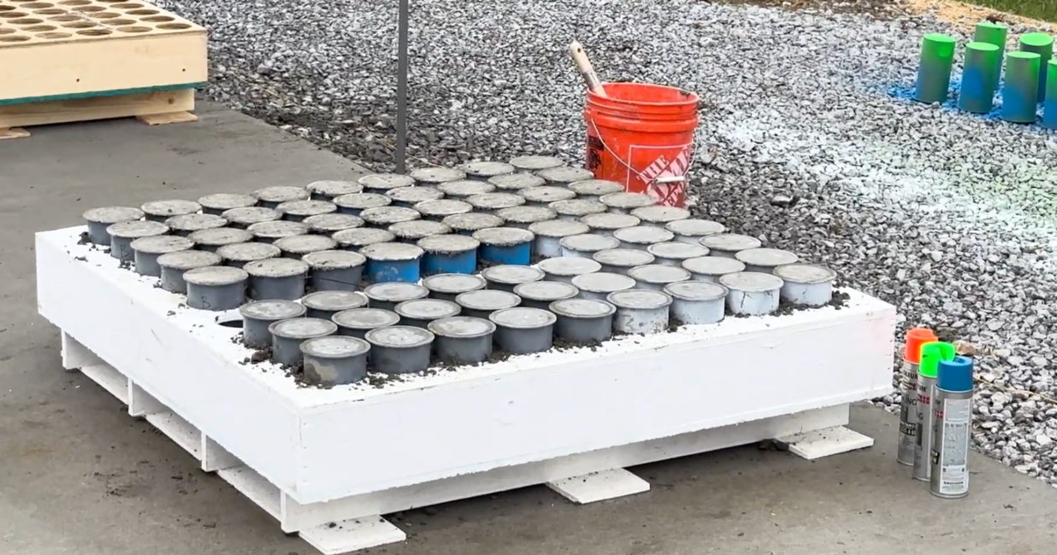
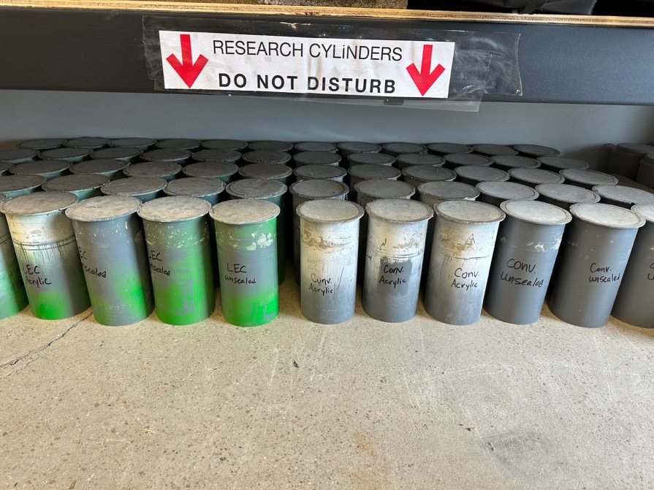

Slide 11
Carbonation Testing Methodology
Measurement Age: Approximately 1 year.
Procedure:
Specimens were sawed and then fractured longitudinally.
1% phenolphthalein solution was applied to the fractured surface.
The portion that turned dark pink/purple was considered non-carbonated.
The depth of carbonation was measured from the finished surface down to the non-carbonated concrete.

Slide 12
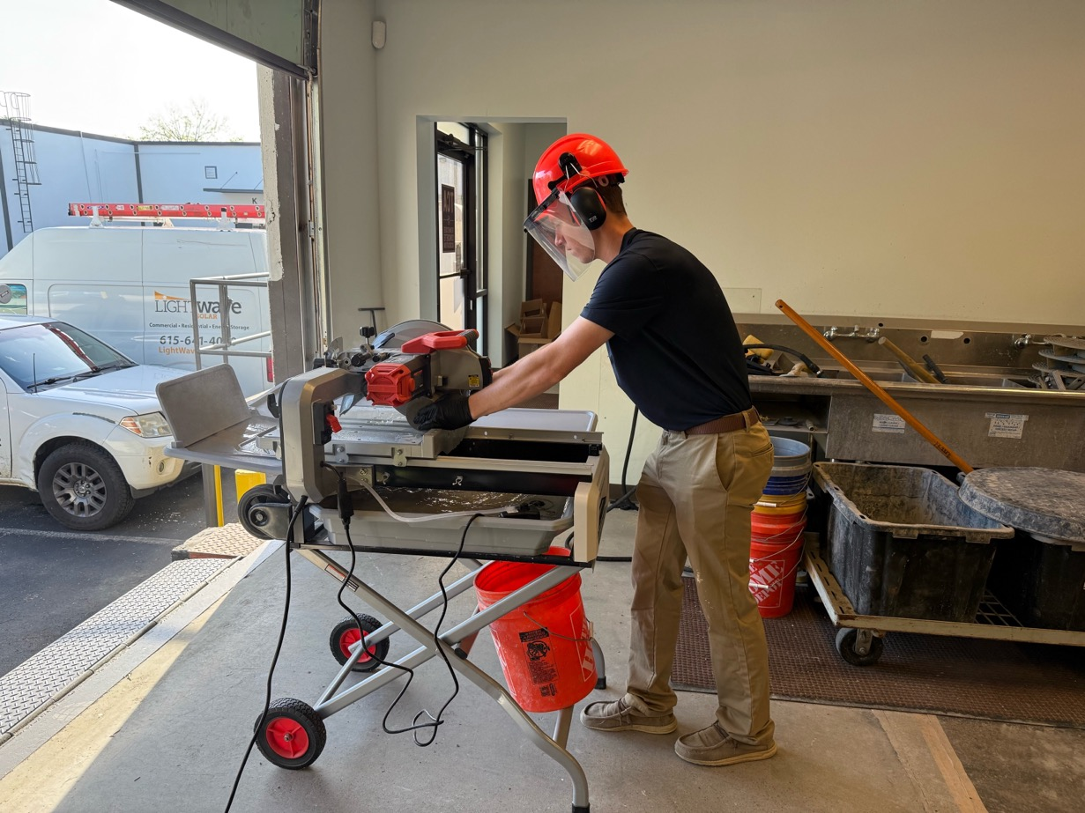
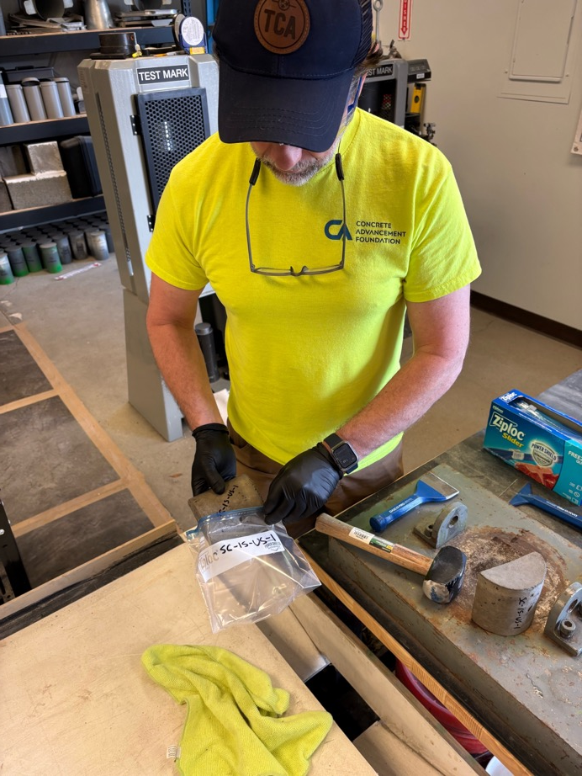
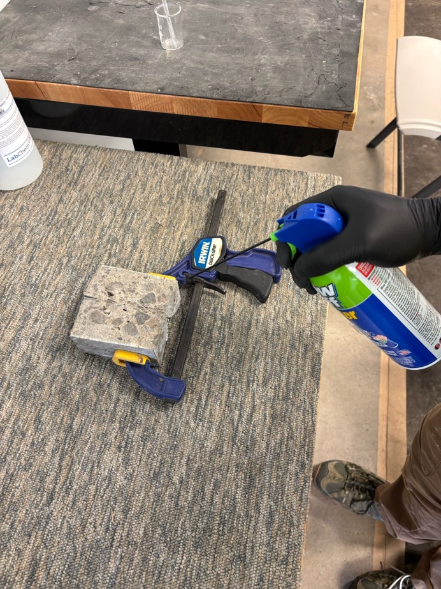
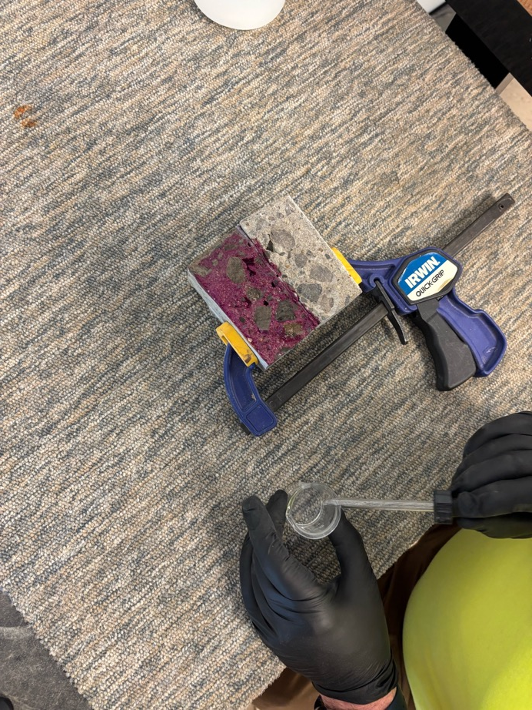
Sample Preparation

Slide 13
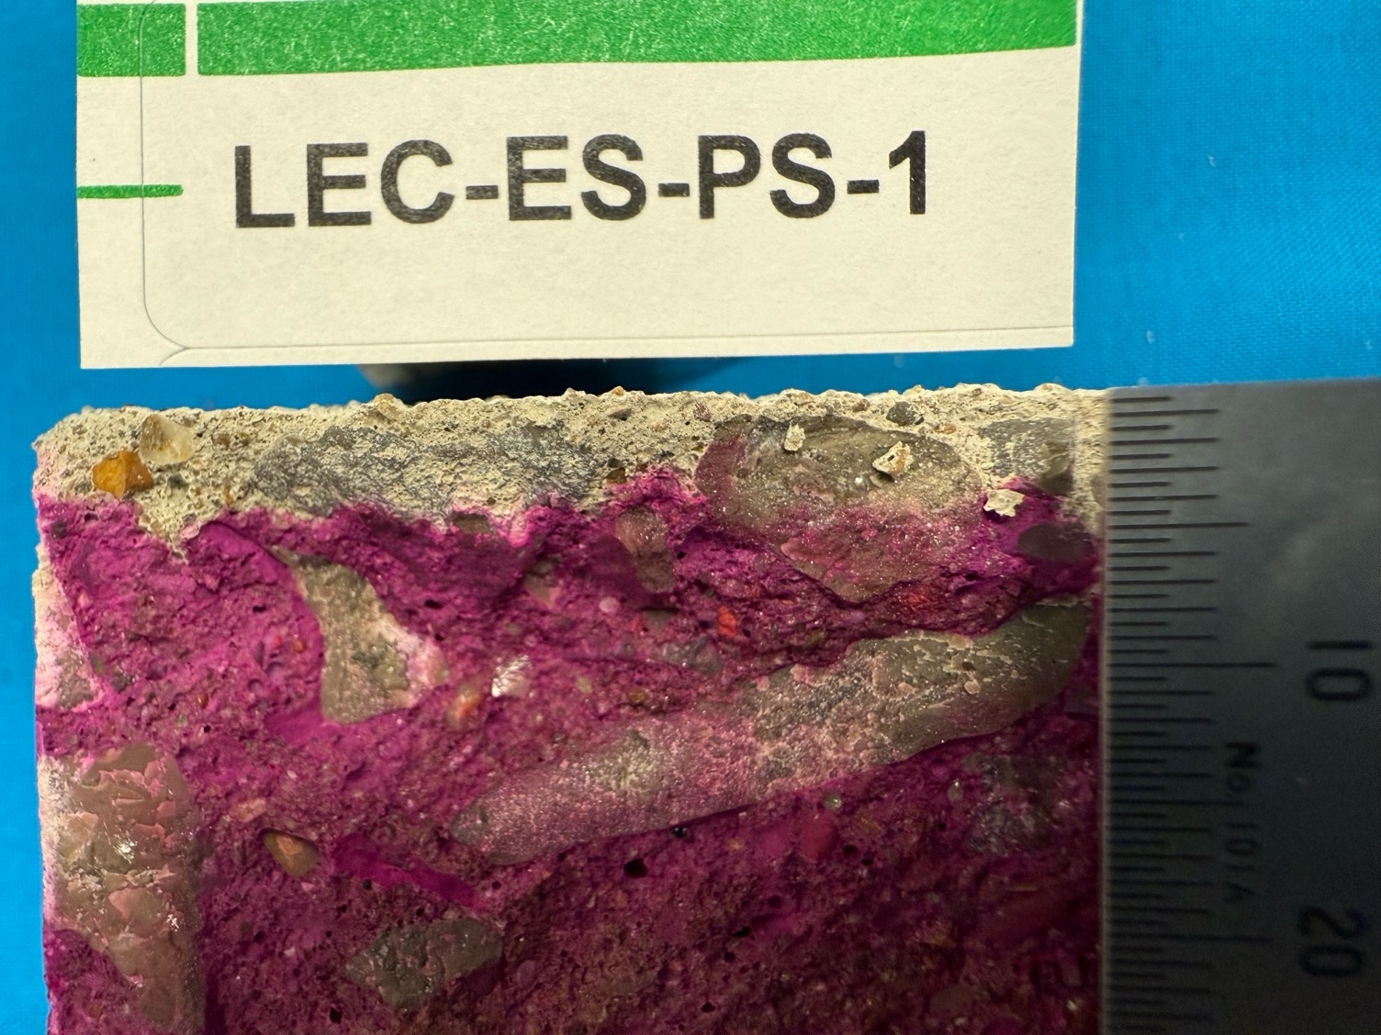
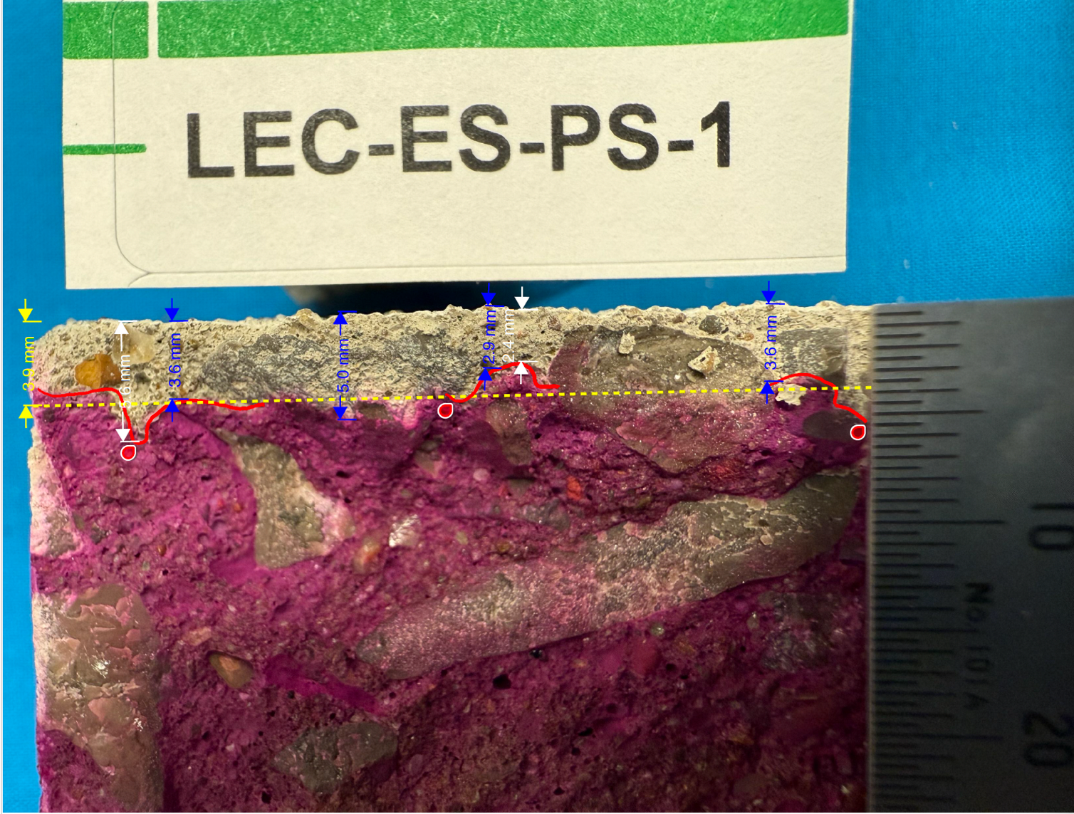

Methodology
3 Reading Protocols Implemented (Resulted in similar averages, max range 0.5 mm):
Method 1: Average of up to 5 readings at predetermined locations. (blue)
Method 2: Average of the maximum and minimum carbonation values. (White)
Method 3: A visually estimated "typical" value. (Yellow)

Slide 14
Year One Observations: General Trends
Dry vs. Wet: Carbonation depths were larger for Interior concrete flatwork (dry conditions) than for Exterior concrete flatwork (exposed to water/rain).
SCM Impact: Measured carbonation depths were generally larger for the LEC mix (higher SCM) than the SC mix, as predicted.
Vertical vs. Horizontal: Vertical wall sections exhibited a higher carbonation rate than comparable horizontal flatwork using the same mix, despite theoretical models not differentiating between them.
Possible Reason: Differences in the degree of saturation and the amount of time the surfaces are dry due to orientation and exposure.

Slide 15
Year One Observations: Sealer Impact
Acrylic Sealer (AS):
The acrylic sealer slowed carbonation considerably in all cases.
One-year carbonation depths for AS-sealed concrete were almost negligible.
Penetrating Sealer (PS):
The penetrating sealer did not appear to slow the observed carbonation rate.
Resulted in higher carbonation depths compared to the unsealed flatwork.
Possible Test Skew: The hydrophobic nature or chemical makeup of the sealer might prevent the phenolphthalein solution from penetrating, thus inhibiting the color change and leading to higher than actual measured depths.

Slide 16
Year One Observations: Predicted vs Measured
General Comparison: There was no universal trend observed; some predictions were higher, some lower, and some were nearly identical to measured depths.
Wall Sections: Measured carbonation depths for wall sections exposed to rain (EW-ER) were more comparable to the higher predicted values for exterior concrete protected from rain (EW-PR).
Example: SC Mix
Predicted (EW-ER): 1.7 mm
Measured (EW-ER): 4.2 mm Predicted (EW-PR): 4.6 mm
Potential Cause: The vertical orientation and slight roof overhang may be reducing the impact of rain, causing the element to behave more like it’s protected from rain.

Slide 17
FUTURE ACTIVITIES:
Continuation: Sampling and testing will be repeated at years 2, 3, 5, and 10. Later age readings will provide more insight into how sealers are affecting long- term carbonation.
Later age readings will provide insight on whether prediction equations are more accurate as the concrete ages and continues to carbonate.
Industry Education: The research platform will be used to educate visitors to the TCA Campus on:
How concrete sequesters carbon over time. How prediction models estimate carbon uptake. The industry's continuous work toward climate goals.

Slide 18
Special thanks to:
The Concrete Advancement Foundation for funding
Wiss, Janney, Elstner Associates for technical assistance with testing protocols.

