Slide 1
TDOT Regional Concrete Meeting
April 27-28, 2026

Slide 2

Specifications – New Publication
Available online NOW!
April_1_2026_Standard_Specifications.pdf
Hard copies to be printed
In Spring 2026

Slide 3
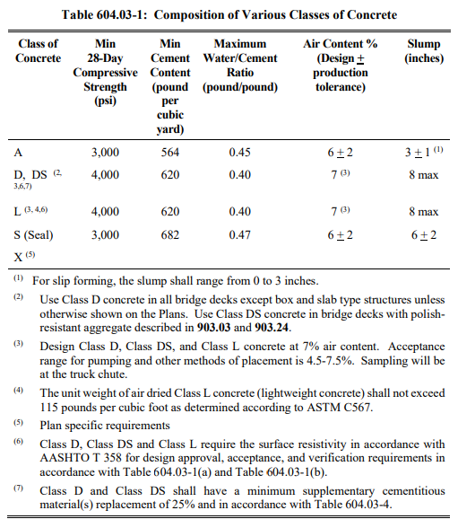
Specifications – Class D/DS
Keep Class D in the specifications

Slide 4
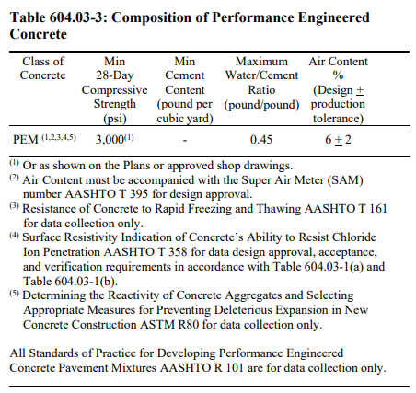
Specifications – PEM Designs
Proposal to remove footnote 3 requiring AASHTO T161 Rapid Freezing and Thawing
Additionally, allow the contractor to use PEM as an alternate/option in replacement of any class of concrete (except DS) provided it meets all departmental guidelines

Slide 5

Local Government Guidelines

Slide 6
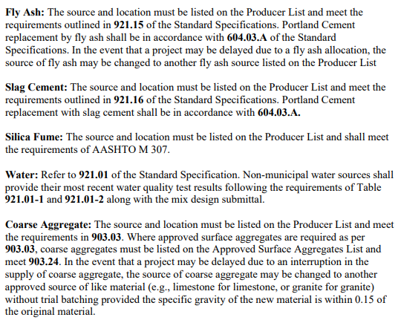
Materials Substitutions
Cement?

Slide 7
NCC Spring 2026 Agenda Topics
Blended Cements
Trial Batching and Trial Placement
Industry and State Perspectives
Alkali-Silica Reactivity
Pavements
Bridge Deck Overlays
Curing and Finishing Concrete
States-Only Meeting

Slide 8
NCC – Type IL and Type IC Cement
Type IL issues are still being debated
TN Producers should inform their suppliers of issues that they are experiencing with Type IL
Speak up at industry meetings, ASTM, AASHTO COMP
We did STOP the adoption of an AASHTO Type IC Spec

Slide 9
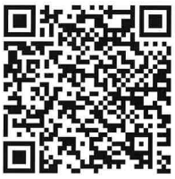
Access NCC Spring 2026 Presentations

Slide 10
Ready Mix Concrete Audit Program
Producer Approval/General Compliance
Control of Materials
Batching & Plant Equipment
Mix Design Control
Production QC Testing
Technician Qualification & Training
Transportation & Delivery
Nonconformance & Corrective Action
Documentation & Recordkeeping
TDOT Oversight
Safety & Environmental Compliance
Completion of Audit

Slide 11
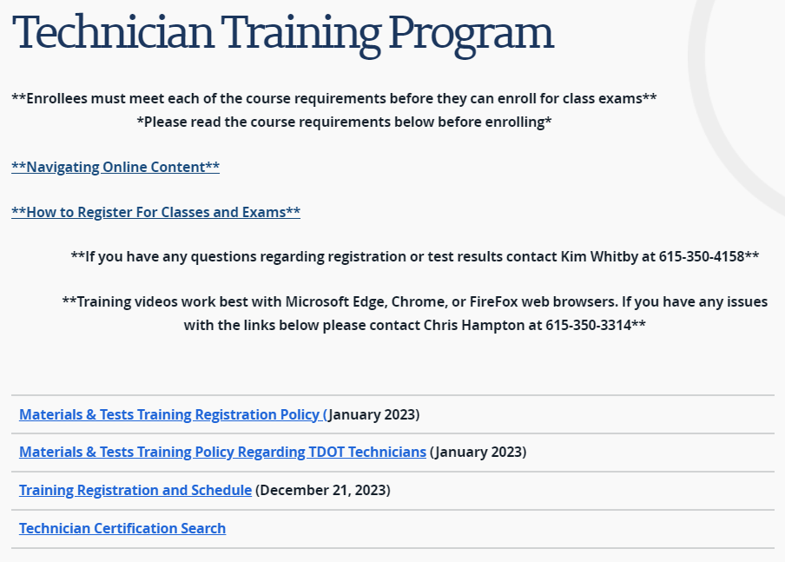

Training Schedule

Slide 12
Training – Winter/Spring 2026
CLASS | MATERIAL | TYPE | FOR | DATE (FROM) | DATE (TO) | TIME (DAY 1) | LOCATION | ROOM
Concrete Field Technician | Concrete | Demonstration | TDOT/CEI/Industry | Monday, January 6, 2025 | Monday, January 6, 2025 | 0800 | Nashville | Region 3 Complex, D/G Building
Concrete Field Technician | Concrete | Demonstration | TDOT/CEI/Industry | Tuesday, January 27, 2026 | Tuesday, January 27, 2026 | 0800 | Chattanooga | Region 2 Complex
Concrete Field Technician | Concrete | Demonstration | TDOT/CEI/Industry | Thursday, February 5, 2026 | Thursday, February 5, 2026 | 0800 | Jackson | Region 4 Auditorium
Aggregate Testing Technician | Aggregate | Certification | CEI/Industry | Tuesday, March 24, 2026 | Tuesday, March 24, 2026 | 0800 | Knoxville | Region 1 Auditorium
Concrete Field Technician | Concrete | Demonstration | TDOT/CEI/Industry | Wednesday, March 25, 2026 | Wednesday, March 25, 2026 | 0800 | Knoxville | Region 1 Complex
Aggregate Testing Technician | Aggregate | Certification | TDOT/CEI/Industry | Tuesday, April 14, 2026 | Tuesday, April 14, 2026 | 0800 | Chattanooga | Region 2 Auditorium
Concrete Field Technician | Concrete | Certification | TDOT/CEI/Industry | Wednesday, April 15, 2026 | Wednesday, April 15, 2026 | 0800 | Chattanooga | Region 2 Auditorium
Aggregate Testing Technician | Aggregate | Certification | TDOT/CEI/Industry | Wednesday, April 22, 2026 | Wednesday, April 22, 2026 | 0800 | Nashville | Region 3 Auditorium
Concrete Field Technician | Concrete | Certification | TDOT/CEI/Industry | Thursday, April 23, 2026 | Thursday, April 23, 2026 | 0800 | Nashville | Region 3 Complex, D/G Building
Aggregate Testing Technician | Aggregate | Certification | TDOT/CEI/Industry | Tuesday, May 26, 2026 | Tuesday, May 26, 2026 | 0800 | Jackson | Region 4 Auditorium
Concrete Field Technician | Concrete | Certification | TDOT/CEI/Industry | Wednesday, May 27, 2026 | Wednesday, May 27, 2026 | 0800 | Jackson | Region 4 Auditorium
Concrete Plant QC Technician | Concrete | Certification | Industry/Selected TDOT | Tuesday, June 9, 2026 | Tuesday, June 9, 2026 | 0800 | Nashville | Region 3 Auditorium
Concrete Mix Design Certification | Concrete | Certification | Industry/Selected TDOT | Wednesday, June 10, 2026 | Wednesday, June 10, 2026 | 0800 | Nashville | Region 3 Auditorium
All training events begin at 8:00 AM local time

Slide 13
Recertification Process
Attend respective course prior to expiration
Written Assessment REQUIRED​
≥80 requires no demonstration​
70-79 requires demonstration​
Slump, temperature, air content, and cylinders
Nonproficient requires demonstration to be repeated
< 70 requires course to be repeated​

Slide 14
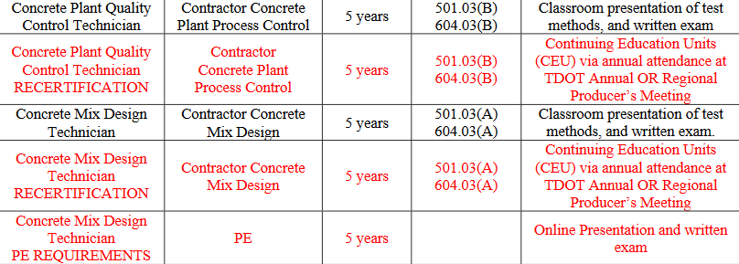
Continuing Education

Slide 15
CEU Opportunities
SOP 1-3: Procedure for recertification
1.5 units per in-person events (6 events)
Must accrue nine (9) units
One event in the most recent meeting cycle
Regional Concrete Meeting
Annual Concrete Meeting
Other opportunities
TCA Meeting – Franklin

Slide 16
Regional Meetings – Spring 2026
MEETING | MATERIAL | DATE | TIME (FROM) | TIME (TO) | LOCATION
Knoxville Regional Meeting | Concrete | Monday, April 27, 2026 | 0930 | 1100 | Nashville
Chattanooga Regional Meeting
Knoxville Regional Meeting | Aggregate | Monday, April 27, 2026 | 1300 | 1430 | Nashville
Chattanooga Regional Meeting
Nashville Regional Meeting | Concrete | Tuesday, April 28, 2026 | 0930 | 1100 | Knoxville
Jackson Regional Meeting
Nashville Regional Meeting | Aggregate | Tuesday, April 28, 2026 | 1300 | 1430 | Knoxville
Jackson Regional Meeting

Slide 17
Contacts for Materials Control Team
Concrete Mix: TDOT.Concrete.Email@tn.gov
Precast/Prestressed: TDOT.PrecastMTR@tn.gov
Aggregate: TDOT.AggregateMTR@tn.gov
Cement: TDOT.CementitiousMTR@tn.gov
Steel: TDOT.SteelMTR@tn.gov

Slide 18
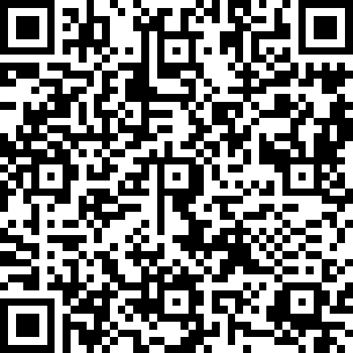
CEU’s for Recertification
Select Regional Producers Meeting
Thank you!

