Slide 1


Durham Emergency Rental Assistance Program (ERAP)
Presented by:
Janeen S Gordon, Assistant Director
Durham County Social Services

Slide 2

US Department of Treasury
On January 5, 2021, the U.S. Department of the Treasury launched the $25 billion Emergency Rental Assistance Program (ERAP)
ERAP assists households that are unable to pay rent and utilities due to the COVID-19 pandemic.
The funds are provided directly to States and local governments with more than 200,000 residents as “eligible grantees”. Durham ERAP program includes direct allocations to both the City and the County, which have been combined.
Eligible grantees must use the funds to help eligible households through existing or newly created rental assistance programs.

Slide 3

Durham Emergency Rental Assistance Program (ERAP)
Durham ERAP received over $9M for rental and utility assistance
Eligibility to Apply:
  COVID related financial hardship
  <80% of AMI eligible
  Priority for those <50% AMI
  At risk of homelessness

Slide 4

Durham ERAP Program
Treasury Regulations
Program Guidelines
Verify Income
Verify financial hardship due to COVID
Verify Eligible Costs and Calculation of Benefits (arears, future rents, energy costs)
Establish Landlord Requirements
Avoid Duplication of Benefits
Application priority groups
Income verification – will accept annual and/or monthly documents (those without income are still eligible for assistance)
Verification financial hardship – this is self-reported ONLY
ERAP will pay for rent and energy costs for up to 12 months (arears and forward)
Landlord Requirements – review and sign landlord agreement
Tenant attests to requesting ERAP for a period not previously paid for by HOPE/CDBG
Application reviewed in order of identified priority groups

Slide 5
Tenant Applicants
To begin an application, please ensure*:
You understand which “priority group” you’re in to apply, based on income (or no income)
Documentation you reside in Durham; proof of citizenship or legal residency is not required.
Verification of financial hardship related to COVID - this is self-reported ONLY
Documentation of arears for rent† and/or energy costs †house, apartment, boarding room, hotel room, etc.
Have agreement with landlord on amount of arears
Tenant attests to requesting ERAP for a period not previously paid for by HOPE/CDBG
*only one application per household can be submitted

Slide 6

Help is available assisting tenants to complete applications
There are community non-profits and agencies volunteering throughout the City and County to assist tenants in completing an application. The contracted non-profits to assist underserved populations with applications are:
Church World Services
Community Empowerment Fund
Healing with CAARE, Inc
Center for Homeownership and Economic Development
El Centro

Slide 7

Non-Tenant Applicants
If applying on someone else’s behalf*, please ensure you have, or can get the following:
A release of information up front from tenant to (a) complete applicant on their behalf and (b) to share rental information.
Documentation tenant resides in Durham; proof of citizenship or legal residency is not required.
Documentation of tenant’s income, or no income
Documentation of tenant’s arears for rent † and/or energy costs †house, apartment, boarding room, hotel room, etc.
If applicant is not the landlord, an agreement with landlord on amount of arears
Tenant attests to requesting ERAP for a period not previously paid for by HOPE/CDBG
*only one application per household can be submitted

Slide 8

What Documents Could be used to Apply??
Income verification documentation could include, but is not limited to:
Pay stubs
Bank Statements
SSI Statements
Unemployment Check stub
Attestation from employer
2020 tax forms
Venmo (etc.) Invoices
Categorical eligibility used as income verification

Slide 9
What qualifies for Categorical Eligibility?
The following income-verified benefits are automatically considered to be eligible:
Supplemental Nutrition Assistance Program (SNAP),
Medicaid and Children’s Health Insurance Program (CHIP),
Child Care subsidy,
Temporary Assistance for Needy Families (TANF),
Supplemental Security Income (SSI),
Crisis Intervention Program (CIP),
Low Income Energy Assistance Program (LIEAP),
Free school meals,
Recent Legal Services through Legal Aid
Section 8 Housing or Voucher

Slide 10

What Sorts of Documents Can Be Used to Apply??
Verify Eligible Arears (What’s Due) :
Notice with total amount owed and/or eviction notice:
  Lease signed by applicant and the landlord or sublessor that identifies unit and rent - OR
  Bank statements or check stubs that show pattern of paying rent - OR
  Written & signed attestation by landlord
Past due energy bill
  Energy bills for unit in applicant’s name, OR invoices, OR other evidence of payment/nonpayment.
This Photo by Unknown Author is licensed under CC BY-NC-ND

Slide 11

What “home energy costs” are included for assistance?
Electricity
Gas
Water/wastewater
Trash
Fuel Oil
Internet
**utilities covered by landlord will be treated as rent

Slide 12

The Landlord/Tenant Agreement – What to Expect
Charge only reasonable late fees.
Not to evict for nonpayment for 60 days from month paid for in advance, or from date of payment for arears.
Not to increase the rent for the remainder of the lease
To maintain a safe and habitable dwelling for the renter
Not to impose new service fees, charges, penalties, or legal fees on the tenant for the remainder of the lease.
This Photo by Unknown Author is licensed under CC BY-SA

Slide 13
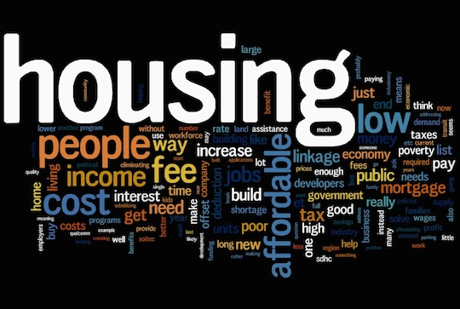
Durham ERAP Program
Changes between Durham ERAP and other Emergency Assistance Programs:
A non-household resident can apply (landlord or nonprofit application assistant)
Distinction between “utilities” and “home energy costs”
Less documentation required for a complete application
The data tool to gather the information
Timetable

Slide 14

Durham ERAP Program
Questions??

