Slide 1
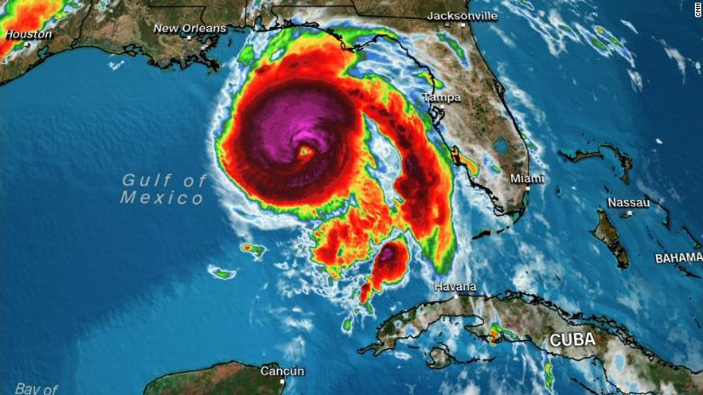
HURRICANE PREP 2019
Notes:
So let's get into talking HURRICANES!
DISCLAIMER: You should always refer to your Company’s policies & procedures guide on disaster prep.

Slide 2
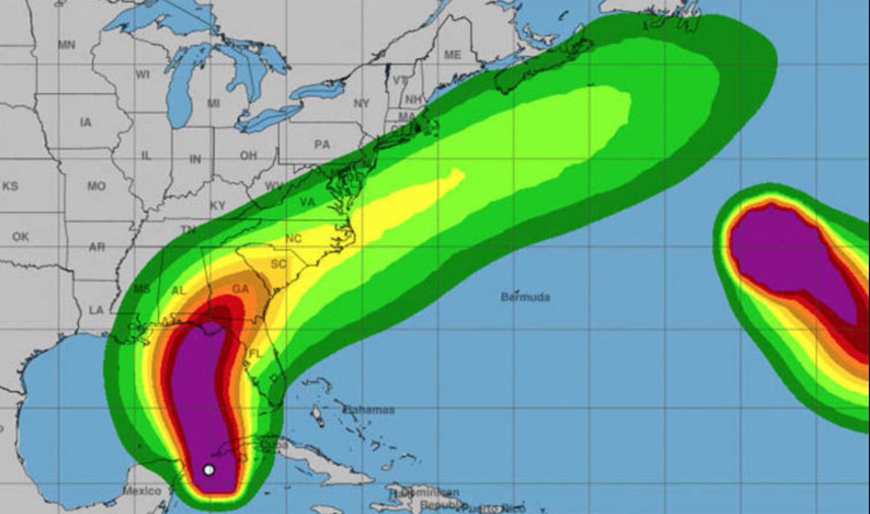
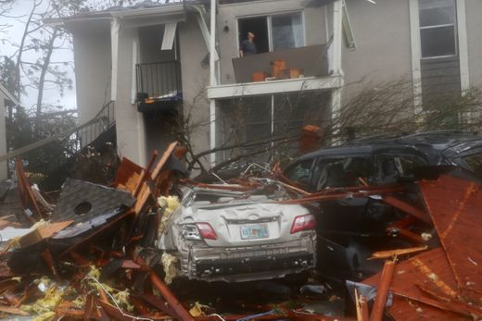
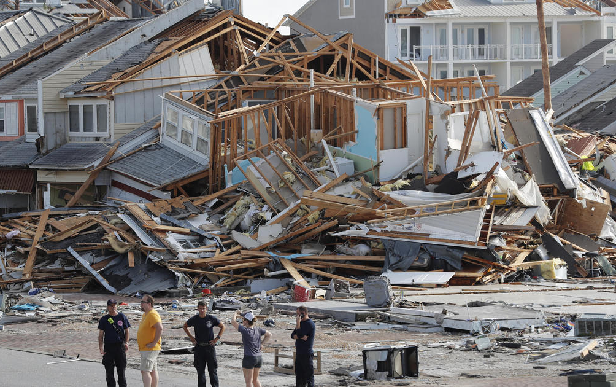
Wind gusts 139 mph
(recorded before instrumentation at Tyndall AFB malfunctioned)
Sustained Winds 160 mph
(sustained for 1 minute)
Storm Surge 14 feet
Timber destroyed $1.3 Billion
(3 million acres)
Agricultural loss $1.49 Billion
Property loss $5 Billion
Insurance claims $6.65 Billion
Total Damages $12 Billion +
Lives lost 50
HURRICANE MICHAEL
Florida Panhandle 10/10/18 – CAT 5
Notes:
Rewind 9 months. Hurricane Michael hits the Florida Panhandle as Category 5.

Slide 3
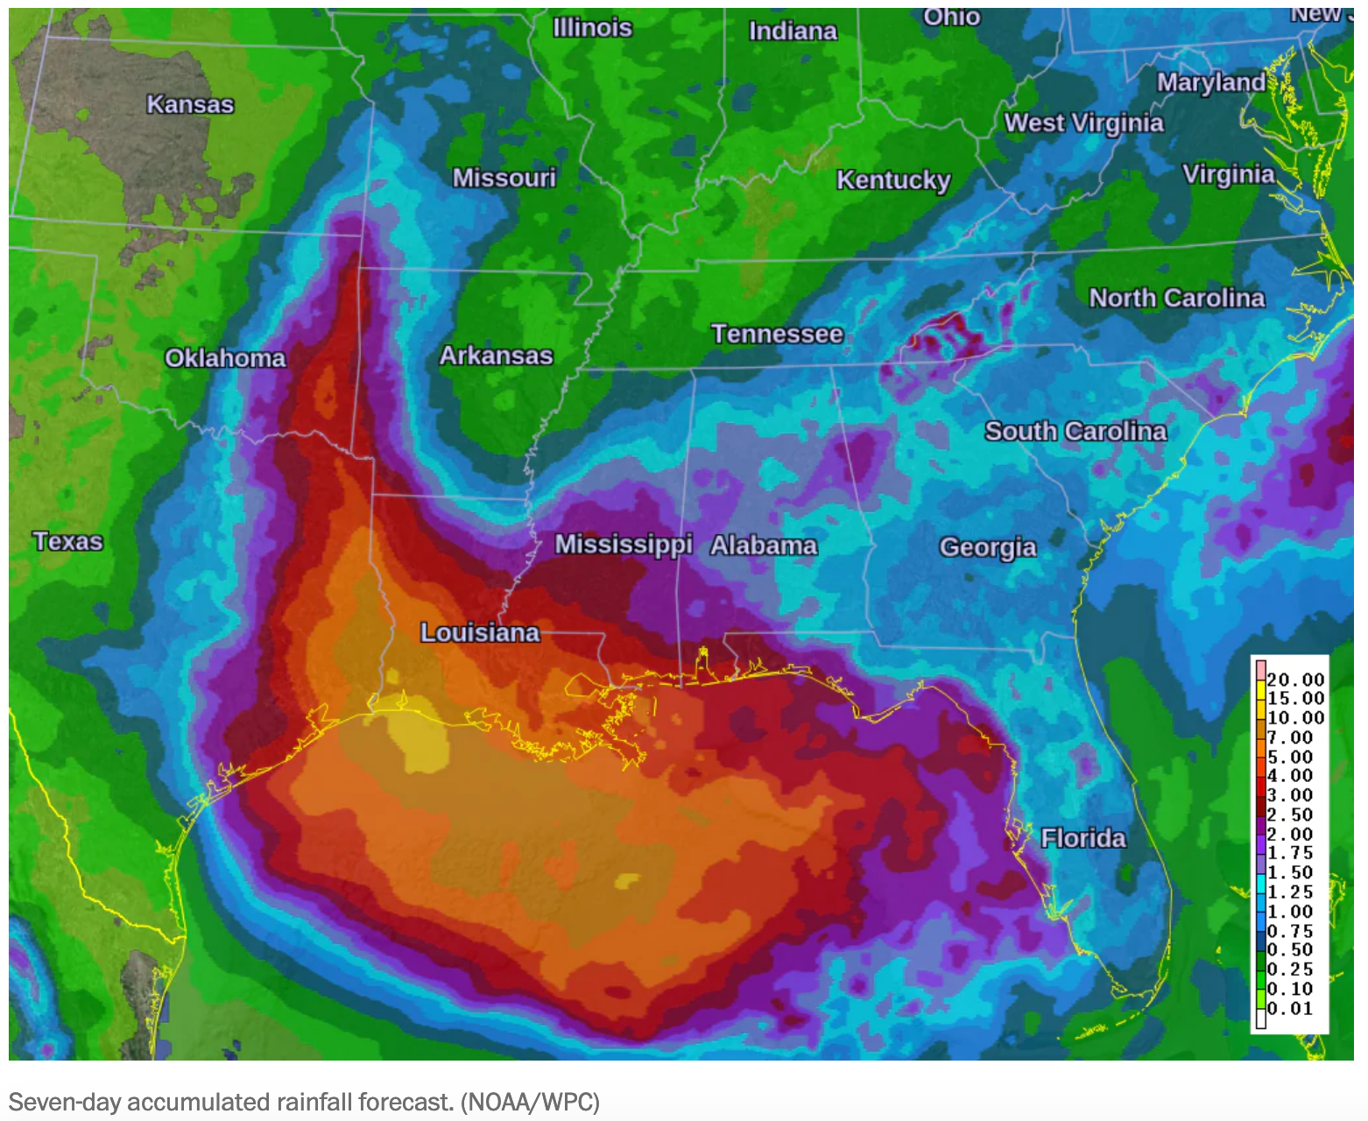
Stay Informed
The Florida Hurricane Season runs from June 1 – November 30. It is important that you stay tuned to local & social media and download weather alert apps to your phones, so that you can be informed of potential threats. We’re currently watching a Tropical Depression that is likely to become Tropical Storm Barry by Thursday.
Notes:
CLICK VIDEO LINK.

Slide 4
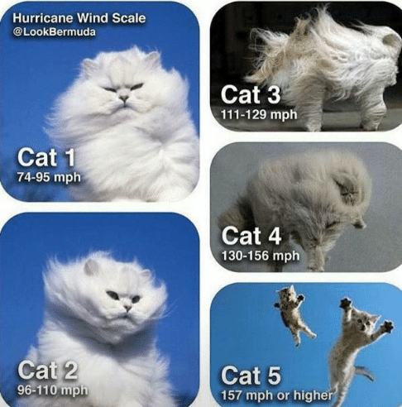
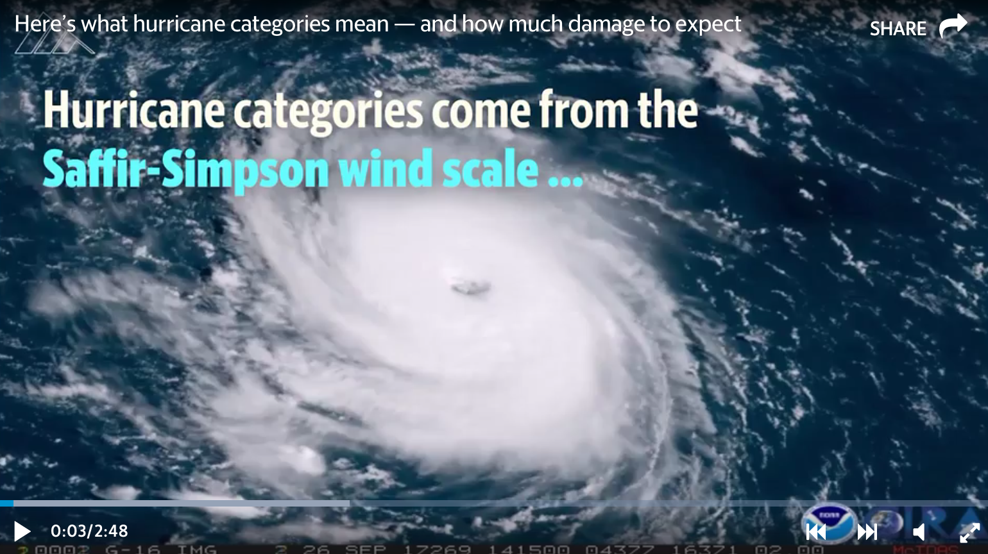
Understanding Categories
CLICK VIDEO LINK
Notes:
Hurricane categories are used by the National Hurricane Center to gauge a hurricane's strength and predict potential property damage with each storm. Here's how the NHC defines each hurricane category — and how much damage each strength can cause.
CLICK VIDEO LINK.

Slide 5
Take Inventory
As your property portfolio changes from year to year, ensure that you have updated contact information for each of your residents, including names of those currently residing and individuals to contact in case of emergency.
Obtain a letter or document on management company letterhead stating that you are the key point-of-contact for your property. You may need to show this to first responders to be permitted to enter the property after the storm.
Check current vendor service agreements for priority clauses.
Notes:
Before the chaos of hurricane season begins, take the time to gather the information you will need in the event of a storm.
After a storm, residents will expect that any damage be addressed in a timely matter. Having service providers prioritizing your work will help maintain good will with your renters. If you don’t currently have a priority clause in your service agreements, think about renegotiating them when they come up for renewal. Today’s sponsors, along with landscapers and pool companies will be in high demand AFTER the storm.

Slide 6
Take Inventory
Our SWFAA Supplier Member sponsors here today like Roofers & General Contractors- First Service -, Tree Removal Specialists- Grow, Inc-, Restoration & Mold Specialists- Spectrum Cleaning- and Fire & Safety Companies- Superior Fire- should at the top of your list.
Remember, you can find SWFAA suppliers for all of these categories & more in the Supplier Marketplace on SWFAA.org and search by expertise

Slide 7
Take Inventory for Maintenance
Emergency Supplies
Updated Emergency Site Map
Generator
(2) Battery operated radio
Batteries
(4) industrial handheld flashlights
300’ all-purpose rope
(3) 20x30 or 20x25 tarps
First Aid Kit- check the expiration date!
Several rolls of duct tape
Case of 55-60 Gallon trash bags
Several gallons of gasoline and propane
Several gallons of purified drinking water
Notes:
It’s important for maintenance teams to take inventory as well.

Slide 8
Make a Plan
The project team should identify each employee’s capacity to offer hurricane aid.
Make a list of roles & responsibilities for each stage: pre, during and post-hurricane.
List employee roles & communicate them to the organization.
Notes:
Designate a project team to update and communicate your hurricane plan to the rest of the organization. The balance between care for employees and care for renters can be a difficult one. Each employee’s situation is different and can affect their ability to help renters before, during and after a storm. Those employees in high-risk areas will need to take care of their needs first before lending a hand to the collective cause.

Slide 9
Make a Plan
Revisit your company’s policies on storm-related topics to see if anything has changed.
Policies on plywood, holes, storm shutters & sandbags should be discussed.
Residents, especially new ones, will have expectations about your organization’s responsibility for hurricane preparation & repair.
Have clear definitions of your policies, so you can set expectations with residents before a storm.

Slide 10
Prepare Residents
Even hurricane veterans can begin to panic before an imminent storm. Imagine the stress your residents will feel before their first hurricane. Giving your renters a sense of stability through adequate preparation & strong guidance will go a long way to ensuring their safety and their confidence in you as their property manager.
Important: direct communication to your renters about hurricane preparedness should be seen as concern for their safety NOT a review of your organization’s policies.

Slide 11
Prepare Residents
Help residents identify if they are in a flood zone and what their local county’s evacuation plan is.
Encourage them to make a plan & know their options.
Most clubhouses are not designated storm shelters, so remind them if appropriate.
Now would be a good time for residents to revisit their renter’s insurance policy.**
Make resources available to residents to prepare themselves.
Hurricane Checklist - hand out
Evacuation Routes
Download NOAA App
Notes:
According to the Washington Post, about 4 out of 5 homeowners in the area devasted by Hurricane Harvey did not have flood insurance. There is a common misunderstanding about what is covered by renter’s insurance. Help your renters know the difference, so they can make an informed decision.
<HANDOUT CHECKLIST>

Slide 12
Prepare Residents
Highly stress the importance of following local emergency alerts including mandatory evacuations, curfews & location of local shelters.
Communicate your organization’s policies on storm-related maintenance and repair.
Many residents will want to take precautions out of general goodwill that will technically be considered damage to the property.
Let residents know if actions like drilling holes in the exterior to hang plywood or hanging storm shutters is against your policies.

Slide 13
Prepare Residents
\
If there are certain precautions you would like your residents to take, like clearing patios or moving vehicles, let them know.
If your organization plans to send a crew to take similar precautions, tell them. It will give them a greater sense of confidence that you have things in control.

Slide 14
Stay in Control
It is important to be a source of stability during this time.
Maintain contact with your residents during & after the storm to the extent possible.
Power & cell outages are likely to occur but keep track as best you can; let genuine concern be your guide.
If you currently implement a resident texting service, this is a great time to use it!
Notes:
With an employee and resident’s plan in place, it’s now time to weather the storm, literally and metaphorically. A resident’s worry over what could happen is often worse than what actually happens.

Slide 15
Stay in Control
If you don’t currently have a resident texting service, reach out to SWFAA members like Apartments.com & Rentpath for solutions. Yardi, RealPage & other property management systems offer this service as well.
After the storm, go through each contact & get an initial read on resident safety & property damage.
Reach out to SWFAA for assistance in finding temporary housing, if needed, for residents. You can stay tuned to www.SWFAA.org for important disaster announcement before, during & after the storm, as conditions permit.
Begin capturing a list of repairs that will need to be claimed & addressed.

Slide 16
Document Everything
Disaster recovery is expensive. The more documentation and evidence you can provide to your insurer to support your claim, the easier it should be to collect on your insurance claim.
Be sure to document:
Damage to the property with photos
Professional assessments of the property damage and recommended restoration measures
Maintenance expenses for parts and labor incurred specifically during property restoration work
Pertinent police/first responder reports and public records of the event that damaged the property.
Notes:
The challenge is that insurers need to make money too—so they may not pay out on a policy because you only have an estimate for damages. The insurer needs to know the exact extent of the damage, see proof that the damage was caused by an event covered under the insurance policy, and that the repairs conducted were necessary for restoring the property to working order.

Slide 17
Bringing It All Together
Taking steps to make sure your residents know they are being taken care of will help build trust that will pay dividends if and when friction occurs in the future.
Hurricane preparedness for property managers is all about putting yourself in the shoes of your residents & anticipating their needs, so they don’t have to.
Notes:
Hurricane season can be a stressful time for any property manager, but a little planning can go a long to putting you in control and gaining long-term goodwill from your renters\

Slide 18
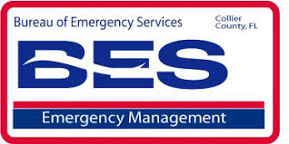
Relief Resources

Slide 19
***Presentation Sources: American Red Cross, Wikipedia, Homee, Inc.
Notes:
FACEBOOK VIDEO CHAT WITH KELI LYNCH-WRIGHT.
Hatching Hope is an organization that provides disaster relief specifically for multifamily residents. Often times displaced Residents are placed into a vacant apartment home or even in the clubhouse until a plan is devised for the next steps. Hatching Hope provides air mattresses, comfy bedding, and much needed supplies for that first night or two following a disaster.
They understand that this is very difficult for children as they try to understand disaster & recovery and they provide soft Hatching Hope Teddy Bears for them as well. Each and every dollar donated is used to build awesome care kits for these victims. And you can actually sponsor someone for $30! This will provide a victim with a air mattress, comfy bedding, and much needed toiletries.
Hatching Hope contacted me the morning after Hurricane Irma made landfall here. They notified me that trucks were on the way! As an association, SWFAA donates to Harching Hope on a regular basis. In addition both the Florida & National Apartment Associations have adopted Hatching Hope as their primary beneficiary for disaster relief.

