Slide 1
LEADING WITH SCIENCE. ADVANCING WITH CARE.

Slide 2
Welcome Diversity, Equity, and Inclusion Reception January 29, 2025
LEADING WITH SCIENCE. ADVANCING WITH CARE.
Notes:
Sebastian to introduce Dr. Gyamfi-Bannerman.

Slide 3
Welcome Dr. Cynthia Gyamfi-Bannerman SMFM President
#SMFM25
LEADING WITH SCIENCE. ADVANCING WITH CARE.

Slide 4
Thank you to our sponsor!
#SMFM25
LEADING WITH SCIENCE. ADVANCING WITH CARE.

Slide 5
SMFM D&I Committee Members
#SMFM24
#SMFM25
Chair:
Dr. Sarahn Wheeler*
Vice Chair:
Dr. Kacey Eichelberger*
Board Liaison:
Dr. Juan Gonzalez-Velez
Members:
Dr. Sandy Ramos*
Dr. Edward Miller*
Dr. Sebastian Ramos*
Dr. Jodi Abbott
Dr. Terri-Ann Bennett
Dr. Moeun Son
Dr. Arthurine Zakama
Dr. Victoria Adewale
Dr. Michelle Debbnick
Dr. Lauren Dungy-Poythress
Dr. Cedar Durfee
Dr. Etoi Garrison
Dr. Kimberly Herrera
Dr. Maeve Hopkins
Dr. Kirat Sandhu (Fellow Rep)
Dr. Anne Waldrop
* Members’ term ending
LEADING WITH SCIENCE. ADVANCING WITH CARE.

Slide 6
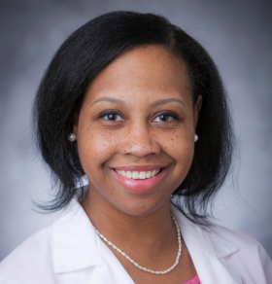
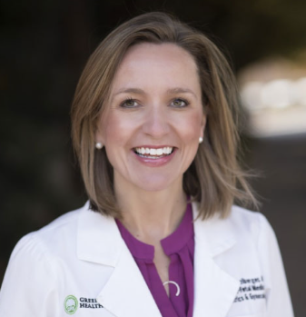
Thank you to our outgoing leaders!
#SMFM25
Chair:
Dr. Sarahn Wheeler
Vice Chair:
Dr. Kacey Eichelberger
LEADING WITH SCIENCE. ADVANCING WITH CARE.

Slide 7
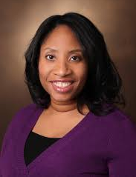
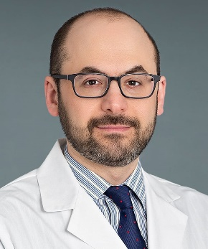
New Committee Members
#SMFM24
#SMFM25
New Members:
Dr. Connisha Holloman
Dr. Diana Robles
Dr. Shelly Soni
Dr. Oluseyi Ogunleye
Dr. Michelle Wang, Fellow Member
Dr. Maura Jones
Mariana Espinal, Fellow Member
Andrea Sanchez Velazquez, Resident Member
Chair:
Dr. Rolanda Lister
Vice Chair:
Dr. Justin Brandt
LEADING WITH SCIENCE. ADVANCING WITH CARE.

Slide 8
Congratulations to our Emerging Leaders!
#SMFM25
LEADING WITH SCIENCE. ADVANCING WITH CARE.
Notes:
The Emerging Leaders Program (ELP) develops leadership skills for outstanding maternal-fetal medicine candidates from groups who are traditionally underrepresented in medicine both within our field and within the SMFM’s organizational structure.
With generous support from Johnson&Johnson, the program includes training in leadership best practices, personalized career coaching, networking opportunities and mentorship for a small group of early career MFM physicians.
This year's class included an impressive group of four individuals from institutions across the country: Connisha Holloman, Raminder Khangura, Charisma Manley, and Vero Pimentel. [Emerging Leaders are in attendance at the reception]

Slide 9
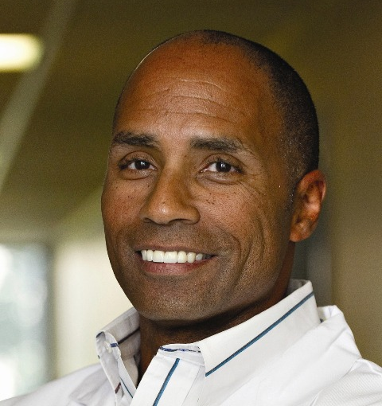
2025 Diversity, Equity & Inclusion Award
#SMFM24
#SMFM25
Dr. James Hill
Professor
Director, Maternal-Fetal Medicine Division
Obstetrics and Gynecology Department
CHRISTUS Children’s
San Antonio, Texas
LEADING WITH SCIENCE. ADVANCING WITH CARE.
Notes:
Dr. James Hill currently serves as Professor, Director of the Maternal-Fetal Medicine, and Chair of the Department of Ob/Gyn at the Children’s Hospital of San Antonio, Baylor College of Medicine. He has published numerous papers in peer review journals and co-investigator on several funded studies, including a NIH-grant studying advancing diagnostics for congenital syphilis. Dr. Hill is also an exceptional teacher, and has earned numerous teaching awards including the national CREOG Teaching Award, the national APGO Excellence in Teaching Award in Obstetrics and Gynecology, and the Fred T. Given Faculty Teaching Award at EVMS.
Dr. Hill serves as the co-Chair of the Maternal Disparities Subcommittee to the Texas Maternal Mortality and Morbidity Review Committee and helped to update the Determinants of Health Facility Discussion Tool which develops a standardized process to guide discussion around maternal deaths, with an emphasis on identifying and addressing social determinants of health and system inequities. Dr Hill was also part of a 3-member panel to the Texas Advisory Committee to the US Commission on Civil Rights, and his testimony focused on addressing racial disparities in maternal mortality and morbidity. During his long career, Dr. Hill has mentored close to 100 medical students, residents, and MFM colleagues from diverse and traditionally underrepresented backgrounds and created a culture of belonging. I had the pleasure of getting to know him when he invited me to give grand rounds at his place several years ago.
This honor is a testament to Dr. Hill’s unwavering dedication and remarkable contributions to promoting equity, diversity, and inclusion within the field of maternal fetal medicine. Throughout his illustrious career, he has worked to foster an inclusive environment that has enriched the lives of countless patients and colleagues. This award not only honors his past contributions but also serves as a powerful reminder of the ongoing impact of his work.

Slide 10
Enjoy the Reception!
#SMFM24
#SMFM25
LEADING WITH SCIENCE. ADVANCING WITH CARE.

