Slide 1
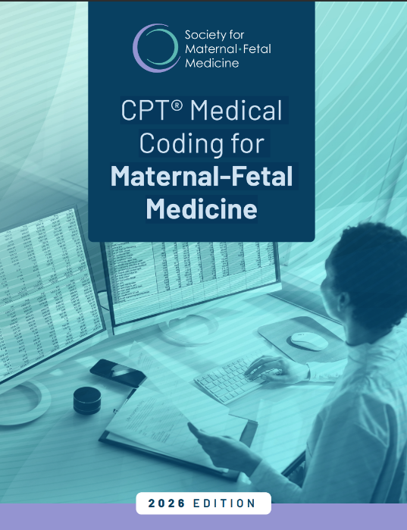
CPT® Medical Coding for Maternal-Fetal Medicine – 2026 Edition
All-new design in a convenient, searchable electronic format
Covers the latest coding updates and changes from 2024 through January 2026, including telehealth, remote monitoring, and detailed first-trimester ultrasound
Offers myriad examples to illustrate common coding questions and concerns
Presents complex information, such as time-based coding, in easy-to-understand tables
www.smfm.org/coding-manual
COMING SOON!

