Slide 1

Medical and Division Director's Roundtable
Monday, February 9, 2026  5:15 PM – 7:00 PM  Summit 222 - 223

Slide 2
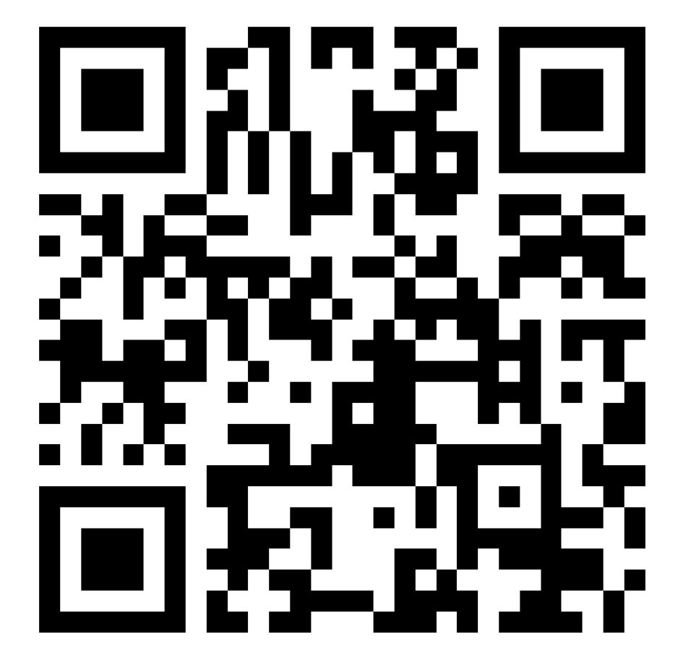
Medical and Division Director's Roundtable
Sign Up!
Thank you for attending the Medical and Division Directors Roundtable! Scan the QR Code if you would like to be contacted about future events like this, including our virtual panel later this year.

