Slide 1
2024 Data from the Pregnancy Mortality Surveillance System (PMSS)

Slide 2
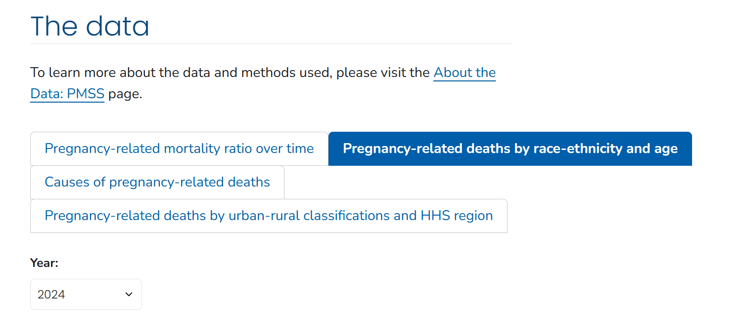

Visit the Dashboard
Learn more about the data by scanning the QR code or visiting cdc.gov/maternal-mortality/php/pregnancy-mortality-surveillance-data
Notes:
When CDC launched 2023 data, they also launched a new dashboard where you can toggle between individual years starting in 2020. You can also see grouped data from 2017-2019, as well as from 2020-2022 to see the impact of the COVID-19 pandemic. All charts and tables include links to download the data tables.

Slide 3
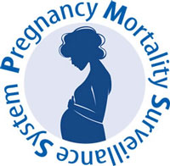
Pregnancy-Related Mortality Ratio by Year: 1987-2024, Pregnancy Mortality Surveillance System (PMSS)
*Pregnancy-related deaths per 100,000 live births
https://www.cdc.gov/maternal-mortality/php/pregnancy-mortality-surveillance
Notes:
Here, we can see the steady increase in the PRMR over time, with a large jump during peak COVID in 2021. In fact, between 2019 and 2021, the pregnancy-related mortality ratio nearly doubled. If you look at the leading causes of death in 2021, COVID-19 accounted for more than 40% of pregnancy-related deaths that year.
Since then, the PRMR has come back down, at 18.4 pregnancy-related deaths per 100,000 live births in 2024. However, this is still higher than pre-COVID levels, showing that the increasing trend does not appear to be changing.

Slide 4
Leading Causes of Pregnancy-Related Deaths in 2024
Total: 22.0%
Total: 14.4%
Notes:
The top leading cause was cardiovascular conditions, at 22% total. You can see we separated out deaths by cardiomyopathy from other cardiovascular diseases, with cardiomyopathy leading to 10.7% of deaths.
Following cardiovascular conditions, the next leading cause is other noncardiovascular medical conditions at 15.2% - Samantha previously mentioned a new report from CDC on this category. The third leading cause is infection or sepsis at a total of 14.4%, with COVID accounting for 0.6% of deaths.
Maybe add that Samantha referenced the report earlier for context, helping people connect the dots.

Slide 5
Pregnancy-Related Mortality Ratio by Race-Ethnicity in 2024
Notes:
While the overall pregnancy-related mortality ratio in 2024 was 18.4 pregnancy related deaths per 100,000 live births, the ratio varies when we disaggregate for race-ethnicity.
These variations highlight the huge disparities in maternal health outcomes.

Slide 6
Pregnancy-Related Mortality Ratio by Race-Ethnicity in 2024
According to 2024 PMSS data, non-Hispanic Black and American Indian or Alaska Native persons were 3-4 times more likely to die from a pregnancy-related death than non-Hispanic white persons.
Notes:
In 2024, non-Hispanic American Indian or Alaska Native and non-Hispanic Black persons were 3-4 more times likely to die than non-Hispanic white persons.
This is not new, but rather an ongoing trend that highlights how important it is to center equity in our efforts to address this crisis. It is not enough to just look at overall data – we need to address the disparities in outcomes.

Slide 7
Pregnancy-Related Mortality Ratio by Age in 2024
Notes:
pregnancy-related mortality ratio also varies by age group. In fact, after the 24-29 age group, the ratio increases with each age group.

Slide 8
Pregnancy-Related Mortality Ratio by Age in 2024
According to 2024 PMSS data, those aged 45-49 were 18 times more likely to die from a pregnancy-related death than those aged 25-29.
Notes:
We know that pregnancy becomes riskier with age – these numbers highlight that, with those aged 45-49 18 times more likely to die from a pregnancy-related death than those aged 25-29.

Slide 9
Pregnancy-Related Mortality Ratio by Urban-Rural Classification in 2024
Rural
Urban
Notes:
Here we see the two rural categories – noncore and micropolitan – are higher than the urban categories.

Slide 10
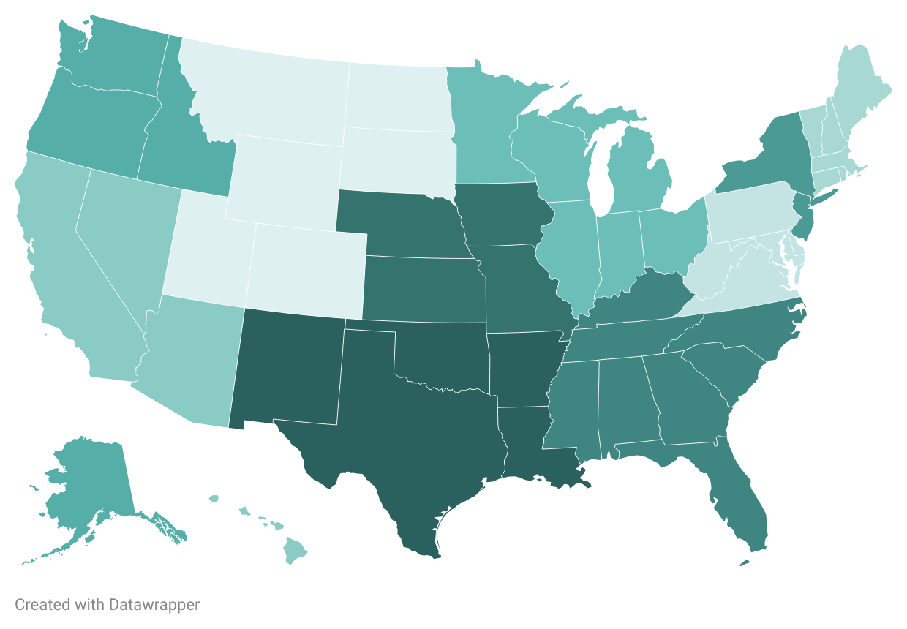
Pregnancy-Related Mortality Ratio by HHS Region in 2024
10
1
8
2
5
3
PR
VI
7
9
AS
GU
MP
FM
PW
MH
4
6
Notes:
These regions are based off of the 10 Regional Offices hosted by the Office of Intergovernmental and External Affairs that serve state and local organizations.
This map shows us that Region 8 has the lowest PRMR at 8.6 pregnancy-related deaths per 100,000 live births, while Region 6 has the highest PRMR at 23 pregnancy-related deaths per 100,000 live births.

Slide 11
Pregnancy-Related Mortality Ratio by HHS Region in 2024
10
1
8
2
Region 6 has a pregnancy-related mortality ratio that is nearly 3 times that of Region 8.
5
3
PR
VI
7
9
AS
GU
MP
FM
PW
MH
4
6
Notes:
Even within these regions with low overall pregnancy-related mortality rates, major disparities exist – and are sometimes worse than in regions with larger PRMRs overall.

Slide 12
Visit the Dashboard
Learn more about the data by scanning the QR code or visiting cdc.gov/maternal-mortality/php/pregnancy-mortality-surveillance-data
Notes:
You can access the data dashboard with the link or QR code on your screen.

