Slide 1
2022 Data from the Maternal Mortality Review Information App (MMRIA)

Slide 2
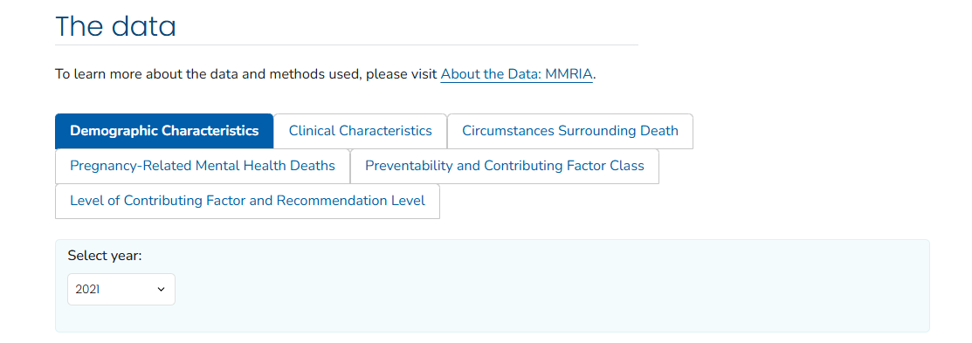
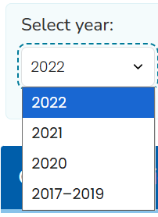

Visit the Dashboard
Learn more about the data by scanning the QR code or visiting cdc.gov/maternal-mortality/php/data-research/mmrc
Notes:
MMRIA launched a data dashboard in 2025, allowing us to toggle between data from 2022, 2021, 2020, and 2017-2019.

Slide 3
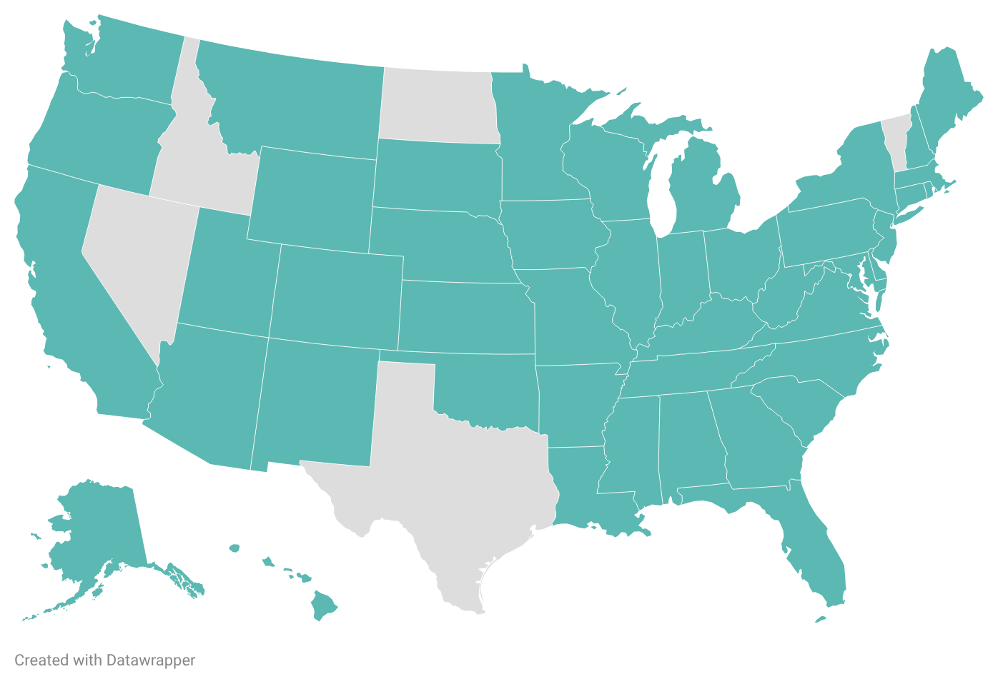
MMRCs in 45 states contributed data on 807 pregnancy-related deaths in 2022
Notes:
This MMRIA report looks at MMRC data from 45 states. This is one less state than the 2022 data, which included these states plus Idaho.
From this map, you can see that the five states that did not contribute data were Idaho, Nevada, North Dakota, Texas, and Vermont. Since we don’t have data from every state, we unfortunately cannot get a true national picture or pregnancy-related mortality ratio from this data. However, we can still get a lot of important information.
Maybe phrase as "that have been represented in MMRIA reports." A small distinction that maybe isn't a big deal.

Slide 4
Pregnancy-Related Deaths Occur Up to a Year from the End of Pregnancy
20.9%
11.2%
9.5%
20.6%
37.8%
During pregnancy
Day of delivery
1-6 days after end
of pregnancy
7-42 days after end
of pregnancy
43 days-1 year after
end of pregnancy
Notes:
the MMRIA dashboard includes data on when these pregnancy-related deaths occurred: during pregnancy, on the day of delivery, 1-6 days after the end of pregnancy, 7-42 days after the end of pregnancy, or 43 days to 1 year after the end of pregnancy

Slide 5

Pregnancy-Related Deaths Occur Up to a Year from the End of Pregnancy
20.9%
11.2%
9.5%
20.6%
37.8%
During pregnancy
Day of delivery
1-6 days after end
of pregnancy
7-42 days after end
of pregnancy
43 days-1 year after
end of pregnancy
58.4% occurred 1 week to 1 year after the end of pregnancy
Notes:
We can see that 58.4% of deaths occurred 1 week to 1 year after the end of pregnancy.

Slide 6
Pregnancy-Related Deaths Occur Up to a Year from the End of Pregnancy
20.9%
11.2%
9.5%
20.6%
37.8%
During pregnancy
Day of delivery
1-6 days after end
of pregnancy
7-42 days after end
of pregnancy
43 days-1 year after
end of pregnancy
Over 1/3 of deaths occurred after 6 weeks postpartum. This is why we look at pregnancy-related data!
Notes:
Now just looking at the last period, 37.8% of deaths occurred 43 days to 1 year after pregnancy. This highlights the importance of looking at pregnancy-related death data, since maternal death data does not include deaths after 42 days.

Slide 7
MMRCs determine whether pregnancy-related deaths were preventable.
Notes:
A death is considered preventable if the committee determines that there was at least some chance of the death being averted by one or more reasonable changes to patient, community, provider, facility, and/or systems factors . This means that preventability doesn’t just come down to providers and patients – for example, a death could be considered preventable if the patient didn’t have insurance and thus couldn’t get regular care.
MMRIA allows MMRCs to document preventability decisions in two ways: (1) determining preventability as a yes or no, and/or 2) determining the chance to alter the outcome by using a scale that indicates no chance, some chance, or good chance. Any death with a yes response or a response that there was some chance or a good chance to alter the outcome was considered preventable. Deaths with a no response or no chance were considered not preventable.

Slide 8
85.7% of pregnancy-related deaths were determined to be preventable.
A preventability determination was missing (n=2) or unable to determine (n=14) for a total of 16 (1.8%) pregnancy-related deaths. These deaths were not included in percent calculations.
Notes:
According to the 2022 MMRIA data, 85.7% of pregnancy-related deaths were determined to be preventable.

Slide 9
Leading Underlying Causes of Pregnancy-Related Deaths in 2022
Total: 16.6%
Total: 12.2%
Notes:
Mental health conditions were the leading underlying cause of death, at 27.7% of deaths, followed by cardiovascular disease at 16.6% total.
While this is looking across all data from the 2022 MMRIA report, we also are able to see leading underlying causes disaggregated by race-ethnicity.

Slide 10
Leading Underlying Causes of Pregnancy-Related Deaths in 2022 – non-Hispanic American Indian or Alaska Native Persons
3.2%
Notes:
Starting with non-Hispanic American Indian and Alaska Native persons, we can see that mental health conditions was the leading cause at 35.5%, followed by infection at 16.1%. COVID alone accounted for 9.7% of deaths.

Slide 11
Leading Underlying Causes of Pregnancy-Related Deaths in 2022 – Hispanic Persons
Total: 15.0%
Total: 15.0%
Total: 7.6%
Notes:
Looking at Hispanic persons, we can see that infection was the mental health conditions was again the leading underlying cause at 18% total, followed by cardiovascular conditions and infection, both at 15% total

Slide 12
Leading Underlying Causes of Pregnancy-Related Deaths in 2022 – non-Hispanic Asian Persons
Total: 21.7%
Notes:
For non-Hispanic Asian persons, the leading cause of death was infection, at 21.7% total, with COVID alone leading at 8.7%.
This is followed by mental health conditions at 17.4%

Slide 13
Leading Underlying Causes of Pregnancy-Related Deaths in 2022 – non-Hispanic Black Persons
Total: 20.0%
Total: 10.2%
Notes:
Among non-Hispanic Black persons, the leading underlying cause of death was cardiovascular conditions at 20% total, with cardiomyopathy accounting for 11.1%.
Mental health conditions was the second leading underlying cause of death, at 16.9%.

Slide 14
Leading Underlying Causes of Pregnancy-Related Deaths in 2022 – non-Hispanic Persons of Multiple Races
Total: 16.7%
Total: 16.7%
Notes:
For non-Hispanic persons of multiple races, mental health conditions was the leading underlying cause of death, at 38.9%, followed by cardiovascular conditions and infection, each contributing 16.7% of deaths.

Slide 15
Leading Underlying Causes of Pregnancy-Related Deaths in 2022 – non-Hispanic White Persons
Total: 15.6%
Total: 11.2%
Notes:
among non-Hispanic white persons, the leading cause of death was mental health conditions, at 37.9%, followed by cardiovascular conditions at a total of 15.6% of deaths.
The purpose of disaggregating data by race ethnicity is not simply for comparison, or for a thought experiment. Rather, we know that major disparities exist between racial-ethnic groups. In order to address the disparities, we need to first see how the leading causes of death vary so we can better identify solutions that truly center equity.

Slide 16
Circumstances Contributing to Pregnancy-Related Deaths
Obesity
Discrimination
Mental health conditions
Substance use disorder
Notes:
These are documented using a standard checkbox, with Yes, No, Probably, and Unknown as the options.
The MMRC determination for a circumstance surrounding a pregnancy-related death documents if one of these circumstances both was present and contributed to the chain of events leading to a death, but may not have been the underlying cause of death. The MMRC separately considers and documents each circumstance so each death may have multiple circumstances identified

Slide 17
Circumstances Contributing to Pregnancy-Related Deaths
Obesity
Discrimination
Mental health conditions
Substance use disorder
Notes:
MMRCs determine whether obesity contributed to the death, and not just whether the patient was obese. An MMRC may determine that obesity contributed to the death when the condition directly compromised the patient’s health. For example, obesity complicated ventilation options for a pregnant woman with the flu.

Slide 18
Circumstances Contributing to Pregnancy-Related Deaths
Obesity
Discrimination
Mental health conditions
Substance use disorder
Notes:
Added as an option in May 2020, discrimination is not just whether the patient was exposed to discrimination. Discrimination is defined as treating someone less or more favorably based on the group, class, or category they belong to. For example, dismissing symptoms of abdominal pain described by someone with a history of substance use disorder, which led to a delay in diagnosis and care for ruptured ectopic pregnancy.

Slide 19
Circumstances Contributing to Pregnancy-Related Deaths
Obesity
Discrimination
Mental health conditions
Substance use disorder
Notes:
MMRCs determine whether a mental health condition other than substance use disorder contributed to the death, and not just whether the patient had a mental health condition. Mental health conditions are defined as present when there is a documented diagnosis of a psychiatric disorder or if criteria for a diagnosis of a mental health condition are met according to subject matter experts. The committee may determine that a mental health condition is a circumstance when the condition directly compromised a patient’s healthcare (for example, mental health condition impacted her ability to manage type 2 diabetes).

Slide 20
Circumstances Contributing to Pregnancy-Related Deaths
Obesity
Discrimination
Mental health conditions
Substance use disorder
Notes:
Lastly, substance use disorder is characterized by recurrent use of alcohol and/or drugs causing clinically and functionally significant impairment (for example, health problems or disability).
The committee may determine that substance use disorder contributed to the death when the disorder directly compromised a patient’s healthcare (for instance, acute methamphetamine intoxication made preeclampsia worse, or she was more vulnerable to infections or medical conditions).

Slide 21
Circumstances Contributing to Pregnancy-Related Deaths in 2022
Total: 23.7%
Total: 32.8%
Total: 34.3%
Total: 27.9%
Notes:
Here, we can see that obesity was checked as Yes or Probably in a total of 23.7% of deaths; discrimination was checked in a total of 32.8% of deaths; mental health conditions was checked in 34.3% of deaths; and substance use disorder was checked in 27.9% of deaths.

Slide 22
Circumstances Contributing to Pregnancy-Related Deaths in 2022
Notes:
when we look at the unknown, the numbers could be even greater.
Especially when looking at discrimination. Nearly as many deaths were marked unknown for discrimination as marked yes.
It’s not that surprising that there were more unknowns in this category than in the others – discrimination is arguably the most subjective of the four circumstances. This is why informant interviews are so critical, as is having a diverse group of people sitting on MMRCs.

Slide 23
Pregnancy-Related Mental Health Deaths in 2022
Among pregnancy-related deaths with mental health condition as the underlying cause:
45.4%
Were determined by MMRCs to be suicide (yes or probably)
51.4%
Were determined by MMRCs to be unintentional or unknown intent poisoning/overdose
Notes:
Here we can see that among pregnancy-related deaths with mental health condition as the underlying cause, just under half were determined to be suicide and just over half were determined to be unintentional or unknown intent poisoning or overdose.
When we say that mental health is a leading cause of death, it’s easy to assume a majority of these deaths were by suicide – but according to this data, this is not the case.

Slide 24
Pregnancy-Related Mental Health Deaths in 2022
Notes:
this graphic shows us specific conditions that were present for those whom mental health conditions was the leading underlying cause for pregnancy-related death

Slide 25
Pregnancy-Related Mental Health Deaths in 2022
Substance use disorder was the underlying cause of half of pregnancy-related mental health deaths, according to 2022 MMRIA data
Notes:
substance use disorder was the underlying cause of over one half of pregnancy-related mental health deaths
This highlights how important it is to treat substance use disorder like the illness it is, not as a moral failing. When policies are punitive, people are less likely to seek treatment

Slide 26
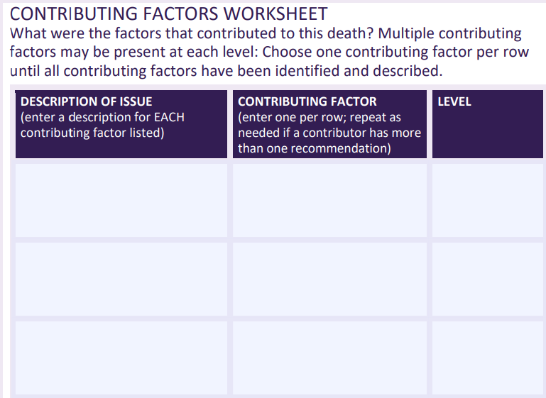
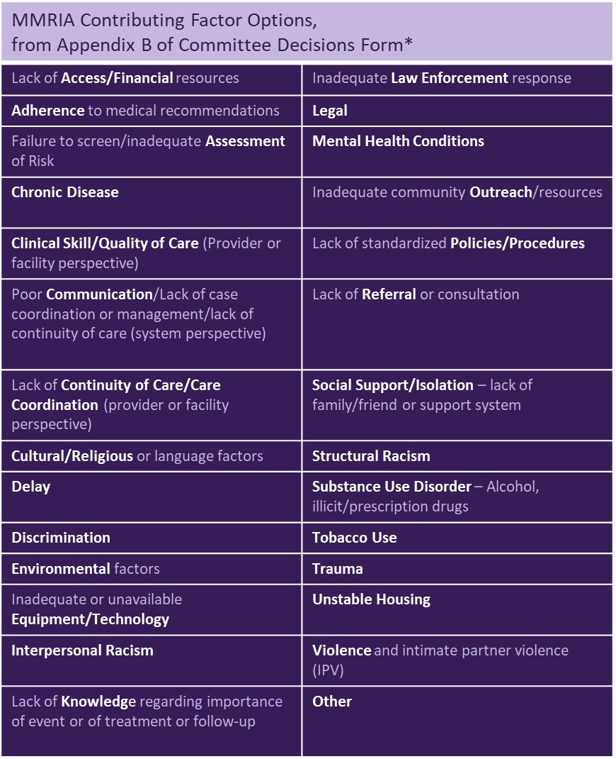
Contributing Factor Classes and Levels
Notes:
Contributing factor classes include but are not limited to: lack of access or financial resources; chronic disease; clinical skill or quality of care; lack of continuity of care; and more
The contributing factors are sorted into five levels, as are subsequent recommendations. These levels are: patient or family; provider; facility; system; and community.

Slide 27
Top Five Contributing Factor Classes in 2022
Notes:
Among the pregnancy-related deaths analyzed in the 2022 MMRIA data, there were nearly 5,000 contributing factor classes among nearly 700 preventable pregnancy-related deaths
This shows the top five.

Slide 28
Contributing Factor Levels in 2022
Notes:
Those contributing factor classes were assigned levels – here we can see the provider level had the most classes, at 29.7%, followed closely by system at 28.1%, while community had the least, at 5.2%.

Slide 29
Recommendation Levels in 2022
Notes:
Here we can see what levels the MMRC recommendations were assigned to

Slide 30
Contributing Factor and Recommendation Levels in 2022
Notes:
We can look at these levels side by side – you’ll see the bars are almost equal for all levels except patient/family. This is because it’s hard to create recommendations on that level that are scalable and can have widespread impact.

Slide 31
Visit the Dashboard
Learn more about the data by scanning the QR code or visiting cdc.gov/maternal-mortality/php/data-research/mmrc
Notes:
MMRIA launched a data dashboard in 2025, allowing us to toggle between data from 2022, 2021, 2020, and 2017-2019.

