Slide 1
2021 Data from the Maternal Mortality Review Information App (MMRIA)

Slide 2
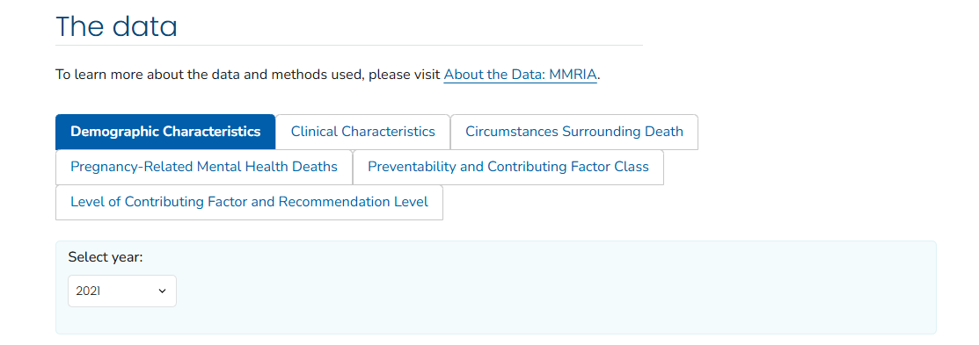


Visit the Dashboard
Learn more about the data by scanning the QR code or visiting cdc.gov/maternal-mortality/php/data-research/mmrc
Notes:
MMRIA launched a data dashboard in 2025, allowing us to toggle between data from 2021, 2020, and 2017-2019.

Slide 3

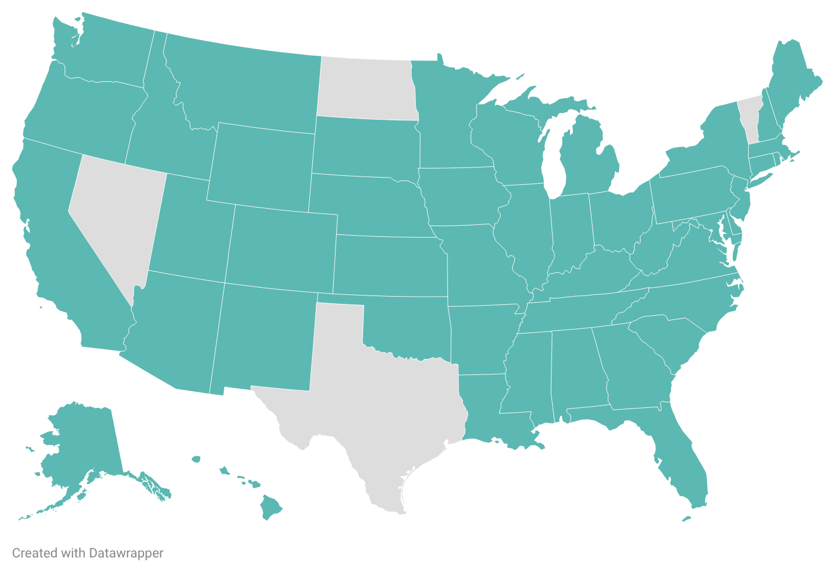
MMRCs in 46 states contributed data on 2021 pregnancy-related deaths
Notes:
This MMRIA report looks at MMRC data from 46 states. This is the largest number of states that have been represented in MMRIA reports , with the 2020 report including data from 38 states.
From this map, you can see that the four states that did not contribute data were Nevada, North Dakota, Texas, and Vermont. Since we don’t have data from every state, we unfortunately cannot get a true national picture or pregnancy-related mortality ratio from this data. However, we can still get a lot of important information.
Maybe phrase as "that have been represented in MMRIA reports." A small distinction that maybe isn't a big deal.

Slide 4
Pregnancy-Related Deaths Occur Up to a Year from the End of Pregnancy
19.5%
9.1%
14.1%
29.2%
28.1%
During pregnancy
Day of delivery
1-6 days after end
of pregnancy
7-42 days after end
of pregnancy
43 days-1 year after
end of pregnancy
Notes:
the MMRIA dashboard includes data on when these pregnancy-related deaths occurred: during pregnancy, on the day of delivery, 1-6 days after the end of pregnancy, 7-42 days after the end of pregnancy, or 43 days to 1 year after the end of pregnancy

Slide 5
Pregnancy-Related Deaths Occur Up to a Year from the End of Pregnancy
19.5%
9.1%
14.1%
29.2%
28.1%
During pregnancy
Day of delivery
1-6 days after end
of pregnancy
7-42 days after end
of pregnancy
43 days-1 year after
end of pregnancy
57.3% occurred 1 week to 1 year after the end of pregnancy – up from 47% in 2020
Notes:
We can see that 57.3% of deaths occurred 1 week to 1 year after the end of pregnancy.
This is up from 47% in 2020.

Slide 6
Pregnancy-Related Deaths Occur Up to a Year from the End of Pregnancy
19.5%
9.1%
14.1%
29.2%
28.1%
During pregnancy
Day of delivery
1-6 days after end
of pregnancy
7-42 days after end
of pregnancy
43 days-1 year after
end of pregnancy
Nearly 1/3 of deaths occurred after 6 weeks postpartum. This is why we look at pregnancy-related data!
Notes:
Now just looking at the last period, 28.1% of deaths occurred 43 days to 1 year after pregnancy. This highlights the importance of looking at pregnancy-related death data, since maternal death data does not include deaths after 42 days.

Slide 7
MMRCs determine whether pregnancy-related deaths were preventable.
Notes:
A death is considered preventable if the committee determines that there was at least some chance of the death being averted by one or more reasonable changes to patient, community, provider, facility, and/or systems factors . This means that preventability doesn’t just come down to providers and patients – for example, a death could be considered preventable if the patient didn’t have insurance and thus couldn’t get regular care.
MMRIA allows MMRCs to document preventability decisions in two ways: (1) determining preventability as a yes or no, and/or 2) determining the chance to alter the outcome by using a scale that indicates no chance, some chance, or good chance. Any death with a yes response or a response that there was some chance or a good chance to alter the outcome was considered preventable. Deaths with a no response or no chance were considered not preventable.

Slide 8
87% of pregnancy-related deaths were determined to be preventable.
A preventability determination was missing (n=2) or unable to determine (n=14) for a total of 16 (1.8%) pregnancy-related deaths. These deaths were not included in percent calculations.
Notes:
According to the 2021 MMRIA data, 87% of pregnancy-related deaths were determined to be preventable. That means that out of 100 deaths, 87 had some chance of being avoided.

Slide 9
Leading Underlying Causes of Pregnancy-Related Deaths in 2021
Total: 33.2%
Total: 10.4%
Notes:
infection was the leading underlying cause in 2021, at 33.2% total, with COVID alone accounting for 27.7% of deaths.
Following infection, mental health conditions accounted for 22.5% of deaths, followed by cardiovascular disease at 10.4% total.
While this is looking across all data from the 2021 MMRIA report, we also are able to see leading underlying causes disaggregated by race-ethnicity.

Slide 10
Leading Underlying Causes of Pregnancy-Related Deaths in 2021 – non-Hispanic American Indian or Alaska Native Persons
Total: 37.1%
Notes:
Starting with non-Hispanic American Indian and Alaska Native persons, we can see that mental health conditions was the leading cause at 40%, followed by infection at 37.1%. COVID alone accounted for 28.6% of deaths.
While cardiovascular conditions was the third leading cause of death overall, here we see it drop down, accounting for 2.9% of deaths among non-Hispanic American Indian and Alaska Native people.

Slide 11
Leading Underlying Causes of Pregnancy-Related Deaths in 2021 – Hispanic Persons
Total: 39.6%
Total: 7.6%
Notes:
Looking at Hispanic persons, we can see that infection was the leading cause, at 39.6% total and 36.1% due to COVID alone, followed by mental health conditions at 22.2%

Slide 12
Leading Underlying Causes of Pregnancy-Related Deaths in 2021 – non-Hispanic Asian Persons
Total: 46.2%
Notes:
For non-Hispanic Asian persons, the leading cause of death was infection, at 46.2% total, with COVID alone leading at 38.5%.
This is followed by mental health conditions and amniotic fluid embolism, each accounting for 15.4% of deaths.

Slide 13
Leading Underlying Causes of Pregnancy-Related Deaths in 2021 – non-Hispanic Black Persons
Total: 33.6%
Total: 16.0%
Notes:
Among non-Hispanic Black persons, again, we see infection as the leading cause of death, at 33.6% total, with COVID alone accounting for 27.3%.
The second leading cause of death was cardiovascular conditions at 16% total, with cardiomyopathy accounting for 10.1%.
Mental health conditions was the fourth leading cause of death, at 9.3%.

Slide 14
Leading Underlying Causes of Pregnancy-Related Deaths in 2021 – non-Hispanic Persons of Multiple Races
Notes:
For non-Hispanic persons of multiple races, mental health conditions and COVID-19 were tied as leading causes, each contributing 40% of deaths.

Slide 15
Leading Underlying Causes of Pregnancy-Related Deaths in 2021 – non-Hispanic White Persons
Total: 28.3%
Total: 8.4%
Notes:
among non-Hispanic white persons, the leading cause of death was mental health conditions, at 30.5%, followed by infection, at 28.3% total. COVID alone accounted for 22.9% of deaths.
The purpose of disaggregating data by race ethnicity is not simply for comparison, or for a thought experiment. Rather, we know that major disparities exist between racial-ethnic groups. We saw that in the PMSS data. In order to address the disparities, we need to first see how the leading causes of death vary so we can better identify solutions that truly center equity.

Slide 16
Circumstances Contributing to Pregnancy-Related Deaths
Obesity
Discrimination
Mental health conditions
Substance use disorder
Notes:
These are documented using a standard checkbox, with Yes, No, Probably, and Unknown as the options.
The MMRC determination for a circumstance surrounding a pregnancy-related death documents if one of these circumstances both was present and contributed to the chain of events leading to a death, but may not have been the underlying cause of death. The MMRC separately considers and documents each circumstance so each death may have multiple circumstances identified

Slide 17
Circumstances Contributing to Pregnancy-Related Deaths
Obesity
Discrimination
Mental health conditions
Substance use disorder
Notes:
MMRCs determine whether obesity contributed to the death, and not just whether the patient was obese. An MMRC may determine that obesity contributed to the death when the condition directly compromised the patient’s health. For example, obesity complicated ventilation options for a pregnant woman with the flu.

Slide 18
Circumstances Contributing to Pregnancy-Related Deaths
Obesity
Discrimination
Mental health conditions
Substance use disorder
Notes:
Added as an option in May 2020, discrimination is not just whether the patient was exposed to discrimination. Discrimination is defined as treating someone less or more favorably based on the group, class, or category they belong to. For example, dismissing symptoms of abdominal pain described by someone with a history of substance use disorder, which led to a delay in diagnosis and care for ruptured ectopic pregnancy.

Slide 19
Circumstances Contributing to Pregnancy-Related Deaths
Obesity
Discrimination
Mental health conditions
Substance use disorder
Notes:
MMRCs determine whether a mental health condition other than substance use disorder contributed to the death, and not just whether the patient had a mental health condition. Mental health conditions are defined as present when there is a documented diagnosis of a psychiatric disorder or if criteria for a diagnosis of a mental health condition are met according to subject matter experts. The committee may determine that a mental health condition is a circumstance when the condition directly compromised a patient’s healthcare (for example, mental health condition impacted her ability to manage type 2 diabetes).

Slide 20
Circumstances Contributing to Pregnancy-Related Deaths
Obesity
Discrimination
Mental health conditions
Substance use disorder
Notes:
Lastly, substance use disorder is characterized by recurrent use of alcohol and/or drugs causing clinically and functionally significant impairment (for example, health problems or disability).
The committee may determine that substance use disorder contributed to the death when the disorder directly compromised a patient’s healthcare (for instance, acute methamphetamine intoxication made preeclampsia worse, or she was more vulnerable to infections or medical conditions).

Slide 21
Circumstances Contributing to Pregnancy-Related Deaths in 2021
Total: 36.3%
Total: 32.8%
Total: 30.2%
Total: 26.5%
Notes:
Here, we can see that obesity was checked as Yes or Probably in a total of 36.3% of deaths; discrimination was checked in a total of 32.8% of deaths; mental health conditions was checked in 30.2% of deaths; and substance use disorder was checked in 26.5% of deaths.

Slide 22
Circumstances Contributing to Pregnancy-Related Deaths in 2021
Notes:
when we look at the unknown, the numbers could be even greater.
Especially when looking at discrimination. A higher percentage of deaths were marked unknown for discrimination than marked yes or marked probably.
It’s not that surprising that there were more unknowns in this category than in the others – discrimination is arguably the most subjective of the four circumstances. This is why informant interviews are so critical, as is having a diverse group of people sitting on MMRCs.

Slide 23
Pregnancy-Related Mental Health Deaths in 2021
Among pregnancy-related deaths with mental health condition as the underlying cause:
31.3%
Were determined by MMRCs to be suicide (yes or probably)
64.7%
Were determined by MMRCs to be unintentional or unknown intent poisoning/overdose
Notes:
Here we can see that among pregnancy-related deaths with mental health condition as the underlying cause, nearly one third were determined to be suicide and nearly two thirds were determined to be unintentional or unknown intent poisoning or overdose.
When we say that mental health is a leading cause of death, it’s easy to assume a majority of these deaths were by suicide – but according to this data, this is not the case.

Slide 24
Pregnancy-Related Mental Health Deaths in 2021
Notes:
this graphic shows us specific conditions that were present for those whom mental health conditions was the leading underlying cause for pregnancy-related death

Slide 25
Pregnancy-Related Mental Health Deaths in 2021
Substance use disorder was the underlying cause of two-thirds of pregnancy-related mental health deaths, according to 2021 MMRIA data
Notes:
substance use disorder was the underlying cause of two thirds of pregnancy-related mental health deaths
This highlights how important it is to treat substance use disorder like the illness it is, not as a moral failing. When policies are punitive, people are less likely to seek treatment

Slide 26
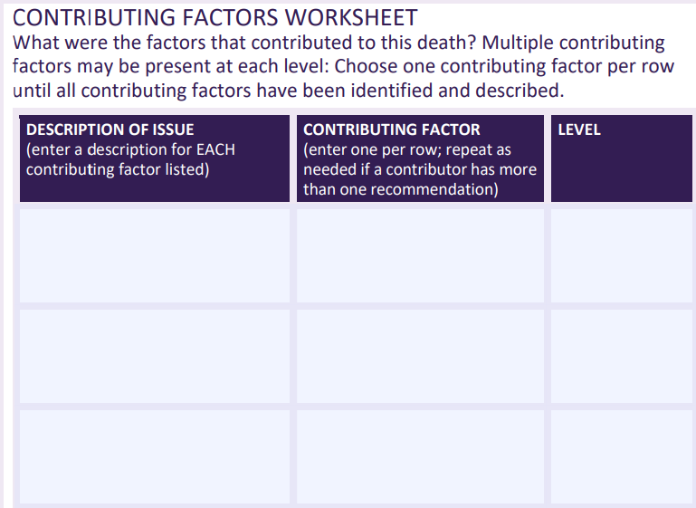
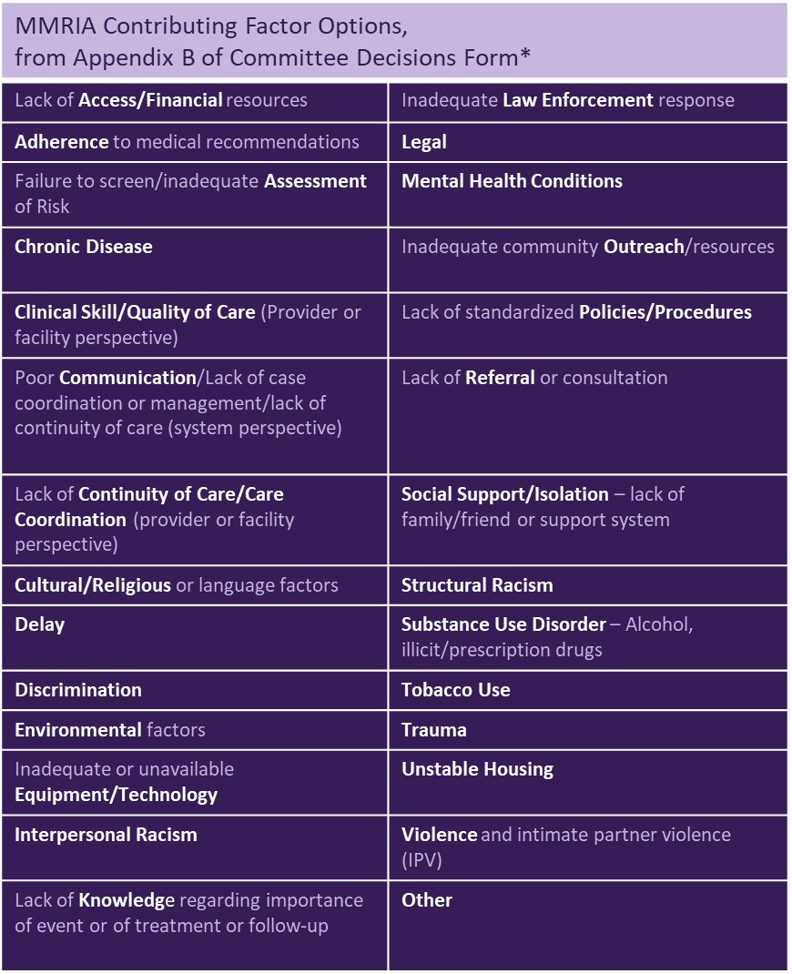
Contributing Factor Classes and Levels
Notes:
Contributing factor classes include but are not limited to: lack of access or financial resources; chronic disease; clinical skill or quality of care; lack of continuity of care; and more
The contributing factors are sorted into five levels, as are subsequent recommendations. These levels are: patient or family; provider; facility; system; and community.

Slide 27
Top Five Contributing Factor Classes in 2021
Notes:
Among the pregnancy-related deaths analyzed in the 2021 MMRIA data, there were over 5,000 contributing factor classes.
This shows the top five.

Slide 28
Contributing Factor Levels in 2021
Notes:
Those 5,000+ contributing factor classes were assigned levels – here we can see the patient/family had the most classes, at 33%, while community had the least, at 5.5%.

Slide 29
Recommendation Levels in 2021
Notes:
Here we can see what levels the MMRC recommendations were assigned to

Slide 30
Contributing Factor and Recommendation Levels in 2021
Notes:
Even though most contributing factor levels were assigned to patient/family, the reality is that it’s hard to create recommendations on that level that are scalable and can have widespread impact. On the other hand, looking at system and hospital level recommendations allows us to enact broader, wide-reaching change. And ideally, some of these system and facility level recommendations can still address contributing factors on the patient/family level.

Slide 31
Visit the Dashboard
Learn more about the data by scanning the QR code or visiting cdc.gov/maternal-mortality/php/data-research/mmrc
Notes:
You can access this dashboard via the link and QR code on your screen

