Slide 1
Improving Maternal & Infant Health Through Inclusion in Clinical Trials
Health Policy & Advocacy Committee
Society for Maternal-Fetal Medicine

Slide 2
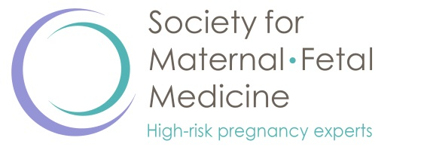
Vision
SMFM is dedicated to the advancement of optimal and equitable perinatal outcomes for all people who desire or experience pregnancy.
Mission
As experts in maternal-fetal medicine, SMFM and its members lead the evidence-based practice of high-risk pregnancy care by providing education, promoting research, and engaging in advocacy.

Slide 3
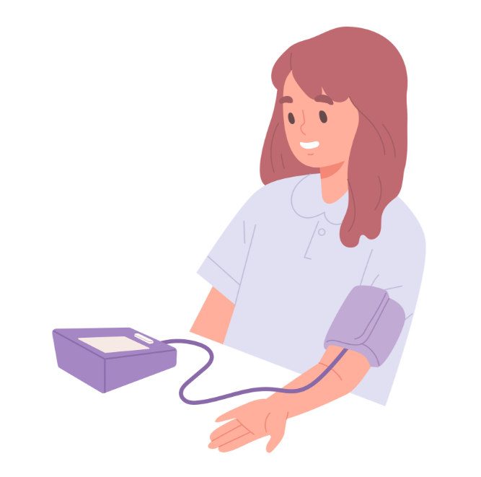
What is a high-risk pregnancy?
People with pre-existing medical conditions get pregnant
Studies estimate 20% to 40% women of reproductive age have at least one chronic condition that could adversely affect their health while pregnant.

Slide 4
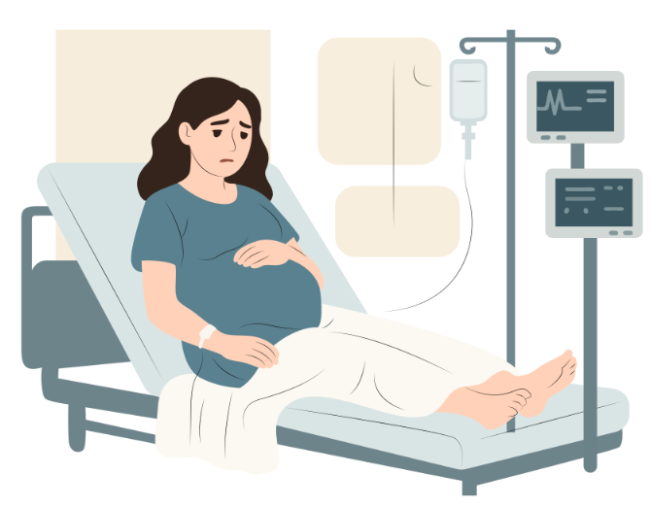
What is a high-risk pregnancy?
Pregnant people develop complications during pregnancy

Slide 5
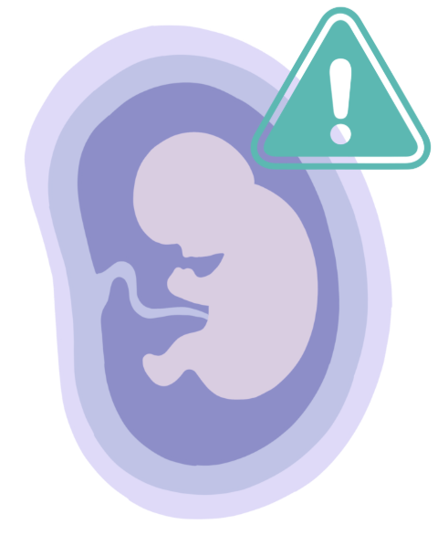
What is a high-risk pregnancy?
Complications are identified that affect fetal health

Slide 6
Why is clinical research in pregnant and lactating people important?
9 in 10 people use medications in pregnancy, 7 in 10 take at least one prescription medication
More than 90% of new FDA approved medications lack sufficient obstetric data
Pregnancy-specific conditions are under-researched
  Pre-eclampsia, preterm labor, obstetric hemorrhage, gestational diabetes
Pregnant patients require medication in a range of contexts:
  Chronic illness
  Acute emergencies
  New illnesses first arising in pregnancy
  Obstetric-specific conditions

Slide 7
Protect pregnant patients through research rather than from research
When pregnant patients are excluded from trials, they face greater clinical risks after the trials are completed.
There will always be risks; exclusion just shifts those risks from within a regulatory structure out into the real world.

Slide 8
Case study: COVID-19 mRNA Vaccines
The original RCTs of the COVID-19 mRNA vaccine excluded pregnant patients
There was no ethical or scientific reason for exclusion
  Low biologic plausibility of fetal harm and pregnant patients are at greater risk of disease severity
SMFM and other national obstetric organizations advocated strongly for inclusion
However, pregnant patients were never enrolled

Slide 9
Case study: COVID-19 mRNA Vaccines
As a result, vaccinations were released with limited obstetric data
Clinicians thus faced significant patient skepticism
Although vaccination is now well demonstrated to be safe, this lack of inclusion from original trials continues to haunt efforts to protect pregnant patients from COVID
Unvaccinated pregnant patients face increased COVID related morbidity and mortality
The net impact of trial exclusion was harm rather than benefit

Slide 10
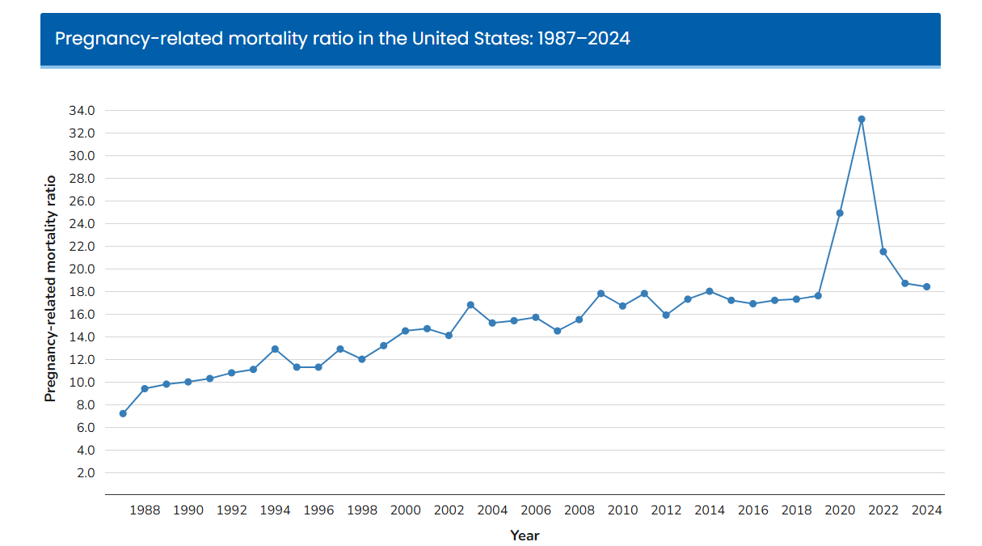
Exclusion Lead to Harm
Data available at https://www.cdc.gov/maternal-mortality/php/pregnancy-mortality-surveillance-data/index.html?cove-tab=2.
Notes:
Only the small number of inadvertent conceptions during the trial

Slide 11
Exclusion Lead to Harm
In 2020, 2021, and 2022, infection and sepsis was the leading cause of pregnancy-related death.
Data available at https://www.cdc.gov/maternal-mortality/php/pregnancy-mortality-surveillance-data/index.html?cove-tab=2.

Slide 12
Barriers to obstetric clinical research
Funding
Liability Concerns
Unnecessary regulatory burdens,
including with Institutional Review Boards

Slide 13
3 best practices for IRBs
Inclusion of a team member with clinical expertise in obstetrics
Default inclusion rather than exclusion of pregnant and lactating people
Designation of pregnant and lactating people as “scientifically complex” rather than “vulnerable”

Slide 14
Inclusion of team member with clinical obstetric expertise
This is broadly defined:
  Maternal-fetal medicine subspecialist
  OB/GYN
  Certified nurse-midwife
  Family medicine provider who practices obstetrics or provides outpatient prenatal care
  Any specialist who also focuses on pregnancy:
    Cardiologist with expertise in cardio-obstetrics
    Nephrologist with expertise in renal disease in pregnancy
    Pharmacist with pregnancy expertise

Slide 15
“Scientifically complex” rather than “Vulnerable”
“Vulnerable” patients are historically those who may be unable to consent or be subject to coercion
  Incarcerated individuals
  Children
  Individuals without capacity secondary to neurologic illness
Pregnant patients are overwhelmingly free adults without capacity limitations
In 2017 the federal government changed the Common Rule to remove pregnant patients from vulnerable populations in human research

Slide 16
“Scientifically complex”
Alternative designation to “vulnerable”
Still entails a careful review pregnant patients’ specific risks:
  Differences in physiology
  Potential for teratogenicity
But unlike “vulnerability” the standpoint is scientific rather than focused on autonomy or coercion

Slide 17
3 best practices for IRBs
Inclusion of a team member with clinical expertise in obstetrics
Default inclusion rather than exclusion of pregnant and lactating people
Designation of pregnant and lactating people as “scientifically complex” rather than “vulnerable”

Slide 18
Resources
SMFM FAQ for IRB members and professionals
Health Affairs Forefront Article: Pregnant People Can Freely Make Decisions About Participation In Clinical Research
Society for Maternal-Fetal Medicine Position Statement: Prioritizing and investing in pregnancy research
ACOG Committee Statement No. 9: Ethical Considerations for Increasing Inclusivity in Research Participants

Slide 19
Thank you!

