Slide 1
WEBINAR
SERIES
www.shlb.org/webinars
February 26, 2025
Should Congress Repeal the FCC’s E-Rate HotSpot Lending Decision?

Slide 2
SOCIAL MEDIA
Follow us @SHLBCoalition
Join the conversation with #SHLBWebinars

Slide 3
SPEAKERS
Moderator: John Windhausen Jr., Executive Director, SHLB Coalition
Moderator: Kristen Corra, Policy Counsel, SHLB Coalition
Jill Hobson, Chief Technology Officer, Gainesville City Schools (GA)
Tammy Blackwell, Director, Marshall County Public Library (KY)
Jeffery Herbel, Director of Information and Instructional Technology, Enid Public School District (OK)
Ben Weintraub, CEO Kajeet

Slide 4
About Gainesville City Schools
45 miles north of Atlanta
Founded in 1892
Minority Majority
All students eat free via Provision 2
Highest percentage of English Learners in GA

Slide 5
Current Hotspot Usage 24-25 School Year

Slide 6
Homework Hours Online 24-25 School Year

Slide 7
Bus Hotspot Homework Hours Online 24-25 School Year

Slide 8
What are students doing?

Slide 9
About Enid Public Schools
Largest city and school district in Northwest Oklahoma
101 miles Northwest of OKC
116 miles East of Tulsa
7,500 Student

Slide 10
Looking at the Data
Student Diversity:
White – 42.2%
Hispanic – 29.3%
Pacific Islander – 13.5%
Multiracial – 9.2%
African American – 3%
Native American – 1.7%
Asian - .9%
Free and Reduce Status:
District Wide – 71%
Internet at Home:
65% say they don’t have usable internet at home
Notes:
Talk about Pacific Islanders

Slide 11
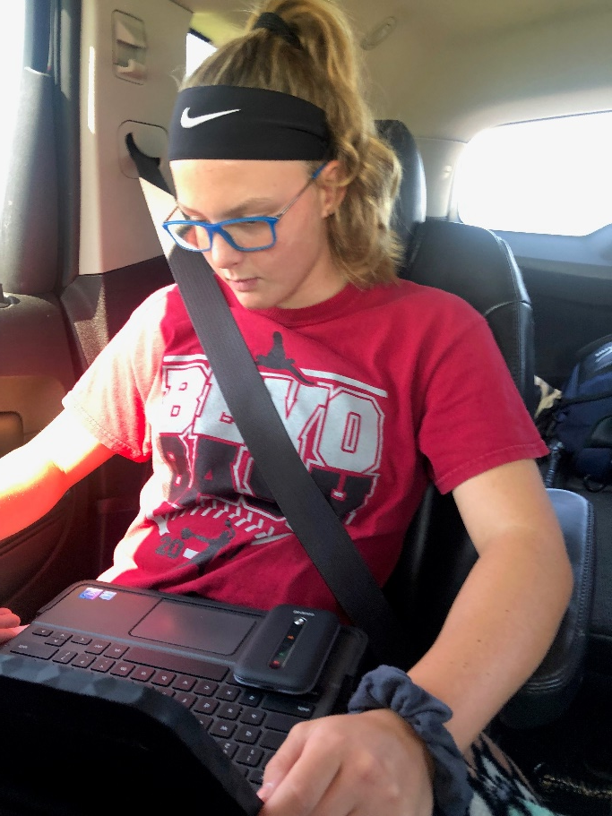
Paving the Road to Anytime Anywhere Learning
T-Mobile EmpowerED Grant Impact
All Secondary Students
Anytime Anywhere Learning
No excuses
Last 7 Day Usage
5,495 hrs on YouTube
4,543 hrs on Google Docs
2,673 hrs on Google.com
2,226 hrs on Google Classroom
1,930 hrs on Edgenuity
1,923 hrs on Mastery Connect
We were ready for Covid, but the grant ended in the summer of 21
Notes:
Student on her way to OKC for softball practice on her Chromebook using her T-Mobile HotSpot the first week of school!

Slide 12
The Future of the Digital Divide – slide recreated in 2019
Not enough grants for all schools
EBS – Education Broadband Service
Schools don’t know about it
Schools can’t afford it
Desert Sands Unified School District
Spent $600,000 to build out WiFi network
Deployed 283 HotSpots
FCC and E-Rate
Schools can't afford to provide HotSpots to every student
Schools can't afford to build out EBS on their own
The FCC must add HotSpots to the Eligible Services List
Notes:
We were fortunate to win the T-Mobile Grant
Its becoming a big buzz term
Spectrum was setup in the 60’s for local educational channels
In 2003 wireless networking allowed on the spectrum
Desert Sands Unified School District in Palm Desert

Slide 13
Ben Weintraub
Chief Executive Officer
Kajeet

Slide 14
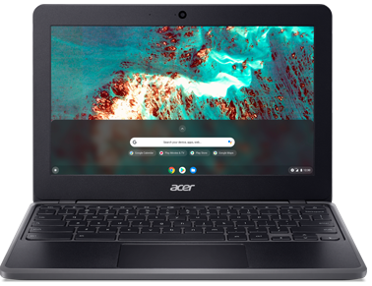
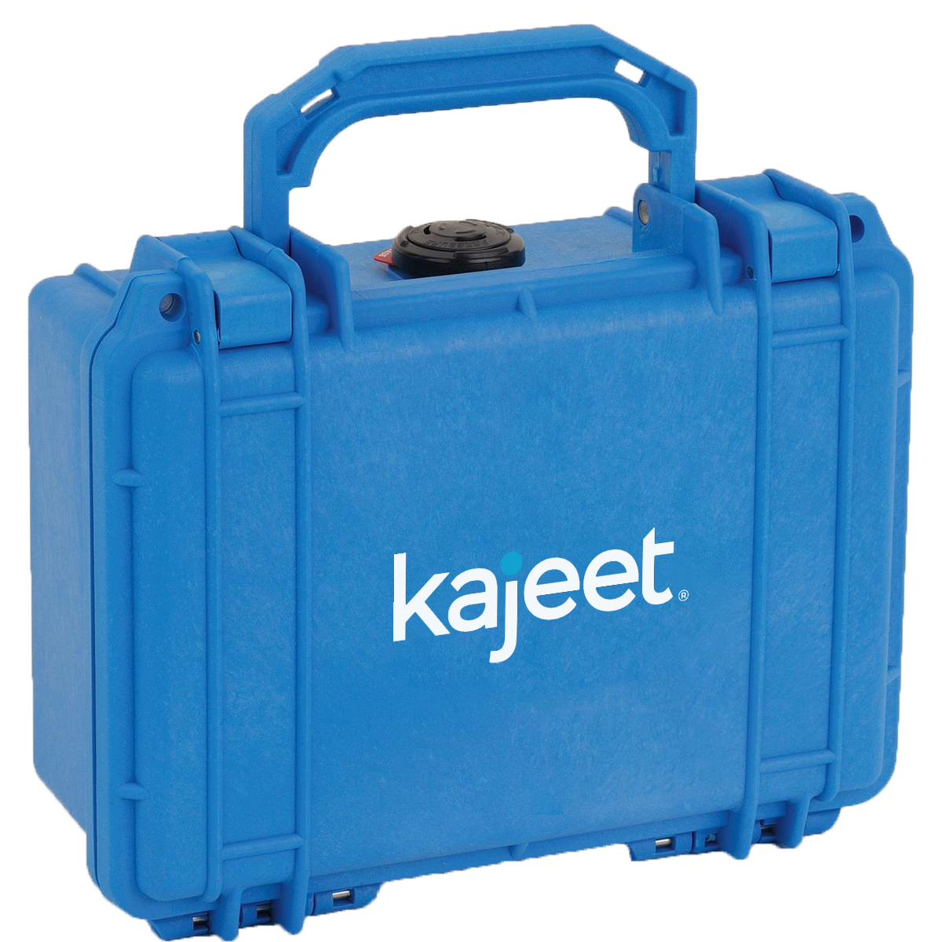
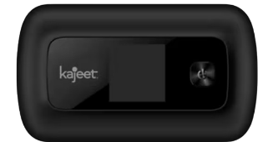
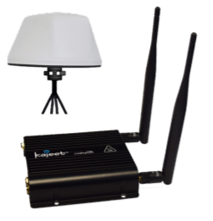
SCHOOL AND LIBRARY SOLUTIONS
Kajeet SmartSpot®
LTE-Embedded Devices
Kajeet SmartBus ®
A filtered Wi-Fi hotspot connecting users anytime, anywhere
Integrating Wi-Fi connectivity into a field-ready laptop
#1 Provider of School Bus Wi-Fi in North America

Slide 15
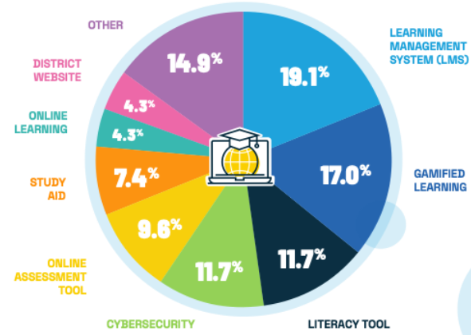
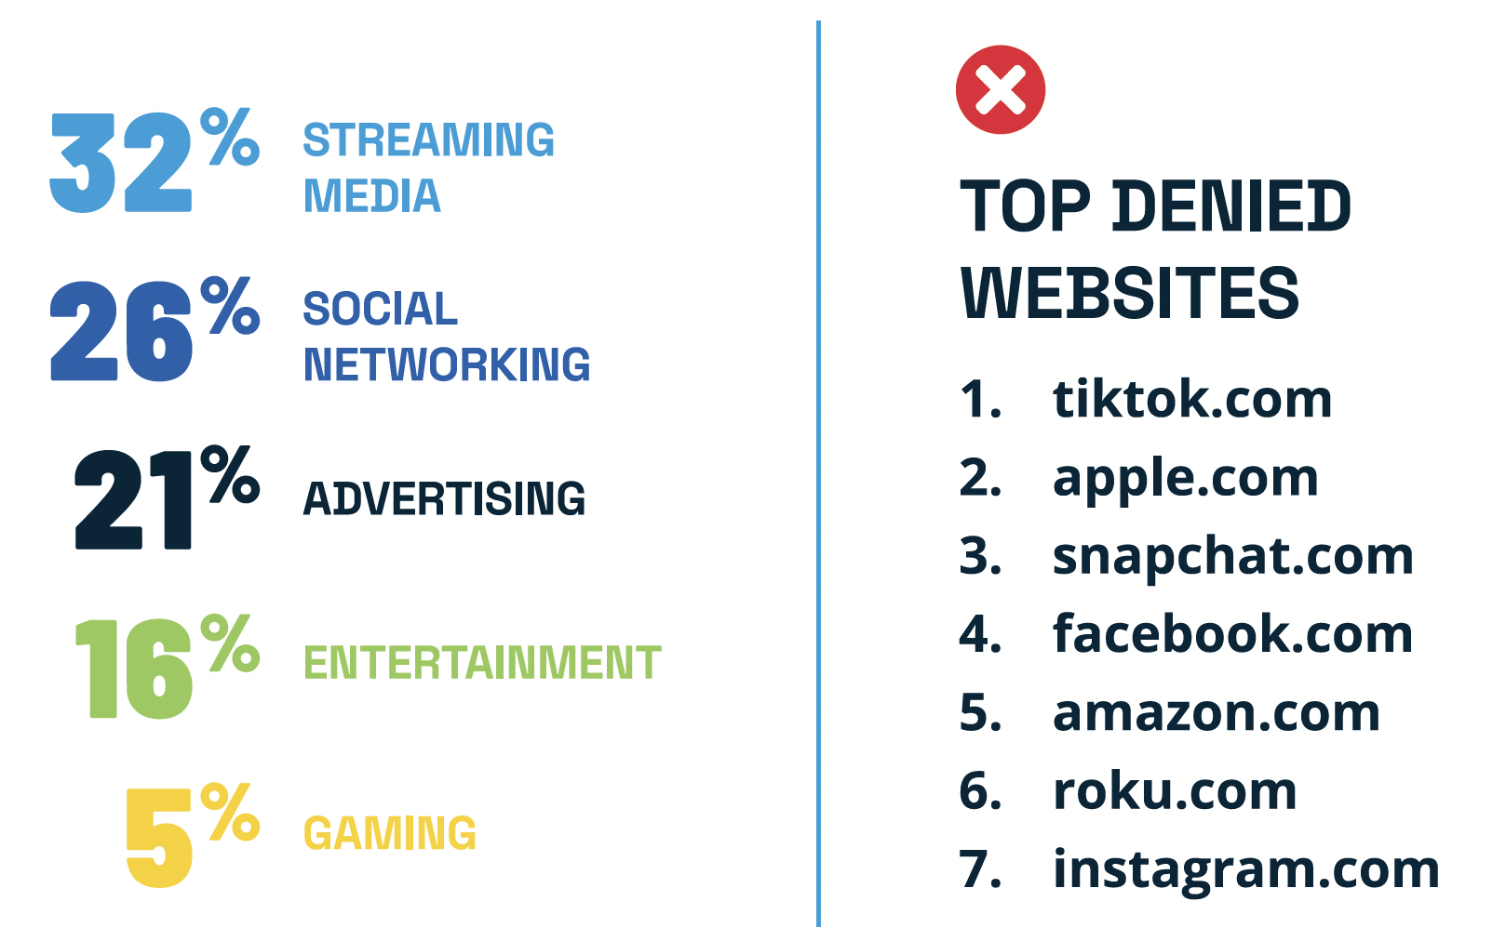
Educational Use
E-RATE 2025
Top Visited Sites
Top Denied Sites
24%
75%
Usage by Time of Day
4 in every 5 domain requests are blocked
Non-School Hours (75.4%)
School
Hours
(24.6%)
Notes:
In 2024 more than 20 Billion domain requests were denied for K-12 students.

Slide 16
E-Rate Unit Volume by Category
E-RATE 2025
As of 2/22/25 (Source: Signal Analytics) | 470s | Total | TAM ($)
Library Hotspots | 442 | 49,778 | $12.2M
School Hotspots | 648 | 803,503 | $162.9M
Bus Wi-Fi | 445 | 33,121 | $42.6M

Slide 17
Distribution of 470 Applications by State
E-RATE 2025

Slide 18
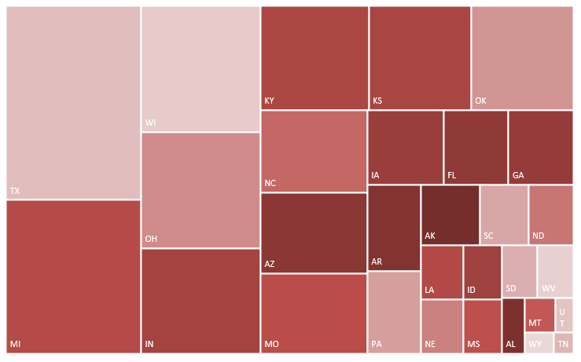
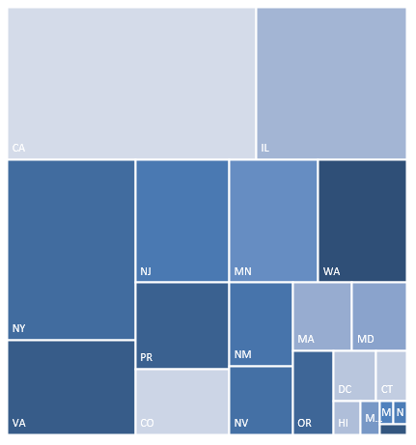
Active 470 Applications by State
E-RATE 2025

Slide 19
Moderated Q&A
Moderator: John Windhausen Jr., Executive Director, SHLB Coalition
Moderator: Kristen Corra, Policy Counsel, SHLB Coalition
Jill Hobson, Chief Technology Officer, Gainesville City Schools (GA)
Tammy Blackwell, Director, Marshall County Public Library (KY)
Jeffery Herbel, Director of Information and Instructional Technology, Enid Public School District (OK)
Ben Weintraub, CEO Kajeet

Slide 20
Thank You!
www.shlb.org | @SHLBCoalition
The SHLB Coalition is proudly supported by over 321 member organizations, and our generous corporate sponsors:

