Slide 1


Preserving Universal Service
Connected America - March 11, 2025
Joey Wender, Executive Director, SHLB Coalition

Slide 2
National Public Interest Organization supporting broadband for schools, libraries and anchor institutions.
Based in Washington, DC.
320+ Members. Membership is open to any organization
that supports our Mission. www.shlb.org/membership.

Slide 3
What is the Universal Service Fund (USF)?
E-Rate – Provides internet access and internal connections to eligible schools and libraries.
  FY2024 demand: $3.2 Billion
Rural Health Care - Allows rural health care providers to pay rates for telecommunications services similar to those of their urban counterparts.
  FY2024 demand: $789 million
Lifeline - Assists low-income customers by helping to pay for monthly mobile phone charges.
  Up to $9.25 monthly for low-income subscribers/up to $34.25 monthly for Tribal lands
  FY2024: $943 million disbursed
High Cost – Supports certain qualifying telephone companies that serve high cost areas
  FY2024: $4.5 billion disbursed
Notes:
2024 E-Rate and RHC caps include a 3.6% inflation increase from FY2023

Slide 4
What is the potential impact of eliminating the Universal Service Fund?
54,367,186 students would lose internet access in schools and libraries, cutting off their ability to learn and access vital educational resources. (E-rate)
16,080 healthcare providers would be disconnected, limiting access to telehealth services, especially for rural and underserved populations. (Rural Health care program)
7,596,720 subscribers would lose discounted phone and internet services, exacerbating the digital divide. (Lifeline)
In 2023, $4.26 billion was allocated to connect households in rural areas, ensuring equitable access to basic telecommunications and internet service. (High Cost program)

Slide 5
Consumers Research USF Decision
5th, 6th and 11th Circuits found NO constitutional problem.
Upon re-hearing, 5th Circuit found (9-7) USF contribution mechanism is unconstitutional.
Supreme Court grants cert petition by Government and SHLB.
  March 26: Oral argument
  Decision by June
SHLB is a named party to the SCOTUS case

Slide 6
FCC “Learn without Limits” program
3 Opportunities
Wi-Fi Hotspot Lending program (New - Adopted 2024)
  As of early March 2025: 1,200 applications submitted for devices and service (comprising 19,896 schools/libraries and 5.3 million students)
School Bus W-Fi (Adopted 2023)
  Y2024: 405 requests submitted; $19 million demand
Cybersecurity pilot program (New - Adopted 2024)
  2,734 applications submitted; $3.7 billion demand
  Program allows up to $200 million over 3 years

Slide 7
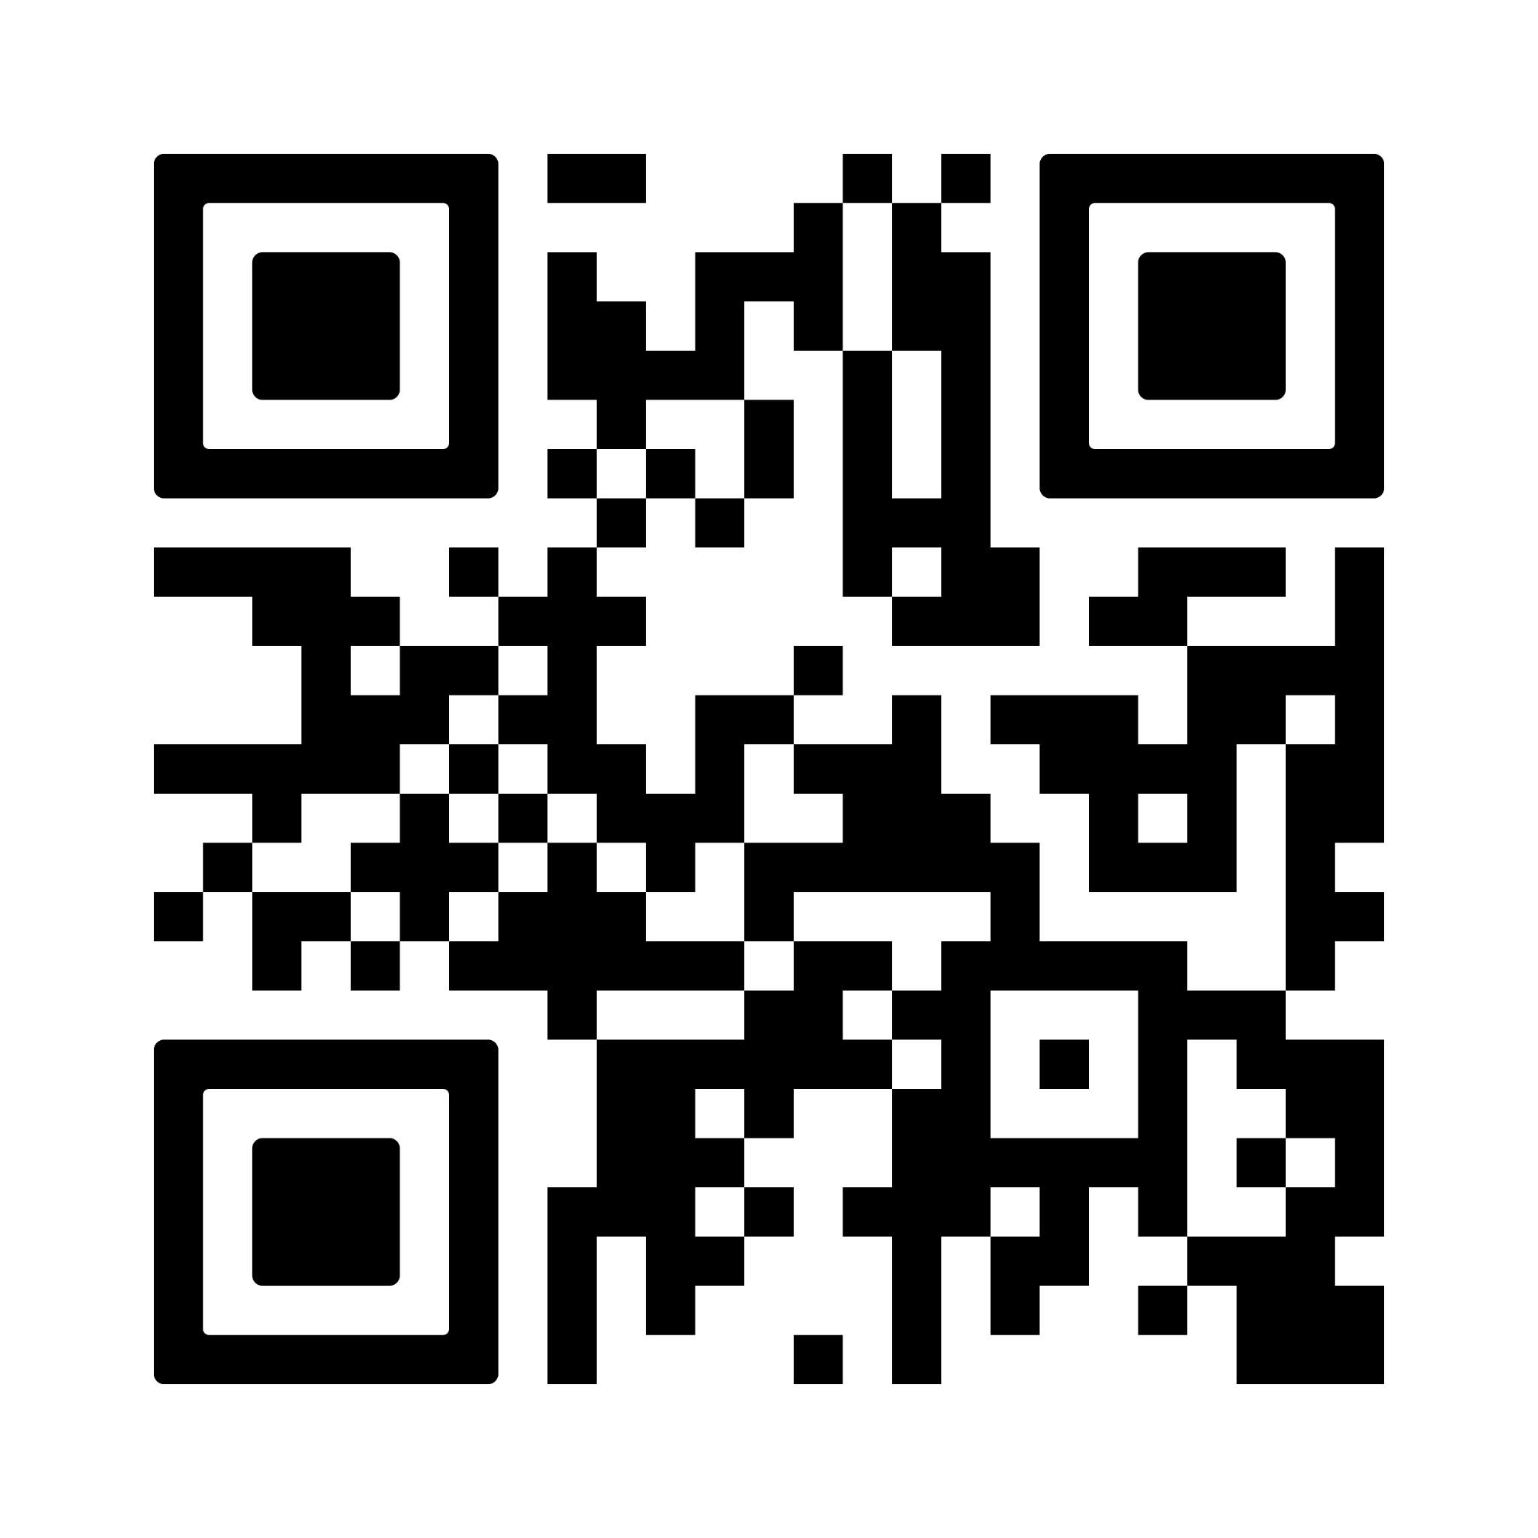
SHLB Congressional Fly In
The SHLB Coalition is organizing a fly-in of SHLB members to support E-rate, the Rural Health Care program and the Universal Service Fund. The purpose of the fly-in is to educate Congress about the importance of preserving E-rate and the RHC program so that schools, libraries and healthcare providers can make affordable broadband service available to unserved and underserved communities.
April 9, 2025-April 11, 2025
Learn more by scanning the code:

Slide 8
Become a SHLB Member
Why should your organization join SHLB?
Shape broadband policy and funding
Connect and collaborate for success
Stay ahead of the curve
Learn more at www.shlb.org/membership

Slide 9




Questions?
jwender@shlb.org
@SHLBCoalition
www.shlb.org
Thank you!

